Slide 1
A gentle introduction to the bootstrap
Steve Simon

Slide 2
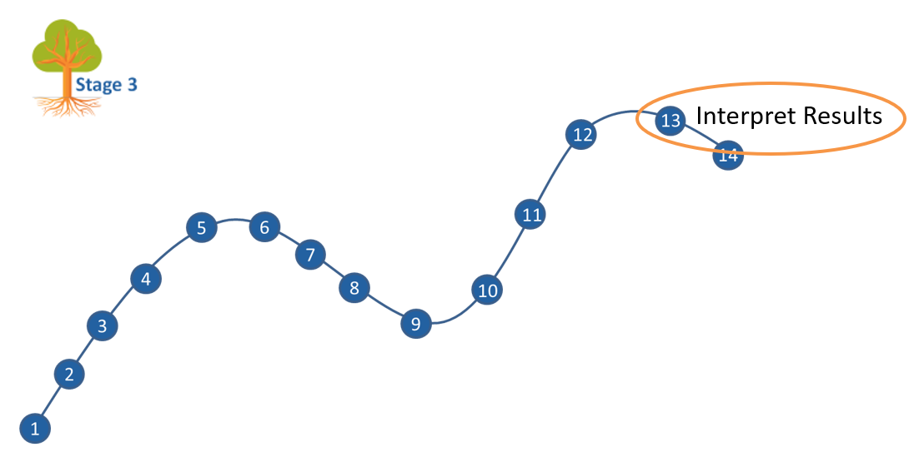
Where this fits
Notes:
Most of you should be familiar with the components and stages that The Analysis Factor uses to classify their talks. This talk is in Stage 3, Extensions of Linear Models. It covers a pretty broad swath, but might be considered as interpreting results. Perhaps validating results might be a second component.

Slide 3
Goal
For you to have a good understanding of:
what the bootstrap is
when it is appropriate to use it
the steps to implement the bootstrap.
The goal is not to cover every possible application of the bootstrap.
Notes:
Much of the material about bootstraps is either very specific to one problem or very mathematical. Althoug a few formulas are needed, I will try to avoid too much mathematics. I also want to give an appreciation of the broad range of areas where the bootstrap is appropriate. If you want to implement the bootstrap yourself, you need some basic programming skills, and I will talk about those skills. But if the programming is beyond you, don’t fret because bootstrapping is automated for several commonly used settings.
It’s not possible to cover every possible application of the bootstrap today. I hope just to get you a bit more comfortable with the methodology in general.

Slide 4
What you’ll learn today
History
Algorithms
Software
Special settings
Notes:
This talk will cover four major areas.
First, I will provide a historical overview, starting with a simpler method that the bootstrap was based on called the jackknife. Then I will talk about Bradley Efron’s work to develop the bootstrap and establish its theoretical foundations. Then I will mention how bootstrapping has developed into a methodology used in machine learning called bagging.
I will illustrate the mechanics of the bootstrap: to estimate bias, calculate standard errors, compute confidence intervals, test hypotheses, and to visualize variations in statistical plots.
Then I will show some sample code on how to implement the bootstrap in SAS, Stata, and R.
Then I will discuss some special settings where you might consider more complex forms of bootstrapping.

Slide 5
1. History
Notes:
Let’s start with a historical overview.

Slide 6
History of the bootstrap
Can you rely on asymptotic normality?
The jackknife
Bradley Efron’s contributions
Recent application: bagging
Notes:
Before the bootstrap came along, researchers relied on a variety of mathematical theorems like the Central Limit Theorem and extensions to the Central Limit Theorem to estimate bias, calculate standard errors, produce confidence intervals, and test hypotheses.
The bootstrap represents an early attempt to use the power of computer simulation to estimate bias, calculate standard errors, produce confidence intervals, and test hypotheses. The bootstrap provides these answers in many settings where you can’t find a version of the Central Limit Theorem that would apply or when you don’t trust the approximation. I’ll provide a brief overview of the jackknife, an earlier approach that the bootstrap was based on. Then I’ll talk about Bradley Efron’s work in the 1970’s and 1980’s to develop the bootstrap and to establish the mathematical principles that make the bootstrap work in so many different areas. Finally, I will talk about how bootstrapping came to be relied on in various machine learning algorithms.

Slide 7
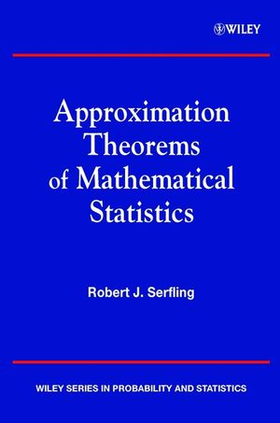
Can you rely on asymptotic normality? (1/3)
Figure 1. Cover of book by Robert Serfling
Notes:
I need to start with a book that I used when I was in graduate school. The title is “Approximation Theorems in Mathematical Statistics” by Robert Serfling. It was all about the variety of ways to show that some statistic followed an asymptotic normal distribution.

Slide 8
Can you rely on asymptotic normality? (2/3)
$\overset{‾}{X}$ is approximately normal, even if the individual values are not normal.
Furthermore,
$E\left[\overset{‾}{X}\right]=μ$
$Var\left(\overset{‾}{X}\right)=\frac{σ^{2}}{n}$
$std.err\left(\overset{‾}{X}\right)=\frac{σ}{\sqrt{n}}$
Notes:
I’m sure you’re all familiar with the Central Limit Theorem. It’s the granddaddy of all approximation theorems. It states that the average of independent identically distributed random variables is approximately normal.
The rule of thumb is that you can trust the normal approximation when the sample size is greater than 30. There is a lot that you can quibble about with respect to the cut-off of 30, but we’re not going to get too fussy about this.
You can also show easily that the expected value of the sample mean is mu (the sample mean is an unbiased estimate of the population mean) and that the variance of the sample mean is the variance of an individual X value divided by the sample size n. Equivalently, the standard error of X-bar is the standard deviation of an individual value divided by the square root of the sample size.

Slide 9
Can you rely on asymptotic normality? (3/3)
What about:
$MAD\left(X\right)=\frac{1}{n}\sum_{i=1}^{n}{\left|X_{i}−\overset{‾}{X}\right|}$
$IQR=X_{.75}−X_{.25}$
$n<30$
Notes:
What about more complex settings?
What if you are measuring the mean absolute deviation (the average of the absolute values of each individual value minus the sample mean) or the interquartile range (the difference between the 75th percentile and the 25th percentile).
If you are really clever and if you understand all the approximation theorems in Robert Serfling’s book, you will know how to establish an approximation to these statistics (usually a normal approximation, but sometimes there are other distributions like the chi-square distribution that represent a good approximation).
But there are lots of settings where even Dr. Serfling’s hard work will still leave you high and dry. Some statistics are just so messy that no one can figure out an asymptotic approximation.
But an even more fundamental question is what do you do when the sample size is not large enough to justify the use of the Central Limit Theorem? I put down n<30 here, but in some settings (well behaved distributions without much skewness and only a weak tendency to produce outliers), you might get by with only 10 observations. Other times (extremely skewed distributions and/or a strong tendency to produce outliers), even a sample size of 300 is inadequate to assume an approximately normal distribution.
It turns out that you can use simulations involving the data itself to establish an underlying distribution.
You might find, after applying the bootstrap, that the normal distribution is a reasonable approximation. If so, great! Consider the bootstrap to be a sensitivity check that you passed with flying colors.
If the results of the bootstrap are markedly different from the results assuming approximate normality, then investigate further. But you can almost always rely on the bootstrap results to provide valid confidence intervals and hypothesis tests. Although there are a few settings where you shouldn’t rely on a bootstrap approach, it is a credible approach for a surprisingly broad range of settings.

Slide 10

The jackknife (1/4)
Figure 2. Image of a jackknife
Notes:
To understand the bootstrap, you need to understand the approach that it was intended to improve upon, the jackknife.
The jackknife was first developed in 1949 by Maurice Quenouille and was extended to a more general setting by John Tukey in the 1950s. Dr. Tukey was fond of giving clever names to various statistical terms. He was the one, for example, who coined the term “bit” as a shorted form of binary digit. He chose the name “jackknife” for the Quenouille approach because the jackknife is an all-purpose tool.

Slide 11
The jackknife (2/4)
$X =\left(2,3,7,5,6\right)$
$X^{\left(−1\right)}=\left( ,3,7,5,6\right)$
$X^{\left(−2\right)}=\left(2, ,7,5,6\right)$
$X^{\left(−3\right)}=\left(2,3, ,5,6\right)$
$X^{\left(−4\right)}=\left(2,3,7, ,6\right)$
$X^{\left(−5\right)}=\left(2,3,7,5, \right)$
Notes:
For the jackknife, you create subsamples by leaving one data point out.
The original data set in this small artificial example is 2, 3, 7, 5, 6. The first subsample leaves out the 2. The second subsample leaves out the 3. And so forth. With five data points, you have five subsamples.

Slide 12
The jackknife (3/4)
Calculate $MAD$ (2, 3, 7, 5, 6)
Note that mean (3, 7, 5, 6) = 4.6.
$\left(\left|2−4.6\right|+\left|3−4.6\right|+\left|7−4.6\right|+\left|5−4.6\right|+\left|6−4.6\right|\right)/5$
$\left(2.6+1.6+2.4+0.4+1.4\right)/5$
$8.4/5$
1.68
Notes:
Then calculate a statistic (in this case, the mean absolute deviation). Do it first for the entire sample. Here are the actual calculations.

Slide 13
Calculate MAD for each jackknife sample
Calculate $MAD$ (3, 7, 5, 6)
Note that mean (3, 7, 5, 6) = 5.25
$\left(\left|3−5.25\right|+\left|7−5.25\right|+\left|5−5.25\right|+\left|6−5.25\right|\right)/4$.
$\left(2.25+1.75+0.25+0.75\right)/4$
$5/4$
1.25
Notes:
Then repeat the calculation with the first observation left out. Notice that we are dividing now by four rather than by five.

Slide 14
The remaining calculations
$MAD$ (2, 7, 5, 6) = 1.5
$MAD$ (2, 3, 5, 6) = 1.5
$MAD$ (2, 3, 7, 6) = 2
$MAD$ (2, 3, 7, 5) = 1.75
Notes:
Here are the results for the remaining jackknife sample. Notice that there is some variation in the results from one jackknife subsample to another.

Slide 15
Mean and standard deviations for the jackknife samples
MAD (Full sample) = 1.68
Average MAD (Jackknife subsamples) = 1.6
Standard deviation MAD (Jackknife subsamples) = 0.285
Notes:
The average of the jackknife subsamples is a bit less than 1.68. This indicates a small amount of bias, though I would argue that the size of the bias is manageable. The standard deviation of the jackknife subsamples is around 0.3 (I’m rounding liberally here). This standard deviation is a reasonable estimate for the standard error of the mean absolute deviation. So plus or minus two standard errors gives you an approximate confidence interval from 1.0 to 2.2. A fair amount of imprecision, but hardly surprising for a dataset with a total sample size of 5.

Slide 16

Bradley Efron’s contribution (1/6)
Figure 3. Photograph of Bradley Efron with President Bush
Notes:
This image is from a White House ceremony where Bradley Efron received the President’s National Medal of Science. I was quite shocked when I found this picture a few days ago, and I’ve been trying to call Joe Biden ever since to see where my medal is. Seriously, you have to be a really special statistician to deserve an honor like this.
Most of the information about Bradley Efron comes from
Denise LaFontaine. The History of Bootstrapping: Tracing the Development of Resampling With Replacement. The Mathematics Enthusiast 2021, 18(1). Available in pdf format.
Bradley Efron entered the PhD program in Statistics at Stanford University in 1960. He was influenced by one of the faculty at Stanford, Rupert Miller, who was working on establishing conditions under which the jackknife did or did not perform well. Shortly after graduating, Dr. Efron started working on an approach that would fix some of the shortcomings of the jackknife.
It turns out that the jackknife works in a variety of settings, but fails badly for certain statistics like the median and the interquartile range. The bootstrap handles all the cases that the jackknife handles but also handles quite a few that the jackknife can’t.

Slide 17
Bradley Efron’s contribution (2/6)
The bootstrap sample=sampling with replacement.
The original data: (2, 3, 7, 5, 6)
Bootstrap sample #1: (7, 2, 5, 3, 5)
Bootstrap sample #2: (5, 7, 3, 5, 7)
Bootstrap sample #3: (7, 2, 2, 2, 2)
…
Bootstrap sample #500: (7, 7, 3, 2, 7)
Notes:
Bradley Efron decided to create subsamples by sampling from the full data set, but with replacement.
Sampling with replacement means that the first data value selected gets tossed back into the pool and is available for selection later on. It might get selected a second, or even a third time. A consequence of this is that one or more of the original values might not make it into the bootstrap sample. If one data value is hogging two or three spots, that squeezes out room for another data value.
The first bootstrap sample picks the 5 twice and skips over the 6. The second bootstrap sample picks the 5 twice and the 7 twice and skips over the 2 and the 6.
One big advantage of the bootstrap samples is that you can do this hundreds or even thousands of times.

Slide 18
Bradley Efron’s contribution (3/6)
Calculate $MAD$ (7, 2, 5, 3, 5)
Note that mean (7, 2, 5, 3, 5) = 4.4.
$\left(\left|7−4.4\right|+\left|2−4.4\right|+\left|5−4.4\right|+\left|3−4.4\right|+\left|5−4.4\right|\right)/5$
$\left(2.6+2.4+0.6+1.4+0.6\right)/5$
$7.6/5$
1.52
Notes:
Here are the calculations for the mean absolute deviation for the first bootstrap sample.
This is not difficult, but you need to repeat the calculations 499 more times.

Slide 19
Bradley Efron’s contribution (4/6)
MAD(5, 7, 3, 5, 7) = 1.28
MAD(7, 2, 2, 2, 2) = 1.6
…
MAD(7, 7, 3, 2, 7) = 2.16
Notes:
Here’s what you might do with the bootstrap samples. Suppose you are interested in the behavior of the mean absolute deviation for this particular dataset. You can calculate that statistic for each bootstrap sample. It is 1.52 for the first bootstrap sample, 1.28 for the second bootstrap sample, and so forth. Notice how much this statistic varies from one sample to the next.

Slide 20
Bradley Efron’s contribution (5/6)
MAD (Full sample) = 1.68
Average MAD (Bootstrap samples) = 1.405
Standard deviation MAD (Bootstrap samples) = 0.461
Notes:
The average across all the bootstrap samples is a bit smaller than the estimate for the original data. This indicates, as you noticed before with the jackknife, a small amount of bias.
The standard deviation from the bootstrap mean absolute deviations is an estimate of the standard error of that statistic. It is fairly large, but as noted earlier, not too much of a surprise.

Slide 21
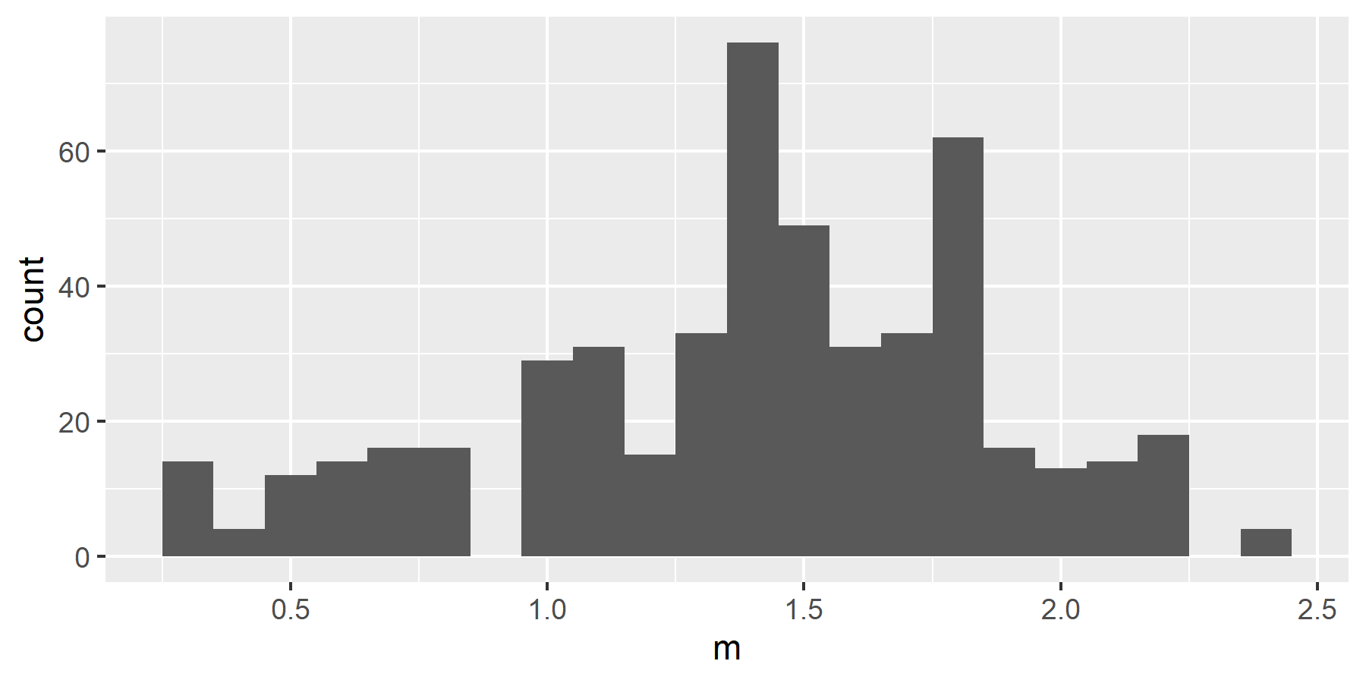
Bradley Efron’s contribution (6/6)
Figure 4. Histogram of bootstrapped estimates
Notes:
This is a histogram of the 500 bootstrapped estimates of the mean absolute deviation. Notice that it is “patchy” and does not follow a smooth bell shaped curve. This is an important issue that you will address when computing confidence intervals.

Slide 22
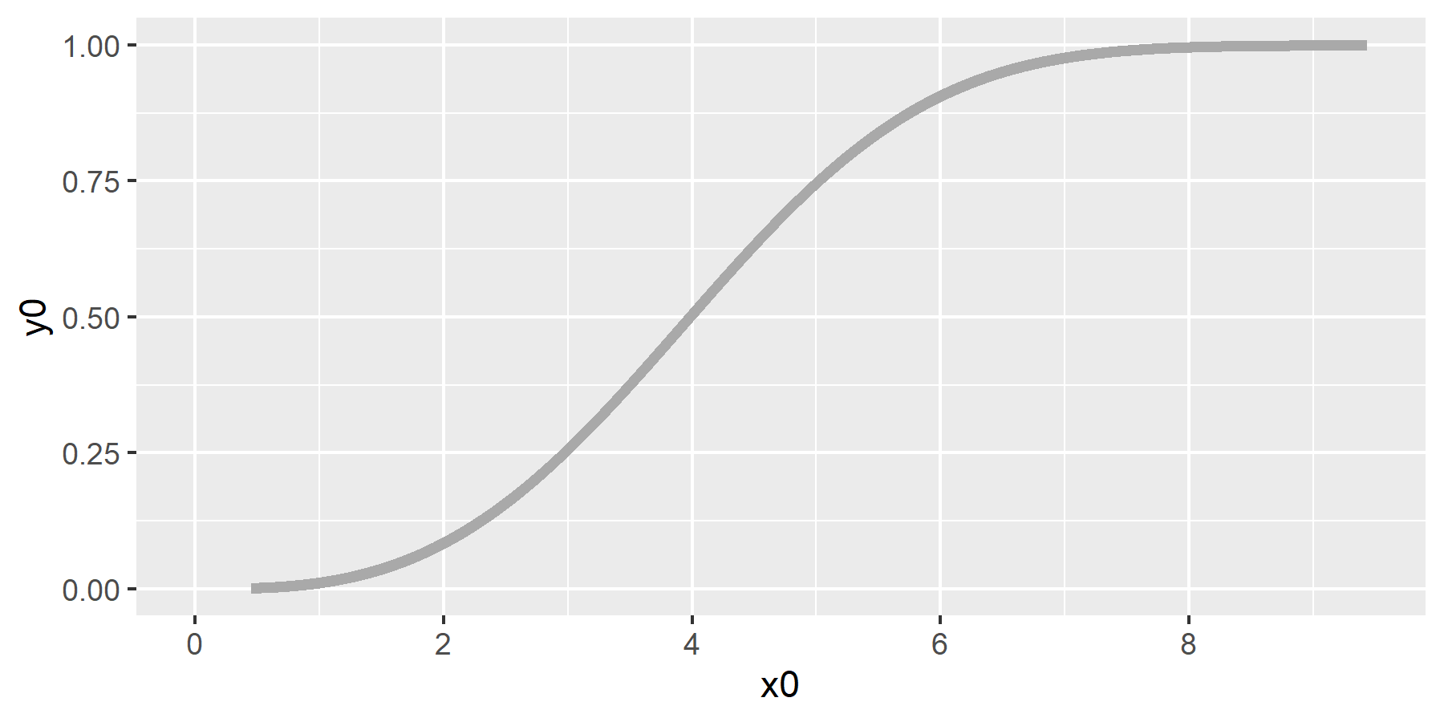
A bit of intuition about the bootstrap (1/6)
Figure 5. An example of a cumulative density function
Notes:
Suppose you have inside knowledge about the true probabilities for the data in our sample. Here is a cumulative distribution function that can generate data for a particular distribution.
The cumulative distribution allows you to compute the cumulative probability for any data value. Select the data value on the X axis, project up to the curve and slide horizontally to read the cumulative probability on the Y axis.
You can also invert the process to get a percentile. Select a percentile level on the Y-axis, project horizontally until you intersect the curve, then drop down to the X-axis to get the percentile.
To get the median, for example, find 0.5 on the y-axis, project over to the curve and down to about 4.
It’s subtle, but notice that the curve is a just a bit lopsided, indicating a tiny amount of a skewness in this data.
If you had inside knowledge, enough to specify the cumulative distribution function, you could generate random samples from this distribution and calculate statistics on those random samples. It is a basic tool in Statistics known as Monte Carlo simulation.

Slide 23
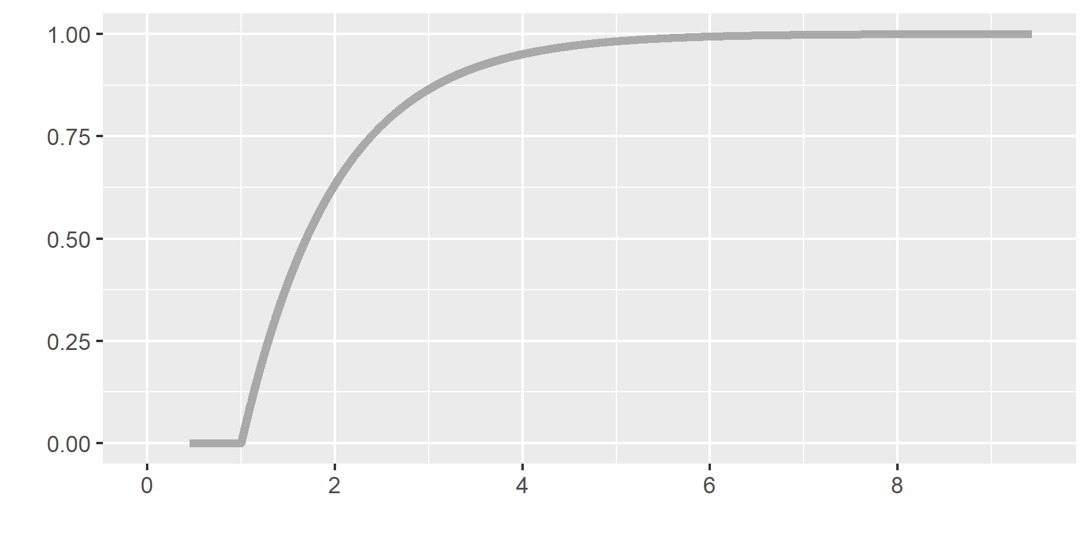
A bit of intuition about the bootstrap (2/6)
Figure 6. An alternative cumulative density function

Slide 24
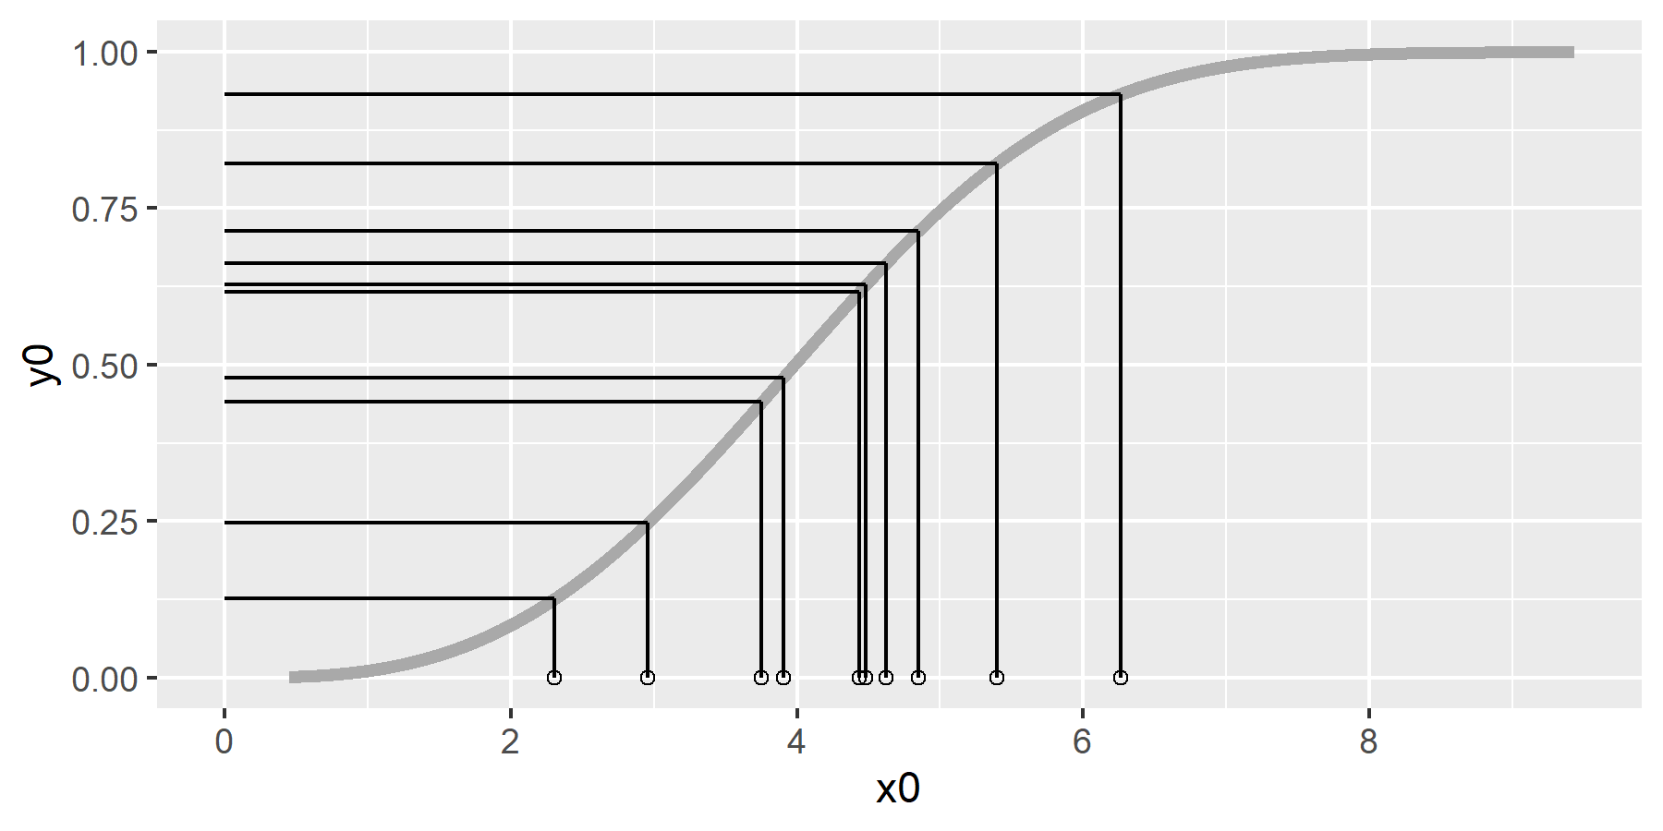
A bit of intuition about the bootstrap (3/6)
Figure 7. Using random uniform values to simulate data from a cumulative distribution function
Notes:
The simplest way to generate random variables from a specific cumulative density function is to select values on the y-axis from a random variable uniformly distributed on the interval 0 to 1. Project those values horizontally until they intersect the curve and then drop down to the X-axis. What you’re doing is picking random percentiles from the distribution.
So grab n uniform random variables, convert them into percentiles from the cumulative distribution function, and then calculate some statistic like the mean absolute deviation. Get another set of n uniform random variables and repeat the process. With computers as fast as they are today, you could do this a few hundred or even a few thousand times and not break a sweat.
Of course, most of the time, you can’t run this Monte Carlo simulation without making some strong assumptions. If you have a particular set of data, do you ever really know what the cumulative distribution function is that created this data? Even if you were lucky enough to have some inside information–that it was associated with a normal random variable, for example–you wouldn’t know which normal. You wouldn’t know the mu and you wouldn’t know the sigma.

Slide 25
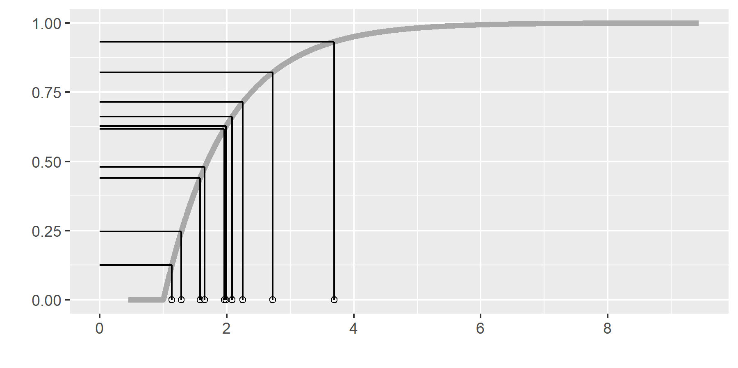
A bit of intuition about the bootstrap (4/6)
Figure 8. Using random uniform values to simulate data from an alternative cumulative distribution function

Slide 26
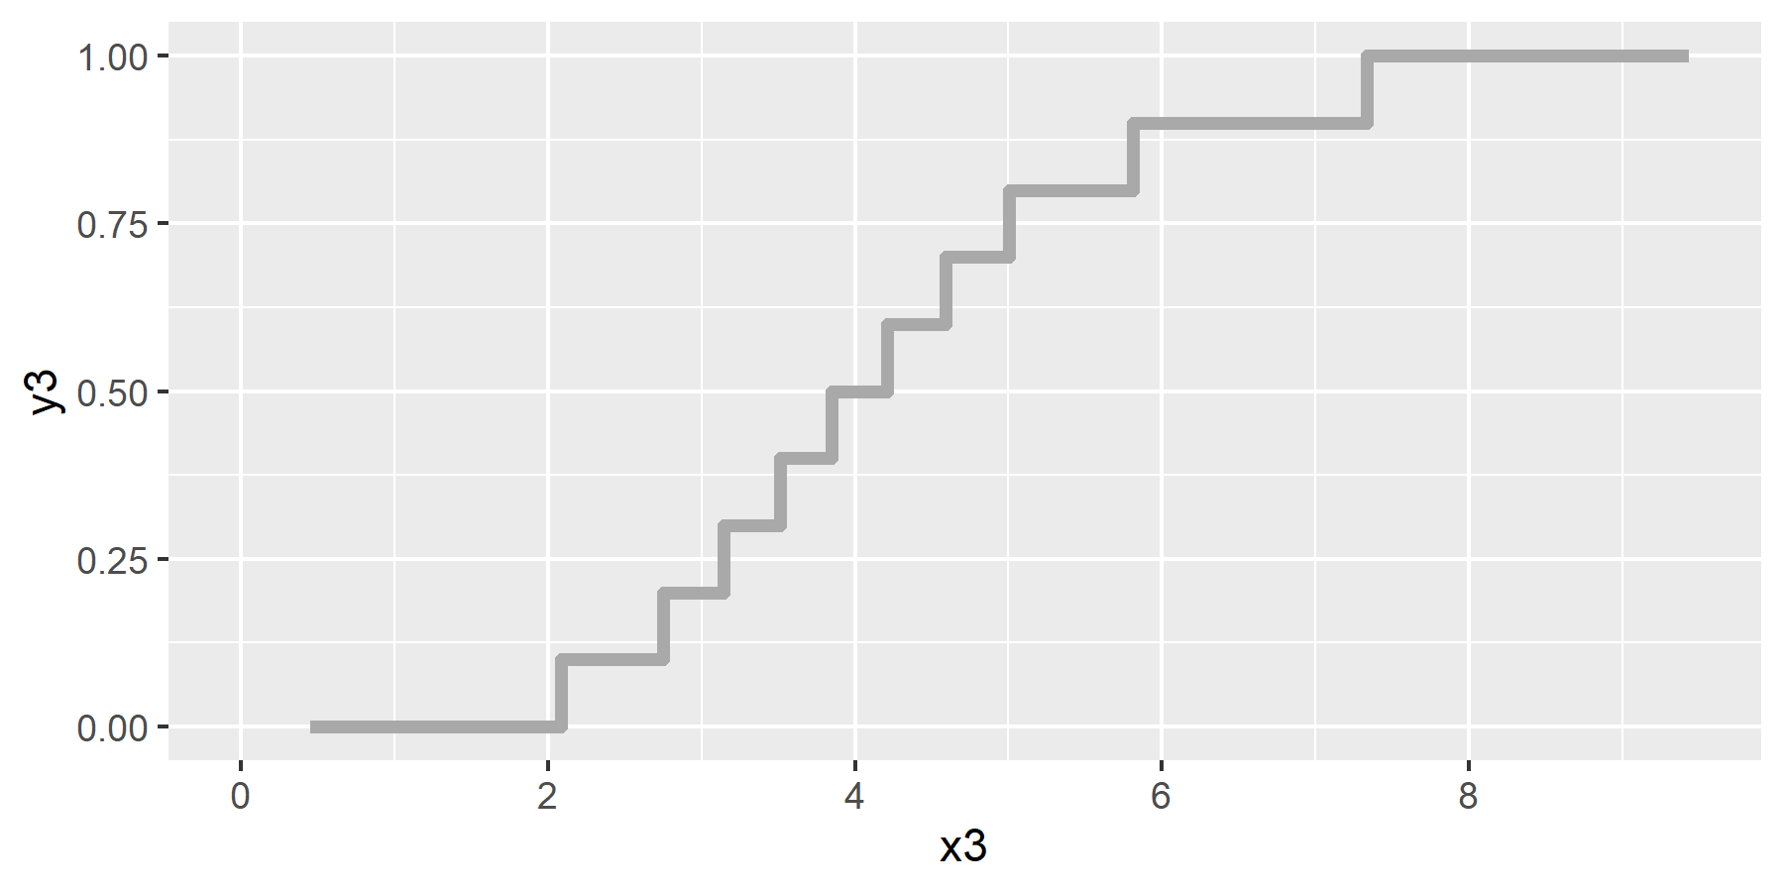
A bit of intuition about the bootstrap (5/6)
Figure 9. Estimate of cumulative density function from the data
Notes:
You can get a good approximation to the cumulative distribution function using the data. Draw a step function with a jump of 1/n at each data point where n is the number of data points.
This step function is known as the empirical cumulative distribution function.
The empirical cumulative distribution function does a pretty good job. It is unbiased and converges to the true cumulative distribution function as the sample size increases.

Slide 27
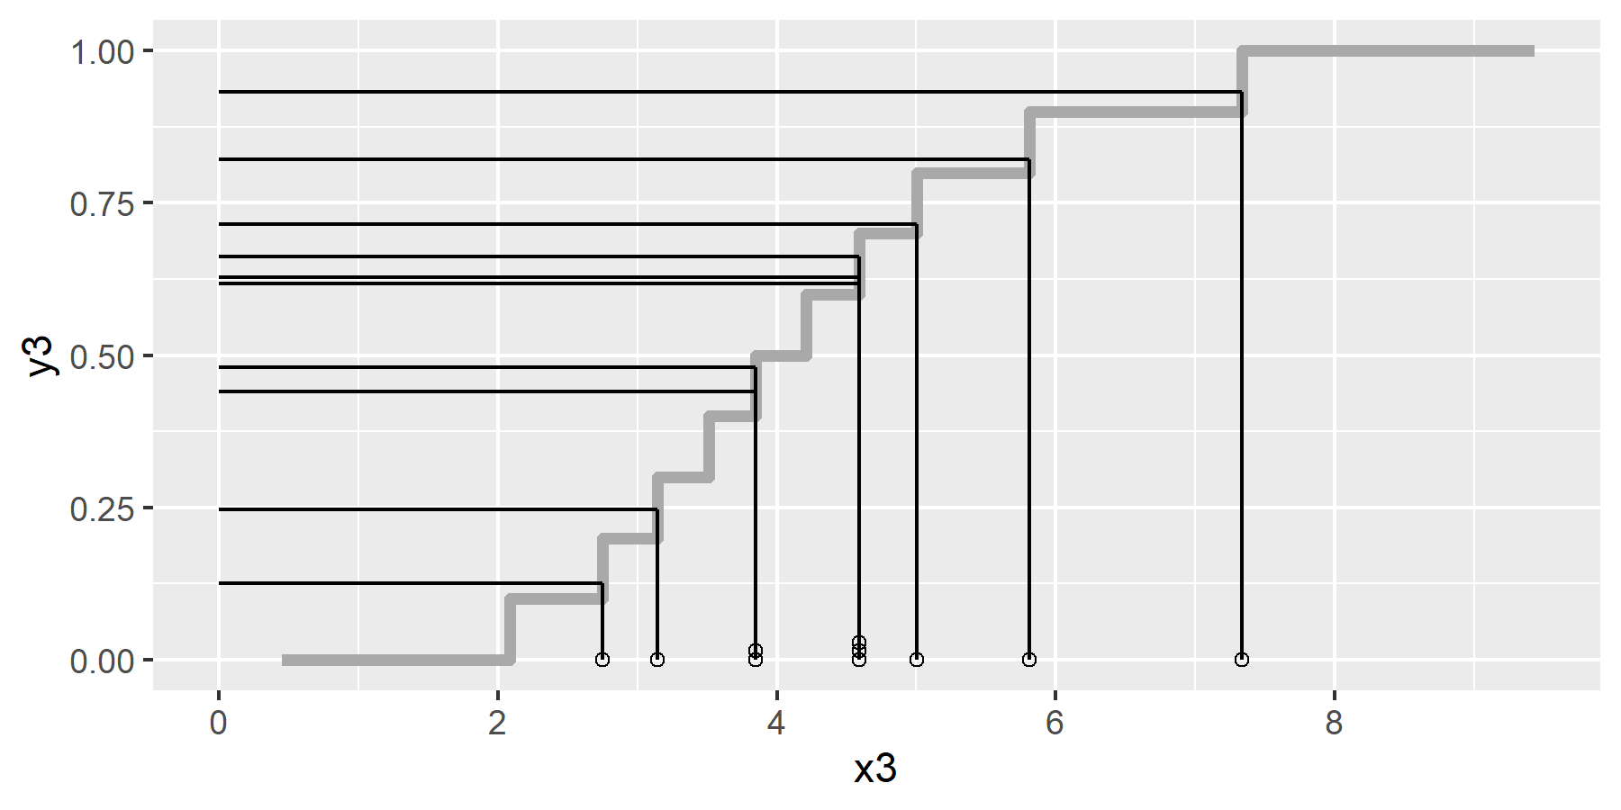
A bit of intuition about the bootstrap (6/6)
Figure 10. Random uniform values converted into a bootstrap
Notes:
If you can’t generate random variables from the true cumulative distribution function, then a good approximation would be to generate random variables from the empirical cumulative distribution function. Generate values on the Y-axis that are uniformly distributed on the interval 0 to 1, project over horizontally and then drop down to the X-axis.
What you’re doing here is sampling from the data with replacement. So, at least intuitively, this is equivalent to an approximate Monte Carlo simulation based on the empirical cumulative distribution function.
Notice in this example that some of the data values appear two or more times and others are not selected at all. Because it is done randomly, you get a reasonable set of simulated values, even without knowing the true underlying cumulative distribution function.

Slide 28
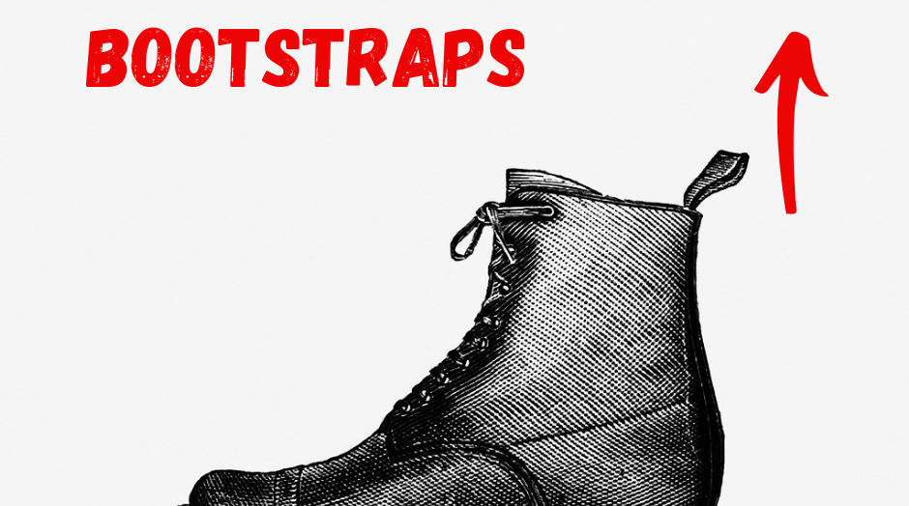
Meaning of the term “bootstrap”
Figure 11. Image of a bootstrap
Notes:
The name bootstrap comes from the saying “Lift yourself up by your bootstraps”. It is a reference to getting something done without any help. This is analogous to the statistical bootstrap. It produces results with just the data at hand and no outside help from an assumed distribution.
But the image of lifting yourself into the air by yanking on a loop of your shoe is also an analogy to doing something that seems impossible. The Useless Etymology website has a nice discussion of this saying, and the image you see here is taken from their website.
The origin of this phrase “Lift yourself up by your bootstraps” is unclear. Several web pages trace this phrase back to a book, The Surprising Adventures of Baron Munchausen. This was a litany of tall tales somewhat akin to the Paul Bunyan character in American folklore. One of the improbable tasks that Baron Munchausen did was lifting himself out of a deep well by pulling on his bootstraps.

Slide 29
Random Forests/Bagging (1/5)
Portmanteau for bootstrap aggregation
Used in random forests
Developed by Leo Breiman in 1996
Start with CART model
Classification And Regression Tree
Notes:
I want to briefly address bagging, an important application of the bootstrap to machine learning. Bagging is a portmanteau, a combination and shortening of two words: bootstrap aggregation.
The basic building block for bagging in the random forest model is the CART model. CART is an acronym for Classification and Regression Trees.

Slide 30
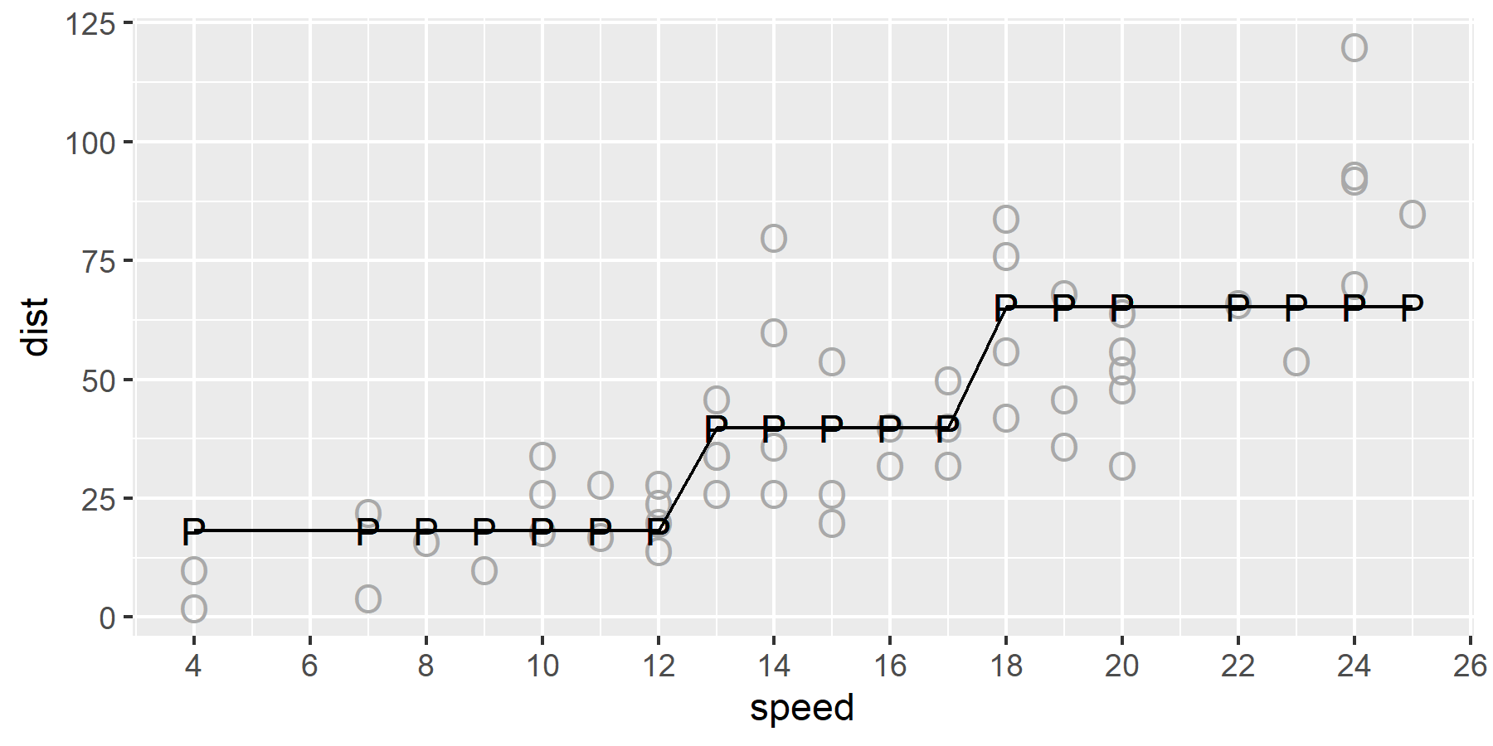
Random Forests/Bagging (2/5)
Figure 11. Regression tree predictions from a single model

Slide 31
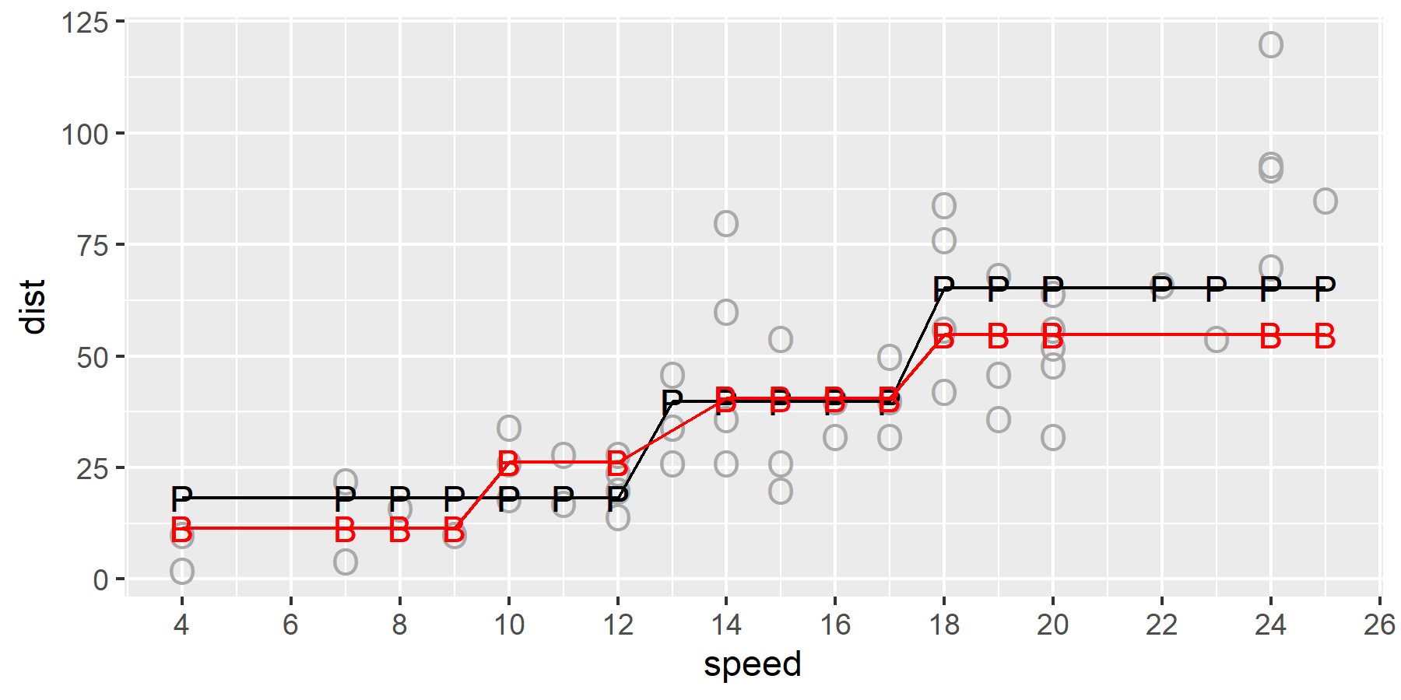
Random Forests/Bagging (3/5)
Figure 12. Regression tree predictions from a bootstrap sample
Notes:
Here are the results from a bootstrap sample. Notice how the regression tree from the bootstrap sample differs slightly from the regression tree from the original sample.
The regression tree might have different cut points. It might have only a single cut point or maybe three or more cut points.

Slide 32
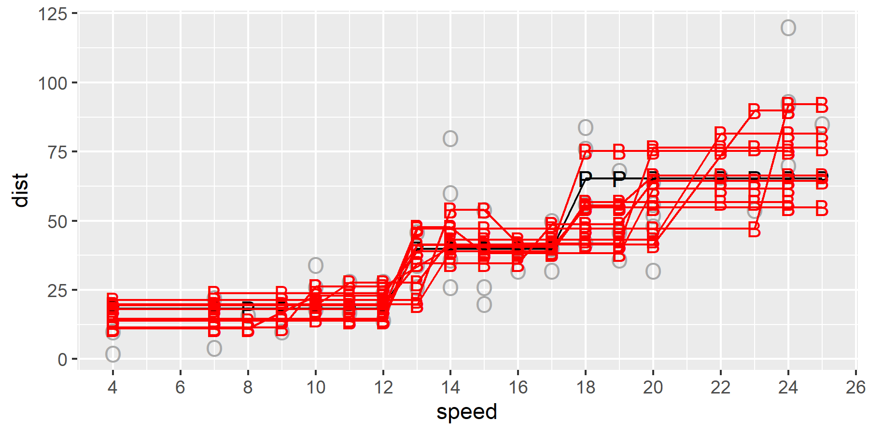
Random Forests/Bagging (4/5)
Figure 13. Regression tree predictions from multiple bootstrap samples
Notes:
Here are what the results look like for multiple bootstrap samples.
You would average the predicted values across all the bootstrap predictions to get a final average prediction.

Slide 33
Random Forests/Bagging (5/5)
Random forests are very good at
Modeling nonlinearities
Modeling interactions
Avoiding overfitting
Notes:
There are some additional enhancements to the Random Forest models, but the key element is the bagging step.
The regression tree itself has discrete jumps, so it is a bit artificial. But when you average across multiple trees, each having differing locations for the cut points and possibly a different number of cutpoints, this can end up producing a fairly broad range of nonlinearities.
This example is a bit simplistic, but regression trees are very good at identifying interactions, and this becomes another strong feature of random forests.
Finally, the random forest is really good at avoiding overfitting.
Note: Each bootstrap sample might produce a different set of independent variables, so you can’t say anything directly about which variables help the most in predicting the outcome. You can’t get p-values or confidence intervals for individual independent variables. There are some indirect ways to assess this, but I will not talk about these.

Slide 34
Break #1
What have you learned
History of the bootstrap
What’s coming next
Algorithms

Slide 35
Algorithms
Estimate bias
Calculate standard errors
Compute confidence intervals
Test hypotheses
Visualizations
How many bootstraps
Notes:
I want to show the algorithms used in bootstrapping. These fall into five categories: estimating bias, calculating standard errors, computing confidence intervals, testing hypotheses, and visualization. I also want to provide some guidance on how many bootstrap samples you need.

Slide 36
Evaluate estimates on bootstrapped samples
$\hat{θ}=\hat{θ}\left(X_{1},X_{2},...,X_{n}\right)$ is an estimate of $θ$.
Recalculate for B bootstrap samples
${\hat{θ}}^{\left(1\right)}=\hat{θ}\left(X_{1}^{\left(1\right)},X_{2}^{\left(1\right)},...,X_{n}^{\left(1\right)}\right)$
${\hat{θ}}^{\left(2\right)}=\hat{θ}\left(X_{1}^{\left(2\right)},X_{2}^{\left(2\right)},...,X_{n}^{\left(2\right)}\right)$
…
${\hat{θ}}^{\left(B\right)}=\hat{θ}\left(X_{1}^{\left(B\right)},X_{2}^{\left(B\right)},...,X_{n}^{\left(B\right)}\right)$
Notes:
For all of the proposed uses of the bootstrap, you start with an estimate based on the full dataset. Call that estimate theta-hat.
Then for each bootstrap sample, you calculate the same estimate. Call these theta-hat superscript 1, theta-hat superscript 2, all the way through to theta-hat superscript B, where B is the number of bootstrap samples.

Slide 37
Estimate bias
Compare the bootstrap average to the original estimate
$\overset{‾}{θ}−\hat{θ}$
where $\overset{‾}{θ}=\frac{1}{B}\sum_{b=1}^{B}{{\hat{θ}}^{\left(b\right)}}$
Notes:
To estimate bias, see how much the average of the bootstrapped estimates differs from the estimate based on the full sample.
For what it’s worth, many people (including myself) consider concerns about bias to be overblown. There are times when a biased estimate can be quite serious, especially if the bias is caused by a flaw in the sampling process. But debates about whether you should divide n versus n-1 in the formula for variance are a bit silly.
Furthermore, a small amount of bias in an estimator may be worth it if you can get less sampling error in return.
There’s no correct answer about if and when you should adjust for bias, but I am presenting it here as a simple application of the bootstrap. In all candor, the use of the bootstrap for calculating standard errors, computing confidence intervals, and testing hypotheses are far more common uses of the bootstrap.

Slide 38
Calculate standard errors
Calculate the standard deviation of the bootstrap estimates
$σ^{\left(B\right)}=\sqrt{\frac{1}{B−1}\sum_{b=1}^{B}{{\left({\hat{θ}}^{\left(b\right)}−\overset{‾}{θ}\right)}^{2}}}$
Notes:
You can use the standard deviation of the bootstrapped estimates as an estimate of the standard error of your statistic.
We’ll talk next about confidence intervals and hypothesis tests. But the question arises: why would you want a bootstrap estimate of the standard error if not to use it in a confidence interval or a hypothesis test?
Perhaps there is some value in getting the standard error using a classic approach and comparing it to the bootstrap estimate of the standard error. If the two are close, that gives you some reassurance that the classic approach is appropriate. If they differ, then examine things like whether the sample size is large enough to justify the normal approximation or if one of the assumptions that you need is questionable.

Slide 39
Compute confidence intervals
Use bootstrap standard error
Use percentiles from the bootstrap distribution
Use bias corrected and adjusted percentiles
Notes:
The most frequent use of the bootstrap, by far, is the creation of confidence intervals. There are many ways to do this, but three of the most common approaches are a classical interval using the bootstrap standard error, an interval that relies on percentiles from the bootstrap distribution, and some corrections that improve the accuracy of percentile confidence interval.

Slide 40
Compute confidence intervals, bootstrap standard error
Easy, once you have a standard error
${\hat{θ}}^{\left(b\right)}±z_{1−α/2}σ^{\left(B\right)}$
Should you use a t-distribution?
Uncertain degrees of freedom
Notes:
Once you have a standard error, the simplest confidence interval is going use the bootstrap estimate plus or minus a percentile from the standard normal distribution times the bootstrap standard deviation.
There is some controversy about whether you should use a t distribution here. I personally do not recommend it, because it is unclear what the degrees of freedom should be.
Other approaches may be preferred. The classic interval makes a pretty strong assumption. It assumes that the sampling distribution of the estimate is symmetric. Even so, the classical approach is still reasonable.

Slide 41
Compute confidence intervals, percentiles
Take percentiles directly from the bootstrap sample
Example, B=1000
Select the 25th and 975 observations in sorted order
Notes:
An even simpler approach is to take percentiles directly from the bootstrap sample. For this, you need a pretty large number of bootstrap samples. Although some sources say that a few hundred might be okay, I would recommend at least a thousand.
With a thousand bootstrap samples, you would select the 25th and 975th observations, after sorting the data.

Slide 42
Compute confidence intervals, Bias corrected and accelerated (BCa)
Very good convergence properties
Bias adjustment
Acceleration (skewness)
Notes:
There bootstrap standard error intervals and the percentile intervals work reasonably well, but you can improve significantly on the percentile interval using an approach known as bias correction and acceleration.
The work is tricky–So tricky that every reference that I reviewed showed these equations and immediately apologized for their complexity.
The bootstrap is good at identifying bias. It also allows you to look for skewness. The BCa approach shifts the percentiles to account for bias and skewness.
It’s a bit counter-intuitive, because the percentile intervals already adjust for bias and skewness, but shifting the percentiles can improve things even more.
It’s hard to define what “improve” means, but I’ll try. When you compute a 90% confidence interval, you expect that coverage probability is 90%. That means that 90% of the samples from the same underlying population with the same size as your sample will produce bootstrap confidence intervals that contain the population mean.
This 90% is only accurate for a sample size of infinity. For smaller sample sizes this is only approximate. The bigger the sample size the better the approximation.
Note that the approximation is based on the size of the original sample and not the number of bootstrap samples that you take.
The rate that the approximate coverage probability converges to the true coverage probability is a lot faster with the BCa adjustment. A lot faster.

Slide 43
Test hypotheses
Test
$H_{0}: θ≤0$
$H_{1}: θ>0$
Reject $H_{0}$ if fewer than $α$ of the ${\hat{θ}}^{\left(b\right)}$’s are less than 0.
Could also test using a bootstrap confidence interval
Notes:
To test a hypothesis, count the proportion of bootstrap values that agree with the null hypothesis. If it is less than alpha, then you reject the null hypothesis. Extension to two sided hypotheses is not difficult.
You could also look at any one of the bootstrap confidence intervals and see whether that interval includes or excludes the null value.

Slide 44
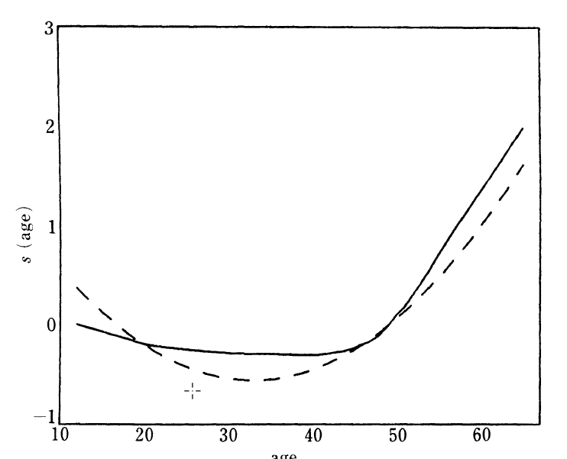
Visualization (1/3)
Figure 15. Age changes in risk for heart transplant patients
Notes:
This image comes from a 1986 publication in Statistical Science by Bradley Efron and Robert Tibshirani.
There are two curves shown here which show two different ways of measuring risk as a function of age. One estimate shows a flat level (same amount of risk) for anyone under 45 and the other shows an increase in risk for patients under 30. Which one is correct? The bootstrap can help answer this question.

Slide 45
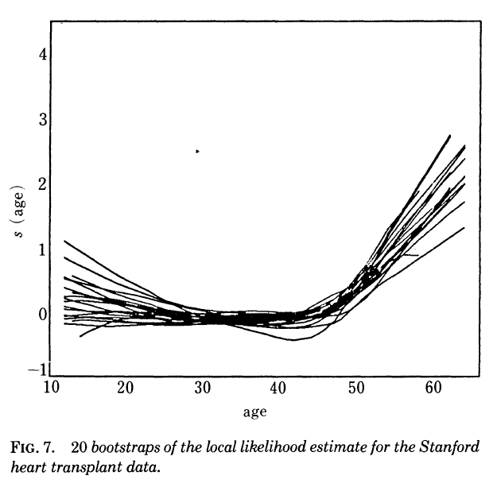
Visualization (2/3)
Figure 16. Age changes in risk using bootstrap samples
Notes:
The bootstrap curves show a few with an increase in risk at younger ages, but more showing a flat curve (same level of risk) and a few showing a further decrease in risk. So there is little evidence that risk increases for patients under 30.
In contrast, every single bootstrap sample shows an increase in risk after 45 years of age. That trend is well supported by the data.

Slide 46
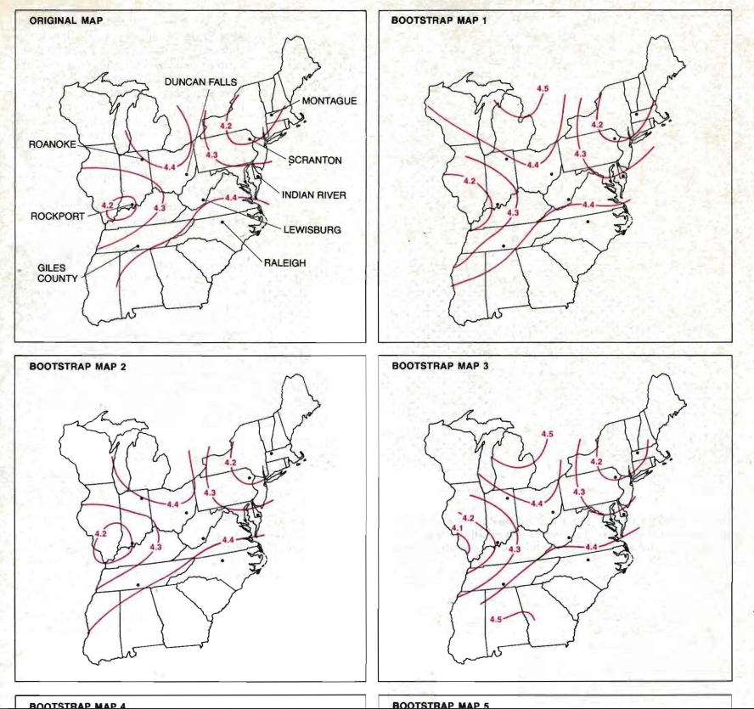
Visualization (3/3)
Figure 17. Map
Notes:
This figure is from a Scientific American article on the bootstrap.
It shows countour curves fir to the map of the eastern United States. The upper left panel uses contours from the original data and the remaining panels represent contours drawn from bootstrap samples. It’s a bit hard to read at this resolution, but it looks like the contours are reasonably stable.

Slide 47
How many bootstraps?
For estimating bias or a standard error: 50 to 100
For confidence intervals or hypothesis tests: 500 to 1,000
For visualization: 10 to 50
Notes:
Although there are no formal justifications, there is general consensus in the research community that you would need about 50 to 100 bootstrap samples to estimate bais or compute a standard error. You need an order of magnitude more bootstrap samples (500 to 1,000) if you are computing confidence intervals or hypothesis tests.
I have not seen any guidance on visualizations, but from a practical perspective you want to avoid so many bootstrap samples that the family of curves looks like a big black splotch. Around 10 to 50 seems to me to be about right.

Slide 48
Break #2
What you have learned
Algorithms
What’s coming next
Software
Notes:
You just saw the general algorithms for estimating bias, calculating standard errors, computing confidence intervals, testing hypotheses, and evaluating visualizations. Next you will see software applications in SAS, Stata, and R.

Slide 49
Software
You should know
How to loop (explicitly or implicitly)
How to extract specific values from the output
Why you should (should not) program a bootstrap
Examples
SAS
Stata
R
SPSS
Notes:
If you want to program a bootstrap, you need to have enough familiarity with your statistical software to run a loop and extract specific values from the output. Looping in SAS, Stata, and R can be done explicitly, but often the code is simpler if you take advantage of some implicit looping.
If the examples that follow seem a bit frightening, you might want to only use bootstraps that are completely automated for you. The advantage of the code shown on the following slides is that it allows you to apply a bootstrap in cases that are a little bit off in left field. In other words, cases that are different enough that no one has taken the trouble to fully automate them.
I want to show briefly, how to do a simple bootstrap in SAS, Stata, and R. It may be possible to do this in SPSS, but I am not familiar enough with SPSS to outline how the approach might work.

Slide 50
Bootstrap in SAS (1/10)
Example taken from UCLA Statistical Methods and Data Analytics site
ods output FitStatistics = t0; proc reg data = hsb2; model read = female math write ses; run; quit;
Notes:
This example is taken from the UCLA Statistical Methods and Data Analytics site. It pops up easily on a simple google search. Try the search terms “ucla,” “bootstrap,” and “sas.”
The first statement tells SAS that it should take the output from the following procedure, pull out a particular number from the output called “FitStatistics” and store it in a dataset with the name t0.
I’m guess that the “quit” statement is important here because of the way you are handling output with the ods statement.

Slide 51
Bootstrap in SAS (2/10)
*store the estimated r-square; data _null_; set t0; if label2 = "R-Square" then call symput('r2bar', cvalue2); run;
Notes:
The data step here creates a dataset with the sole purpose of moving the r-squared value from a dataset to a macro variable. The key function here is symput and if you are not familiar with it, check out the SAS documentation.

Slide 52
Bootstrap in SAS (3/10)
%let rep = 500; proc surveyselect data= hsb2 out=bootsample seed = 1347 method = urs samprate = 1 outhits rep = &rep; run; ods listing close;
Notes:
Although you could use a loop here, the surveyselect procedure allows you to create 500 bootstrap samples and store them all in a single dataset.

Slide 53
Bootstrap in SAS (4/10)
Sample Size 200 Expected Number of Hits 1 Sampling Weight 1 Number of Replicates 500 Total Sample Size 100000 Output Data Set BOOTSAMPLE
Notes:
Here is part of the output from surveyselect. The original dataset has 200 observations. You are creating 500 replicates using sampling with replacement. That creates a dataset of 100,000 observations.

Slide 54
Bootstrap in SAS (5/10)
ods output FitStatistics = t (where = (label2 = "R-Square")); proc reg data = bootsample; by replicate; model read = female math write ses; run; quit;
Notes:
The ods statement on the first line of code on this slide tells SAS to look at the output from the following procedure and store the result in a dataset called t.
The “by replicate” statement tells SAS to run a separate regression for each bootstrap sample.

Slide 55
Bootstrap in SAS (6/10)
* converting character type to numeric type; data t1; set t; r2 = cvalue2 + 0; run;
Notes:
The output stored in the dataset, however, is a string, and you have to convert it to a numeric value by adding zero. This is a classic SAS hack.

Slide 56
Bootstrap in SAS (7/10)
%let alphalev = .05; %let a1 = %sysevalf(&alphalev/2*100); %let a2 = %sysevalf((1 - &alphalev/2)*100);
Notes:
The first three lines are just a fancy way of getting from a 0.05 alpha level to selecting the 2.5 percentile and the 97.5 percentile.

Slide 57
Bootstrap in SAS (8/10)
* creating confidence interval, percentile method; proc univariate data = t1 alpha = .05; var r2; output out=pmethod mean = r2hat pctlpts=&a1 &a2 pctlpre = p pctlname = _lb _ub ; run;
Notes:
proc univariate produces the mean as well as the 2.5 and 97.5 percentiles. The pctlpre and pctlname make the variable names of the output dataset look nice.
Although the folks at UCLA take great pains to make everything look nice, they should have used a noprint option for proc univariate to keep the output cleaner.

Slide 58
Bootstrap in SAS (9/10)
data t2; set pmethod; bias = r2hat - &r2bar; r2 = &r2bar; run; ods listing;
Notes:
That &r2bar is a macro variable of the estimate of R-squared from the original dataset. You subtract it from the mean of the bootstrap samples (r2hat) to get the estimated bias.

Slide 59
Bootstrap in SAS (10/10)
proc print data = t2; var r2 bias p_lb p_ub; run; Obs r2 bias 1 0.5189 .0066164 p_lb p_ub 0.436 0.6017
Notes:
After all this careful work, you now have the original estimate of R-squared (52% after rounding), the estimated bias (less than 1%) and the confidence interval (44% to 60%).
As a quick recap, knowledge of the output delivery system (ods) and macro variables were critical. Thankfully, you did not need a loop here, but familiarity with looping mechanisms in SAS is probably worth knowing for other bootstrap examples.
If you want to learn more, Rick Wicklin of SAS Institute has a nice series of blog posts. Start with this one.

Slide 60
Bootstrap in Stata (1/4)
A bit easier
Built-in bootstrap command
Simpler handling of output
Example taken from UCLA Statistical Methods and Data Analytics site
Notes:
I am not an expert on Stata, but it was created in 1985 about two decades later than SAS. So it did not have any holdovers from the restricted options available in the age of IBM mainframe computers.
This example is taken from the UCLA Statistical Methods and Data Analytics site. It pops up easily on a simple google search. Try using the search terms “ucla,” “bootstrap,” and “stata.”

Slide 61
Bootstrap in Stata (2/4)
use http://statistics.ats.ucla.edu/stat/stata/notes/hsb2, clear regress read female math write ses
Notes:
Here is the Stata code to get the estimates from the original data.

Slide 62
Bootstrap in Stata (3/4)
bootstrap rmse=e(rmse), reps(100) seed(12345): regress read female math write ses
Notes:
Stata has a bootstrap function built-in. It is both a good thing and a bad thing. It is good in that it simplifies your code. It is bad in that it can only bootstrap on prespecified parts of the output. In fairness, this is also a limitation with the output delivery system in SAS. Both systems are pretty good at letting you pick out the pieces of the output that you are most interested in.

Slide 63
Bootstrap in Stata (4/4)
Observed Bootstrap Coef. Std. Err. rmse 7.184202 .2594069 Normal-based z P>|z| [95% Conf. Interval] 27.69 0.000 6.675774 7.69263
Notes:
Here is the output. By default, it provides a confidence interval based on the bootstrap standard error, but you can get other confidence intervals as well.
In this example, the original data produced a root mean squared error of 7.2 and the bootstrap 95% confidence interval goes from 6.7 to 7.7.

Slide 64
Bootstrap in R (1/4)
Easiest and most flexible choice
Special library
Simple looping stuctures
Easy to extract specific values
Example taken from UCLA Statistical Methods and Data Analytics site
Notes:
R was created in 1999, and relied on a modular approach that makes it ideal for bootstrapping. There is a special library that works for most cases, even some very exotic ones. Looping in R is easy as is extracting specific values.
Again, I am using an example from the UCLA Statistical Methods and Data Analytics site. It pops up easily on a simple google search. Try using the search terms “ucla,” “bootstrap,” and “r”.
By the way, one disadvantage of the R programming language is that a google search just using the term “r” is going to bring up a bunch of things related to the letter “r” other than just the R programming language. You don’t have as much trouble with SAS, although you might be routed to the Scandinavian Airlines website. Stockholm, anyone?

Slide 65
Bootstrap in R (2/4)
library(boot) hsb2 <- read.table("https://stats.idre.ucla.edu/stat/data/hsb2.csv", sep=",", header=T)
Notes:
You can read the data directly from the web.

Slide 66
Bootstrap in R (3/4)
fc <- function(d, i){ d2 <- d[i,] return(cor(d2$write, d2$math)) } set.seed(626) bootcorr <- boot(hsb2, fc, R=500)
Notes:
Define a function that takes your dataset and returns a single number. In this example, the single number is the correlation between two measures of knowledge. Plug this function into the boot function. This will prepare R=500 bootstrap samples and apply them to the function you just defined.
By the way, I get a lot of questions: should I learn R or Python or SAS or Stata or something else. There’s very little reason to prefer one over the other, but here’s a small thing. In R, you can use a function like “boot” and have it evaluate another function like “hsb2.” This seamless integration of functions within functions provides a powerful yet easy to use approach for handling complex settings.

Slide 67
Bootstrap in R (4/4)
Bootstrap Statistics : original bias std. error t1* 0.6174493 -0.001528707 0.04020362
Notes:
Here are the results. The correlation from the orginal data is 0.62 (I’m rounding here). There is almost no bias and the standard error demonstrates that there is very little sampling error.
You can get confidence intervals and hypothesis tests fairly easily as well. Go the the UCLA site for details.

Slide 68
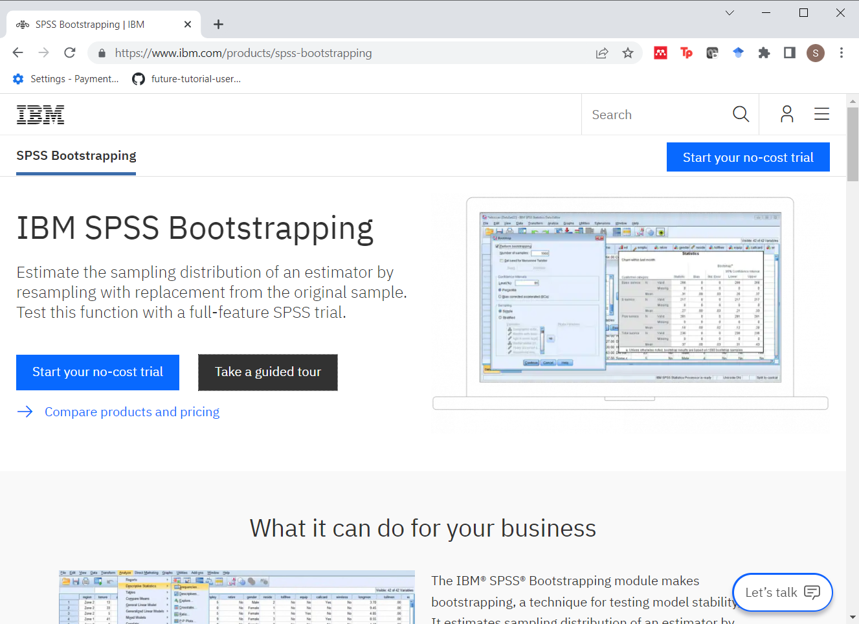
Bootstrap in SPSS (1/4)
Notes:
https://www.ibm.com/products/spss-bootstrapping
SPSS has a special add-on for bootstrapping. Thanks to Karen Grace-Martin for finding this. It is a separate license from SPSS, so you may or may not have it. I did not get a chance to investigate this in any detail, but it looks to work similarly to Stata. You find a place with standard errors and/or confidence intervals are computed in the main SPSS package and if you have the add-on package, you can request that the traditional standard errors and confidence intervals be replaced with bootstrap standard errors and confidence intervals.
According to their website, you can use this module to “etimate standard errors and confidence intervals of a population parameter such as a mean, median, proportion, odds ratio, correlation coefficient, regression coefficient or others. Control the numbers of bootstrap samples, set a random number seed and indicate whether a simple or stratified method is appropriate.”
You could also use the Python or R add-ons to SPSS to run a bootstrap. I am not familiar enough with either to show an example.

Slide 69
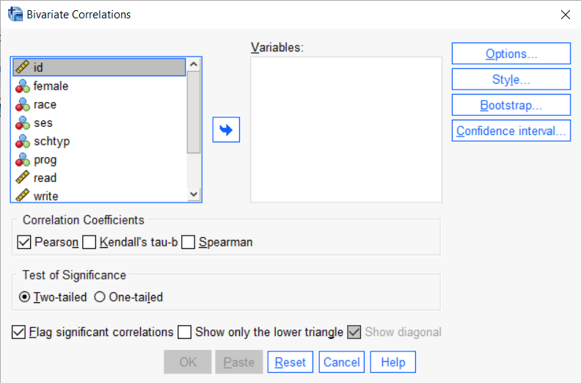
Bootstrap in SPSS (2/4)
Notes:
If you use the menus in SPSS rather than syntax, you may notice a button that reads “Bootstrap”. This is one such menu, after selecting ANALYZE | CORRELATE |BIVARIATE.

Slide 70
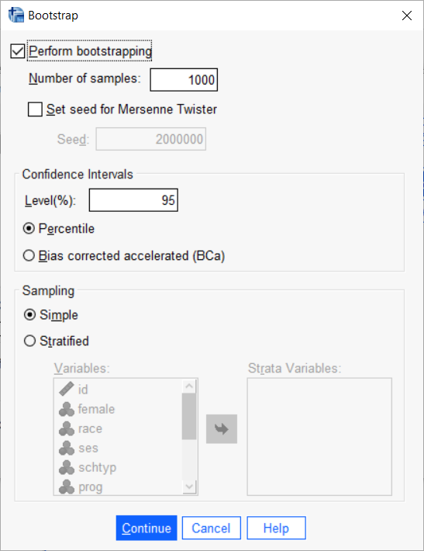
Bootstrap in SPSS (3/4)
Notes:
When you click on that button a new dialog box appears. Generally, the default options are good at least 90% of the time.

Slide 71
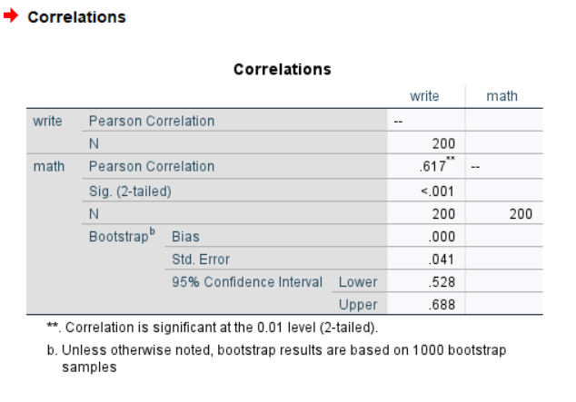
Bootstrap in SPSS (4/4)
Notes:
This is the output that SPSS produces.

Slide 72
Break #3
What have you learned
Software
What’s coming next
Special settings
Notes:
So you’ve seen how to apply the bootstrap in SAS, Stata, and R. Next, I want to discuss special settings where you might want to modify the bootstrap approach.

Slide 73
Special settings
Multiple groups
Time series
Regression models
Notes:
In more complex settings, you need to consider some modifications to the bootstrap. I have almost no experience in these settings and there is scant guidance in the published literature and on the web.
If you find yourself in one of these settings, I would encourage you to find a few publications that use the bootstrap in a setting reasonably similar to yours and emulate their approach.
I call this the “lemming school of research” which is a reference to the warning about peer pressure that almost every parent has nagged their children with (“If all your friends jumped off a cliff, would you jump off the cliff as well?”).
It actually is not as bad as I make it sound. If a certain methodology has survived the peer review process, that gives you a bit more confidence that you can survive the peer review process as well if you emulate their approach. There are no guarantees, of course, but this is perhaps an illustration of a more positive message: “there is safety in numbers.”
The three settings I want to discuss are multiple groups, time series, and regression models.

Slide 74
Multiple groups
Do you allow the group sizes to vary?
Stratified bootstrap
Two group example
Notes:
Suppose you have two or more groups and want to estimate a statistic across all of the groups. For example, you have a treatment and a control group and you want to estimate the difference in medians between the two groups.
You have two options. The first is to apply a simple bootstrap. This allows the relative sizes in the groups to vary. If one of the groups has a small relative sample size, then you run a slight risk having zero observations in that group for one or more of your bootstrap samples.
If the group sizes are all reasonably large, this is not a serious problem.
An alternative is to use a stratified bootstrap sample. It’s easy enough to envision with two groups. Let’s say that the two groups have sample sizes n1 and n2. Sample n1 observation with replacement from the first group, sample with n2 observations with replacement from the second group and then combine.
The stratified bootstrap answers a different question than the simple bootstrap. The simple bootstrap calculates uncertainty in a setting where you are collecting a single sample and that sample has a random number of subjects in each group. The stratified bootstrap calculates uncertainty where you are collecting samples from multiple groups, each with a fixed quota.
Is this a huge difference? I’m not sure, but my guess is that it is not all that important except when one or more of the group sizes is small. By small, I mean 10 or less. I should note, however, that I have not seen an “official” guidance on this question.

Slide 75
Time series
Simple bootstrap destroys important features of time series models
Evenly spaced observations
Serial correlation
Seasonality
Temporal trends
Solutions
Bootstrap blocks of consecutive observations
Detrend/decompose the time series
Notes:
There are special features of time series data that make them difficult to use with a simple bootstrap. The first and most obvious feature is that most time series have even spacing, a nice neatly ordered pattern over time. A bootstrap sample is going to have gaps in some places and multiple observations at the same time point.
Most time series also exhibit serial correlation, seasonality, and/or temporal trends. These features are either seriously distorted or totally destroyed in a bootstrap sample.
There are several possible solutions. One is to bootstrap consecutive blocks of observations. This preserves time series features within a block and appears to perform reasonably well.
A second option is to remove any trend and decompose the time series into independent components, take a bootstrap sample of the independent components, and then recompose a new series from the bootstrap sample.
The approach you take largely depends on the context of your problem and what statistic you are trying to characterize. For example, if you detrend the data and remove seasonality, then any bootstrapped estimate from the reconstructed time series will be fine if it is modeling a feature of the data other than the trend or seasonality.

Slide 76
Regression models
Subsample may have perfect collinearity
Are the independent variables fixed or random?
Solution: bootstrap residuals
Notes:
The regression model has some of the same issues as the setting with multiple groups described earlier. If some of the independent variables are very strongly correlated, you might end up with a setting where the correlation is exactly 1 for one or more of the bootstrap samples. This is not a serious issue unless you have both a strong correlation and a small sample size.
But another consideration is that the bootstrap sample treats the independent variables as if they are selected randomly along with the dependent variable. This may be the case, but there are some datasets where the X values are fixed in advance and the dependent variable is the only thing being sampled.
One possible solution is to compute the residuals and reconstruct a new dependent variable from the bootstrapped residuals.
Context is important here. If you bootstrap the residuals, you can’t use the reconstructed dependent variable as an estimate of the regression slopes themselves. You could use them to reconstruct a statistic that is independent of those slopes.

Slide 77
Final bits of advice (1/2)
Situations where the bootstrap performs poorly
Data from “weird” distributions
Statistics at or near the extremes
Situations where a simple bootstrap performs poorly
Multiple groups with small sample sizes
Time series models
Regression models
Notes:
Although the bootstrap works in a very broad range of settings, it can fail miserably in certain cases. Weird distributions like the Cauchy distribution which have no finite moment are going to cause problems. Also troublesome are statistics at or near the extremes of the data. The range, for example, is a statistic where the bootstrap does not perform well.
We’ve also talked about settings where a simple bootstrap does not perform well and may need some modification. This includes setting with multiple groups and small sample sizes, time series models, and regression models.

Slide 78
Final bits of advice (2/2)
Situations where the bootstrap performs well
Statistics with no known theoretical results
Statistics where approximations are questionable
But you can’t squeeze blood from a turnip.
Very small sample sizes are still very small sample sizes
Notes:
The bootstrap performs well in settings where you do not have any theoretical results to guide your work. It also works well when the normal approximations that you rely on are questionable, either because the sample size is small or because the underlying distribution of the data is troublesome. By troublesome, I mean extreme skew or high probability of producing outliers. Both will tend to slow down the asymptotic approximation to normality.
Keep in mind, though, that the bootstrap can’t compensate for a limited sample size. The confidence intervals may be valid, but often they will be so wide as to be meaningless. There’s a saying that you can’t squeeze blood from a turnip. That’s an attempt to explain that you can’t get something from nothing.

Slide 79
Summary
History
Algorithms
Software
Special settings
Notes:
So we’ve covered the history of the bootstrap, illustrated some algorithms, showed how to compute a bootstrap in SAS, Stata, and R, and discussed some special issues where you might want to modify the bootstrap approach.
I’d be glad to take any questions you might have.

Slide 80
Bibliography
Persi Diaconis, Bradley Efron. Computer-intensive Methods in Statistics. Scientific American, 1983, 248(5), 116-130.
Bradley Efron, Gail Gong. A Leisurely Look at the Bootstrap, Jackknife, and Cross-Validation. The American Statistician, 1983, 37(1), 36-48.
Bradley Efron, Robert Tibshirani. Bootstrap Methods for Standard Errors, Confidence Intervals, and Other Measures of Statistical Accuracy. Statistical Science, 1986, 1(1), 54-75.
Notes:
https://www.vanderbilt.edu/psychological_sciences/graduate/programs/quantitative-methods/quantitative-content/diaconis_efron_1983.pdf
http://users.cla.umn.edu/~nwaller/prelim/efronbootjackcrossv.pdf
http://www.nielsen.sites.oasis.unc.edu/soci709/cdocs/efron.pdf

