Slide 1
Introduction
Steve Simon

Slide 2

I will use my resume to introduce myself.
Resume, found at https://github.com/pmean/resume

Slide 3

I got my degree almost 40 years ago
Education section of my resume

Slide 4
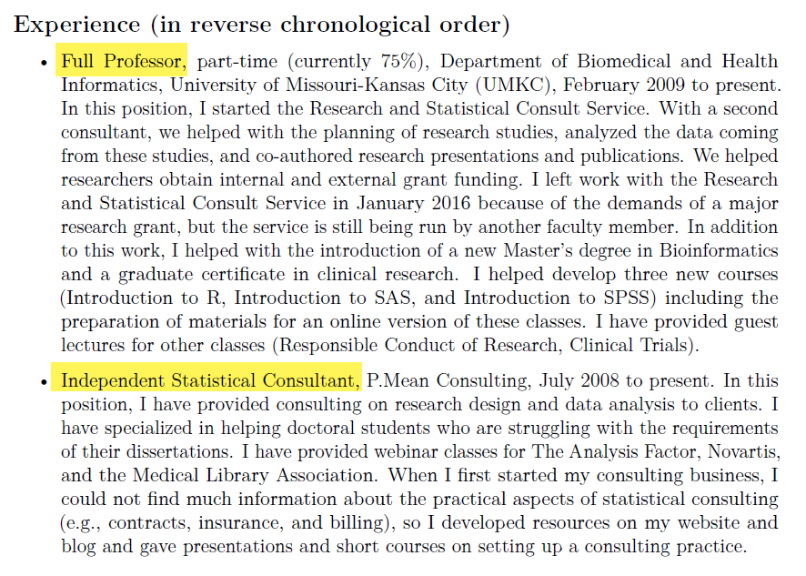
I juggle two part time jobs.
Experience section of my resume

Slide 5
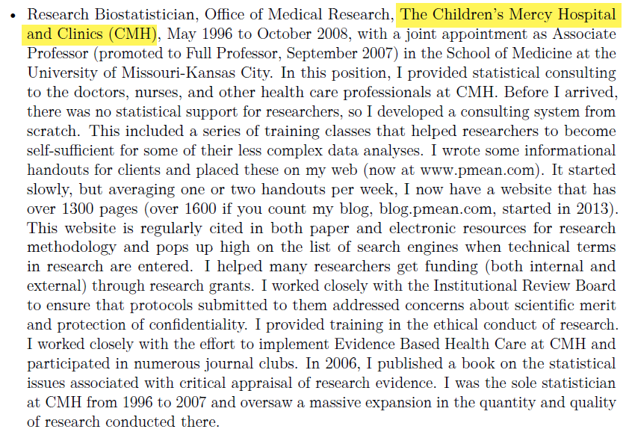
I used to work at a hospital, …
Work experience at Children’s Mercy Hospital

Slide 6
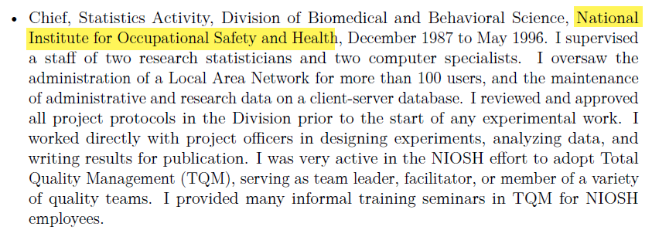
for Uncle Sam, …
Work experience at National Institute for Occupational Safety and Health

Slide 7
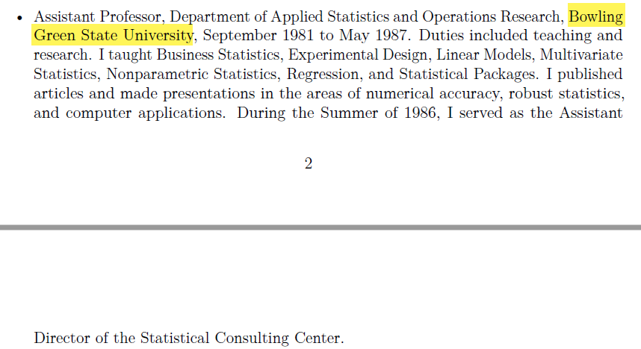
at a different University, …
Work experience at Bowling Green State University

Slide 8
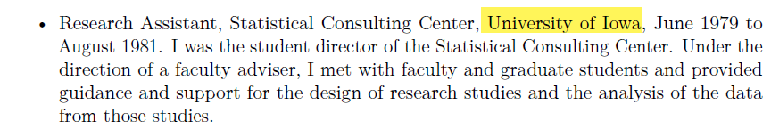
and as student director of a consulting center.
work experience at the Unversity of Iowa

Slide 9
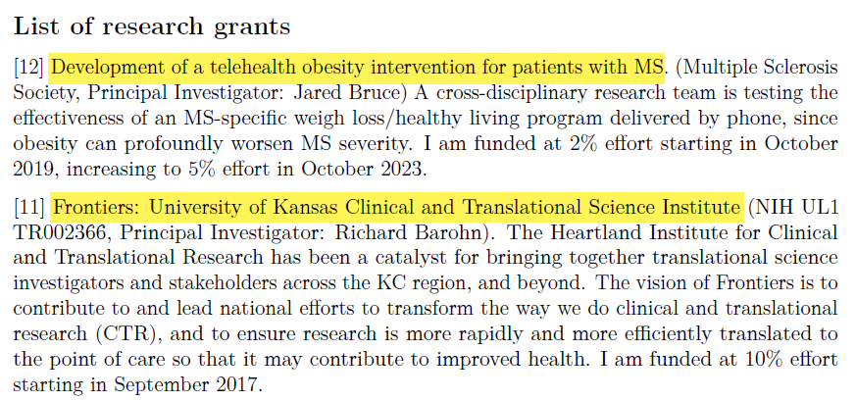
I’ve been on a few reserach grants, …
Two grants from my resume

Slide 10
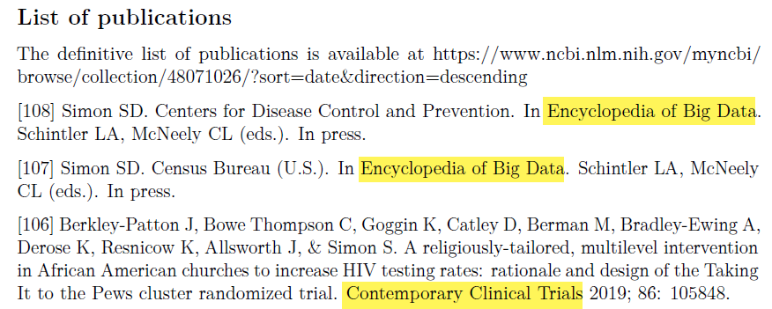
written a few papers, …
Three publications from my resume

Slide 11
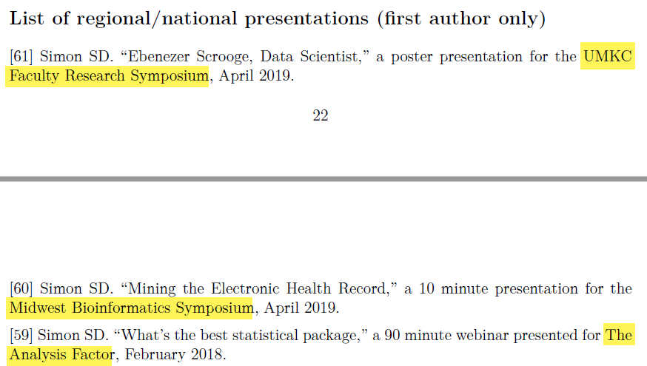
and given a few talks.
Three presentations from my resume

Slide 12
I’m not actively looking for a job, but …
These PowerPoint slides available at https://github.com/pmean/papers-and-presentations.
My resume available at https://github.com/pmean/resume.

Slide 13
What were the courses you have taken that have been the most beneficial for your job?
Applied courses outside Department of Statistics
Biostatistics, Education
Very practical advice
Specialized perspectives ()
Theory of Mathematical Statistics
KNowing foundations increases your confidence level
Also makes you a quick learner of new methods

Slide 14
Which aspects of your work did you learn on the job?

Slide 15
What, if anything, do you wish you knew before entering the workforce or taking your current position?

Slide 16
How much should an entry level statistician expect to make in your field? After 5 years of experience?
Outside my area of expertise (sorry!)
See various salary surveys

Slide 17
What do you recommend as the best places to look for new job opportunities?
Outside my area of expertise (sorry!)

Slide 18
How do you find your clients/collaborators?
Word of mouth
Let everyone know you are looking
Increase your visibility
Blogs
Social media
Presentations
Volunteer

Slide 19
What advice do you have to give regarding balancing competing priorities?
Life is short. Do the fun stuff first.
Ask your boss for priorities

Slide 20
What do you do when you have a project that is outside your level of expertise (who or what resources do you consult)?
Nothing is ever outside my area of expertise!
Just kidding
But I do try to know a bit about everything
Opportunity to learn on the job
Books, short courses, Internet resources
Build a network of helpers

Slide 21
What is an issue you have faced working with a client or collaborator, and what did you learn from it?
Get and give regular feedback

Slide 22
What are some ethical dilemmas you have faced in your job?
Asking for the impossible
“Blood from a turnip” test

