Slide 1
Posters using PageDown
Steve Simon

Slide 2
Hall of Fame for R ( 1 of 2)
John Chambers
Becker, Chambers and Wilks, The New S Language: A Programming Environment for Statistical Analysis and Graphics (1988)
Chambers and Hastie (Eds), Statistical Models in S (1992)
Ross Ihaka and Robert Gentleman
R: A language for data analysis and graphics. Journal of Computational and Graphical Statistics, 5(3):299-314, 1996. Available in PDF format

Slide 3
Hall of Fame for R (2 of 2)
William Venables and Brian Ripley
Modern Applied Statistics with S
Frank Harrell
Hmisc, rms packages
Hadley Wickham
tidyverse packages

Slide 4
Hall of Fame for R, latest addition (1 of 2)
Yihui Xie
animation: a gallery of animations in statistics and utilities to create animations, blogdown: create blogs and websites with R Markdown, bookdown: author books and technical documents with R Markdown, DT: a wrapper of the JavaScript library DataTables, formatR: Format R code automatically, knitr: Dynamic report generation with R, printr: Some printing methods for knitr, Rd2roxygen: Convert Rd to roxygen documentation

Slide 5
Hall of Fame for R, latest addition (2 of 2)
Yihui Xie
rlp: Write an R package using literate programming techniques, servr: a simple HTTP server to serve static files or dynamic documents, testit: a simple package for testing R packages, tinytex: a lightweight LaTeX distribution based on TeX Live, tufte: Tufte styles for R Markdown documents, xaringan: presentation ninja, xfun: miscellaneous functions

Slide 6
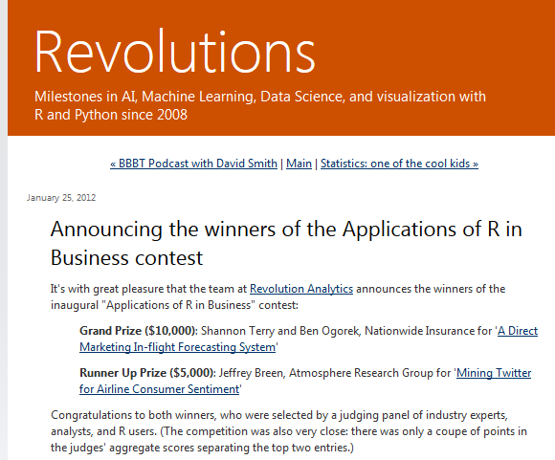
One degree of separation (1 of 2)
Revolutions blog entry

Slide 7
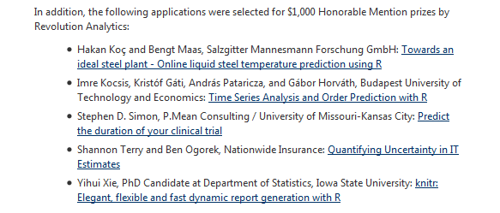
One degree of separation (2 of 2)
Revolutions blog entry

Slide 8

Strange fact about Yihui Xie
Image of Karl Broman

