Slide 1
Posters using PageDown
Steve Simon

Slide 2
Hall of Fame for R ( 1 of 2)
John Chambers
Becker, Chambers and Wilks, The New S Language: A Programming Environment for Statistical Analysis and Graphics (1988)
Chambers and Hastie (Eds), Statistical Models in S (1992)
Ross Ihaka and Robert Gentleman
R: A language for data analysis and graphics. Journal of Computational and Graphical Statistics, 5(3):299-314, 1996. Available in PDF format

Slide 3
Hall of Fame for R (2 of 2)
William Venables and Brian Ripley
Modern Applied Statistics with S
Frank Harrell
Hmisc, rms packages
Hadley Wickham
tidyverse packages

Slide 4
Hall of Fame for R, latest addition (1 of 2)
Yihui Xie
animation: a gallery of animations in statistics and utilities to create animations, blogdown: create blogs and websites with R Markdown, bookdown: author books and technical documents with R Markdown, DT: a wrapper of the JavaScript library DataTables, formatR: Format R code automatically, knitr: Dynamic report generation with R, printr: Some printing methods for knitr, Rd2roxygen: Convert Rd to roxygen documentation

Slide 5
Hall of Fame for R, latest addition (2 of 2)
Yihui Xie
rlp: Write an R package using literate programming techniques, servr: a simple HTTP server to serve static files or dynamic documents, testit: a simple package for testing R packages, tinytex: a lightweight LaTeX distribution based on TeX Live, tufte: Tufte styles for R Markdown documents, xaringan: presentation ninja, xfun: miscellaneous functions

Slide 6
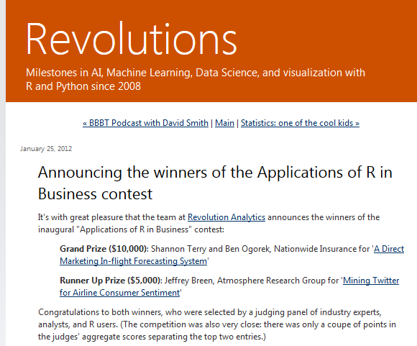
One degree of separation (1 of 2)
Revolutions blog entry

Slide 7
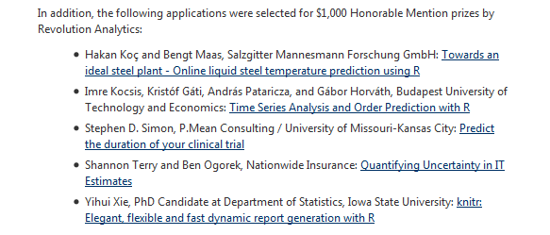
One degree of separation (2 of 2)
Revolutions blog entry

Slide 8
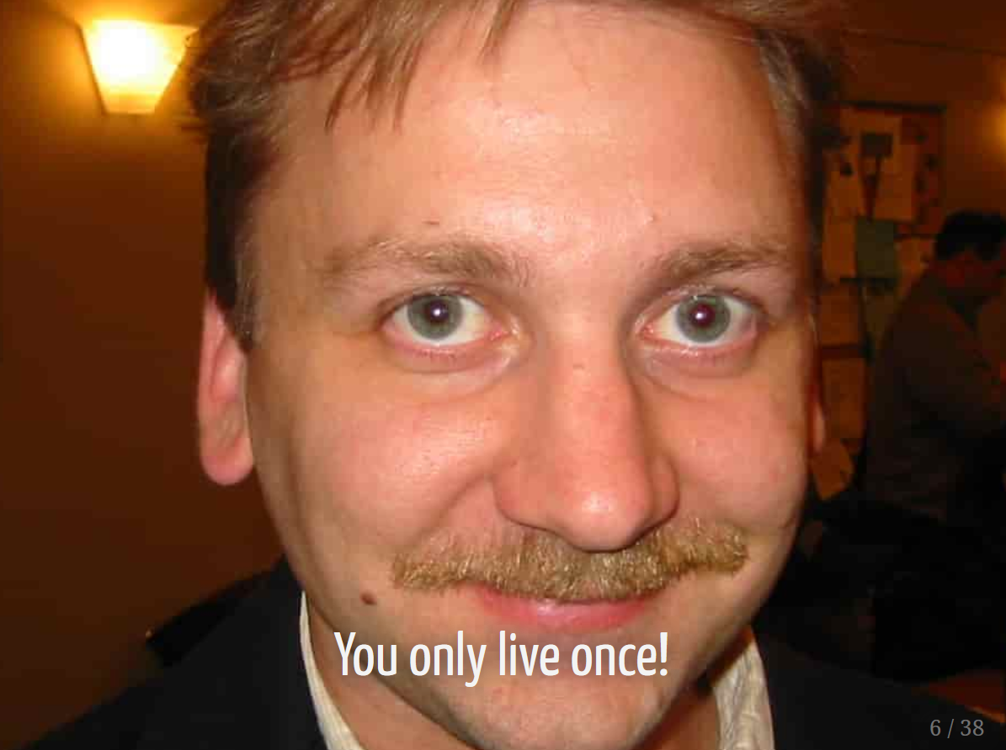
Strange fact about Yihui Xie
Image of Karl Broman

Slide 9
Yihui Xie’s major contributions to R
Using markdown language in creative ways
Successor to sweave

Slide 10
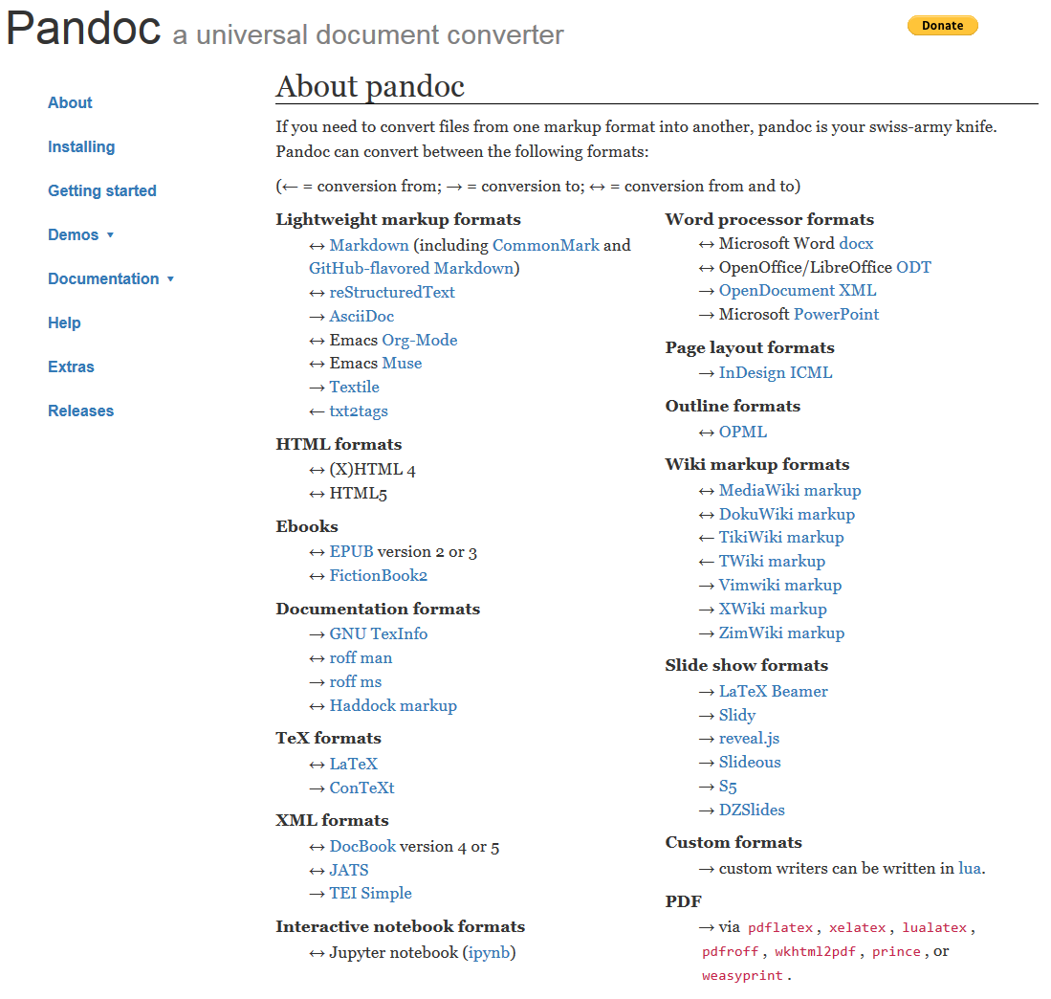
Pandoc is the foundation
Pandoc website

Slide 11
Markdown
Simplified version of markup (html, LaTeX)
Smaller feature set
Readable input
Easy to learn
Similar in spirit to yaml

Slide 12
What can you create?
Web pages
Blog site
Books
PDF documents
Presentations
Powerpoint
html presentations (ioslides, slidy)
PDF presentations (Beamer)

Slide 13
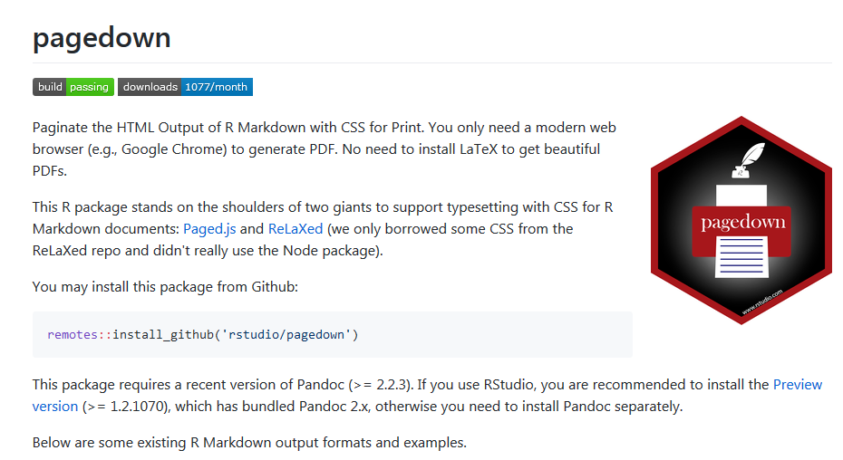
Pagedown
pagedown readme file

Slide 14
Why pagedown?
Paged
Features not found in knitr, bookdown

