Slide 1
Test
Steve Simon

Slide 2

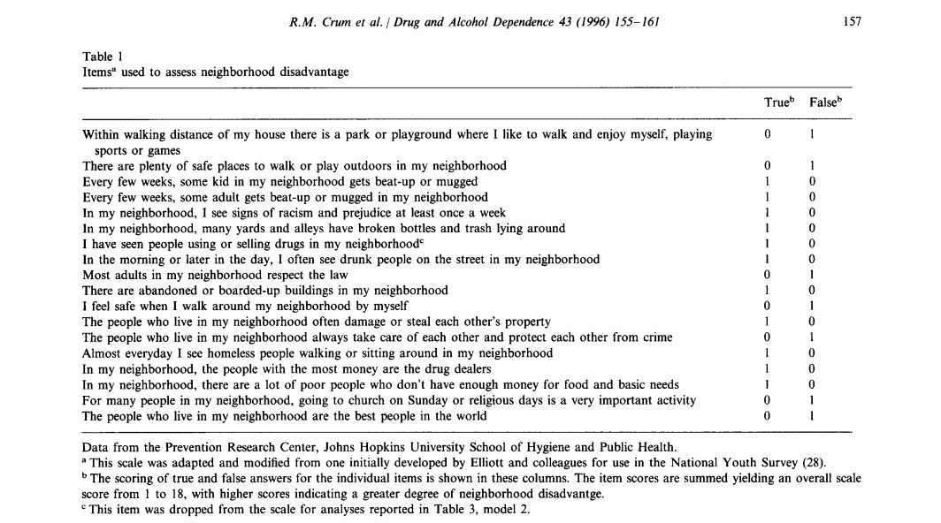
Two column format
Notes:
Test notes.

