Slide 1
Model fitting and diagnostics for the Cox model
Steve Simon

Slide 2
Abstract
Lecture 4. Model fitting and diagnostics for the Cox model. In this lecture, you will work with more complex forms of the Cox model with multiple predictor variables. You’ll include covariates in the Cox model to produce risk adjusted survival curves. You will also assess the underlying assumptions of the Cox model, particularly the assumption of proportional hazards.

Slide 3
Review the whas500 data set
## id age gender hr sysbp diasbp bmi cvd afb ## 1 1 83 Male 89 152 78 25.54051 No Yes ## 2 2 49 Male 84 120 60 24.02398 No No ## sho chf av3 miord mitype year ## 1 No No No Recurrent Non Q-wave <NA> ## 2 No No No First Q-wave <NA> ## admitdate disdate fdate los dstat ## 1 01/13/1997 01/18/1997 12/31/2002 5 Alive ## 2 01/19/1997 01/24/1997 12/31/2002 5 Alive ## lenfol fstat time_yrs ## 1 2178 Alive 5.963039 ## 2 2172 Alive 5.946612

Slide 4
Model fitting strategies
Fit univariate models first.
Add variables one at a time or in very small batches.
Look at interactions and nonlinearities last.

Slide 5
Univariate model for age
## term hr p.value conf.int ## 1 age 1.07 0.001 1.06 to 1.08

Slide 6
Univariate model for gender
## term hr p.value conf.int ## 1 genderFemale 1.46 0.006 1.12 to 1.92

Slide 7
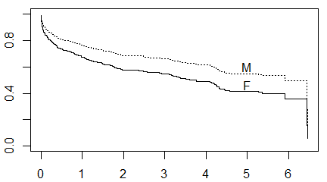
Estimated survival by gender

Slide 8
Model with age and gender
## term hr p.value conf.int ## 1 age 1.07 0.637 1.06 to 1.08 ## 2 genderFemale 0.94 0.637 0.71 to 1.23

Slide 9
What is happening here?
The average age across all subjects is 69.8, but the averages by gender are quite different. For males, the average age is 66.6, but for females, the average age is 74.7.

Slide 10
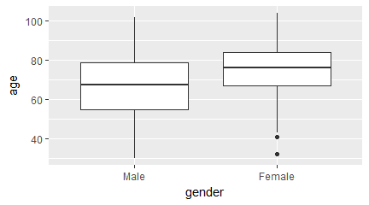
Boxplots of age by gender

Slide 11
## term estimate std.error statistic ## 1 age 0.06692776 0.006195843 10.8020422 ## 2 genderFemale -0.06628511 0.140584936 -0.4714951 ## p.value conf.low conf.high ## 1 0.0000000 0.05478413 0.07907139 ## 2 0.6372872 -0.34182652 0.20925630

Slide 12
Adjusting for covariate imbalance
There is a 8.1 year difference between the average ages of men and women. The hazard ratio for age, 1.069, can get extrapolated to a 8.1 year difference by exponentiating. That is 1.069^8.1 = 1.72 which is actually larger than the hazard ratio that we saw for the unadjusted model with just gender.

Slide 13
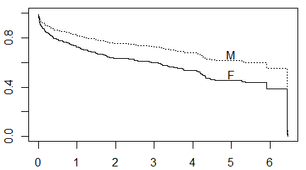
66.6 year male versus 74.7 year female

Slide 14
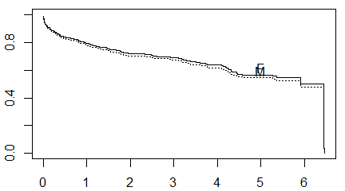
69.8 year male versus 69.8 year female

Slide 15
Univariate analysis of bmi
## term hr p.value conf.int ## 1 bmi 0.91 0.001 0.88 to 0.93

Slide 16
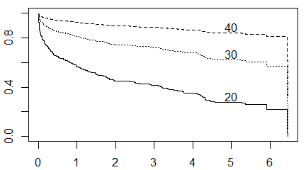
Unadusted survival curves for different bmi values

Slide 17
Adjusting bmi for age, gender
## term hr p.value conf.int ## 1 bmi 0.96 0.509 0.93 to 0.99 ## 2 age 1.06 0.509 1.05 to 1.08 ## 3 i_female 0.91 0.509 0.69 to 1.2

Slide 18
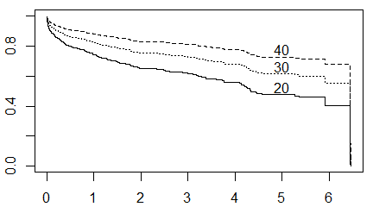
Adjusted bmi survival plots

Slide 19
An interaction model; the raw interaction is hard to interpret
## term hr p.value conf.int ## 1 age 1.08 0.019 1.06 to 1.1 ## 2 i_female 10.32 0.019 1.47 to 72.19 ## 3 age:i_female 0.97 0.019 0.95 to 0.99

Slide 20
Interaction using centered values is easier to interpret
## term hr p.value conf.int ## 1 age_c 1.08 0.244 1.06 to 1.1 ## 2 i_female 1.23 0.244 0.87 to 1.73 ## 3 age_c:i_female 0.97 0.244 0.95 to 0.99

Slide 21
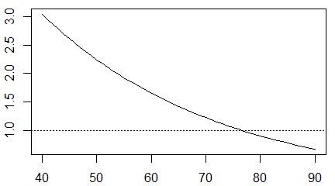
Gender hazard ratio by age

Slide 22
You can use a sequence of Wald tests to compare different models
## Model 1
## term hr p.value conf.int ## 1 genderFemale 1.46 0.006 1.12 to 1.92
## ## Model 2
## term hr p.value conf.int ## 1 age 1.07 0.637 1.06 to 1.08 ## 2 genderFemale 0.94 0.637 0.71 to 1.23
## ## Model 3
## term hr p.value conf.int ## 1 bmi 0.96 0.509 0.93 to 0.99 ## 2 age 1.06 0.509 1.05 to 1.08 ## 3 genderFemale 0.91 0.509 0.69 to 1.2

Slide 23
Comparing using likelihoods
You use the log partial likelihood and/or the AIC (Akaike Information Criteria) to compare models of different complexity.
AIC = -2 log Likelihood + 2 k.
AIC = -2 log Likelihood + log(n) k.

Slide 24
AIC comparisons
## lab logLik AIC BIC ## 1 gender only -1223.522 2449.043 2452.414 ## 2 gender, age -1156.138 2316.276 2323.017 ## 3 gender, age, bmi -1152.310 2310.620 2320.732

Slide 25
Martingale residuals
There are several residuals available for Cox regression. The Martingale residual is defined as
$M(t_{i})=δ_{i}−H_{0}(t_{i})e^{Xβ}$
where $δ_{i}$ = 0 if censored, 1 if dead.

Slide 26
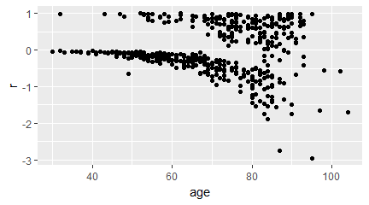
Residual plot for age

Slide 27
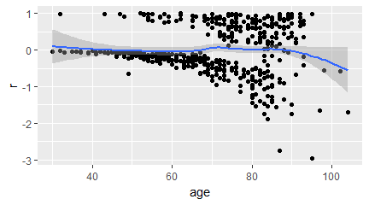
Residual plot for age with smoothing line

Slide 28
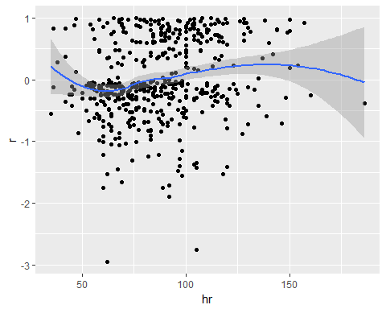
Residual plots for hr

Slide 29
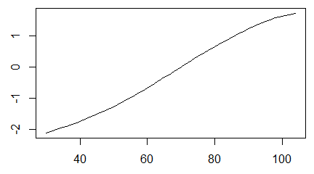
Header

Slide 30
## lab logLik AIC BIC ## 1 linear (df=1) -1152.310 2310.620 2320.732 ## 2 spline (df=3) -1151.288 2308.714 2319.058 ## 3 spline (df=8) -1143.118 2302.204 2329.116

Slide 31
Header
Testing.

Slide 32
Header
## Call: ## coxph(formula = Surv(time_yrs, fstat == "Dead") ~ hr, data = whas500) ## ## coef exp(coef) se(coef) z p ## hr 0.01505 1.01516 0.00269 5.6 2.1e-08 ## ## Likelihood ratio test=28.9 on 1 df, p=7.45e-08 ## n= 500, number of events= 215
## Call: ## coxph(formula = Surv(time_yrs, fstat == "Dead") ~ sysbp, data = whas500) ## ## coef exp(coef) se(coef) z p ## sysbp -0.00452 0.99549 0.00223 -2.03 0.042 ## ## Likelihood ratio test=4.19 on 1 df, p=0.0406 ## n= 500, number of events= 215
## Call: ## coxph(formula = Surv(time_yrs, fstat == "Dead") ~ diasbp, data = whas500) ## ## coef exp(coef) se(coef) z p ## diasbp -0.01602 0.98411 0.00328 -4.88 1.1e-06 ## ## Likelihood ratio test=23.8 on 1 df, p=1.07e-06 ## n= 500, number of events= 215
## Warning in fitter(X, Y, strats, offset, init, ## control, weights = weights, : Loglik converged ## before variable 1 ; beta may be infinite.
## Call: ## coxph(formula = Surv(time_yrs, fstat == "Dead") ~ cvd, data = whas500) ## ## coef exp(coef) se(coef) z p ## cvdYes 2.19e+01 3.20e+09 2.20e+03 0.01 0.99 ## ## Likelihood ratio test=568 on 1 df, p=0 ## n= 500, number of events= 215
## Call: ## coxph(formula = Surv(time_yrs, fstat == "Dead") ~ afb, data = whas500) ## ## coef exp(coef) se(coef) z p ## afbYes 0.540 1.716 0.165 3.26 0.0011 ## ## Likelihood ratio test=9.58 on 1 df, p=0.00196 ## n= 500, number of events= 215
## Call: ## coxph(formula = Surv(time_yrs, fstat == "Dead") ~ sho, data = whas500) ## ## coef exp(coef) se(coef) z p ## shoYes 1.190 3.288 0.256 4.65 3.4e-06 ## ## Likelihood ratio test=15.8 on 1 df, p=6.87e-05 ## n= 500, number of events= 215
## Call: ## coxph(formula = Surv(time_yrs, fstat == "Dead") ~ chf, data = whas500) ## ## coef exp(coef) se(coef) z p ## chfYes 1.200 3.319 0.138 8.69 <2e-16 ## ## Likelihood ratio test=72.3 on 1 df, p=0 ## n= 500, number of events= 215
## Call: ## coxph(formula = Surv(time_yrs, fstat == "Dead") ~ av3, data = whas500) ## ## coef exp(coef) se(coef) z p ## av3Yes 0.479 1.614 0.390 1.23 0.22 ## ## Likelihood ratio test=1.31 on 1 df, p=0.252 ## n= 500, number of events= 215
## Call: ## coxph(formula = Surv(time_yrs, fstat == "Dead") ~ miord, data = whas500) ## ## coef exp(coef) se(coef) z ## miordRecurrent 0.427 1.532 0.139 3.07 ## p ## miordRecurrent 0.0022 ## ## Likelihood ratio test=9.14 on 1 df, p=0.0025 ## n= 500, number of events= 215
## Call: ## coxph(formula = Surv(time_yrs, fstat == "Dead") ~ mitype, data = whas500) ## ## coef exp(coef) se(coef) z ## mitypeQ-wave -0.660 0.517 0.167 -3.95 ## p ## mitypeQ-wave 7.9e-05 ## ## Likelihood ratio test=17.5 on 1 df, p=2.94e-05 ## n= 500, number of events= 215

