Slide 1
Parametric survival models
Steve Simon

Slide 2
Abstract
Lecture 5. Parametric models. Parametric models provide an alternative analysis to the Cox proportional hazards model. You’ll compare the hazard function for various popular survival distributions and understand the advantages and disadvantages of a parametric approach to survival. You’ll fit parametric models and interpret the coefficients.

Slide 3
The “standard” exponential distribution
The probability density function for the “standard” exponential distribution is
$f(t)=e^{−t}$
and the survival curve is
$S(t)=e^{−t}$
The hazard function for the “standard” exponential distribution is
$h(t)=1$
Notes:
The simplest distribution for survival outcomes is the exponential distribution. You can’t use a normal distribution because every normal distribution extends into negative values, which are not allowed in survival analysis.
The “standard” exponential distribution (my term) has a rate parameter of 1.

Slide 4
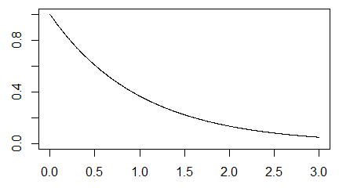
Plot of the survival curve

Slide 5
Exponential distibution with a rate parameter
You can include a rate parameter, $λ$, to create a density,
$f(t;λ)=λe^{−λt}$
and the survival curve is
$S(t;λ)=e^{−λt}$

Slide 6
Exponential distribution with a scale parameter
There is an equivalent form using a scale parameter, $θ$,
$f(t;θ)=\frac{1}{θ}e^{−t/θ}$
$S(t;θ)=e^{−t/θ}$

Slide 7
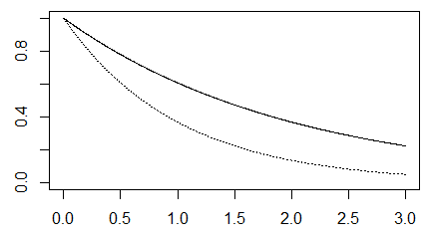
Density function for an exponential distribution with theta=2.

Slide 8
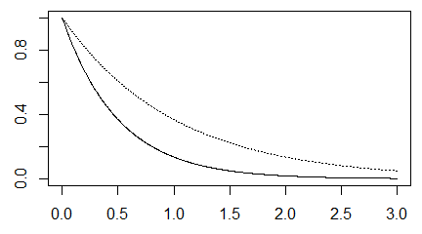
Density function for an exponential distribution with theta=0.5.

Slide 9
Accelerated time model
The accelerated time model replaces $θ$ with
$e^{(β_{0}+β_{1}X)}$
This produces the survival curve
$S(t,X,β_{0},β_{1})=e^{−t/e^{(β_{0}+β_{1}X)}}$
The values of $β_{0}$ and $β_{1}$ will end up stretching or shrinking the time scale.

Slide 10
Percentiles
The pth percentile of the accelerated time model is
$−ln(1−p)e^{β_{0}+β_{1}X}$
and the ratio of percentiles is
$\frac{−ln(1−p)e^{β_{0}+β_{1}X_{1}}}{−ln(1−p)e^{β_{0}+β_{1}X_{2}}}=e^{β_{1}(X_{1}−X_{2})}$
If $X_{1}$ is one unit larger than $X_{2}$, this reduces to
$e^{β_{1}}$.

Slide 11
Different, but not different
The hazard function is
$h(t,x,β_{0},β_{1})=e^{−(β_{0}+β_{1}x)}$
Notice that the hazard is constant with respect to t.
The baseline hazard, the hazard when X=0 is
$h_{0}(t)=e^{−β_{0}}$

Slide 12
Different, but not different
The hazard ratio for a subject with $x=x_{1}$ compared to a subject with $x=x_{2}$ is
$e^{−β_{1}(x_{1}−x_{2})}$

Slide 13
Likelihood ratio test
Here’s a quick review of the likelihood ratio test, as it applies to the exponential accelerated time model.

Slide 14
First, let’s fit a null model.

Slide 15
Some summary statistics
## [1] 4.121561
## ## Alive Dead ## 49 51
The intercept in the null model is 2.09.
$h(t,x,β_{0},β_{1})=e^{−(β_{0}+β_{1}x)}$.
Notice that the hazard is constant with respect to t. The baseline hazard, the hazard when X=0 is
$h_{0}(t)=e^{−β_{0}}$
The hazard ratio for a subject with $x=x_{1}$ compared to a subject with $x=x_{2}$ is
$e^{−β_{1}(x_{1}−x_{2})}$

Slide 16
Mathematical details
How do you arrive at this mathematically. For the null model, the density is
$f(t)=\frac{1}{e^{β_{0}}}e^{−t/e^{β_{0}}}$
and the survival curve is
$S(t)=e^{−t/e^{β_{0}}}$
The likelihood for any parametric regression model is
$L(β)=Π_{i}f(t_{i})^{c_{i}}S(t_{i})^{1−c_{i}}$
Note that for deaths, you use the density, but for censored observations, you use the survival function, which can be thought of as the “average” density from time $t_{i}$ to infinity.

Slide 17
Details, part 2
Let $n_{0}$ reprensent the number of censored observations and $n_{1}$ the number of deaths. Then
$L(β_{0})=Π_{1}\frac{1}{e^{β_{0}}}e^{−t/e^{β_{0}}}Π_{0}e^{−t/e^{β_{0}}}$
Where $Π_{1}$ represents the product across all deaths and $Π_{0}$ represents the product across all censored observations. This simplifies to
$L(β_{0})=\frac{1}{e^{n_{1}β_{0}}}e^{−(n_{0}+n_{1})\overline{t}/e^{β_{0}}}$
The log likelihood is
$l(β_{0})=−n_{1}β_{0}−(n_{0}+n_{1})\overline{t}e^{−β_{0}}$

Slide 18
Details, part 3
To find the maximum, take the derivative and set it equal to zero.
$\frac{∂l}{∂β_{0}}=−n_{1}+(n_{0}+n_{1})\overline{t}e^{−β_{0}}=0$
$(n_{0}+n_{1})\overline{t}e^{−\overset{̂}{β_{0}}}=n_{1}$
$e^{−\overset{̂}{β_{0}}}=\frac{n_{1}}{(n_{0}+n_{1})\overline{t}}$
$e^{\overset{̂}{β_{0}}}=\frac{n_{0}+n_{1}}{n_{1}}\overline{t}$
$\overset{̂}{β_{0}}=log\left(\frac{n_{0}+n_{1}}{n_{1}}\overline{t}\right)$

Slide 19
Details, part 4
Notice that the overall mean is $\overline{t}$ = 4.122 and that there are $n_{0}$ = 49 censored observations and $n_{1}$ = 51 deaths. The estimate of $\overset{̂}{β_{0}}$ is
log((49+51) / 51 4.122) = 2.09.
The second derivative of the log likelihood is
$\frac{∂^{2}l}{(∂β_{0})^{2}}=−(n_{0}+n_{1})\overline{t}e^{−β_{0}}$
If you compute this negative of this second derivative at the maximum likelihood estimate, $\overset{̂}{β_{0}}$, you get the information matrix,
$I(\overset{̂}{β_{0}})=(n_{0}+n_{1})\overline{t}e^{−log\left(\frac{n_{0}+n_{1}}{n_{1}}\overline{t}\right)}$
$=(n_{0}+n_{1})\overline{t}\left(\frac{n_{1}}{(n_{0}+n_{1})\overline{t}}\right)$
$=n_{1}$

Slide 20
Standard error
The standard error of the maximum likelihood estimate is
$\frac{1}{\sqrt{I(\overset{̂}{β_{0}})}}$
which is simply
$\frac{1}{\sqrt{n_{1}}}$
Note that the precision of the estimator is influenced only by deaths and not by censored observations.

Slide 21
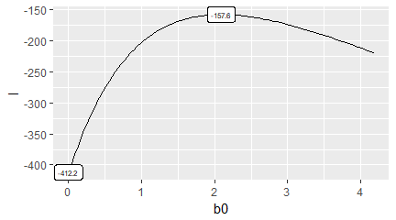
Null calculations

Slide 22
Parametric model with gender
Now let’s fit a model with gender as an independent variable. The survival curve is
$S(t)=e^{−t/e^{β_{0}}}$
for males and
$S(t)=e^{−t/e^{β_{0}+β_{1}}}$
for females. The density functions for males and females are
$f(t)=\frac{1}{e^{β_{0}}}e^{−t/e^{β_{0}}}$
$f(t)=\frac{1}{e^{β_{0}+β_{1}}}e^{−t/e^{β_{0}+β_{1}}}$

Slide 23
Parametric, part 2
The likelihood for any parametric regression model is
$L(β)=Π_{i}f(t_{i})^{c_{i}}S(t_{i})^{1−c_{i}}$
For this particular model, partition the observations into four sets: female censored ($F_{0}$), female deaths ($F_{1}$), male censored ($M_{0}$), and male deaths ($M_{1}$), with $f_{0}$, $f_{1}$, $m_{0}$, and $m_{1}$ observations in each group. Then the likelihood becomes
$L(β)=Π_{F_{0}}e^{−t_{i}/e^{β_{0}+β_{1}}}Π_{F_{1}}\frac{1}{e^{β_{0}+β_{1}}}e^{−t_{i}/e^{β_{0}+β_{1}}}Π_{M_{0}}e^{−t_{i}/e^{β_{0}}}Π_{M_{1}}\frac{1}{e^{β_{0}}}e^{−t_{i}/e^{β_{0}}}$
$L(β)=\frac{1}{e^{(f_{1}+m_{1})β_{0}+f_{1}β_{1}}}e^{−\frac{(f_{0}+f_{1}){\overline{t}}_{F}}{e^{β_{0}+β_{1}}}−\frac{(m_{0}+m_{1}){\overline{t}}_{M}}{e^{β_{0}}}}$

Slide 24
Parametric, part 3
Take the log of both sides to get a log likelihood.
$l(β)=−(f_{1}+m_{1})β_{0}−f_{1}β_{1}−(f_{0}+f_{1}){\overline{t}}_{F}e^{−β_{0}−β_{1}}−(m_{0}+m_{1}){\overline{t}}_{M}e^{−β_{0}}$
To find the maximum, take the two partial derivates and set them equal to zero.
$\frac{∂l}{∂β_{0}}=−(f_{1}+m_{1})+(f_{0}+f_{1}){\overline{t}}_{F}e^{−β_{0}−β_{1}}+(m_{0}+m_{1}){\overline{t}}_{M}e^{−β_{0}}=0$
$\frac{∂l}{∂β_{1}}=−f_{1}+(f_{0}+f_{1}){\overline{t}}_{F}e^{−β_{0}−β_{1}}=0$
The solution to these two equations is
${\overset{̂}{β}}_{0}=log(\frac{m_{0}+m_{1}}{m_{1}}{\overline{t}}_{M})$
${\overset{̂}{β}}_{1}=log(\frac{f_{0}+f_{1}}{f_{1}}{\overline{t}}_{F}−\frac{m_{0}+m_{1}}{m_{1}}{\overline{t}}_{M})$

Slide 25
Parametric, part 4
## ## Call: ## survreg(formula = Surv(time_yrs, fstat == "Dead") ~ gender, data = whas100, ## dist = "exponential") ## Value Std. Error z p ## (Intercept) 2.318 0.189 12.26 1.42e-34 ## genderFemale -0.602 0.281 -2.14 3.25e-02 ## ## Scale fixed at 1 ## ## Exponential distribution ## Loglik(model)= -155.4 Loglik(intercept only)= -157.6 ## Chisq= 4.42 on 1 degrees of freedom, p= 0.036 ## Number of Newton-Raphson Iterations: 5 ## n= 100
## Male Female ## 4.372769 3.655031
## ## Alive Dead ## Male 37 28 ## Female 12 23

Slide 26
Parametric, part 5
You can calculate the likelihoods yourself.
$L(β)=Π_{i}f(t_{i},X_{i},β)^{c_{i}}S(t_{i},X_{i},β)^{1−c_{i}}$
Create a function for the likelihood.
Draw likelihood surface

Slide 27
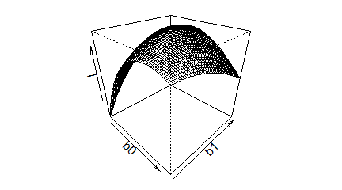

Slide 28
Parametric, part 6
Draw contour plot.
## [1] 2.068333

Slide 29
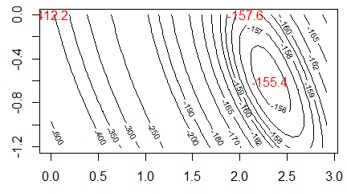

Slide 30
## [1] -155.3602
## [1] -157.58
## [1] -412.1561

Slide 31
What have you learned today?
The exponential and Weibull regression models fit a parametric survival curve to the data.
You can interpret both models in terms of accelerated time. The exponential survival curve is associated with a constant hazard.
The Weibull survival curve is associated with …
… a decreasing hazard if the scale parameter is less than one,
… a constant hazard if the scale parameter equals one, and
… an increasing hazard if the scale parameter is greater than one.

