Slide 1
Parametric models, A minor correction
Steve Simon

Slide 2
Correction
There is more than a little inconsistency in how distributions like the exponential and Weibull distributions are presented. I may have made some mistakes in how I presented the results from a Weibull regression model. This presentation is an attempt to fix things up.

Slide 3
How I presented the Weibull distribution
The Weibull density and survival function
$f(t,k,θ)=\frac{k}{θ}(\frac{t}{θ})^{k−1}e^{−t^{k}}$;
$S(t,k,θ)=e^{−(\frac{t}{θ})^{k}}$
In most setting, k called the shape parameter and theta is called the scale parameter.
If k > 1, the Weibull distribution has an increasing hazard rate. If k < 1, the Weibull distribution has a decreasing hazard rate.

Slide 4
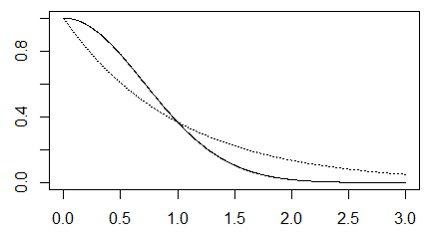
Solid line is Weibull with k=2

Slide 5
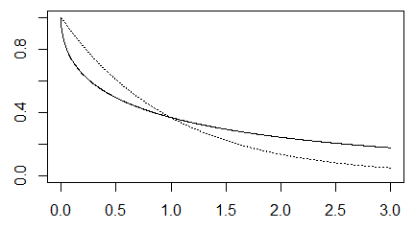
Solid line is Weibull with k=0.5

Slide 6
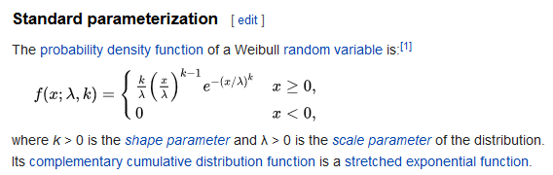
How Wikipedia presents the Weibull distribution
Excerpt from Wikipedia page

Slide 7
The Weibull accelerated time model
Although I did not present the Weibull accelerated time model directly, you can infer that it replaces the parameter $θ$ with
$e^{β_{0}+β_{1}X}$
which would give you a survival function of
$S(t,k,β_{0},β_{1})=e^{−(\frac{t}{e^{β_{0}+β_{1}X}})^{k}}$

Slide 8
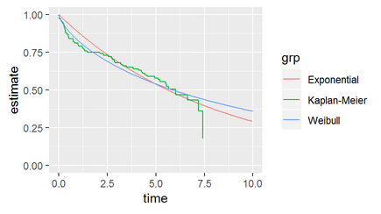
R graph of Weibull survival
Graph of survival curves showing a decreasing hazard rate

Slide 9
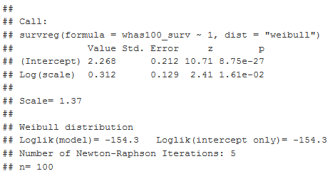
R table of Weibull fit
Table of Weibull model fit

Slide 10
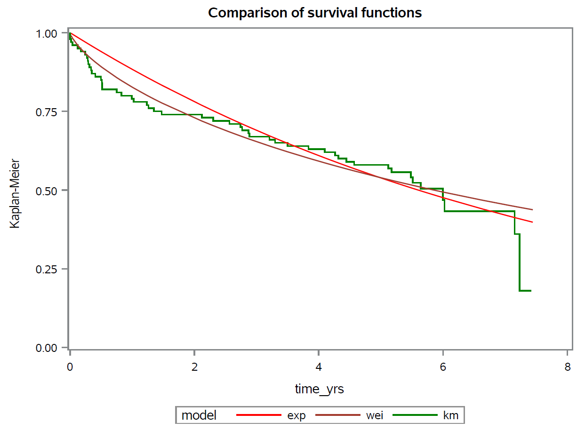
SAS graph of Weibull survival
Graph of survival curves showing a decreasing hazard rate

Slide 11
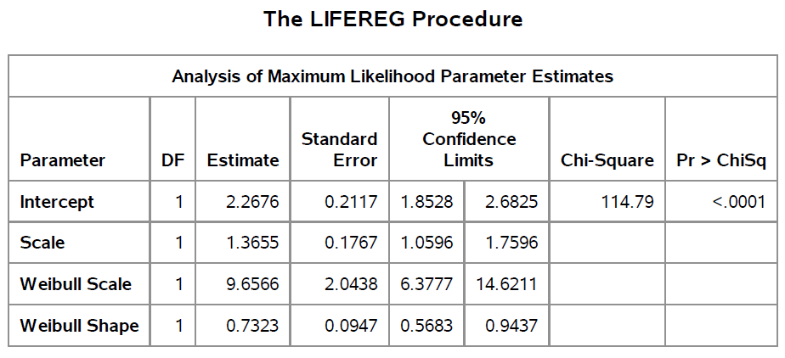
SAS table of Weibull fit
Table of Weibull model fit

