Slide 1
Parametric models, A minor correction
Steve Simon

Slide 2
Correction
There is more than a little inconsistency in how distributions like the exponential and Weibull distributions are presented. I may have made some mistakes in how I presented the results from a Weibull regression model. This presentation is an attempt to fix things up.

Slide 3
How I presented the Weibull distribution
The Weibull density and survival function
$$f(t,k,θ)=\frac{k}{θ}(\frac{t}{θ})^{k−1}e^{−t^{k}}$$
$$S(t,k,θ)=e^{−(\frac{t}{θ})^{k}}$$
In most settings, k called the shape parameter and $θ$ is called the scale parameter. In an accelerated time model, the term “scale parameter” is used differently, and I was careless in how I described this change.

Slide 4
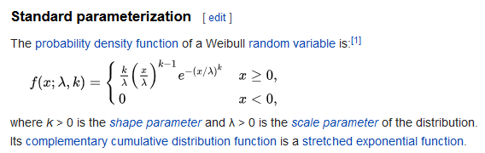
How Wikipedia presents the Weibull distribution
Excerpt from Wikipedia page

Slide 5
Relationship between k and hazard for the Weibull distribution
k > 1, increasing hazard rate.
k < 1, decreasing hazard rate.
k = 1, constant hazard rate (exponential distribution)

Slide 6
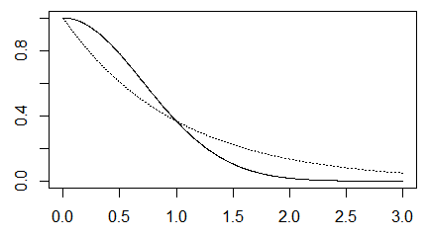
Solid line is Weibull with k=2

Slide 7
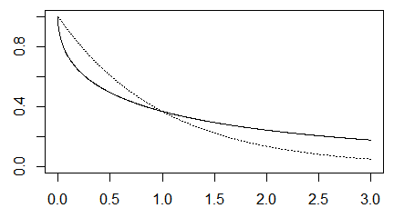
Solid line is Weibull with k=0.5

Slide 8
The Weibull accelerated time model
Although I did not present the Weibull accelerated time model directly, you can infer that it replaces the parameter $θ$ with
$$e^{β_{0}+β_{1}X}$$
which would give you a survival function of
$$S(t,k,β_{0},β_{1})=e^{−(\frac{t}{e^{β_{0}+β_{1}X}})^{k}}$$

Slide 9
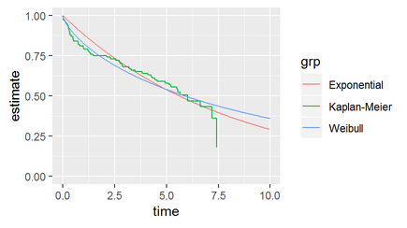
R graph of Weibull survival
Graph of survival curves showing a decreasing hazard rate

Slide 10
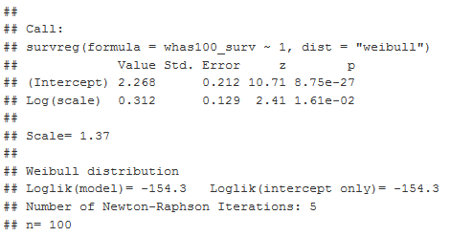
R table of Weibull fit
Table of Weibull model fit

Slide 11
The graph and table don’t seem to agree
The graph clearly shows a rapid decline early (relative to an exponential fit) and a slower decline later. This is a decreasing hazard rate, which should be consistent with k < 1.
The table, however, shows a value of “k” much larger than 1.

Slide 12
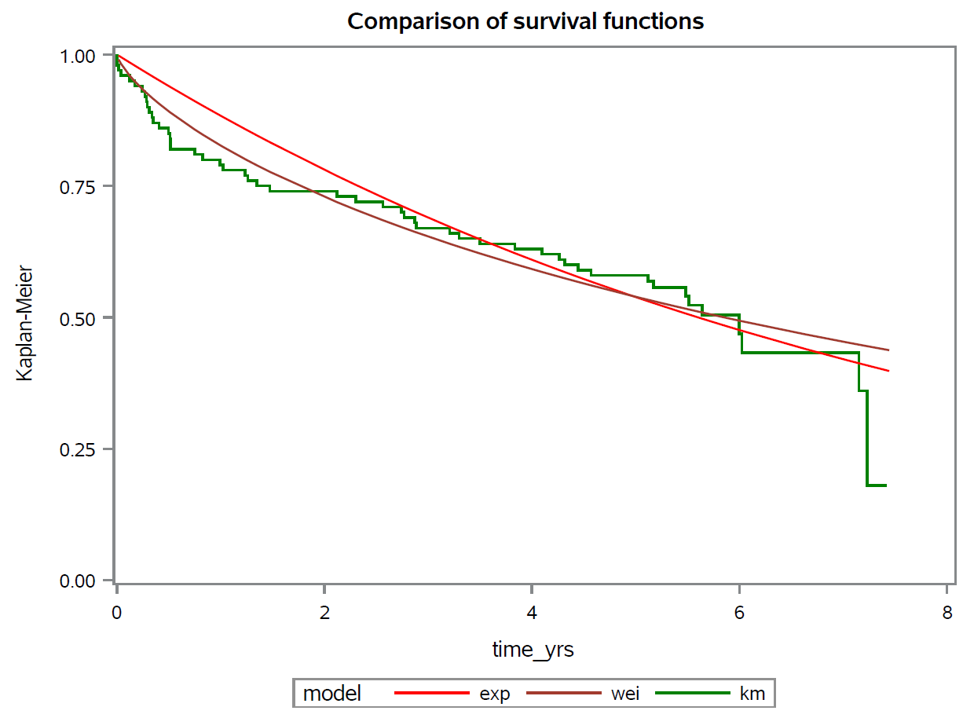
SAS graph of Weibull survival
Graph of survival curves showing a decreasing hazard rate

Slide 13
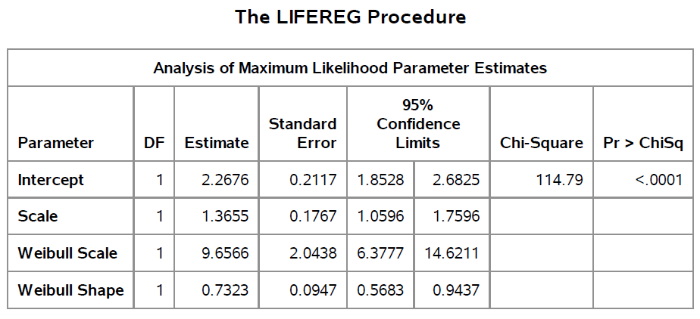
SAS table of Weibull fit
Table of Weibull model fit

Slide 14
SAS is consistent with R
The survival curve in SAS implies the same pattern associated with a decreasing hazard rate.
The table in SAS shows scale of 1.3655, which is the same as R. SAS introduces two new estimates to further confuse things.

Slide 15
The correct interpretation
The scale parameter in a Weibull accelerated time model is not k, it is $σ$=1/k.
This allows an alternate formulation of the Weibull accelerated time model
$$ln(T)=β_{0}+β_{1}X+σε$$
where $ε$ has a log-Weibull distribution (aka an extreme value distribution, a Gumbel distribution).

Slide 16
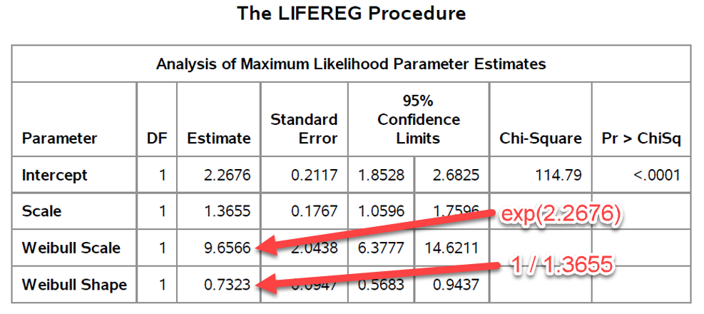
What are those two extra values in the SAS code?
Annotated table of Weibull model fit

Slide 17
The two extra SAS parameters
If you use the “traditional” form of the Weibull distribution
$$f(t,k,θ)=\frac{k}{θ}(\frac{t}{θ})^{k−1}e^{−t^{k}}$$
$$S(t,k,θ)=e^{−(\frac{t}{θ})^{k}}$$
then SAS is telling you that
$$θ=9.6566$$
$$k=0.7323$$

Slide 18
Conclusions
There are a lot of different ways to parameterize the Weibull regression model.
My mistake was not to RTFM. See pages 80-81 in Paul Allison’s book or section 8.3 of Hosmer, Lemeshow, and May for more details.

