Slide 1
Parametric survival models
Steve Simon

Slide 2
Supplemental material
This presentation provides some interesting supplemental material for the module 5 lecture.
Here’s a quick review of the likelihood ratio test, as it applies to the exponential accelerated time model.
First, let’s fit a null model.

Slide 3
Some summary statistics
The intercept in the null model is 2.09. That implies an overall hazard function of exp(2.09) = 8.08. There are 51 deaths and 49 censored observations. The average time of all patients (ignoring censoring) is 4.122.

Slide 4
Mathematical details
How do you arrive at this mathematically. For the null model, the density is
$$f(t)=\frac{1}{e^{β_{0}}}e^{−t/e^{β_{0}}}$$
and the survival curve is
$$S(t)=e^{−t/e^{β_{0}}}$$

Slide 5
Mathematical details
The likelihood for any parametric regression model is
$$L(β)=Π_{i}f(t_{i})^{c_{i}}S(t_{i})^{1−c_{i}}$$
Note that for deaths, you use the density, but for censored observations, you use the survival function, which can be thought of as the “average” density from time $t_{i}$ to infinity.

Slide 6
Mathematical details
Let $n_{0}$ reprensent the number of censored observations and $n_{1}$ the number of deaths. Then
$$L(β_{0})=Π_{1}\frac{1}{e^{β_{0}}}e^{−t/e^{β_{0}}}Π_{0}e^{−t/e^{β_{0}}}$$
Where $Π_{1}$ represents the product across all deaths and $Π_{0}$ represents the product across all censored observations. This simplifies to
$$L(β_{0})=\frac{1}{e^{n_{1}β_{0}}}e^{−(n_{0}+n_{1})\overline{t}/e^{β_{0}}}$$

Slide 7
Mathematical details
The log likelihood is
$$l(β_{0})=−n_{1}β_{0}−(n_{0}+n_{1})\overline{t}e^{−β_{0}}$$
To find the maximum, take the derivative and set it equal to zero.
$$\frac{∂l}{∂β_{0}}=−n_{1}+(n_{0}+n_{1})\overline{t}e^{−β_{0}}=0$$

Slide 8
Mathematical details
$$(n_{0}+n_{1})\overline{t}e^{−\overset{̂}{β_{0}}}=n_{1}$$
$$e^{\overset{̂}{β_{0}}}=\frac{n_{0}+n_{1}}{n_{1}}\overline{t}$$
$$\overset{̂}{β_{0}}=log\left(\frac{n_{0}+n_{1}}{n_{1}}\overline{t}\right)$$
For the WHAS100 data set, the estimate of $\overset{̂}{β_{0}}$ is
log(((49+51) / 51) 4.122) = 2.09.

Slide 9
Mathematical details
The second derivative of the log likelihood is
$$\frac{∂^{2}l}{(∂β_{0})^{2}}=−(n_{0}+n_{1})\overline{t}e^{−β_{0}}$$
If you compute this negative of this second derivative at the maximum likelihood estimate, $\overset{̂}{β_{0}}$, you get the information matrix.

Slide 10
Mathematical details
$$I(\overset{̂}{β_{0}})=(n_{0}+n_{1})\overline{t}e^{−log\left(\frac{n_{0}+n_{1}}{n_{1}}\overline{t}\right)}$$
$$=(n_{0}+n_{1})\overline{t}\left(\frac{n_{1}}{(n_{0}+n_{1})\overline{t}}\right)$$
$$=n_{1}$$

Slide 11
Standard error
The standard error of the maximum likelihood estimate is
$$\frac{1}{\sqrt{I(\overset{̂}{β_{0}})}}$$
which is simply
$$\frac{1}{\sqrt{n_{1}}}$$

Slide 12
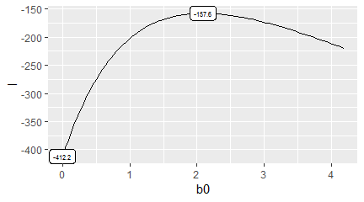
Null calculations

Slide 13
Parametric model with gender
Now let’s fit a model with gender as an independent variable. The survival curve is
$$S(t)=e^{−t/e^{β_{0}}}$$
for males and
$$S(t)=e^{−t/e^{β_{0}+β_{1}}}$$
for females.

Slide 14
Parametric model with gender
The density functions for males and females are
$$f(t)=\frac{1}{e^{β_{0}}}e^{−t/e^{β_{0}}}$$
$$f(t)=\frac{1}{e^{β_{0}+β_{1}}}e^{−t/e^{β_{0}+β_{1}}}$$

Slide 15
Parametric model with gender
The likelihood for any parametric regression model is
$$L(β)=Π_{i}f(t_{i})^{c_{i}}S(t_{i})^{1−c_{i}}$$
For this particular model, partition the observations into four sets: female censored ($F_{0}$), female deaths ($F_{1}$), male censored ($M_{0}$), and male deaths ($M_{1}$), with $f_{0}$, $f_{1}$, $m_{0}$, and $m_{1}$ observations in each group.

Slide 16
Parametric model with gender
Then the likelihood becomes
$$L(β_{0},β_{1})=Π_{F_{0}}Π_{F_{1}}Π_{M_{0}}Π_{M_{1}}$$
where
$$Π_{F_{0}}=Π_{F_{0}}e^{−t_{i}/e^{β_{0}+β_{1}}}$$
$$Π_{F_{1}}=Π_{F_{1}}\frac{1}{e^{β_{0}+β_{1}}}e^{−t_{i}/e^{β_{0}+β_{1}}}$$
$$Π_{M_{0}}=Π_{M_{0}}e^{−t_{i}/e^{β_{0}}}$$
$$Π_{M_{1}}=Π_{M_{1}}\frac{1}{e^{β_{0}}}e^{−t_{i}/e^{β_{0}}}$$

Slide 17
Parametric model with gender
$$L(β_{0},β_{1})=\frac{1}{e^{(f_{1}+m_{1})β_{0}+f_{1}β_{1}}}e^{−\frac{(f_{0}+f_{1}){\overline{t}}_{F}}{e^{β_{0}+β_{1}}}−\frac{(m_{0}+m_{1}){\overline{t}}_{M}}{e^{β_{0}}}}$$

Slide 18
Parametric model with gender
Take the log of both sides to get a log likelihood.
$$l(β0,β1)=−(f_{1}+m_{1})β_{0}−f_{1}β_{1}−(f_{0}+f_{1}){\overline{t}}_{F}e^{−β_{0}−β_{1}}−(m_{0}+m_{1}){\overline{t}}_{M}e^{−β_{0}}$$

Slide 19
Parametric model with gender
To find the maximum, take the two partial derivates and set them equal to zero.
$$\frac{∂l}{∂β_{0}}=−(f_{1}+m_{1})+(f_{0}+f_{1}){\overline{t}}_{F}e^{−β_{0}−β_{1}}+(m_{0}+m_{1}){\overline{t}}_{M}e^{−β_{0}}=0$$
$$\frac{∂l}{∂β_{1}}=−f_{1}+(f_{0}+f_{1}){\overline{t}}_{F}e^{−β_{0}−β_{1}}=0$$

Slide 20
Parametric model with gender
The solution to these two equations is
$${\overset{̂}{β}}_{0}=log(\frac{m_{0}+m_{1}}{m_{1}}{\overline{t}}_{M})$$
$${\overset{̂}{β}}_{1}=log(\frac{f_{0}+f_{1}}{f_{1}}{\overline{t}}_{F}−\frac{m_{0}+m_{1}}{m_{1}}{\overline{t}}_{M})$$

Slide 21
Parametric model with gender
## term estimate std.error statistic ## 1 (Intercept) 2.3175792 0.1889822 12.263476 ## 2 genderFemale -0.6016208 0.2814117 -2.137867 ## p.value conf.low conf.high ## 1 1.422631e-34 1.947181 2.68797756 ## 2 3.252753e-02 -1.153178 -0.05006402

Slide 22
Calculate the parameters yourself
m0 = 37, m1 = 28, f0 = 12, f1 = 23
${\overline{t}}_{M}$ = 4.37, ${\overline{t}}_{F}$ = 3.66,

Slide 23
Parametric model with gender
You can calculate the likelihoods yourself.
$$L(β)=Π_{i}f(t_{i},X_{i},β)^{c_{i}}S(t_{i},X_{i},β)^{1−c_{i}}$$

Slide 24
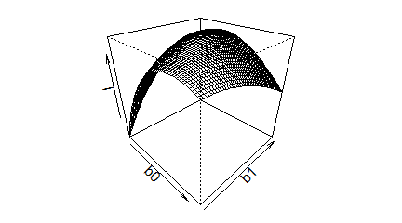
Draw the likelihood surface

Slide 25
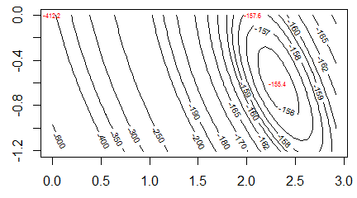
Draw contour plot.

