Slide 1
Parametric survival models
Steve Simon

Slide 2
Abstract
Lecture 5. Parametric models. Parametric models provide an alternative analysis to the Cox proportional hazards model. You’ll compare the hazard function for various popular survival distributions and understand the advantages and disadvantages of a parametric approach to survival. You’ll fit parametric models and interpret the coefficients.

Slide 3
The “standard” exponential distribution
The probability density function for the “standard” exponential distribution is
$f(t)=e^{−t}$
and the survival curve is
$S(t)=e^{−t}$
The hazard function for the “standard” exponential distribution is
$h(t)=1$
Notes:
The simplest distribution for survival outcomes is the exponential distribution. You can’t use a normal distribution because every normal distribution extends into negative values, which are not allowed in survival analysis.
The “standard” exponential distribution (my term) has a rate parameter of 1.

Slide 4
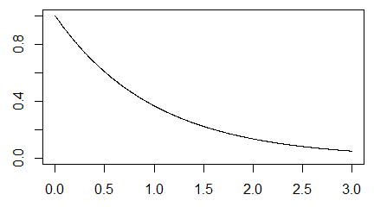
Plot of the survival curve

Slide 5
Notes:
The survival curve for the “standard” exponential distribution shows an exponential decay in the survival probability over time.

Slide 6
Exponential distibution with a rate parameter
You can include a rate parameter, $λ$, to create a density,
$f(t;λ)=λe^{−λt}$
and the survival curve is
$S(t;λ)=e^{−λt}$

Slide 7
Exponential distribution with a scale parameter
There is an equivalent form using a scale parameter, $θ$,
$f(t;θ)=\frac{1}{θ}e^{−t/θ}$.
$S(t;θ)=e^{−t/θ}$

Slide 8
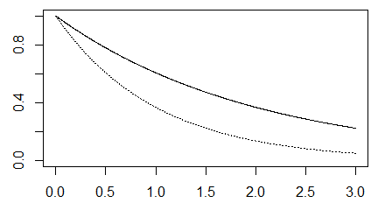
Density function for an exponential distribution with $θ=2$.

Slide 9
Notes:
If theta is larger than 1, the effect is to stretch out the exponential and slow down time. “Slow down” means that events occur less frequently than with a standard normal.

Slide 10
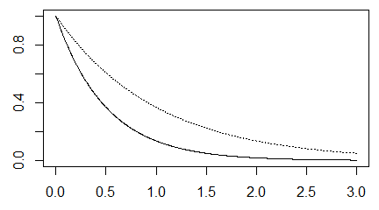
Density function for an exponential distribution with $θ=0.5$.

Slide 11
Notes:
If theta is smaller than 1, the effect is to squeeze the exponential and speed up time.

Slide 12
Accelerated time model
The accelerated time model replaces $θ$ with
$e^{(β_{0}+β_{1}X)}$
This produces the survival curve
$S(t,X,β_{0},β_{1})=e^{−t/e^{(β_{0}+β_{1}X)}}$
The values of $β_{0}$ and $β_{1}$ will end up stretching or shrinking the time scale.

Slide 13
Percentiles
The pth percentile of the accelerated time model is
$−ln(1−p)e^{β_{0}+β_{1}X}$
and the ratio of two percentiles, one with X=$X_{1}$ and the other with X=$X_{2}$ is
$\frac{−ln(1−p)e^{β_{0}+β_{1}X_{1}}}{−ln(1−p)e^{β_{0}+β_{1}X_{2}}}=e^{β_{1}(X_{1}−X_{2})}$
If $X_{1}$ is one unit larger than $X_{2}$, this reduces to $e^{β_{1}}$.

Slide 14
Different, but not different
This may look quite different than the model we used for Kaplan-Meier curves and the Cox proportional hazards model, but it actually is not. The hazard function is
$h(t,x,β_{0},β_{1})=e^{−(β_{0}+β_{1}x)}$.
Notice that the hazard is constant with respect to t. The baseline hazard, the hazard when X=0 is
$h_{0}(t)=e^{−β_{0}}$
The hazard ratio for a subject with $x=x_{1}$ compared to a subject with $x=x_{2}$ is
$e^{−β_{1}(x_{1}−x_{2})}$

Slide 15
Likelihood ratio test
Here’s a quick review of the likelihood ratio test, as it applies to the exponential accelerated time model.
First, let’s fit a null model.
## ## Call: ## survreg(formula = Surv(time_yrs, fstat == "Dead") ~ 1, data = whas100, ## dist = "exponential") ## Value Std. Error z p ## (Intercept) 2.09 0.14 14.9 2.35e-50 ## ## Scale fixed at 1 ## ## Exponential distribution ## Loglik(model)= -157.6 Loglik(intercept only)= -157.6 ## Number of Newton-Raphson Iterations: 5 ## n= 100
## [1] 4.121561
## ## Alive Dead ## 49 51

Slide 16
Mathematical details
How do you arrive at this mathematically. For the null model, the density is
$f(t)=\frac{1}{e^{β_{0}}}e^{−t/e^{β_{0}}}$
and the survival curve is
$S(t)=e^{−t/e^{β_{0}}}$
The likelihood for any parametric regression model is
$L(β)=Π_{i}f(t_{i})^{c_{i}}S(t_{i})^{1−c_{i}}$
Note that for deaths, you use the density, but for censored observations, you use the survival function, which can be thought of as the “average” density from time $t_{i}$ to infinity.

Slide 17
Details, part 2
Let $n_{0}$ reprensent the number of censored observations and $n_{1}$ the number of deaths. Then
$L(β_{0})=Π_{1}\frac{1}{e^{β_{0}}}e^{−t/e^{β_{0}}}Π_{0}e^{−t/e^{β_{0}}}$
Where $Π_{1}$ represents the product across all deaths and $Π_{0}$ represents the product across all censored observations. This simplifies to
$L(β_{0})=\frac{1}{e^{n_{1}β_{0}}}e^{−(n_{0}+n_{1})\overline{t}/e^{β_{0}}}$
The log likelihood is
$l(β_{0})=−n_{1}β_{0}−(n_{0}+n_{1})\overline{t}e^{−β_{0}}$

Slide 18
Details, part 3
To find the maximum, take the derivative and set it equal to zero.
$\frac{∂l}{∂β_{0}}=−n_{1}+(n_{0}+n_{1})\overline{t}e^{−β_{0}}=0$
$(n_{0}+n_{1})\overline{t}e^{−\overset{̂}{β_{0}}}=n_{1}$
$e^{−\overset{̂}{β_{0}}}=\frac{n_{1}}{(n_{0}+n_{1})\overline{t}}$
$e^{\overset{̂}{β_{0}}}=\frac{n_{0}+n_{1}}{n_{1}}\overline{t}$
$\overset{̂}{β_{0}}=log\left(\frac{n_{0}+n_{1}}{n_{1}}\overline{t}\right)$

Slide 19
Details, part 4
Notice that the overall mean is $\overline{t}$ = 4.122 and that there are $n_{0}$ = 49 censored observations and $n_{1}$ = 51 deaths. The estimate of $\overset{̂}{β_{0}}$ is
log((49+51) / 51 4.122) = 2.09.
The second derivative of the log likelihood is
$\frac{∂^{2}l}{(∂β_{0})^{2}}=−(n_{0}+n_{1})\overline{t}e^{−β_{0}}$
If you compute this negative of this second derivative at the maximum likelihood estimate, $\overset{̂}{β_{0}}$, you get the information matrix,
$I(\overset{̂}{β_{0}})=(n_{0}+n_{1})\overline{t}e^{−log\left(\frac{n_{0}+n_{1}}{n_{1}}\overline{t}\right)}$
$=(n_{0}+n_{1})\overline{t}\left(\frac{n_{1}}{(n_{0}+n_{1})\overline{t}}\right)$
$=n_{1}$

Slide 20
Standard error
The standard error of the maximum likelihood estimate is
$\frac{1}{\sqrt{I(\overset{̂}{β_{0}})}}$
which is simply
$\frac{1}{\sqrt{n_{1}}}$
Note that the precision of the estimator is influenced only by deaths and not by censored observations.

Slide 21
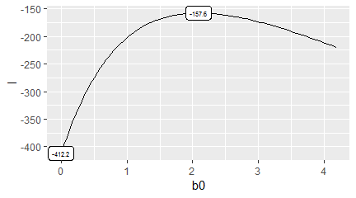
Null calculations

Slide 22
Parametric model with gender
Now let’s fit a model with gender as an independent variable. The survival curve is
$S(t)=e^{−t/e^{β_{0}}}$
for males and
$S(t)=e^{−t/e^{β_{0}+β_{1}}}$
for females. The density functions for males and females are
$f(t)=\frac{1}{e^{β_{0}}}e^{−t/e^{β_{0}}}$
$f(t)=\frac{1}{e^{β_{0}+β_{1}}}e^{−t/e^{β_{0}+β_{1}}}$

Slide 23
Parametric, part 2
The likelihood for any parametric regression model is
$L(β)=Π_{i}f(t_{i})^{c_{i}}S(t_{i})^{1−c_{i}}$
For this particular model, partition the observations into four sets: female censored ($F_{0}$), female deaths ($F_{1}$), male censored ($M_{0}$), and male deaths ($M_{1}$), with $f_{0}$, $f_{1}$, $m_{0}$, and $m_{1}$ observations in each group. Then the likelihood becomes
$L(β)=Π_{F_{0}}e^{−t_{i}/e^{β_{0}+β_{1}}}Π_{F_{1}}\frac{1}{e^{β_{0}+β_{1}}}e^{−t_{i}/e^{β_{0}+β_{1}}}Π_{M_{0}}e^{−t_{i}/e^{β_{0}}}Π_{M_{1}}\frac{1}{e^{β_{0}}}e^{−t_{i}/e^{β_{0}}}$
$L(β)=\frac{1}{e^{(f_{1}+m_{1})β_{0}+f_{1}β_{1}}}e^{−\frac{(f_{0}+f_{1}){\overline{t}}_{F}}{e^{β_{0}+β_{1}}}−\frac{(m_{0}+m_{1}){\overline{t}}_{M}}{e^{β_{0}}}}$

Slide 24
Parametric, part 3
Take the log of both sides to get a log likelihood.
$l(β)=−(f_{1}+m_{1})β_{0}−f_{1}β_{1}−(f_{0}+f_{1}){\overline{t}}_{F}e^{−β_{0}−β_{1}}−(m_{0}+m_{1}){\overline{t}}_{M}e^{−β_{0}}$
To find the maximum, take the two partial derivates and set them equal to zero.
$\frac{∂l}{∂β_{0}}=−(f_{1}+m_{1})+(f_{0}+f_{1}){\overline{t}}_{F}e^{−β_{0}−β_{1}}+(m_{0}+m_{1}){\overline{t}}_{M}e^{−β_{0}}=0$
$\frac{∂l}{∂β_{1}}=−f_{1}+(f_{0}+f_{1}){\overline{t}}_{F}e^{−β_{0}−β_{1}}=0$
The solution to these two equations is
${\overset{̂}{β}}_{0}=log(\frac{m_{0}+m_{1}}{m_{1}}{\overline{t}}_{M})$
${\overset{̂}{β}}_{1}=log(\frac{f_{0}+f_{1}}{f_{1}}{\overline{t}}_{F}−\frac{m_{0}+m_{1}}{m_{1}}{\overline{t}}_{M})$

Slide 25
Parametric, part 4
## ## Call: ## survreg(formula = Surv(time_yrs, fstat == "Dead") ~ gender, data = whas100, ## dist = "exponential") ## Value Std. Error z p ## (Intercept) 2.318 0.189 12.26 1.42e-34 ## genderFemale -0.602 0.281 -2.14 3.25e-02 ## ## Scale fixed at 1 ## ## Exponential distribution ## Loglik(model)= -155.4 Loglik(intercept only)= -157.6 ## Chisq= 4.42 on 1 degrees of freedom, p= 0.036 ## Number of Newton-Raphson Iterations: 5 ## n= 100
## Male Female ## 4.372769 3.655031
## ## Alive Dead ## Male 37 28 ## Female 12 23

Slide 26
Parametric, part 5
You can calculate the likelihoods yourself.
$L(β)=Π_{i}f(t_{i},X_{i},β)^{c_{i}}S(t_{i},X_{i},β)^{1−c_{i}}$
Create a function for the likelihood.
Draw likelihood surface

Slide 27
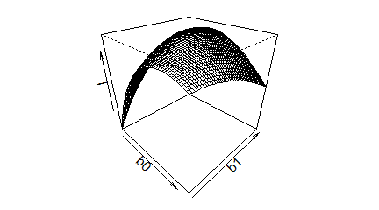

Slide 28
Parametric, part 6
Draw contour plot.
## [1] 2.068333

Slide 29
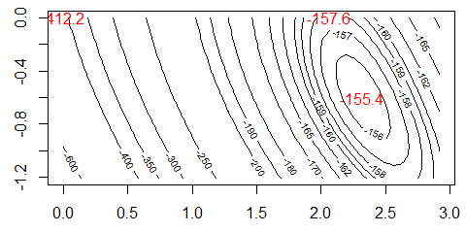

Slide 30
## [1] -155.3602
## [1] -157.58
## [1] -412.1561

Slide 31
Weibull model
The standard Weibull distribution has a density
$f(t,k)=kt^{k−1}e^{−t^{k}}$
and a survival function
$S(t,k)=e^{−t^{k}}$.

Slide 32
Scale parameter for the Weibull.
You can add a scale parameter, $θ$, to get
$f(t,k,θ)=\frac{k}{θ}{\left(\frac{t}{θ}\right)}^{k−1}e^{−{\left(\frac{t}{θ}\right)}^{k}}$
and a survival function
$S(t,k,θ)=e^{−{\left(\frac{t}{θ}\right)}^{k}}$.
The value of k controls whether the Weibull distribution has an increasing hazard (k>1), constant hazard (k=1), or decreasing hazard (k<1).

Slide 33
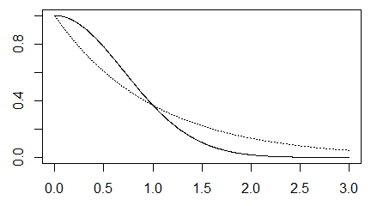
Weibull with changing k

Slide 34
Weibll with changing theta
The scale parameter, $θ$, will stretch or squeeze the survival curve along the time axis.

Slide 35
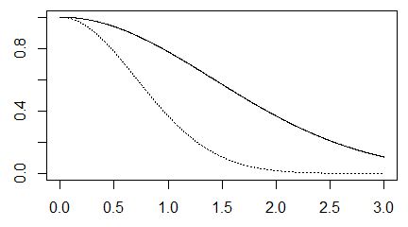

Slide 36
Weibull accelerated time model
You can fit an accelerated time model for the Weibull distribution as well.
$S(t,k,X,β_{0},β_{1})=e^{−{\left(\frac{t}{e^{β_{0}+β_{1}x}}\right)}^{k}}$.

Slide 37
Residuals
## 1 2 3 4 ## -12.9601327 -4.8628205 -6.3482231 -5.6184673 ## 5 6 ## -9.6774496 -0.2331148
## 1 2 3 4 ## -2.80477222 -1.06420041 -0.45817710 -1.66280936 ## 5 6 ## -0.86595930 -0.02968477
## (Intercept) genderFemale Log(scale) ## 1 0.002670449 0.011493880 0.052513319 ## 2 -0.003313129 -0.040312072 -0.003432221 ## 3 -0.036191315 0.031363980 -0.017897028 ## 4 0.013827934 -0.062829310 0.014324988 ## 5 -0.043676477 0.040071167 -0.013366451 ## 6 -0.016005658 0.009802495 -0.016580992
## [,1] [,2] [,3] ## 1 0.009389456 0.02936025 0.40882945 ## 2 -0.011649157 -0.10297416 -0.02672071 ## 3 -0.127250805 0.08011693 -0.13933288 ## 4 0.048619833 -0.16049276 0.11152365 ## 5 -0.153569076 0.10235879 -0.10406120 ## 6 -0.056276838 0.02503974 -0.12908721
## 1 2 3 ## -185.34171645 -3.57259032 -0.86972639 ## 4 5 6 ## -11.88989605 -2.36848758 -0.04101387
## 1 2 3 4 ## 0.20233950 0.02357388 0.02487482 0.04747801 ## 5 6 ## 0.02528389 0.01670107
## 1 2 3 4 ## 0.01727897 0.02063152 0.01435138 0.02080320 ## 5 6 ## 0.01387842 0.04126048
## [1] 12.976560 5.886777 12.976560 5.886777 ## [5] 12.976560 5.886777
## [1] 2.563145 1.772709 2.563145 1.772709 2.563145 ## [6] 1.772709
## [1] 12.976560 5.886777 12.976560 5.886777 ## [5] 12.976560 5.886777
## gender ## 1 0.2766526 ## 2 -0.5137834 ## 3 0.2766526 ## 4 -0.5137834 ## 5 0.2766526 ## 6 -0.5137834
## 1 2 3 4 ## 0.2766526 -0.5137834 0.2766526 -0.5137834 ## 5 6 ## 0.2766526 -0.5137834

Slide 38
Weibull hazard
The hazard function for the Weibull distribution is
$h(t,k)=kt^{k−1}$
There is an alternate formulation for the Weibull regression model.

Slide 39
What have you learned today?

