Slide 1
Interval censoring and frailty models
Steve Simon

Slide 2
Abstract
Two alternatives to right censoring are left censoring (you only know that the event occurred before a particular time) and interval censoring (you only know that the event occured sometime in a particular time interval). You will see examples of both types of censoring as well as left truncation.

Slide 3
Abstract (continued)
You can incorporate mutliple events per patient and account for center effects using frailty models, the survival data analysis equivalent to mixed models in linear regression. You’ll see how to define random effects and how to fit and interpret these models.

Slide 4
Ignore this slide.
## Warning: package 'coxme' was built under R version 3.4.4
## ## Attaching package: 'bdsmatrix'
## The following object is masked from 'package:base': ## ## backsolve

Slide 5
Interval censored data
An event is said to be interval censored in the interval (a,b) if you know that the event did not occur before time a and that it did occur before time b.
A right censored observation is equivalent to interval censoring on the interval (a, $∞$).
A left censored observation is equivalent to interval censoring on the interval (0, b).

Slide 6
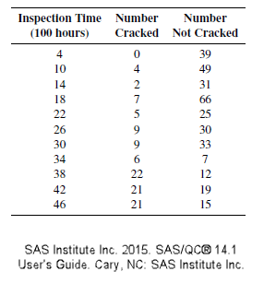
Example of left censored data

Slide 7
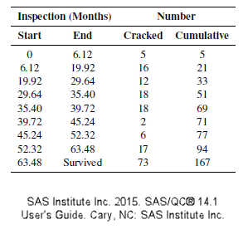
Example of interval censored data

Slide 8
Brief explanation of analysis
The likelihood in most settings is the product of the density functions, but with left censoring, you replace the density by
$$\int_{0}^{b}{f}(t;β)=1−S(b;β)$$
with interval censoring, you replace the density by
$$\int_{a}^{b}{f}(t;β)=S(a;β)−S(b;β)$$

Slide 9
Exponential likelihood for left/right censoring
$$L(λ)=$$
$$(1−e^{−4λ})^{0}(e^{−4λ})^{39}$$
$$(1−e^{−10λ})^{4}(e^{−10λ})^{49}$$
$$(1−e^{−14λ})^{2}(e^{−14λ})^{31}$$
$$...$$

Slide 10
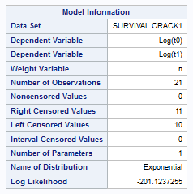
Model results for left censored data (1 of 4)

Slide 11
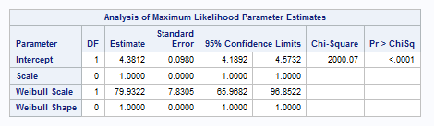
Model results for left censored data (2 of 4)

Slide 12
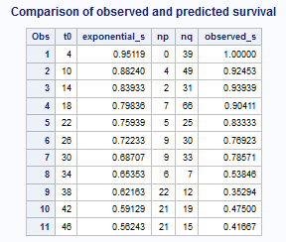
Model results for left censored data (3 of 4)

Slide 13
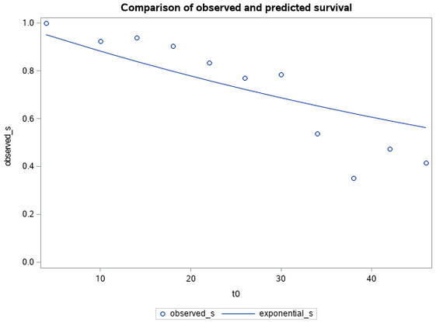
Model results for left censored data (4 of 4)

Slide 14
Exponential likelihood for interval censoring
$$L(λ)=$$
$$(1−e^{−6.12λ})^{5}$$
$$(e^{−6.12λ}−e^{−19.92λ})^{16}$$
$$(e^{−19.92λ}−e^{−29.64λ})^{12}$$
$$(e^{−29.64λ}−e^{−35.40λ})^{18}$$
$$...$$

Slide 15
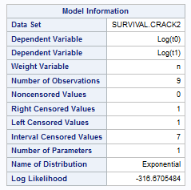
Model results for interval censored data (1 of 4)

Slide 16
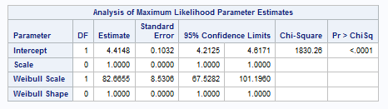
Model results for interval censored data (2 of 4)

Slide 17
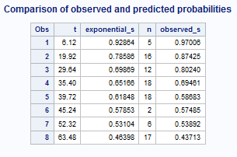
Model results for interval censored data (3 of 4)

Slide 18
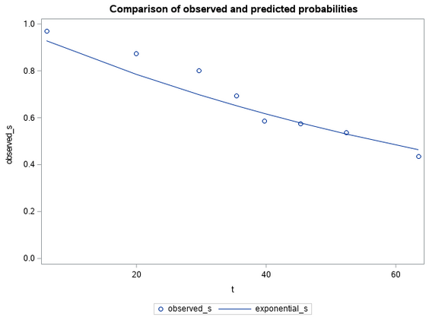
Model results for interval censored data (4 of 4)

Slide 19
Left truncation
In most studies, patients are considered part of the risk set from time 0 to the time that they either die or are censored. But sometimes patients start contributing information about survival only from a certain point forward. This is left truncation.

Slide 20
Example: Mortality in an inpatient psych unit
## sex age time death ## 1 2 51 1 1 ## 2 2 58 1 1 ## 3 2 55 2 1 ## 4 2 28 22 1 ## 5 1 21 30 0 ## 6 1 19 28 1
math.usu.edu/jrstevens/biostat/projects2013/pres_LeftTruncation.pdf

Slide 21
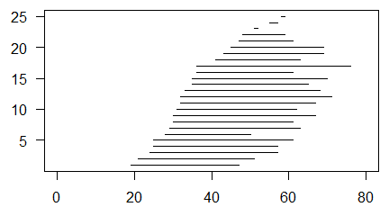
Plot of entry/exit for each patient

Slide 22
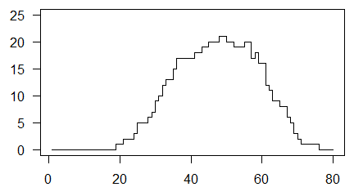
Changes in number at risk

Slide 23
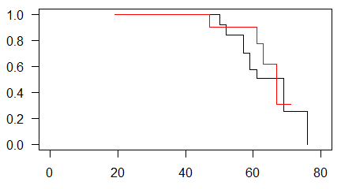
Kaplan-Meier survival estimates

Slide 24
Sandwich estimate
You can account for cluster effects by modifying the variance-covariance of the coefficients. For the normal model without frailty effects, the information matrix is
$$I(β)=\frac{∂^{2}L_{p}}{(∂β)^{2}}$$
and the estimated variance covariance matrix, $\overset{̂}{V}$, is
$$\overset{̂}{V}=I(\overset{̂}{β})^{−1}$$

Slide 25
Sandwich
The robust sandwich estimator (similar to the sandwich estimator in Generalized Estimating Equations) is
$$\overset{̂}{R}=\overset{̂}{V}(\overset{̂}{L}′\overset{̂}{L})\overset{̂}{V}$$
where $\overset{̂}{L}$ is the vector of Schoenfeld residuals. The middle of this sandwich, the $\overset{̂}{L}′\overset{̂}{L}$, adjusts the variance covariance matrix to account for the correlation within clusters.

Slide 26
Frailty model
Recall that the proportional hazards model assumes that the hazard function of a given patient,
$$h(t,X,β)=h_{0}(t)e^{Xβ}$$
The frailty model multiplies all the hazards within a family f by a frailty term $z_{f}$.
$$h(t,X,β)=z_{f}h_{0}(t)e^{Xβ}$$
Typically, $z_{f}$ is given a gamma distribution with a mean of 1 and a variance of $\frac{1}{α}$.

Slide 27
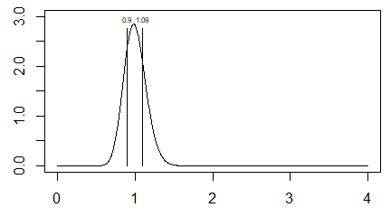
Gamma distribution, alpha=50

Slide 28
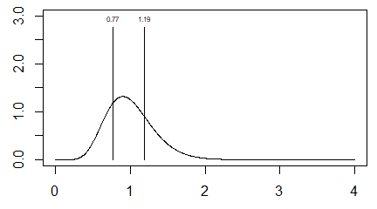
Gamma distribution, alpha=10

Slide 29
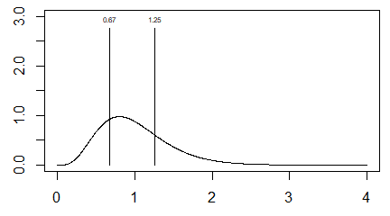
Gamma distribution: alpha=5

Slide 30
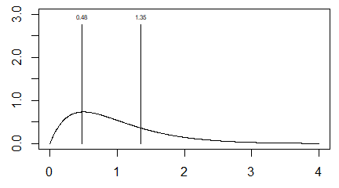
Gamma distribution: alpha=2

Slide 31
Partial listing of rats data
## litter rx time status sex ## 1 1 1 101 0 f ## 2 1 0 49 1 f ## 3 1 0 104 0 f ## 4 2 1 91 0 m ## 5 2 0 104 0 m ## 6 2 0 102 0 m

Slide 32
Descriptive statistics for rats data
## ## 0 1 ## 200 100
## ## 0 1 ## 258 42
## ## f m ## 150 150
## Min. 1st Qu. Median Mean 3rd Qu. Max. ## 23.00 80.75 98.00 90.44 104.00 104.00

Slide 33
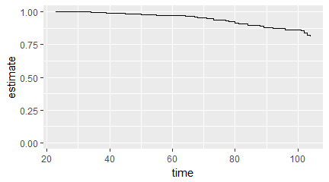
Overall survival

Slide 34
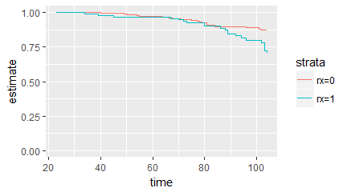
Survival by treatment

Slide 35
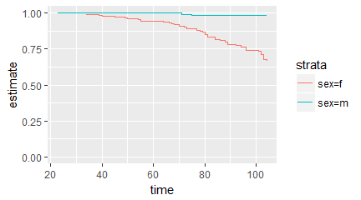
Survival by sex

Slide 36
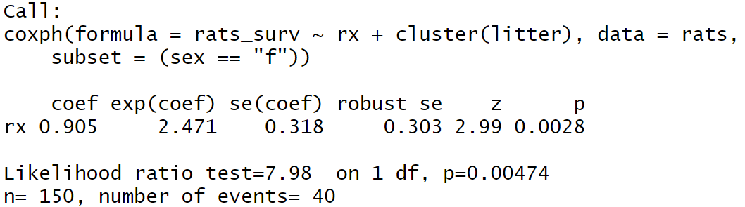
Cluster effect
Cluster model for rats data

Slide 37
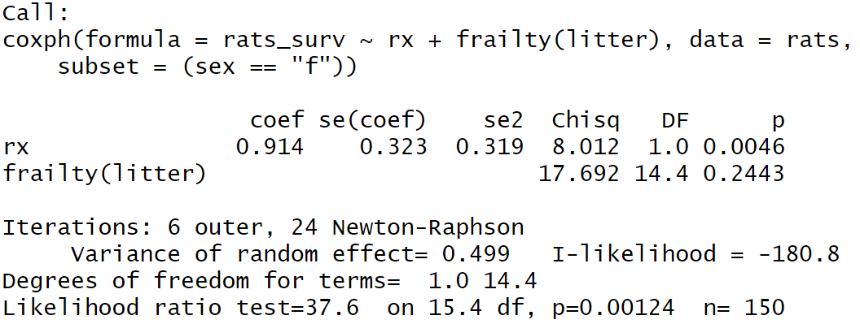
Frailty effect
Frailty model for rats data

Slide 38
Three models
When you have two or more events occurring on a single patient, you have three different options for analyzing the data. It all depends on what the clock restarts at after the first event.

Slide 39
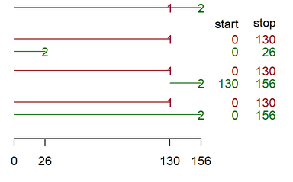
Graphical display of three models
Different models for timing multiple events

Slide 40
What have you learned today
Left censoring versus left truncation
Interval censoring
Cluster models
Frailty models

Slide 41
Your homework
Open the file, diabetes.csv.
Calculate and graph a Kaplan-Meier curve comparing treated to untreated eyes, ignoring for now the correlations inherent in this data set. Does it appear as if these survival curves differ? If so, do they appear to violate the assumption of proportional hazards?

Slide 42
Your homework
Calculate and interpret a Cox regression model using treat as an independent variable and id as a cluster effect.
Calculate and interpret a Cox regression model using treat as an independent variable and id as a frailty effect.

