Slide 1
Survival lecture 4
Steve Simon

Slide 2
Abstract
Lecture 4. Model fitting and diagnostics for the Cox model. In this lecture, you will work with more complex forms of the Cox model with multiple predictor variables. You’ll include covariates in the Cox model to produce risk adjusted survival curves. You will also assess the underlying assumptions of the Cox model, particularly the assumption of proportional hazards.
Notes:
This program was written on 2018-04-08 and last modified on 2020-10-28.
This PowerPoint presentation was developed using R Markdown. The file does not need any special libraries other than the ones listed below. Many of the data sets in this program use data from Hosmer, Lemeshow, and May. I made one minor change, however, which was to force all the variable names to lower case.

Slide 3
Peek at the first few rows of whas500
id age gender hr sysbp diasbp bmi cvd afb 1 1 83 Male 89 152 78 25.54051 No Yes 2 2 49 Male 84 120 60 24.02398 No No sho chf av3 miord mitype year 1 No No No Recurrent Non Q-wave <NA> 2 No No No First Q-wave <NA> admitdate disdate fdate los dstat 1 01/13/1997 01/18/1997 12/31/2002 5 Alive 2 01/19/1997 01/24/1997 12/31/2002 5 Alive lenfol fstat time_yrs 1 2178 Alive 5.963039 2 2172 Alive 5.946612
Notes:
We will be using the WHAS500 dataset. Here are the first couple of rows.

Slide 4
Univariate model for age
term | estimate | std.error | statistic | p.value
age | 0.066339 | 0.0060793 | 10.91228 | 0
Notes:
You should examine your independent variables one at a time before putting them all in a multivariate model.

Slide 5
Hazard ratio and confidence interval for age
term | hazard.ratio | conf.low | conf.high
age | 1.068589 | 1.055932 | 1.081398
Notes:
The estimate is the log hazard ratio, and you compute the hazard ratio by using the exponential function. Calculations for the confidence interval are similar.

Slide 6
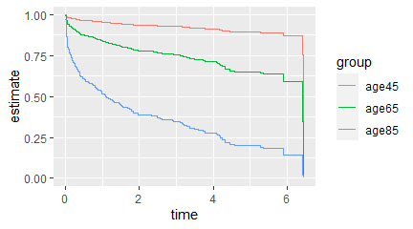
Predicted survival at various ages

Slide 7
Univariate model for gender
term | estimate | std.error | statistic | p.value
genderFemale | 0.381512 | 0.1375836 | 2.772946 | 0.0055551

Slide 8
Hazard ratio and confidence interval for gender
term | hazard.ratio | conf.low | conf.high
age | 1.068589 | 1.055932 | 1.081398

Slide 9
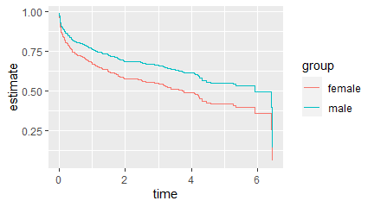
Predicted survival for both genders

Slide 10
Univariate model for bmi
term | estimate | std.error | statistic | p.value
bmi | -0.0984729 | 0.0147507 | -6.675796 | 0

Slide 11
Hazard ratio and confidence interval for bmi
term | hazard.ratio | conf.low | conf.high
bmi | 0.9062203 | 0.8803957 | 0.9328023

Slide 12
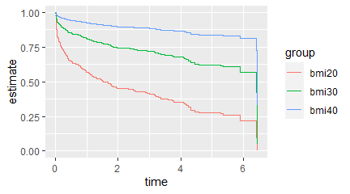
Predicted survival for at various bmi levels

Slide 13
Multivariate model
term | estimate | std.error | statistic | p.value
age | 0.0669278 | 0.0061958 | 10.8020422 | 0.0000000
genderFemale | -0.0662851 | 0.1405849 | -0.4714951 | 0.6372872

Slide 14
Multivariate model
term | hazard.ratio | conf.low | conf.high
age | 1.069218 | 1.0563126 | 1.082282
genderFemale | 0.935864 | 0.7104714 | 1.232761

Slide 15
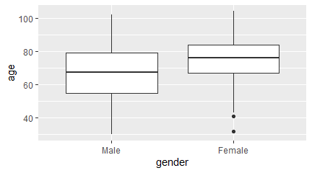
Covariate imbalance

Slide 16
Covariate imbalance
gender | age
Male | 66.59667
Female | 74.72000
Overall | 69.84600

Slide 17
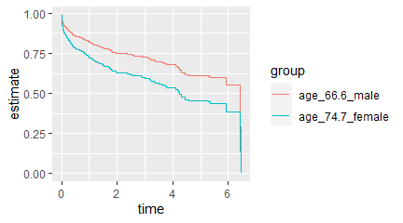
Unadjusted comparison

Slide 18
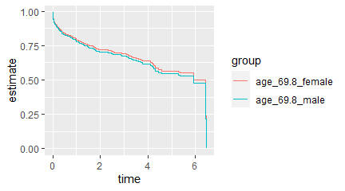
Adjusted comparison

Slide 19
Adjustment for bmi analysis
term | estimate | std.error | statistic | p.value
age | 0.0607912 | 0.0065031 | 9.3480956 | 0.0000000
genderFemale | -0.0930646 | 0.1410847 | -0.6596365 | 0.5094871
bmi | -0.0420840 | 0.0154274 | -2.7278710 | 0.0063745

Slide 20
Adjustment for bmi analysis
term | hazard.ratio | conf.low | conf.high
age | 1.0626770 | 1.0492183 | 1.0763083
genderFemale | 0.9111346 | 0.6910207 | 1.2013624
bmi | 0.9587893 | 0.9302321 | 0.9882231

Slide 21
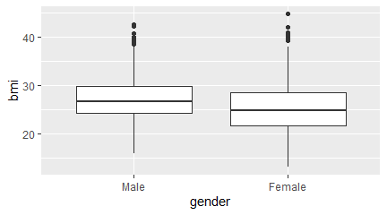
Only a a small covariate imbalance for gender

Slide 22
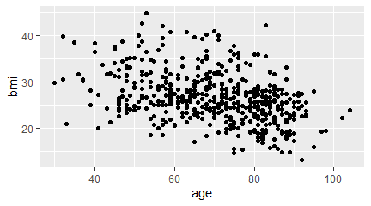
Only a small covariate imbalance for age

Slide 23
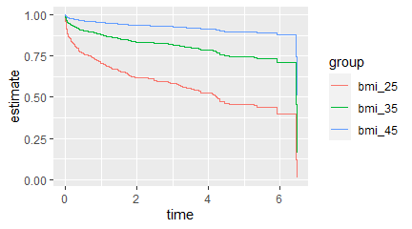
Unadjusted comparison

Slide 24
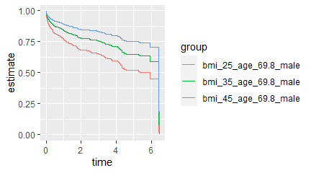
Adjusted comparison, males

Slide 25
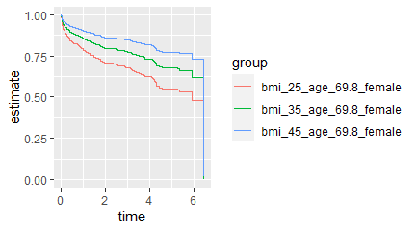
Adjusted comparison, females

Slide 26
Simple interaction
term | estimate | std.error | statistic | p.value
age | 0.0785402 | 0.0080266 | 9.784936 | 0.0000000
genderFemale | 2.3337324 | 0.9926739 | 2.350956 | 0.0187253
age:genderFemale | -0.0305020 | 0.0125405 | -2.432277 | 0.0150042

Slide 27
Simple interaction
term | hazard.ratio | conf.low | conf.high
age | 1.0817069 | 1.0648227 | 1.0988588
genderFemale | 10.3163748 | 1.4742175 | 72.1925982
age:genderFemale | 0.9699585 | 0.9464085 | 0.9940945

Slide 28
Centered interaction
term | estimate | std.error | statistic | p.value
age_c | 0.0785402 | 0.0080266 | 9.784936 | 0.0000000
genderFemale | 0.2032878 | 0.1746054 | 1.164270 | 0.2443147
age_c:genderFemale | -0.0305020 | 0.0125405 | -2.432277 | 0.0150042

Slide 29
Simple interaction
term | hazard.ratio | conf.low | conf.high
age_c | 1.0817069 | 1.0648227 | 1.0988588
genderFemale | 1.2254251 | 0.8702867 | 1.7254850
age_c:genderFemale | 0.9699585 | 0.9464085 | 0.9940945

Slide 30
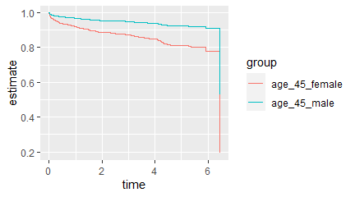
Interaction effect at age 45

Slide 31
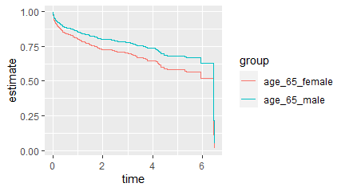
Interaction effect at age 65

Slide 32
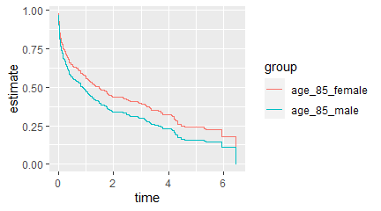
Interaction effect at age 85

Slide 33
Hazard ratio for the interaction model
age | estimate_f | estimate_m | hazard.ratio_f | hazard.ratio_m
45.00000 | -0.9902696 | -1.9514108 | 0.3714765 | 0.1420735
65.00000 | -0.0295054 | -0.3806060 | 0.9709257 | 0.6834471
69.84600 | 0.2032878 | 0.0000000 | 1.2254251 | 1.0000000
76.51073 | 0.5234496 | 0.5234496 | 1.6878399 | 1.6878399
85.00000 | 0.9312589 | 1.1901988 | 2.5377018 | 3.2877347
Notes:
The interaction model with a centered value for age is easier to intepret, because the baseline hazard is computed at a realistic value (gender=M and age=69.8). The simple interaction model had a baseline hazard at a value (gender=M and age=0) that was impossible to interpret.

Slide 34
Fit a sequence of models
term | hazard.ratio | p.value | conf.low | conf.high
genderFemale | 1.464497 | 0.0055551 | 1.118348 | 1.917785

Slide 35
Fit a sequence of models
term | hazard.ratio | p.value | conf.low | conf.high
genderFemale | 0.935864 | 0.6372872 | 0.7104714 | 1.232761
age | 1.069218 | 0.0000000 | 1.0563126 | 1.082282

Slide 36
Fit a sequence of models
term | hazard.ratio | p.value | conf.low | conf.high
genderFemale | 0.9111346 | 0.5094871 | 0.6910207 | 1.2013624
age | 1.0626770 | 0.0000000 | 1.0492183 | 1.0763083
bmi | 0.9587893 | 0.0063745 | 0.9302321 | 0.9882231

