Slide 1
Parametric models
Steve Simon

Slide 2
The exponential distribution
PDF: $f(t)=λe^{−λt}$ or $f(t)=\frac{1}{θ}e^{−t/θ}$
Mean: $E[T]=\frac{1}{λ}=θ$
Think of $λ$ as a failure rate. The faster the failure rate, the shorter the expected failure time.

Slide 3
The exponential distribution
CDF: $F(t)=1−e^{−λt}=1−e^{t/θ}$
Survival: $S(t)=e^{−λt}=e^{−t/θ}$
Hazard: $h(t)=λ=\frac{1}{θ}$

Slide 4
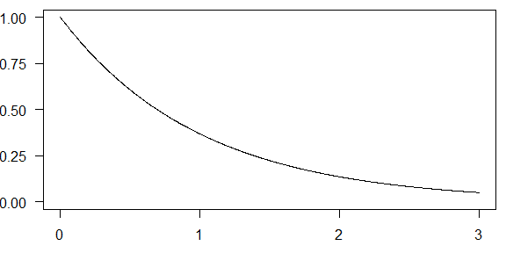
Exponential survival curve for theta=1

Slide 5
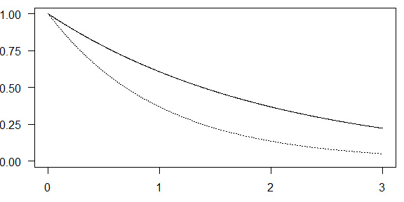
Exponential survival curve for theta=2

Slide 6
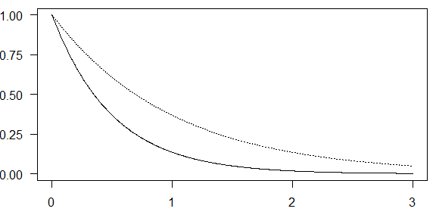
Exponential survival curve for theta=0.5

Slide 7
The Weibull distribution
Survival: $S(t)=e^{−(t/θ)^{k}}$
Hazard: $h(t)=\frac{k}{θ}{\left(\frac{t}{θ}\right)}^{k−1}$
PDF: $f(t)=\frac{k}{θ}{\left(\frac{t}{θ}\right)}^{k−1}e^{−(t/θ)^{k}}$ or $f(t)=\frac{1}{θ}e^{−t/θ}$

Slide 8
Relationship between k and hazard for the Weibull distribution
k > 1, increasing hazard rate.
k < 1, decreasing hazard rate.
k = 1, constant hazard rate (exponential distribution)

Slide 9
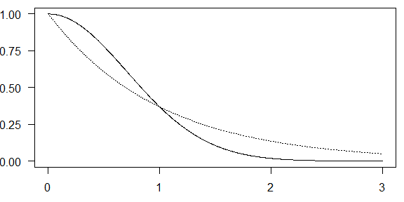
Weibull survival curve for theta=2

Slide 10
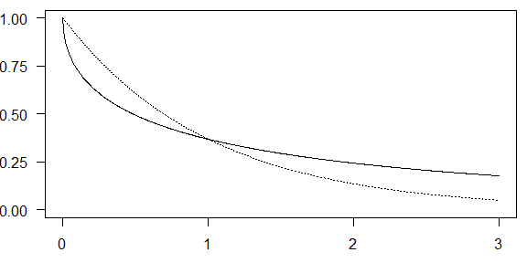
Weibull survival curve for k=0.5

Slide 11
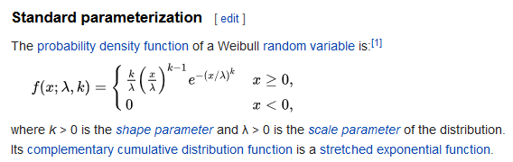
How Wikipedia presents the Weibull distribution, part 1
Excerpt from Wikipedia page

Slide 12
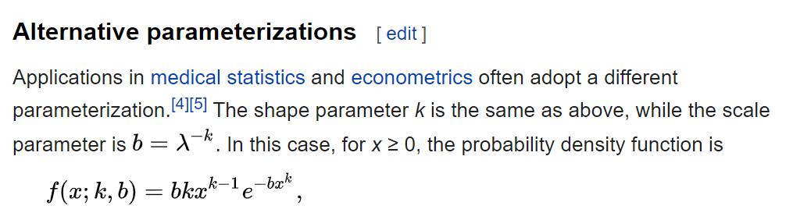
How Wikipedia presents the Weibull distribution, part 2
Excerpt from Wikipedia page

Slide 13
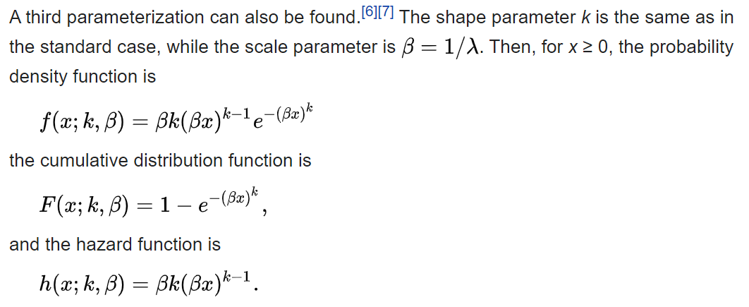
How Wikipedia presents the Weibull distribution, part 3
Excerpt from Wikipedia page

Slide 14
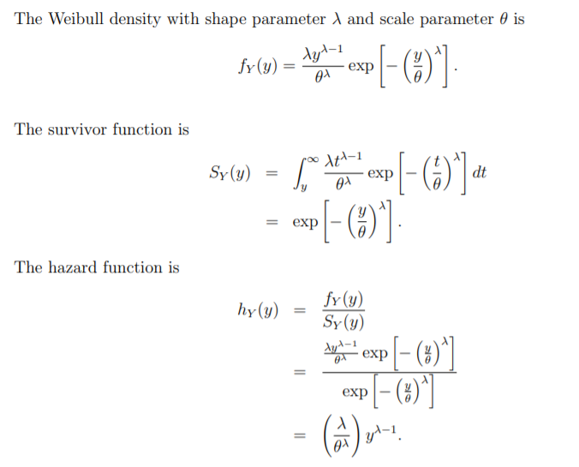
A different presentation of the Weibull distribution
Excerpt from people.stat.sfu.ca/~raltman/stat402/402L32.pdf

Slide 15
The accelerated time model (exponential distribution)
Recall that the survival function for the exponential distribution is
Survival: $S(t)=e^{−t/θ}$
The accelerated time model replaces $θ$ with
$e^{(β_{0}+β_{1}X)}$
This produces the survival curve
$S(t,X,β_{0},β_{1})=e^{−t/e^{(β_{0}+β_{1}X)}}$
The values of $β_{0}$ and $β_{1}$ will end up stretching or shrinking the time scale.

Slide 16
Percentiles
The pth percentile of the accelerated time model is
$−ln(1−p)e^{β_{0}+β_{1}X}$
and the ratio of two percentiles, one with X=$X_{1}$ and the other with X=$X_{2}$ is
$\frac{−ln(1−p)e^{β_{0}+β_{1}X_{1}}}{−ln(1−p)e^{β_{0}+β_{1}X_{2}}}=e^{β_{1}(X_{1}−X_{2})}$
If $X_{1}$ is one unit larger than $X_{2}$, this reduces to $e^{β_{1}}$.

Slide 17
Different, but not different
This may look quite different than the model we used for Kaplan-Meier curves and the Cox proportional hazards model, but it actually is not. The hazard function is
$h(t,x,β_{0},β_{1})=e^{−(β_{0}+β_{1}x)}$.
Notice that the hazard is constant with respect to t. The baseline hazard, the hazard when X=0 is
$h_{0}(t)=e^{−β_{0}}$

Slide 18
Different, but not different
The hazard ratio for a subject with $x=x_{1}$ compared to a subject with $x=x_{2}$ is
$e^{−β_{1}(x_{1}−x_{2})}$

Slide 19
Example with whas100 dataset
## id admitdate foldate los lenfol fstat ## 1 1 03/13/1995 03/19/1995 4 6 Dead ## 2 2 01/14/1995 01/23/1996 5 374 Dead ## 3 3 02/17/1995 10/04/2001 5 2421 Dead ## age gender bmi time_yrs age_group ## 1 65 Male 31.38134 0.0164271 60-69 ## 2 88 Female 22.65790 1.0239562 >=80 ## 3 77 Male 27.87892 6.6283368 70-79

Slide 20
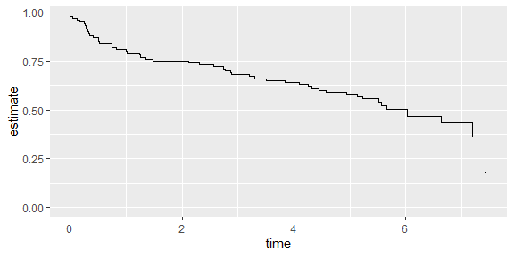
Before you fit the exponential models, fit a Kaplan-Meier curve.

Slide 21
Estimate an exponential model
## ## Call: ## survreg(formula = whas100_surv ~ 1, dist = "exponential") ## Value Std. Error z p ## (Intercept) 2.09 0.14 14.9 <2e-16 ## ## Scale fixed at 1 ## ## Exponential distribution ## Loglik(model)= -157.6 Loglik(intercept only)= -157.6 ## Number of Newton-Raphson Iterations: 5 ## n= 100

Slide 22
Percentile calculations
75th percentile: -ln(0.75) exp(2.09)=2.3
50th percentile: -ln(0.5) exp(2.09)=5.6
25th percentile: -ln(0.25) exp(2.09)=11.2

Slide 23
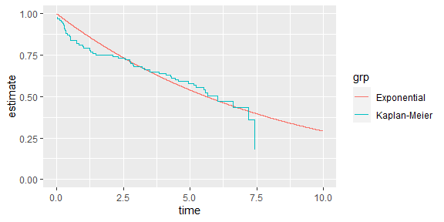
Comparison of exponential fit to Kaplan-Meier

Slide 24
Weibull model
Recall that the survival function for a Weibull distribution is
$S(t)=e^{−(t/θ)^{k}}$
Replace $θ$ with
$e^{(β_{0}+β_{1}X)}$
to get
$S(t)=e^{−(t/e^{(β_{0}+β_{1}X)})^{k}}$

Slide 25
Alternate Weibull formulation
The original development of parametric survival models chose a different, but equivalent formulation.
$ln(T)=β_{0}+β_{1}X+σε$
where $ε$ has a log-Weibull distribution (also known as a Gompertz or extreme value distribution).
The parameter $σ$ is equal to $1/k$.

Slide 26
Estimate a Weibull model
## ## Call: ## survreg(formula = whas100_surv ~ 1, dist = "weibull") ## Value Std. Error z p ## (Intercept) 2.268 0.212 10.71 <2e-16 ## Log(scale) 0.312 0.129 2.41 0.016 ## ## Scale= 1.37 ## ## Weibull distribution ## Loglik(model)= -154.3 Loglik(intercept only)= -154.3 ## Number of Newton-Raphson Iterations: 5 ## n= 100

Slide 27
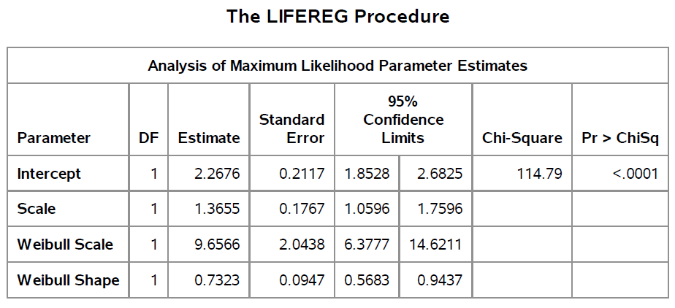
SAS table of Weibull fit
Table of Weibull model fit

Slide 28
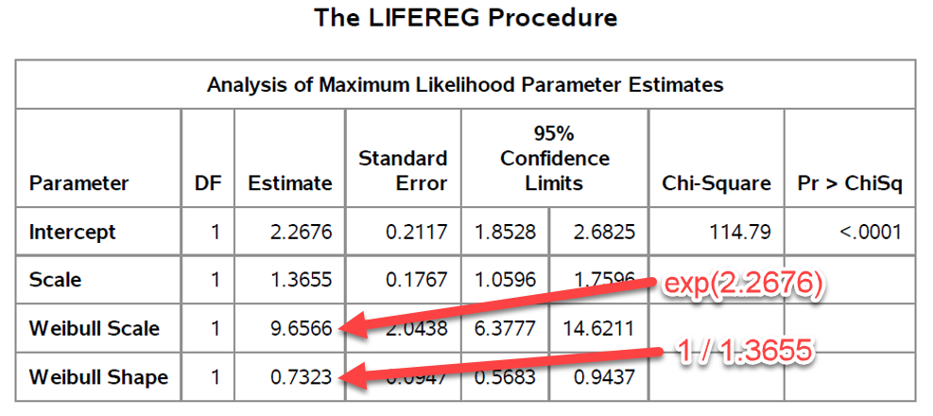
What are those two extra values in the SAS code?
Annotated table of Weibull model fit

Slide 29
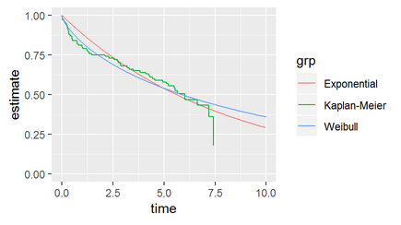
Graph of Weibull survival
Graph of survival curves

Slide 30
Estimate gender effect in a Weibull model
## term estimate std.error statistic ## 1 (Intercept) 2.5631446 0.2844093 9.012168 ## 2 genderFemale -0.7904360 0.3914775 -2.019110 ## 3 Log(scale) 0.3033633 0.1284480 2.361760 ## p.value conf.low conf.high ## 1 2.020223e-19 2.005713 3.12057667 ## 2 4.347583e-02 -1.557718 -0.02315417 ## 3 1.818842e-02 NA NA

Slide 31
Cluster and frailty models
A fundamental assumption of all the models so far is the assumption of independence.
Whether the event time for one patient is early or late has no effect on the event time for a different patient.
There are settings, however, where two event times are correlated, and you can model this correlation using a cluster effect or a frailty effect.

Slide 32
Examples of correlated survival times
Times to failure of pairs of organs (kidneys, eyes) within a patient
Multi-center trials
Recurrent events (infection, re-hospitalization)

Slide 33
Sandwich estimate
You can account for cluster effects by modifying the variance-covariance of the coefficients. For the normal model without frailty effects, the information matrix is
$I(β)=\frac{∂^{2}L_{p}}{(∂β)^{2}}$
and the estimated variance covariance matrix, $\hat{V}$, is
$\hat{V}=I(\hat{β})^{−1}$

Slide 34
Sandwich
The robust sandwich estimator (similar to the sandwich estimator in Generalized Estimating Equations) is
$\hat{R}=\hat{V}(\hat{L}′\hat{L})\hat{V}$
where $\hat{L}$ is the vector of Schoenfeld residuals. The middle of this sandwich, the $\hat{L}′\hat{L}$, adjusts the variance covariance matrix to account for the correlation within clusters.

Slide 35
Frailty model
Recall that the proportional hazards model assumes that the hazard function of a given patient,
$h(t,X,β)=h_{0}(t)e^{Xβ}$
The frailty model multiplies all the hazards within a family f by a frailty term $z_{f}$.
$h(t,X,β)=z_{f}h_{0}(t)e^{Xβ}$
Typically, $z_{f}$ is given a gamma distribution with a mean of 1 and a variance of $\frac{1}{α}$.

Slide 36
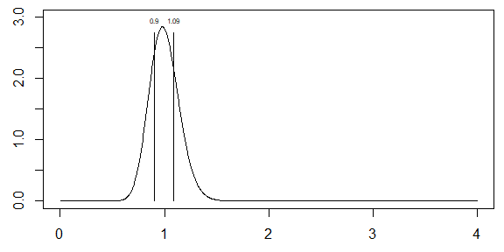
Gamma distribution, alpha=50

Slide 37
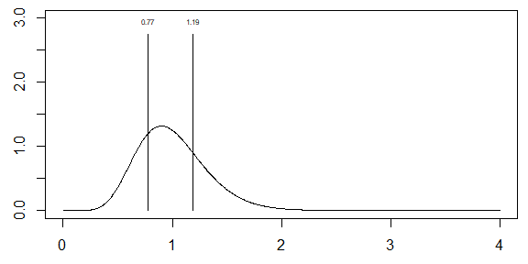
Gamma distribution, alpha=10

Slide 38
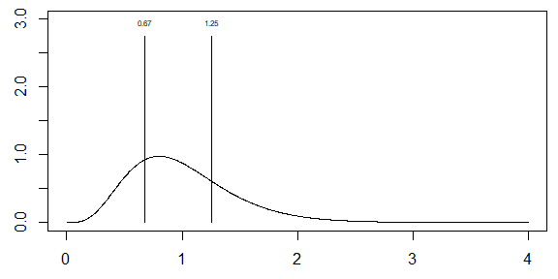
Gamma distribution: alpha=5

Slide 39
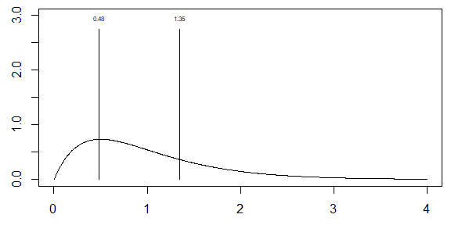
Gamma distribution: alpha=2

Slide 40
Partial listing of rats data
## litter rx time status sex ## 1 1 1 101 0 f ## 2 1 0 49 1 f ## 3 1 0 104 0 f ## 4 2 1 91 0 m ## 5 2 0 104 0 m ## 6 2 0 102 0 m

Slide 41
Descriptive statistics for rats data
## ## 0 1 ## 200 100
## ## 0 1 ## 258 42
## ## f m ## 150 150
## Min. 1st Qu. Median Mean 3rd Qu. ## 23.00 80.75 98.00 90.44 104.00 ## Max. ## 104.00

Slide 42
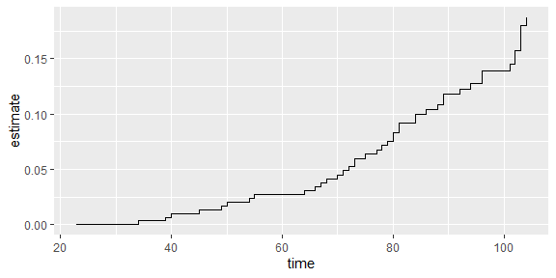
Overall survival

Slide 43
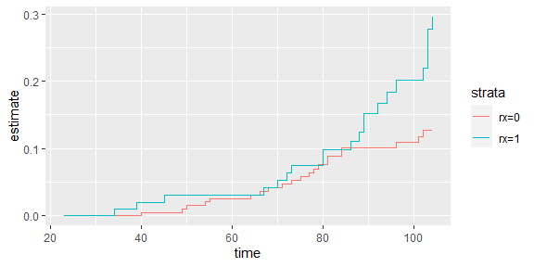
Survival by treatment

Slide 44
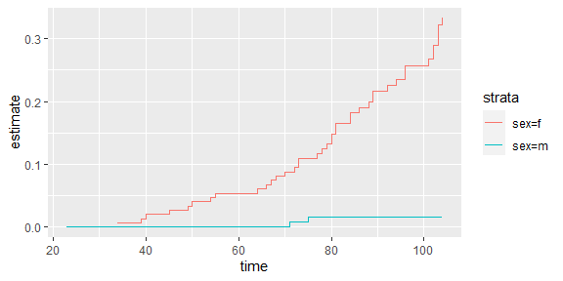
Survival by sex

Slide 45
Fit a model ignoring the effect of litter
## Call: ## coxph(formula = rats_surv ~ rx, data = rats, subset = (sex == ## "f")) ## ## coef exp(coef) se(coef) z p ## rx 0.9047 2.4713 0.3175 2.849 0.00438 ## ## Likelihood ratio test=7.98 on 1 df, p=0.004741 ## n= 150, number of events= 40

Slide 46
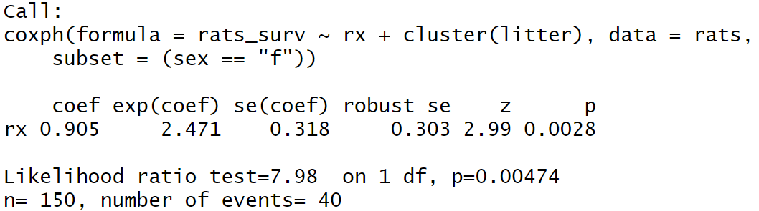
Cluster effect
Cluster model for rats data

Slide 47
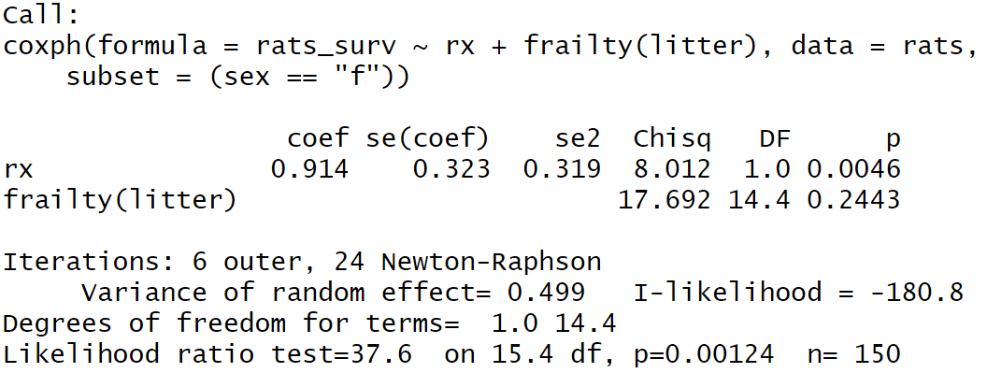
Frailty effect
Frailty model for rats data

