Slide 1
Model fitting and diagnostics for the Cox model

Slide 2
Abstract
Lecture 4. Model fitting and diagnostics for the Cox model. In this lecture, you will work with more complex forms of the Cox model with multiple predictor variables. You’ll include covariates in the Cox model to produce risk adjusted survival curves. You will also assess the underlying assumptions of the Cox model, particularly the assumption of proportional hazards.

Slide 3
Cox multivariate regression
Recall that we ran a log rank test for gender using the WHAS100 data file. Let’s calculate a Cox regression model for the same data and compare it to the log rank test.

Slide 4
Header
## id admitdate foldate los lenfol fstat ## 1 1 03/13/1995 03/19/1995 4 6 Dead ## 2 2 01/14/1995 01/23/1996 5 374 Dead ## 3 3 02/17/1995 10/04/2001 5 2421 Dead ## 4 4 04/07/1995 07/14/1995 9 98 Dead ## 5 5 02/09/1995 05/29/1998 4 1205 Dead ## 6 6 01/16/1995 09/11/2000 7 2065 Dead ## age gender bmi time_yrs age_group ## 1 65 Male 31.38134 0.0164271 60-69 ## 2 88 Female 22.65790 1.0239562 >=80 ## 3 77 Male 27.87892 6.6283368 70-79 ## 4 81 Female 21.47878 0.2683094 >=80 ## 5 78 Male 30.70601 3.2991102 70-79 ## 6 82 Female 26.45294 5.6536619 >=80
## id age gender hr sysbp diasbp bmi cvd ## 1 1 83 Male 89 152 78 25.54051 No ## 2 2 49 Male 84 120 60 24.02398 No ## 3 3 70 Female 83 147 88 22.14290 No ## 4 4 70 Male 65 123 76 26.63187 Yes ## 5 5 70 Male 63 135 85 24.41255 No ## 6 6 70 Male 76 83 54 23.24236 Yes ## afb sho chf av3 miord mitype year ## 1 Yes No No No Recurrent Non Q-wave <NA> ## 2 No No No No First Q-wave <NA> ## 3 No No No No First Q-wave <NA> ## 4 No No Yes No First Q-wave <NA> ## 5 No No No No First Q-wave <NA> ## 6 No No No Yes First Non Q-wave <NA> ## admitdate disdate fdate los dstat ## 1 01/13/1997 01/18/1997 12/31/2002 5 Alive ## 2 01/19/1997 01/24/1997 12/31/2002 5 Alive ## 3 01/01/1997 01/06/1997 12/31/2002 5 Alive ## 4 02/17/1997 02/27/1997 12/11/1997 10 Alive ## 5 03/01/1997 03/07/1997 12/31/2002 6 Alive ## 6 03/11/1997 03/12/1997 03/12/1997 1 Dead ## lenfol fstat time_yrs ## 1 2178 Alive 5.963039014 ## 2 2172 Alive 5.946611910 ## 3 2190 Alive 5.995893224 ## 4 297 Dead 0.813141684 ## 5 2131 Alive 5.834360027 ## 6 1 Dead 0.002737851

Slide 5
Cox
You should examine your independent variables one at a time before putting them all in a multivariate model.

Slide 6
Header
## Call: ## coxph(formula = Surv(time_yrs, fstat == "Dead") ~ age, data = whas500) ## ## n= 500, number of events= 215 ## ## coef exp(coef) se(coef) z ## age 0.066339 1.068589 0.006079 10.91 ## Pr(>|z|) ## age <2e-16 *** ## --- ## Signif. codes: ## 0 '***' 0.001 '**' 0.01 '*' 0.05 '.' 0.1 ' ' 1 ## ## exp(coef) exp(-coef) lower .95 upper .95 ## age 1.069 0.9358 1.056 1.081 ## ## Concordance= 0.731 (se = 0.021 ) ## Rsquare= 0.247 (max possible= 0.993 ) ## Likelihood ratio test= 142.1 on 1 df, p=0 ## Wald test = 119.1 on 1 df, p=0 ## Score (logrank) test = 126.6 on 1 df, p=0
## Call: ## coxph(formula = Surv(time_yrs, fstat == "Dead") ~ gender, data = whas500) ## ## n= 500, number of events= 215 ## ## coef exp(coef) se(coef) z ## genderFemale 0.3815 1.4645 0.1376 2.773 ## Pr(>|z|) ## genderFemale 0.00556 ** ## --- ## Signif. codes: ## 0 '***' 0.001 '**' 0.01 '*' 0.05 '.' 0.1 ' ' 1 ## ## exp(coef) exp(-coef) lower .95 ## genderFemale 1.464 0.6828 1.118 ## upper .95 ## genderFemale 1.918 ## ## Concordance= 0.542 (se = 0.018 ) ## Rsquare= 0.015 (max possible= 0.993 ) ## Likelihood ratio test= 7.6 on 1 df, p=0.005843 ## Wald test = 7.69 on 1 df, p=0.005555 ## Score (logrank) test = 7.78 on 1 df, p=0.005275

Slide 7
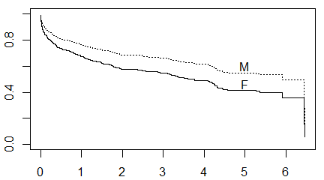

Slide 8
## Call: ## coxph(formula = Surv(time_yrs, fstat == "Dead") ~ age + gender, ## data = whas500) ## ## n= 500, number of events= 215 ## ## coef exp(coef) se(coef) ## age 0.066928 1.069218 0.006196 ## genderFemale -0.066285 0.935864 0.140585 ## z Pr(>|z|) ## age 10.802 <2e-16 *** ## genderFemale -0.471 0.637 ## --- ## Signif. codes: ## 0 '***' 0.001 '**' 0.01 '*' 0.05 '.' 0.1 ' ' 1 ## ## exp(coef) exp(-coef) lower .95 ## age 1.0692 0.9353 1.0563 ## genderFemale 0.9359 1.0685 0.7105 ## upper .95 ## age 1.082 ## genderFemale 1.233 ## ## Concordance= 0.731 (se = 0.021 ) ## Rsquare= 0.248 (max possible= 0.993 ) ## Likelihood ratio test= 142.4 on 2 df, p=0 ## Wald test = 119.7 on 2 df, p=0 ## Score (logrank) test = 126.9 on 2 df, p=0

Slide 9
Header
The effect of gender disappears when you include age in the model.

Slide 10
Header
## [1] 69.846
## Male Female ## 66.59667 74.72000

Slide 11
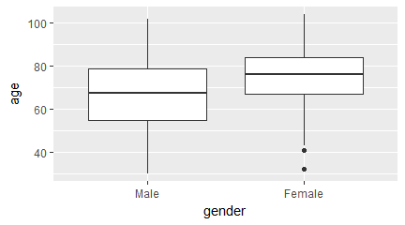

Slide 12
## term estimate std.error ## 1 age 0.06692776 0.006195843 ## 2 genderFemale -0.06628511 0.140584936 ## statistic p.value conf.low ## 1 10.8020422 0.0000000 0.05478413 ## 2 -0.4714951 0.6372872 -0.34182652 ## conf.high ## 1 0.07907139 ## 2 0.20925630

Slide 13
Header
Notice that there is a 8.1 year difference between the average ages of men and women. The hazard ratio for age, 1.069, can get extrapolated to a 8.1 year difference by exponentiating. That is 1.069^8.1 = 1.72 which is actually larger than the hazard ratio that we saw for the unadjusted model with just gender.

Slide 14
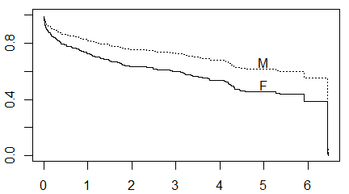
Header

Slide 15
Header
## Call: ## coxph(formula = Surv(time_yrs, fstat == "Dead") ~ bmi, data = whas500) ## ## n= 500, number of events= 215 ## ## coef exp(coef) se(coef) z ## bmi -0.09847 0.90622 0.01475 -6.676 ## Pr(>|z|) ## bmi 2.46e-11 *** ## --- ## Signif. codes: ## 0 '***' 0.001 '**' 0.01 '*' 0.05 '.' 0.1 ' ' 1 ## ## exp(coef) exp(-coef) lower .95 upper .95 ## bmi 0.9062 1.103 0.8804 0.9328 ## ## Concordance= 0.648 (se = 0.021 ) ## Rsquare= 0.092 (max possible= 0.993 ) ## Likelihood ratio test= 48.33 on 1 df, p=3.602e-12 ## Wald test = 44.57 on 1 df, p=2.459e-11 ## Score (logrank) test = 44.31 on 1 df, p=2.807e-11

Slide 16
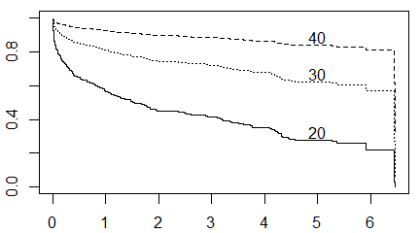

Slide 17
## Call: ## coxph(formula = Surv(time_yrs, fstat == "Dead") ~ bmi + age + ## i_female, data = whas500) ## ## n= 500, number of events= 215 ## ## coef exp(coef) se(coef) ## bmi -0.042084 0.958789 0.015427 ## age 0.060791 1.062677 0.006503 ## i_female -0.093065 0.911135 0.141085 ## z Pr(>|z|) ## bmi -2.728 0.00637 ** ## age 9.348 < 2e-16 *** ## i_female -0.660 0.50949 ## --- ## Signif. codes: ## 0 '***' 0.001 '**' 0.01 '*' 0.05 '.' 0.1 ' ' 1 ## ## exp(coef) exp(-coef) lower .95 ## bmi 0.9588 1.043 0.9302 ## age 1.0627 0.941 1.0492 ## i_female 0.9111 1.098 0.6910 ## upper .95 ## bmi 0.9882 ## age 1.0763 ## i_female 1.2014 ## ## Concordance= 0.739 (se = 0.021 ) ## Rsquare= 0.259 (max possible= 0.993 ) ## Likelihood ratio test= 150 on 3 df, p=0 ## Wald test = 128.7 on 3 df, p=0 ## Score (logrank) test = 135.4 on 3 df, p=0

Slide 18
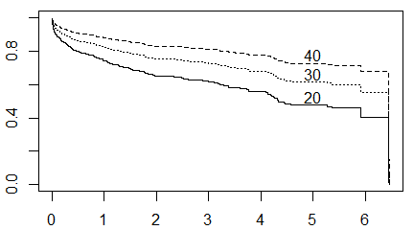

Slide 19
Header
Look at the interaction.

Slide 20
Header
## Call: ## coxph(formula = Surv(time_yrs, fstat == "Dead") ~ age * i_female, ## data = whas500) ## ## n= 500, number of events= 215 ## ## coef exp(coef) se(coef) ## age 0.078540 1.081707 0.008027 ## i_female 2.333732 10.316375 0.992674 ## age:i_female -0.030502 0.969958 0.012541 ## z Pr(>|z|) ## age 9.785 <2e-16 *** ## i_female 2.351 0.0187 * ## age:i_female -2.432 0.0150 * ## --- ## Signif. codes: ## 0 '***' 0.001 '**' 0.01 '*' 0.05 '.' 0.1 ' ' 1 ## ## exp(coef) exp(-coef) lower .95 ## age 1.082 0.92446 1.0648 ## i_female 10.316 0.09693 1.4742 ## age:i_female 0.970 1.03097 0.9464 ## upper .95 ## age 1.0989 ## i_female 72.1926 ## age:i_female 0.9941 ## ## Concordance= 0.734 (se = 0.021 ) ## Rsquare= 0.257 (max possible= 0.993 ) ## Likelihood ratio test= 148.2 on 3 df, p=0 ## Wald test = 119.5 on 3 df, p=0 ## Score (logrank) test = 127.7 on 3 df, p=0
## Call: ## coxph(formula = Surv(time_yrs, fstat == "Dead") ~ age_centered * ## i_female, data = whas500) ## ## n= 500, number of events= 215 ## ## coef exp(coef) ## age_centered 0.078540 1.081707 ## i_female 0.203288 1.225425 ## age_centered:i_female -0.030502 0.969958 ## se(coef) z ## age_centered 0.008027 9.785 ## i_female 0.174605 1.164 ## age_centered:i_female 0.012541 -2.432 ## Pr(>|z|) ## age_centered <2e-16 *** ## i_female 0.244 ## age_centered:i_female 0.015 * ## --- ## Signif. codes: ## 0 '***' 0.001 '**' 0.01 '*' 0.05 '.' 0.1 ' ' 1 ## ## exp(coef) exp(-coef) ## age_centered 1.082 0.9245 ## i_female 1.225 0.8160 ## age_centered:i_female 0.970 1.0310 ## lower .95 upper .95 ## age_centered 1.0648 1.0989 ## i_female 0.8703 1.7255 ## age_centered:i_female 0.9464 0.9941 ## ## Concordance= 0.734 (se = 0.021 ) ## Rsquare= 0.257 (max possible= 0.993 ) ## Likelihood ratio test= 148.2 on 3 df, p=0 ## Wald test = 119.5 on 3 df, p=0 ## Score (logrank) test = 127.7 on 3 df, p=0

Slide 21
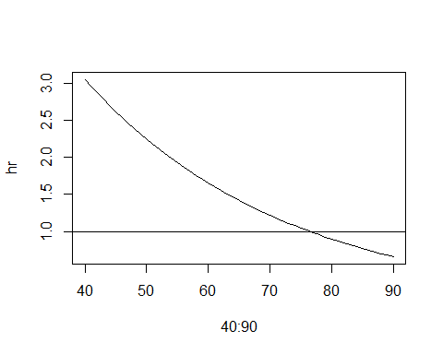

Slide 22
Header
You can use a sequence of Wald tests to compare different models for survival.

Slide 23
Header
## lab term estimate ## 1 gender only genderFemale 0.38151203 ## 2 age, gender age 0.06692776 ## 3 age, gender genderFemale -0.06628511 ## 4 bmi, age, gender bmi -0.04208396 ## 5 bmi, age, gender age 0.06079117 ## 6 bmi, age, gender genderFemale -0.09306460 ## p.value ## 1 0.005555126 ## 2 0.000000000 ## 3 0.637287208 ## 4 0.006374453 ## 5 0.000000000 ## 6 0.509487094

Slide 24
Header
You use the log partial likelihood and/or the AIC (Akaike Information Criteria) to compare models of different complexity.
AIC = -2 log Likelihood + 2 k.
AIC = -2 log Likelihood + log(n) k.

Slide 25
Header
## lab logLik AIC ## 1 gender only -1223.522 2449.043 ## 2 gender, age -1156.138 2316.276 ## 3 gender, age, bmi -1152.310 2310.620 ## BIC ## 1 2452.414 ## 2 2323.017 ## 3 2320.732

Slide 26
Header
There are several residuals available for Cox regression. The Martingale residual is defined as
$$M(t_{i})=δ_{i}−H_{0}(t_{i})e^{Xβ}$$
where $δ_{i}$ = 0 if censored, 1 if dead.

Slide 27
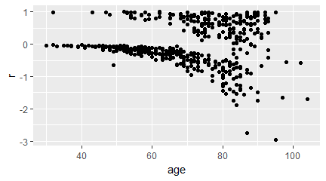
Header

Slide 28
## `geom_smooth()` using method = 'loess' and formula 'y ~ x'

Slide 29
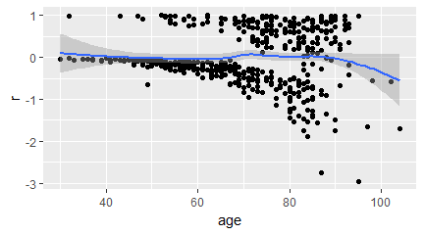

Slide 30
## `geom_smooth()` using method = 'loess' and formula 'y ~ x'

Slide 31
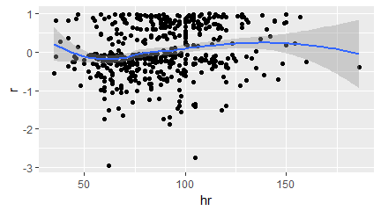

Slide 32
## `geom_smooth()` using method = 'loess' and formula 'y ~ x'

Slide 33
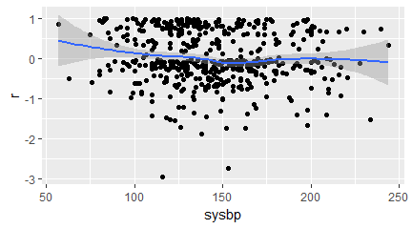

Slide 34
## `geom_smooth()` using method = 'loess' and formula 'y ~ x'

Slide 35
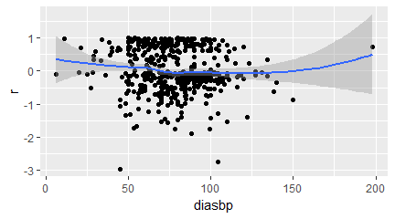

Slide 36
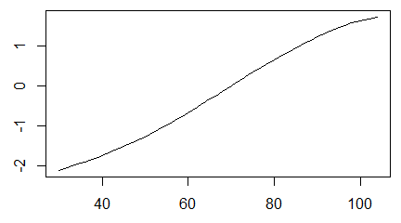
Header

Slide 37
## lab logLik AIC BIC ## 1 linear (df=1) -1152.310 2310.620 2320.732 ## 2 spline (df=3) -1151.288 2308.714 2319.058 ## 3 spline (df=8) -1143.118 2302.204 2329.116

Slide 38
Header
Testing.

Slide 39
Header
## Call: ## coxph(formula = Surv(time_yrs, fstat == "Dead") ~ hr, data = whas500) ## ## coef exp(coef) se(coef) z p ## hr 0.01505 1.01516 0.00269 5.6 2.1e-08 ## ## Likelihood ratio test=28.9 on 1 df, p=7.45e-08 ## n= 500, number of events= 215
## Call: ## coxph(formula = Surv(time_yrs, fstat == "Dead") ~ sysbp, data = whas500) ## ## coef exp(coef) se(coef) z ## sysbp -0.00452 0.99549 0.00223 -2.03 ## p ## sysbp 0.042 ## ## Likelihood ratio test=4.19 on 1 df, p=0.0406 ## n= 500, number of events= 215
## Call: ## coxph(formula = Surv(time_yrs, fstat == "Dead") ~ diasbp, data = whas500) ## ## coef exp(coef) se(coef) z ## diasbp -0.01602 0.98411 0.00328 -4.88 ## p ## diasbp 1.1e-06 ## ## Likelihood ratio test=23.8 on 1 df, p=1.07e-06 ## n= 500, number of events= 215
## Warning in fitter(X, Y, strats, offset, ## init, control, weights = weights, : Loglik ## converged before variable 1 ; beta may be ## infinite.
## Call: ## coxph(formula = Surv(time_yrs, fstat == "Dead") ~ cvd, data = whas500) ## ## coef exp(coef) se(coef) z p ## cvdYes 2.19e+01 3.20e+09 2.20e+03 0.01 0.99 ## ## Likelihood ratio test=568 on 1 df, p=0 ## n= 500, number of events= 215
## Call: ## coxph(formula = Surv(time_yrs, fstat == "Dead") ~ afb, data = whas500) ## ## coef exp(coef) se(coef) z p ## afbYes 0.540 1.716 0.165 3.26 0.0011 ## ## Likelihood ratio test=9.58 on 1 df, p=0.00196 ## n= 500, number of events= 215
## Call: ## coxph(formula = Surv(time_yrs, fstat == "Dead") ~ sho, data = whas500) ## ## coef exp(coef) se(coef) z p ## shoYes 1.190 3.288 0.256 4.65 3.4e-06 ## ## Likelihood ratio test=15.8 on 1 df, p=6.87e-05 ## n= 500, number of events= 215
## Call: ## coxph(formula = Surv(time_yrs, fstat == "Dead") ~ chf, data = whas500) ## ## coef exp(coef) se(coef) z p ## chfYes 1.200 3.319 0.138 8.69 <2e-16 ## ## Likelihood ratio test=72.3 on 1 df, p=0 ## n= 500, number of events= 215
## Call: ## coxph(formula = Surv(time_yrs, fstat == "Dead") ~ av3, data = whas500) ## ## coef exp(coef) se(coef) z p ## av3Yes 0.479 1.614 0.390 1.23 0.22 ## ## Likelihood ratio test=1.31 on 1 df, p=0.252 ## n= 500, number of events= 215
## Call: ## coxph(formula = Surv(time_yrs, fstat == "Dead") ~ miord, data = whas500) ## ## coef exp(coef) se(coef) z ## miordRecurrent 0.427 1.532 0.139 3.07 ## p ## miordRecurrent 0.0022 ## ## Likelihood ratio test=9.14 on 1 df, p=0.0025 ## n= 500, number of events= 215
## Call: ## coxph(formula = Surv(time_yrs, fstat == "Dead") ~ mitype, data = whas500) ## ## coef exp(coef) se(coef) z ## mitypeQ-wave -0.660 0.517 0.167 -3.95 ## p ## mitypeQ-wave 7.9e-05 ## ## Likelihood ratio test=17.5 on 1 df, p=2.94e-05 ## n= 500, number of events= 215

Slide 40
Header
Save everything for possible later re-use.

Slide 41
Header

