Slide 1
Questions about interactions and goodness of fit
Steve Simon

Slide 2
A few extra details
I got two interesting questions. The first was about a Cox regression model that involved the interaction of two categorical variables. The second was about measures of goodness of fit for the Cox model.

Slide 3
Review the whas500 data set
## id age gender hr sysbp diasbp bmi cvd afb ## 1 1 83 Male 89 152 78 25.54051 No Yes ## 2 2 49 Male 84 120 60 24.02398 No No ## sho chf av3 miord mitype year ## 1 No No No Recurrent Non Q-wave <NA> ## 2 No No No First Q-wave <NA> ## admitdate disdate fdate los dstat ## 1 01/13/1997 01/18/1997 12/31/2002 5 Alive ## 2 01/19/1997 01/24/1997 12/31/2002 5 Alive ## lenfol fstat time_yrs ## 1 2178 Alive 5.963039 ## 2 2172 Alive 5.946612

Slide 4
Interaction with age as a categorical variable
In the lecture you saw an interaction between age (a continuous variable) and gender (a categorical variable). The interpretation of the interaction was not too difficult. The interaction meant that the difference in survival between men and women was very large at younger ages, but this difference shrunk for older patients.

Slide 5
Turning age into a categorical variable
## ## Male Female ## 0-60 107 34 ## 61-70 65 28 ## 71-80 64 57 ## 81+ 64 81

Slide 6
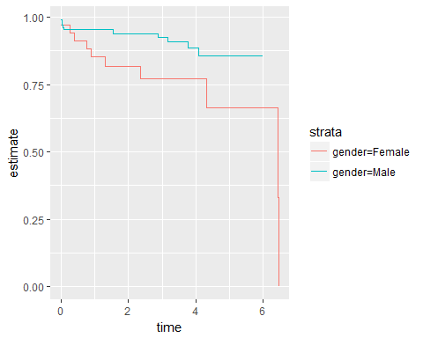
Kaplan-Meier plot for ages 0-60

Slide 7
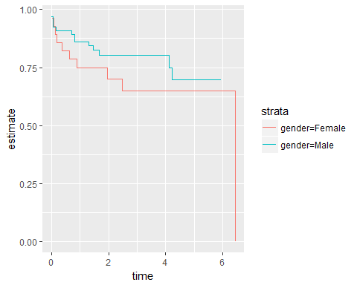
Kaplan-Meier plot for ages 61-70

Slide 8
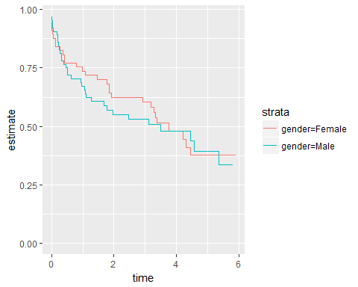
Kaplan-Meier plot for ages 71-80

Slide 9
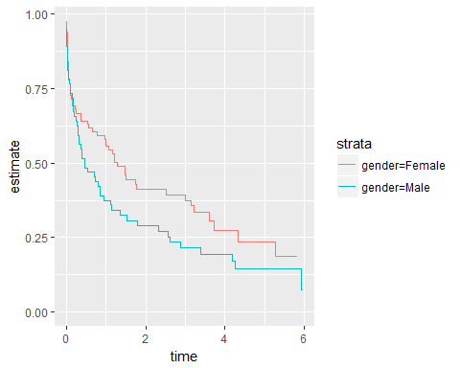
Kaplan-Meier plot for ages 81+

Slide 10
Interaction with age_group
## term hr p.value conf.int ## 1 genderF 2.52 0.054 0.99-6.46 ## 2 g61-70 2.48 0.028 1.1-5.58 ## 3 g71-80 7.21 0.001 3.56-14.59 ## 4 g81+ 15.86 0.001 8.05-31.23 ## 5 genderF:g61-70 0.66 0.512 0.19-2.28 ## 6 genderF:g71-80 0.35 0.055 0.12-1.02 ## 7 genderF:g81+ 0.29 0.015 0.1-0.79

Slide 11
Interpretation of interaction
age | M | F
0-60 | 1.00 (baseline) | genderF
61-70 | g61-70 | genderF x g61-70 x genderF:g61-70
71-80 | g71-80 | genderF x g71-80 x genderF:g71-80
81+ | g81+ | genderF x g81+ x genderF:g81+

Slide 12
Interpretation of hazard ratios
age | Hazard Ratio
0-60 | genderF
61-70 | genderF x genderF:g61-70
71-80 | genderF x genderF:g71-80
81+ | genderF x genderF:g81+

Slide 13
Interaction in the WHAS500 data set
age | M | F
0-60 | 1.00 (baseline) | 2.52
61-70 | 2.48 | 4.12
71-80 | 7.21 | 6.36
81+ | 15.86 | 11.59

Slide 14
Hazard ratios in the WHAS500 data set
age | Hazard Ratio
0-60 | 2.52
61-70 | 1.66
71-80 | 0.88
81+ | 0.73

Slide 15
Goodness of fit
Many researchers want a number comparable to the $R^{2}$ value in linear regression. It should have several properties:
It is always between 0 and 1.
A value of 0 implies a “worthless” model.
A value of 1 implies a “perfect” model.
If one model has an $R^{2}$ value larger than another model, then the first model is a “better” model.

Slide 16
ROC approach to goodness of fit
## gender time_yrs fstat ## 1 M 0.019 Dead ## 2 M 0.049 Dead ## 3 F 0.088 Dead ## 4 M 0.298 Dead ## 5 F 0.397 Dead ## 6 M 0.854 Dead ## 7 M 0.857 Dead ## 8 F 1.465 Dead ## 9 M 1.539 Dead ## 10 F 3.001 Dead

Slide 17
ROC approach to goodness of fit
## gender time_yrs fstat spec sens ## 1 M 0.019 Dead 0.1666667 1.00 ## 2 M 0.049 Dead 0.3333333 1.00 ## 3 F 0.088 Dead 0.3333333 0.75 ## 4 M 0.298 Dead 0.5000000 0.75 ## 5 F 0.397 Dead 0.5000000 0.50 ## 6 M 0.854 Dead 0.6666667 0.50 ## 7 M 0.857 Dead 0.8333333 0.50 ## 8 F 1.465 Dead 0.8333333 0.25 ## 9 M 1.539 Dead 1.0000000 0.25 ## 10 F 3.001 Dead 1.0000000 0.00

Slide 18
Concordant pairs
## 0.088 0.397 1.465 3.001 ## 0.019 "C" "C" "C" "C" ## 0.049 "C" "C" "C" "C" ## 0.298 "D" "C" "C" "C" ## 0.854 "D" "D" "C" "C" ## 0.857 "D" "D" "C" "C" ## 1.539 "D" "D" "D" "C"
## ## ## C/(C+D) = 0.67

Slide 19
Concordant pairs with censoring
## 0.088 0.397 1.465 3.001 ## 0.019 "C" "C" "C" "C" ## 0.049 "C" "C" "C" "C" ## 0.298 "D" "C" "C" "C" ## 0.854 "D" "D" "C" "C" ## 0.857 "D" "D" "C" "C" ## 1.539 "D" "D" "D" "C" ## 2+ "D" "D" "D" "?"

Slide 20
Partial likelihood approach to goodness of fit
There are several measures of goodness of fit that are based on partial likelihoods. The simplest of these is
$$R_{p}^{2}=1−exp(\frac{2}{n}(L_{0}−L_{p}))$$
where $L_{0}$ is the partial log likelihood under the model with no covariates. This measure and others based on the same principle are describes on pages 194-195 of Hosmer, Lemeshow, and May.

Slide 21
Why I dislike goodness of fit measures.
In linear regression, $R^{2}$ has a concrete interpretation in terms of the proportion of explained variation. There is no similar analogy in survival analysis.
All of the measures of goodness of fit are highly sensitive to the proportion of censored values.
There is no consensus in the research community as to which measure of goodness of fit is best.

