Slide 1
Introduction to Survival Analysis Workshop Orientation
Steve Simon
Workshop Instructor

Slide 2
Part 1: Using GoToWebinar

Slide 3
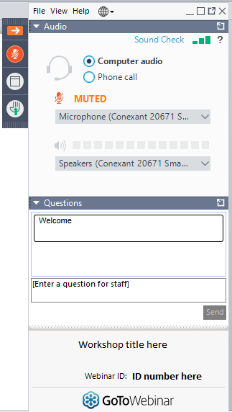
Hide or show control panel
You are muted
Click here to undock your question panel for easy access
Enter questions or comments
©2020 Steve Simon | https://TheAnalysisFactor.com
<number>
Notes:
<number>

Slide 4
Audio Troubleshooting:
1. Switch audio to phone
2. Close all other applications, especially browser windows
3. Shut down GoToWebinar and log back in
©2020 Steve Simon | https://TheAnalysisFactor.com
<number>
Notes:
<number>

Slide 5

Two ways to join the webinar
Link in GoToWebinar reminder emails
1 day before
1 hour before
Link on the Survival Analysis Workshop site
©2020 Steve Simon | https://TheAnalysisFactor.com
<number>

Slide 6

The Workshop Structure
Each Module
Webinar Session
+ Handout
Step-by-Step Software Demos + Syntax
Exercises
+ Solutions
Q&A Session
( + Forum)
©2020 Steve Simon | https://TheAnalysisFactor.com
<number>
Notes:
8 Live sessions
Note about the live sessions:
Everyone is muted to reduce background noise
Questions are encouraged by using the question box on your screen
Only the instructor can see your questions
Questions will be read if answered orally (no names)
Some questions will be saved until the end of the session if they are outside of the scope of the presentation
Slides available to download beforehand
Each week demo videos and example syntax files are provided to replicate everything discussed in the live lecture session
These help to explain menu options, code syntax and other special options
These files are available in each of the 5 software languages… you are encouraged to download all software files
Exercise and answer files are provided for you to practice with
Nothing is collected or graded, just for your practice
Getting your questions answered:
Weekly Q&A sessions
Recorded
Place to ask software specific questions (code syntax, menu options)
Pre-submit your questions or ask live
Participants can be unmuted when needed
Forum for questions as well
Access for 1 year
Goal is to answer questions within 24 hours during the week
Everyone can see questions/answers and contribute to the discussion
<number>

Slide 7
Part 2: A Tour of the Workshop Website

Slide 8
Workshop Structure
Program Center Website
1. Logistics
Calendar
Go To Webinar link
3. The Workshop Content
Data Files and Descriptions
Modules
Recordings
2. Logistical Help
Getting Started
Support form
FAQ
4. Additional Materials
Bonus Videos
Extra Reading
©2020 Steve Simon | https://TheAnalysisFactor.com
<number>
Notes:
Open the actual website and walk them through the four areas.
<number>

Slide 9
Part 3: The Workshop Content

Slide 10
Module 1: The Kaplan-Meier Curve
Constructing a Kaplan-Meier Curve
Censoring and Its Assumptions
Log Rank Test for Subgroup Comparisons
©2020 Steve Simon | https://TheAnalysisFactor.com
<number>

Slide 11
Module 2: The Hazard Function and the Cox Proportional Hazards Model
Definition of a Hazard Function
Constant Hazard vs Increasing or Decreasing Hazard
Steps to Run Cox Regression Models and Interpret Model Coefficients
©2020 Steve Simon | https://TheAnalysisFactor.com
<number>

Slide 12
Module 3: Planning and Data Management Issues
Data Set Up for Survival Analysis
Compute and Compare Power
Problems with Date Variables
©2020 Steve Simon | https://TheAnalysisFactor.com
<number>

Slide 13
Module 4: Cox Model: Model Fitting and Diagnostics for the Cox Model
Multiple Predictor Variables
Risk Adjustment
Proportional Hazards
©2020 Steve Simon | https://TheAnalysisFactor.com
<number>

Slide 14
Module 5: Parametric Models
Comparing Hazard Functions for Popular Distributions
Interpreting Coefficients
Understanding Advantages and Disadvantages
Frailty Models
©2020 Steve Simon | https://TheAnalysisFactor.com
<number>

Slide 15
Module 6: Time-Varying Covariates in a Cox Model
How to Code Data for Time-Varying Covariates
Fit Time-Varying Models
Competing Risks
Interpreting the Results
©2020 Steve Simon | https://TheAnalysisFactor.com
<number>

Slide 16
Questions?
©2020 Steve Simon | https://TheAnalysisFactor.com
<number>

