Slide 1
The Neighborhood Housing Conditions Survey, https://github.com/pmean/talks/nhcs
Steve Simon

Slide 2
Overview
Neighborhood Housing Conditions Survey (NHCS)
Windshield survey
Visible at street level
Notes:
The CEI Neighborhood Housing Conditions Survey (NHCS) is a windshield survey of residential parcels. The parcel geography and other relevant information was provided by the City of Kansas City, Missouri. The conditions surveyed are those that are visible from the street on which a parcel is addressed. Parcels that are non-residential, both in structure type and use type, are noted as such and no additional information is collected, other than whether or not there is a visible address. The original form of the survey was developed by Ed Linnebur of the Kansas City Neighborhood Alliance, prior to the application of the initial KCMo survey in 2000-01. Detailed documentation for that survey is available in the Final Report for the City of Kansas City Missouri Contract No. 1999-032. That survey was primarily conducted on paper. In subsequent years, data collection was programmed on hand-held PDAs.

Slide 3
NHCS
Classification data
Structure type,
Use type,
Residential type,
Structure profile, and
Visible address
Notes:
The housing survey collects two types of data. It collecting information that classifies the type of structure, its use, whether it is residential, the profile of the structure, and the visible address. It also collects data on 15 housing conditions, groups into conditions about the structure itself, the grounds, and the infrastructure.
The first type is classification data. The second type is conditions data. Classification data includes structure type, use type, residential type, structure profile, and visible address. For all parcels other than those that are classified as non-residential in both structure type and use type, conditions data is collected. This report will discuss each of the 15 surveyed conditions both individually, and grouped into three general categories of conditions. The groupings and their component elements are listed in Table I-1:

Slide 4
NHCS
Conditions data
Structure
Grounds
Infrastructure
Notes:
The housing survey collects two types of data. It collecting information that classifies the type of structure, its use, whether it is residential, the profile of the structure, and the visible address. It also collects data on 15 housing conditions, groups into conditions about the structure itself, the grounds, and the infrastructure.
The first type is classification data. The second type is conditions data. Classification data includes structure type, use type, residential type, structure profile, and visible address. For all parcels other than those that are classified as non-residential in both structure type and use type, conditions data is collected. This report will discuss each of the 15 surveyed conditions both individually, and grouped into three general categories of conditions. The groupings and their component elements are listed in Table I-1:

Slide 5
NHCS Structure
Roof
Foundation/walls
Windows/doors
Porch
Exterior Paint
Notes:
The condition of each of these elements is rated on a scale of 1 to 5, with 5 corresponding to the best condition and 1 corresponding to the worst condition. The specific meaning of each condition number for each of the above elements is contained in the Reference Guide. For parcels with no structure (vacant lots, parking lots, parks) there is only data for the Grounds and Infrastructure conditions.

Slide 6
NHCS Grounds
Private sidewalk/drive
Lawn/shrubs
Nuisance vehicles
Litter
Open storage

Slide 7
NHCS Infrastructure
Public sidewalk
Curb
Street lighting
Catch basin
Street

Slide 8
Condition ratings
Likert scale (1-5)
1, Severely deteriorated
2, Seriously deteriorated
3, Substandard
4, Good
5, Excellent
Missing value codes
6, not applicable
7, unable to rate
Notes:
The condition ratings range from 1 to 5 on Likert scale with lower scores indicating more deterioration. A code of 6 is a missing value code for locations where a condition rating is not applicable. A code of 7 is a second missing value code for conditions that could not be rated because of visibility issues.

Slide 9
Example Structure/roof
Severely Deteriorated. There are holes visible through roof sheathing. Rafters are sagging or collapsed. Soffits and fascia boards are missing or display severe rot and deterioration.
Notes:
Let’s look at the details for one of the fifteen conditions, the structure/roof. The lowest rating, 1, represent severe deterioration. It would be marked by visible holes, sagging rafters, or severe rot and deterioration of the soffits.

Slide 10
Example Structure/roof
Seriously Deteriorated. There are no holes present. The roof has sagging rafters, but sagging is not severe. Roofing shingles are extremely deteriorated. More than five shingles are currently missing on the front exposure of the roof. It appears some sheathing needs to be replaced. Soffits and fascia boards display moderate rot and deterioration.
Notes:
The next rating, 2, represent serious deterioration. No holes, but some sagging of the rafters, but not too severe. It would also be indicated by missing or extremely deteriorated roofing shingles or also by moderate rot and deterioration of the soffits and fascia boards

Slide 11
Example Structure/roof
Substandard. There are no holes or sagging. Roofing shingles are deteriorated and should be removed before new shingles are installed. Less than five shingles are missing on the entire roof. Soffits and fascia boards display slight rot deterioration.
Notes:
A rating of 3 represents substandard conditions. No holes or sagging, a small number of missing shingles, or slight rot in soffits and fascia boards.

Slide 12
Example Structure/roof
Good. Roof shingles show slight wear. (discoloration can be seen from street, or faded color do to loss of rock). There are no holes or sagging rafters. Soffits and fascia boards may need painting, but there is no rot or deterioration.
Notes:
A rating of 4 represents slight wear and discoloration.

Slide 13
Example Structure/roof
Excellent. Roofing shingles show no wear. Soffits and fascia boards display no rot nor deterioration and are adequately installed.
Notes:
A rating of 5 is the best rating. No wear, no rot, no deterioriation.

Slide 14
Example Structure/roof
Not applicable. Characteristic does not apply to rated parcel (e.g., roof rating for parcels with no structure).
Notes:
If there is no structure on the parcel, there is no roof to be rated. This is assigned a code of 6 and this is not used in the overall assessment of housing conditions.

Slide 15
Example Structure/roof
Un-ratable. Characteristic applies to rated parcel, but rating could not be determined (e.g., roof rating for structures with flat roofs, or where line of sight to roof is obscured by trees).
Notes:
There’s one more case to consider. Sometimes, you cannot provide a rating because the roof is flat or obscured by trees. This is assigned a code of 7 and this is not used in the overall assessment of housing quality.

Slide 16
Training
Classroom session with visual aids
Group discussion of a test block
Individual survey of two test blocks
Trainee ratings compared with expert
Notes:
The training starts with a classroom session with visual aids. Then the trainees are taken to a test block, chosen for its representativeness of various levels of deterioration. The trainees join in a group discussion with the instructor on the ratings for individual parcels on this test block.
Then the trainees examine two more test blocks individually. Their ratings are compared to those of the instructor and if the average deviation in rating is within plus or minus one, the trainees are certified and able to conduct surveys on their own.

Slide 17
Quality Control
Notes:
The following quality control procedures are performed. Two blocks with a minimum of 20 residential parcels per block are randomly selected from the survey data for each survey team. These parcels are then inspected by the survey developer/trainer to provide a set of standard results for each parcel. For categorical variables (visible address, structure type, use type, residential type, and structure profile) a direct a comparison is made. For ratings variables, an overall average difference per rating is calculated. This is calculated by taking the absolute value of the difference between the original surveyor rating and the standard rating for each parcel and summing over the total number of parcels surveyed, then dividing that value by the total number of parcels surveyed. In cases where the surveyor rates an item as unrateable (a value of 6) and the standard rating was anything other than unrateable, or vice versa, the rating is not counted in the average. An average difference under one is considered passing, and means that overall the ratings fall within the range of -1 to +1 from the standard rating. Any average difference greater than one is considered as failing.

Slide 18
Who uses the NCHS
Notes:
First, parcel level mapping of residential property conditions is of real interest in its own right, to several major urban and community development constituencies. Conventional CDCs whose principle activity is the development of affordable housing in low-income neighborhoods, city urban planners, neighborhood residents themselves, and a variety of private sector interests including developers, real estate agencies, mortgage bankers, construction contractors, and insurance companies, just to name the most obvious, all have a keen interest in the collection and mapping of residential conditions data.
The second (arguably even more) important feature of the GPLAN project is that it establishes a methodological framework for geographic community modeling with virtually unlimited potential. The development of a parcel-level geographic database allows the collection and representation of social and economic data at the finest possible level of “social resolution,” i.e., the houshold.5 Higher level social “geographies” (e.g. “blocks” or “neighborhoods” or “communities”) are (more or less) easily added to the household/institution/enterprise-level model. This, of course, includes the conventional social geographies such as low-level census geography (blocks, block groups and tracts), zip codes, school districts, voting districts, cities, counties, and MSAs.6 The database functions of GIS allow the linkage of virtually unlimited datasets to whatever levels of geography for which they may be relevant and available. The implicit role of space and spatial relationships in the study of community development is rendered integral, explicit, and amenable to formal analysis.

Slide 19
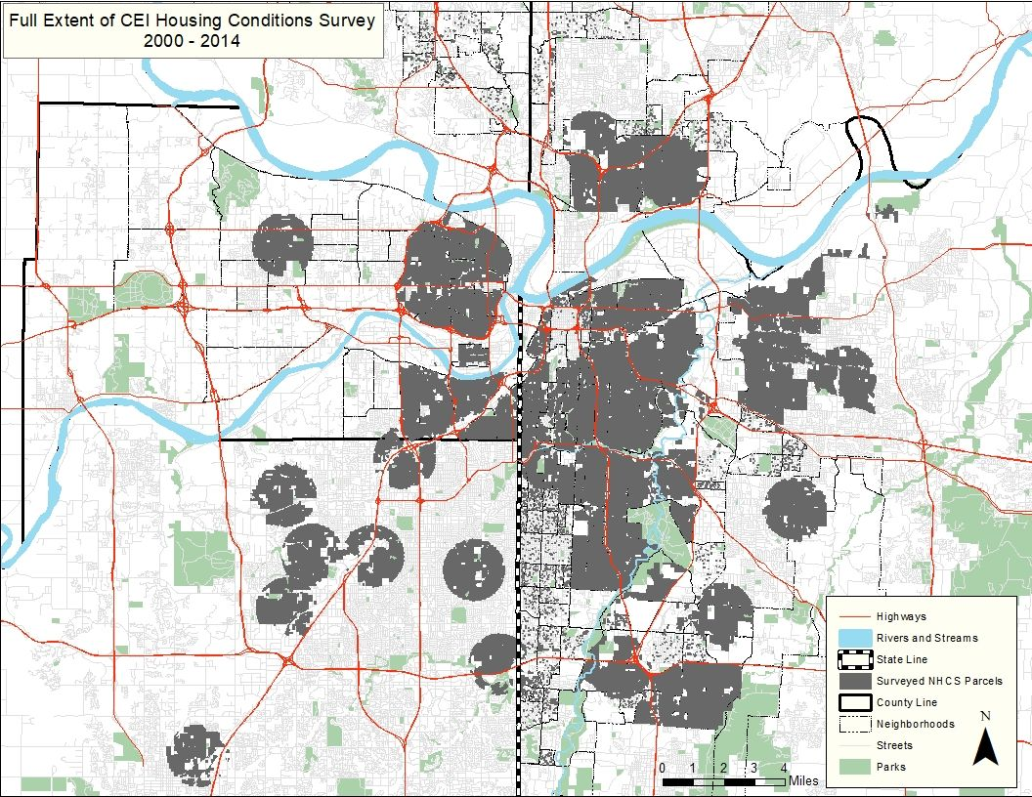
Areas covered by the NHCS
Figure 1. Map of NHCS locations
Notes:
This map shows where the NHCS has been used up to 2014. The survey has been largely inactive since then due to budget problems, but we are using the survey again in the current grant we have received from HUD.
Those of you who know and love Kansas City will notice two important features of this map. First, we have done surveys on both sides of the state line. Second, we have done survey both north and south of the Missouri river.

Slide 20
Advantages of using NHCS

Slide 21

Linking NHCS data with acute asthma visits
Figure 2. Dr. Natalie Kane
Notes:
I worked for quite a few years at Children’s Mercy Hospital and did some great work with various departments at the hospital including the Department of Asthma and Allergy. That group knew that it made no sense to treat serious asthma problems at the hospital and then return the child to an environment that would just create the same problem over and over again. So they set up a program more than two decades ago to help families with home remediation because fixing the environment was the best way to help their asthma patients.
I’m no longer with Children’s Mercy, but I still collaborate with them on various research studies.
This is a picture of Natalie Kane. She currently workks at Children’s Mercy, but I knew her from her work on a dissertation that she successfully defended in 2020. She linked the NCHS data with medical records of asthma visits at Children’s Mercy Hospital and additional geographic markers of pollution to establish a link between disparities in home environment and rates of acute pediatric asthma care encounters.

Slide 22

Linking NHCS data with elevated blood lead levels
Figure 3. Dr. Neal Wilson
Notes:
Here’s a picture of Dr. Neal Wilson. Like Natalie Kane, he took NHCS data and linked it to medical records, this time with blood testing data from the Kansas City, Missouri Department of Health. He showed a strong association between housing conditions and elevated blood lead levels in children. He successfully defended his dissertation on this topic in 2021 and has continued his work in this area with the

Slide 23
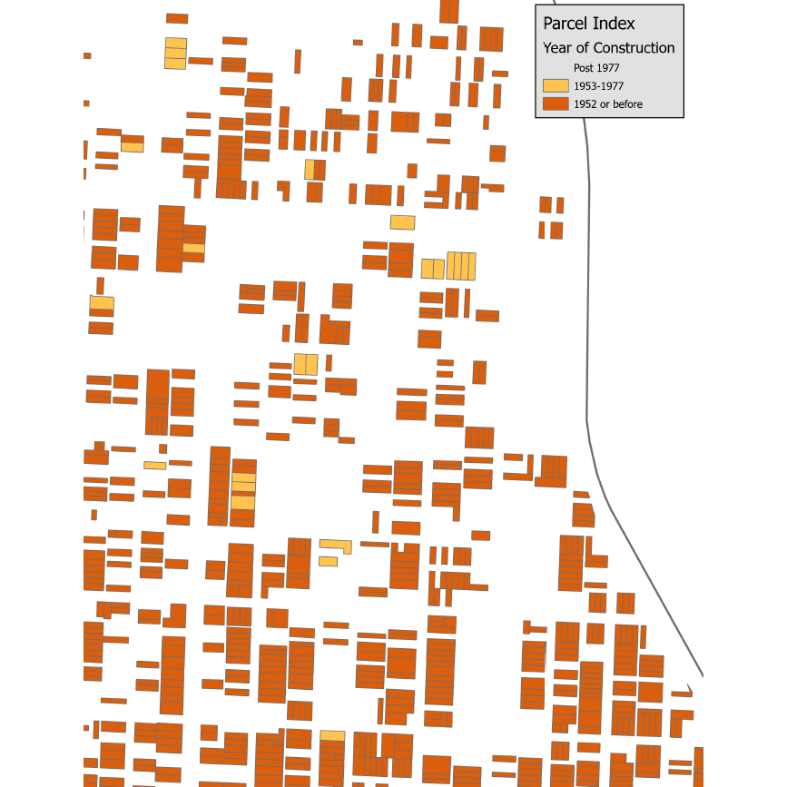
Housing data using just era of construction
Figure 4. Housing data coded by era of construction

Slide 24
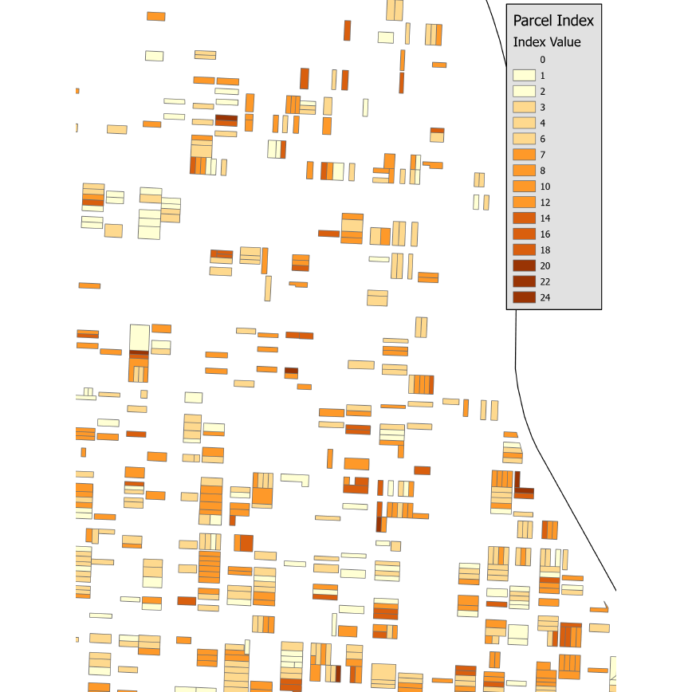
Housing data incorporating NHCS data
Figure 5. Housing data coded using NHCS data

Slide 25
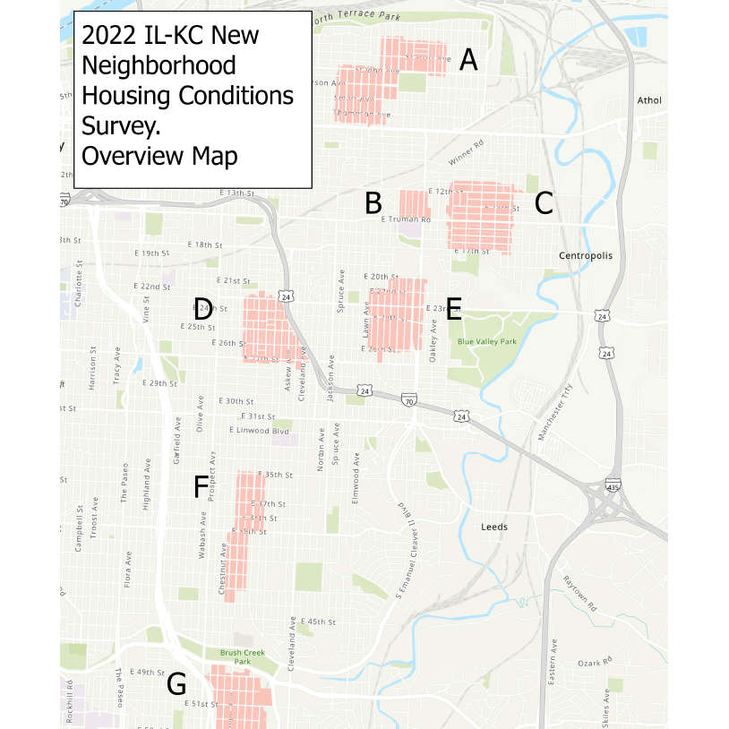
New NHCS surveys
Figure 6. Map of current NHCS surveys

Slide 26
Acknowledgements
Children’s Mercy Hospital
Ryan Allenbrand, Healthy Home Program Manager
Elizabeth Friedman, Medical Director of Environmental Health
Kevin Kennedy, Environmental Health Program Director
Kansas City, Missouri Department of Health
Amy Roberts, Director, Childhood Lead Poisoning Prevention Program

Slide 27
Acknowledgements
University of Missouri-Kansas City
Matthew Applebury, Satya Golla, Chinedu Isoh, Mounika Reddy Jakkidi, Brian Matlock, Nomuunzul Munkhjargal, Lori Reierson, Matthew Robinson, Vishal Vejendla, graduate students
Doug Bowles, Past Director, Center for Economic Information (retired)
Taki Manolakos, Past Director, Center for Economic Information
Ricardo Moniz, Education Program Coordinator for Biomedical and Health Informatics
Neal Wilson, Deputy Director, Center for Economic Information

