Slide 1
What Consulting Statisticians Wish They Had Known as Students or Early-Career Professionals
Steve Simon

Slide 2
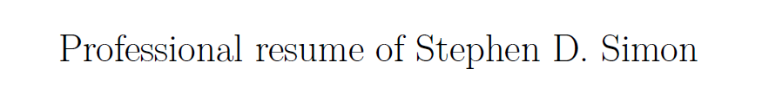
My resume will introduce myself.
Resume, found at https://github.com/pmean/resume
Notes:
I’m going to cut and paste portions of my resume into PowerPoint as a way to introduce myself.

Slide 3
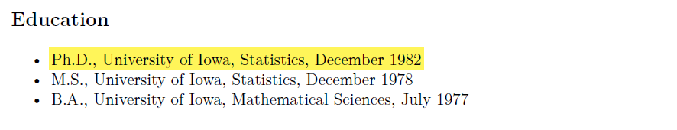
I got my degree almost 40 years ago
Education section of my resume
Notes:
If the saying about teaching an old dog new tricks is accurate, then I am in trouble. I got my PhD in Statistics from the University of Iowa in 1982. Much of what I’ve learned in college and throughout my long career is obsolete.

Slide 4
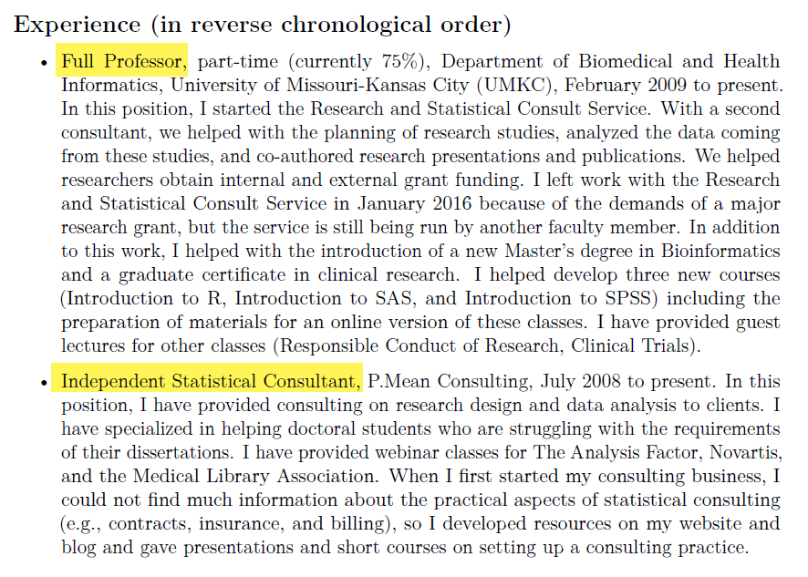
I juggle two part time jobs.
Experience section of my resume
Notes:
I work at two jobs. I am a part-time faculty member in the Department of Biomedical and Health Informatics at the University of Missouri-Kansas City, and I also run an independent consulting business. I will focus my talk on the latter job, because that is the one that most people are interested in hearing about.

Slide 5
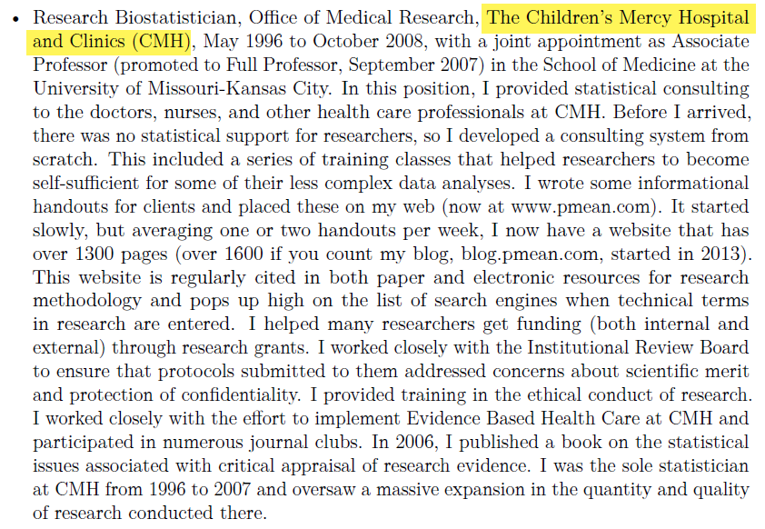
I used to work at a hospital, …
Work experience at Children’s Mercy Hospital
Notes:
Most of my previous work was consulting in health care areas. I worked with a lot of Pediatricians at Children’s Mercy Hospital in Kanas City.

Slide 6
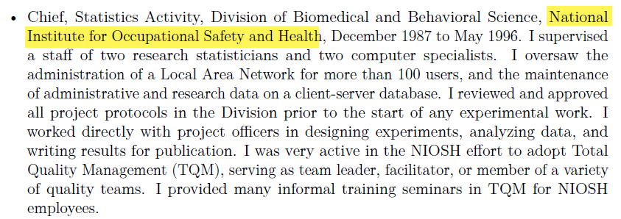
for Uncle Sam, …
Work experience at National Institute for Occupational Safety and Health
Notes:
I also did a lot of work in occupational safety and health.

Slide 7
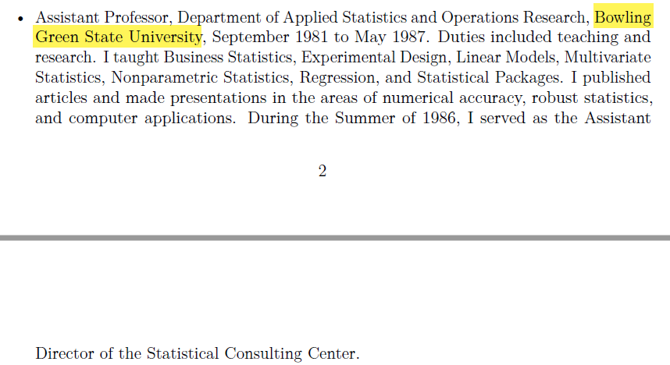
at a different University, …
Work experience at Bowling Green State University
Notes:
Plus I have taught Business Statistics for undergraduate and MBA students.

Slide 8
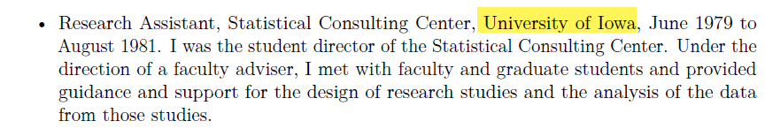
and as student director of a consulting center.
work experience at the Unversity of Iowa
Notes:
During my training at the University of Iowa, I got a lot of applied experience

Slide 9
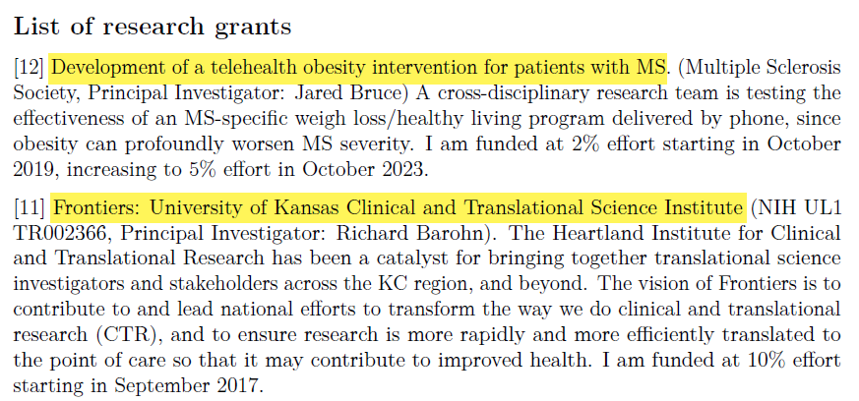
I’ve been on a few research grants, …
Two grants from my resume
Notes:
I’ve been on a few grants and have helped out on many others that were too small to include funding for a statistician.

Slide 10
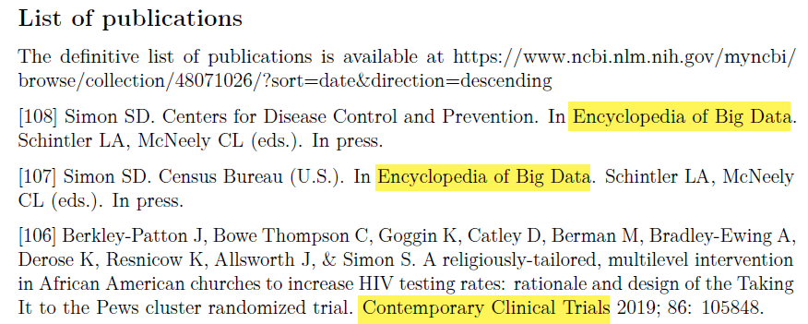
written a few papers, …
Three publications from my resume
Notes:
I’ve written quite a few papers, though only a handful as first author.

Slide 11
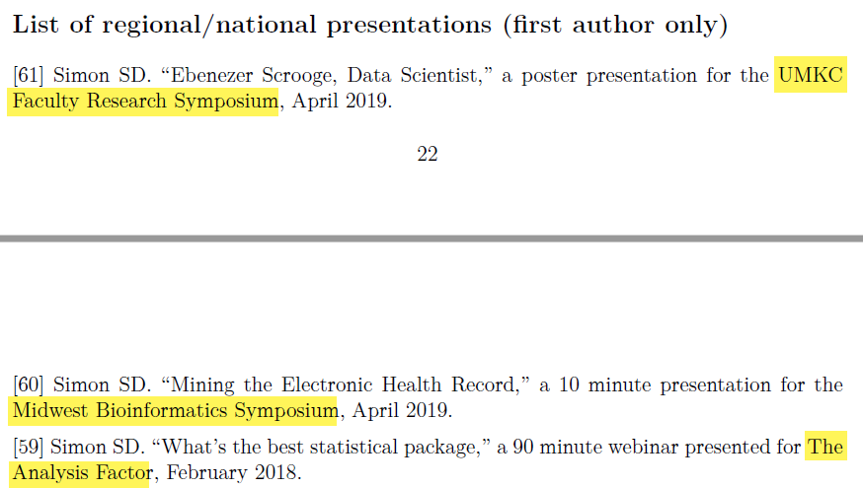
and given a few talks.
Three presentations from my resume
Notes:
I love giving talks like this one. If anyone needs a speaker, I am glad to jump in and help.

Slide 12
How do you find your clients/collaborators?
Word of mouth
  Let everyone know you are looking
Increase your visibility
  Blogs
  Social media
  Presentations
  Volunteer
Also see http://pmean.com/posts/business-essentials/
Notes:
If you are interested in becoming an independent statistical consultant, you have to find customers. The two ways to do this are by word of mouth and by increasing your visibility.
Tell everyone you know that you are starting a consulting business. Then find a way to stay in touch with them regularly. Don’t spam them, but find an excuse. Something like “I saw this article and thought of you.” You don’t have to say directly “I am still looking for new clients.” Just include the name of your consulting business in your signature file.
One way I increased my visibility was by taking over the running of the Kansas City R Users Group. We’re on hiatus now, but when it was active, it was great publicity. People make the presumption that the head of the Kansas City R Users Group knows more about R than anyone else in the Kansas City area. That’s a false presumption, of course, but I wasn’t going to let people know that.

Slide 13
The electives that you take outside your program are just as important as your required courses.
Applied courses outside Department of Statistics
  Biostatistics, Education
  Very practical advice
  Specialized perspectives
Theory of Mathematical Statistics
  Knowing foundations increases your confidence level
  Also makes you a quick learner of new methods
Notes:
I have to cite two extremes. The first set of classes that I got the most out of were the very applied Statistics classes that I took from outside the Department of Statistics at Iowa. There were two classes in Biostatistics: Categorical Data Analysis and Survival Analysis, and one in Education, Scaling methods. These helped me see better how the broadly based classes in my own department could be applied to solve real world problems.
The other class was quite theoretical, and it helped me understand some of the foundations. Knowing the foundations gives you a higher level of confidence in what you do. You know both the how and why of what you do. It also makes you a fast learner. When you can “peek under the hood” and know how a new methodology works, you can pick up that new methodology so much faster.

Slide 14
Embrace continuing education and stay current with new computing advances
Evidence-Based Medicine
Gibbs sampling
How to supervise
Meta-analysis
Mixed models
Model based clustering
Modern statistical software
Setting up a statistical consulting practice
Smoothing splines
Notes:
There are a lot of areas that just didn’t exist when I went to school. I spend a lot of time on continuing education.

Slide 15
No one likes a wishy-washy statistician. Be decisive.
If you’re going to make a mistake, make a loud mistake
Admit when your opinion is a minority perspective
Be decisive about what you know and what you don’t know
Listen to and respect alternative opinions

