Slide 1
Cross-over trials
Steve Simon

Slide 2
Topics to be covered
What you will learn
  The paired t-test
  The AB/BA cross-over
  Period effects and carry-over
  When should you use or not use a cross-over
  Cross-over trials with a binary outcome
  Cross-over trials with more than two treatments
Notes:
Speaker notes
Cross-over trials provide a very powerful approach for comparing two treatment conditions. Research subjects get both treatment conditions, which we will label arbitrarily as A and B. A randomly selected half get A followed by B and the other half gets B followed by A. This is generally referred to as the AB/BA design. Because each subject serves as their own control, you remove a large amount of variation. Often a cross-over trial can produce good results, even with a few dozen patients.
Cross-over trials require that the condition being studied is chronic in nature, and that the effect of the first treatment given does not carry over into the second treatment evaluation. There are important ethical and practical concerns about designing cross-over trials.
In this talk, you will see a review of the paired t-test, followed by an analysis of the AB/BA crossover design as a paired t-test. Then you will see how to account for the order in which the treatments were given.
After discussing the classical AB/BA cross-over design, you will see how to extend the cross-over trial to a binary outcome measure and to more than two treatments.

Slide 3
Quotations from two great philosophers
“A man cannot step into the same river twice, because it is not the same river, and he is not same man.” - Heraclitus, 544 B.C.
“You must unlearn what you have learned.” Yoda, 1980 A.D.
Notes:
Speaker notes.
I want to start with quotes from two great philosophers. You know they are great philosophers because they are known by a single name.
Heraclitus in 544 B.C. said “A man cannot step into the same river twice, because it is not the same river, and he is not same man.”
Yoda, the other great philosopher, said in 1980 A.D. “You must unlearn what you have learned.”

Slide 4
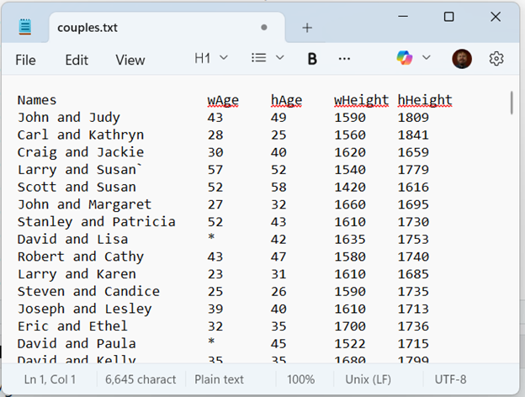
Paired t-test data
Notes:
Speaker notes
Before talking about cross-over trials, you might find it helpful to review how the paired t-test works. Here is some data I found on the web with measurements on married couples. The data has the wife’s age (wAge) and the husband’s age (hAge). Do you think there is a tendency for older men to marry younger women?
There is also data on the wife’s height (wHeight) and the husbands height (hHeight). We won’t analyze this but there is probably something interesting about tall and short patterns.

Slide 5
Descriptive statistics on wife’s age
variable | mean | sd | n
wAge | 40.7 | 11.4 | 170
Notes:
Speaker notes
The average woman is around 41 years old with a standard deviation a bit more than 11.

Slide 6
Descriptive statistics on husband’s age
variable | mean | sd | n
hAge | 42.6 | 11.6 | 199
Notes:
Speaker notes
The average husband is around 43 years old, just slightly older than the average wife. The standard deviation is about the same.

Slide 7
Descriptive statistics on age gap
variable | mean | sd | n
age_gap | 2.2 | 4.1 | 170
Notes:
Speaker notes
The average age gap is about 2 years. This average is not quite the same as the difference between the two averages, because there are some married couples with one age but not the other. These are not included in the computation of the age gap, leading to a slight discrepancy.

Slide 8
Paired t-test on couples ages
Paired t-test
data: couples$hAge and couples$wAge
t = 7.1518, df = 169, p-value = 2.474e-11
alternative hypothesis: true mean difference is not equal to 0
95 percent confidence interval:
1.618286 2.852302
sample estimates:
mean difference
2.235294
Notes:
Speaker notes
The paired t-test shows a statistically significant difference. The 95% confidence interval tells you that even after allowing for sampling error, the average husband’s age is 1.6 years larger than the average wife’s age.

Slide 9
Show the output using a different package

Slide 10
Analyze as completely randomized block design
Analysis of Variance Table
Response: age
Df Sum Sq Mean Sq F value Pr(>F)
spouse 1 425 424.71 51.148 2.474e-11 ***
pair 169 43974 260.20 31.337 < 2.2e-16 ***
Residuals 169 1403 8.30
---
Signif. codes: 0 '***' 0.001 '**' 0.01 '*' 0.05 '.' 0.1 ' ' 1
Notes:
Speaker notes
You could also analyze this as a completely randomized block design. It takes a bit of restructuring because this design expects to see all the ages in a single column.
No one does a paired t-test this way, but if you wanted to handle more complex settings, such as risk adjustments on a paired t-test, you can do this fairly easily using a mixed model.

Slide 11
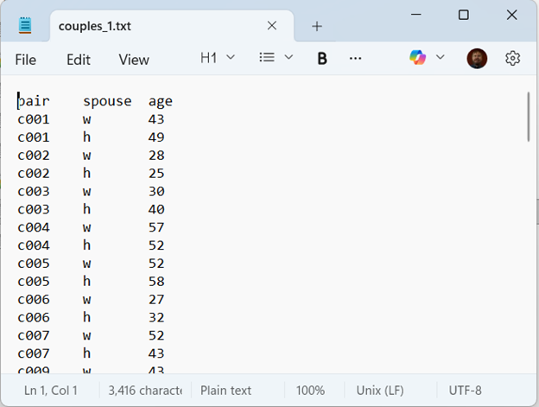
Restructured data for a completely randomized block design

Slide 12
Show the output using a different package

Slide 13
Break #1
What you have learned
  The paired t-test
What’s coming next
  The AB/BA cross-over

Slide 14
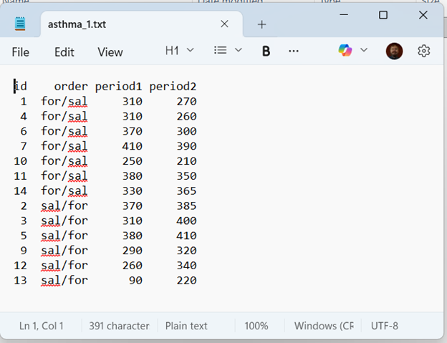
Data layout

Slide 15
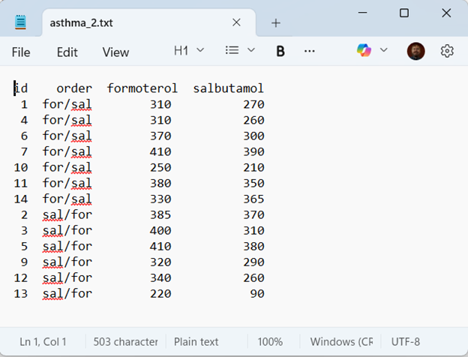
Alternate data layout

Slide 16
Descriptive statistics, period 1
variable | mean | sd | n
period1 | 312.3 | 82.8 | 13

Slide 17
Descriptive statistics, period 2
variable | mean | sd | n
period2 | 324.6 | 67.9 | 13

Slide 18
Descriptive statistics, period gap
variable | mean | sd | n
period_gap | 12.3 | 61.0 | 13

Slide 19
Descriptive statistics, formoterol
variable | mean | sd | n
formoterol | 341.2 | 59.7 | 13

Slide 20
Descriptive statistics, salbutamol
variable | mean | sd | n
salbutamol | 295.8 | 82.9 | 13

Slide 21
Descriptive statistics, drug gap
variable | mean | sd | n
drug_gap | 45.4 | 40.6 | 13

Slide 22
Paired t-test
Paired t-test
data: asthma_2$formoterol and asthma_2$salbutamol
t = 4.0312, df = 12, p-value = 0.001666
alternative hypothesis: true mean difference is not equal to 0
95 percent confidence interval:
20.85477 69.91446
sample estimates:
mean difference
45.38462

Slide 23
Recalculate paired t-test with different package

Slide 24
Analysis using a completely randomized block design
Analysis of Variance Table
Response: pef
Df Sum Sq Mean Sq F value Pr(>F)
treatment 1 13388 13388.5 16.250 0.001666 **
factor(id) 12 115213 9601.1 11.654 7.935e-05 ***
Residuals 12 9887 823.9
---
Signif. codes: 0 '***' 0.001 '**' 0.01 '*' 0.05 '.' 0.1 ' ' 1

Slide 25
Alternate form with different package

Slide 26
Break #2
What you have learned
  The AB/BA cross-over
What’s coming next
  Period effects and carry-over

Slide 27
Adjusting for period effects
Improves precision
Adjusts for imbalances
Requires layout used for completely randomized block design

Slide 28
Why might you see period effects
Temporal trends
Seasonal effects
Carry-over
  Persistence of a treatment applied in one period in a subsequent period of treatment

Slide 29
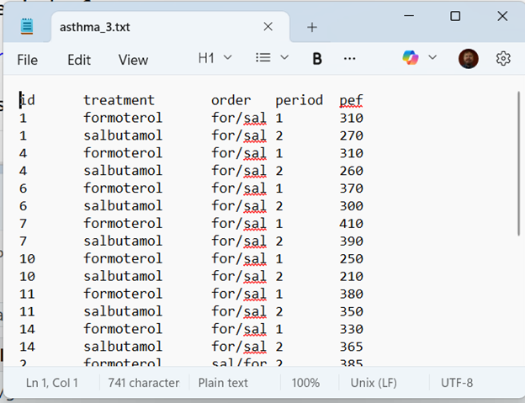
Layout for asthma data

Slide 30
Counts for layout data
treatment | order | period | n
formoterol | for/sal | 1 | 7
formoterol | sal/for | 2 | 6
salbutamol | for/sal | 2 | 7
salbutamol | sal/for | 1 | 6

Slide 31
Means, 1
# A tibble: 2 × 3
order period1_mean period2_mean
<chr> <dbl> <dbl>
1 for/sal 337. 306.
2 sal/for 283. 346.

Slide 32
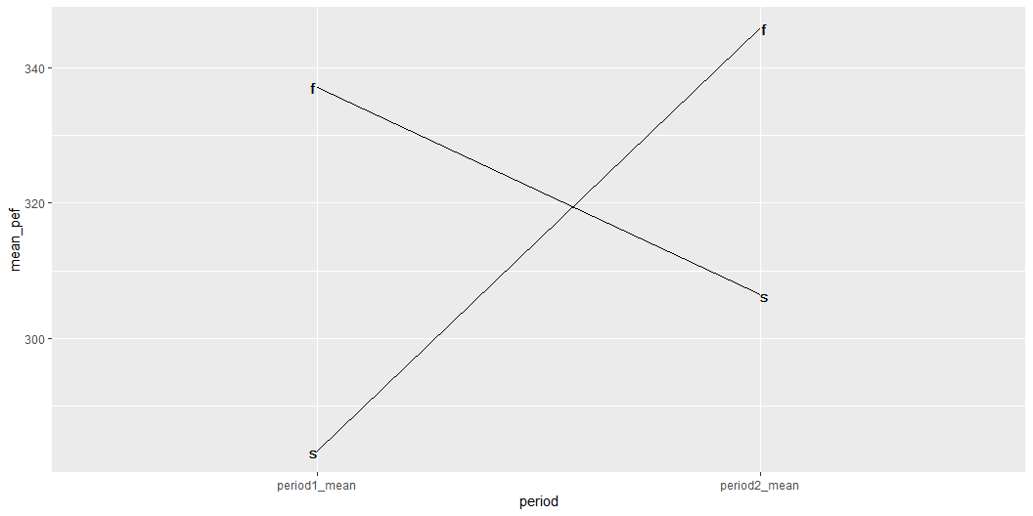
Interaction, 1

Slide 33
Means, 2
# A tibble: 2 × 3
order formoterol_mean salbutamol_mean
<chr> <dbl> <dbl>
1 for/sal 337. 306.
2 sal/for 346. 283.

Slide 34
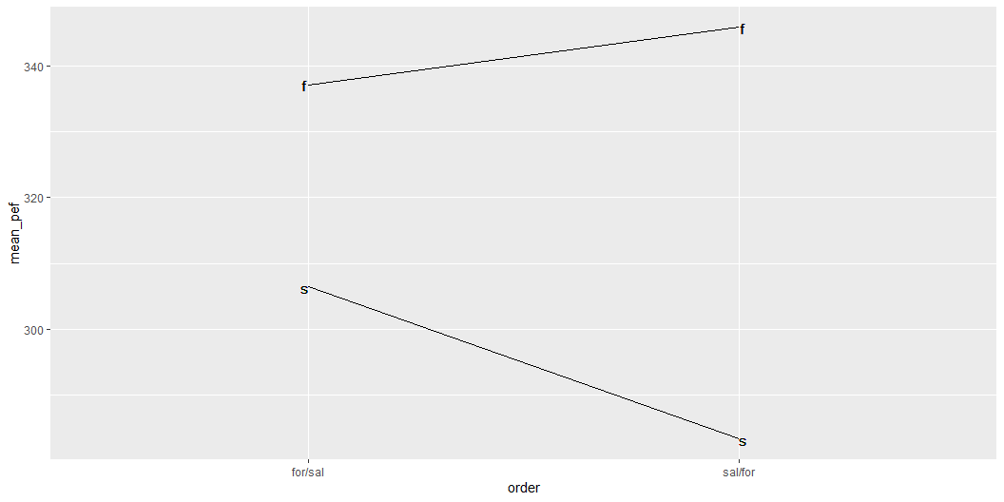
Interaction, 2

Slide 35
Accounting for period effects
Analysis of Variance Table
Response: pef
Df Sum Sq Mean Sq F value Pr(>F)
order 1 335 335.2 0.4467 0.517697
id 11 114878 10443.5 13.9171 6.495e-05 ***
period 1 985 984.6 1.3121 0.276323
treatment 1 14036 14035.9 18.7044 0.001205 **
Residuals 11 8254 750.4
---
Signif. codes: 0 '***' 0.001 '**' 0.01 '*' 0.05 '.' 0.1 ' ' 1

Slide 36
Break #3
What you have learned
  Period effects and carry-over
What’s coming next
  When should you use or not use a cross-over

Slide 37
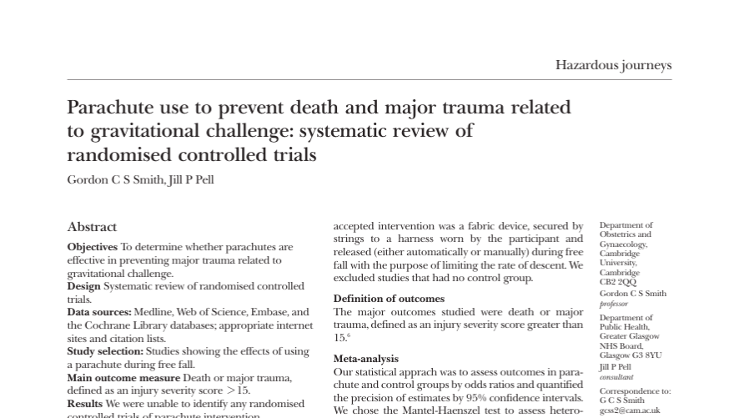
Systematic overview of parachute use
Notes:
Speaker notes
From the abstract: “As with many interventions intended to prevent ill health, the effectiveness of parachutes has not been subjected to rigorous evaluation by using randomised controlled trials. Advocates of evidence based medicine have criticised the adoption of interventions evaluated by using only observational data. We think that everyone might benefit if the most radical protagonists of evidence based medicine organised and participated in a double blind, randomised, placebo controlled, crossover trial of the parachute.”

Slide 38
When you cannot use a cross-over trial
Acute conditions
Mortality/morbidity
Training/education
Irreversible treatments
Persistent effects

Slide 39
When you can use a cross-over trial
Chronic conditions
Short-term benefits
Adequate wash-out period
  Drugs with a short half-life
Notes:
Speaker notes
Recommendation is that the wash-out period be equal to five half lives. Note that 1/2 raisded to the 5th power is 1/32 or 0.03126. Also the washout period should be significantly longer than the amount of time under evaluation for either arm.

Slide 40
Ethical concerns
Can you ask a patient to endure two treatments?
Can you leave the patient untreated during the wash-out period

Slide 41
What is you have a carry-over effect?
No easy answer
  Adjustments have poor power
  Between subject comparison
Unclear where to make adjustments
  Two active treatments:
    Split the difference
  Active treatment versus placebo:
    Assign the carry-over to placebo
  Carry-over could an interaction instead

Slide 42
Change test if carry-over is detected
Test hypothesis of no carry-over
  If accept null, run the cross-over
  If reject null, look at first period only
Not recommended
  Limited power to test carry-over
  First period analysis loses to much power/precision

Slide 43
Break #4
What you have learned
  When should you use or not use a cross-over
What’s coming next
  Cross-over trials with a binary outcome

Slide 44
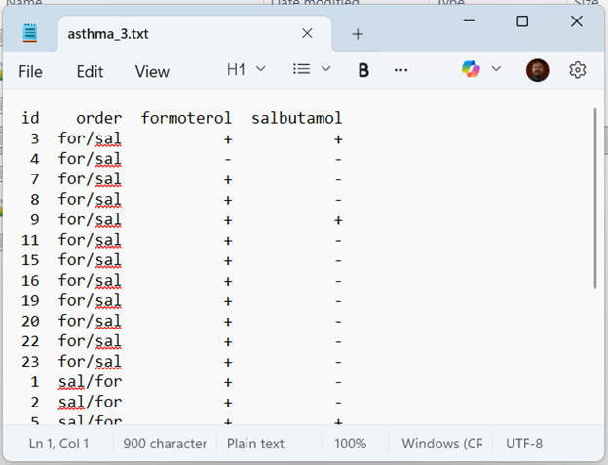
Example of a binary outcome
Notes:
Speaker notes
Data is from page 104 of Senn.

Slide 45
Descriptive statistics
 | F- | F+
S- | 2 | 15
S+ | 1 | 6

Slide 46
Analysis of binary cross-over data
Ignoring period effects
  McNemar’s test
Incorporating period effects
  Mainland-Gart test (hard to find)

Slide 47
Example of McNemar’s test

Slide 48
Break #5
What you have learned
  Cross-over trials with a binary outcome
What’s coming next
  Cross-over trials with more than two treatments

Slide 49
Three treatment cross-over trial
Show example data from page 124 of Senn

Slide 50
Possible sequences
Three treatments
  ABC, ACB, BAC, BCA, CAB, CBA
Four treatments
  ABCD, ACBD, BACD, BCAD, CABD, CBAD,
  ABDC, ACDB, BADC, BCDA, CADB, CBAD,
  ADBC, ADCB, BDAC, BDCA, CDAB, CDBA,
  DABC, DACB, DBAC, DBCA, DCAB, DCBA

Slide 51
Latin square design to reduce the number of sequences
Three treatments
  Sequence 1: A B C
  Sequence 2: B C A
  Sequence 3: C A B
Four treatments
  Sequence 1: A B C D
  Sequence 2: B C D A
  Sequence 3: C D A B
  Sequence 4: D A B C
Notes:
Speaker notes
Speaker notes
Mills, E.J., Chan, AW., Wu, P. et al. Design, analysis, and presentation of crossover trials. Trials 10, 27 (2009). DOI: 10.1186/1745-6215-10-27
Summary
What you have learned
The paired t-test
The AB/BA cross-over
Period effects and carry-over
When should you use or not use a cross-over
Cross-over trials with a binary outcome
Cross-over trials with more than two treatments
Other Latin square designs are possible
The definitive guide
Nice reference

