Slide 1
Exact and randomization tests
Steve Simon

Slide 2
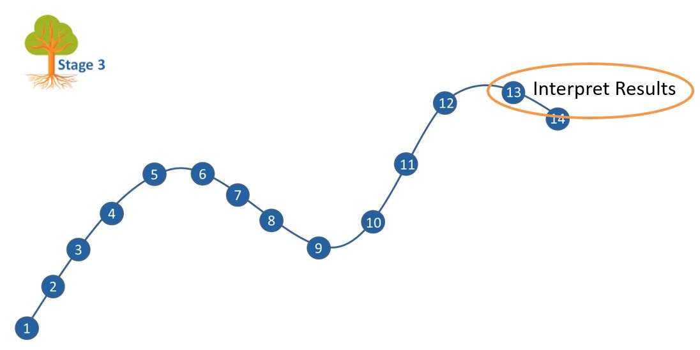
Where this fits
Notes:
Most of you should be familiar with the components and stages that The Analysis Factor uses to classify their talks. This talk is in Stage 3, Extensions of Linear Models. It covers a pretty broad swath, but might be considered as interpreting results. Perhaps validating results might be a second component.

Slide 3
Goal
For you to have a good understanding of:
what randomization and exact tests are,
the steps to implement them.
when it is appropriate to use them,
The goal is not to cover every possible application of the randomization and exact tests.
Notes:
I want to start with an appreciation of when you might consider using exact or randomization tests. These tests are very general, and I will try to show a variety of applications. If you want to implement these tests yourself, it is not too difficult for simpler hypotheses. For more complex hypotheses, you need some basic programming skills. It is not too difficult, if you know how to use loops inside SAS, R, or Stata.
It’s not possible to cover every possible application of exact and randomization tests today. I hope just to get you a bit more comfortable with the methodology in general.

Slide 4
When should you use exact/randomization tests
You don’t want to rely on
underlying distributional assumptions
the Central Limit Theorem
Note: Randomization tests are also commonly called permutation tests. I use the two terms interchangeably.
Notes:
Before I show some examples, I want to mention when you might consider using an exact test or a randomization test.
These tests have fewer assumptions than more traditional tests. In particular, you don’t have to rely on an underlying normal distribution.
Now for larger sample sizes, you can get some relief from a distributional assumption thanks to the Central Limit Theorem and some related theories related to asymptotic distributions. But there really is no magic number for the Central Limit Theorem. It isn’t like you can say that anytime your sample size is larger than 30 you are safe. Extreme skewness or outliers could still trip you up even for sample sizes much larger than 30.
So if you don’t want to rely on normal distributions and you don’t trust the Central Limit Theorem, then you might consider exact tests or randomization tests.

Slide 5
Outline of topics
Historical origins of Fisher’s Exact Test
Other exact tests
Randomization tests
When should you use these tests
Notes:
Here is an outline of the topics you will see today.

Slide 6
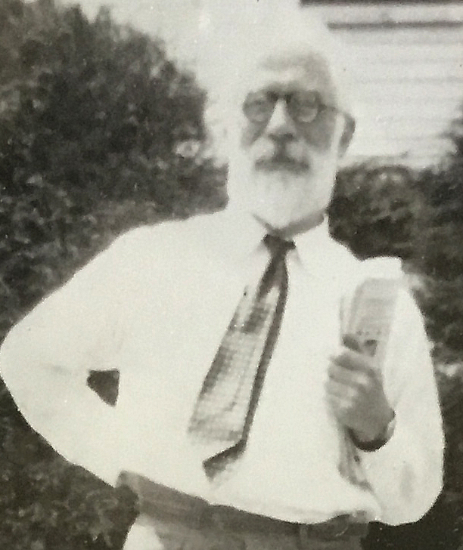
Historical origins of Fisher’s Exact Test
Figure 1. Ronald A. Fisher
Notes:
Let’s start with a historical overview. Ronald Fisher was a pioneer in the field of statistics. He developed many foundational methodologies, such as the use of designed experiments and p-values.
He does have a checkered past, unfortunately. He was a sharp critic of efforts in the 1950s and 60s to draw a link between cigarette smoking and cancer. He felt, quite wrongly as it turned out, that you could only show a link between smoking and cancer through randomized trials.
Even worse were his blatantly racist views and his support for eugenics. This is the topic for another talk. But I did want to highlight a simple experiment he proposed in his 1935 book, The Design of Experiments, known as “The lady testing tea.”
This was a simple example of the use of randomization and blinding to test a simple hypothesis.

Slide 7
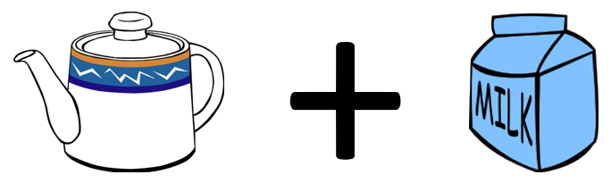
The lady tasting tea, tea plus milk
Figure 2. Tea with milk added
Notes:
In England, there is an interesting practice of pouring hot tea into a cup and then adding milk. It’s not something that I like. Just give me the tea straight. No milk, no sugar, no lemon slices. But tea served with milk is quite popular in England and elsewhere.

Slide 8
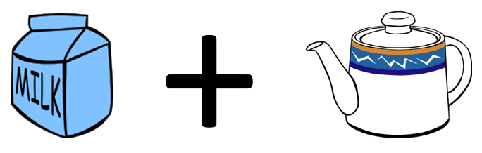
Milk plus tea, can you tell the difference?
Figure 3. Milk with tea added
Notes:
You could change the order, though, putting milk in the cup first and then adding the tea.
A colleague of Fisher’s, Muriel Bristol, claimed that she could tell, just by tasting, whether a cup had the tea first with milk added or milk first with tea added. She preferred the latter. When she told Fisher this, he scoffed and said that no one could tell the difference between tea with milk added and milk with tea added. Along with another colleague, William Roach, they designed an experiment to prove her wrong.

Slide 9
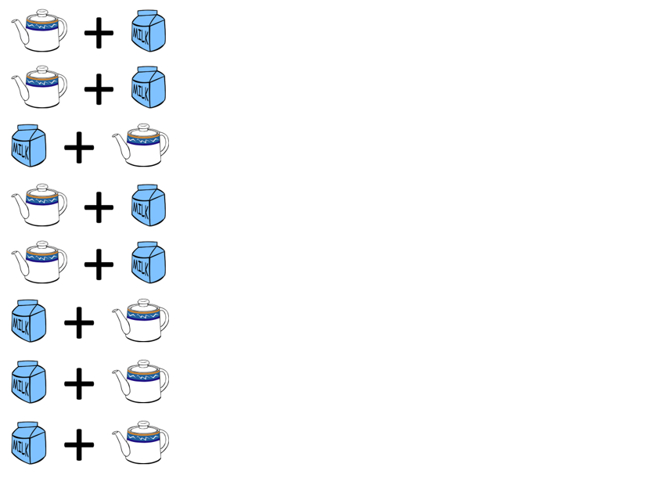
The experiment to test the claim
Figure 4. A randomized experiment
Notes:
Fisher and Roach prepared eight cups of tea, four with the tea added first and four with the milk added first. They presented the eight cups to Bristol in a random order and had her taste each cup and identify which of the four had milk added first.

Slide 10
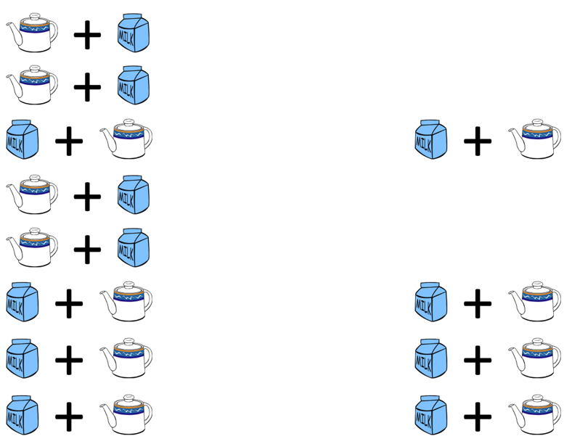
The result of the experiment
Figure 5. Result of the randomized experiment
Notes:
To their surprise, after tasting all eight cups, she correctly identified the four cups that had the milk added first. This is indeed a surprising results, but how surprising?

Slide 11
How likely is this result?
$\frac{4}{8}×\frac{3}{7}×\frac{2}{6}×\frac{1}{5}=\frac{1}{70}$
Note: the probability is NOT ${\left(\frac{1}{2}\right)}^{4}$
Notes:
If Bristol had no ability to tell whether the milk was added first and was effectively picking at random, for the first choice, the probability would be 50-50 or four out of eight, since there were the same number of cups with tea added first and milk added first.
If she picked this correctly, the chances that her second selection would be correct, assuming that she was choosing randomly would be 3/7 since only three of the remaining seven cups had the mill added first. It gets even harder for the third choice, assuming that she got the first two correct. There are only two cups now with milk added first. The last choice is the hardest of all. The probability is one out of five, assuming she got the first three correct. Multiply these four probabilities to get 1/70.
So this is quite surprising indeed. If she had no clue which cups had the milk added first, it would take quite a streak of good luck for her to correctly identify four in a row.
Now notice that the probability is not 1/2 raised to the fourth power. The probabilities change because once a cup is identified correctly, it is taken out of the pool. This is analogous to the concept sampling without replacement.

Slide 12
Break #1
What have you learned?
Simple application of Fisher’s Exact Test
What is coming next?
The hypergeometric distribution
Any questions?

Slide 13
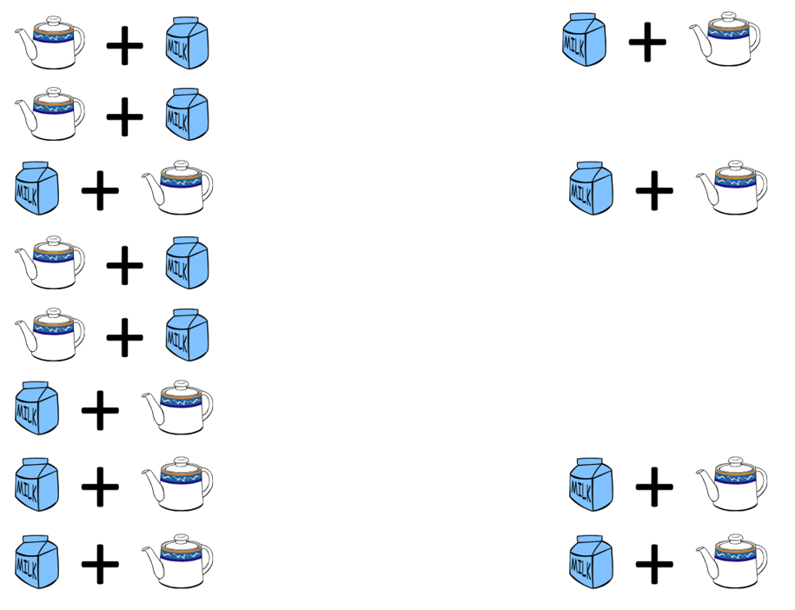
An alternate result
Figure 6. An alternate result with one miss
Notes:
To make things interesting, let’s propose a different result. Suppose Bristol missed on one cup but identified three others correctly.
In this example, she incorrectly picked the first cup as adding the milk frist. She should have chosen the sixth cup. The other three cups (third, seventh, and eighth) she did get correctly.

Slide 14
How likely is three correct results?
$\frac{4}{8}×\frac{4}{7}×\frac{3}{6}×\frac{2}{5} + \frac{4}{8}×\frac{4}{7}×\frac{3}{6}×\frac{2}{5} +$
$\frac{4}{8}×\frac{3}{7}×\frac{4}{6}×\frac{2}{5} + \frac{4}{8}×\frac{3}{7}×\frac{2}{6}×\frac{4}{5}$
Too messy! Use the hypergeometric distribution. Note: this is NOT a binomial distribution.
Notes:
The calculations get quite a bit messier in this case. There are four probabilities you have to compute here. The probability that the first cup is identified incorrectly and the remaining three are identified incorrectly starts with the same 4/8 because if you are choosing at random there are four cups that you could choose incorrectly. Once this is done, your chances get a little bit better, because there are four cups that would represent a correct choice and only three left that represent an incorrect choice. The other probabilities are computed similarly.
But you have to account for another case, one where the first cup is choosen correctly, the second incorrectly, and the remaining two correctly. This is getting a bit tedious, but you can calculate the probability with a bit of work.
You are still not done. There are two more cases to consider: one where the third cup chosen is the one that is mistaken and one where the mistake happens on the last cup.
Now I don’t mind tedious. Tedious is part of being a statistician. But there is a simpler way. You can rely on a well known distribution, the hypergeometric distribution, to calculate the probabilities for you.

Slide 15
Balls in an urn analogy
| W | | B | | B B | | W | | W B | | W | __________________
Notes:
To understand the hypergeometric distribution, you need to visualize an abstract problem of probability known as drawing balls from an urn.
Think of the eight cups of tea as an urn with eight balls, four white and four black. The white balls represent correctly identifying the cup of tea as having the milk added first. The black balls represent mistakes in identification. So what is the probability of getting 3 white balls after drawing 4 balls without replacement?

Slide 16
Combinatorics
Combinatorics = mathematics of defining how many ays you can combine things.
$$\left({a \atop b}\right)=\frac{a!}{b!\left(a−b\right)!}$$
Example:
$$\left({4 \atop 3}\right)=\frac{4!}{3!\left(4−3\right)!}=\frac{24}{6×1}=4$$
Notes:
Before you see the formula for hypergeometric probabilities, I need to introduce some notation used in combinatorics.
If you see a pair of large parentheses with one number above another, that is a combination. It is read as “a choose b”.
It represents the number of ways you can select “b” items from a population of size “a”.
For example, 4 choose 3 is the number of ways you can select 3 items from a population of 4. It is computed as 4 factorial divided by 3 factorial times 1 factorial. This is 4. If there are four members of a population, you can pick
the first, second, and third,
the first, second, and fourth
the first, third, and fourth, or
the second, third, and fourth.
It’s worth noting here that for combinations, order does not matter.

Slide 17
Formula for hypergeometric probabilities
$$\frac{\left({w_{1} \atop w_{0}}\right)\left({b_{1} \atop b_{0}}\right)}{\left({n_{1} \atop n_{0}}\right)}$$
$w_{1}$ = # of white balls in the urn
$b_{1}$ = # of black balls in the urn
$n_{1}=w_{1}+b_{1}$ = total # of balls in the urn
$w_{0}$ = # white balls drawn from the urn
$b_{0}$ = # black balls drawn from the urn
$n_{0}=w_{0}+b_{0}$ = total # of balls drawn
Notes:
The formula for hypergeometric probabilities uses combinatorics. Say that you want to get the probability of drawing w0 white balls and b0 black balls with n0 draws from an urn containing w1 white balls and b1 black balls (n1 balls total). Then it is w1 choose w0 times b1 choose b0 divided by n1 choose n0. Figure out how many ways you can select w0 balls from w1, multiply it by the number of ways you can ch where “choose” is the number of combinations. So the denominator, n1 choose n0, is n1 factorial divided by n0 factorial times (n1-n0) factorial.

Slide 18
Calculation for 3 correct guesses
$$\frac{\left({4 \atop 3}\right)\left({4 \atop 1}\right)}{\left({8 \atop 4}\right)}=\frac{\frac{4!}{3!1!}×\frac{4!}{1!3!}}{\frac{8!}{4!4!}}=$$
$$\frac{\frac{24}{6×1}×\frac{24}{1×6}}{\frac{40320}{24×24}}=\frac{16}{70}$$
Notes:
The calculations are not too difficult. 4 choose 3 is 4 factorial divided by 1 factorial and 3 factorial. 4 choose 1 is 4 factorial divided by 3 factorial and 1 factorial. The denominator, 8 choose 4 is 8 factorial divided by 4 factorial times 4 factorial. Work these out to get a numerator of 16 and a denominator of 70.

Slide 19
Functions for computing hypergeometric probabilities
SAS: PDF(‘HYPER’, w0, n1, w1, n0)
R: dhyper(w0, w1, b1, n0)
Stata: dis hypergeometricp(n1, w1, n0, w0)
SPSS: PDF.HYPER(w0, n1, w1, n0)
Notes:
The functions to calculate hypergeometric probabilities vary from package to package. SAS uses a PDF function (short for Probability Density Function) with the ‘HYPER’ argument. R uses the dhyper function. Stata uses dis hypergeometricp. SPSS uses the PDF.HYPER function.
All of these packages arrange the numeric arguments differently.
Notice that R asks you to specify the number of white balls and the number of black balls. The other packages ask you to specify the number of white balls and the total number of balls, The order that you specify these values in is also inconsistent from package to package.
I show this to emphasize that if you plan to calculate hypergeometric probabilities, read the manual closely.
Fortunately, while it helps to understand that Fisher’s Exact Test relies on hypergeometric probabilities, you don’t have to calculate those probabilities yourself. You’ll see this in a minute.

Slide 20
Break #2
What have you learned?
The hypergeometric distribution
What is coming next?
Using SPSS and Stata
Any questions?

Slide 21
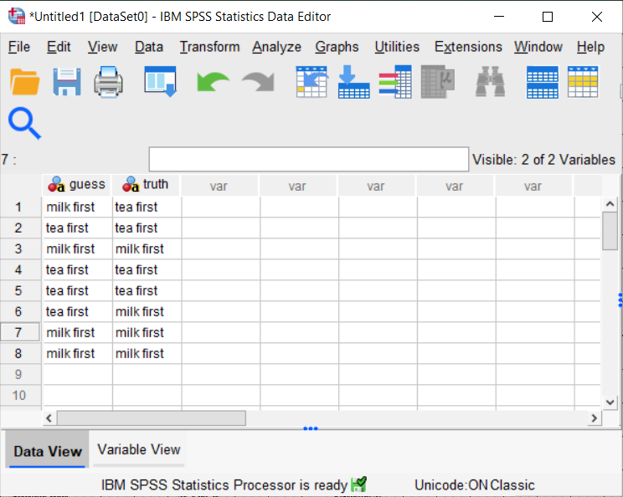
SPSS data for Fisher’s Exact Test
Figure 7. SPSS Dialog box
Notes:
Here is the data layout in SPSS for the lady tasting tea example. I am showing the case where there are three and not four correct guesses.

Slide 22
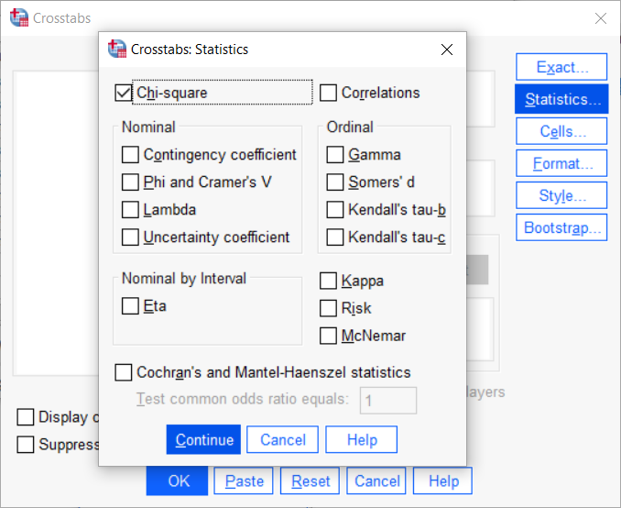
SPSS dialog boxes for Fisher’s Exact Test (1/2)
Figure 8. SPSS Dialog box
Notes:
There are two dialog boxes you need to look at for the crosstabs in SPSS (selected by choosing Analyze, Descriptive Statistics, Crosstabs from the menu).
First you have to ask for the Chi-square test, even though you don’t want it.

Slide 23
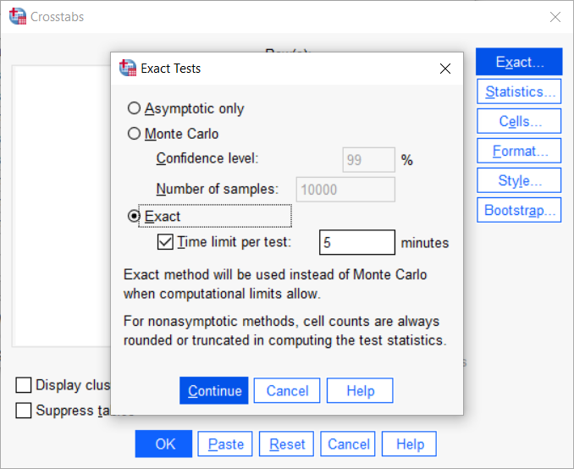
SPSS dialog boxes for Fisher’s Exact Test (2/2)
Figure 9. SPSS Dialog box
Notes:
Then you have to click on the Exact button and ask for an exact test. Note that the Monte Carlo option, will produce a randomization test for this table. We’ll discuss randomization tests a bit later.
As I understand it, not every implementation of SPSS has the Exact button as an option. You need to purchase an extra add-on module.

Slide 24
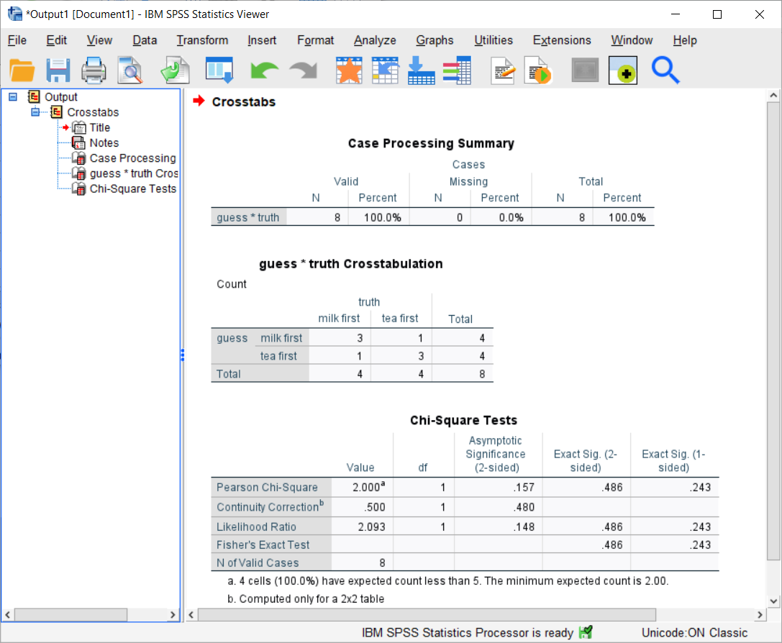
SPSS output for Fisher’s Exact Test
Figure 10. SPSS output box
Notes:
It may be a bit hard to read, but SPSS (bless those programmers) decided to throw in a bunch of different p-values. It’s one of the irritating things about SPSS. In a concern not to leave anything out (a noble concern, I must admit), they err on the side of presenting too much information. It doesn’t bother me, because I am used to looking through a whole page of output to find the one number I am interested in. But SPSS does not allow you to prevent display of the extra p-values.
The one p-value you are looking for is the Exact (1-sided) column and the Fisher’s Exact Test row. The p-value is 0.243. So if Muriel Bristol only got three cups correctly identified as milk first, you’d have to accept the null hypothesis and admit that getting three out of four correct is a fairly common event for someone who is just guessing randomly.

Slide 25
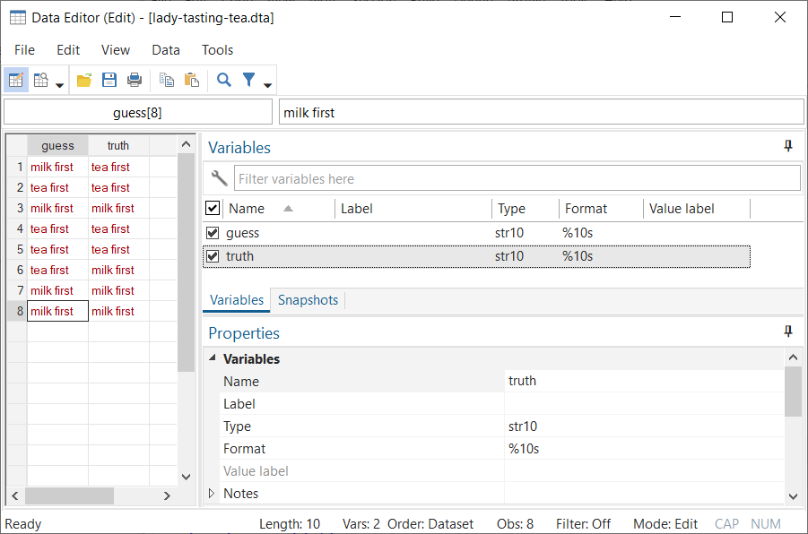
Stata data for Fisher’s Exact Test
Figure 11. Stata data
Notes:
Here’s the layout for Stata, similar to how you lay out the data in SPSS.

Slide 26
Stata code and output for Fisher’s Exact Test
. tabulate guess truth, exact Fisher's exact = 0.486 1-sided Fisher's exact = 0.243
Notes:
The Stata command for Fisher’s Exact Test uses tabulate with an exact option. The output is much simpler, though I did edit away a few details to make this fit easily on a single slide.

Slide 27
SAS and R code for Fisher’s Exact Test
In SAS,
proc freq; tables guess*truth / fisher; run;
In R,
fisher.test(guess, truth)
Notes:
I won’t show the output, but Fisher’s Exact Test is just as easy in SAS and R.

Slide 28
Break #3
What have you learned?
Using SPSS and Stata
What is coming next?
Details on the p-value computation
Any questions?

Slide 29
Recall the definition of a p-value
p-value=P[sample results or more extreme| H0]
What does “more extreme” mean?
Notes:
I just wanted to spend a bit of time talking about the actual computation of the p-value, because it is a bit trickier when you are not right on the edge.

Slide 30
List all possible 2 by 2 tables
Restricted to common marginal totals (fixed row and column totals)
? ? | 4 ? ? | 4 ----+-- 4 4 | 8
Notes:
The first step in getting a p-value is to list all the possible tables that you could get that have the same row and column totals as the data you observed.
While it make sense in this example, fixing both the row and column totals is a bit controversial in other settings.

Slide 31
There are five tables with the same marginal totals
4 0 3 1 2 2 1 3 0 4 0 4 1 3 2 2 3 1 4 0 1/70 16/70 36/70 16/70 1/70 0.014 0.229 0.514 0.229 0.014
Notes:
You can list the tables on a single slide. There are five of them, starting with a table with all four milk first cups being identified correctly (and by implication all four tea first cups identified correctly) and ending with the worst possible result, everything completely wrong.

Slide 32
Consider only tables that are more extreme
4 0 3 1 0 4 1 3 1/70 + 16/70 0.014 + 0.229 p-value = 17/70 = 0.243 (for a one sided test)
Notes:
Now if you observed three correct guesses, the p-value would include the probability for that table (0.229) plus the probability for the one table more extreme (all four correct) which has a probability of 0.014. Add these two probabilities together to get a p-value of 0.243.

Slide 33
More extreme tables for a two-sided test
4 0 3 1 1 3 0 4 0 4 1 3 3 1 4 0 1/70 + 16/70 + 16/70 + 1/70 0.014 + 0.229 + 0.229 + 0.014 p-value = 34/70 = 0.486 (for a two-sided test)
Notes:
While a two-sided test makes no sense in this setting, there are times when you prefer to use a two-sided Fisher’s Exact test. To get that, count the tables on the opposite side. Now there is a symmetry here that makes things easy but there are times where the probabilities are skewed and don’t match up on the opposite side. In that case, the more extreme tables are those where the probability under the null hypothesis is equal to or smaller than the probability of the observed table.

Slide 34
Computing a two-sided p-value for the asymmetric case
4 0 3 1 2 2 1 3 0 3 1 2 2 1 3 0 1/35 12/35 18/35 4/35 0.029 0.343 0.514 0.114 p-value for 3 correct is 0.343 + 0.029 + 0.114 = 0.486.
Notes:
Suppose one of the cups with tea added first had spilled on the way out. In that case, Muriel Bristol had to identify which four of the seven cups had milk added first. The probabilities are asymmetric, and the two-sided p-value associated with getting three out of four correct would add to the observed table probability of 0.343 the two smaller probabilities, 0.029 and 0.114, to get a p-value of 0.486.

Slide 35
Break #4
What have you learned?
Details on the p-value computation
What is coming next?
More exact tests
Any questions?

Slide 36
Fisher-Freeman-Halton test
Generalization of Fisher’s Exact Test
Tabulate all possible R by C tables
Fixed row and column totals
Notes:
The Fisher-Freeman-Halton test is an extension of Fisher’s Exact Test to table bigger than 2 by 2. It works for any table with R rows and C columns as long as both R and C are 2 or greater. This means that you like every possible R by C table with the same row and column totals as your sample results.

Slide 37
R code for Fisher-Freeman-Halton test
> v <- c(4, 0, 0, 0, 4, 0, 0, 0, 4) > m <- matrix(v, nrow=3) > m [,1] [,2] [,3] [1,] 4 0 0 [2,] 0 4 0 [3,] 0 0 4
Notes:
The R code works fairly easily. In this example, I am thinking about an extension of the Lady Tasting Tea example where Muriel Bristol had to choose correctly between 4 cups of tea prepared one way, another 4 cups prepared a second way and a third set of 4 cups prepared a third way.
The matrix I created here represents the case where Muriel Bristol nailed it on all thee types of tea preparation.

Slide 38
R output for Fisher-Freeman-Halton test in R
> fisher.test(m) Fisher's Exact Test for Count Data data: m p-value = 0.0001732 alternative hypothesis: two.sided
Notes:
The same fisher.test function that you use for Fisher’s Exact test can handle data from a larger table, in this case a three by three table.
The chances that Muriel Bristol, guessing randomly, could perfectly identify among all twelve cups and three preparations methods is very small, less than two chances in ten thousand.

Slide 39
Code for SAS, Stata, SPSS
SAS: Same as for a 2 by 2 table.
Stata: Same as for a 2 by 2 table.
SPSS: Same as for a 2 by 2 table.
Notes:
This is a fairly recent development, but all the software that I am familiar with handles the Fisher-Freeman-Halton test, and using precisely the sampe code as you used for Fisher’s Exact Test for 2 by 2 tables.

Slide 40
Mann-Whitney U
Hypothetical data
T: 14, 23, 37 C: 12, 13, 15, 25
Notes:
Let’s look at another example. This is data that I just made up on the spot. Three patients are in the treatment group and they got pretty high values: 14, 23, and 37.
The four control patients had relatively smaller values. But there is some overlap.
The data is a bit skewed and the sample size small, so a t-test might not be the best choice.
A good alternative is the Mann-Whitney U test, sometimes called the Wilcoxon-Mann-Whitney test.
This is a well known nonparametric test, but I want to point out that it is also an exact test.

Slide 41
Rank the data
T: 3, 5, 7 C: 1, 2, 4, 6
Notes:
To compute the Mann-Whitney test statistic, first rank the values. The treatment group had the third, fifth, and seventh largest values. The control group has the two smallest values, as well as the fourth and sixth largest values.

Slide 42
Sum of the ranks
T = 15 C = 13
How likely is this result under the null hypothesis?
Notes:
Add up the ranks for the treatment and control groups. Actually, just one group is fine. Let’s focus on the treatment group. The ranks of 3, 5, and 7 add up to 15. It’s a bit higher than you might expect, but is it enough of an increase so that you could rule out sampling error.

Slide 43
List all possible ranking for T
1,2,3 1,2,4 1,2,5 1,2,6 1,2,7 1,3,4 1,3,5 1,3,6 1,3,7 1,4,5 1,4,6 1,4,7 1,5,6 1,5,7 1,6,7 2,3,4 2,3,5 2,3,6 2,3,7 2,4,5 2,4,6 2,4,7 2,5,6 2,5,7 2,6,7 3,4,5 3,4,6 3,4,7 3,5,6 3,5,7 3,6,7 4,5,6 4,5,7 4,6,7 5,6,7
Notes:
The trick to the Mann-Whitney U test (and most other non-parametric tests) is that under the null hypothesis, all rank orderings of the data are equally likely. So on this slide, I listed the 35 different possible rank orderings that you could get from 1, 2, 3 which happens only when the three treatment group values are smaller than any of the control values to 5, 6, 7 whic happnes only when the three treatment values are all larger than any of the control values.
Each of these rankings gets a probability of 1/35.

Slide 44
Select as extreme or more extreme rankings
2,6,7 3,5,7 3,6,7 4,5,6 4,5,7 4,6,7 5,6,7
p-value = 7/35 = 0.20
Notes:
The value of 15 is a bit high, but there are 7 values that are as extreme or more extreme than a sum of 15. This starts with 2, 6, 7, which also has a sum of 15 to 5, 6, 7, which has a sum of 18.
The probability of getting a sum of 15 or more extreme (meaning higher) is 7/35 or 20%.

Slide 45
Rankings for a two-sided test
1,2,3 1,2,4 1,2,5 1,2,6 1,3,4 1,3,5 2,3,4 2,6,7 3,5,7 3,6,7 4,5,6 4,5,7 4,6,7 5,6,7
p-value = 14/35 = 0.40
Notes:
There are four values as large as or larger than 15 for the rank sum: 15, 16, 17, and 18. On the low end the extreme values would be 9, 8, 7, and 6.
When you look in both directions, there are 14 cases as extreme or more extreme as a rank sum of 15. So the two-sided p-value is 14/35 or 0.40.

Slide 46
SAS code for Mann-Whitney test in SAS
proc npar1way wilcoxon; class grp; var x; exact wilcoxon; run;
Notes:
SAS will compute an exact Mann-Whitney test for you, as long as you know that the test is also known as the Wilcoxon test.

Slide 47
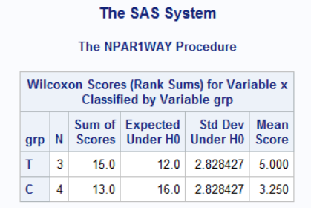
SAS output for Mann-Whitney test (1/2)
Figure 12. SAS output
Notes:
Here’s part of the output from SAS. The sum of scores for the treatment group is 15 compared to the sum for the controls of 13. It might be easier to compare the means. The average rank is 5 for the treatment group and 3.25 for the control group.

Slide 48
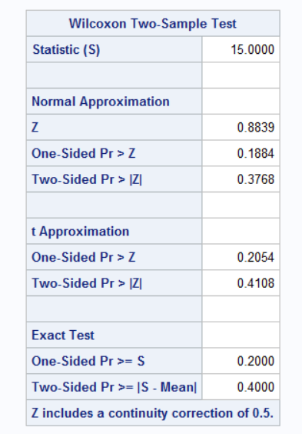
SAS output for Mann-Whitney test (2/2)
Figure 13. SAS output
Notes:
The exact one sided p-value is 0.2 and the exact two-sided p-value is 0.4.

Slide 49
R, Stata, and SPSS
R: wilcox.test
Stata: ranksum
SPSS: Analyze, Nonparametric tests, Independent Samples
Notes:
In R use, the wilcox.test function.
In Stata, use the ranksum command.
In SPSS, choose Analyze, Nonparametric tests, Independent Samples from the menu.

Slide 50
Mechanics for additional exact tests
General algorithm
Assume a null hypothesis
List all possible outcomes
Find probabilities for each
Add up as extreme or more extreme probabilities
Exact tests have very few assumptions
Usually only independence
StatXact software
Notes:
There are literally hundreds of possibilities for the use of exact test. Most involve discrete distributions or the use of nonparametric approaches like ranking.
The general algorithm is to assume a null hypothesis. In the lady tasting tea, the null hypothesis is that Muriel Bristol’s guesses are totally random. For the Mann-Whitney test, the null hypothesis is that all possible rankings are equally likely. Then list every possible outcome and attach a probability to each outcome. Then figure out which outcomes are as extreme or more extreme than your outcome and add up all the probabilities associated with those outcomes. That is your p-value.
If you find a setting where you want an exact test, but you can’t find one in your software, you might consider a package, StatXact, that can do literally hundreds of exact tests. The programmers at StatXact have figured out really efficient algorithms for listing all possible outcomes, even when the sample size is not trivially small.

Slide 51
Break #5
What have you learned
More exact tests
What is coming next
Randomization tests
Any questions?

Slide 52
Randomization tests
Impractical to list all possible outcomes
Randomly sample instead
Notes:
Once you understand how exact tests work, randomization tests represent a fairly simple generalization.
With larger data sets, it may not be too easy to list every possible outcome. So what you do is to randomly sample from the list of all possible outcomes. Find the proportion of randomly sampled outcomes that are as extreme or more extreme than the result that you actually observed in the data. If many of the randomly sampled outcomes are more extreme than your observed result, then maybe your observed result is not all that extreme. It seems reasonable in this case to accept the null hypothesis. If only a few randomly sampled results are more extreme that your observed result, then something odd is going on. Your observed result is much farther out than you would expect and you should reject the null hypothesis. The proportion as extreme or more extreme represents an estimated p-value.

Slide 53
Titanic data
Alive Dead Total Female 308 (67%) 154 (33%) 462 Male 142 (17%) 709 (83%) 851 Total 450 (34%) 863 (66%) 1,313 Average age Alive 29.4 Dead 31.1 Overall 30.4
Notes:
There is an interesting dataset on mortality that I use in a lot of my classes. The data has results for individuals aboard the Titanic. The Titanic was a large passenger ship, the largest one of its time actually. It was so large that it was reputed to be unsinkable. But on its maiden voyage, it struck an iceberg in the North Atlantic Ocean and sunk.
We actually have a lot of information about the passengers on the Titanic. We know whether they lived or died, whether they traveled in first, second, or third class, and whether they were male or female. For most, but not all of the passengers, we know their ages.
Now the Titanic sunk in 1912, and that was an age where they really believed in “women and children first.” Today, all us old guys would mow over the women and children to get to the lifeboats first. But you can see from the tables on this slide that it really was different. Overall, the survival rate was 34%, but if you looked just at the men, the survival rate was half that.
Now the average ages might not be telling the full story, but the average age of all passengers was 30.4 years, but it was a bit younger among the survivors, 29.4 years on average.

Slide 54
R code for the Titanic data
prop_male_survivors <- rep(NA, 10000) avg_age_survivors <- rep(NA, 10000) for (i in 1:10000) { prop_male_survivors[i] <- sum(sample(t$Sex, 450)=="male")/851 avg_age_survivors[i] <- mean(sample(t$Age, 450), na.rm=TRUE) }
Notes:
Now, let’s try an experiment. What would have happened if the Titanic crew assigned the 450 spots on the lifeboats randomly. Would the survival probability of men be closer to the overall survival probability? Would the average age among survivors be closer to the overall average age?
It certainly would, but the more important question is how much variation would there be if you randomly assigned the 450 lifeboat spots.
The R code is a bit terse, but you need to set up a vector with 10,000 empty spots for the survival proportion among men and another 10,000 empty spots for the average age of survivors.
Then you use the sample function to randomly pick 450 survivors. The number of males among those 450 randomly selected survivors divided by 851, the total number of men on the ship is the survival probability.

Slide 55
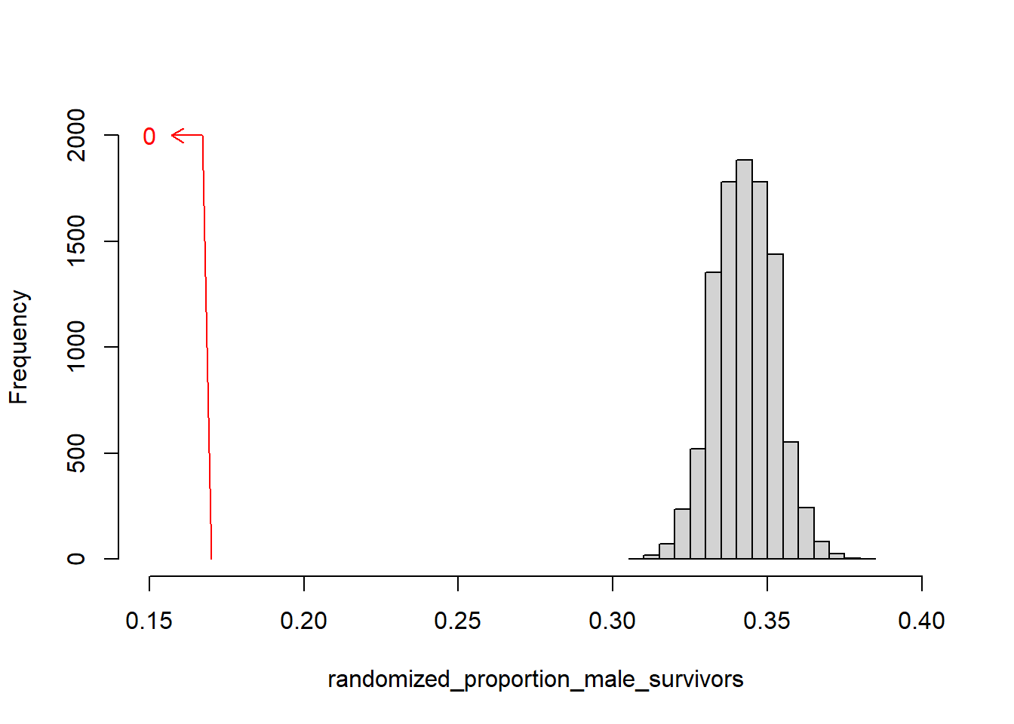
Randomization results for proportion of male survivors
Figure x. Histogram of randomized counts of male survivors
Notes:
This shows the histogram of the proportion of male survivors. It is centered around the overall survival proportion of 0.34, but it does extend out a bit, maybe down to 0.30 and up to 0.38. But it comes nowhere close to the actual male survival proportion of 0.17.
Bottom line: if men and women were randomly assigned to life boats, there’s no way that you see a male survival rate as small as 17%. This supports the hypothesis that women had an edge over men in surviving the collision with an iceberg in the cold North Atlantic Ocean.

Slide 56
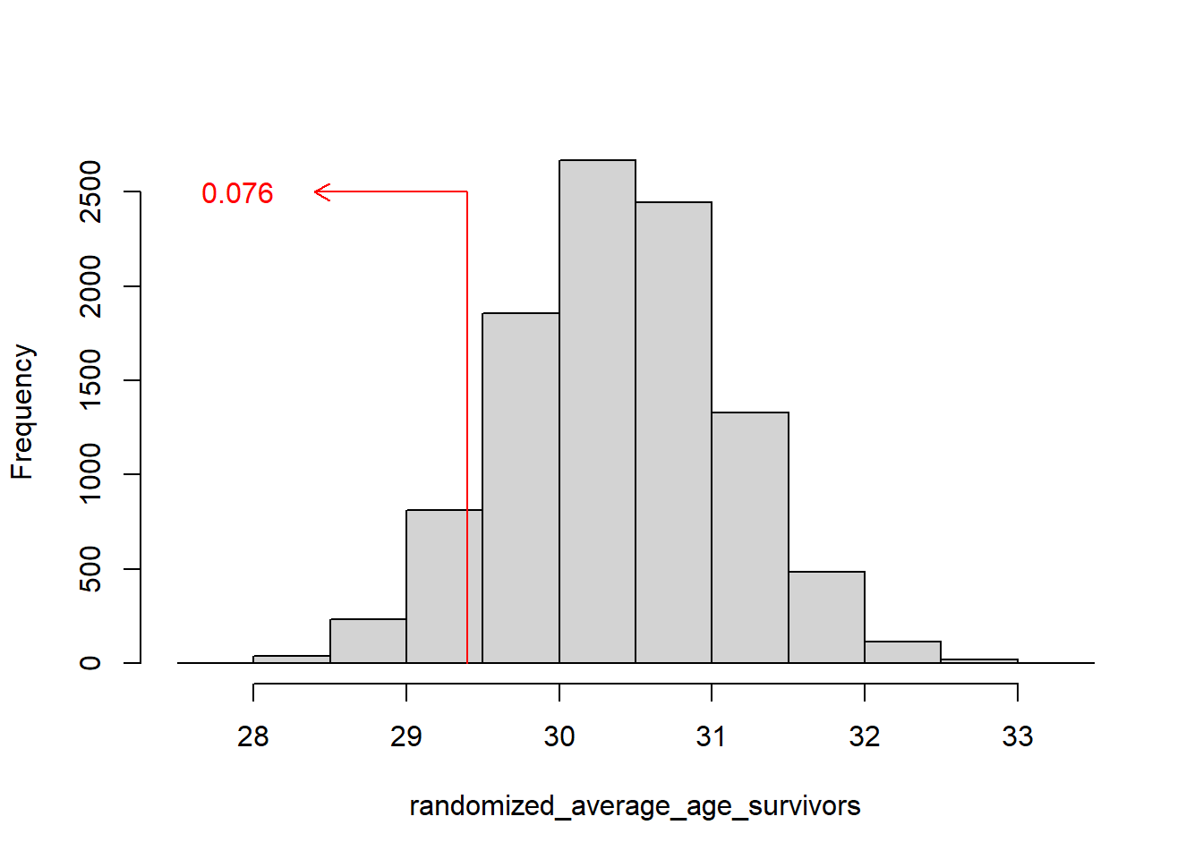
Randomization results for average age of survivors
Figure x. Histogram of randomized average ages of survivors
Notes:
The age data is a different story. The randomized ages are centered around the overall average age of survivors, 30.4. But the variation in the randomized ages easily extends as low as 28 and as high as 33. The proportion of randomized average ages that are as extreme or more extreme than the observed sample mean of 29.4 is about 7.6%. Suggestive, perhaps, of a favorable survival probabily for younger passengers, but not statistically significant.
Now, there are some caveats here. The model did not look at children directly, and failed to factor in the effect on survival for those passengers who were 60 or older. A more careful examination of the data is in order, but it will have to wait until they do a sequel to the Titanic movie.

Slide 57
Break #6
What have you learned
Randomization tests
What is coming next
A practical example

Slide 58
A practical example
Therapy Old: -1 -1 -1 0 0 0 0 0 New: 0 1 1 1 2 2 2 2 2 2 3 3 -1 = slight decline 0 = no change 1 = slight improvement 2 = moderate improvement 3 = large improvement
Notes:
I received some data from a project where the outcome measure was the degree of improvement after a treatment, with values of -1 (slight decline), 0 (no change), 1 (slight improvement), 2 (moderate improvement), and 3 (large improvement). The two treatments had quite different results. The old therapy had eight patients, three of whom showed a slight decline and five of whom showed no change. Among the twelve patients in the new therapy, one showed no change, three showed a slight improvement, six showed moderate improvement, and two showed a large improvement. There are several approaches that you could try with this data.
A simple t-test would be suspect because of the small sample size and the decidedly non-normal distributions.
A nonparametric test would be tricky because of the large number of ties.
But there is clearly a big difference between the old and the new treatments. This is an example of the intra-ocular trauma test, a difference so obvious that it hits you right between the eyes.
I decided to try a randomization test. Imagine that the labels that identified the eight old treatment and twelve new treatment patients got lost and you randomly assigned them. That would create pure noise. Do it again and you get more noise. Repeat this enough times and you get an estimate of how much variation you’d see if the two groups were comparable. If, as I suspected, the actual result (a difference of 2.13 units in the means) was well outside the variation estimated by the randomization algorithm, you’d have pretty strong evidence that the difference seen in the data would be very unlikely to arise if there were no difference between the two therapies.
Now some of you might quibble about using means here, but I could have just as easily used a median.

Slide 59
A practical example
Average Old therapy: -0.38 New therapy: 1.75 All patients: 0.84 Difference: 2.13
Notes:
The mean for the old therapy is -0.38 which is much smaller than the overall mean of 0.84.

Slide 60
Randomize
2 -1 0 2 3 1 -1 1 Old mean = 0.88 1 0 3 2 2 -1 3 0 Old mean = 1.25 0 1 3 2 3 0 0 2 Old mean = 1.38 0 -1 0 3 1 0 2 2 Old mean = 0.88 -1 -1 2 3 0 1 0 1 Old mean = 0.62 1 0 0 -1 0 2 2 2 Old mean = 0.75 2 0 -1 0 3 1 0 2 Old mean = 0.88 1 1 1 3 2 2 0 0 Old mean = 1.25 1 -1 2 3 0 -1 2 2 Old mean = 1
Notes:
To do a randomization test here, you randomly allocate 8 of the 20 total observations to the old therapy allocate the remaining 12 to the new therapy.
There’s an important short cut, though when you are using two groups. The overall mean, 0.84, doesn’t change when you randomly allocate 8 to the old therapy and 12 to the new therapy. So rather than comparing the old therapy mean to the new therapy mean, compare it to the overall mean.
If you randomly sample 8 observations from all 20, then the expected value is going to equal the overall mean. But how often does the randomly sampled 8 observations have a mean that is as small as what we observed in the data (-0.38)? Not too often, just looking at the first eight observations.
I show the results eight times because that is all that I could fit on a single slide. But to be honest, you’d need to do this at least a thousand times. Maybe ten thousand if your computer is up for the challenge.
Notice that the non-normality and the large number of ties is not at issue here. The only really serious assumption you need to make here is independence from one patient to another. Now lack of independence in a medical trial does happen, such as with infectious diseases, but most of the time you don’t have to worry about the independence assumption.

Slide 61
Programming a randomization test
Can you get it directly (without programming)?
If not,
R: for and sample.
SAS: do and ranperm in IML.
Stata: ritest.
SPSS: not recommended (maybe with Python add-on?)
Notes:
I don’t want to get into all the details about how I programmed this randomization test, but it is not too difficult.
I should warn you that you should look first for something that you can access directly in your software package. But you will find, at times, that you might have to write a bit of code. If you do, you need a bit of familiarity with how to loop and how to take samples.
In R, the for loop and the sample function work pretty well together. You can do this particular randomization test with less than a dozen lines of code.
In SAS, there is a ranperm function, but this is best used inside proc iml. Looping inside a data step is very tricky.
In Stata, there is an ritest, a user contributed program by Simon Hess. I have not used it, but there is extensive guidance on the web.

Slide 62
Break #7
What have you learned.
A practical example of the randomization test
What is coming next
When should you use exact and randomization tests?
Questions?

Slide 63
When should you use exact or randomization tests?
Fisher’s Exact Test
Lots of guidance
Other exact or randomization tests
No so much guidance
Notes:
When should you use exact tests? Well, there is a lot of guidance for the use of Fisher’s Exact, a bit less for other exact tests and for randomization tests.

Slide 64
When should you use Fisher’s Exact Test?
Your alternative is the Pearson Chi-squared test
$$T=Σ\frac{{\left(O_{ij}−E_{ij}\right)}^{2}}{E_{ij}}$$
Under $H_{0}$, T is approximately $χ^{2}\left(1\right)$
Poor approximation if any $E_{ij}$ < 5
Notes:
The most commonly used test for measuring association in a two by two table is the Chi-squared statistic. You compute the expected count Eij for each cell in the table under an assumption of no association (or independence) and look for the deviation from the observed counts.
This is approximately distributed as a Chi-squared distribution, but the approximation is poor if one or more of the expected counts is small. How small is open to debate. Some people say anything less than 5 is trouble. Others are a bit more permissive and will still use the Chi-squared approximation even with expected counts as small as 1.
Note that a small value for the observed count is not troublesome. Sometimes you can even tolerate a zero in a two by two table if all the other numbers are quite big.
So some people use the expected count less than 5 as a rationale for when to switch to Fisher’s Exact test.
To be honest, I tend to switch to Fisher’s Exact test anytime there is even a hint of trouble, such as a low observed count in one of the row or column totals.
Why not, I say. Fisher’s Exact Test is easy enough to compute and it removes any lingering doubt about whether the Chi-squared distribution is a good approximation.

Slide 65
Criticisms of Fisher’s Exact Test
Too conservative
Fixed row and column totals are unrealistic.
Notes:
There are some criticisms of Fisher’s Exact Test. It is a point for debate, but some experts claim that Fisher’s Exact Test is too conservative. This relates in part to the discrete nature of the test. In the lady tasting tea example, the p-value for four correct is 1/70 or 0.014 but for three correct, it jumps to 17/70 or 0.243. What is happening is that you can’t use an alpha level of 0.05, but you are forced to use an alpha level at 0.014. This leads to a loss in power compared to tests that actually have an alpha level equal to 0.05. That’s the theory, anyway, but from a practical perspective, any test of counts using a total sample size of 8 will have difficulty finding an alpha level equal to 0.05.
A more common criticism of Fisher’s Exact test is that the restriction of 2 by 2 tables only to those with the same marginal totals is unrealistic, at times. In the lady tasting tea, such a restriction makes sense because the experiment did not allow for different marginal totals. There were exactly 4 of each type of tea and the request to pick four was implicit. If the number of milk first and tea first cups would be allowed to vary, you shouldn’t use an approach that fixes both the row and column totals.
In some settings, it is more realistic to assume that the row totals are fixed and the column totals are random. On the Titanic, there were a fixed number of men and women, but the deaths of 450 people was not fixed.
There are variations on Fisher’s Exact test that look at a broader number of tables than just those with fixed row and column totals. These tests are also controversial. So there’s no easy way out.

Slide 66
When should you use other exact/randomization tests?
Concern about small sample sizes
Concern about distributional assumptions
As a safety/sensitivity check
Notes:
The guidance for other exact/randomization tests is a bit less clear. Often exact tests are used when there are concerns about small sample sizes, because the small sample sizes allow for easy enumeration of all possible outcomes. You might also consider exact or randomization tests when you are concerned about distributional assumptions. The last practical example, where there were only five possible values and a fair amount of skewness to the data is a good example of when an exact or randomization test might bail you out of having to make iffy assumptions.
Often the exact and randomization tests are a safety valve. If you run the traditional test, which may rely on the Central Limit Theorem or another approximation, why not check whether the approximation is good by calculating an additional test using exact or randomization principles. This could be considered as a sensitivity check, and would help silence those who might criticize the more traditional approaches.

Slide 67
Criticisms of other exact/randomization tests?
No easy way to get confidence intervals
No easy extension to more complex settings
Risk adjustment
Longitudinal/hierarchical models
Sometimes too computationally difficult
Inadequate computer speed and capacity
Difficulty in programming
Notes:
A big problem with exact and randomization tests is that there is no easy way to compute confidence intervals. You can do it, but the programming complexity and the computational demands skyrocket.
While these approaches are fine for simple settings, there are often no easy adjustments for more complex settings like risk adjustment or the use of longitudinal or hierarchical data.
Also, there is some concern about the computational difficulty. This comes in two flavors. First, your computer might not have enough speed and capacity to list all the possible outcomes for some settings. Second, you yourself may need to do a bit of programming to set up an exact or randomization test.
For what it’s worth, the programming skills required for randomization tests is often much simpler than for exact tests. You need to know how to loop and how to draw random samples and not much more.

Slide 68
Exact versus randomization tests
Use exact test if
it is pre-programmed, and
sample size is small or moderate.
Use randomization test if
you have to program it yourself, or
sample size is large
Notes:
If you can easily get an exact test, grab it. It gives you an exact p-value while the randomization test gives you an approximate p-value. Admitedly, the approximation is pretty good if you repeat the randomization a thousand times or more. But there is some comfort in having a p-value that doesn’t change when you change the seed for your random number generator.
If you are lucky, your exact test already exists in your software. Writing code that lists every single possible outcome and assigning probabilities to each of these outcomes is not fun. So if you are in a setting complicated enough that you can’t find a good exact test, the code for a randomization test is quite a bit easier.
The size of your sample also is a consideration. Exact tests work well for small or moderate sample sizes. Back when I first learned about exact tests, any sample size bigger than a few dozen was out of reach for most exact tests. Now, maybe it would take several hundred or even several thousand variables before an exact test becomes prohibitive from a computational perspective. Try it on your computer and see.

Slide 69
Randomization tests versus bootstrap
Bootstrap = repeated sample WITH replacement
Randomization = repeated samples WITHOUT replacement.
Advantages of bootstrap
Very easy confidence intervals
Applicable to descriptive statistics
Advantages of randomization test
Simplicity
Neither extends easily to complex settings.
Notes:
I gave a talk earlier about bootstrapping. The bootstrap represents repeated sampling with replacement. This is quite different than randomization tests which use repeated sampling without replacement.
The bootstrap has one big advantage. Confidence intervals come out very easily with the bootstrap. The randomization test is designed only to compute p-values, and it takes a lot of work to get a confidence interval associated with a randomization test. You can do it, but it takes a lot more work. What you have to do is find all values of your parameter that produce a two-sided p-value larger than 0.05.
A randomization test only applies to settings where you have a research hypothesis. In contrast, the bootstrap can provide interesting results where there is no particular research hypothesis.
The randomization test is simpler to program than a bootstrap. Not that the randomization test is perfectly easy, mind you, but it does take a bit less effort than the bootstrap.
Neither randomization tests nor the bootstrap extend easily to complex settings like longitudinal data or risk adjustments. You can actually do some of this, but it is not easy and there are a lot of perilous pitfalls if you are not careful.

Slide 70
Conclusion
What have you learned?
Fisher’s Exact Test (the lady tasting tea)
Fisher-Freeman-Halton test
Mann-Whitney test
Randomization tests
Titanic data
Practical example
When to use/not use exact and randomization tests
Questions?

