Slide 1
Exact and randomization tests
Steve Simon

Slide 2
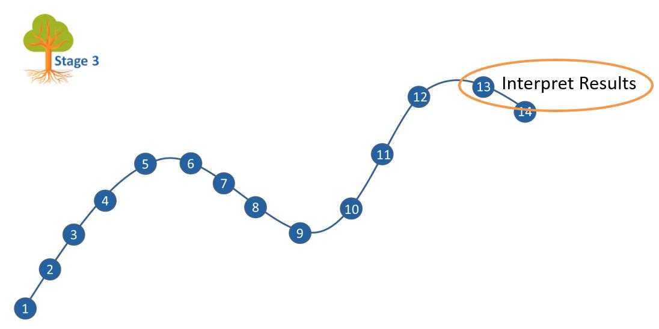
Where this fits
Notes:
Most of you should be familiar with the components and stages that The Analysis Factor uses to classify their talks. This talk is in Stage 3, Extensions of Linear Models. It covers a pretty broad swath, but might be considered as interpreting results. Perhaps validating results might be a second component.

Slide 3
Goal
For you to have a good understanding of:
what randomization and exact tests are,
when it is appropriate to use them,
the steps to implement them.
The goal is not to cover every possible application of the randomization and exact tests.
Notes:
I want to start with an appreciation of when you might consider using exact or randomization tests. These tests are very general, and I will try to show a variety of applications. If you want to implement these tests yourself, it is not too difficult for simpler hypotheses. For more complex hypotheses, you need some basic programming skills. It is not too difficult, if you know how to use loops inside SAS, R, or Stata.
It’s not possible to cover every possible application of exact and randomization tests today. I hope just to get you a bit more comfortable with the methodology in general.

Slide 4
Outline of topics
Historical origins of Fisher’s Exact Test
Other exact tests
Randomization tests
Programming requirements
When should you use these tests
Notes:
First, I will provide a historical overview, with an example derived in 1931, when Statistics was still in its infancy.

Slide 5
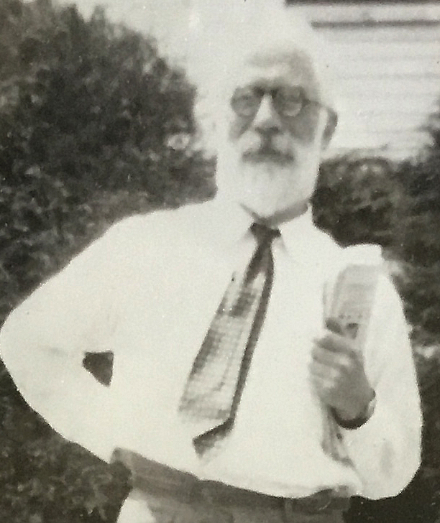
1. Historical origins
Figure 1. Ronald A. Fisher
Notes:
Let’s start with a historical overview.

Slide 6

The lady tasting tea
Figure 2. Tea with milk added

Slide 7

If you change the order?
Figure 3. Milk with tea added

Slide 8
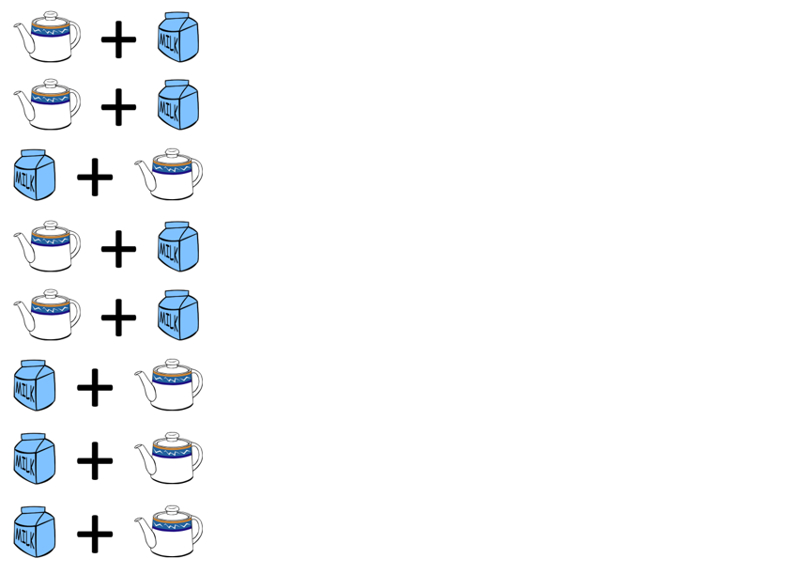
The experiment
Figure 4. A randomized experiment

Slide 9
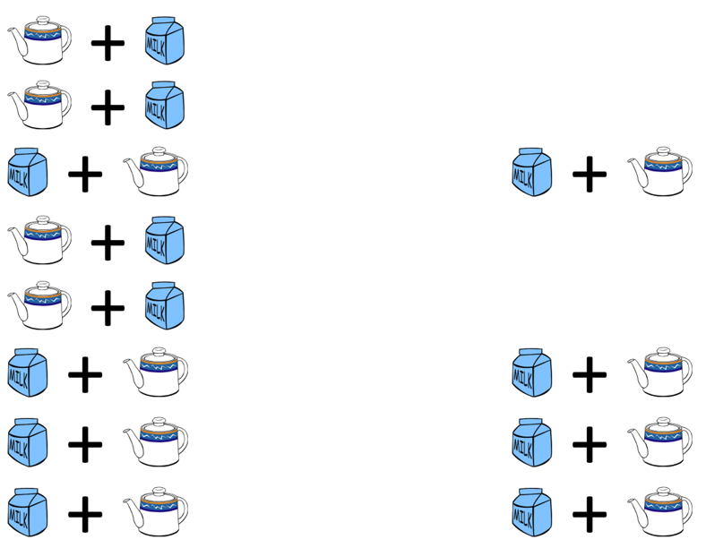
The result
Figure 5. Result of the randomized experiment

Slide 10
How likely is this result?
If the lady had no ability to tell whether the milk was added first and was effectively picking at random, the probability would be
$\frac{4}{8}×\frac{3}{7}×\frac{2}{6}×\frac{1}{5}=\frac{1}{70}$
Note: the probability is NOT ${\left(\frac{1}{2}\right)}^{4}$

Slide 11
Break #2
What have you learned? + Simple application of Fisher’s Exact test
What is coming next? + The hypergeometric distribution

Slide 12
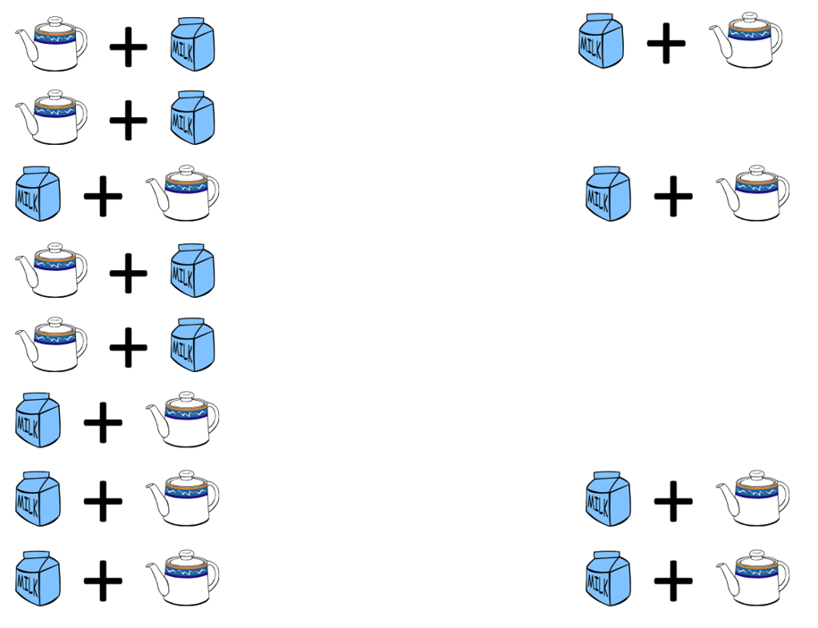
An alternate result
Figure 6. An alternate result with one miss

Slide 13
How likely is three correct results?
$\frac{4}{8}×\frac{4}{7}×\frac{3}{6}×\frac{2}{5}+\frac{4}{8}×\frac{4}{7}×\frac{3}{6}×\frac{2}{5}+...$
Too messy! Use the hypergeometric distribution. Note: this is NOT a binomial distribution.

Slide 14
Balls in an urn analogy
| W | | B | | B B | | W | | W B | | W | __________________
Notes:
Most of the discussion of these functions describe the hypergeometric distribution as an abstract problem of drawing balls from an urn. So think of the eight cups of tea as an urn with eight balls, four white and four black. The white balls represent correctly identifying the cup of tea as having the milk added first. The black balls represent mistakes in identification. So what is the probability of getting 3 white balls after drawing 4 balls without replacement?

Slide 15
Use the hypergeometric distribution
SAS: PDF(‘HYPER’, 3, 8, 4, 4)
R: dhyper(3, 4, 4, 4)
Stata: dis hypergeometricp(8, 4, 4, 3)
SPSS: PDF.HYPER(3, 8, 4, 4)
Notes:
The functions to calculate hypergeometric probabilities vary from package to package. SAS uses a PDF function (short for Probability Density Function) with the ‘HYPER’ argument. R uses the dhyper function. Stata uses dis hypergeometricp. SPSS uses the PDF.HYPER function.
All of these packages arrange the numeric arguments differently.

Slide 16
Use the hypergeometric distribution
W=# of white balls in the urn
B=# of black balls in the urn
N=W+B=# of balls total in the urn
d=# of balls drawn from the urn
x=# of drawn balls that are white
SAS: PDF(‘HYPER’, x, N, W, d)
R: dhyper(x, W, B, d)
Stata: dis hypergeometricp(N, W, d, x)
SPSS: PDF.HYPER(x, N, W, D)
Notes:
Notice that R asks you to specify the number of white balls and the number of black balls. The other packages ask you to specify the number of white balls and the total number of balls, The order that you specify these values in is also inconsistent from package to package.
I show this to emphasize that if you plan to calculate hypergeometric probabilities, read the manual closely. It also helps to first do some simple calculations like an urn with 4 white and 4 black balls. Compare what the statistical package tells you with what you calculated by hand.
Fortunately, you don’t need to resort to the hypergeometric probabilities.

Slide 17
Break #2
What have you learned? + The hypergeometric distribution
What is coming next? + Using SPSS and Stata

Slide 18
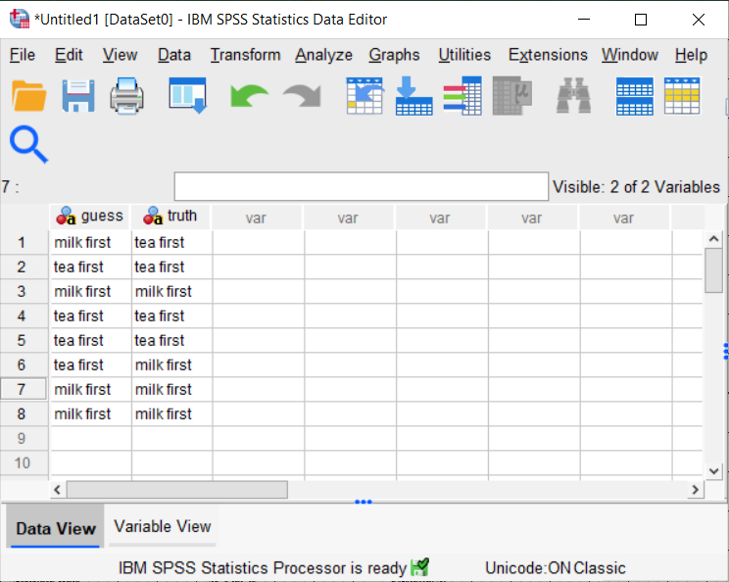
Fisher’s Exact Test in SPSS (1/4)
Figure 7. SPSS Dialog box

Slide 19
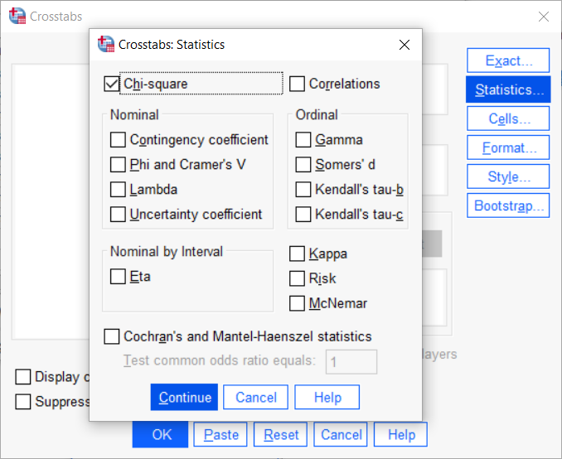
Fisher’s Exact Test in SPSS (2/4)
Figure 7. SPSS Dialog box

Slide 20
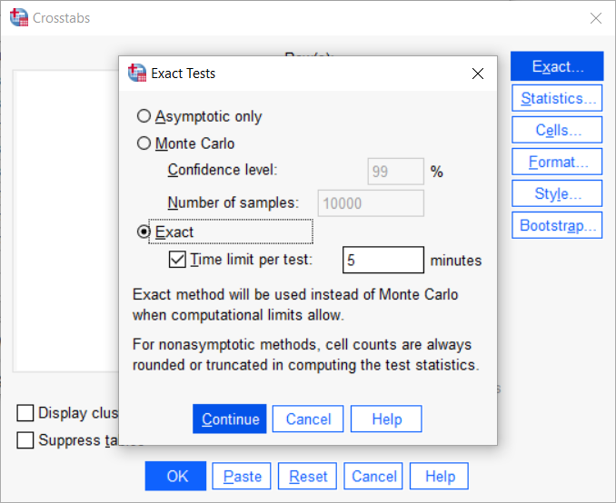
Fisher’s Exact Test in SPSS (3/4)
Figure 7. SPSS Dialog box

Slide 21
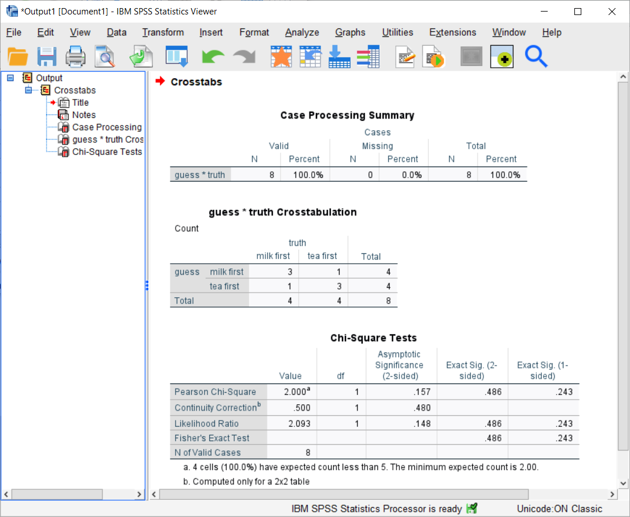
Fisher’s Exact Test in SPSS (4/4)
Figure 7. SPSS output box

Slide 22
Fisher’s Exact Test in Stata
. tabulate guess truth, exact Fisher's exact = 0.486 1-sided Fisher's exact = 0.243

Slide 23
Break #3
What have you learned? + Using SPSS and Stata
What’s coming next? + Details on the p-value computation

Slide 24
Details on the p-value computation (1/5)
p-value=P[sample results or more extreme| H0]
What does “more extreme” mean?

Slide 25
Details on the p-value computation (2/5)
List all possible 2 by 2 tables
? ? | 4 ? ? | 4 ----+-- 4 4 | 8

Slide 26
Details on the p-value computation (3/5)
4 0 3 1 2 2 1 3 0 4 0 4 1 3 2 2 3 1 4 0 0.014 0.229 0.514 0.229 0.014

Slide 27
Details on the p-value computation (4/5)
For a one-sided p-value
4 0 3 1 0 4 1 3 0.014 + 0.229 p-value = 0.243

Slide 28
Details on the p-value computation (5/5)
For a two sided p-value
4 0 3 1 1 3 0 4 0 4 1 3 3 1 4 0 0.014 + 0.229 + 0.229 + 0.014 p-value = 0.486

Slide 29
Break #4
What have you learned? + Details on the p-value computation
What’s coming next? + More exact tests

Slide 30
Fisher-Freeman-Halton test
Generalization of Fisher’s Exact test
Tabulate all possible R by C tables
Fixed row and column totals

Slide 31
Fisher-Freeman-Halton test in R (1/2)
> v <- c(4, 0, 0, 0, 4, 0, 0, 0, 4) > m <- matrix(v, nrow=3) > m [,1] [,2] [,3] [1,] 4 0 0 [2,] 0 4 0 [3,] 0 0 4

Slide 32
Fisher-Freeman-Halton test in R (1/2)
> fisher.test(m) Fisher's Exact Test for Count Data data: m p-value = 0.0001732 alternative hypothesis: two.sided

Slide 33
Mann-Whitney U
Hypothetical data
T: 14, 23, 37 C: 12, 13, 15, 25

Slide 34
Rank the data
T: 3, 5, 7 C: 1, 2, 4, 6

Slide 35
Sum of the ranks
T = 15 C = 13
How likely is this result under the null hypothesis?

Slide 36
List all possible ranking for T
1,2,3 1,2,4 1,2,5 1,2,6 1,2,7 1,3,4 1,3,5 1,3,6 1,3,7 1,4,5 1,4,6 1,4,7 1,5,6 1,5,7 1,6,7 2,3,4 2,3,5 2,3,6 2,3,7 2,4,5 2,4,6 2,4,7 2,5,6 2,5,7 2,6,7 3,4,5 3,4,6 3,4,7 3,5,6 3,5,7 3,6,7 4,5,6 4,5,7 4,6,7 5,6,7

Slide 37
Select more extreme rankings
2,6,7 3,5,7 3,6,7 4,5,6 4,5,7 4,6,7 5,6,7
p-value = 7/35 = 0.20

Slide 39
Calculation for a two-sided test
1,2,3 1,2,4 1,2,5 1,2,6 1,3,4 1,3,5 2,3,4 2,6,7 3,5,7 3,6,7 4,5,6 4,5,7 4,6,7 5,6,7
p-value = 14/35 = 0.40

Slide 40
Mann-Whitney test in SAS (1/3)
data a; input grp $ x; datalines; proc npar1way wilcoxon; class grp; var x; exact wilcoxon; run;

Slide 41
Mann-Whitney test in SAS (2/3)
T 14 T 23 T 37 C 12 C 13 C 15 C 25 run;

Slide 42
Mann-Whitney test in SAS (3/5)
proc npar1way wilcoxon; class grp; var x; exact wilcoxon; run;

Slide 43
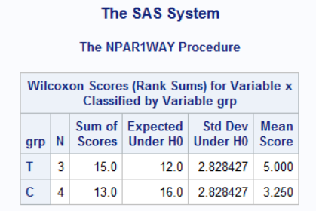
Mann-Whitney test in SAS (4/5)
Figure x. SAS output

Slide 44
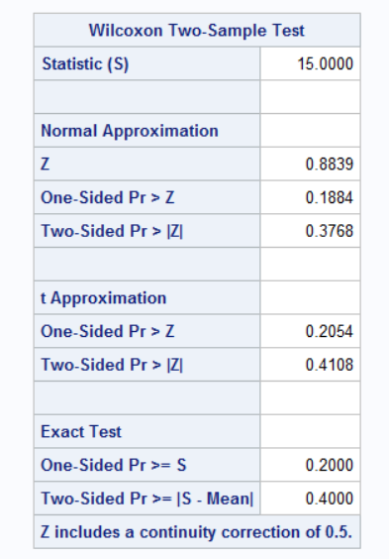
Mann-Whitney test in SAS (5/5)
Figure x. SAS output

Slide 45
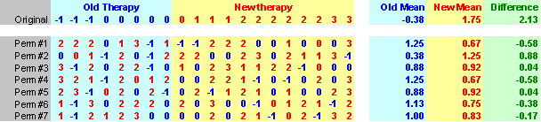
Randomization test
Figure x. 25 permutations

Slide 46
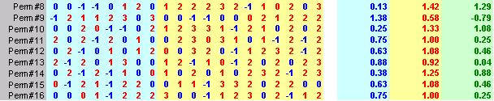
Randomization test
Figure x. 25 permutations

Slide 47
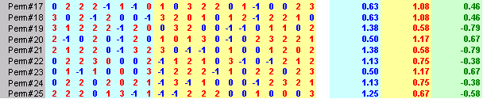
Randomization test
Figure x. 25 permutations

Slide 48
When should you use exact or randomization tests?

Slide 49
Fisher’s Exact Test in R (1/2)
labs <- c( "Milk first", "Tea first") guess <- c(1, 2, 1, 2, 2, 2, 1, 1) truth <- c(2, 2, 1, 2, 2, 1, 1, 1) fisher.test( factor(guess, labels=labs), factor(truth, labels=labs))

Slide 50
Fisher’s Exact Test in R (2/2)
p-value = 0.4857 alternative hypothesis: true odds ratio is not equal to 1 95 percent confidence interval: 0.2117329 621.9337505 sample estimates: odds ratio 6.408309

