Slide 1
Panel discussion on careers in Statistics
Steve Simon

Slide 2
Outline of this talk
Brief introduction
Embrace continuing education
No one likes a wishy-washy statistician
Find this talk at
  https://github.com/pmean/talks/blob/master/consulting-careers/2026-panel.md

Slide 3
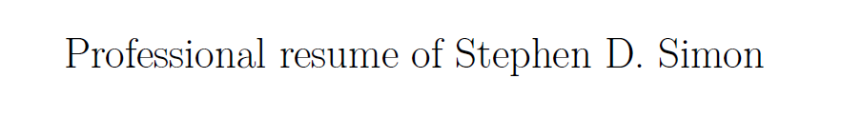
My resume will introduce myself.
Resume, found at https://github.com/pmean/resume
Notes:
I’m going to cut and paste portions of my resume into PowerPoint as a way to introduce myself.

Slide 4
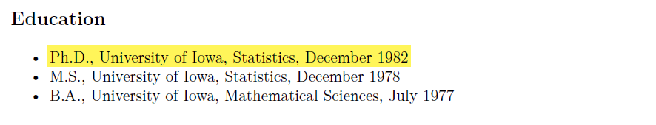
I got my degree almost 40 years ago
Education section of my resume
Notes:
If the saying about teaching an old dog new tricks is accurate, then I am in trouble. I got my PhD in Statistics from the University of Iowa in 1982. Much of what I’ve learned in college and throughout my long career is obsolete.

Slide 5
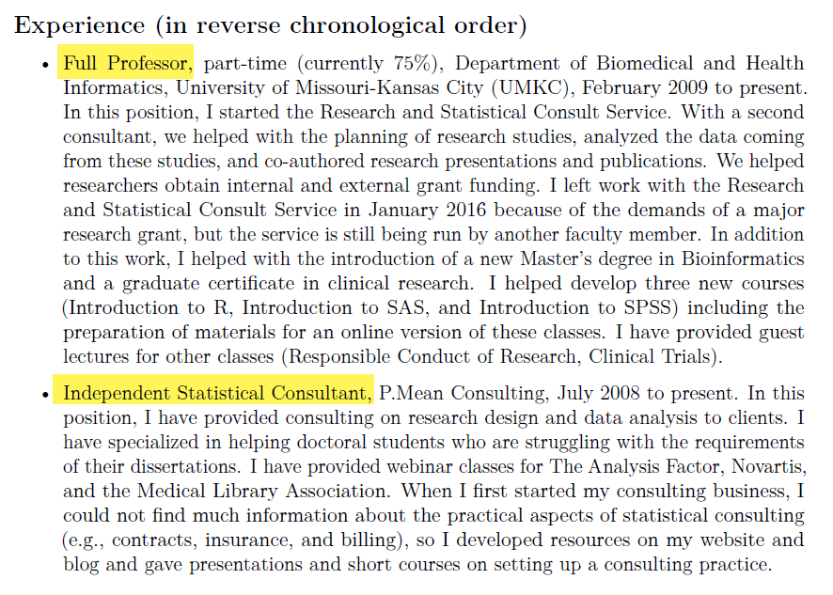
I juggle two jobs.
Experience section of my resume
Notes:
I work at two jobs. I am a faculty member in the Department of Biomedical and Health Informatics at the University of Missouri-Kansas City, and I also run an independent consulting business. I will focus my talk on the latter job, because that is the one that most people are interested in hearing about.

Slide 6
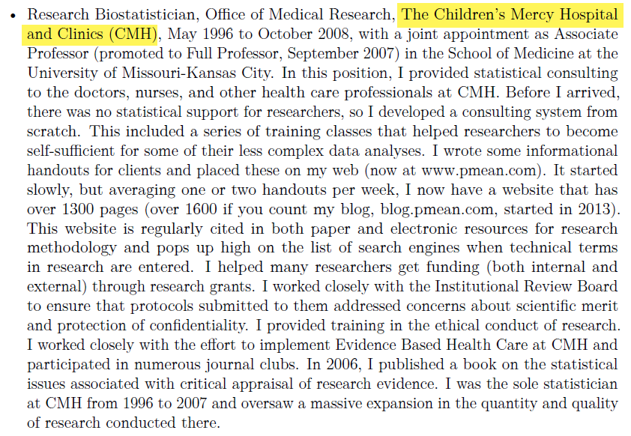
I used to work at a hospital, …
Work experience at Children’s Mercy Hospital
Notes:
Most of my previous work was consulting in health care areas. I worked with a lot of Pediatricians at Children’s Mercy Hospital in Kanas City.

Slide 7
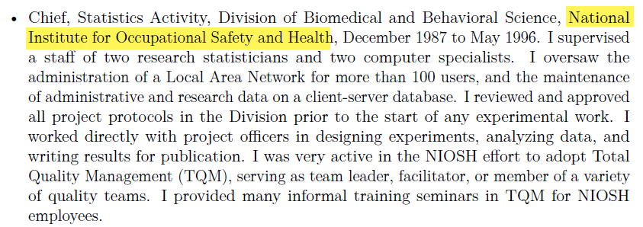
for Uncle Sam, …
Work experience at National Institute for Occupational Safety and Health
Notes:
I also did a lot of work in occupational safety and health.

Slide 8
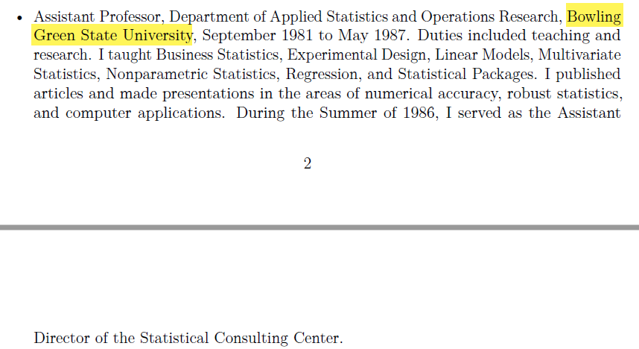
at a different University, …
Work experience at Bowling Green State University
Notes:
Plus I have taught Business Statistics for undergraduate and MBA students.

Slide 9
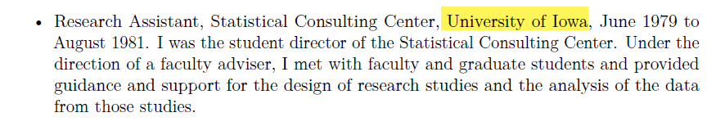
and as student director of a consulting center.
work experience at the Unversity of Iowa
Notes:
During my training at the University of Iowa, I got a lot of applied experience

Slide 10
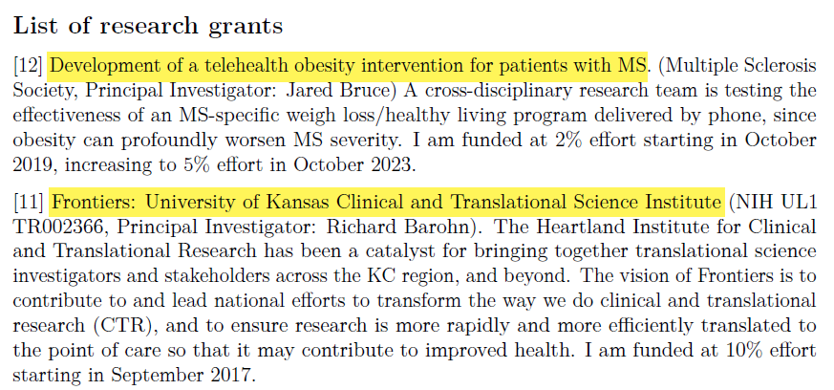
I’ve been on a few research grants, …
Two grants from my resume
Notes:
I’ve been on a few grants and have helped out on many others that were too small to include funding for a statistician.

Slide 11
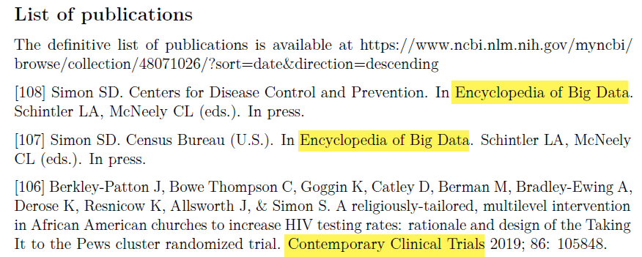
written a few papers, …
Three publications from my resume
Notes:
I’ve written quite a few papers, though only a handful as first author.

Slide 12
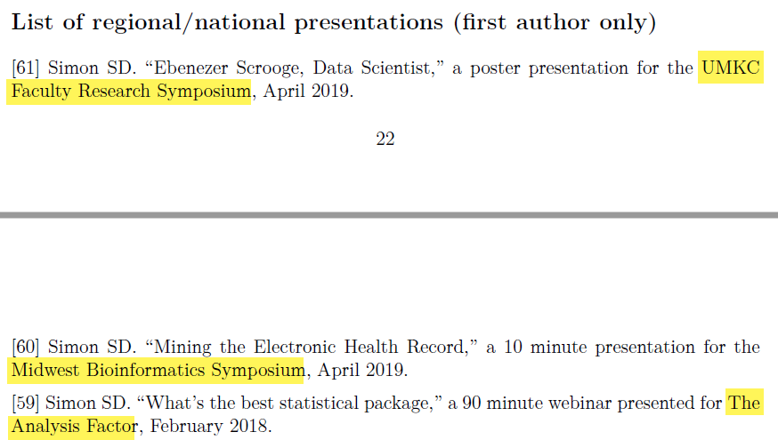
and given a few talks.
Three presentations from my resume
Notes:
I love giving talks like this one. If anyone needs a speaker, I am glad to jump in and help.

Slide 13
Embrace continuing education
Evidence-Based Medicine
Markov Chain Monte Carlo
Meta-analysis
Mixed models
Model based clustering
Reproducible research
Smoothing splines
Notes:
There are a lot of areas that just didn’t exist when I went to school. I spend a lot of time on continuing education.
In twenty years, you will have a similar list. It won’t be these things, it will be things that none of us know about today.

Slide 14
No one likes a wishy-washy statistician.
Be decisive
  If you’re going to make a mistake, make a loud mistake
  Clients can articulate better after seeing a bad proposal
But don’t be arrogant
  Admit when your opinion is a minority perspective
  Be honest about what you know and what you don’t know
  Listen to and respect alternative opinions
Notes:
Be firm in your recommendations. Don’t sugar coat things, but when you choose an approach tell your clients that this is the best approach. It will have weaknesses, for sure, but all the alternatives are worse. So use the word “best” in your descriptions.
Now nobody is perfect, and sometimes what you recommend may not be the best approach. So I fall back on what I learned about playing piano when I was dating a piano major in college. She said, when you make a mistake make a loud mistake. Play boldly. If you are afraid of making a mistake, you will still make mistakes, but you style will be weak and tentative.
Be the same with your consulting. Consult boldly. The few times when your recommendation is not the best is counterbalanced by the more numerous times that your good recommendations come across as weak and tentative.
The other thing to note is that your clients will often have a difficult time articulating exactly what they want. But if they see something that isn’t what they want, they can do a better job explaining why what you gave them is not right and what they really want.
Being decisive, though, does not mean being arrogant. Be honest about what you know and what you don’t know. Say that you’ve never done a meta-analysis before, so you need to work cautiously and review the literature carefully.
Also, listen to and respect alternative opinions. The people you work with have an advantage over you in that they know the commonly used standards in their discipline. So if they say they want something and it isn’t what you feel is the best option, ask if it is defensible. Can it pass peer review. You do want to avoid giving in when the approach they choose does violence to the data. But when only then.
I’ve heard quotes like statisticians are the guardians of objectivity and the gatekeepers of the scientific method. Fine, maybe, but don’t act like everyone else is subjective or that they don’t know how to apply the scientific method.

Slide 15
Summary
Brief introduction
Embrace continuing education
No one likes a wishy-washy statistician.
Find this talk at
  https://github.com/pmean/talks/blob/master/consulting-careers/2026-panel.md

