Slide 1
Splines, part 1

Slide 2
xkcd comic
Title “CURVE-FITTING METHODS AND THE MESSAGE THEY SEND”
Drawn by Scott Munro
Open-source license
Link to comic at xkcd.com
More details at explain-xkcd.com
Notes:
Let me start with a cartoon from the xkcd site of Scott Munro. Scott Munro produces comics that poke fun at various scientific and mathematical concepts. There are a handful that directly address statistics, including this one. The actual panels in the comic are small, so I split them up onto separate slides.

Slide 3
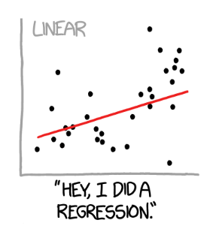
xkcd comic, panel 01
Notes:
This shows a scatter of data points with a linear regression fit. The caption reads, “Hey, I did a regression.”

Slide 4
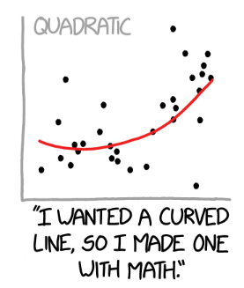
xkcd comic, panel 02
Notes:
This shows a scatter of data points with a quadratic regression fit. The caption reads, “I wanted a curved line, so I made one with Math.”

Slide 5
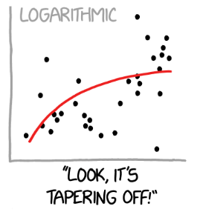
xkcd comic, panel 03
Notes:
This shows a scatter of data points with a logarithmic regression fit. The caption reads, “Look, it’s tapering off!”

Slide 6
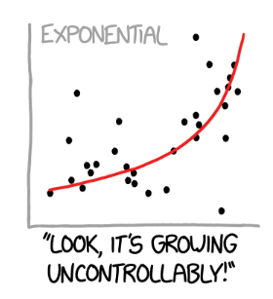
xkcd comic, panel 04
Notes:
This shows a scatter of data points with an exponential regression fit. The caption reads, “Look, it’s growing uncontrollably.”

Slide 7
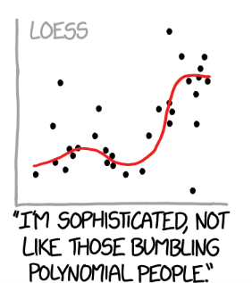
xkcd comic, panel 05
Notes:
This shows a scatter of data points with a loess smoothing curve. The caption reads, “I’m sophisticated, not like those bumbling polynomial people.”

Slide 8
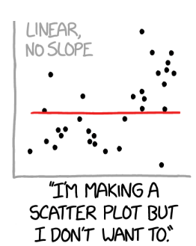
xkcd comic, panel 06
Notes:
This shows a scatter of data points with a flat linear regression fit (slope=0). The caption reads, “I’m making a scatter plot but I don’t want to.”

Slide 9
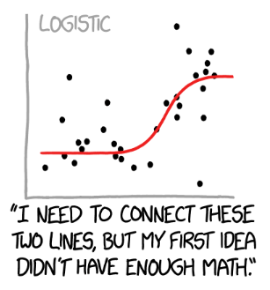
xkcd comic, panel 07
Notes:
This shows a scatter of data points with a logistic curve regression fit. The caption reads, “I need to connect these two lines, but my first idea didn’t have enough Math.”

Slide 10
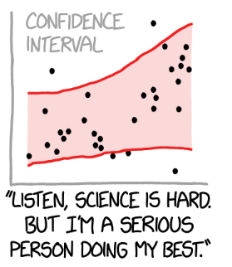
xkcd comic, panel 08
Notes:
This shows a scatter of data points with no particular regression line, but a very wide (nd probably appropriate) confidence band. This captures the idea that there is uncertainty not only in the deviation of the points from the regression curve, but true uncertainty about the shape of that regression curve. The caption reads, “Listen, science is hard. But I’m a serious person doing my best.”
There is an active field of research under the topic uncertainty quantification that tries to take into account all the sources of uncertainty including uncertainty about which model is the correct model.

Slide 11
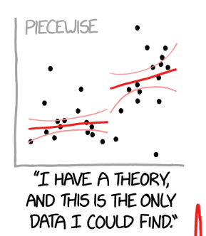
xkcd comic, panel 09
Notes:
This shows a scatter of data points with a piecewise linear regression fit. The caption reads, “I have a theory and this is the only data I could find.”

Slide 12
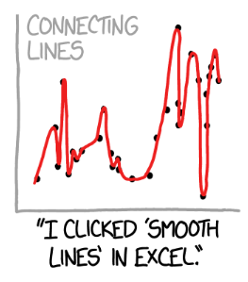
xkcd comic, panel 10
Notes:
Here the proposed regression model gets a bit silly. This shows a scatter of data points with a smooth curve connecting every data point. The caption reads, “I clikced ‘smooth lines’ in Excel.”

Slide 13
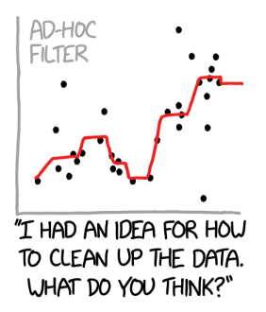
xkcd comic, panel 11
Notes:
This shows a scatter of data points with a smoother that looks like it uses medians somehow. The caption reads, “I had an idea for how to clean up the data. What do you think?”

Slide 14
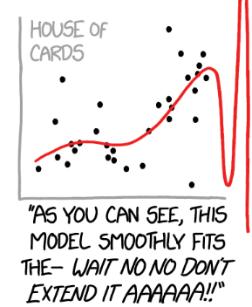
xkcd comic, panel 12
Notes:
This shows a scatter of data points with what looks like a B-spline. The caption reads, “As you can see, this model smoothly fits the - Wait, No, No, Don’t extend it. AAAAAA!!”

Slide 15

Examples of splines, 1
Notes:
Here’s a peer-reviewed study of sleep duration and how it relates to your gut microbiota–all those tiny bugs living inside your intestines. The authors used a composite score called the dietary index for gut micrtobiota with the acronym DI-GM. This article is published under an open source license, like all the other papers you will see today.

Slide 16
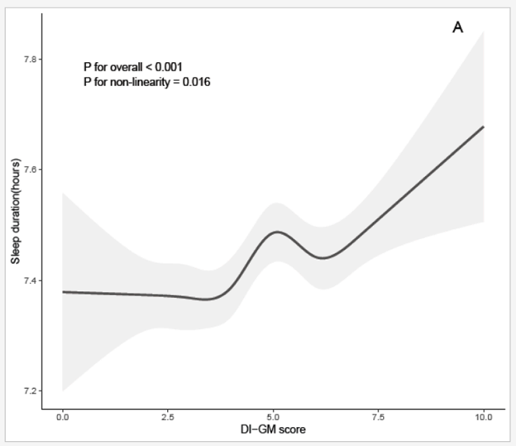
Examples of splines, 2
Notes:
The cubic spline starts out flat for low values of DI-GM, then rises, dips, and rises again.

Slide 17

Examples of splines, 3
Notes:
Here’s another open source article, a peer-reviewed study of patients with Duchene muscular dystrophy (DMD). The authors measured spine bone mineral density and sought to see how that related to various cholesterol measures, including triglycerides and remnant cholesterol both in patients with DMD and age-matched healthy controls. The authors controlled for a variety of factors including steroid use.

Slide 18
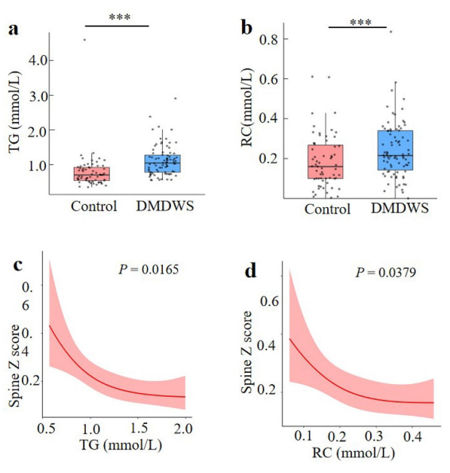
Examples of splines, 4
Notes:
The box plot examines DMD patients without corticosteroid treatment (DMDWS) to the healthy controls. Triglycerides and remnant cholesterol was elevated in the DMDWS group. The cubic spline shows a deline in bone health for larger values of triglycerides and remnant cholesterol, but the effect is not quite as strong for larger values of these cholesterol measurements.

Slide 19

Examples of splines, 5
Notes:
Here’s a peer-reviewed study of how nutrtion is associated with the risk of chronic kidney disease (CKD). The authors got their data from the National Health and Nutrition Examination Survey (NHANES) data, a large scale CDC survey that includes a medical exam and dietary history. They estimated niacin intake through a dietary recall and classified patients as having CKD based on their Albumin to creatinine ratio and the estimated glomerular filtration rate.

Slide 20
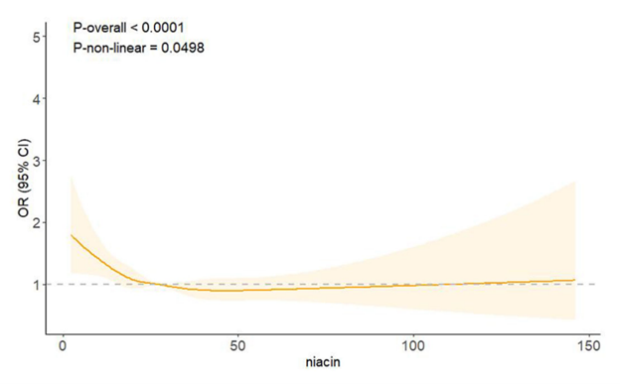
Examples of splines, 6
Notes:
The cubic spline shows that a deficiency of niacin increases the odds of CKD, but that larger levels of NIACIN above 20 to 30 do not have an impact.

Slide 21
A real-world problem, without the data
Threshold model
Nothing happens until you meet a threshold
Then things get worse
Notes:
Several decades ago, I was faced with a data analysis problem. I wanted to fit a threshold model where everything is fine and normal until the exposure level meets a certain threshold. Then things get worse.
I don’t have the data for this problem but let me illustrate conceptually how a threshold model might work. It provides a simple but useful analog to regression splines.

Slide 22
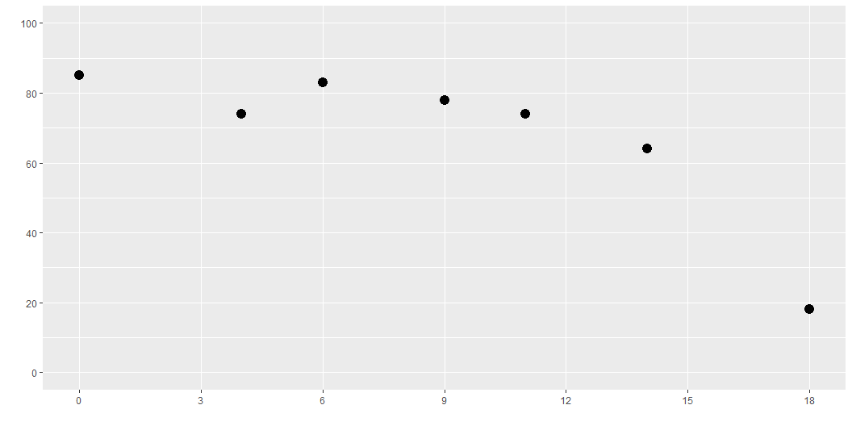
Fake data

Slide 23
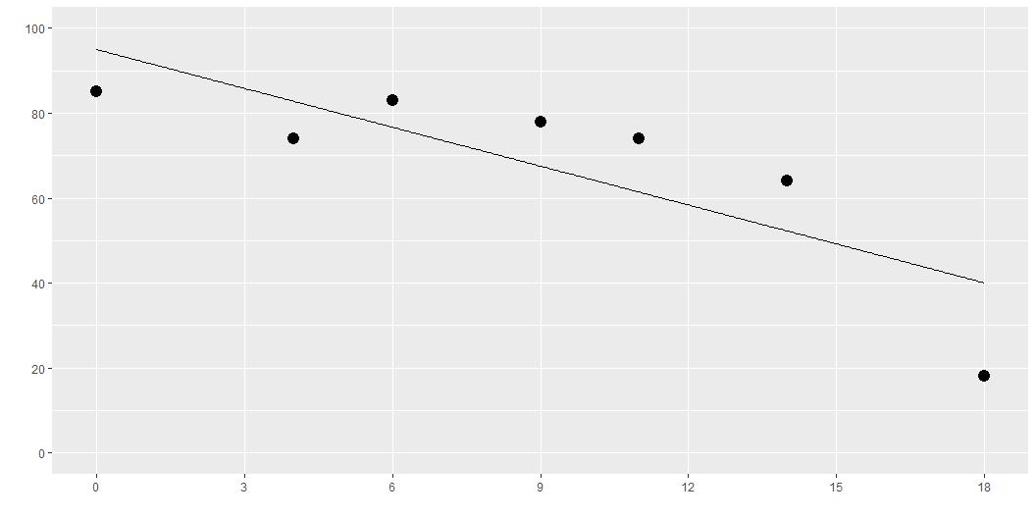
Linear function
Notes:
Here is what a linear function might look like. It is not what we want, but always start with the easiest model.

Slide 24
Computational formula for linear regression
$\hat{β}={\left(X′X\right)}^{−1}X′Y$
$X=\left[\begin{matrix}1 & 0 \\ 1 & 4 \\ 1 & 6 \\ 1 & 9 \\ 1 & 11 \\ 1 & 14 \\ 1 & 18\end{matrix}\right]$
Notes:
This is the matrix formula for linear regression. Don’t worry if you haven’t used matrices before. Just note how the X matrix is laid out for linear regression. The first column is all 1’s and the second column contains the X values.
In multiple linear regression, you would have additional columns, but let’s keep it simple for now.
I do want to note here that you can get a different regression model by changing the second column.

Slide 25
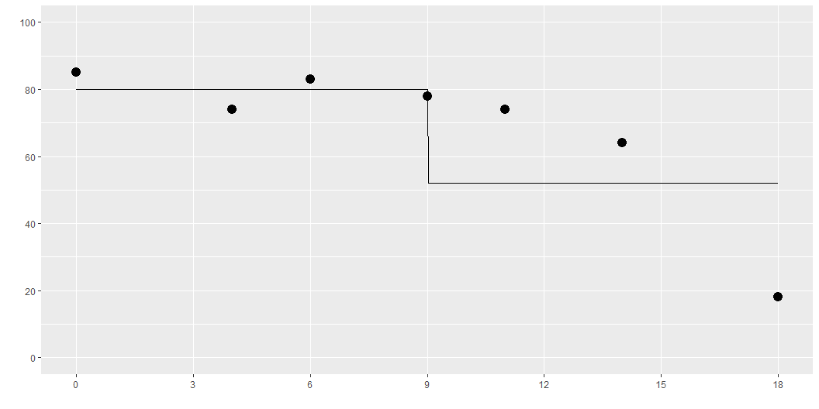
Step function
Notes:
Here is what a step function might look like. It is better than a linear fit, but the sudden jump at x=9 is not quite what you want.
This is a discontinuous function. It might make sense in some settings. In other settings, you might expect the decline to be not so sudden and abrupt.

Slide 26
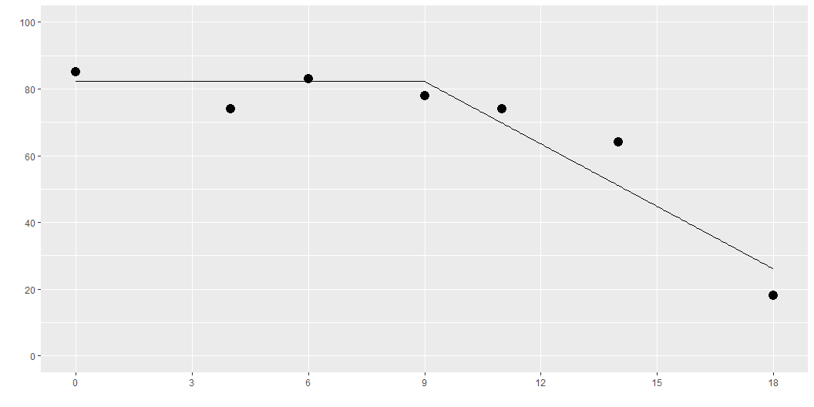
Elbow function
Notes:
A threshold model could look like this. It is a step function that is at a high level prior to the threshold at X=9 and then drops after.
Here is a better model. It is flat and at a high level for values less than 9 and declines linearly for values greater than 9.
Note the “elbow” at the threshold. This might be okay, but it might be better for a transition that does not change slope so suddenly.

Slide 27
$Y=β_{0}+β_{1}I_{\left[X>9\right]}$
1 0 1 0 1 0 1 0 1 1 1 1 1 1
Notes:
Here is the formula and the design matrix for a step function. The I notation is an indicator function that is equal to 1 if the logical comparison is true and 0 if it is false.

Slide 28
$Y=β_{0}+β_{1}I_{\left[X>9\right]}\left(X−9\right)$
1 0 1 0 1 0 1 0 1 3 1 6 1 9
Notes:
This is the formula and design matrix for an elbow regression. The independent variable is computed by multiplying the indicator variable by the value of X, but only after subtracting the threshold of 9. It is important to subtract the nine so that the linear decline after the threshold matches up with the flat section before the threshold.

Slide 29
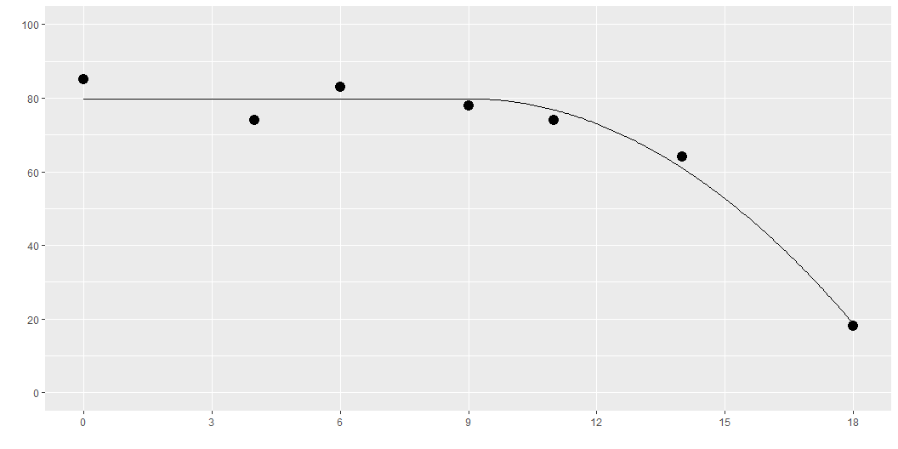
Quadratic analog
Notes:
Here is a functional form that avoid the elbow at the threshold value. It fits a quadratic decline, or a parabola, but the parabola starts at the point where the derivative is equal to zero.

Slide 30
$Y=β_{0}+β_{1}I_{\left[X>9\right]}{\left(X−9\right)}^{2}$
1 0 1 0 1 0 1 0 1 9 1 36 1 81
Notes:
This is the formula and design matrix for the quadratic analog, or the elbowless regression.

