Slide 1
The dark side of big data
Steve Simon

Slide 2
Who am I?
Steve Simon
PhD Statistics, 1982, U Iowa
Teach in Biomedical and Health Informatics
Previous jobs at CMH, CDC
Part-time independent statistical consultant (P.Mean Consulting)
Married to a Pediatric Cardiologist (retired)
Run 5K and 4 mile races
Notes:
Let me introduce myself. I am Steve Simon. I got a PhD in Statistics almost 40 years ago from the University of Iowa. The world has changed a lot since then, but I have tried to keep up. Today, if you want to sound trendy, you are a “data scientist”. I teach in the Department of Biomedical and Health Informatics at UMKC. I have had previous jobs at Children’s mercy Hospital, and the Centers for Disease Control and Prevention. I’m also a part-time statistical consultant. I have a sole proprietorship, P.Mean Consulting. That’s short for Professor Mean. For people who don’t get the joke, I point out that Professor Mean is not just your average Professor. Related to this talk, I should point out that I am obsessed with computers.

Slide 3
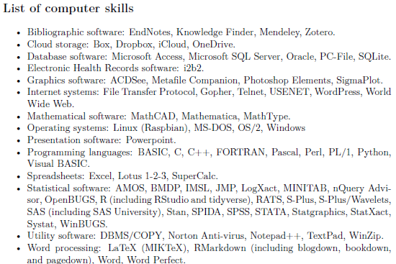
Obsessed with computers since 1972
Figure 1. Section on computer skills from my resume
Notes:
I should add that I am a bit of a computer geek. Here’s a list of computer skills that I put on my resume. I deliberately made this too small to read so that you wouldn’t recognize that half of the computer skills I mention have been obsolete for several deades. The computers I used in the 1970s were nothing like today’s computers.

Slide 4
Worked with health care applications since 1987
Recent positions
Centers for Disease Control and Prevention (1987-1996)
Children’s Mercy Hospital (1996-2008)
UMKC School of Medicine (2008 to present)
But…
I am not a doctor
Still confused about many things
Example: Difference between good and bad cholesterol.
Notes:
I’ve also been working with a variety of health care professionals for many decades. I have learned a lot along the way, but I am not a doctor. Not an MD doctor anyway. When I talk about medical examples, keep that in mind. I don’t always describe things accurately from a mdedical perspective, and I’m always forgetting which one is the bad cholesterol.
Is it ldl or hdl? Does anyone know?

Slide 5
Quiz questions (1/3)
Why does Joel Best call statistics a social construct?
Statistics are misquoted often on social media.
Statistics are selected, shaped, and presented by human beings.
Statistics are used to promote socialism.
Statistics are dehumanizing.
Notes:
I want to list a few quiz questions relating to this lecture. Remember these questions when I get to the slide that discusses them.

Slide 6
Quiz questions (2/3)
What is the main philosophical foundation of empiricism?
Everything can be reduced to a mathematical equation.
Experiments can reveal the realities of the world.
Some questions are impossible to answer.
We construct our own reality based on our own lived experiences
Notes:
Here’s the second question.

Slide 7
Quiz questions (3/3)
What is a major problem with data science?
Data scientists rely on large amounts of data with uneven quality.
Models developed by data scientists can lead to loss of privacy.
Prediction models are a black box that can hide discriminatory intent.
All of the above.
Notes:
Here’s the third question. You don’t need to answer these questions now. Just be ready to answer them after the lecture.

Slide 8
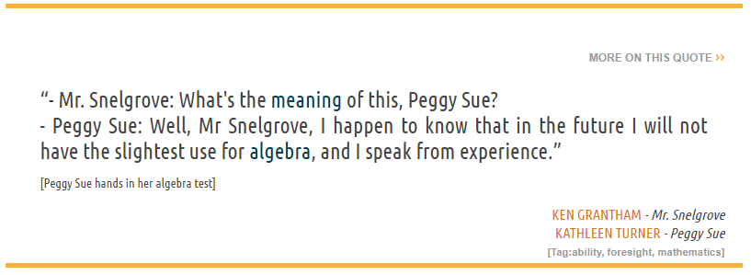
First poll question
Figure 2. Quote from “Peggy Sue Got Married”
Notes:
I want to get a quick feel for your background and interests. Here’s a quote from a romantic comedy starring Kathleen Turner from 1986. A forty year old woman, played by Kathleen Turner, travels back in time to her high school senior year, 1960. She has an amusing interchange with her high school math teacher.
“I happend to know that in the future, I will not have the slightest use for algebra, and I speak from experience.”
Think back to your high school algebra class.
Do you remember any important formulas from that class?
Did you hate, hate, hate high school algebra?
Did you love high school algebra?
Big question: Will you use high school algebra in your future?
Source: https://www.moviequotes.com/s-movie/peggy-sue-got-married/

Slide 9
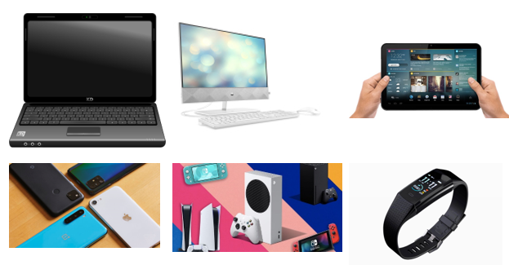
Second poll question
Figure 3. Images of various computers
Notes:
How many of these computational devices have you used?
Laptop computer
Desktop computer
Tablet computer
Smart phone
Gaming console
Smart watch
Big question: What impact does the current generation’s immersion of computing have on society?
Images found at
https://commons.wikimedia.org/wiki/File:Black_laptop_computer_open_frontal.svg https://www.pcmag.com/picks/the-best-desktop-computers https://www.cleverfiles.com/howto/what-is-tablet-computer.html https://www.theverge.com/21420196/best-budget-smartphone-cheap https://www.vulture.com/article/best-video-game-console-2020-ps5-xbox-series-x-nintendo-switch.html https://www.homernews.com/marketplace/fitnus-smartwatch-review-legit-fitness-tracker-smart-watch/

Slide 10
Are Statisticians Gods?
I’m helping someone who wants an alternative statistical analysis to the one used by the principal investigator. I’m happy to help and will offer advice about why my approach may be better, but I was warned that the PI considers the analysis chosen to be ordained by the “Statistical Gods” at her place of work.
Notes:
True story. I was asked to review a report from a federal agency, but was warned that negative comments, even if accurate, might not be well received because the agency’s work was ordained by their Statistic Gods. At first, I thought this was amusing. If I could get the title of “Statistical God”, I could double my hourly consulting rate. But deep down this story really bothered me. It implies that Statistical skills are supernatural, and only available to a select few special people. I learned Statistics through hard work, and you can learn Statistics through hard work also. Some people will learn it faster than others because they have good aptitudes in mathematics and programming. But there is nothing other than time to stop you.

Slide 11
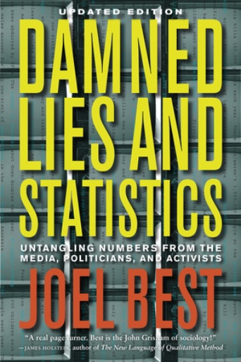
Statistics are a social construct
Figure 4. Cover from Joel Best’s book
Notes:
I’m going to share a message that is controversial, but which I believe deeply in. It’s a message from a book by Joel Best: Lies, Damned Lies, and Statistics. Untangling Numbers from the Media, Politicians, and Activists. He argues that Statistics are a social construct. I need to define social construct here. A social construct is a method by which people create their perception of reality.
That’s certainly true of Statistics. Statistcs are “selected, shaped, and presented by human beings”
Source of quote: Milo Shield, Teaching the Social Construction of Statistics. Available at https://www.researchgate.net/publication/277299441_Teaching_the_Social_Construction_of_Statistics
Image taken from https://www.ucpress.edu/book/9780520274709/damned-lies-and-statistics.

Slide 12
The arrogance of empiricism (1/2)
“I often say that when you can measure what you are speaking about, and express it in numbers, you know something about it; but when you cannot measure it, when you cannot express it in numbers, your knowledge is of a meagre and unsatisfactory kind; it may be the beginning of knowledge, but you have scarcely in your thoughts advanced to the state of Science, whatever the matter may be.” Lord Kelvin.
Notes:
The idea that Statistics are a social construction flies in the face of empiricism, the philosophy that experiments can reveal the realities of the world.
Here is a quote in support of empiricism. I won’t read all of the first quote, but notice the sneering phrase that without numbers, “your knowledge is of a meagre and unsatisfactory kind.”

Slide 13
The arrogance of empiricism (2/2)
“No human investigation can be called real science if it cannot be demonstrated mathematically.” Leonardo da Vinci
Notes:
Here is a second quote that is just as bad. Science without numbers (math) is not real.

Slide 14
Why empiricism fails (1/3)
“The government is very keen on amassing statistics. They collect them, add them, raise them to the nth power, take the cube root and prepare wonderful diagrams. But you must never forget that every one of these figures comes in the first instance from the village watchman, who just puts down what he damn well pleases.” Sir Josiah Stamp
Notes:
This quote from Josiah Stamp illustrates why Statistics are a social construct. It doesn’t matter how fancy we dress up the numbers, nth powers, cube roots. It all comes down to the village watchman who does what he damn well pleases.
The village watchman is part of the social constuction of Statistics. So are the government officials who do all sorts of mathematical manpulations which provide an impression of objectivity.

Slide 15
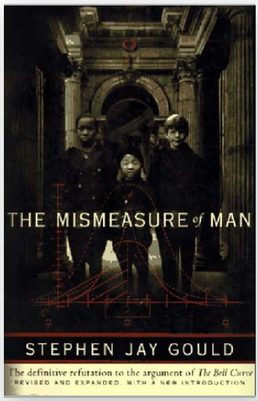
Why empricism fails (2/3)
Figure 5. Cover of Stephen Jay Gould’s book
Notes:
There’s a great book by Stephen Jay Gould that really makes you think hard about numbers. The book, The Mismeasure of Man, talks about IQ testing from a historical perspective and totally destroys the idea that intelligence is a trair that can be easily quantified. He starts with efforts in the 1800s to use the size of a person’s skull as a measure of their intelligence. A big skull means a big brain that lives inside there and bigger brains are smarter brains.

Slide 16
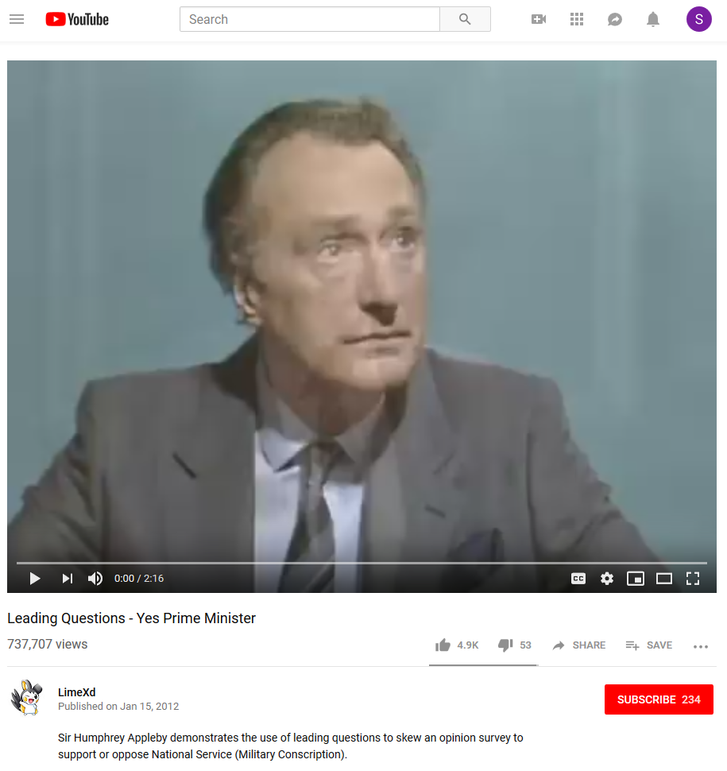
Why empricism fails (3/3)
Figure 6. Frame from Yes, Prime Minister video clip
Notes:
This short video clip is an excellent illustration of how the questions leading up to a particular question on a survey can bias the response to that survey. It comes from a British comedy, Yes Prime Minister, that ran in the 1980s.
YouTube. Leading Questions- Yes Prime Minister. Taken from the 1st Season of Yes Prime Minister – Episode 2, The Ministerial Broadcast. 2:16 running time. Published on Jan 15, 2012.
https://www.youtube.com/watch?v=G0ZZJXw4MTA

Slide 17
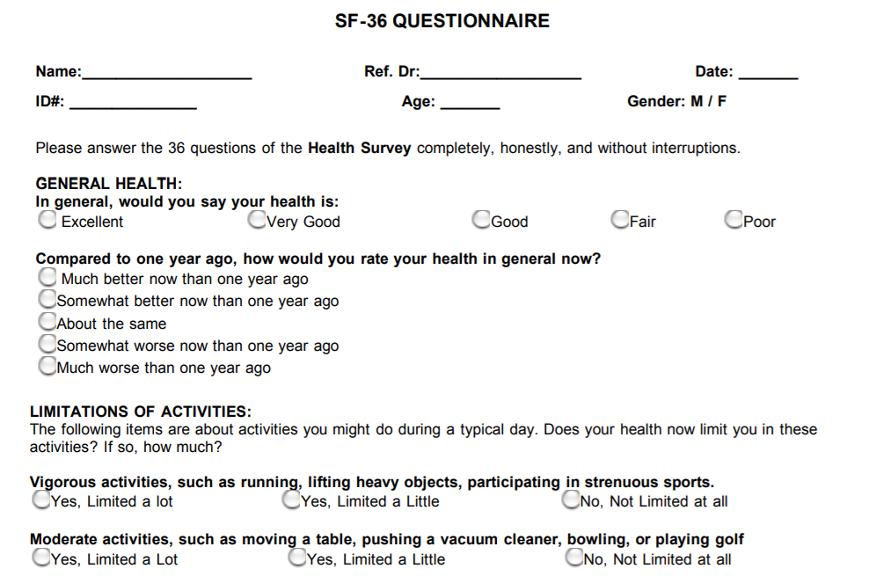
But numbers still have value. Example: Quality of Life
Figure 7. First few questions from SF-36 form
Notes:
Recognizing that Statistics are a social construction does not mean that Statistics are worthless and that experiments are a waste of time. The best example I can give for this is the measure of quality of life.
Quality of Life is a measure that is reported in many research studies. There is no question that quality of life is a social construction. It is measured by forms like the SF-36 shown here. But it is not an objective reality but something that was constructed by humans.
Now I mentioned earlier that I like to run. It is a pretty strenuous activity, but one that I enjoy. A friend of mine said, though, that she couldn’t understand why you would want to run, unless you were being chased. One the other hand, I would not miss a thing if I did not push a vacuum.
There is no objective measure of quality of life. It depends on the values of the people who are developing forms like the SF-36.
Problems occur when these social constructs are developed by research teams with limited diversity (they may have blind spots) or if the social constructs are not evaluated in diverse populations.
But we can still use social constructs like quality of life, as long as we do it carefully.
In fact, we should use these measures because they get at information which is important, and which cannot be measured by a laboratory.
There’s a lot of uncertainty about treatments for cancer, for example, which can sometimes extend a person’s lifetime, but can also substantially interfere with their ability to do things that they feel are important. You can’t discuss this trade-off without first measuring the deterioration of quality of life associated with some of these aggressive therapies.
Image obtained from
https://clinmedjournals.org/articles/jmdt/jmdt-2-023-figure-1.pdf

Slide 18
Rules for using Statistics as social constructs
Understand the context in which the Statistic was generated.
Identify possible biases
Recognize limitations
Beware of confirmation bias
Avoid nihilistic thinking
Notes:
Once you recognize that Statistics are a social construct, you can take steps to make sure that these statistics are used properly. You need to think about the process the generates the statistics. Is there a “night watchman” who puts down whatever he pleases?
Just as an example, I do a lot of work with electronic health records. The health care professionals who populate the data in a system like Cerner or Epic are not doing this because they want to make sure that I have something interesting to publish. They have two objectives. First, they want to make sure that the information they put in is helpful to other members of the health care team. Second, they want to make sure they get the maximum possible billing from the insurance companies. Third, they want to wrap this up quickly so they can get home to their families.
Second, identify possible biases. Does the desire to maximize billing skew the results?
Third, recognize limitations. Am I, as a researcher, asking for information that is not important for documenting the care a patient receives to other members of the treatment team?
Fourth, beware of confirmation bias. Confirmation bias is the tendency to look harder for information that reinforces our preconceived notions, or to overlook or downweight information that contradicts our view of the world.
Fifth, avoid nihilistic thinking. Once you recognize that Statistics are a social construct, you have to work harder, but it is not an impossible task. Our tendency to treat Statistics as hard and objective has led us astray at times, but we’ve still made a lot of progress in science and medicine, thanks to Statistics.

Slide 19
Things have gotten worse, thanks to big data
Large amounts of data of uneven quality
Black box models
Lack of accountability
Scaling problems
Loss of privacy
Notes:
Now everything I’ve mentioned so far is a problem in Statistics that has been around since before I was born. But we are in a new era, the era of big data. We have data today at a size and a level of detail that was unavailable twenty years ago. This is thanks to the internet, the human genome project, and many other things.
I’m glad we have all these data, because it increases the opportunities for learning. But at the same time, the flaws of empiricism have gotten worse.
Part of the problem is that the massive data sets that we use today have a great unevenness of quality. it is not too hard to identify obvious typos in a data set with a few hundred observations, but you would never been able to spot them in a data set with a few million observations.
Second, big data requires more complex data analysis methods and these methods are often difficult to understand. Not just from a how do these new methods work, but also in what aspects of the data are emphasized and what aspects of the data are ignored. A small model that has ten inputs is easily taken apart and examined, but you can’t do that with a model that has ten thousand inputs.
Third, there is a lack of accountability. These complex models are rarely audited, for example, to look for hidden biases.
Fourth, big data provides an opportunity to produce answers not just for a small number of people, but for thousands or millions of them all at once. If the big data model is flawed, the flaws are multiplied across the large number of people who are affected by the big data model.
Fifth, there is so much data out there that you can often infer quite intimate and private details about individuals, often without them being aware of this.

Slide 20
Small group exercises
Form groups of 4-5 people.
Answer the following questions
Who is the villain?
Who is the victim?
How was the victim harmed?
What could have prevented this?
Did anything surprise you?
Did you disagree with anything in the article?
Is there a single quote from the article that summarizes it well?
Notes:
I want to do a small group exercise where you look at a newspaper article that discusses harm that occurred thanks to computer models. Do this in groups of 4 to 5 people. Read the article quicly. It should not take more than 5 minutes to read. Then designate someone as a note taker and a different individual as the spokesperson for the group. Come up with answers for the questions listed here.
Given the size of the class, we may not have the opportunity to let every group speak, but I will try to spread things around as much as possible.
Here are the hyperlinks to the articles:
https://www.nytimes.com/2006/08/09/technology/09aol.html
https://www.wired.com/story/null-license-plate-landed-one-hacker-ticket-hell/
https://www.nytimes.com/2011/07/08/health/research/08genes.html

Slide 21
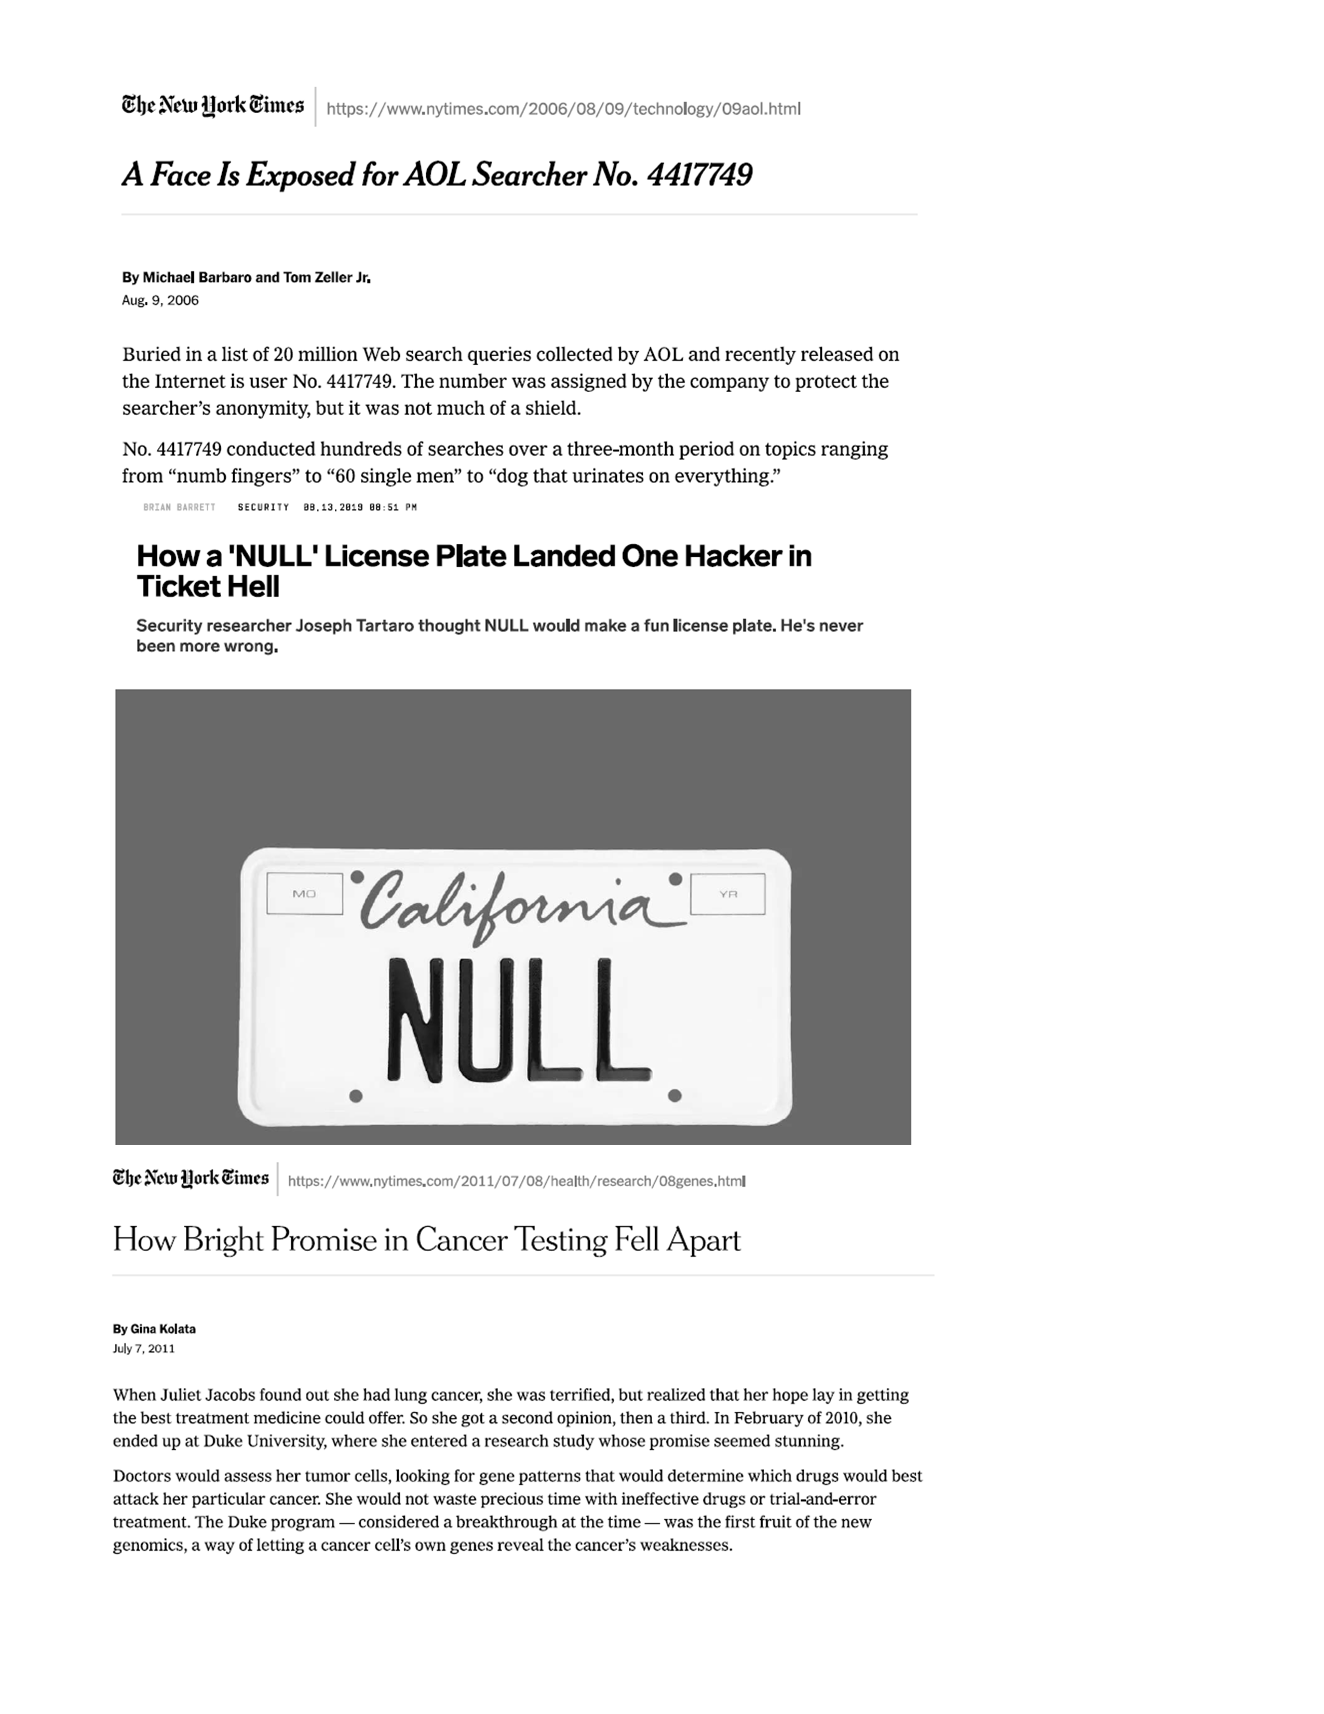
Here are the articles for your review
Figure 8. Excerpts from three articles
Notes:
Here are the three articles. “A Face Is Exposed for AOL Searcher No. 4417749,” published in 2006 in the New York Times, “How a ‘NULL’ License Plate Landed One Hacker in Ticket Hell,” published in Wired Magazine in 2019, and “How Bright Promise in Cancer Testing Fell Apart,” published in the New York Times in 2011.
Each small group will get a different article. If you’ve read the article already, re-read it with an eye to answer the questions posed on the previous slide. If you’ve not read the article already, skim through it quickly and contribute a few thoughts to your group.
I want each group to read silently for five minutes and then start discussing the article for the next ten minutes. Then I want to hear from some of the groups about their thoughts. I won’t have time to get information from every group, but I’ll try to get a variety of thoughts and opinions.

Slide 22
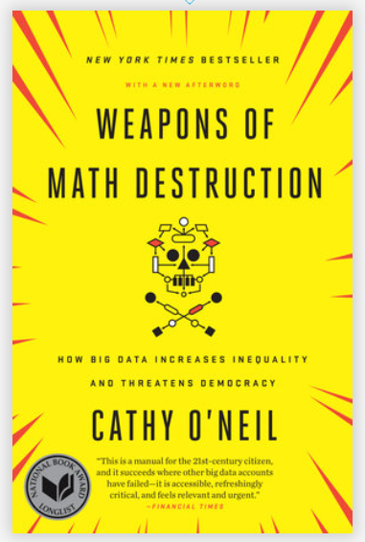
Weapons of Math Destruction
Figure 9. Cover of Cathy O’Neill’s book
Notes:
Before I start the individual groups, let me give an example of how this works.
This is a great book with lots of interesting examples, but I want to discuss one example in detail and answer the questions about it. It comes from chapter 1 of the book, Weapons of Math Destruction, by Cathy O’Neil.

Slide 23
First villain
Walter Quijano
Provided testimony on recidivism rates at seven trials
Unfairly included race in his calculations and testimony
Six of seven convictions later overturned
Notes:
The big data example in O’Neil’s book starts with the story of a person, Walter Quijano, who provided testimony in seven trials about the risk of recidivism. Recidivism is the unfortunate event where someone who has been released from prison commits a new crime and gets tossed back in jail. Mr. Quijano gave overtly biased recommendations at these trials that incorporated race into his assessment of recidivism. This was noted in the appeals of one of the defendants, and led to six of the seven convictions being overturned.

Slide 24
Second villain
LSI-R questionnaire
Given to thousands of inmates
Classifies risk of recidivism
Does not explicitly ask about race
But does have “leading” questions
Notes:
It contrasts this individual with a big data prediction model based on the LSI-R questionnaire. LSI-R stands for Level of Service Inventory-Revised that asks a bunch of questions like “How many prior convictions have you had?” This questionnaire weights the responses to various questions to provide an estimate of the risk of recidivism. Although the questionnaire does not explicitly ask about race, it can still indirectly identify a person’s race by their pattern of responses to a series of leading questions.

Slide 25
Victims
Inmates at parole hearings
Defendants at trial sentencing
Notes:
This questionnaire was used at a large number of parole hearings in multiple states and at sentencing hearings in a few states as well.

Slide 26
How were the victims harmed
Disproportionate recidivism risks by race
Fewer paroles grants
Longer sentences
No avenue to appeal
Model presumed to be unbiased
Complexity prevents examination of bias
Scale issues
Walter Quijano harmed 7 defendants
LSI-R harmed thousands of defendants.
Notes:
The model was shown to grossly overstate the recidivism risk of black defendants. This led to fewer grants of parole to black prisoners and longer prison sentences for newly convicted black defendants.
There was no avenue of appeal for those harmed by the LSI-R. You can’t cross-examine an algorithm at trial, and the company that developed the LSI-R model did not want to disclose details about how the model worked. It was a trade secret and revealing its details would allow other companies to steal their technology. To be honest, the model itself was so complex that the company would have been unable to reveal its inner workings, even if it wanted to.
The other important is issue is the scale of the harm. A biased witness could only influence a handful of defendants. Walter Quijano had only enough time and energy to taint the sentencing of seven defendants. The LSI-R algorithm, however, was applied to many people. , but the impact of the LSI-R questionnaire ended up influencing thousands.
That’s a hallmark of big data models. They are expensive to build and very labor intensive, but once they are built, it costs almost nothing to deploy it broadly.

Slide 27
What could have prevented this
Insist on transparency
Test the model for bias
Build the model with better objective

Slide 28
Did anything surprise you?
Questionnaire includes questions that would be inadmissable if they were asked during a normal trial
When was the first time you were ever involved with the police?
Do any of your friends or relatives have a criminal record?
Notes:
I read about this a couple of years ago, but I think the thing that surprised me was the number of questions on the LSI-R that would not have been allowed in an open trial, because the questions would have been ruled as prejudicial.
But apparently, you can ask prejudicial questions outside of a courtroom in a questionnaire and then use that information to create a recidivism risk score.

Slide 29
Did you disagree with anything in the article?
No

Slide 30
Is there are single quote that summarizes the article well
“The questionnaire includes circumstances of a criminal’s birth and upbringing, including his or her family, neighborhood, and friends. These details should not be relevant to a criminal case or to the sentencing.”

Slide 31
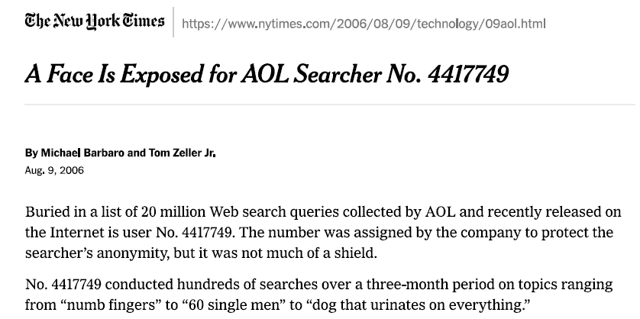
A Face Is Exposed for AOL Searcher No. 4417749
Figure 10. First page of newspaper article
Notes:
Answer the following questions
Who is the villain?
Who is the victim?
How was the victim harmed?
What could have prevented this?
Did anything surprise you?
Did you disagree with anything in the article?
Is there a single quote from the article that summarizes it well?
https://www.nytimes.com/2006/08/09/technology/09aol.html

Slide 32
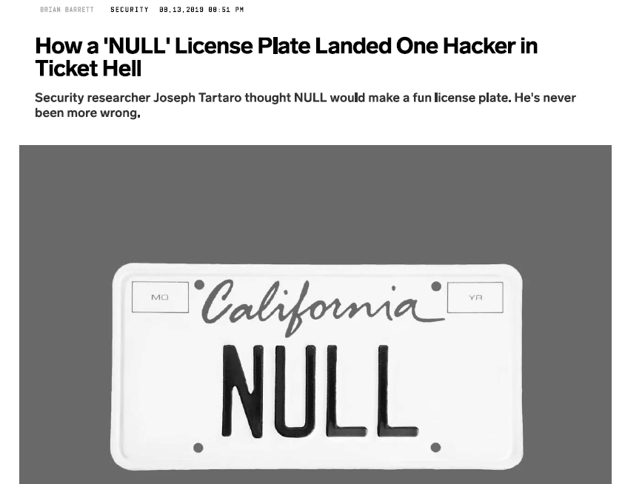
How a ‘NULL’ License Plate Landed One Hacker in Ticket Hell
Figure 11. First page of newspaper article
Notes:
Answer the following questions
Who is the villain?
Who is the victim?
How was the victim harmed?
What could have prevented this?
Did anything surprise you?
Did you disagree with anything in the article?
Is there a single quote from the article that summarizes it well?
https://www.wired.com/story/null-license-plate-landed-one-hacker-ticket-hell/

Slide 33
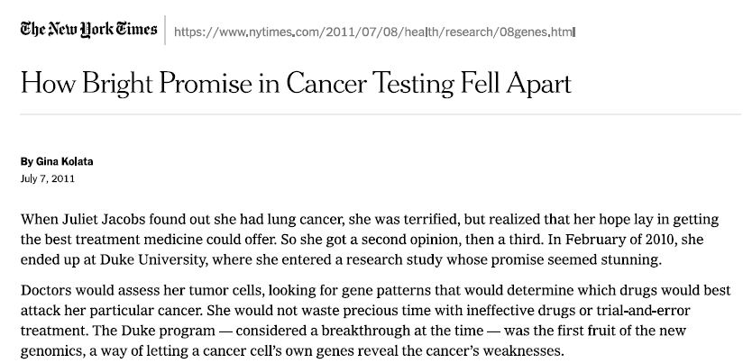
How Bright Promise in Cancer Testing Fell Apart
Figure 12. First page of newspaper article
Notes:
Answer the following questions
Who is the villain?
Who is the victim?
How was the victim harmed?
What could have prevented this?
Did anything surprise you?
Did you disagree with anything in the article?
Is there a single quote from the article that summarizes it well?
https://www.nytimes.com/2011/07/08/health/research/08genes.html

Slide 34
Myths about big data
Algorithms are objective
If you have enough data, quality is no longer an issue
We are getting better at this
Notes:
If there are any big lessons from this, they are that you should be skeptical about big data. Algorithms are not objective. They are a social construct. Also, don’t believe that bigger datasets are always better. A lot of data does not compensate for poor quality. Finally, while I am a big believer in progress, I think that too many of us are making mistakes and those mistakes are a lot worse when the data is big.

Slide 35
No single cause of these problems
Wrong data
Wrong objective
Wrong deployment
Wrong team
Notes:
There is no single cause for these problems. They are built into the system and it takes a lot of effort to work these biases out of the system.
On the next couple of slides, I want to show a classic Venn diagram and my variation on it to illustrate an important point.
Here’s a classic Venn diagram that you will see in pretty much any article that talks about big data or data science (I use those words interchangeably).
There are three areas of expertise that you need as a data scientist: knowledge of mathematics and statistics, skill with computer science and coding, and expertise in medical or scientific specialties.
A more accurate picture would show that there is not enough overlap among these disciplines. Not that many people are skilled at both science and statistics. Fewer still know both of those skills well and can program effectively.
That’s actually good news from your perspective. You don’t have to be a genius in all three areas. Be good in one area and have an appreciation of the the other two and you’ll do just fine.

Slide 36
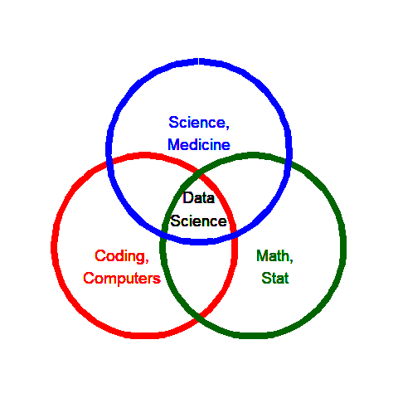
What they say data science is
## Warning: Using `size` aesthetic for lines was deprecated in ggplot2 3.4.0. ## ℹ Please use `linewidth` instead. ## This warning is displayed once every 8 hours. ## Call `lifecycle::last_lifecycle_warnings()` to see where this warning was ## generated.

Slide 37
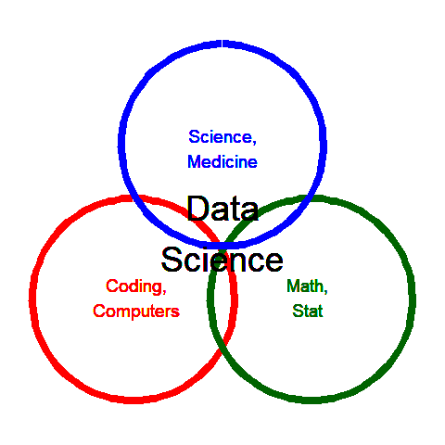
What data science really is

Slide 38
Repeat of quiz questions (1/3)
Why does Joel Best call statistics a social construct?
Statistics are misquoted often on social media.
Statistics are selected, shaped, and presented by human beings.
Statistics are used to promote socialism.
Statistics are dehumanizing.
Notes:
I want to list a few quiz questions relating to this lecture. Remember these questions when I get to the slide that discusses them.

Slide 39
Repeat of quiz questions (2/3)
What is the main philosophical foundation of empiricism?
Everything can be reduced to a mathematical equation.
Experiments can reveal the realities of the world.
Some questions are impossible to answer.
We construct our own reality based on our own lived experiences
Notes:
Here’s the second question.

Slide 40
Repeat of quiz questions (3/3)
What is a major problem with data science?
Data scientists rely on large amounts of data with uneven quality.
Models developed by data scientists can lead to loss of privacy.
Prediction models are a black box that can hide discriminatory intent.
All of the above.
Notes:
Here’s the third question. You don’t need to answer these questions now. Just be ready to answer them after the lecture.

Slide 41
Why you are needed
Too many geeks, not enough scientists
More racial, gender diversity is needed
If you are interested, email me: simons@umkc.edu
You can find my talk here:
https://github.com/pmean/talks/blob/master/dark-side/2022-talk.pptx
Notes:
I’d like to end with an exhortation. We need people like you in data science. It’s okay to spend most of your time learning the complexities of medicine, but some of you have a bit of talent and aptitude in math/stat and in computers/coding. That’s an advantage your generation has that my generation did not. So you have the ability to appreciate the full picture more so than people my age. A few of us knew computers well, but today’s generation is saturated in computational experience.
Second, these research teams need a lot more racial and gender diversity. I try really hard to appreciate the viewpoints of people different than me, bit I can’t understand it at a level of someone who has seen life from a different perspective. If the only people developing these data science models are white males, then the models will continue to be biased against women and minorities.

