Slide 1
Splines, part 02

Slide 2
Splines
Piecewise cubic polynomial
Continuous
Smooth
Transition points = knots
Notes:
A spline is a piecewise cubic polynomial. It converts from one cubic polynomial to a different cubic polynomial at pre-defined transition points known as knots. The individual cubic polynomials are constrained to be continuous and smooth at the knots. Smooth means a continuous first and second derivative. In practical terms, smooth means “no elbows”.

Slide 3
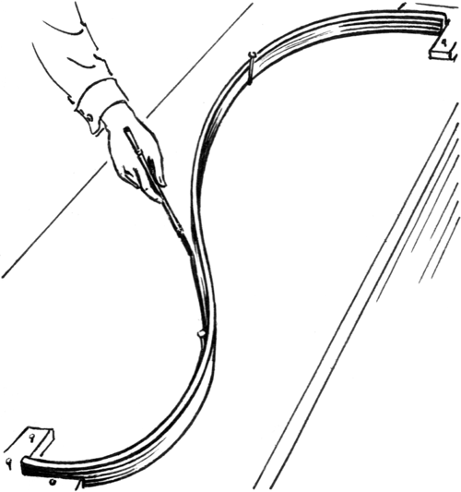
A physical spline
Notes:
Before computers became powerful enough to compute splines, we had several alternatives.
Here is an image from Wikipedia of physical spline. It is a thin strip of wood–thin enough to allow it to bend. It is constrained so that the bend follows a path that covers a few points.

Slide 4
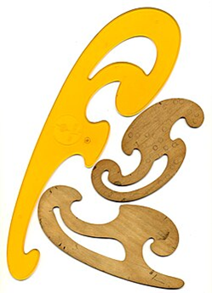
A french curve
Notes:
The french curve was a plastic template that showed a range of curvatures. You would line up the curve to four data points, draw along the french curve between the two interior points and then shift to the right and line up the french curve again. The resulting path looked seamless.

Slide 5
Artificial data, 1
x | y
0 | 39.9
1 | 41.1
2 | 38.7
3 | 40.6
4 | 40.5
5 | 40.4
6 | 38.9
7 | 34.8
8 | 30.5
9 | 27.2
10 | 24.8
Notes:
Suppose you have some data where you suspect the behavior differs for x=1 to 5, x=6 to 10, x=11 to 15, and x=16 to 20.

Slide 6
Artificial data, 2
x | y
11 | 29.7
12 | 34.4
13 | 38.2
14 | 38.7
15 | 45.5
16 | 47.8
17 | 51.3
18 | 47.6
19 | 46.3
20 | 40.1

Slide 7
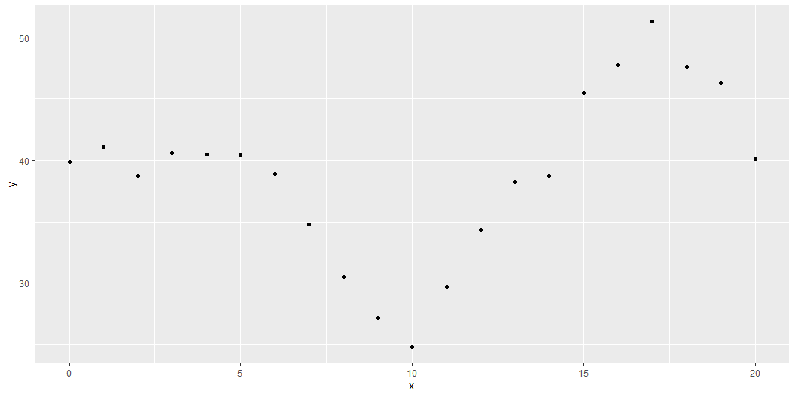
Graph of artificial data

Slide 8
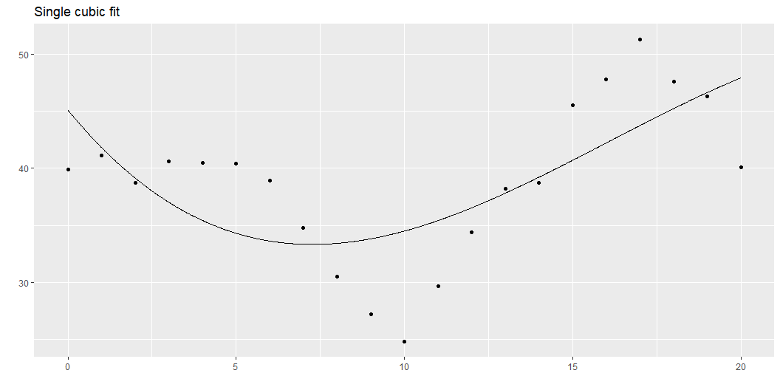
Single cubic polynomial
Notes:
The graph shown here represents the best fitting single cubic polynomial. It doesn’t fit the data very well. The problem is that the data is largely flat from 0 to 5 and then starts wiggling a lot from 5 onward. A cubic polynomial (or any polynomial for that matter) can be mostly flat or very wiggly but it generally can’t be both.
You need a way to transition between a wiggly cubic and a mostly flat cubic.

Slide 9
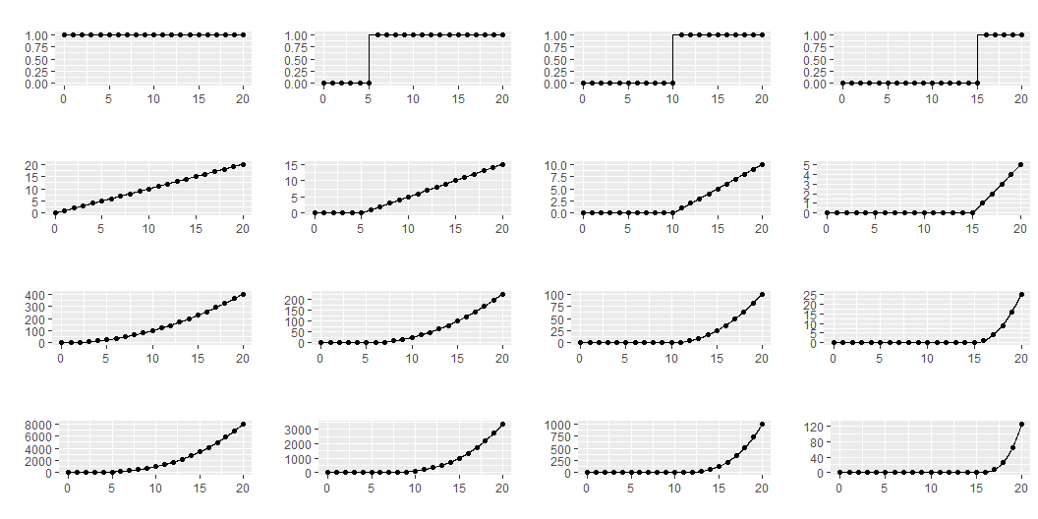
Cubic polynomials with knots at x=5, 10, 15

Slide 10
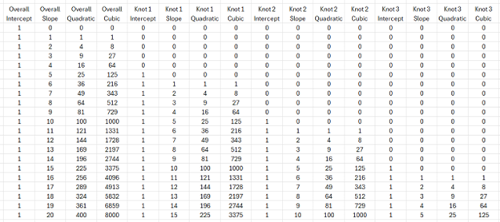
What the numbers look like
Notes:
This is what the raw numbers look like. I apologize for the size of the fonts. I want you to focus just on the patterns shown here.

Slide 11
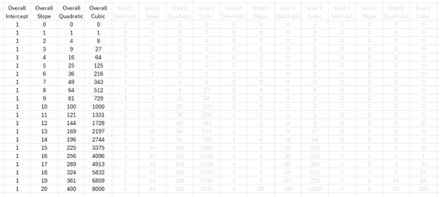
What the numbers look like, overall terms
Notes:
This is what the raw numbers look like. I apologize for the size of the fonts. I want you to focus just on the patterns shown here.

Slide 12
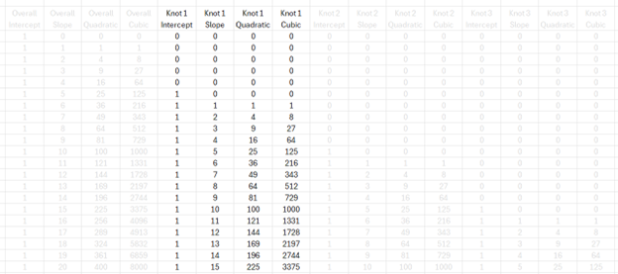
What the numbers look like, knot 1 terms
Notes:
This is what the raw numbers look like. I apologize for the size of the fonts. I want you to focus just on the patterns shown here.

Slide 13
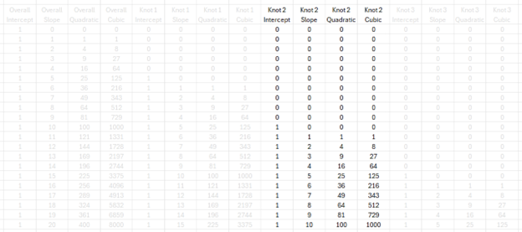
What the numbers look like, knot 2 terms
Notes:
This is what the raw numbers look like. I apologize for the size of the fonts. I want you to focus just on the patterns shown here.

Slide 14
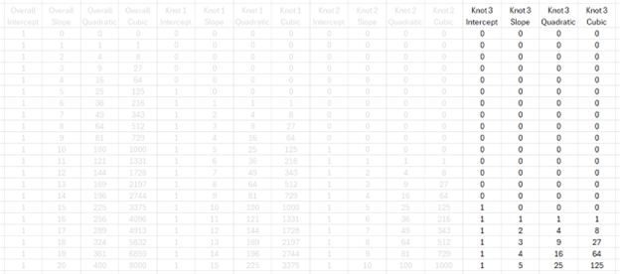
What the numbers look like, knot 3 terms
Notes:
This is what the raw numbers look like. I apologize for the size of the fonts. I want you to focus just on the patterns shown here.

Slide 15
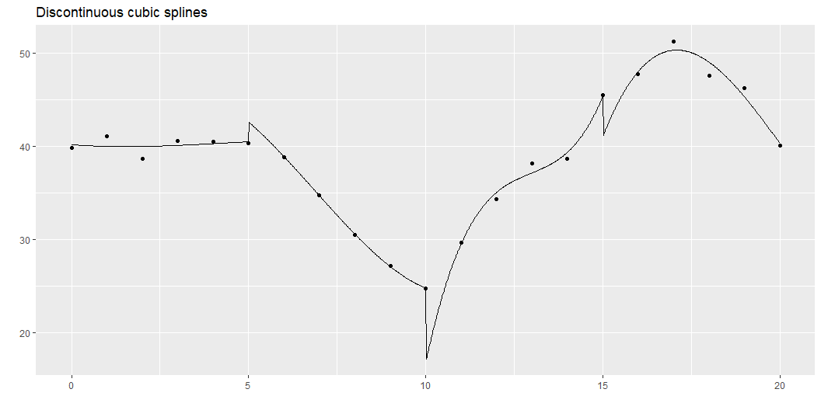
Discontinuous cubic spline
Notes:
So, we could fit a cubic model for the first five data points, for the second five, the third five, and the fourth five. This is a bit much: a cubic model has four parameters, so fitting four of them would use up 16 degrees of freedom in a data set with only 20 observations. But bear with me a bit on this.
The trick to fitting four separate cubic polynomials is to “restart” the intercept, linear, quadratic, and cubic terms after x=5, x=10, and x=15, as shown above. This leads to a model with 16 degrees of freedom. This is way too many degrees of freedom for only 20 data points, but it helps anchor a series of more reasonable models.
This function is not continuous or smooth. To make the function continuous, drop the extra intercept terms.

Slide 16
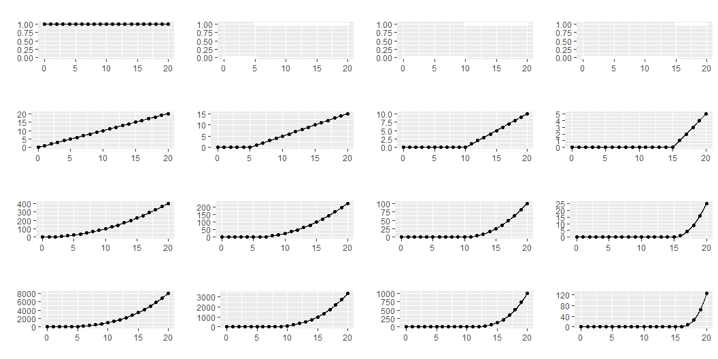
Remove piece-wise intercepts

Slide 17
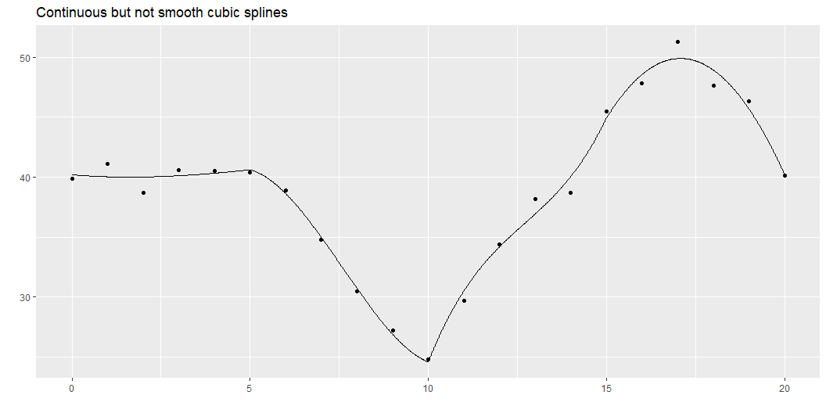
Continuous spline
Notes:
While this graph is continuous, it still takes some abrupt turns. What this curve lacks is smoothness. The mathematical concept of smoothness is measured in terms of the continuity of derivatives.

Slide 18
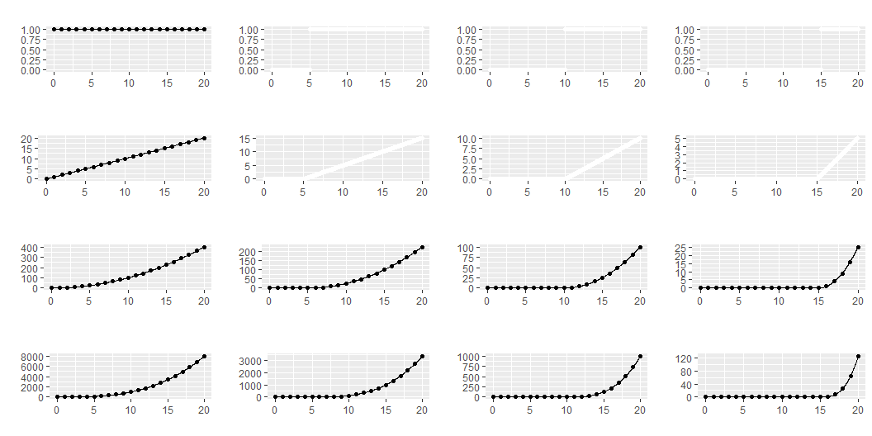
Remove piecewise linear terms

Slide 19
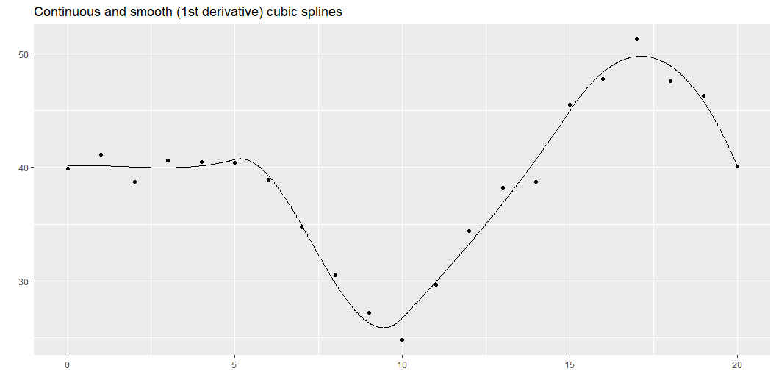
Smooth splines
Notes:
Here is a function that has a continuous first derivative. You fit this model by dropping the extra linear terms beyond the first one. Notice a pattern here. As you place additional restrictions on the spline (continuity, smoothness), you need fewer parameters. The four cubic models with no restrictions used up 16 degrees of freedom. When you added a continuity restriction, you only needed 13 degrees of freedom for the model. Add a smoothness restriction and you only need 10 degrees of freedom.

Slide 20
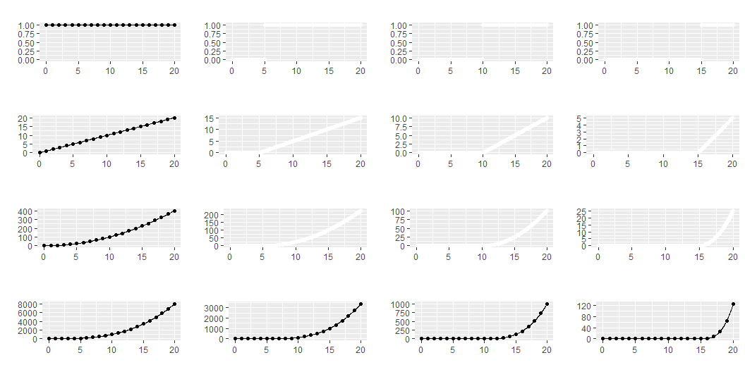
Remove piecewise quadratic terms

Slide 21
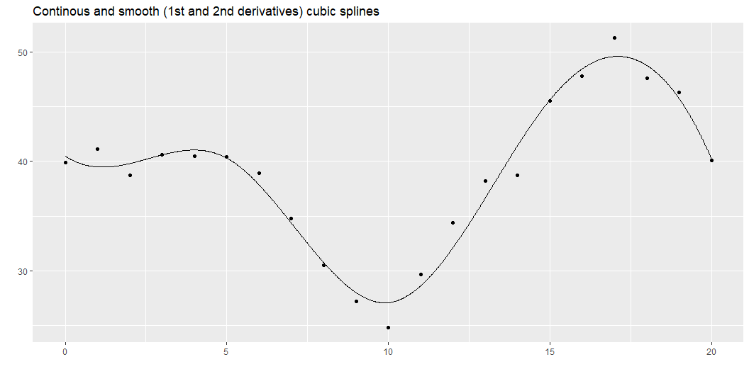
Even smoother
Notes:
Here is a function that has continuous first and second derivatives. This is a greater degree of smoothness than above and it requires only 7 degrees of freedom.
This is what most people refer to when they talk about splines: a piecewise cubic model with continuity and continuous first and second derivatives. It is a fairly simple model (not that many degrees of freedom), but it produces a curve that has the flexibility to fit a variety of curves that have the aesthetically pleasing features of continuity and smoothness.
Continuity and smoothness are more than just aesthetics, though. There are many scientific settings where we expect no jumps (discontinuities) and no abrupt turns (lack of smoothness). If you are measuring the onset of symptoms from a disease, you know that the viruses or bacteria that are causing the disease are increasing in a continuous and smooth pattern. So any problems that they cause should also increase in a continuous and smooth pattern.
Other settings, however, should not necessarily be expected to produce continuous and smooth outcomes. If a particular metabolic pathway becomes saturated or an anotomical barrier is breached, the suddenness transition could result in an abrupt turn or a discontinuity. So do think about the particular context of your problem when deciding what type of spline model to use.
This approach is simple and easy to follow, but there is one catch. There is an issue with multicollinearity.

Slide 22
Multicollinearity
S1 S2 S3 S4 S5 S6 S1 1.00 0.97 0.92 0.98 0.73 0.55 S2 0.97 1.00 0.99 0.99 0.86 0.67 S3 0.92 0.99 1.00 0.96 0.93 0.76 S4 0.98 0.99 0.96 1.00 0.79 0.59 S5 0.73 0.86 0.93 0.79 1.00 0.92 S6 0.55 0.67 0.76 0.59 0.92 1.00
Notes:
The correlations are quite high and this can lead to computational problems, including rounding errors. So most spline models implemented on a computer use a different approach.

