Slide 1
The Dark Side of Data Science
Steve Simon

Slide 2
Quiz questions (1/3)
Why does Joel Best call statistics a social construct?
Statistics are misquoted often on social media.
Statistics are selected, shaped, and presented by human beings.
Statistics are used to promote socialism.
Statistics are dehumanizing.
Notes:
I want to list a few quiz questions relating to this lecture. Remember these questions when I get to the slide that discusses them.

Slide 3
Quiz questions (2/3)
What is the main philosophical foundation of empiricism?
Everything can be reduced to a mathematical equation.
Experiments can reveal the realities of the world.
Some questions are impossible to answer.
We construct our own reality based on our own lived experiences
Notes:
Here’s the second question.

Slide 4
Quiz questions (3/3)
What is a major problem with data science?
Our models rely on data with uneven quality.
Our models can lead to loss of privacy.
Our models are a black box that can hide discriminatory intent.
All of the above.
Notes:
Here’s the third question. You don’t need to answer these questions now. Just be ready to answer them after the lecture.

Slide 5
Some informal definitions
In my talk, I will use the following terms interchangeably
Statistics
Data Science
Machine Learning
Big data
I will NOT talk about
Large language models
Generative AI
Notes:
I tend to use a variety of terms interchangeably, and I will continue to do so in today’s talk. But there are subtle but important differences that are worth remembering.
Statistics, to many people, means using information from a sample to make inferences about a population. The might be a bit narrow, but it does cover a broad swath of what we statisticians do.
Data science is often described as a venn diagram showing the intersection of three groups. The firs is statistics/mathematics. The second is computer science. The third is science and medicine. It tends to emphasize a more holistic attitude than pure statistics.
Machine learning is a class of statistical models where the emphasis is on prediction more so than on inference.
Big data does mean big in gigabyte/terabyte/petabyte sense, but that is just part of it. You will often see big data characterized by three Vs: volume (how much data you have), velocity (how quickly the data streams in at you), and variety (how very different sources of data can be combined).
I will not talk about large language models and generative AI. These models raise a separate set of serious concerns and have a very dark side to them. If Karen invites me back, maybe I can talk about these in a separate webinar.

Slide 6
Why am I giving this talk
Nothing is off limits to us
Never let others define our problems
Never surrender to statistical nihilism
“It is easy to lie with statistics; it is easier to lie without them”
Notes:
I have been practicing statistics since the late 1970s and I have always been aggressive (in a friendly way) with the clients that I work with. If something doesn’t seem to make sense to me from a medical or scientific perspective, I’ll speak up. There’s nothing wrong with challenging the assumptions that our clients make, though we do have to be deferential to them if they make a strong case.
I also believe that ethics is well within our purview. We are often the first line of defense against unethical research. We are not the only line of defense and we may not be the most important line of defense, but if ethical issues arise, they often arise in the initial planning of the study. If we are there, as we should be, during the planning, we need to point out ethical problems during the planning. Perhaps ethical constraints may change how we collect and analyze the data. Best to find out early.
I also think that if we don’t step in to address these problems, someone from the outside will step in and address them for us.
But I also need to fight this idea that statistics are worthless. You can prove anything with statistics, so the saying goes. It is easy to lie with statistics, so the saying goes, but a famous statistician, Frederick Mosteller, adds that it is even easier to lie without them. I do recognize that statistics have their problems but these are not unsolvable problems.

Slide 7
Are Statisticians Gods?
I’m helping someone who wants an alternative statistical analysis to the one used by the principal investigator. I’m happy to help and will offer advice about why my approach may be better, but I was warned that the PI considers the analysis chosen to be ordained by the “Statistical Gods” at her place of work.
Notes:
True story. I was asked to review a report from a federal agency, but was warned that negative comments, even if accurate, might not be well received because the agency’s work was ordained by their Statistic Gods. At first, I thought this was amusing. If I could get the title of “Statistical God”, I could double my hourly consulting rate. But deep down this story really bothered me. It implies that Statistical skills are supernatural, and only available to a select few special people. I learned Statistics through hard work, and you can learn Statistics through hard work also. Some people will learn it faster than others because they have good aptitudes in mathematics and programming. But there is nothing other than time to stop you.

Slide 8
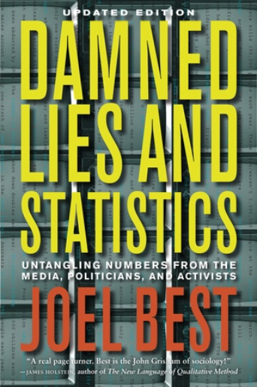
Statistics are a social construct
Figure 3. Cover from Joel Best’s book
Notes:
I’m going to share a message that is controversial, but which I believe deeply in. It’s a message from a book by Joel Best: Lies, Damned Lies, and Statistics. Untangling Numbers from the Media, Politicians, and Activists. He argues that Statistics are a social construct. I need to define social construct here. A social construct is a method by which people create their perception of reality.
That’s certainly true of Statistics. Statistcs are “selected, shaped, and presented by human beings”
Source of quote: Milo Shield, Teaching the Social Construction of Statistics. Available at https://www.researchgate.net/publication/277299441_Teaching_the_Social_Construction_of_Statistics
Image taken from https://www.ucpress.edu/book/9780520274709/damned-lies-and-statistics.

Slide 9
The arrogance of empiricism (1/2)
“I often say that when you can measure what you are speaking about, and express it in numbers, you know something about it; but when you cannot measure it, when you cannot express it in numbers, your knowledge is of a meagre and unsatisfactory kind; it may be the beginning of knowledge, but you have scarcely in your thoughts advanced to the state of Science, whatever the matter may be.” Lord Kelvin.
Notes:
The idea that Statistics are a social construction flies in the face of empiricism, the philosophy that experiments can reveal the realities of the world. A closely related philosophy is positivism.
Here is a quote in support of empiricism. I won’t read all of the first quote, but notice the sneering phrase that without numbers, “your knowledge is of a meagre and unsatisfactory kind.”

Slide 10
The arrogance of empiricism (2/2)
“No human investigation can be called real science if it cannot be demonstrated mathematically.” Leonardo da Vinci
Notes:
Here is a second quote that is just as bad. Science without numbers (math) is not real.

Slide 11
Why empiricism fails (1/3)
“The government is very keen on amassing statistics. They collect them, add them, raise them to the nth power, take the cube root and prepare wonderful diagrams. But you must never forget that every one of these figures comes in the first instance from the village watchman, who just puts down what he damn well pleases.” Sir Josiah Stamp
Notes:
This quote from Josiah Stamp illustrates why Statistics are a social construct. It doesn’t matter how fancy we dress up the numbers, nth powers, cube roots. It all comes down to the village watchman who does what he damn well pleases.
The village watchman is part of the social constuction of Statistics. So are the government officials who do all sorts of mathematical manpulations which provide an impression of objectivity.

Slide 12
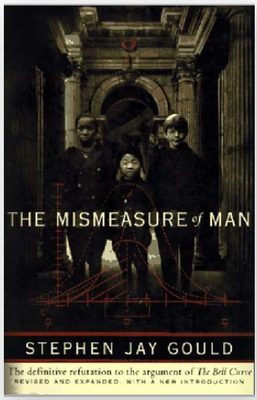
Why empricism fails (2/3)
Figure 4. Cover of Stephen Jay Gould’s book
Notes:
There’s a great book by Stephen Jay Gould that really makes you think hard about numbers. The book, The Mismeasure of Man, talks about IQ testing from a historical perspective and totally destroys the idea that intelligence is a trair that can be easily quantified. He starts with efforts in the 1800s to use the size of a person’s skull as a measure of their intelligence. A big skull means a big brain that lives inside there and bigger brains are smarter brains.

Slide 13
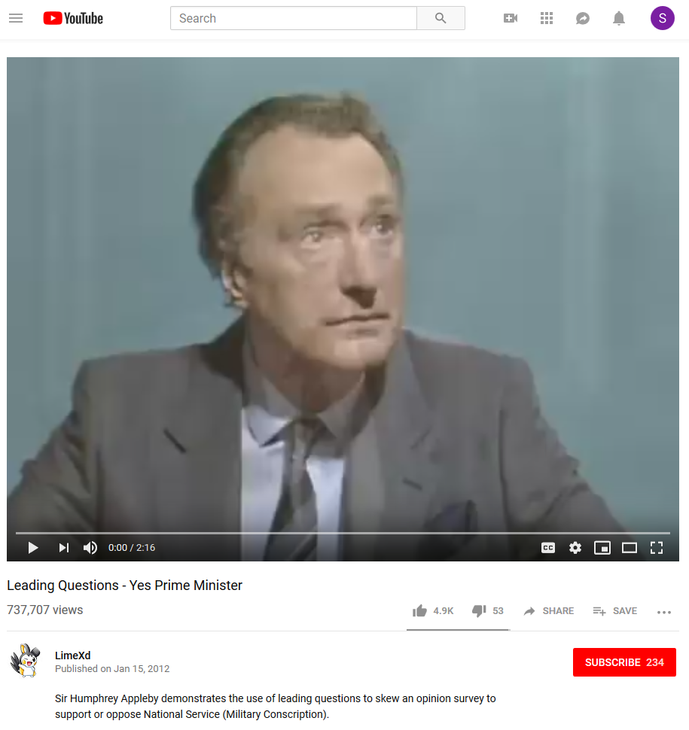
Why empricism fails (3/3)
Figure 6. Frame from Yes, Prime Minister video clip
Notes:
This short video clip is an excellent illustration of how the questions leading up to a particular question on a survey can bias the response to that survey. It comes from a British comedy, Yes Prime Minister, that ran in the 1980s.
YouTube. Leading Questions- Yes Prime Minister. Taken from the 1st Season of Yes Prime Minister – Episode 2, The Ministerial Broadcast. 2:16 running time. Published on Jan 15, 2012.
https://www.youtube.com/watch?v=G0ZZJXw4MTA

Slide 14
But statistics still have value.
Post-positivist perspective
There is an objective reality
Empirical research can get us close to that reality
But, you have to recognize biases
I’m attacking empiricism but not attacking statistics
Notes:
While it is dangerous to fall deeply into any philosophical camp, I tend to like the perspective that is known as post-positivism. Post-positivism rejects the notion of empiricism. But it does accept the concept of an objective reality. You cannot attain that objective reality, but you can get close. You need to use both hard statistics and qualitative research. You also need to recognize biases and unstated assumptions that all of us have.
It’s important to remember that replacing an empirical approach with a post-positivist approach is not a wholesale abandonment of statistics. It’s easy to fall into a cynical trap. We are saying that the people collecting the data influence what is collected and how. What we are not saying is that these influences make an effort at data analysis worthless.
One example of how we can use statistics to get at a social construct is the development of measures of quality of life.

Slide 15
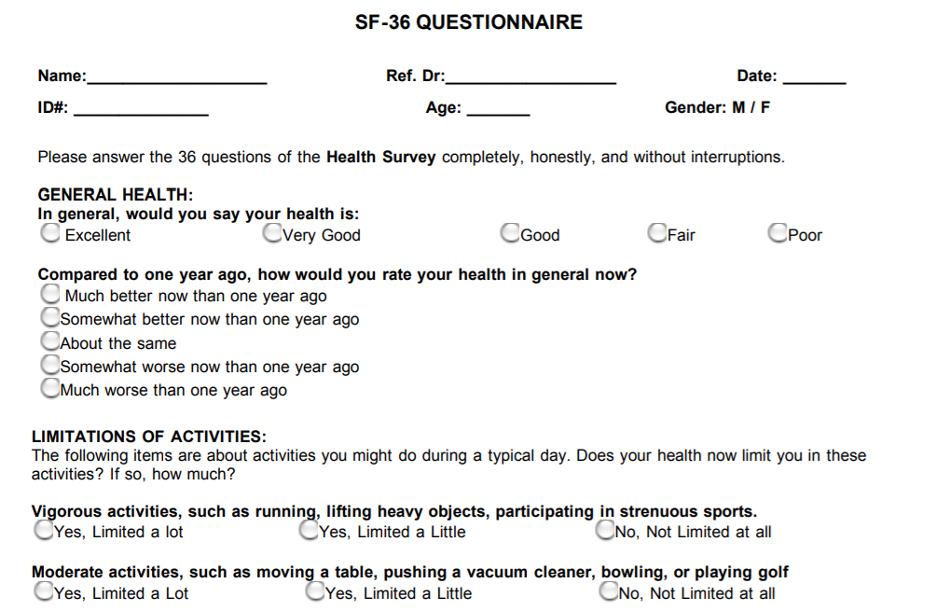
But statistics still have value. Example: Quality of Life
Figure 7. First few questions from SF-36 form
Notes:
Recognizing that Statistics are a social construction does not mean that Statistics are worthless and that experiments are a waste of time. The best example I can give for this is the measure of quality of life.
Quality of Life is a measure that is reported in many research studies. There is no question that quality of life is a social construction. It is measured by forms like the SF-36 shown here. But it is not an objective reality but something that was constructed by humans.
Now I mentioned earlier that I like to run. It is a pretty strenuous activity, but one that I enjoy. A friend of mine said, though, that she couldn’t understand why you would want to run, unless you were being chased.
Linda Rondstadt retired from singing at the age of 65 because of a condition, progressive supranuclear palsy, that left her unable to sing. The is a huge loss of quality of life for her. If I lost the ability to sing, it would not be a major loss and my wife might actually view the absence of my singing as a benefit.
So there is no objective measure of quality of life. It depends on the values of the people who are developing forms like the SF-36.
Problems occur when these social constructs are developed by research teams with limited diversity (they may have blind spots) or if the social constructs are not evaluated in diverse populations.
But we can still use social constructs like quality of life, as long as we do it carefully.
In fact, we should use these measures because they get at information which is important, and which cannot be measured by a laboratory.
There’s a lot of uncertainty about treatments for cancer, for example, which can sometimes extend a person’s lifetime, but can also substantially interfere with their ability to do things that they feel are important. You can’t discuss this trade-off without first measuring the deterioration of quality of life associated with some of these aggressive therapies.
Image obtained from
https://clinmedjournals.org/articles/jmdt/jmdt-2-023-figure-1.pdf

Slide 16
Rules for using Statistics as social constructs
Understand the context in which the Statistic was generated.
Identify possible biases
Recognize limitations
Beware of confirmation bias
Avoid nihilistic thinking
Notes:
Once you recognize that Statistics are a social construct, you can take steps to make sure that these statistics are used properly. You need to think about the process the generates the statistics. Is there a “night watchman” who puts down whatever he pleases?
Just as an example, I do a lot of work with electronic health records. The health care professionals who populate the data in a system like Cerner or Epic are not doing this because they want to make sure that I have something interesting to publish. They have two objectives. First, they want to make sure that the information they put in is helpful to other members of the health care team. Second, they want to make sure they get the maximum possible billing from the insurance companies. Third, they want to wrap this up quickly so they can get home to their families.
Second, identify possible biases. This is not bias in the mathematical definition (is the expected value of a statistic much alrger than the parameter it is trying to estimate. Instead, bias here is a more generic term indicating biases exist in how the data was collected.
An example of this type of bias might exist inthe electronic health record. Physicians are often exhorted to bill at the maximum possible rate as long as that rate does not consistute fraud. Does this pressure skew the data in ways that might reflect badly on your research? It’s a question that none of us considers carefully enough.
Third, recognize limitations. Am I, as a researcher, asking for information that is not important for documenting the care a patient receives to other members of the treatment team?
Fourth, beware of confirmation bias. Confirmation bias is the tendency to look harder for information that reinforces our preconceived notions, or to overlook or downweight information that contradicts our view of the world.
Fifth, avoid nihilistic thinking. Once you recognize that Statistics are a social construct, you have to work harder, but it is not an impossible task. Our tendency to treat Statistics as hard and objective has led us astray at times, but we’ve still made a lot of progress in science and medicine, thanks to Statistics.

Slide 17
Things have gotten worse, thanks to big data
Large amounts of data of uneven quality
Black box models
Lack of accountability
Scaling problems
Loss of privacy
Notes:
Now everything I’ve mentioned so far is a problem in Statistics that has been around since before I was born. But we are in a new era, the era of big data. We have data today at a size and a level of detail that was unavailable twenty years ago. This is thanks to the internet, the human genome project, and many other things.
I’m glad we have all these data, because it increases the opportunities for learning. But at the same time, the flaws of empiricism have gotten worse.
Part of the problem is that the massive data sets that we use today have a great unevenness of quality. it is not too hard to identify obvious typos in a data set with a few hundred observations, but you would never been able to spot them in a data set with a few million observations.
Second, big data requires more complex data analysis methods and these methods are often difficult to understand. Not just from a how do these new methods work, but also in what aspects of the data are emphasized and what aspects of the data are ignored. A small model that has ten inputs is easily taken apart and examined, but you can’t do that with a model that has ten thousand inputs.
Third, there is a lack of accountability. These complex models are rarely audited, for example, to look for hidden biases.
Fourth, big data provides an opportunity to produce answers not just for a small number of people, but for thousands or millions of them all at once. If the big data model is flawed, the flaws are multiplied across the large number of people who are affected by the big data model.
Fifth, there is so much data out there that you can often infer quite intimate and private details about individuals, often without them being aware of this.

Slide 18
Case studies
Address the following questions
Who is the villain?
Who is the victim?
How was the victim harmed?
What could have prevented this?
Did anything surprise you?
Is there a single quote from the article that summarizes it well?
Notes:
In a previous version of this talk, I tried some small group exercises where the audience would read some case studies and comment on them. For a variety of reasons it did not work and it would be even harder to try it in this Zoom session. So I will just review two case studies: one on privacy and one on discrimination. Here are the questions I want to address.

Slide 19
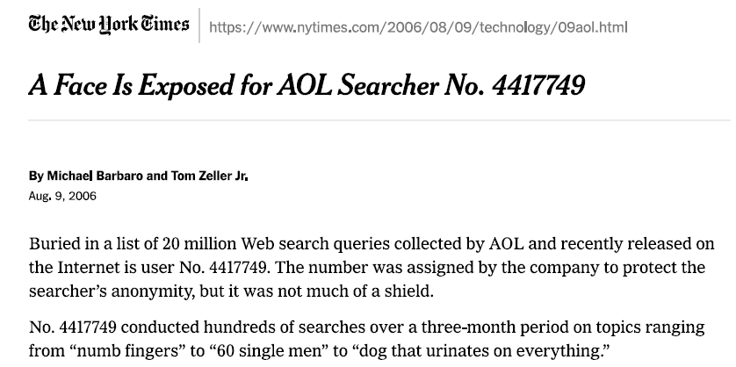
A Face Is Exposed for AOL Searcher No. 4417749
Figure 10. First page of newspaper article
Notes:
This paper is available on my github site. It is probably a violation of copyright, so don’t you compound my sin by sharing it widely beyond this webinar.
Michael Barbaro and Tom Zeller Jr. A Face Is Exposed for AOL Searcher No. 4417749. The New York Times, 2006-08-09. If you have a subscription, it is available at the New York Times website,
https://www.nytimes.com/2006/08/09/technology/09aol.html.
You can also find a PDF printout of this article at
https://github.com/pmean/talks/blob/master/dark-side/doc/barbaro-aol-searcher-2006-08-09.pdf

Slide 20
Background
AOL search engine
Predated Google
Stored search queries in database
Made database available to researchers
Only after changing user names to numbers
Notes:
Before Google, there was search engines through providers like America Online. And America Online had a massive database of search queries of its users, with thousands of individuals users a total of over 20 million queries. It created a database from these queries, changed the user names to anonymous numbers and put it out on the web. Go at it, all you amateur researchers and see if you can find some interesting trends and patterns in all the search queries.

Slide 21
An example
User 4417749
“numb fingers”
“60 single men”
“dog that urinates on everything”
Quickly identified as Thelma Arnold
Queries that indicated where she lived
Queries that asked about close relatives
Many other users just as easily identified
Notes:
As an example, a user listed only by a number, 4417749, made queries about numb fingers, single men, and dogs that misbehaved. With a little bit of detective work, the reporter for the New York Times identified that this person was Thelma Arnold of Lilburn Georgia. This was done by queries that asked for landscapers in Lilburn, GA, for home sales in her subdivision, and for various close relatives. The reporter contacted Ms. Arnold who was did verify that she made the queries listed for user 4417749. She was quite surprised to here about this, but did agree to be interviewed.
Many other users were just as easily identified. Some did what I have done, and put their own names into a search engine. This is called ego surfing, and for the record, there is a Steve Simon who was Minnesota’s 22nd Secretary of State, a Steve Simon who researches condensed matter theory at the University of Oxford, and a Steve Simon who manages real estate banking services for Transwestern in Dallas, Texas.

Slide 22
What about you?
Answer the following questions (yes/no only please)
Have you searched for your own names?
Have do done other searches that might identify yourself?
Have you searched for something that you would not want others to know about?
Most search engines store your searches.
Do they sell this information to outsiders?
Can your search history be hacked?
Notes:
So what about you? Have you ever ego-surfed (checked for your own name)? Have you done other searches that might identify you? Have you searched for something that you might be embarrassed if it was revealed to others? Answer yes/no in the chat box. Type yes/yes/yes if your answer to all three questions is yes, but don’t tell me about the embarrassing search you made for Mailbu Stacy doll collections. If your answers to all three questions are no/no/no, let me know that also, but I suspect no one listening today will say “no” to all three questions.
Now most search engines will store your searches. Do they sell your search information to outsiders? Well that is an open question. Can someone hack your search history? Again that is an open question.

Slide 23
Who was the villain?
America Online
Clumsy and inadequate attempt at anonymization
Did try to fix things
Withdrew data, but too late
But we do this to ourselves
Thoughtlessly sacrifice our privacy
Notes:
The villain here is America Online. Hey, I love research about as much as anyone, and if I had known about the 20 million queries that America Online released, I probably would have been doing all sorts of word frequency analyses. But just changing a person’s name to a number was clumsy and inadequate.
To their credit, America Online did pull back the databases once it realized the problem, but the database had already been copied to dozens of other locations.
But we ourselves are not blameless. We don’t read the privacy policies of Google or Bing. We join loyalty programs that track all of our purchases. In general, we thoughtlessly sacrifice our privacy.

Slide 24
Who is the victim?
User 4417749 aka Thelma Arnold
Many other users
We ourselves might be current or future victims
Charles Duhigg. How Companies Learn Your Secrets. The New York Times, 2012-02-16.
Marshall Allen. Health Insurers Are Vacuuming Up Details About You — And It Could Raise Your Rates. Propublica, 2018-07-18.
Tracy Samilton. Being A Loyal Auto Insurance Customer Can Cost You. NPR, 2015-05-08.
Notes:
The New York Times article is available, if you have a subscription, at
https://www.nytimes.com/2012/02/19/magazine/shopping-habits.html
and you can also find it at my github site
https://github.com/pmean/talks/blob/master/dark-side/doc/duhigg-target-2012-02-16.pdf
The ProPublica artice is available without subscription at
https://www.propublica.org/article/health-insurers-are-vacuuming-up-details-about-you-and-it-could-raise-your-rates
as is the NPR article
Tracy Samilton. Being A Loyal Auto Insurance Customer Can Cost You. NPR, 2015-05-08
The victim was Thelma Arnold and many other users of America Online. But we ourselves might be current or future victims. The New York Times discussed a statistical model developed by Target using purchasing information in their databases to send targetted advertising. Here’s a quote from that article.
“My daughter got this in the mail!” he said. “She’s still in high school, and you’re sending her coupons for baby clothes and cribs? Are you trying to encourage her to get pregnant?”
The manager didn’t have any idea what the man was talking about. He looked at the mailer. Sure enough, it was addressed to the man’s daughter and contained advertisements for maternity clothing, nursery furniture and pictures of smiling infants. The manager apologized and then called a few days later to apologize again.
On the phone, though, the father was somewhat abashed. “I had a talk with my daughter,” he said. “It turns out there’s been some activities in my house I haven’t been completely aware of. She’s due in August. I owe you an apology.”
So data scientists can figure out that a 16 year old is pregnant before her father can. Target is very interested in pregnancy, because it opens up a lot of new purchases that they would like to see flow into their store. Hence the targetted coupons.
There is also a lot of discussion about how insurance companies are using data to identify good and bad prospects for insurance.
The LexisNexis booth was emblazoned with the slogan “Data. Insight. Action.” The company said it uses 442 non-medical personal attributes to predict a person’s medical costs. Its cache includes more than 78 billion records from more than 10,000 public and proprietary sources, including people’s cellphone numbers, criminal records, bankruptcies, property records, neighborhood safety and more. The information is used to predict patients’ health risks and costs in eight areas, including how often they are likely to visit emergency rooms, their total cost, their pharmacy costs, their motivation to stay healthy and their stress levels.
…and later in the same article…
Kaufman said she had concerns about the accuracy of drawing inferences about an individual’s health from an analysis of a group of people with similar traits. Health scores generated from arrest records, home ownership and similar material may be wrong, she said.
Pam Dixon, executive director of the World Privacy Forum, a nonprofit that advocates for privacy in the digital age, shares Kaufman’s concerns. She points to a study by the analytics company SAS, which worked in 2012 with an unnamed major health insurance company to predict a person’s health care costs using 1,500 data elements, including the investments and types of cars people owned.
The SAS study said higher health care costs could be predicted by looking at things like ethnicity, watching TV and mail order purchases.
Another article from NPR talks about the possibility of using information about price insensitivity. THere is data out there that can identify you as someone who quickly looks around if the price of your insurance changes or someone who would not be bothered to look for a better price. If you are the latter group, insurance companies have been alleged to increase your prices, capitalizing on the belief that they can do this without losing you as a customer.

Slide 25
How was the victim harmed?
Thelma Arnold did a lot of health care queries
hand tremors
nicotine effects on the body
dry mouth
bipolar
Not her health care
Inquiries for friends
Notes:
Thelma Arnold did a lot of queries about health care and she might have been mistakenly labeled as having all of those conditions herself. Actually, she had a habit of doing searches when friends and family mentioned health care issues so she could provide some reassuring information.

Slide 26
What could have prevented this
For those who might share data
Careful filtering of additional details
Be careful of small subgroups
Think about combinations
Add small random perturbations
Get a signed agreement prior to data release
For you if you want to control what is shared
Pick your software carefully
Refuse cookies
Read the privacy statements
Notes:
While the obvious answer, don’t release sensitive information pops into mind, there are good reasons why we need to sometimes do this. During the COVID crisis, medical professionals had to share lots of data and they did it with great care. I’m glad that this type of data is being made available.
When you do share do this, there are several steps that you can take. Look for anything other than just the person’s name that might be revelatory. This might take a lot of time, but it has to be done.
If you are presenting aggregate statistics about subgroups, watch out for very small subgroups. A group of size 5 or less could end up revealing information not about the group as a whole, but about individuals within that group.
Think about combinations. A five digit zip code might easily include tens of thousands of people. But if you combine a person’s zip code with their birthdate, you could more often than not, reduce this from tens of thousands down to a single individual.
In a lot of sensitive datasets, the researchers will include small random perturbations to help mask information. If a date for a medical procedure might be revelatory, you can randomly shift this data by 7 days or by 30 days. Do this carefully with all the dates for a single patient and you can still identify the hospital length of stay and the time until a patient is rehospitalized.
You may find that obtaining sensitive data requires you to sign a statement saying that you promise to only use the data in various statistical models and that you will not to try to identify any individuals from the data itself.
If some of this scares you as an average person, there are steps that you can take that can help, at least to some extent. First, be careful about what software you put on your computer. Some software can run roughshod over your privacy expectations. This is especially true for software that you might be directed to by ads on the internet.
Cookies do make your life easier, especially for websites that you visit on a regular basis. But they also allow for tracking across sites that you may not want. Finally, no one does this, but do try to read the privacy policies for the software that you use and the websites that you visit. Often you have options about saying how your data could be used.
To be honest, the horse is already out of the barn on the privacy issue. There is too much out there about you already and it is being used to your possible detriment.

Slide 27
Did anything surprise you?
How many ways we can lose privacy
Ego-surfing
Asking about friends and relatives
Location specific queries
Notes:
I was suprised at how self-revelatory our searches can be. We leave lots of hints about ourselves when we search. We search about ourselves, about our friends and relatives, and about where we live.

Slide 28
Is there a single quote from the article that summarizes it well?
Ms. Arnold says she loves online research, but the disclosure of her searches has left her disillusioned. In response, she plans to drop her AOL subscription. “We all have a right to privacy,” she said. “Nobody should have found this all out.”
Notes:
We have to be thankful to Thelma Arnold for agreeing to a further disclosure of privacy by agreeing to the interview with the New Yor Times. Apparently, she was willing to be placed out in the spotlight again because she wanted others to know about this. There is a nice quote from her at the end of this article.

Slide 29
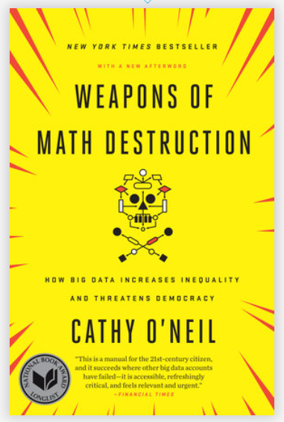
Weapons of Math Destruction
Figure 9. Cover of Cathy O’Neill’s book
Notes:
This is a great book with lots of interesting examples, but I want to discuss one example in detail and answer the questions about it. It comes from chapter 1 of the book, Weapons of Math Destruction, by Cathy O’Neil.
There is no source online for Chapter 1 of this book, but some closely related articles can be found at
https://www.propublica.org/article/machine-bias-risk-assessments-in-criminal-sentencing
and
https://www.atlantis-press.com/proceedings/sdmc-21/125968551

Slide 30
First villain, not a statistical villain
Walter Quijano
Provided testimony on recidivism rates at seven trials
Unfairly included race in his calculations and testimony
Six of seven convictions later overturned
Notes:
The big data example in O’Neil’s book starts with the story of a person, Walter Quijano, who provided testimony in seven trials about the risk of recidivism. Recidivism is the unfortunate event where someone who has been released from prison commits a new crime and gets tossed back in jail. Mr. Quijano gave overtly biased recommendations at these trials that incorporated race into his assessment of recidivism. This was noted in the appeals of one of the defendants, and led to six of the seven convictions being overturned.

Slide 31
Second villain, a statistical villain
LSI-R questionnaire
Given to thousands of inmates
Classifies risk of recidivism
Does not explicitly ask about race
But does have “leading” questions
Notes:
It contrasts this individual with a big data prediction model based on the LSI-R questionnaire. LSI-R stands for Level of Service Inventory-Revised that asks a bunch of questions like “How many prior convictions have you had?” This questionnaire weights the responses to various questions to provide an estimate of the risk of recidivism. Although the questionnaire does not explicitly ask about race, it can still indirectly identify a person’s race by their pattern of responses to a series of leading questions.

Slide 32
Victims
Inmates at parole hearings
Defendants at trial sentencing
Notes:
This questionnaire was used at a large number of parole hearings in multiple states and at sentencing hearings in a few states as well.

Slide 33
How were the victims harmed
Disproportionate recidivism risks by race
Fewer paroles grants
Longer sentences
No avenue to appeal
Model presumed to be unbiased
Complexity prevents examination of bias
Scale issues
Walter Quijano harmed 7 defendants
LSI-R harmed thousands of defendants.
Notes:
The model was shown to grossly overstate the recidivism risk of black defendants. This led to fewer grants of parole to black prisoners and longer prison sentences for newly convicted black defendants.
There was no avenue of appeal for those harmed by the LSI-R. You can’t cross-examine an algorithm at trial, and the company that developed the LSI-R model did not want to disclose details about how the model worked. It was a trade secret and revealing its details would allow other companies to steal their technology. To be honest, the model itself was so complex that the company would have been unable to reveal its inner workings, even if it wanted to.
The other important is issue is the scale of the harm. A biased witness could only influence a handful of defendants. Walter Quijano had only enough time and energy to taint the sentencing of seven defendants. The LSI-R algorithm, however, was applied to many people. , but the impact of the LSI-R questionnaire ended up influencing thousands.
That’s a hallmark of big data models. They are expensive to build and very labor intensive, but once they are built, it costs almost nothing to deploy it broadly.

Slide 34
What could have prevented this
Insist on transparency
Test the model for bias
Build the model with better objective
Notes:
A human witness like Walter Quijano can be cross-examined, but can you cross-examine a statistical model? Maybe not, but any model that makes important decisions in a court of law needs to provide information that a defendant can cite if they believe that the model is wrong. The companies that produce models like LSI-R have insisted on keeping the details of their models secret to avoid disclosing their innner workings to potential competitors. That is a legitimate concern, but there are ways to allow disclosure to a defense lawyer without compromising trade secrets.
You can also feed the model test cases and see how they perform. There is plenty of data from previous defendants. Look to see if released prisoners who are black and who commit no further crimes score worse on the model than released prisoners who are white and who do commit additional crimes.
Also, these models are built to satisfy a single objective: minimize the overall classification error rate. But these models need to satisfy additional objectives associated with fairness. I’ll talk more about this later.

Slide 35
Did anything surprise you?
Questionnaire includes questions that would be inadmissable if they were asked during a normal trial
When was the first time you were ever involved with the police?
Do any of your friends or relatives have a criminal record?
Notes:
I read about this a couple of years ago, but I think the thing that surprised me was the number of questions on the LSI-R that would not have been allowed in an open trial, because the questions would have been ruled as prejudicial.
But apparently, you can ask prejudicial questions outside of a courtroom in a questionnaire and then use that information to create a recidivism risk score.

Slide 36
Is there are single quote that summarizes the article well
“The questionnaire includes circumstances of a criminal’s birth and upbringing, including his or her family, neighborhood, and friends. These details should not be relevant to a criminal case or to the sentencing.”

Slide 37
Myths about big data
Algorithms are objective
If you have enough data, quality is no longer an issue
We are getting better at this
Notes:
If there are any big lessons from this, they are that you should be skeptical about big data. Algorithms are not objective. They are a social construct. Also, don’t believe that bigger datasets are always better. A lot of data does not compensate for poor quality. Finally, while I am a big believer in progress, I think that too many of us are making mistakes and those mistakes are a lot worse when the data is big.

Slide 38
No single cause of these problems
Wrong data
Wrong objective
Wrong deployment
Wrong team
Notes:
There is no single cause for these problems. They are built into the system and it takes a lot of effort to work these biases out of the system.

Slide 39
A hypothetical classification problem
Hypothetical scenario
1,000 patients
90 misclassified, 9% overall error rate
50 false positives, 5% overall false positive rate
Notes:
Here is a hypothetical model that shows a pretty good result. You have one thousand patients and 900 are classified correctly. Of the 100 that are misclassified, 40 are false positives and 60 are false negatives.
The overall error rate is 10%. The false positive rate is 5%. So the model makes very few errors, about half of them false positives.

Slide 40
Details for the racial categories
Errors by race
200 black, 50 misclassified, 25% overall error rate
800 white, 40 misclassified, 5% overall error rate
False positives by race
200 black, 34 false positives, 17% false error rate
800 white, 16 false positives, 2% false error rate
Notes:
When you look at the distribution of errors by race, something disturbing emerges. Among the 200 blacks, 50 are misclassified for an overall error rate of 25%. Among the 800 whites, 50 are misclassified, but this represents only a 5% overall error rate.
So model that looks great when examining all one thousand patients does poorly for the minority group.
If you look at the false positive rate, it is even worse. For a model like recidivism, a false positive represents an unfair and unfounded accusation. That occurs in 17% of the blacks, and only 2% in the whites.
Now this is just hypothetical, but you can see that a modle that makes only a moderate amount of mistakes could end up concentrating a disproportionate number of those mistakes in a minority group.
There are lots of examples where the overall false positive rate is at an acceptable level but the false positive rate in a minority group is outrageously bad.

Slide 41
Solutions
Demand diversity
Rethink your minimization criteria
Share your code
Audit your work
Notes:
Part of the problems associated with these data science models is that they are developed in teams with limited diversity. Now I don’t mean to attack anyone, including myself. I try very hard to look at things from a different perspective. But I do have blind spots. So do the members of the minorities who are underrepresented on these programming teams. But the blind spots will be different and the collective number of blind spots will be much smaller.
While diversity could represent women and it could represent minorities, there are others to consider. A company that builds models to predict recidivism should have a few ex-cons on the programming team.
Rethink your minimization criteria. Principles like least squares are great when you want to try to fit most of the observations well, but it can often do poorly for minorities. The penalty for poor predictions in the minority group is sometimes so small that the model just forgets about the minorities altogehter.
Instead of using just one overall criteria like least squares, you should use that criteria along with other fairness criteria. Live with a little worse fit overall if you can get a reasonable fit to the data in every group including minorities.
Also, make a practice, if you can, of sharing your code. Let other people inspect it and comment on it. This helps makes some of the black box models in data science a little bit more open.
Finally, conduct audits of your work. Look for evidence that your model has no hidden discriminatory intent.

Slide 42
Repeat of quiz questions (1/3)
Why does Joel Best call statistics a social construct?
Statistics are misquoted often on social media.
Statistics are selected, shaped, and presented by human beings.
Statistics are used to promote socialism.
Statistics are dehumanizing.
Notes:
Here’s the first question again. Statistics area a social construct because they are selected, shaped, and presented by human beings.

Slide 43
Repeat of quiz questions (2/3)
What is the main philosophical foundation of empiricism?
Everything can be reduced to a mathematical equation.
Experiments can reveal the realities of the world.
Some questions are impossible to answer.
We construct our own reality based on our own lived experiences
Notes:
Here’s the second question. Empiricism is the belief that experiments can reveal the realities of the world. This is a false belief because the statistics that underlie all experiments are a social construct. Experiments are still useful, but you must understand the context in which they are designed and analyzed.

Slide 44
Repeat of quiz questions (3/3)
What is a major problem with data science?
Data scientists rely on large amounts of data with uneven quality.
Models developed by data scientists can lead to loss of privacy.
Prediction models are a black box that can hide discriminatory intent.
All of the above.
Notes:
Here’s the third question. All of these statements represent major problems with data science.

