Slide 1
Exact and randomization tests
Steve Simon

Slide 2
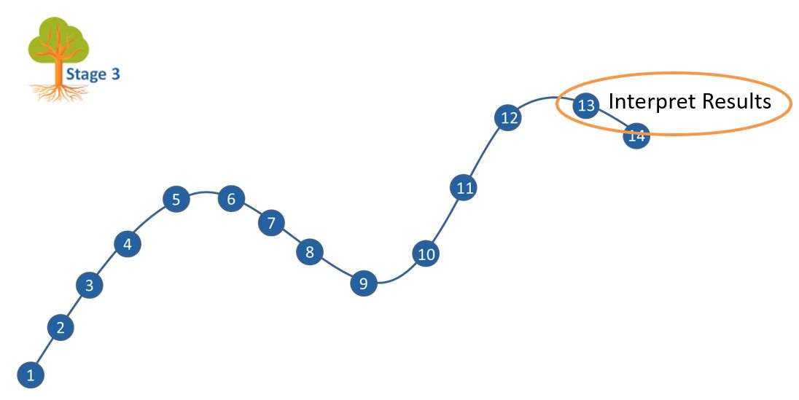
Where this fits
Notes:
Most of you should be familiar with the components and stages that The Analysis Factor uses to classify their talks. This talk is in Stage 3, Extensions of Linear Models. It covers a pretty broad swath, but might be considered as interpreting results. Perhaps validating results might be a second component.

Slide 3
Goal
For you to have a good understanding of:
what randomization and exact tests are,
when it is appropriate to use them,
the steps to implement them.
The goal is not to cover every possible application of the randomization and exact tests.
Notes:
I want to start with an appreciation of when you might consider using exact or randomization tests. These tests are very general, and I will try to show a variety of applications. If you want to implement these tests yourself, it is not too difficult for simpler hypotheses. For more complex hypotheses, you need some basic programming skills. It is not too difficult, if you know how to use loops inside SAS, R, or Stata.
It’s not possible to cover every possible application of exact and randomization tests today. I hope just to get you a bit more comfortable with the methodology in general.

Slide 4
What you’ll learn today
Historical origins
Fisher’s Exact Test
Other exact tests
Ranomization tests
Three specific randomization tests
Programming requirements
When should you use these tests
Notes:
First, I will provide a historical overview, with an example derived in 1931, when Statistics was still in its infancy.

Slide 5
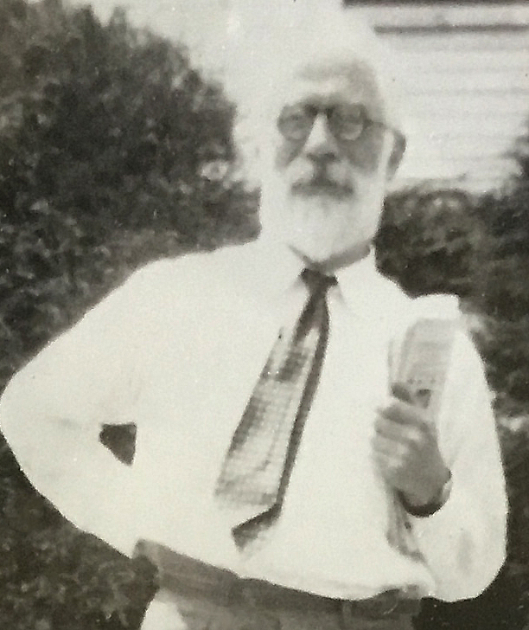
1. Historical origins
Figure 1. Ronald A. Fisher
Notes:
Let’s start with a historical overview.

Slide 6
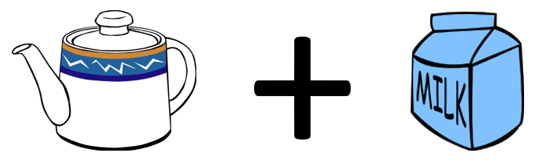
The lady tasting tea
Figure 2. Tea with milk added

Slide 7
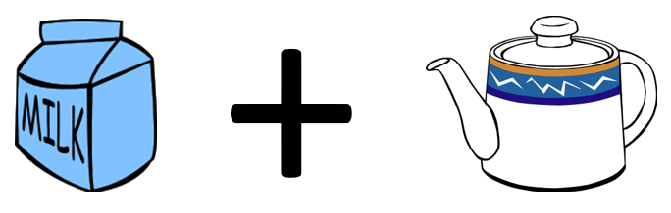
If you change the order?
Figure 3. Milk with tea added

Slide 8
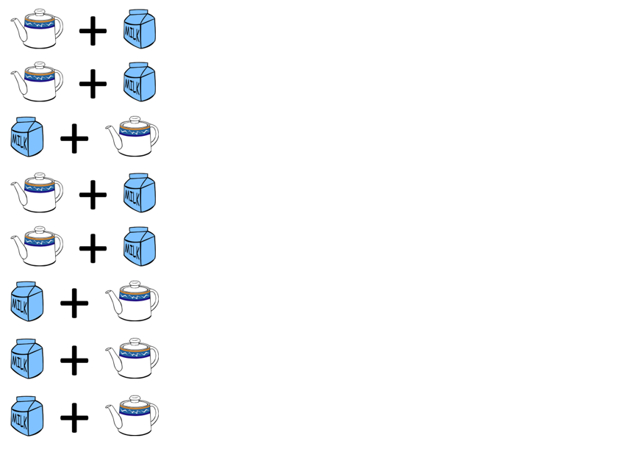
The experiment
Figure 4. A randomized experiment

Slide 9
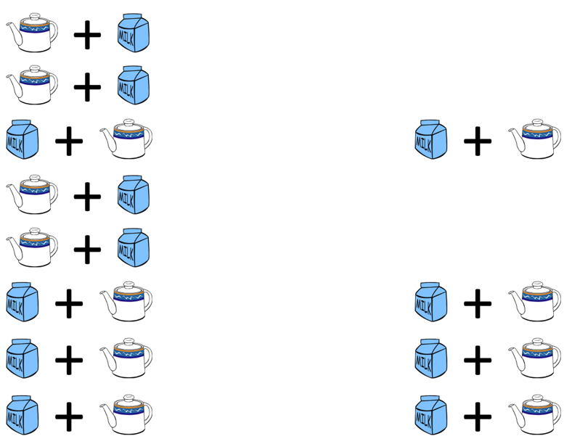
The result
Figure 5. Result of the randomized experiment

Slide 10
How likely is this result?
If the lady had no ability to tell whether the milk was added first and was effectively picking at random, the probability would be
$\frac{4}{8}×\frac{3}{7}×\frac{2}{6}×\frac{1}{5}=\frac{1}{70}$
Note: the probability changes over time!

