Slide 1
Frailty models
Steve Simon

Slide 2
what you will learn today
Review of handling censored values
Motivation for hazard function
Review of Cox Proportional Hazards Regression
How to handle violations of the independence assumption
Analyses using Stata, SAS, and R
Issues with repeated measures
Notes:
Here’s the list of topics that I will cover today. Ask lots of questions during the talk. You can unmute and ask a question directly, or you can type your question into the chat box. I love questions and I usually get very good ones from this group. If I don’t get to cover all the material, but I answer a bunch of questions that you have, that still counts as a successful talk.

Slide 3

Fruit fly example
Source: Wikipedia

Slide 4
Fruit fly study, round 1 data
37 58 73 40 59 75 43 60 77 44 61 79 45 62 89 47 68 94 49 70 96 54 71 56 72
Notes:
Imagine an experiment where you monitor the survival time of 25 fruit flies. This is actually adapted from a real data set, but I have tweaked a few of the numbers to make things work out a bit easier.
The first fly dies on day 37 and the last fly dies on day 96.

Slide 5
Fruit fly study, round 1 probabilities
37 96% 58 60% 73 24% 40 92% 59 56% 75 20% 43 88% 60 52% 77 16% 44 84% 61 48% 79 12% 45 80% 62 44% 89 8% 47 76% 68 40% 94 4% 49 72% 70 36% 96 0% 54 68% 71 32% 56 64% 72 38%
Notes:
If you want to estimate survival probabilities, just count the number of flies still alive on a given day and divide by 25. Each fly funeral leads to a 4% reduction in survival probability.

Slide 6
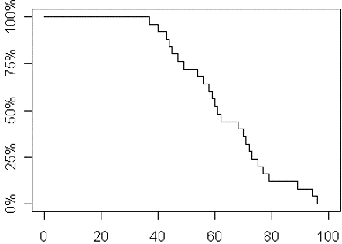
Fruit fly study, round 1 graph
Notes:
Here is what a graph of these probabilities would look like.

Slide 7
Fruit fly study, round 2 data
37 58 70+ 40 59 70+ 43 60 70+ 44 61 70+ 45 62 70+ 47 68 70+ 49 70+ 70+ 54 70+ 56 70+
Notes:
Suppose that you ran that experiment, but on day 70, you left the cover off and 10 flies escaped. What a disaster, you think. The experiment is ruined.

Slide 8
Fruit fly study, round 2 probabilities
37 96% 58 60% 70+ ? 40 92% 59 56% 70+ ? 43 88% 60 52% 70+ ? 44 84% 61 48% 70+ ? 45 80% 62 44% 70+ ? 47 76% 68 40% 70+ ? 49 72% 70+ ? 70+ ? 54 68% 70+ ? 56 64% 70+ ?
Notes:
But hold on. You can still estimate survival probabilities up to 70 days. You can still estimate the median survival time (61 days). So all is not lost. You just lose survival times beyond 70 days.

Slide 9
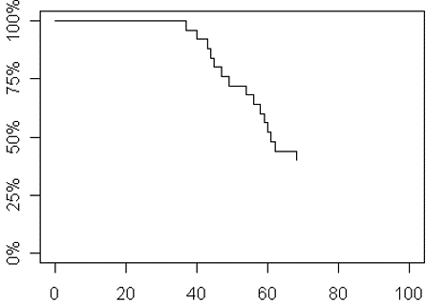
Fruit fly study, round 2 graph

Slide 10
Fruit fly study, round 3 data
37 58 70+ 40 59 75 43 60 70+ 44 61 70+ 45 62 89 47 68 70+ 49 70+ 96 54 71 56 70+
Notes:
Suppose that you ran that experiment, but on day 70, you left the cover off and 6 of the 10 flies escaped. Now, you still have some data after 70 days. What do you do with it?

Slide 11
Fruit fly study, round 3 probabilities
37 96% 58 60% 70+ 40 92% 59 56% 75 20% 43 88% 60 52% 70+ 44 84% 61 48% 70+ 45 80% 62 44% 89 10% 47 76% 68 40% 70+ 49 72% 70+ 96 0% 54 68% 71 30% 56 64% 70+
Notes:
You have to divvy up the remaining 40% of the survival probability among the 4 flies that remain. That means that each fly now carries 10% of the survival probability on their shoulders.

Slide 12
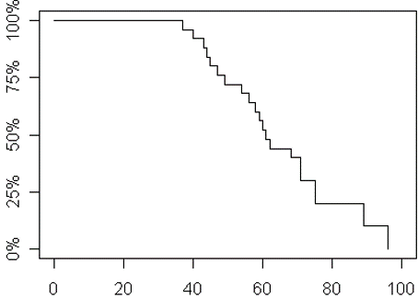
Fruit fly study, round 3 graph
Notes:
Here is what a graph of these probabilities would look like.

Slide 13
Break #1
What have your learned
Review of handling censored values
What’s coming next
Motivation for hazard function

Slide 14
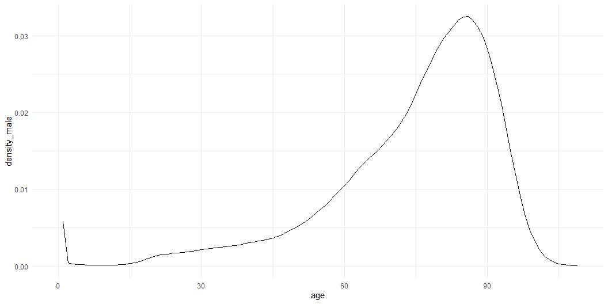
Life insurance example
Notes:
I found some data on mortality from the Social Security website and plotted an approximation to the probability density function. There is an unusual early peak in this function because the first year of your life is one of the most dangerous ones you will have to face.
Imagine yourself working in life insurance sales. You want to price your policies so that you only ask for low payments on the policy when the risk of death is low. So let’s calculate some probabilities.

Slide 15
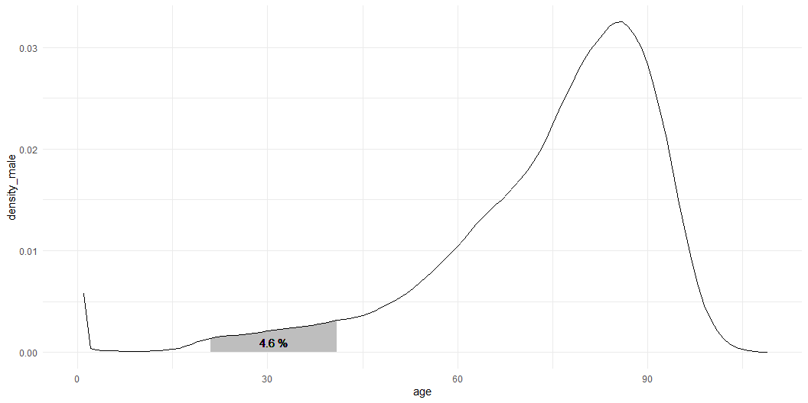
Probabilities for ages 21 through 41
Notes:
The probability of a potential customer dying between the ages of 21 and 41 is 0.04638.

Slide 16
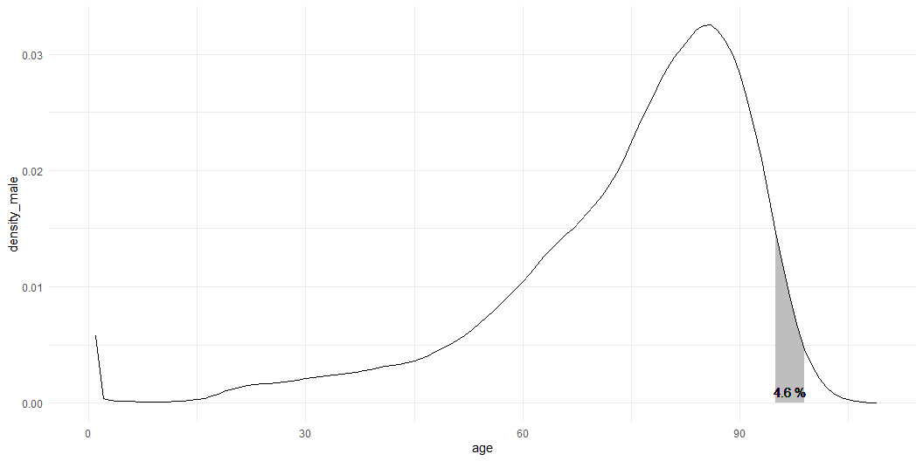
Probabilities for ages 95 through 99
Notes:
The probability of a potential customer dying between the ages of 95 and 99 is about the same, 0.04626. So should you charge the same amount for an insurance policy for someone 21 years old and someone 95 years old?

Slide 17
Why are these probabilities not comparable?
Unequal time intervals
Fix by computing a rate
Non-uniform probabilities over the interval
Fix by looking at narrow interval
No adjustment for survivorship
Fix by dividing by survival probabilty
Notes:
Obviously not. There are three things you need to fix first.
The most obvious flaw is the unequal time intervals, 20 years for the first probability and 4 years for the second probability.
You can fix this by computing a rate. You get the rate by dividing the probability by the width of the time interval.
The second flaw is that the probability changes over the interval, increasing in the first case and decreasing in the second case.
You can fix this by shrinking the width of the time interval.
The third flaw is a bit more subtle. The probability of dying between the ages of 95 and 99 are probabilities computed from the perspective of a newborn child. That probability is small not because the chances of dying are small at that age, but because so many have died before their 95th birthday.
If you are in insurance sales, you do not sell policies to newborn infants. You sell to people who have survived to a certain age. No one rises from their grave on their 95th birthday and asks for an insurance policy. First, because zombies aren’t real, and second the zombie who died prior to year 95 would not be able to collect on an insurance policy that paid off for a death between 95 and 99.
You can fix this by dividing by the survivor probability.

Slide 18
Hazard function, definition
$h\left(t\right)=lim_{Δt→0}\frac{P\left[t≤T≤t+Δt\right]/Δt}{P\left[T≥t\right]}$
$h\left(t\right)=\frac{f\left(t\right)}{S\left(t\right)}$
where $f$ is the density function, and
$S$ is the survival function ($S\left(t\right)=1−F\left(t\right)$)
Notes:
The hazard function addresses all three of the concerns mentioned above. It computes a rate by dividing by \Delta t. It shrinks the interval but using a limit. And it adjusts for survivorship by dividing by the survivor probability.

Slide 19
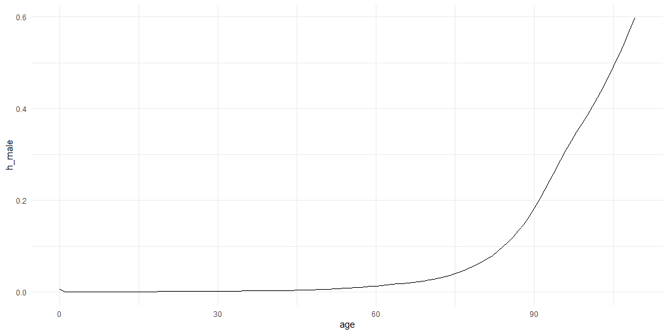
Hazard function, example
Notes:
This is what the hazard function for mortality data looks like.

Slide 20
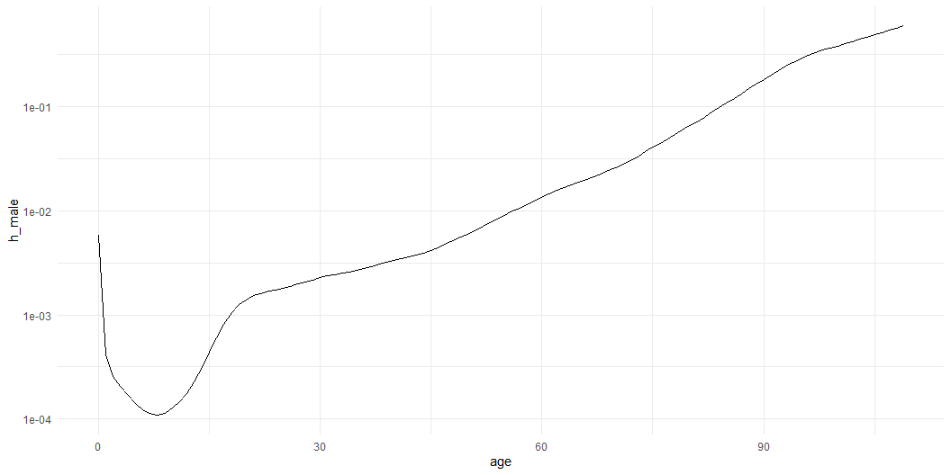
Hazard function on a log scale
Notes:
The pattern becomes a bit clearer when you look at the hazard function on a log scale. The risk of death is high early in your life, but drops. There is a safe period during your pre-teen and early teen years, but then the risk rises because of an increase in deaths associated with things like driving, alcohol, and other drugs. Some of that fades as you mature but other risks increase because of the unavoidable aging of your body.

Slide 21
Break #2
What have your learned
Motivation for hazard function
What’s coming next
Review of Cox Proportional Hazards Regression

Slide 22
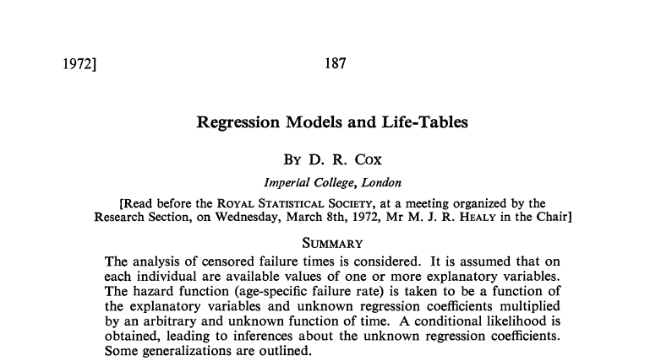
Cox publication
Notes:
The hazard function provides the foundation for much work in survival analysis. This paper by Sir David Roxbee Cox introduced the proportional hazards regression model, also known as the Cox regression model. This paper has been cited over 28,000 times and represents the 24th most cited research paper in any field, according to a 2014 publication in Nature.

Slide 23
The Cox regression model
$h\left(t,X_{i},β\right)=exp\left(X_{i}β\right)h_{0}\left(t\right)$
The meaning of proportional hazards
$\frac{h\left(t_{i},X_{i},β\right)}{h\left(t_{i},X_{j},β\right)}=exp\left(X_{i}−X_{j}\right)β$
Notes:
The Cox regression model states that the hazard function for a particular value of the independent variable is the exponential of X beta times a baseline hazard, h0. If you compare the hazard function at two levels of the covariate, Xi and Xj, the hazard function changes by a proportion equal to exp((Xi-Xj)).

Slide 24
Estimation in the Cox model
Partial likelihood
$𝓁_{p}\left(β\right)=Π_{i}\frac{exp\left(X_{i}β\right)}{Σ_{j∈R_{i}}exp\left(X_{j}β\right)}$
R is all patients in the risk set
Log partial likelihood
$ℒ_{p}\left(β\right)=Σ_{i}\left(X_{i}β−ln\left(Σ_{j∈R_{i}}exp\left(X_{j}β\right)\right)\right)$
$\hat{β}$ is the value that maximizes $ℒ_{p}\left(β\right)$
Notes:
A maximum likelihood approach to estimation does not work well because the hazard function burns up too many degrees of freedom. But you can compute a partial likelihood. The estimates from a Cox regression maximize this partial likelihood.
It is often easier to work on the log scale, and maximizing the log partial likelihood is equivalent.

Slide 25
Testing in the Cox model
Likelihood ratio test
$ℒ_{p}\left( \right)$
Score test
$U\left( \right)=\frac{∂}{∂β_{j}}ℒ_{p}\left( \right)$
Wald test (information matrix)
Uses $I\left( \right)=−\frac{∂^{2}}{∂β^{2}}ℒ_{p}\left( \right)$
Notes:
There are three tests that you can use for the Cox regression model. The likelihood ratio test uses the log partial likelihood directly. The score test uses the vector of first derivatives of the log partial likelihood. The Wald test uses the information matrix which is defined as the matrix of second derivatives of the log partial likelihood.
The three tests are asymptotically equivalent, but they will sometimes disagree for small samples.
The Wald test is simple, the score test is fast, and the likelihood ratio test is best for small sample sizes. But in my experience, there is very little difference among these tests.

Slide 26
Break #3
What have your learned
Review of Cox Proportional Hazards Regression
What’s coming next
How to handle violations of the independence assumption

Slide 27
Violations of the independence assumption, 1 of 2
Cox regression assumes that individual observations are independent. This may be problematic.
Family/litter effects
Multi-center trials
Repeated measurements
Left eye/right eye
Infection
Rehospitalization
Notes:
The Cox regression model assumes that the times are independent from one observation to another. This may be an issue in several settings, such as data from related family members, from multi-center trials, or from repeated measurements on the same subject.

Slide 28
Violations of the independence assumption, 2 of 2
If observations are correlated
Estimated coefficients, $\hat{β}$, are unbiased, but
Estimated variance covariance matrix is biased.

Slide 29
Frailty model
Use double subscript for covariates
i represents common family, litter, center, etc.
$h\left(t,X_{ij},β\right)=Z_{i}exp\left(X_{ij}β\right)h_{0}\left(t\right)$
$Z_{i}$ is usually a Gamma or lognormal distribution with a mean of 1.
Z_i > 1 implies greater frailty
Notes:
The frailty model adds an extra random term to the proportional hazards model that multiplies the hazard function by a variable that is constant across the cluster creating all the troublesome correlations.
The frailty term is usually a Gamma distribution or (less often) a lognormal distribution. The mean of either distribution is held to be 1.0. Clusters with a term greater than 1 represent clusters that are more frail or more likely to experience the event. If the term is less than 1, that means the cluster is less frail or less likely to experience the event.
The frailty term is a latent variable, one that is not directly observable.

Slide 30
Alternative analysis: Robust variance (sandwich estimator)
In many ways, very similar to frailty models
But some subtle differences
Replace $I{\left(\hat{β}\right)}^{−1}$ with $I{\left(\hat{β}\right)}^{−1}\left(\hat{L}′\hat{L}\right)I{\left(\hat{β}\right)}^{−1}$
$\hat{L}$ are score residuals, computed from the score statistic.
Comparable to the Generalized Estimating Equations (gee) model.
Notes:
When the observations are not independent, the regression coefficients, \hat\beta, are still unbiased, but the variances and covariances of these coefficients are messed up. This leads to confidence intervals that are way too wide or way too narrow. It also messes up the Type I error probabilities. Any sample size justifications based on an independence assumptions are invalid.
One approach to getting a proper estimate of the variances and covariances is to replace the inverse of the information matrix with a more complex estimate. This estimate uses residuals from the score statistic to adjust for the correlations induced by the family/litter effect, center effect, or repeated measurements.

Slide 31
Alternative analysis: stratification
Use a different baseline hazard for each cluster
Only works with a few very large clusters
Does not identify “frail” or “strong” clusters
Notes:
An alternative worth considering is stratification. Stratification fits a separate baseline hazard function for each cluster. This can use up a lot of degrees of freedom, so only consider this if you have a few clusters and each cluster is very large. This might occur in some multi-center clinical trials, but is unlikely with many other research scenarios.

Slide 32
Break #4
What have your learned
How to handle violations of the independence assumption
What’s coming next
Analyses using Stata, SAS, and R

Slide 33
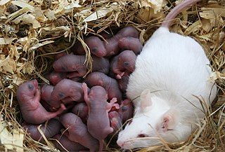
Rats example
Source: Wikipedia

Slide 34
Rats data
litter rx time status sex 1 1 101 0 f 1 0 49 1 f 1 0 104 0 f 3 1 104 0 f 3 0 102 0 f 3 0 104 0 f 5 1 104 0 f
Notes:
Here are the first few rows of a data set looking at survival in rats. The researchers took either three males or three female rats from the same litter. One of the rats received an experimental treatment and the other two in the litter served as controls. I have reduced the dataset by looking only at female rats.

Slide 35
Analysis ignoring litter effect, Stata, 1 of 2
stset time, failure(status) stcox rx
Notes:
Here is the code in Stata to do a Cox regression. You suspect that the Cox model will not be valid, but it is still a useful first step.

Slide 36
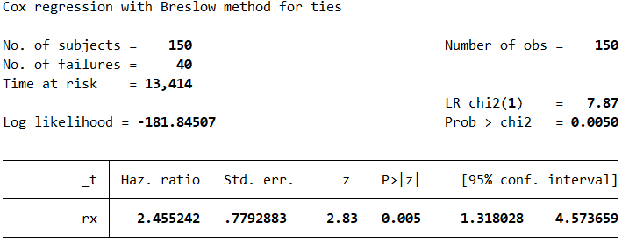
Analysis ignoring litter effect, Stata, 2 of 2
Notes:
This is the output from Stata.

Slide 37
Analysis ignoring litter effect, SAS, 1 of 4
proc phreg data=storage.rats; model time*status(0) = rx; run;
Notes:
This is the code in SAS.

Slide 38

Analysis ignoring litter effect, SAS, 2 of 4
Notes:
SAS places its output in several tables. Here and on the next two slides are some of the key tables.

Slide 39

Analysis ignoring litter effect, SAS, 3 of 4

Slide 40

Analysis ignoring litter effect, SAS, 4 of 4

Slide 41
Analysis ignoring litter effect, R, 1 of 3
rats_surv <- Surv(rats$time, rats$status) coxph(rats_surv ~ rx, data=rats)
Notes:
Here is the code in R.

Slide 42
Analysis ignoring litter effect, R, 2 of 3
Call: coxph(formula = rats_surv ~ rx, data = rats) coef exp(coef) se(coef) z p rx 0.9047 2.4713 0.3175 2.849 0.00438
Notes:
Here are the first few lines of output.

Slide 43
Analysis ignoring litter effect, R, 3 of 3
Likelihood ratio test=7.98 on 1 df, p=0.004741 n= 150, number of events= 40
Notes:
Here is the rest of the output.

Slide 44
Analysis with frailty term, Stata, 1 of 2
stset time, failure(status) stcox rx, shared(litter)
Notes:
Stata refers to a “shared” frailty term, implying that the random term is shared by observations in the same cluster.

Slide 45
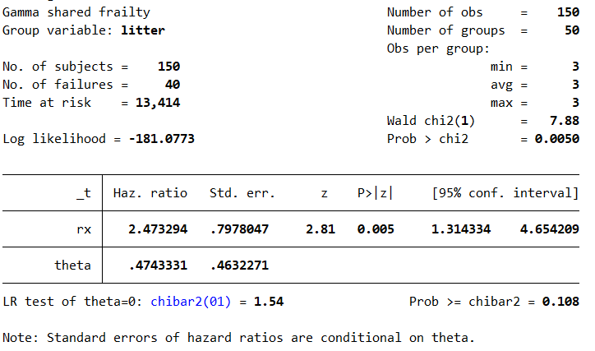
Analysis with frailty term, Stata, 2 of 2
Notes:
Here is the output in Stata.

Slide 46
Analysis with frailty term, SAS, 1 of 4
proc phreg data=storage.rats; class litter; model time*status(0) = rx; id litter; random litter / dist=gamma; run;

Slide 47

Analysis with frailty term, SAS, 2 of 4
Notes:
SAS (and other software) offers two options for frailty models and other models with random effects. The most common approach is REML, restricted maximum likelihood, which you see here. An alternative, ML or maximum likelihood, is a bit more complex computationally but useful when you want to contrast a simple random effects model to a more complex random effects model. For most analyses, either REML or ML is just fine.

Slide 48

Analysis with frailty term, SAS, 3 of 4

Slide 49

Analysis with frailty term, SAS, 4 of 4

Slide 50
Analysis with frailty term, R, 1 of 2
rats_surv <- Surv(rats$time, rats$status) coxph(rats_surv ~ rx + frailty(litter), data=rats)

Slide 51
Analysis with frailty term, R, 2 of 3
Call: coxph(formula = rats_surv ~ rx + frailty(litter), data = rats) coef se(coef) se2 Chisq DF p rx 0.914 0.323 0.319 8.012 1.0 0.0046 frailty(litter) 17.692 14.4 0.2443

Slide 52
Analysis with frailty term, R, 3 of 3
Iterations: 6 outer, 24 Newton-Raphson Variance of random effect= 0.499 I-likelihood = -180.8 Degrees of freedom for terms= 1.0 14.4 Likelihood ratio test=37.6 on 15.4 df, p=0.001 n= 150, number of events= 40

Slide 53
Analysis with robust variance (sandwich) estimate, Stata, 1 of 2
stset time, failure(status) stcox rx, vce(cluster litter)
Notes:
To fit the robust variance or sandwich estimate, include “vce” with the stcox procedure.
There are several variations on this code, and you should read the Stata manual carefully.

Slide 54
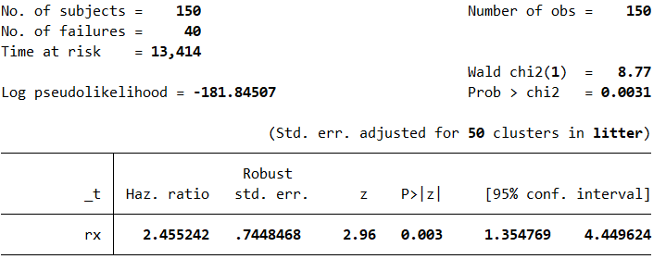
Analysis with robust variance (sandwich) estimate, Stata, 2 of 2
Notes:
Here is the output. Things have not changed that much, mainly because the litter effect is not very strong.

Slide 55
Analysis with robust variance (sandwich) estimate, SAS, 1 of 4
proc phreg data=storage.rats covs(aggregate); model time*status(0) = rx; id litter; run;
Notes:
The SAS code uses the “covs” keyword to get the robust variances.

Slide 56

Analysis with robust variance (sandwich) estimate, SAS, 2 of 4
Notes:
The key tables in SAS appear here and on the next two slides.

Slide 57

Analysis with robust variance (sandwich) estimate, SAS, 3 of 4

Slide 58

Analysis with robust variance (sandwich) estimate, SAS, 4 of 4

Slide 59
Analysis with robust variance (sandwich) estimate, R, 1 of 2
rats_surv <- Surv(rats$time, rats$status) coxph(rats_surv ~ rx + cluster(litter), data=rats)
Notes:
Use the “cluster” function in R to fit the robust variance model.

Slide 60
Analysis with robust variance (sandwich) estimate, R, 2 of 3
Call: coxph(formula = rats_surv ~ rx, data = rats, cluster = litter) coef exp(coef) se(coef) robust se z p rx 0.9047 2.4713 0.3175 0.3025 2.991 0.00278
Notes:
The output from R appears here and on the next slides.

Slide 61
Analysis with robust variance (sandwich) estimate, R, 3 of 3
Likelihood ratio test=7.98 on 1 df, p=0.004741 n= 150, number of events= 40

Slide 62
Break #5
What have your learned
Analyses using Stata, SAS, and R
What’s coming next
Issues with repeated measures

Slide 63
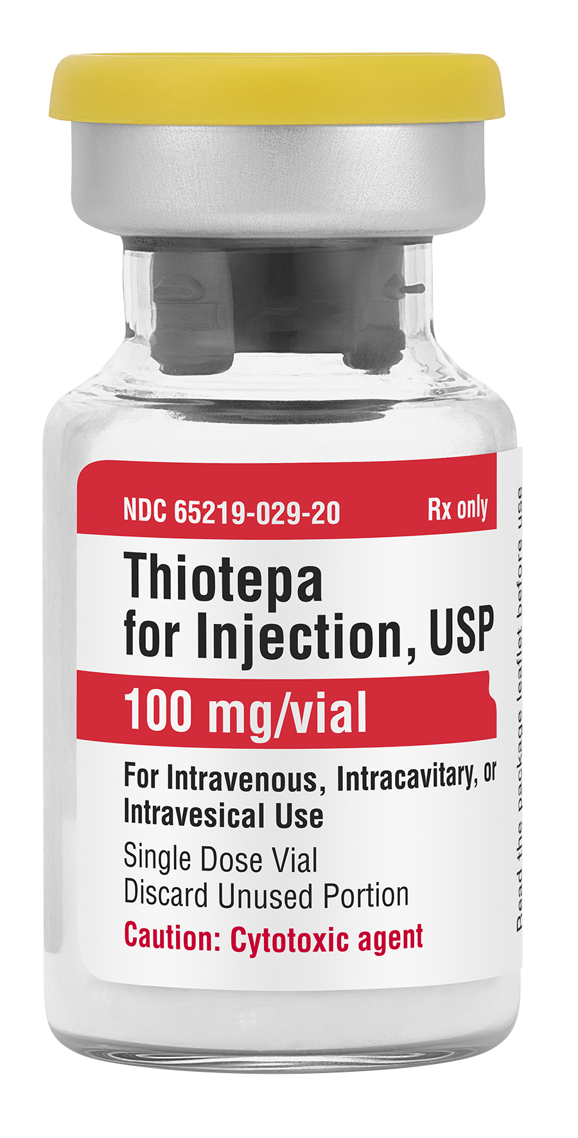
Thiotepa example
Source: Business Wire

Slide 64
Thiotepa data
id rx number size start stop event enum 1 1 1 3 0 1 0 1 2 1 2 1 0 4 0 1 3 1 1 1 0 7 0 1 4 1 5 1 0 10 0 1 5 1 4 1 0 6 1 1 5 1 4 1 6 10 0 2 6 1 1 1 0 14 0 1

Slide 65
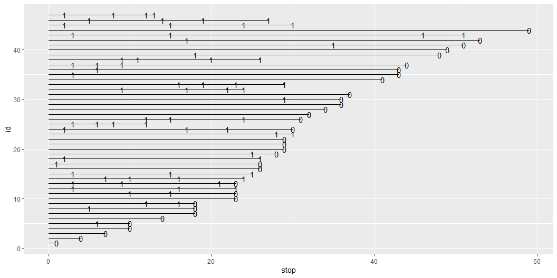
Plot of thiotepa data, 1 of 2

Slide 66
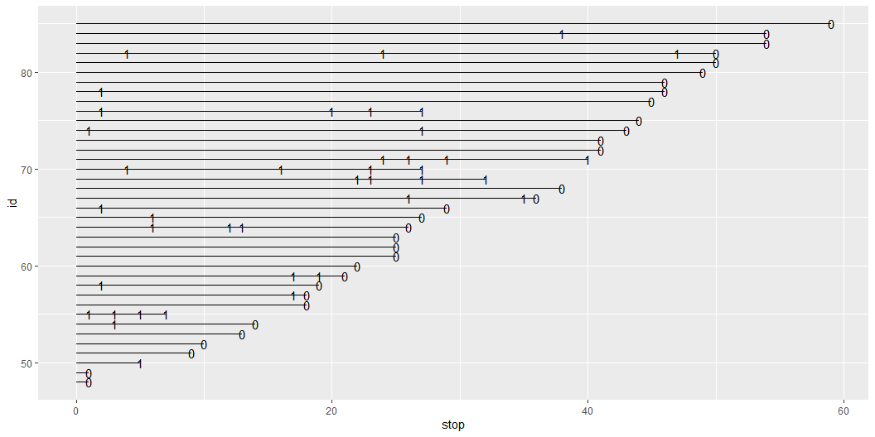
Plot of thiotepa data, 2 of 2

Slide 67
Data for subject 82
id rx number size start stop event enum 82 2 4 1 0 4 1 1 82 2 4 1 4 24 1 2 82 2 4 1 24 47 1 3 82 2 4 1 47 50 0 4

Slide 68
Re-setting the clock
id rx number size start stop event enum 82 2 4 1 0 4 1 1 82 2 4 1 0 20 1 2 82 2 4 1 0 23 1 3 82 2 4 1 0 3 0 4

Slide 69
Alternative analysis: Poisson regression
id rx number size event_count time_at_risk 82 2 4 1 3 50

Slide 70
So many choices…
Frailty estimates
Provides individual estimates
Identifies “good” and “bad” clusters
Robust variance (sandwich)
Provides marginal estimates
Stratified analysis
Only works for small number of clusters
Poisson regression
Assumes risk independent of time
Never ignore clusters

Slide 71
Summary, 1 of 4
Notes:
In today’s talk, you’ve seen this handsome devil, who helped you understand the concept of censoring.

Slide 72
Summary, 2 of 4
Notes:
You also saw this happy family, who helped you see how to apply frailty models and some alternatives.

Slide 73
Summary, 3 of 4
Notes:
You also saw this cancer drug, that helped you visualize the issues associated with repeated measures.

Slide 74
Summary, 4 of 4
What have your learned
Review of handling censored values
Motivation for hazard function
Review of Cox Proportional Hazards Regression
How to handle violations of the independence assumption
Analyses using Stata, SAS, and R
Issues with repeated measures

