Slide 1
The Neighborhood Housing Conditions Survey
Steve Simon, https://github.com/pmean/talks/tree/master/nhcs

Slide 2
My background
PhD in Statistics
Faculty member
Department of Biomedical and Health Informatics
University of Missouri-Kansas City (UMKC)
Informal consultant with Center for Economic Information (CEI)
Notes:
Before I start my talk, let me fill you in on my background. I am a data geek, with a PhD in Statistics and a faculty appointment in the Department of Biomedical and Health Informatics. I also have been providing informal consulting with the Center for Economic Information (CEI), a research group with expertise in geographic information systems, economic statistics, and big data. with a long history of working with local communities and governments in the Kansas City metropolitan area.

Slide 3
Acknowledgements
Children’s Mercy Hospital
Ryan Allenbrand, Healthy Home Program Manager
Elizabeth Friedman, Medical Director of Environmental Health
Kevin Kennedy, Environmental Health Program Director
Kansas City, Missouri Department of Health
Amy Roberts, Director, Childhood Lead Poisoning Prevention Program
Notes:
Research is a team sport, and I need to acknowledge my partners in this work at Children’s Mercy Hospital and the Kansas City, Missouri Department of Health.

Slide 4
Acknowledgements
University of Missouri-Kansas City
Matthew Applebury, Satya Golla, Chinedu Isoh, Mounika Reddy Jakkidi, Brian Matlock, Nomuunzul Munkhjargal, Lori Reierson, Matthew Robinson, Vishal Vejendla, graduate students
Doug Bowles, Past Director, Center for Economic Information (retired)
Taki Manolakos, Past Director, Center for Economic Information
Ricardo Moniz, Education Program Coordinator for Biomedical and Health Informatics
Neal Wilson, Deputy Director, Center for Economic Information
Notes:
I work at the University of Missouri-Kansas City, and we have many others where I work helping out with this research. I should pay special thanks to the army of graduate students who have done all the heavly lifting in the work I am about to describe.

Slide 5
Impact Lead-Kansas City grant
Lead Technical Study funded by HUD
Three years, $700,000
Aim 1, retrospective review of lead remediation efforts
Aim 2, prospective identification of houses at risk for lead contamination
Use of Neighborhood Housing Conditions Survey
Potential for collaboration with other HUD grantees
Notes:
I am the principal investigator on Impact Lead-Kansas City. This is a lead technical study funded by the Department of Housing and Urban Development. We’ve been funded for three years, 2021 through 2023. I appreciate this invitation to talk about the work on this grant.
The grant has two aims, a retrospective review of lead remediation efforts funded by HUD through the Kansas City, Missouri Department of Health. and a prospective effort to more efficiently identify houses that might be targets for future remediation.
I want to highlight a key component of the second aim, a survey that we hope will be useful in prospective identification of houses at risk for lead contamination, the Neighborhood Housing Conditions Survey. I am focussing on this survey because it has the potential for collaboration with other HUD grantees at this meeting.

Slide 6
Overview of the Neighborhood Housing Conditions Survey (NHCS)
Windshield survey
Features visible at street level
Collection primarily of residential parcels
Notes:
The CEI Neighborhood Housing Conditions Survey (NHCS) is a windshield survey of residential parcels. The parcel geography and other relevant information was provided by the City of Kansas City, Missouri.
This is windshield survey, which means you collect the data by slowly driving down a street and observing housing conditions that are visible from the street level. You don’t have to go inside the house or even step inside the property boundaries.
The primary intent of the survey is to collect conditions of residential structures. The survey will also note information on non-residential structures and vacant lots.
The survey was developed in 1999 and has been applied continuously through 2014.

Slide 7
NHCS classification data
Structure type,
Use type,
Residential type,
Structure profile, and
Visible address
Notes:
The housing survey collects two types of data. It collects classification data, information that classifies the type of structure, its use, whether it is residential, the profile of the structure, and the visible address.

Slide 8
NHCS conditions data
Fifteen ratings
Structure
Grounds
Infrastructure
Notes:
The NHCS also collects data on housing conditions, grouped into conditions about the structure itself, the grounds, and the infrastructure.
The condition of each of these elements is rated on a scale of 1 to 5, with 5 corresponding to the best condition and 1 corresponding to the worst condition.
For parcels with no structure (vacant lots, parking lots, parks) there is only data for the Grounds and Infrastructure conditions.

Slide 9
NHCS conditions data on structure
Roof
Foundation/walls
Windows/doors
Porch
Exterior Paint
Notes:
Ratings are done on five features of the structure itself: the roof, foundation and walls, windows and doolrs, the porch, and exterior paint.

Slide 10
NHCS conditions data on grounds
Private sidewalk/drive
Lawn/shrubs
Nuisance vehicles
Litter
Open storage
Notes:
Ratings are also done on five features of the grounds: the private sidewalk, lawn, nuisance vehicles, litter, and open storage.

Slide 11
NHCS Infrastructure
Public sidewalk
Curb
Street lighting
Catch basin
Street
Notes:
Finally, there are ratings for the infrastructure: the public sidewalk, curb, street lighting, catch basin and street.

Slide 12
Condition ratings
Likert scale (1-5)
1, Severely deteriorated
2, Seriously deteriorated
3, Substandard
4, Good
5, Excellent
Missing value codes
6, not applicable
7, unable to rate
Notes:
The condition ratings range from 1 to 5 on Likert scale with lower scores indicating more deterioration. A code of 6 is a missing value code for locations where a condition rating is not applicable. A code of 7 is a second missing value code for conditions that could not be rated because of visibility issues.

Slide 13
Example Structure/roof
Severely Deteriorated. There are holes visible through roof sheathing. Rafters are sagging or collapsed. Soffits and fascia boards are missing or display severe rot and deterioration.
Notes:
I want to show details for one of the fifteen conditions that are rated by the NHCS, so you can see the specificity detailed in this survey.
For the roof of a structure, the lowest rating, 1, represent severe deterioration. These represent pretty extreme conditions like holes in the roof.

Slide 14
Example Structure/roof
Seriously Deteriorated. There are no holes present. The roof has sagging rafters, but sagging is not severe. Roofing shingles are extremely deteriorated. More than five shingles are currently missing on the front exposure of the roof. It appears some sheathing needs to be replaced. Soffits and fascia boards display moderate rot and deterioration.
Notes:
The next rating, 2, represent serious deterioration. No holes, thank gooodness, but some visible sagging, and/or missing shingles.

Slide 15
Example Structure/roof
Substandard. There are no holes or sagging. Roofing shingles are deteriorated and should be removed before new shingles are installed. Less than five shingles are missing on the entire roof. Soffits and fascia boards display slight rot deterioration.
Notes:
A rating of 3 represents substandard conditions. This represents a small number of missing shingles or slight rot in soffits and fascia boards.

Slide 16
Example Structure/roof
Good. This represents slight discoloration or the need to repaint soffits and fascia boards.
Notes:
A rating of 4 represents slight wear and discoloration.

Slide 17
Example Structure/roof
Excellent. Roofing shingles show no wear. Soffits and fascia boards display no rot nor deterioration and are adequately installed.
Notes:
A rating of 5 is the best rating. No wear, no rot, no deterioriation.

Slide 18
Example Structure/roof
Not applicable. Characteristic does not apply to rated parcel (e.g., roof rating for parcels with no structure).
Notes:
If there is no structure on the parcel, there is no roof to be rated. This is assigned a code of 6 and this is not used in the overall assessment of housing conditions.

Slide 19
Example Structure/roof
Un-ratable. Characteristic applies to rated parcel, but rating could not be determined (e.g., structures with flat roofs, or where line of sight to roof is obscured by trees).
Notes:
There’s one more case to consider. Sometimes, you cannot provide a rating because the roof is flat or obscured by trees. This is assigned a code of 7 and this is not used in the overall assessment of housing quality.

Slide 20
Training
Classroom session with visual aids
Group discussion of a test block
Individual survey of two test blocks
Trainee ratings compared with expert
Notes:
The training starts with a classroom session with visual aids. Then the trainees are taken to a test block, chosen for its representativeness of various levels of deterioration. The trainees join in a group discussion with the instructor on the ratings for individual parcels on this test block.
Then the trainees examine two more test blocks individually. Their ratings are compared to those of the instructor and if the average deviation in rating is within plus or minus one rating point, the trainees are certified and able to conduct surveys on their own.

Slide 21
Quality Control
Tow raters for every parcel
Two blocks randomly select from survey data
Qualitative agreement on classification data
Quantitative agreement on condition data
Notes:
The NHCS has several quality checks built in. First, and most importantly, there are two independent ratings on every parcel. In addition, two blocks are randomly selected and inspected by an expert who compares their results on both the qualitative classification data and the quantitative condition data. The quantitative data must not deviation on average by more than one rating unit on average.

Slide 22
Who uses the NHCS
Community development corporations
City urban planners
Real estate agencies
Mortgage bankers
Construction contractors
Insurance companies
Neighborhood and community associations
Notes:
There are a broad range of individuals and groups who are interested in the NHCS data.
I want to focus, though, on the last bullet point, neighborhood and community associations. These groups are very eager to find and use data that will help them advocate on behalf of the places where they live.

Slide 23
Research applications of the NHCS
Data at the finest level of detail
Easy to incorporate with higher level geographies
Easy to link with other records
Electronic health records
Notes:
I would be remiss in my duties as a data geek if I did not point out the research applications of the NHCS.
Too many studies of geographic features lump everyone into a large groups, like zip codes or counties. This mixes apples, oranges, and every type of fruit together in a one big batch and pretends that a single summary number can characterize such a diverse group.
The NHCS, on the other hand, collects data at the finest possible level of social resolution, the household.
You can still be easily incorporated with data at higher level geographies like the American Community Survey which collects data at the Census block group and tract level.
You also have the option of linking this data with other records at the address level. Of particular interest to me is the linking of the NHCS data with data from the electronic health record. There are serious privacy concerns with such matching of course that require careful oversight by the Institutional Review Board. But I will cite two examples shortly that show how productive this linkage can be.

Slide 24
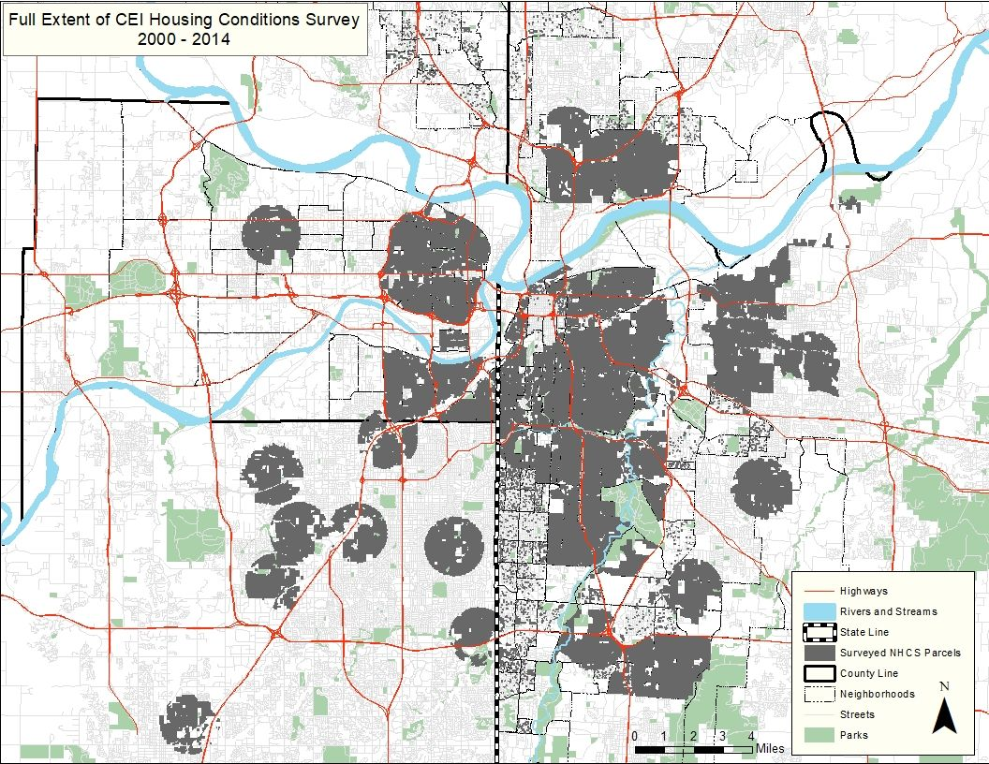
Areas covered by the NHCS
Figure 1. Map of NHCS locations
Notes:
The NCHS has been used for over 200,000 parcels over a fifteen year span.
This map shows where the NHCS has been used. Those of you who know and love Kansas City will notice two important features of this map. First, we have done surveys on both sides of the state line. Second, we have done survey both north and south of the Missouri river.
The survey has been largely inactive since 2014 due to budget problems, but we are using the survey again in the current grant we have received from HUD.

Slide 25
Advantages of using NHCS
Fast and inexpensive
Estimated total costs $6.50 per parcel
Simple ethical review
Observation in a public setting
Detailed training and quality control
Easy to use in other locations
Notes:
The NHCS is fast and inexpensive. For our current grant, we estimated the total costs (including labor) for the NHCS to be $6.50 per parcel, though there is evidence that the costs would be even less for larger surveys. The NHCS scales very well.

Slide 26

Linking NHCS data with acute asthma visits
Figure 2. Dr. Natalie Kane
Notes:
The revitalization of the NHCS should be credited to two graduate students, Natalie Kane and Neal Wilson.
This is a picture of Natalie Kane. She currently works at Children’s Mercy, but I knew her from her work on a dissertation that she successfully defended in 2020. She linked the NCHS data with medical records of asthma visits at Children’s Mercy Hospital and additional geographic markers of pollution to establish a link between disparities in home environment and rates of acute pediatric asthma care encounters.

Slide 27

Linking NHCS data with elevated blood lead levels
Figure 3. Dr. Neal Wilson
Notes:
Here’s a picture of Dr. Neal Wilson. Like Natalie Kane, he took NHCS data and linked it to medical records, this time with blood testing data from the Kansas City, Missouri Department of Health. He showed a strong association between housing conditions and elevated blood lead levels in children. He successfully defended his dissertation on this topic in 2021 and has continued his work in this area with the Impact Lead-Kansas City grant that I will describe on the next few slides.

Slide 28
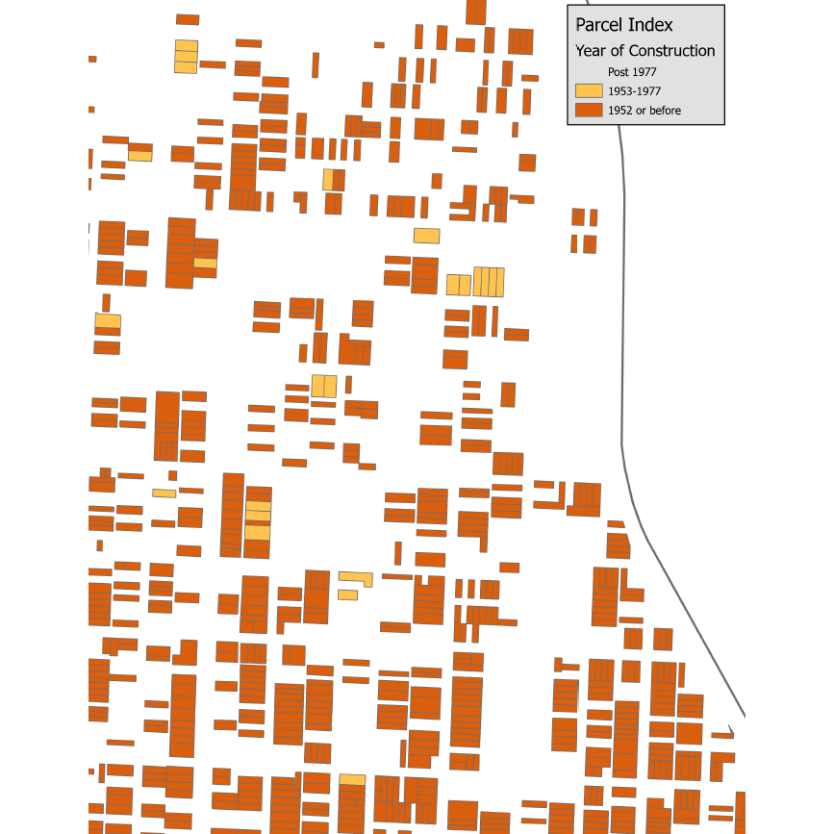
Housing data using just era of construction
Figure 4. Housing data coded by era of construction
Notes:
Here is a map of housing units in a Kansas City neighborhood. It is just west of the infamous Benton curve of I-70. The houses are color coded by era of construction. If you are interested in lead remediation efforts, the age of the house is your first criteria for where to focus your work.
This is a map shows where the houses that you should skip: the white houses built after 1977. Earlier construction is worth looking at, but especially the homes in dark orange, built in 1952 or earlier. You can see on this map that there are quite a few orange rectangles.

Slide 29
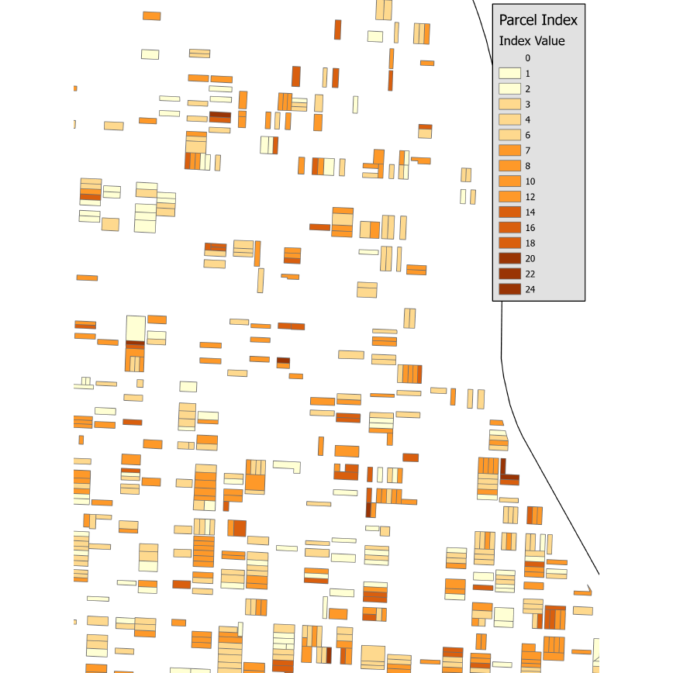
Housing data incorporating NHCS data
Figure 5. Housing data coded using NHCS data
Notes:
Work on this is not quite complete, but Neal Wilson is creating an index that accounts for both the construction era and the information from the NHCS. This map is drawn with color coding using this index. Note that there are substantially more distinctions among the housing units. There are seventeen different colors on this graph, compared to only three in the previous map. If these index proves to be more strongly associated with lead exposure than era of construction alone, and we think it will, then you have a lot fewer dark orange rectangles to focus on.

Slide 30
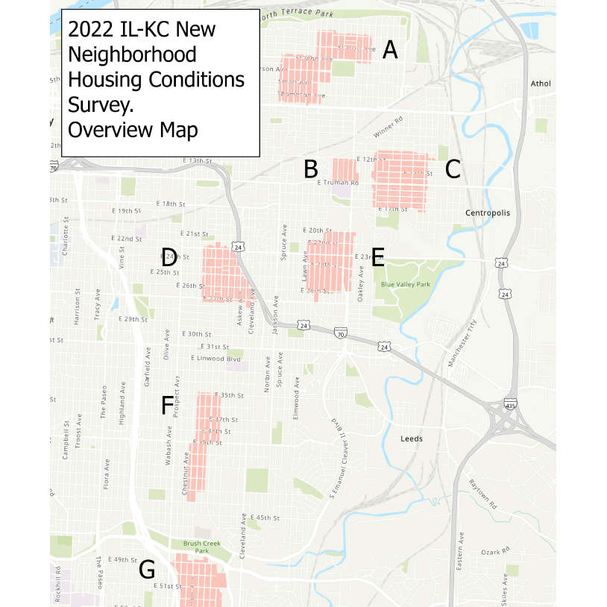
Location of current NHCS surveys
Figure 6. Map of current NHCS surveys
Notes:
We are currently surveying about 6,000 housing units in six neighborhoods in the Kansas City area. These houses are all on the Missouri side of the state line because of our partnership with the Kansas City, Missouri Department of Health. These neighborhoods have predominantly older construction. We plan to recruit 50 owners or renters in homes that score poorly on the NCHS and get permission to do detailed assessment of environmental lead exposure. These will be compared to a matched set of 50 control housing units. Our hypothesis is that poor exterior conditions as measured by the NHCS are predictive of increased risk of lead exposure in the interior of the home.

Slide 31
Possible future applications of the NHCS
Just a few of many possibilities
Other health outcomes affected by housing quality
Training data for deep learning models
Replication in other communities
Want to learn more?
https://github.com/pmean/talks/tree/master/nhcs
simons@umkc.edu
Notes:
While this work is interesting in its own right, I want to explore possible future applications of the NHCS.
Two graduate students have shown strong links between the NHCS data and health outcomes in acute asthma visits and elevated blood lead levels. Our current work intends to show a link to environmental lead inside the home. But there are other health outcomes that can be tied to housing quality. I am not a doctor, but even I can see a potential link with acute injuries like falls. There may be others worth examining.
A second application is the use of the NHCS as training data for deep learning models. You are probably aware of the many successful uses of deep learning models to analyze image data, starting with the famous study of dogs versus cats. It is very easy to collect image data on houses through street cameras mounted on garbage trucks or on drones. These deep learning models are very powerful, but they require massive amounts of training data. The NHCS can provide that data cheaply, quickly, and on a large scale.
A third application is even simpler, but just as important. We have had a lot of success applying the NHCS in the Kansas City metropolitan area, and the process is well defined and carefully tested. It should not be too difficult to take the NHCS on the road to other communities and see if you can replicate the successes that we have seen in Kansas City.
These slides are available on my github site. If you have any questions, please contact me.

