Slide 1
Put title here

Slide 2
Topics to be covered
What you will learn
Variety of regressions
Building cubic splines from scratch
B-splines, N-splines, Harrell splines
How many knots and where to put them
Logistic regression example
Some code hints for R, SAS, Stata

Slide 3
xkcd comic
Title “CURVE-FITTING METHODS AND THE MESSAGE THEY SEND”
Drawn by Scott Munro
Open-source licenses
Link to comic at xkcd.com
More details at explain-xkcd.com
Notes:
Let me start with a cartoon from the xkcd site of Scott Munro. Scott Munro produces comics that poke fun at various scientific and mathematical concepts. There are a handful that directly address statistics, including this one. The actual panels in the comic are small, so I split them up onto separate slides.

Slide 4
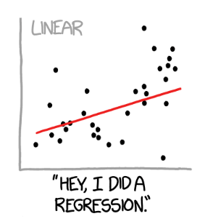
xkcd comic, panel 01
Notes:
This shows a scatter of data points with a linear regression fit. The caption reads, “Hey, I did a regression.”

Slide 5
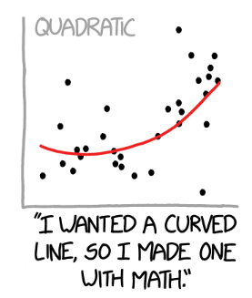
xkcd comic, panel 02
Notes:
This shows a scatter of data points with a quadratic regression fit. The caption reads, “I wanted a curved line, so I made one with Math.”

Slide 6
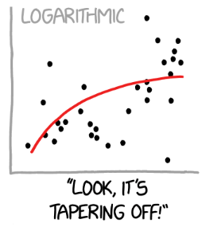
xkcd comic, panel 03
Notes:
This shows a scatter of data points with a logarithmic regression fit. The caption reads, “Look, it’s tapering off!”

Slide 7
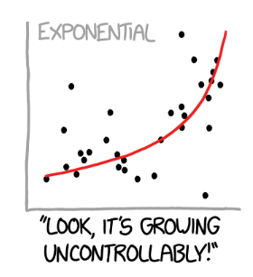
xkcd comic, panel 04
Notes:
This shows a scatter of data points with an exponential regression fit. The caption reads, “Hey, I did a regression.”

Slide 8
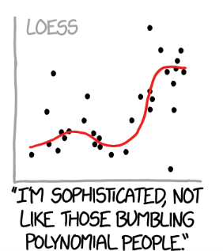
xkcd comic, panel 05
Notes:
This shows a scatter of data points with a loess smoothing curve. The caption reads, “I’m sophisticate, not like those bumlbing polynomial people.”

Slide 9
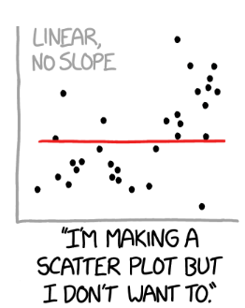
xkcd comic, panel 06
Notes:
This shows a scatter of data points with a flat linear regression fit (slope=0). The caption reads, “I’m making a scatter plot but I don’t want to.”

Slide 10
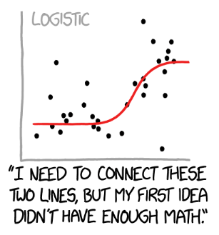
xkcd comic, panel 07
Notes:
This shows a scatter of data points with a logistic curve regression fit. The caption reads, “I need to connect these two lines, but my first idea didn’t have enough Math.”

Slide 11
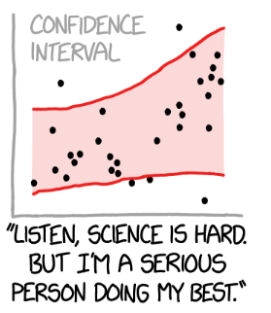
xkcd comic, panel 08
Notes:
This shows a scatter of data points with no particular regression line, but a very wide (nd probably appropriate) confidence band. This captures the idea that there is uncertainty not only in the deviation of the points from the regression curve, but true uncertainty about the shape of that regression curve. The caption reads, “Listen, science is hard. But I’m a serious person doing my best.”
There is an active field of research under the topic uncertainty quantification that tries to take into account all the sources of uncertainty including uncertainty about which model is the correct model.

Slide 12
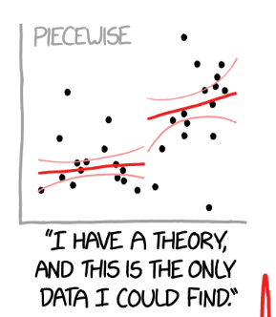
xkcd comic, panel 09
Notes:
This shows a scatter of data points with a piecewise linear regression fit. The caption reads, “I have a theory and this is the only data I could find.”

Slide 13
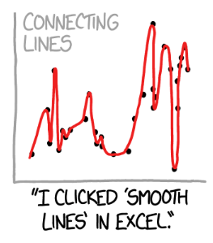
xkcd comic, panel 10
Notes:
Here the proposed regression model gets a bit silly. This shows a scatter of data points with a smooth curve connecting every data point. The caption reads, “I clikced ‘smooth lines’ in Excel.”

Slide 14
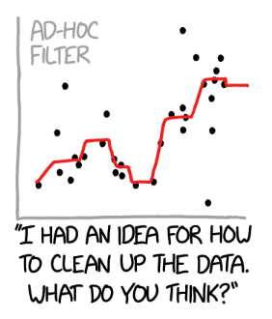
xkcd comic, panel 11
Notes:
This shows a scatter of data points with a smoother that looks like it uses medians somehow. The caption reads, “I had an idea for how to clean up the data. What do you think?”

Slide 15
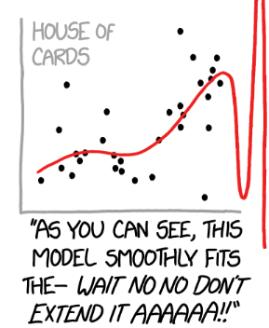
xkcd comic, panel 12
Notes:
This shows a scatter of data points with what looks like a B-spline. The caption reads, “As you can see, this model smoothly fits the - Wait, No, No, Don’t extend it. AAAAAA!!”

Slide 16
A real world problem, without the data
Threshold model
Nothing happens until you meet a threshold
Then things get worse
Notes:
Several decades ago, I was faced with a data analysis problem. I wanted to fit a threshold model where everything is fine and normal until the exposure level meets a certain threshold. Then things get worse.
I don’t have the data for this problem, but let me illustrate conceptually how threshold model might work. It provides a simple but useful analog to regression splines.

Slide 17
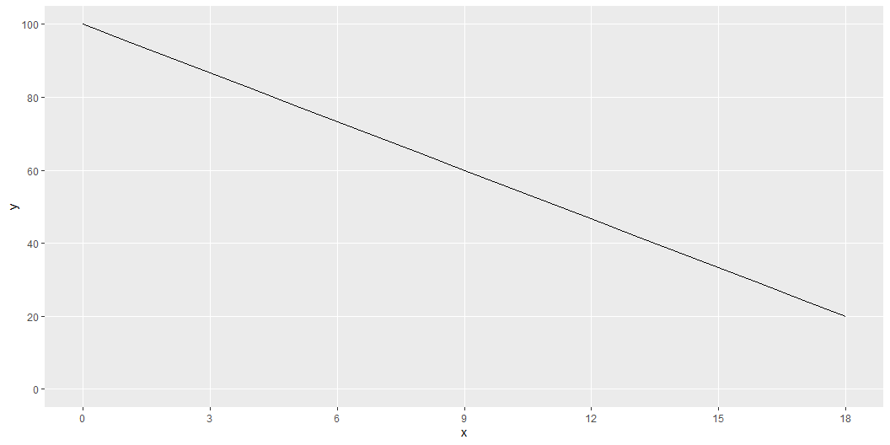
Linear function
Notes:
Here is what a linear function might look like. It is not what we want, but always start with the easiest model.

Slide 18
$Y=β_{0}+β_{1}X$
1 0 1 3 1 6 1 9 1 12 1 15 1 18
Notes:
This is the formula and the design matrix for a linear fit.

Slide 19
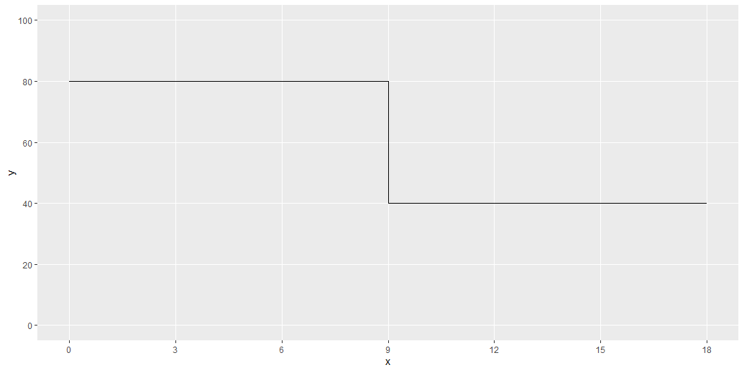
Step function
Notes:
A threshold model could look like this. It is a step function that is at a high level prior to the threshold at X=9 and then drops after.
This is a discontinuous function. It might make sense in some settings. In other settings, you might expect the decline to be not so sudden and abrupt.

Slide 20
$Y=β_{0}+β_{1}I_{X>9}$
1 0 1 0 1 0 1 0 1 1 1 1 1 1
Notes:
Here is the formula and the design matrix for a step function. The I notation is an indicator function that is equal to 1 if the logical comparison is true and 0 if it is false.

Slide 21
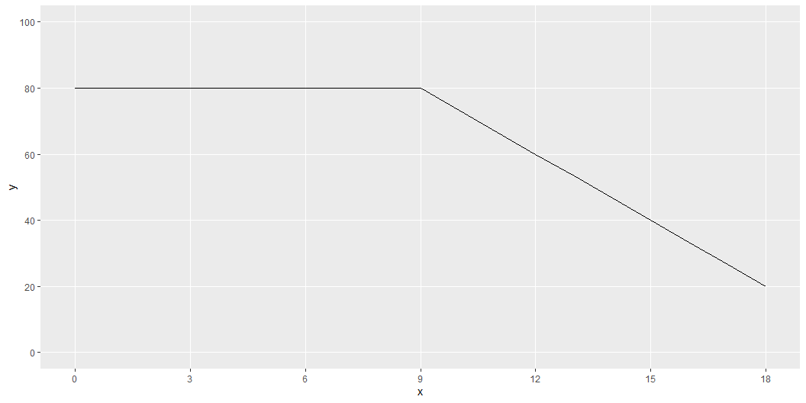
Elbow regression
Notes:
Here is a better model. It is flat and at a high level for values less than 9 and declines linearly for values greater than 9.
Note the “elbow” at the threshold. This might be okay, but it might be better for a transition that does not change slope so suddenly.

Slide 22
$Y=β_{0}+β_{1}I_{X>9}\left(X−9\right)$
1 0 1 0 1 0 1 0 1 3 1 6 1 9
Notes:
This is the formula and design matrix for an elbow regression. The independent variable is computed by multiplying the indicator variable by the value of X, but only after subtracting the threshold of 9. It is important to subtract the nine so that the linear decline after the threshold matches up with the flat section before the threshold.

Slide 23
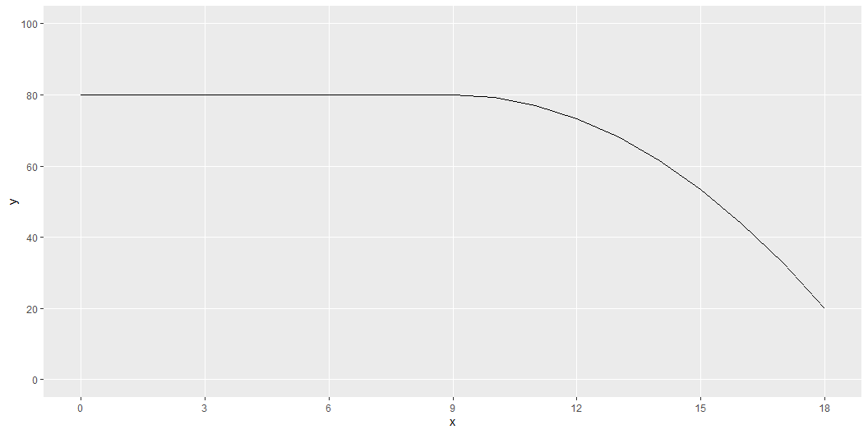
Quadratic analog
Notes:
Here is a functional form that avoid the elbow at the threshold value. It fits a quadratic decline, or a parabola, but the parabola starts at the point where the derivative is equal to zero.

Slide 24
$Y=β_{0}+β_{1}I_{X>9}{\left(X−9\right)}^{2}$
1 0 1 0 1 0 1 0 1 9 1 36 1 81
Notes:
This is the formula and design matrix for the quadratic analog, or the elbowless regression.

Slide 25
Break #1
What you have learned
Variety of regressions
What’s coming next
Building cubic splines from scratch

Slide 26
Artificial data, 1
x | y
0 | 38.7
1 | 39.2
2 | 40.2
3 | 40.6
4 | 40.6
5 | 41.2
6 | 35.4
7 | 33.1
8 | 31.6
9 | 29.4
10 | 24.9
Notes:
Suppose you have some data where you suspect the behavior differs for x=1 to 5, x=6 to 10, x=11 to 15, and x=16 to 20.

Slide 27
Artificial data, 2
x | y
11 | 30.2
12 | 32.2
13 | 36.5
14 | 39.2
15 | 44.6
16 | 49.4
17 | 48.5
18 | 46.6
19 | 44.5
20 | 39.7

Slide 28
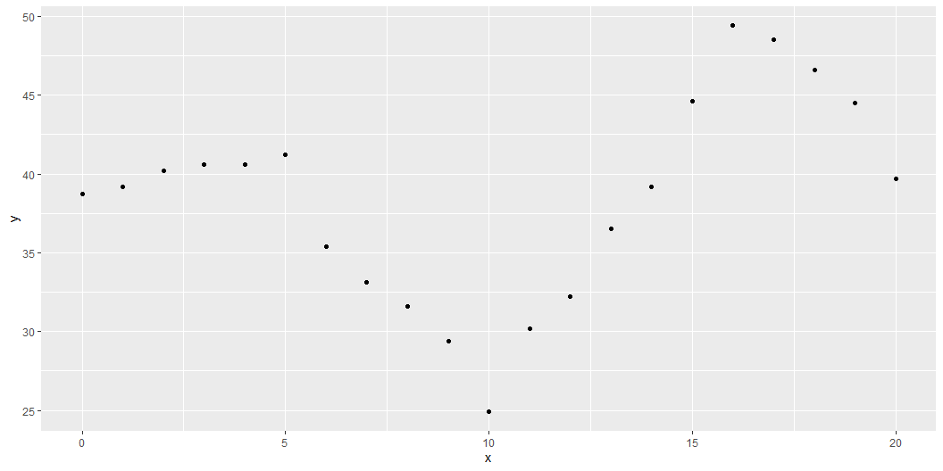
Graph of artificial data

Slide 29
Components needed for a cubic spline, 1
c1 | c2 | c3 | c4 | c5 | c6 | c7 | c8 | c9 | c10 | c11 | c12 | c13 | c14 | c15 | c16
1 | 0 | 0 | 0 | 0 | 0 | 0 | 0 | 0 | 0 | 0 | 0 | 0 | 0 | 0 | 0
1 | 1 | 1 | 1 | 0 | 0 | 0 | 0 | 0 | 0 | 0 | 0 | 0 | 0 | 0 | 0
1 | 2 | 4 | 8 | 0 | 0 | 0 | 0 | 0 | 0 | 0 | 0 | 0 | 0 | 0 | 0
1 | 3 | 9 | 27 | 0 | 0 | 0 | 0 | 0 | 0 | 0 | 0 | 0 | 0 | 0 | 0
1 | 4 | 16 | 64 | 0 | 0 | 0 | 0 | 0 | 0 | 0 | 0 | 0 | 0 | 0 | 0
1 | 5 | 25 | 125 | 0 | 0 | 0 | 0 | 0 | 0 | 0 | 0 | 0 | 0 | 0 | 0
Notes:
You can get a variety of splines by defining constant, linear, quadratic, and cubic terms and then shift those functions to the right. After shifting, fill in the hole to the left with zeros.

Slide 30
Components needed for a cubic spline, 2
c1 | c2 | c3 | c4 | c5 | c6 | c7 | c8 | c9 | c10 | c11 | c12 | c13 | c14 | c15 | c16
1 | 6 | 36 | 216 | 1 | 1 | 1 | 1 | 0 | 0 | 0 | 0 | 0 | 0 | 0 | 0
1 | 7 | 49 | 343 | 1 | 2 | 4 | 8 | 0 | 0 | 0 | 0 | 0 | 0 | 0 | 0
1 | 8 | 64 | 512 | 1 | 3 | 9 | 27 | 0 | 0 | 0 | 0 | 0 | 0 | 0 | 0
1 | 9 | 81 | 729 | 1 | 4 | 16 | 64 | 0 | 0 | 0 | 0 | 0 | 0 | 0 | 0
1 | 10 | 100 | 1000 | 1 | 5 | 25 | 125 | 0 | 0 | 0 | 0 | 0 | 0 | 0 | 0

Slide 31
Components needed for a cubic spline, 3
c1 | c2 | c3 | c4 | c5 | c6 | c7 | c8 | c9 | c10 | c11 | c12 | c13 | c14 | c15 | c16
1 | 11 | 121 | 1331 | 1 | 6 | 36 | 216 | 1 | 1 | 1 | 1 | 0 | 0 | 0 | 0
1 | 12 | 144 | 1728 | 1 | 7 | 49 | 343 | 1 | 2 | 4 | 8 | 0 | 0 | 0 | 0
1 | 13 | 169 | 2197 | 1 | 8 | 64 | 512 | 1 | 3 | 9 | 27 | 0 | 0 | 0 | 0
1 | 14 | 196 | 2744 | 1 | 9 | 81 | 729 | 1 | 4 | 16 | 64 | 0 | 0 | 0 | 0
1 | 15 | 225 | 3375 | 1 | 10 | 100 | 1000 | 1 | 5 | 25 | 125 | 0 | 0 | 0 | 0

Slide 32
Components needed for a cubic spline, 4
c1 | c2 | c3 | c4 | c5 | c6 | c7 | c8 | c9 | c10 | c11 | c12 | c13 | c14 | c15 | c16
1 | 16 | 256 | 4096 | 1 | 11 | 121 | 1331 | 1 | 6 | 36 | 216 | 1 | 1 | 1 | 1
1 | 17 | 289 | 4913 | 1 | 12 | 144 | 1728 | 1 | 7 | 49 | 343 | 1 | 2 | 4 | 8
1 | 18 | 324 | 5832 | 1 | 13 | 169 | 2197 | 1 | 8 | 64 | 512 | 1 | 3 | 9 | 27
1 | 19 | 361 | 6859 | 1 | 14 | 196 | 2744 | 1 | 9 | 81 | 729 | 1 | 4 | 16 | 64
1 | 20 | 400 | 8000 | 1 | 15 | 225 | 3375 | 1 | 10 | 100 | 1000 | 1 | 5 | 25 | 125

Slide 33
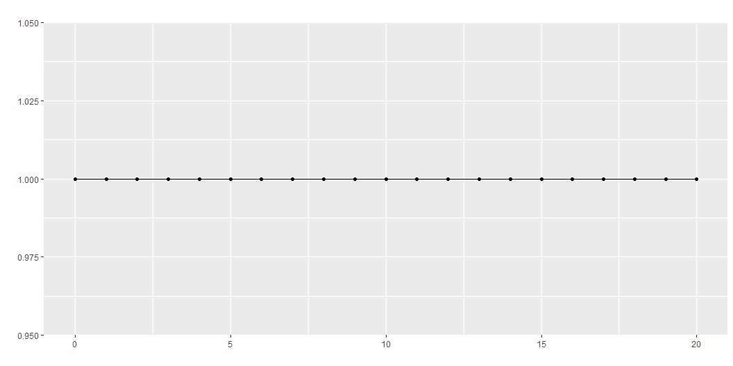
Intercept for the full range

Slide 34
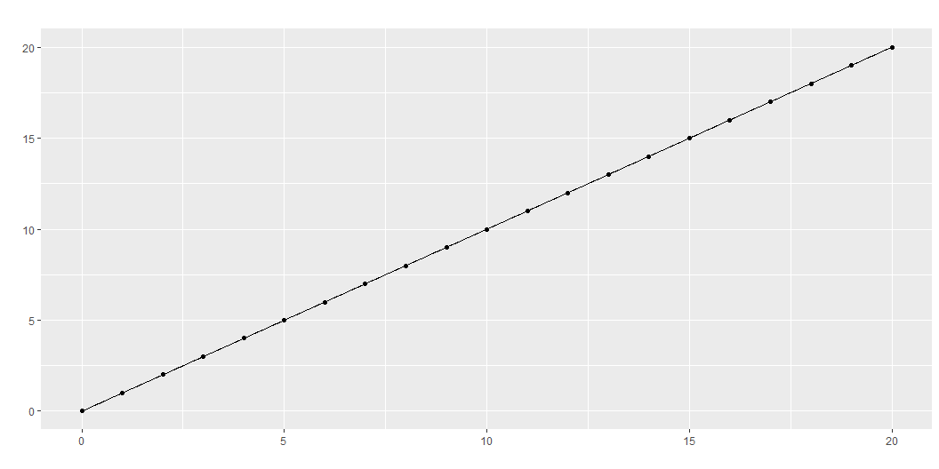
Linear term for the full range

Slide 35
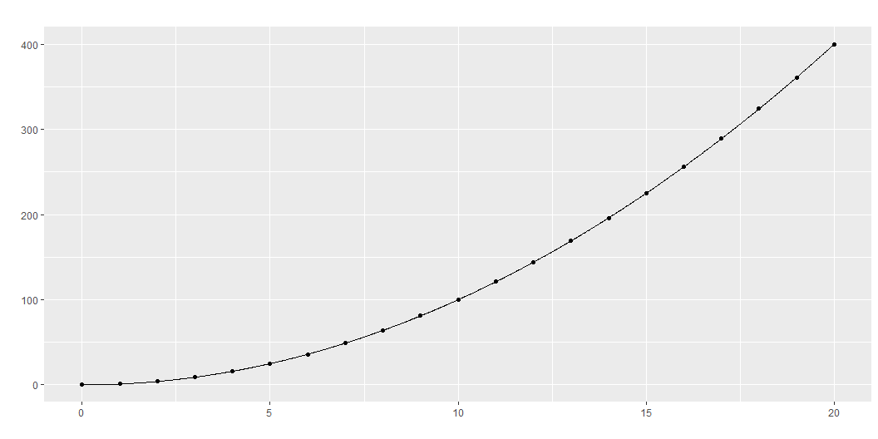
Quadratic term for the full range

Slide 36
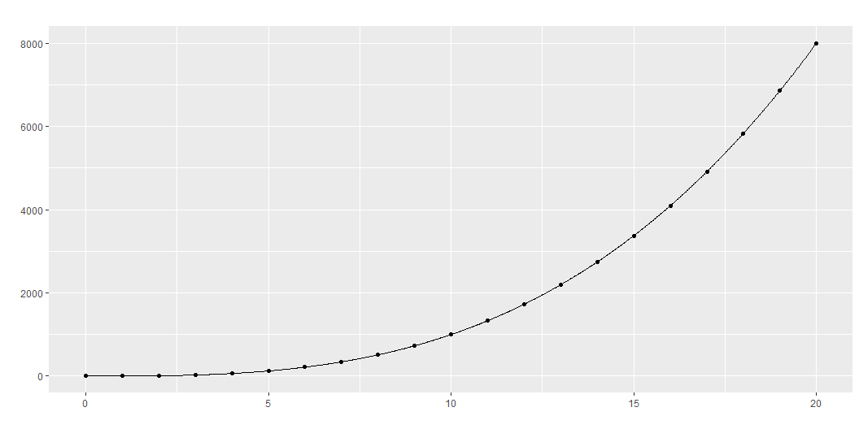
Cubic term for the full range

Slide 37
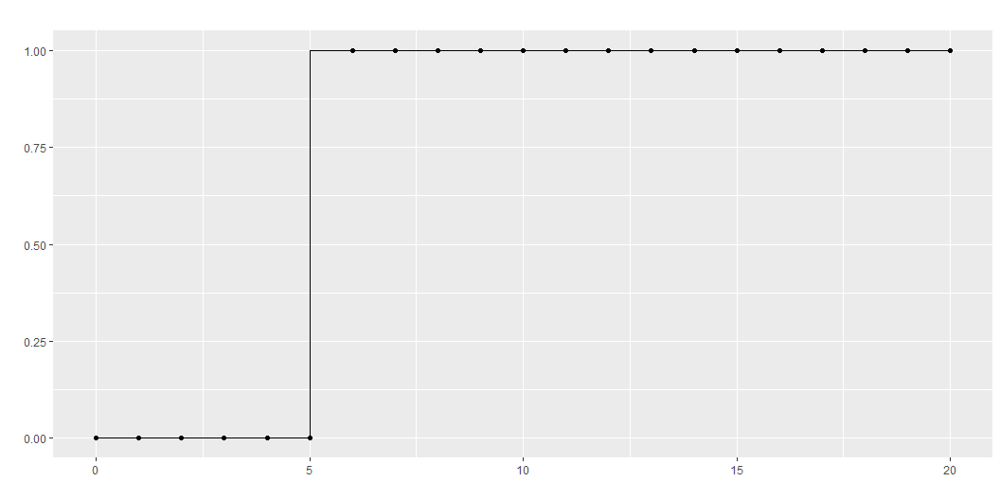
Intercept restarted at x=5

Slide 38
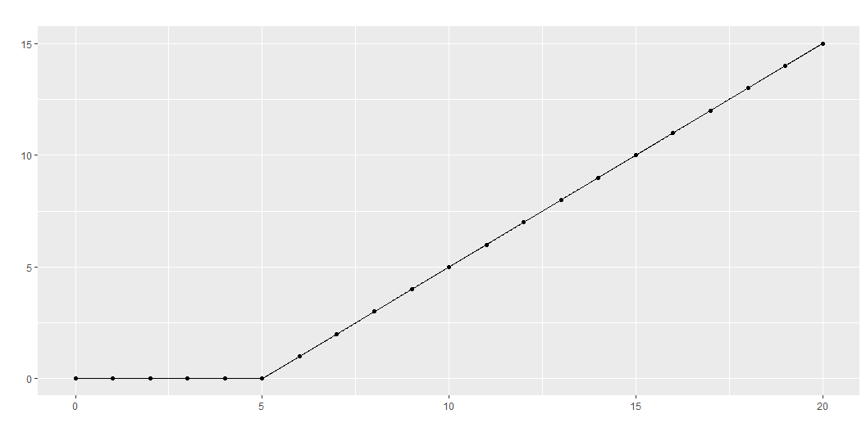
Linear term restarted at x=5

Slide 39
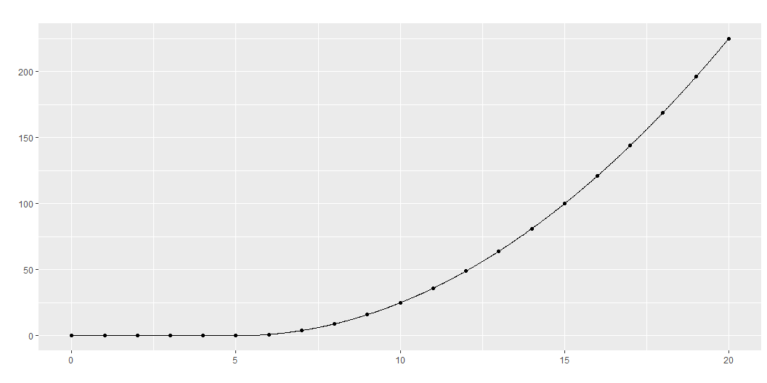
Quadratic term restarted at x=5

Slide 40
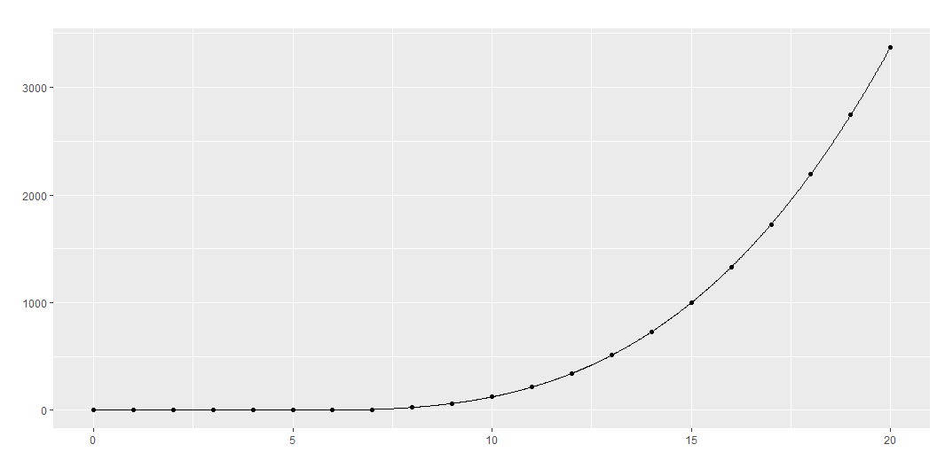
Cubic term restarted at x=5

Slide 41
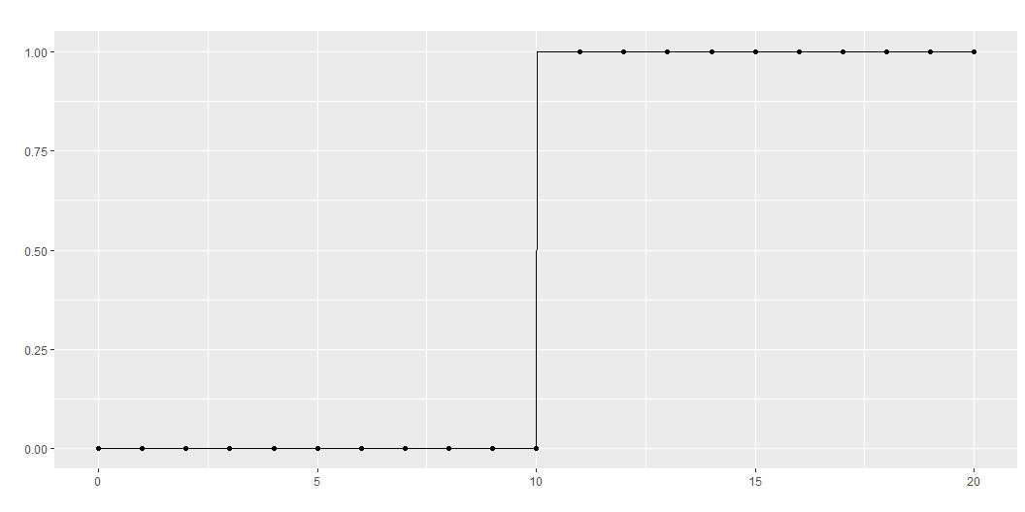
Intercept restarted at x=10

Slide 42
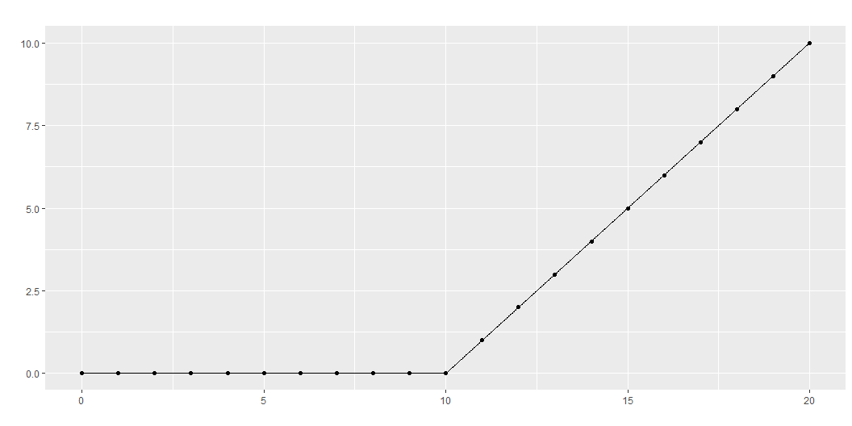
Linear term restarted at x=10

Slide 43
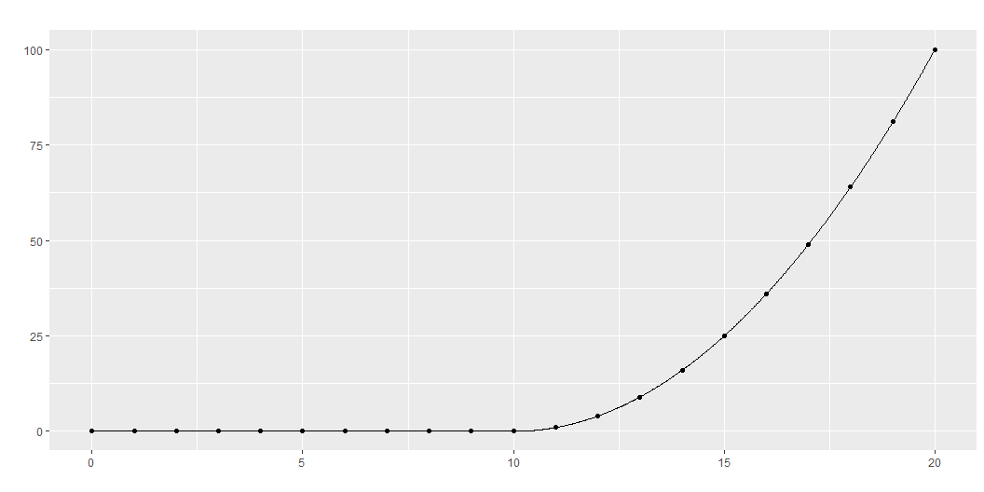
Quadratic term restarted at x=10

Slide 44
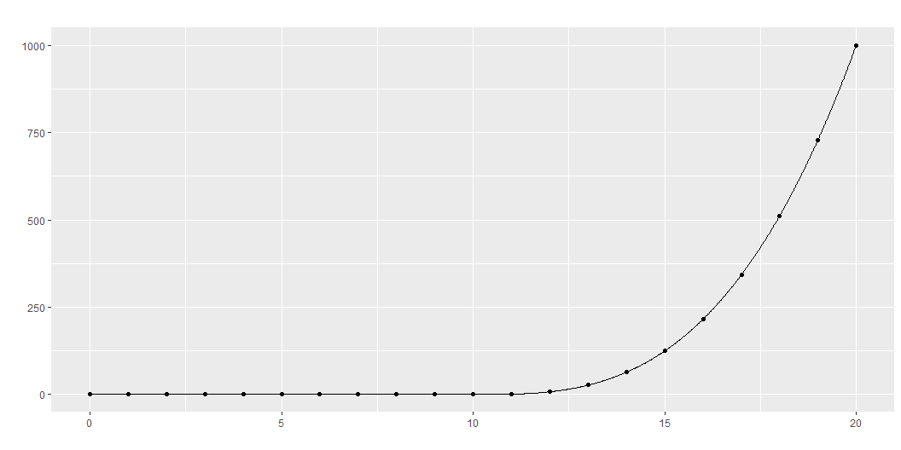
Cubic term restarted at x=10

Slide 45
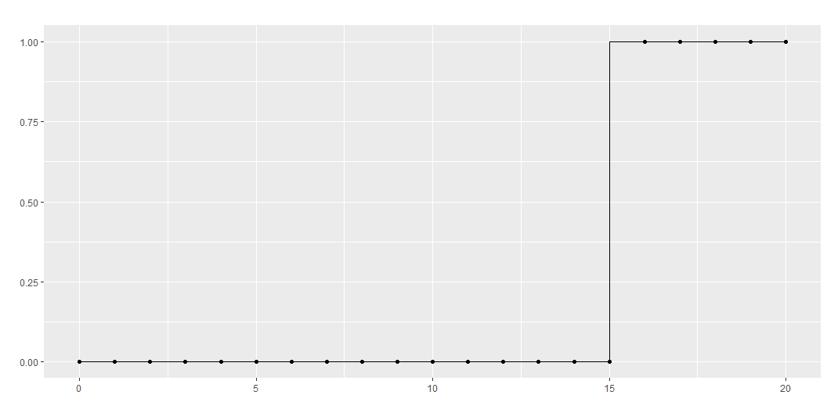
Intercept restarted at x=15

Slide 46
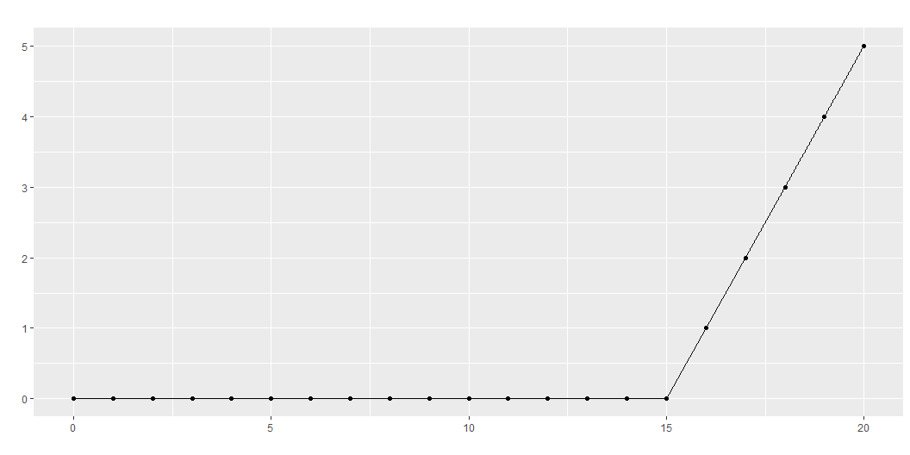
Linear term restarted at x=15

Slide 47
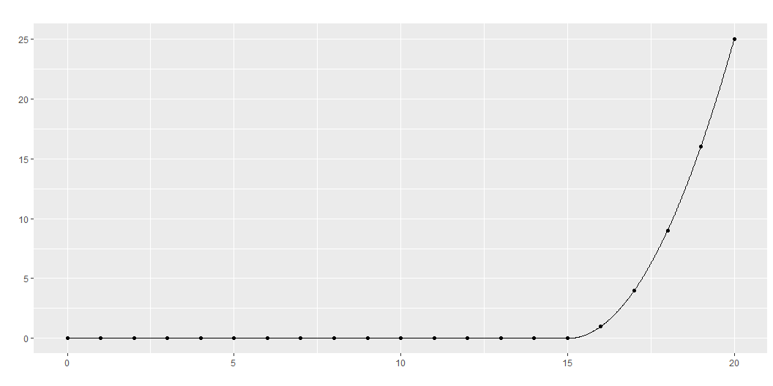
Quadratic term restarted at x=15

Slide 48
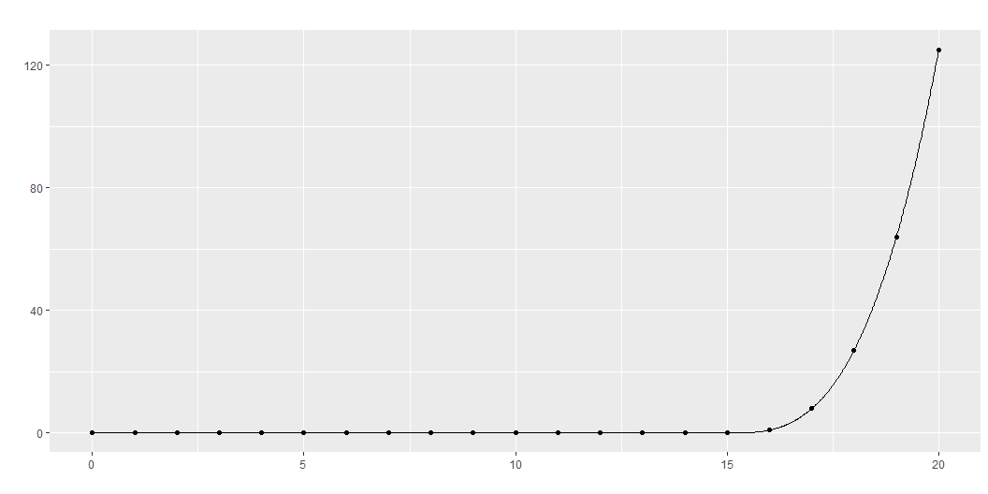
Cubic term restarted at x=15

Slide 49
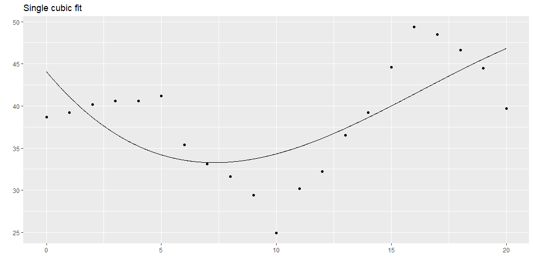
Single cubic polynomial
Notes:
The graph shown here represents the best fitting single cubic polynomial. It uses
c1, the intercept for the overall range,
c2, the linear term for the overall range,
c3, the quadratic term for the overall range, and
c4, the cubic term for the overall range.
It doesn’t fit the data very well.

Slide 50
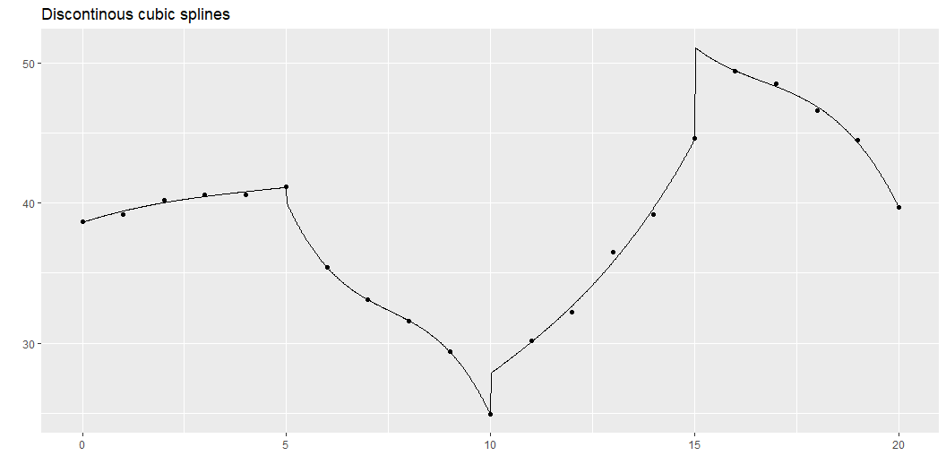
Separate cubic polynomials
Notes:
So, we could fit a cubic model for the first five data points, for the second five, the third five, and the fourth five. This is a bit much: a cubic model has four parameters, so fitting four of them would use up 16 degrees of freedom in a data set with only 20 observations. But bear with me a bit on this.
The trick to fitting four separate cubic polynomials is to “restart” the intercept, linear, quadratic, and cubic terms after x=5, x=10, and x=15, as shown above. This leads to a model with 16 degrees of freedom. This is way too many degrees of freedom for only 20 data points, but it helps anchor a series of more reasonable models.
This function is not continuous or smooth. To make the function continuous, drop the extra intercept terms.

Slide 51
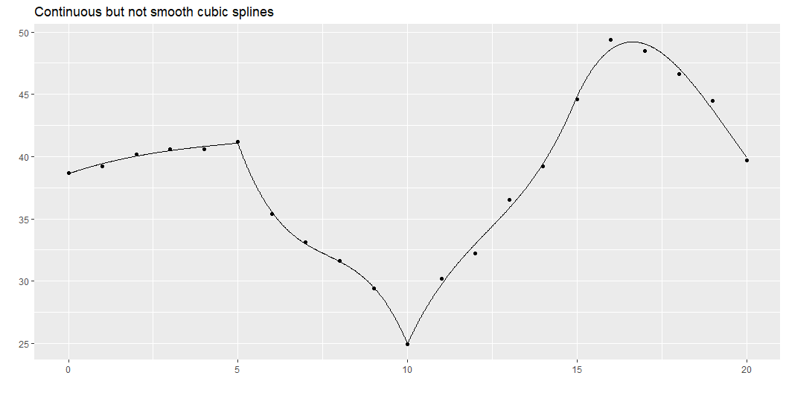
Continuous splines
Notes:
While this graph is continuous, it still takes some abrupt turns. What this curve lacks is smoothness. The mathematical concept of smoothness is measured in terms of the continuity of derivatives.

Slide 52
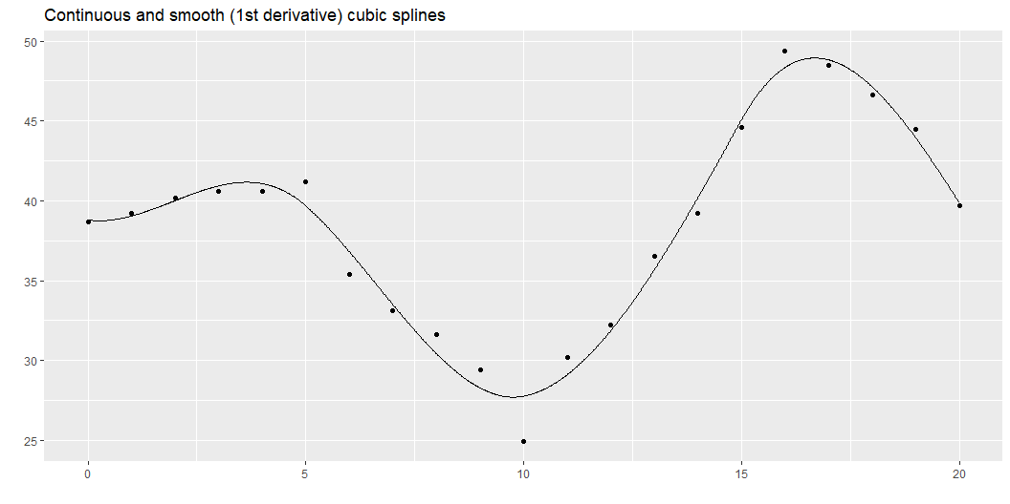
Smooth splines
Notes:
Here is a function that has a continuous first derivative. You fit this model by dropping the extra linear terms beyond the first one. Notice a pattern here. As you place additional restrictions on the spline (continuity, smoothness), you need fewer parameters. The four cubic models with no restrictions used up 16 degrees of freedom. When you added a continuity restriction, you only needed 13 degrees of freedom for the model. Add a smoothness restriction and you only need 10 degrees of freedom.

Slide 53
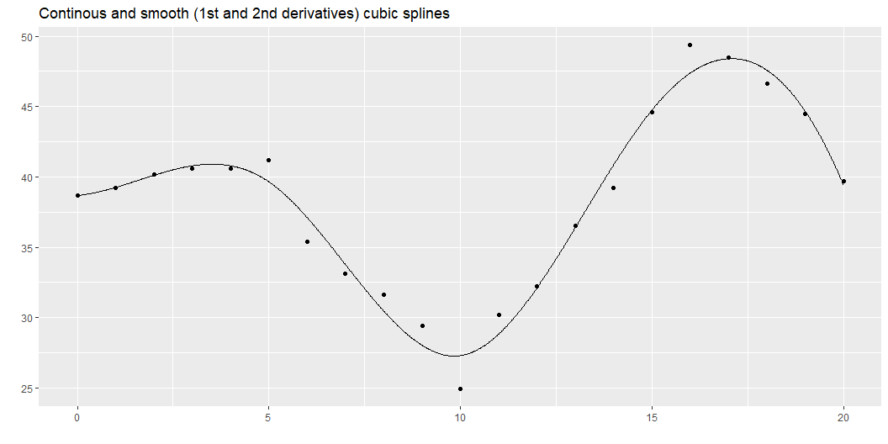
Even smoother
Notes:
Here is a function that has continuous first and second derivatives. This is a greater degree of smoothness than above and it requires only 7 degrees of freedom.
This is what most people refer to when they talk about splines: a piecewise cubic model with continuity and continuous first and second derivatives. It is a fairly simple model (not that many degrees of freedom), but it produces a curve that has the flexibility to fit a variety of curves that have the aesthetically pleasing features of continuity and smoothness.
Continuity and smoothness are more than just aesthetics, though. There are many scientific settings where we expect no jumps (discontinuities) and no abrupt turns (lack of smoothness). If you are measuring the onset of symptoms from a disease, you know that the viruses or bacteria that are causing the disease are increasing in a continuous and smooth pattern. So any problems that they cause should also increase in a continuous and smooth pattern.
Other settings, however, should not necessarily be expected to produce continuous and smooth outcomes. If a particular metabolic pathway becomes saturated or an anotomical barrier is breached, the suddenness transition could result in an abrupt turn or a discontinuity. So do think about the particular context of your problem when deciding what type of spline model to use.
This approach is simple and easy to follow, but there is one catch. There is an issue with multicollinearity.

Slide 54
Multicollinearity
c2 c3 c4 c8 c12 c16 c2 1.00 0.97 0.92 0.85 0.73 0.55 c3 0.97 1.00 0.99 0.95 0.86 0.67 c4 0.92 0.99 1.00 0.99 0.93 0.76 c8 0.85 0.95 0.99 1.00 0.97 0.83 c12 0.73 0.86 0.93 0.97 1.00 0.92 c16 0.55 0.67 0.76 0.83 0.92 1.00
Notes:
The correlations are quite high and this can lead to computational problems, including rounding errors. So most spline models implemented on a computer use a different approach.

Slide 55
Break #2
What you have learned
Building cubic splines from scratch
What’s coming next
B-splines, N-splines, Harrell splines

Slide 56
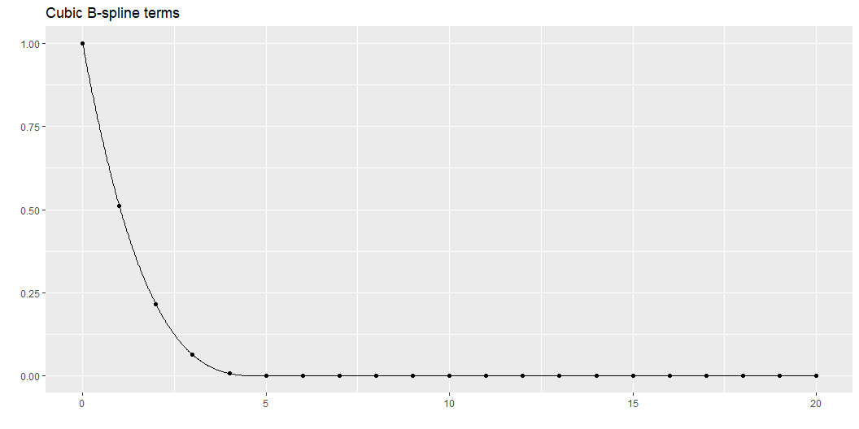
B-splines
B-splines provide a solution with less issues of multi-collinearity. You use the bs function in the splines package to compute B-splines.
The individual columns represent piecwise cubic polynomials. Notice how they are concentrated in certain intervals and there is only a partial overlap between these intervals. Notice also how they transition smoothly to zero outside those intervals.

Slide 57
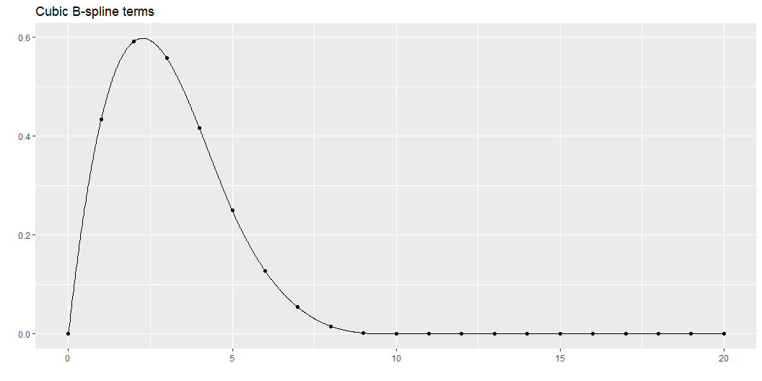

Slide 58
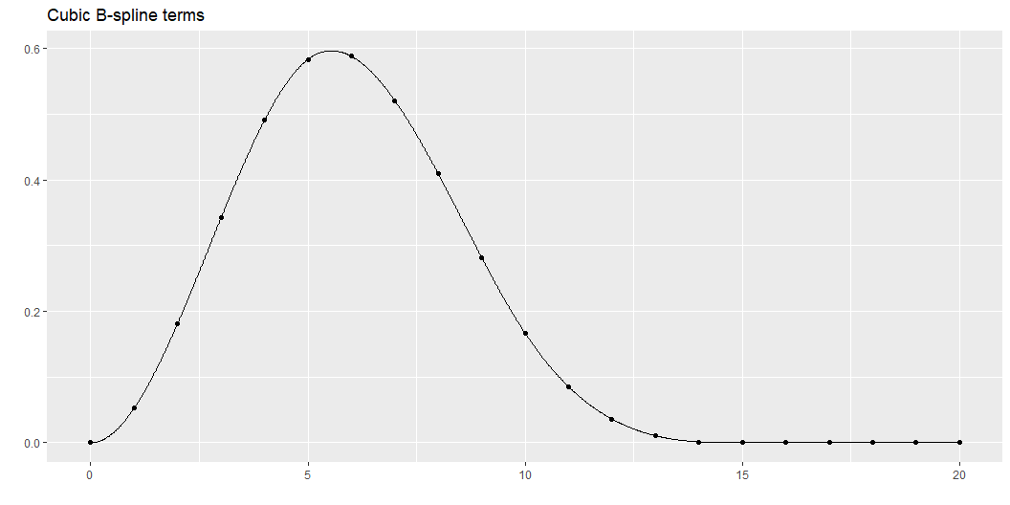

Slide 59
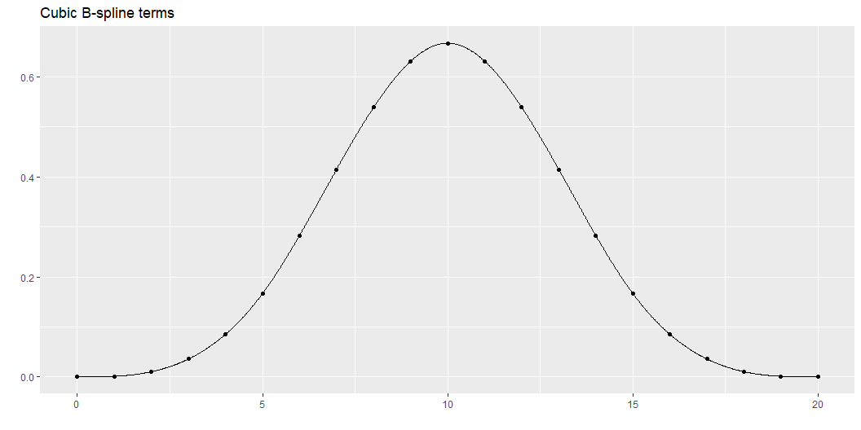

Slide 60
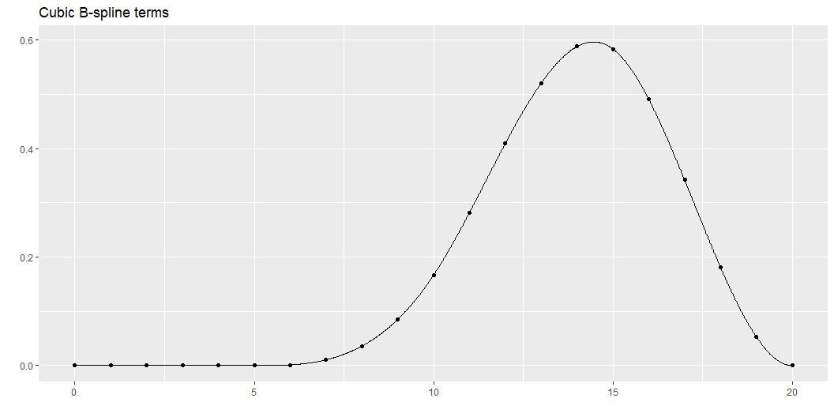

Slide 61
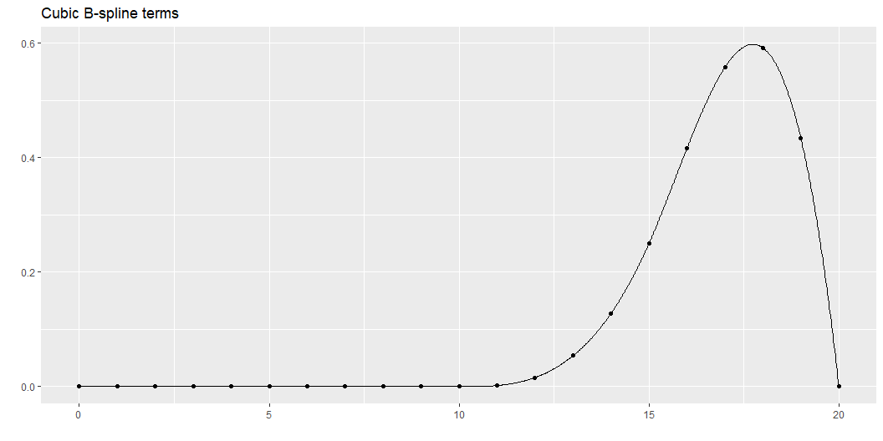

Slide 62
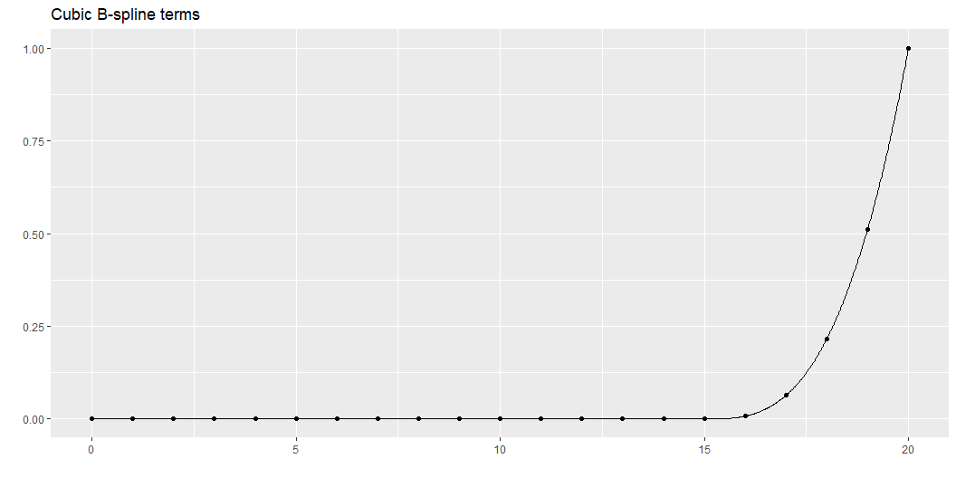

Slide 63
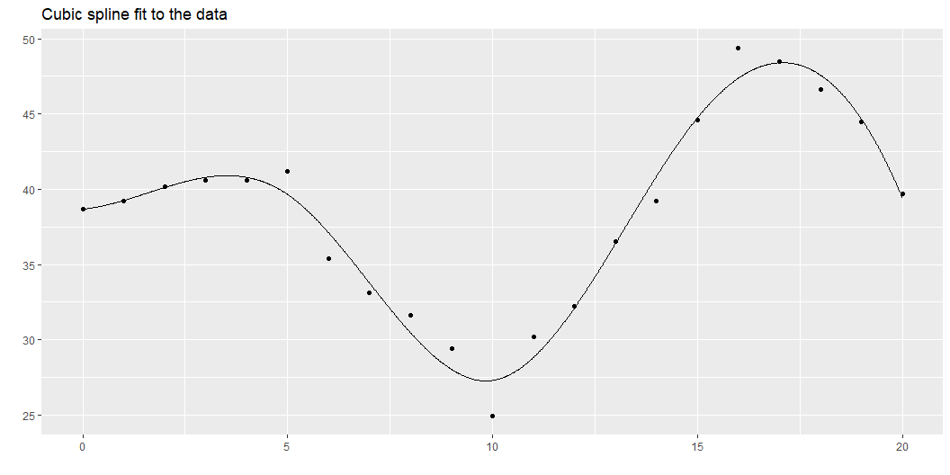
B-splines have less issues with multicollinearity.
1 2 3 4 5 6 7 1 1.0 0.4 -0.2 -0.4 -0.3 -0.2 -0.1 2 0.4 1.0 0.4 -0.5 -0.5 -0.4 -0.2 3 -0.2 0.4 1.0 0.2 -0.6 -0.5 -0.3 4 -0.4 -0.5 0.2 1.0 0.2 -0.5 -0.4 5 -0.3 -0.5 -0.6 0.2 1.0 0.4 -0.2 6 -0.2 -0.4 -0.5 -0.5 0.4 1.0 0.4 7 -0.1 -0.2 -0.3 -0.4 -0.2 0.4 1.0
Although there is some correlation, this not nearly as bad as the piecewise approach.

Slide 64
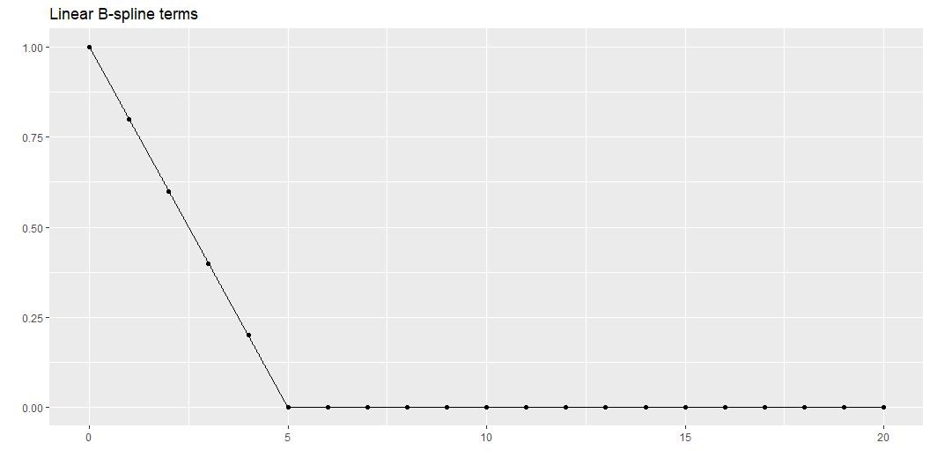
Linear and quadratic B-splines
Although most applications use cubic B-splines, they are available in other forms. Here is the linear spline.
The terms in the linear B-splines are mostly piecewise linear functions. Notice how they are zero outside certain ranges, with only a small amount of overlap between adjacent terms.

Slide 65
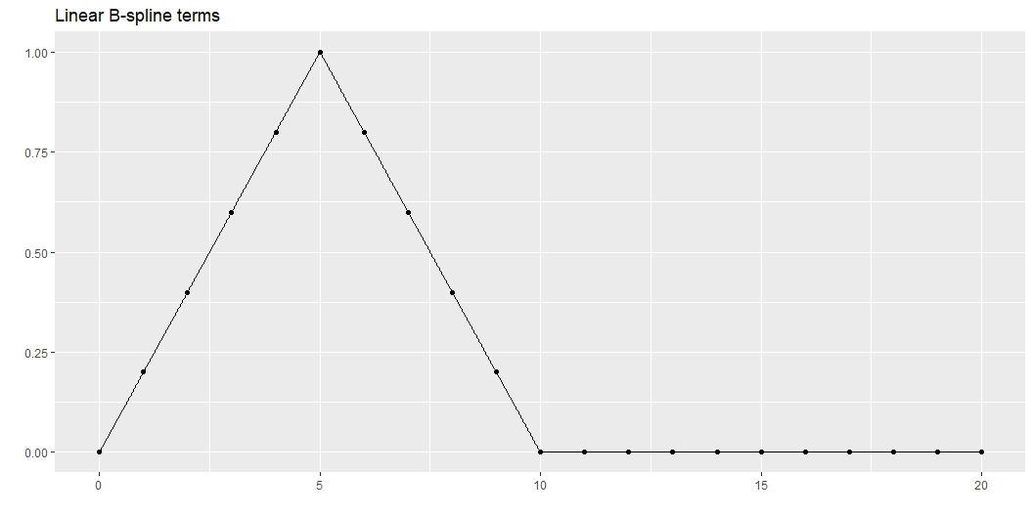

Slide 66
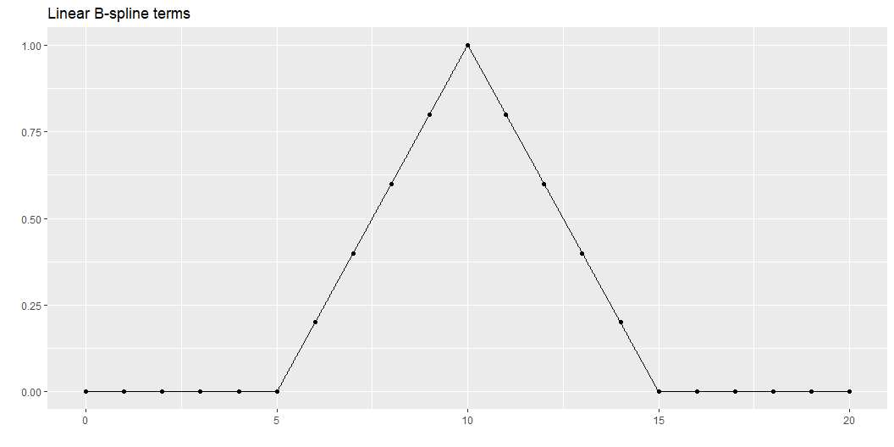

Slide 67
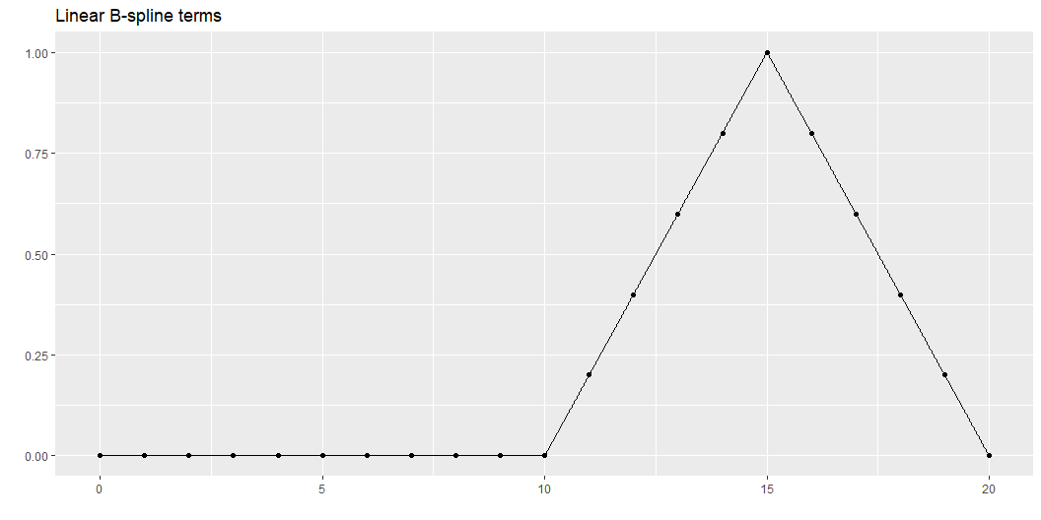

Slide 68


Slide 69

This is a linear spline fit to the data you have been using.

Slide 70

A linear spline has continuity, but the nature of linear function makes it impossible to get smoothness.
You can also compute quadratic splines.
Notice how the quadratic spline terms transition smoothly to zero outside certain intervals.

Slide 71


Slide 72


Slide 73


Slide 74


Slide 75


Slide 76

This is the fit of the quadratic spline. It can only produce smoothness up to a continuous first derivative, but the difference between this and smoothness with continuous first and second derivatives is subtle.

Slide 77
The quadratic spline seems to do fairly well here and there is often little difference between it and the cubic spline. Nevertheless, cubic splines are far more common.
You could also look at quartic splines (using fourth order polynomials) or even higher. Sometimes these are used when you need to examine not just the function itself, but its derivatives. These applications, however, are rare.

Slide 78

Natural splines
A variant on B splines are natural splines (also called restricted cubic splines). These splines place an additional restriction to the left of the first knot and to the right of the last knot. The spline is constrained to be linear at both extremes. This makes practical sense, as there is less data at the extremes, making estimation of a complex cubic function here worrisome. This also makes extrapolation outside of the range of data less problematic. Cubic polynomials have the potential of extreme shifts and if these occur outside the range of the data, they could lead to some awful extrapolations.
You should always be very careful, of course, as any effort to extrapolate beyond the range of data is dangerous. Nevertheless, restricting the extrapolation to a linear function is probably safer than letting the cubic polynomial wiggle around.
It is a bit tricky to show the extrapolation of nte natural splines. This approach uses the predict function.

Slide 79


Slide 80


Slide 81


Slide 82


Slide 83

Here is the natural spline fit to your simulated dataset.

Slide 84
You can probably see the linearity at the extremes of the data.

Slide 85
How many knots?
A difficult question is how many knots to use. Too many knots and you might end up overfitting. Too few and you might end up with not enough flexibility to fit your data well.

Slide 86

Use AIC or BIC
The AIC (Akaike Information Criterion) and the BIC (Bayesian Information Criterion) are useful measures for comparing different statistical models. In linear regression both AIC and BIC look at how close the fitted curve is to the data, but adds a penalty for model complexity. This helps avoid the situation where an excessively complex model with only marginally better predictive power is selected over a simpler model that predicts almost as well.
NOte that a p-value will not work here except in some special cases where all of the knots but one coincide. The p-value fails because (with a few rare exceptions) one spline model is not nested inside another.

Slide 87


Slide 88


Slide 89


Slide 90


Slide 91
Eyeball the data
Look at the number of bends in the data. If the data increases to a single maximum and then decreases after that, a simpler spline with 2 or 3 knots may be sufficient. This also applies if the data decreases to a single minimum and then increases after that. If there are more bends (e.g., increase to a maximum, decrease to a minimum, and then increase again), then a larger number of knots may be needed.

Slide 92
Frank Harrell’s suggestions
Use 4 knots if the total sample size is less than 100 and use 5 knots if it is more than 100.

Slide 93
Pick a number based on your a priori beliefs
You may have a feel for how much complexity is appropriate based on your years of experience as a data analyst and your scientific knowledge of the process at hand. After you work with enough splines, you do get an appreciation on how wiggly they can get. If you also have a rough idea of how the nonlinear relationship is going to be, perhaps based on seeing other similar problems in the area, you can match the degrees of freedom of the spline to your expectation, prior to looking at the data.

Slide 94
Pick a number after looking at some preliminary graphs
This is a bit controversial. Selecting a statistical model post hoc (after viewing the data) leaves you open to a charge of data dredging or going on a fishing expedition. To be fair, it is not as bad as some approaches (such as running ten tests and then choosing the one with the smallest p-value).

Slide 95
Where to place the knots?

Slide 96
Use inside knowledge
Sometimes you have knowledge of the specific application that will help you to figure out where to put your knots.
I am not an expert on cars, but I have been told that many newer cars with automatic transmission change how the transmission behaves around 40 miles per hour. This transition helps with highway mileage. So if you are fitting a spline curve to data where how the transmission behaves, make sure that you place one or two of your knots near 40 miles per hour.
I am also not an expert on kidneys, but I have been told that the Glomerural Filtration Rate is not too critical if the value is above 90, but becomes very serious when it is less than 30. So a model looking at health effects using GFR should probably have knots around 30 and 90.
Similarly, CD4 cell counts above 500 are a good sign, but things turn rapidly worse if they dip below 200.

Slide 97
Frank Harrell’s suggestion
Frank Harrell suggests that you place the knots not evenly across the range of X but at equally spaced quantiles of the X distribution. This makes sense when the distribution of the X values is not uniform. If, for example, X is skewed to the right (has a tendency to produce most of the data on the left with a few scattered outliers on the right), the knots will tend to favor the data-rich left side of the distribution. He also suggests placing the leftmost and rightmost knots near, but not at the extremes of the X values, such as at the 10th or 90th percentiles or at the fifth smallest and the fifth largest values in the data. The actual percentiles are a bit tricky to explain.
“For 3 knots, the outer quantiles used are 0.10 and 0.90. For 4-6 knots, the outer quantiles used are 0.05 and 0.95. For more than 6 knots, the outer quantiles are 0.025 and 0.975. The knots are equally spaced between these on the quantile scale. For fewer than 100 non-missing values of x, the outer knots are the 5th smallest and the 5th largest x.” as quoted here,
If you pick this apart, you can deduce that 4 knots for a large dataset would be placed at the 5th, 35th, 65th and 95th percentiles.

Slide 98

It doesn’t matter
Most references I have looked at state that it is the number of knots rather than the placement of the knots that is critical.
Here are B-spline models with knots sliding from 3, 8, 13 to 7, 12, 17.

Slide 99


Slide 100


Slide 101


Slide 102


Slide 103
There are a few change in the spline functions as the knots move, but the changes are not very large in magnitude.

Slide 104
References
Donald H. House. Chapter 14. Spline Curves. Available in pdf format.
Aris Perperoglou, Willi Sauerbrei, Michal Abrahamowicz, Matthias Schmid. A review of spline function procedures in R. BMC Medical Research Methodology 19, 46 (2019). DOI: 10.1186/s12874-019-0666-3. Available in html format or pdf format.

Slide 105
Break #3
What you have learned
B-splines, N-splines, Harrell splines
What’s coming next
How many knots and where to put them

Slide 106
Part 04
x1 x2 x3 x4 x5 x6 1 -0.9741878 1.52238054 1.483758268 -1.208639128 0.47221181 0.02840415 2 2.2237697 1.43567152 0.282606063 -0.129559592 -0.87710060 -1.11430064 3 0.7294402 1.32446306 -1.176349339 -0.903528903 -0.66549730 -0.35052687 4 -1.0672656 1.34760969 -1.379377251 0.176156470 0.31490841 -1.82147625 5 -1.1495715 0.78705630 1.211881765 -0.204666773 0.72737651 0.48604983 6 -0.6649633 -0.30862082 0.053094181 0.293621016 -2.39783555 -0.45199938 7 0.1231528 -0.35850274 -0.397019781 -0.826850899 1.20586156 -1.07867239 8 1.0371776 0.62523729 -0.564743499 -0.342181623 -1.27900334 0.21220826 9 -0.5100129 0.74719455 0.235847031 -0.246544238 0.60308953 1.17374984 10 0.8738914 0.44079098 0.903915514 0.237780640 1.22261967 0.01532434 11 0.2181101 -0.23045231 -2.360541487 1.452735747 0.05233547 0.99618999 12 0.5887287 -0.14813277 -0.005688358 1.418221966 1.02008882 -0.39133890 13 -0.0759152 -0.06415957 0.548306902 0.815496767 0.54036177 -0.60215127 14 0.8317204 0.30954236 1.438586538 0.392858417 0.33155088 -0.32807729 15 -0.3847872 1.21743393 1.560518469 -0.070626640 -0.07410055 1.20694432 16 2.2786741 -1.71125832 -1.571627057 0.160934674 2.28670593 -0.85641196 17 0.3910452 -1.58830287 -0.223951679 -0.682670669 0.78668151 0.90271492 18 2.5204090 -0.74894227 0.745647502 -0.967604895 -1.75245538 -0.91129414 19 1.0640830 0.30334056 0.707646654 -0.008068039 0.92699771 -0.85679128 20 0.2093347 -0.65909503 -1.076138069 -0.970802046 -0.93278255 -0.54552911

Slide 107

Part 04

Slide 108
Break #4
What you have learned
How many knots and where to put them
What’s coming next
Logistic regression example

Slide 109
Part 05
x1 x2 x3 x4 x5 x6 1 -0.30827773 -0.67200758 -0.76018362 -0.66435828 -0.1127999 -0.19610852 2 0.50720211 0.25143456 -1.20111657 -0.33042476 0.3953219 -0.26877383 3 -1.53222311 2.39285450 -0.70573233 -0.29549136 -0.8889928 0.06442995 4 1.08617405 0.18445848 -0.34985561 1.01534156 0.7301196 1.04665783 5 -0.55092853 2.68551978 -1.10544036 0.66819256 1.0100903 -0.40988697 6 0.66465503 0.44836746 -0.55292406 -0.34947931 -0.6432855 -1.12153047 7 -0.62894289 -0.41231625 1.21769395 -0.21282504 0.6390797 0.47519775 8 0.07020654 -0.48372060 0.71895257 0.09285985 -0.6462215 -0.01898570 9 -1.08002566 0.60936438 -0.02992644 -0.83917747 0.2083882 0.63855026 10 0.41049864 -0.87693654 -1.87215252 -0.09433216 0.1995522 1.34137226 11 -1.52316720 1.82155073 -0.51368075 -1.25970282 1.8322318 -0.11897052 12 -0.27175856 0.90851614 -0.09183294 -0.02524934 0.6713953 1.06650796 13 -0.89654502 0.96392310 1.74642052 -0.70852822 1.5653082 0.30749885 14 0.64123430 -0.66050978 0.64728214 2.78168785 2.0396084 -0.33750999 15 0.37134552 -1.94012668 -0.66279037 -1.20328664 0.1498590 -0.28028715 16 -0.14577531 -0.01890228 0.63525548 -0.54654764 0.6616350 1.17849565 17 -0.26326881 0.95247250 0.34969514 0.96953632 0.8938588 -0.36954004 18 2.57073671 -1.31913030 -2.02966662 0.76226927 1.2163280 0.26228220 19 -0.82666996 -1.18844970 -0.84047073 -0.98294533 -0.1179564 1.14917736 20 0.43123385 0.84470083 -1.31713902 1.54069753 1.1729769 1.25237129

Slide 110

Part 05

Slide 111
Break #5
What you have learned
Logistic regression example
What’s coming next
Some code hints for R, SAS, Stata

Slide 112
Part 06
x1 x2 x3 x4 x5 x6 1 -0.17675699 1.27390207 2.0829081 -0.61547687 -1.01454456 -0.68679785 2 1.13861109 -2.99176420 0.4908653 1.12811113 -0.41221883 -2.04501875 3 1.28466986 0.72352003 1.7390673 -0.32389834 0.45339576 1.00430422 4 -1.97986630 -0.58856294 1.6849179 1.51549925 0.55901294 0.53072325 5 -0.40872999 1.70189151 -0.4211657 0.61777709 -2.88411102 -1.21237202 6 0.11880155 1.86018790 -0.1621096 1.52249829 0.65472725 -0.30683920 7 1.03939455 0.55011988 -0.6827092 0.62522100 -0.97896036 0.42454738 8 0.25931940 -2.21987787 -0.7444022 0.30157750 -0.03290672 0.99367218 9 -1.58035076 -1.30969473 1.1001644 0.14777603 -1.66249619 -1.20848615 10 0.34631011 -1.52571328 0.5639960 -0.59494896 -0.41713984 0.42607120 11 -2.01746821 -1.14993564 1.3457350 0.36007141 1.15144092 1.31224501 12 0.41796947 -0.10437396 -0.4905218 -0.38622622 0.11598024 -0.85558689 13 -0.68973860 1.03614435 0.8097603 -0.85302048 -1.51123533 1.13465184 14 -0.25296210 -0.38599672 0.1199182 -0.01010412 -2.11006927 -0.08664072 15 -0.06712562 0.52734605 -1.6426261 0.59652887 1.07954269 1.50921842 16 -0.65775740 0.06878021 0.1887953 0.35029581 0.39321654 -0.38551020 17 0.02506503 2.53418552 0.1343927 -0.28913446 0.91178561 -0.03764718 18 1.88987923 -0.98819293 0.2251274 0.32878176 0.82044801 1.35587617 19 0.50185630 1.66880015 -0.2920417 -0.94314136 -1.43645666 0.44260470 20 -0.64703857 -0.63023464 -1.6771369 -0.63636712 -0.32344230 -0.12054495

Slide 113

Part 06

Slide 114
Summary
What you have learned
Variety of regressions
Building cubic splines from scratch
B-splines, N-splines, Harrell splines
How many knots and where to put them
Logistic regression example
Some code hints for R, SAS, Stata

