Slide 1
Cross-over Trials
Steve Simon

Slide 2

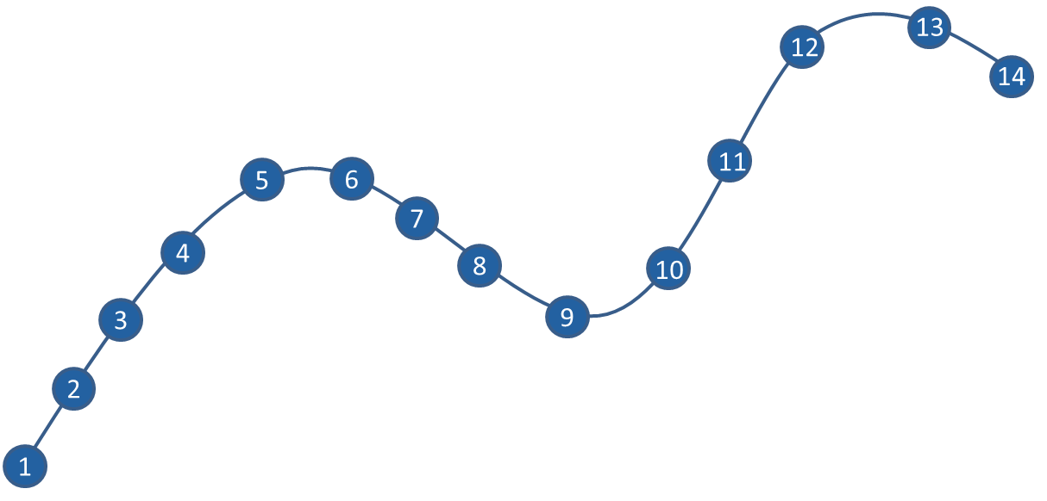
Where this fits

Slide 3
Topics to be covered
What you will learn
The paired t-test
The AB/BA cross-over
Period effects and carry-over
When should you use or not use a cross-over
Cross-over trials with a binary outcome
Cross-over trials with more than two treatments
Notes:
Speaker notes
Cross-over trials provide a very powerful approach for comparing two treatment conditions. Research subjects get both treatment conditions, which we will label arbitrarily as A and B. A randomly selected half get A followed by B and the other half gets B followed by A. This is generally referred to as the AB/BA design. Because each subject serves as their own control, you remove a large amount of variation. Often a cross-over trial can produce good results, even with a few dozen patients.
Cross-over trials require that the condition being studied is chronic in nature, and that the effect of the first treatment given does not carry over into the second treatment evaluation. There are important ethical and practical concerns about designing cross-over trials.
In this talk, you will see a review of the paired t-test, followed by an analysis of the AB/BA crossover design as a paired t-test. Then you will see how to account for the order in which the treatments were given.
After discussing the classical AB/BA cross-over design, you will see how to extend the cross-over trial to a binary outcome measure and to more than two treatments.

Slide 4
Pop quiz, true or false
Cross-over trials can only be used if the two treatments are drugs.
A paired t-test is a simple way to analyze a basic cross-over design.
A carry-over effect is easily accounted for and adjustments are relatively simple.
Cross-over trials should only be used if the disease being treated is acute, meaning that it does not persist over long periods of time.
Put your answers in the chat box as a sequence of T’s and F’s or question marks if you are not sure (e.g., TF?T).
Notes:
Speaker notes
Try these true/false questions. Put your answers in the chat box.

Slide 5
Quotations from two great philosophers
“A man cannot step into the same river twice, because it is not the same river, and he is not same man.” - Heraclitus, 544 B.C.
“You must unlearn what you have learned.” Yoda, 1980 A.D.
Notes:
Speaker notes.
I want to start with quotes from two great philosophers. You know they are great philosophers because they are known by a single name.
Heraclitus in 544 B.C. said “A man cannot step into the same river twice, because it is not the same river, and he is not same man.”
Yoda, the other great philosopher, said in 1980 A.D. “You must unlearn what you have learned.”

Slide 6
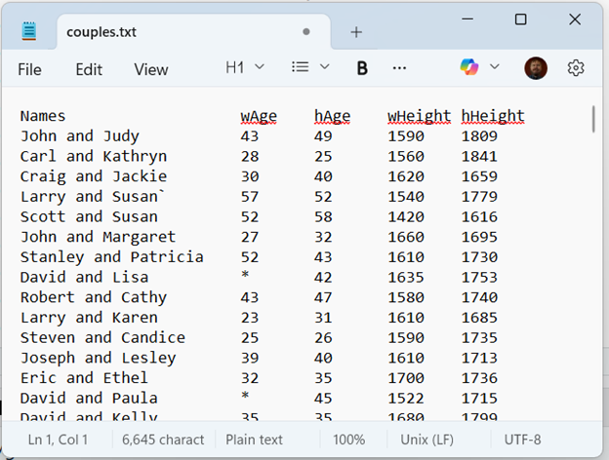
Paired t-test data
Notes:
Speaker notes
Before talking about cross-over trials, you might find it helpful to review how the paired t-test works. Here is some data I found on the web with measurements on married couples. The data has the wife’s age (wAge) and the husband’s age (hAge). Do you think there is a tendency for older men to marry younger women?
There is also data on the wife’s height (wHeight) and the husbands height (hHeight). We won’t analyze this but there is probably something interesting about tall and short patterns.

Slide 7
Descriptive statistics on wife’s age
variable | mean | sd | n
wAge | 40.7 | 11.4 | 170
Notes:
Speaker notes
The average woman is around 41 years old with a standard deviation a bit more than 11.

Slide 8
Descriptive statistics on husband’s age
variable | mean | sd | n
hAge | 42.6 | 11.6 | 199
Notes:
Speaker notes
The average husband is around 43 years old, just slightly older than the average wife. The standard deviation is about the same.

Slide 9
Descriptive statistics on age gap
variable | mean | sd | n
age_gap | 2.2 | 4.1 | 170
Notes:
Speaker notes
The average age gap is about 2 years. This average is not quite the same as the difference between the two averages, because there are some married couples with one age but not the other. These are not included in the computation of the age gap, leading to a slight discrepancy.

Slide 10
Paired t-test on couples ages
Difference mean ($\overset{‾}{D}$) = 2.2
Difference standard deviation ($S_{D}$) = 4.1
Difference standard error ($S_{D}/\sqrt{n}$) = 0.3
Test statistic $\left(\frac{\overset{‾}{D}}{S_{D}/\sqrt{n}}\right)$ = 7.15
p<0.001
Notes:
Speaker notes
The paired t-test shows a statistically significant difference. The 95% confidence interval tells you that even after allowing for sampling error, the average husband’s age is 1.6 years larger than the average wife’s age.

Slide 11
Analyze as completely randomized block design
Analysis of Variance Table Response: age Df Sum Sq Mean Sq F value Pr(>F) spouse 1 425 424.71 51.148 2.474e-11 *** pair 169 43974 260.20 31.337 < 2.2e-16 *** Residuals 169 1403 8.30 --- Signif. codes: 0 '***' 0.001 '**' 0.01 '*' 0.05 '.' 0.1 ' ' 1
Notes:
Speaker notes
You could also analyze this as a completely randomized block design. It takes a bit of restructuring because this design expects to see all the ages in a single column.
A block represents a nuisance factor that you have to account for. Blocks could represent individual patients, different clinics, separate treatment days, among other things. You control for the nuisance factors by assigning each level of a treatment to each block. Often this level of control can greatly improve the precision and power of your research study.
No one does a paired t-test this way, but if you wanted to handle more complex settings, such as risk adjustments on a paired t-test, you can do this fairly easily using simple extensions of the completely randomized block design.

Slide 12
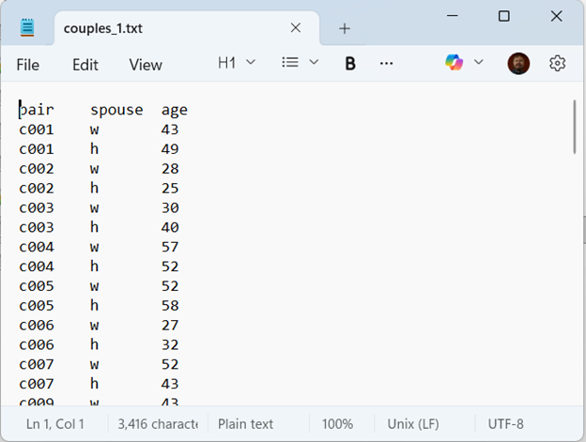
Restructured data for a completely randomized block design
Notes:
Speaker notes
Here is what the data must look like if you want to analyze it using a completely randomized block design.

Slide 13
Mixed model/random coefficient analysis
Uses long format
Dependent variable: age
Fixed effect: spouse
Random intercept: pair
Notes:
Speaker notes
You could also analyze the paired t-test using a mixed models or random coefficients approach. It would use the same long format that you use for the completely randomized block design. Specify age as the dependent variable, spouse as a fixed effect and specify a random intercept for each value of pair.
This may seem like killing a fly with cannon. True enough, but when you start looking at more complex settings, you may find this approach to be useful.
I’m not going to show any analyses using mixed models in this talk, but wanted to mention this in case you run into something later where this can help.

Slide 14
Break #1
What you have learned
The paired t-test
What’s coming next
The AB/BA cross-over

Slide 15
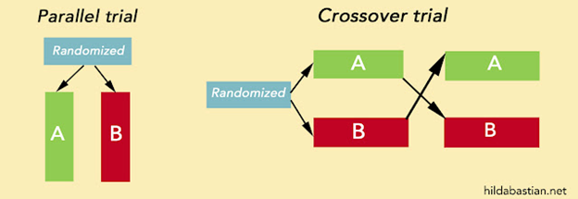
Parallel groups versus the AB/BA cross-over

Slide 16
https://statistically-funny.blogspot.com/2021/03/in-clinical-trials-you-can-have-it-both.html
Warning:
Try to use the term “treatment” and not “drug”.
Cross-over trials not limited to just drugs
Notes:
Speaker notes
This image illustrates the parallel group design and the crossover design. In the parallel groups design, you get a group of patients to volunteer to be in your study. You flip a coin. A random half of your patients get treatment A and the rest get treatment B.
In a cross-over study, you also get a group of patients. You flip a coin. A random half of the patients get treatment A followed by treatment B and the rest get treatment B followed by treatment A.
I should warn you that I might slip and use the term “drug” instead of “treatment” at times during this talk. The vast majority of cross-over trials are trials involving drugs, but do not forget that cross-over trials are more general than that. Many non-drug treatments (surgery is one example) cannot be studied using a cross-over trial, but other can. Don’t limit yourself to considering cross-trials for only drug interventions.

Slide 17
Why do you need both orders?
Can you use just AB or BA?
Yes, but…
Important unanswered questions
“A man cannot step into the same river twice”
Notes:
Speaker notes
Do you have to do both orders, AB and BA? Wouldn’t it be simpler to always do A first and always do B second? Or vice versa?
It is possible to do this. The analysis would be valid under some assumptions. The problem with using just AB or just BA is that is leaves some important questions unanswered. Remember the quote about stepping into the same river twice? If you do AB, you are always stepping into one river with A and stepping into a different river with B. Switching the order and randomly allocating which patients get which order insures that both A and B are tested in the first river and both A and B are tested in the second river.

Slide 18
Do I have to randomize?
No.
Balanced allocation is an alternative
Advantages and disadvantages
Notes:
Speaker notes
Randomization is commonly done with treatment order. But you can simply insure balanced allocation by alternating AB and BA treatments. There are advantages to this. Perfect balance removes the problems with unbalanced data. Randomization will almost always lead to unblanced data. Not a large imbalance, but still a potential complication.
Alternating AB and BA creates a predictable sequence and sometimes this can destroy blinding (if blinding is used) or lead to subversion of the study. Sometimes the systematic alternation can create statistical artefacts.
In many studies the disadvantages of alternating assignments are small enough that you can ignore them.

Slide 19
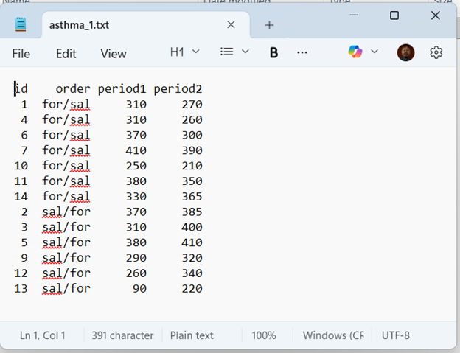
Data layout
Notes:
Speaker notes
Here is how the data might be laid out for a cross-over trial. This is for an actual clinical trial. Seven patients got formoterol followed by salbutamol. These are indicated by for/sal. Six salbutamol followed by formoterol. These are indicated by sal/for.
Both drugs are intended to treat asthma. The outcome in this study is PEF, Peak Expiratory Flow. A large value means a better outcome.
Period1 is the measurement taken at the first time point and period2 is the measurement taken at the second time point.

Slide 20
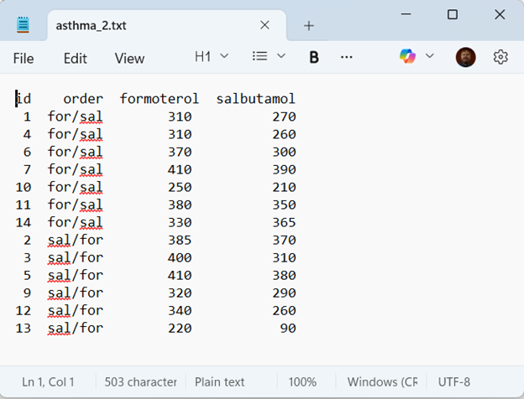
Alternate data layout
Notes:
Speaker notes
You might see the data laid out differently. In this layout, the column formoterol indicates the PEF measurement when the patient received formoterol. The column salbutamol indicates the PEF measurement when the patient received salbutamol.

Slide 21
Descriptive statistics, period 1
variable | mean¹ | sd | n
period1 | 312.3 | 82.8 | 13
¹ Larger values imply better outcomes
Notes:
Speaker notes
The simple descriptive statistics that you get with an AB/BA cross-over design will depend on how your data is laid out. With the first layout, you get descriptive statistics on period1 …

Slide 22
Descriptive statistics, period 2
variable | mean¹ | sd | n
period2 | 324.6 | 67.9 | 13
¹ Larger values imply better outcomes
Notes:
Speaker notes
… and period2. Notice that the period2 values are slightly higher on average. Not by much, but you should probably consider how to account for this in the analysis of your cross-over design.

Slide 23
Descriptive statistics, period gap
variable | mean¹ | sd | n
period_gap | 12.3 | 61.0 | 13
¹ Defined as period2 - period1
Notes:
Speaker notes
Since the data is in a wide format with the period1 and period2 values side by side, you can easily compute the period gap. Notice that the standard deviation for the period gap is only slightly smaller than the standard deviations for period1 and period2. This is because a large effect due to the different drugs being administered has not yet been accounted for.

Slide 24
Descriptive statistics, formoterol
variable | mean¹ | sd | n
formoterol | 341.2 | 59.7 | 13
¹ Larger values imply better outcomes
Notes:
Speaker notes
In the second layout, where the two variables are labeled by the drug names, you can get an average outcome for formoterol …

Slide 25
Descriptive statistics, salbutamol
variable | mean¹ | sd | n
salbutamol | 295.8 | 82.9 | 13
¹ Larger values imply better outcomes
Notes:
Speaker notes
… and salbutamol. Notice that the salbutamol average is lot lower, implying that formoterol is the better drug on average.

Slide 26
Descriptive statistics, drug gap
variable | mean¹ | sd | n
drug_gap | 45.4 | 40.6 | 13
¹ Defined as formoterol - salbutamol
Notes:
Speaker notes
Because the two drugs are listed side by side in the wide format, you can compute the average gap between the two drugs.

Slide 27
Paired t-test for the AB/BA cross-over data
Difference mean ($\overset{‾}{D}$) = 45.4
Difference standard deviation ($S_{D}$) = 40.6
Difference standard error ($S_{D}/\sqrt{n}$) = 11.3
Test statistic $\left(\frac{\overset{‾}{D}}{S_{D}/\sqrt{n}}\right)$ = 4.03
p<0.001
Notes:
Speaker notes
Just like with the couples data, you can run a paired t-test on this. It ignores the order in which the treatments were given, but this may not be such a terrible thing. It depends a lot on the context of the problem. You’ll see some reasons for running a more complex model in just a little bit.

Slide 28
Analysis using a completely randomized block design
Analysis of Variance Table Response: pef Df Sum Sq Mean Sq F value Pr(>F) treatment 1 13388 13388.5 16.250 0.001666 ** id 12 115213 9601.1 11.654 7.935e-05 *** Residuals 12 9887 823.9 --- Signif. codes: 0 '***' 0.001 '**' 0.01 '*' 0.05 '.' 0.1 ' ' 1
Notes:
Speaker notes
If you arrange the data in the long format, with all of the PEF values in a single column, then you can also analyze this data as a completely randomized block design. The patient ids are the blocks in this design.

Slide 29
Break #2
What you have learned
The AB/BA cross-over
What’s coming next
Period effects and carry-over

Slide 30
Accounting for period effects
Improves precision
Adjusts for imbalances
Requires layout used for completely randomized block design
Notes:
Speaker notes
Using a paired t-test to analyze the AB/BA cross-over design is a good approach. It may or may not pass muster with whoever is reviewing your work.
You may, however, elect to adjust your model for period effects. There are several reasons for this.
First, removing variation associated with the period effect will improve power and precision.
If there are imbalances in period (one treatment getting first period more often and the other getting second period more often), then adjusting for period will remove a potential source of bias.
Adjusting for period requires you to use the long format, where all the outcomes are stored in a single column. T he layout, which you will see in a minute, is a bit tricky.

Slide 31
Why might you see period effects
Temporal trends
Learning/fatigue effect
Degenerative diseases, acute conditions
Seasonal effects
Carry-over: Persistence of a treatment applied in one period in a subsequent period of treatment
Physical persistence
Curative effect
Notes:
Speaker notes
Period effects are an acknowledgement of the Heraclitus quote “No man can step into the same river twice.”
There are several possible explanations for a period effect. There may be a time trend. There are many possible causes for a trend over time.
There may be a learning effect. A patient may develop better self-care habits over time. They may comply more closely with the treatment requirements over time. Practice makes perfect. In an extreme case, the outcome in the second period could always be better than the outcome in the first period, no matter what the treatment. This harkens back to the Yoda quote “You must unlearn what you have learned”.
There may be a fatigue effect. Patients may start out with an enthusiasm that has them complying with all the treatment requirements. That enthusiasm, though, could fade over time. So the outcome in the second period could be worse that the outcome in the first period, no matter what.
Some diseases are degenerative (Alzheimer’s is an example). They inevitably get worse over time, and even the best treatments are only good at slowing the progression.
Some diseases are acute (or short-term). There’s a joke going around about the common cold. If you treat it aggressively, it will be gone in only seven days. If you don’t it will last an entire week. It doesn’t have to be this extreme, but any medical condition where the condition tends to ease up over time could produce a temporal effect.
As you can see, context is all important. Temporal effects could cause a change in either direction, depending on the medical condition and the treatments being used.
There may be seasonal effects. If all of the first period treatments are in the dead of winter and the second period treatments are in the early spring, maybe the outcome changes from winter to spring. It could be that outcomes are worse in the cold dry winters, or maybe they are worse in the pollen laden spring.
Researchers need to worry more about temporal effects and not just in cross-over trials.
The one thing that everyone worries about is the carry-over effect. Let’s define this carefully to distinguish from any of the temporal effects discussed earlier.
A carry-over effect is a persistence of a treatment across time.
It could be caused by a residual amount of the first drug remaining in your body at the time that the second drug is administered. You can also have a residual effect for non-drug treatments. If the first intervention involves an exercise program, your patients might enjoy those 30 minute walks in the exercise intervention so much that they keep doing it when the second, non-exercise intervention begins. Maybe less frequently, but still it’s a good habit that is hard to break away from completely.
It could also be a residual curative effect of the first treatment that adds to the impact on the outcome when the second treatment is started. The benefits of an intervention can sometimes disappear all at once the intervention is over, but sometimes the benefits just fade slowly over time.
A big problem is that you often cannot tell, just by looking at the data, whether a period effect is temporal or due to a carry-over. You need to evaluate this qualitatively by looking at what you know about things like the mechanism of action for each treatment.

Slide 32
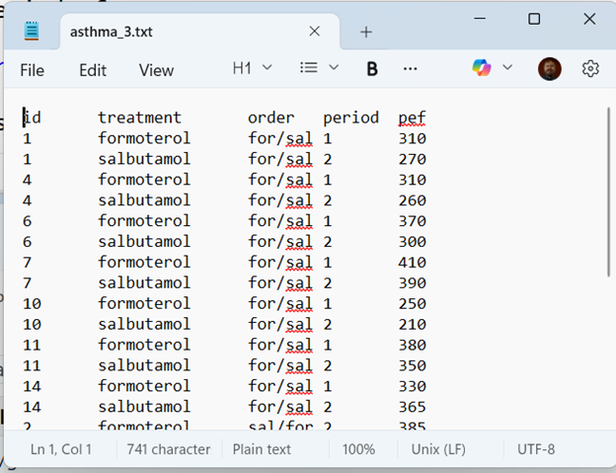
Layout for asthma data
Notes:
Speaker notes
The layout puts all of the outcome data in a single column. It also has to track which patient (the id variable), which drug (the treatment variable), which sequence (the order variable), and whether the treatment in question was administered first or second (the period variable).
Notice that there is a redundancy here. If you know which treatment and which order, you can figure out what the period is. That’s okay. You still need all of these variables to fit the model properly.

Slide 33
Counts for layout data
treatment | order | period | n
formoterol | for/sal | 1 | 7
formoterol | sal/for | 2 | 6
salbutamol | for/sal | 2 | 7
salbutamol | sal/for | 1 | 6
Notes:
Speaker notes
Just a reminder that there is a slight imbalance in treatment order, seven for/sal and only six sal/for.
Notice also that the three binary categories (treatment, order, and period) would normally produce eight combinations if you crossed all of them together. But certain combinations are not possible, such as treatment=formoterol, order=for/sal, and period=2. This means that you can’t estimate certain interactions. In particular, the treatment by period interaction is confounded with the main effect of order.

Slide 34
Period by order means
order | period1_mean | period2_mean
for/sal | 337 | 306
sal/for | 283 | 346
Notes:
Speaker notes
Here are the means for each period stratified by order. Notice that the period1 mean is highest for the for/sal order and the period2 mean is highest for the sal/for order.

Slide 35
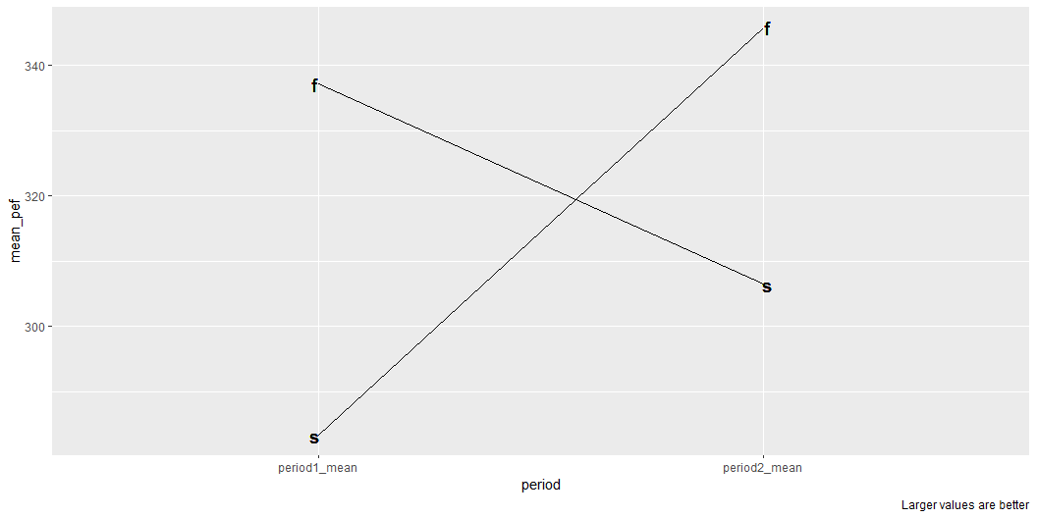
Period by order plot
Notes:
Speaker notes
This is a plot of the four means. The line sloping upward shows the results when salbutamol is given first. A positive slope shows that the patient improves when switching from salbutamol to formoterol.
The line sloping downward shows the results when formoterol is given first. A negative slope shows that the patient does worse when switching from formoterol to salbutamol.
Notice also that the period1 formoterol value (the f in the upper left) is not quite as good as the period2 formoterol value (the f in the upper right). Similarly, the period1 salbutamol value (the s in the lower left) is not quite as good as the period2 salbutamol value (the s in the lower right).
Two conclusions are obvious from this graph. First, you always are better off with formoterol. Second, no matter which drug you take, you see better results in period2 than in period1.

Slide 36
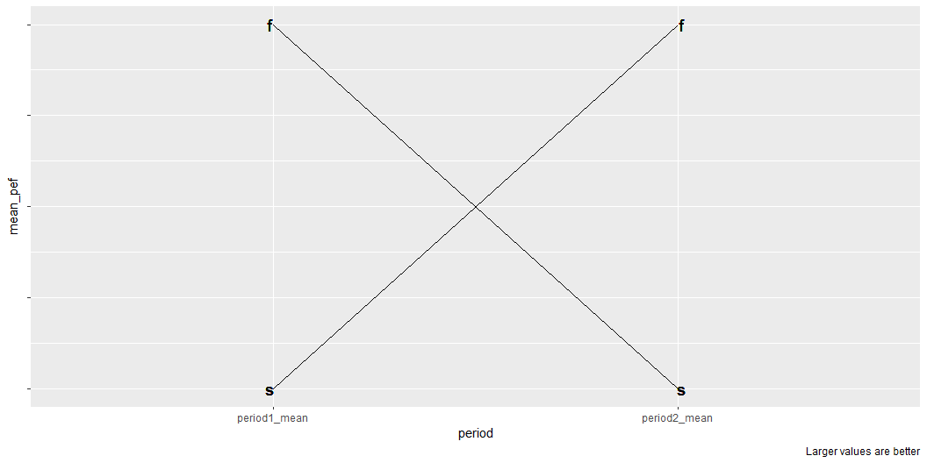
What this graph would look like without a period effect
Notes:
Speaker notes
If there were no period effect then the positive slope for the for/sal order would match the negative slope for the sal/for order. The mean effect for either drug would be the same in period1 and period2.

Slide 37
Treatment by order means
order | formoterol_mean | salbutamol_mean
for/sal | 337 | 306
sal/for | 346 | 283
Notes:
Speaker notes
If you use the second layout, where the first column is the formoterol outcomes and the second column is the salbutamol outcomes, the summary statistics are not quite the same, but they do tell a similar story. The formoterol means are better (higher) than the salbutamol means. The formoterol mean in the for/sal order is not quite as good as the formoterol mean in the sal/for order. The salbutamol mean in the for/sal order is better than the salbutamol mean in the sal/for order. So testing in the second period is slightly better than testing in the first period, no matter which drug.

Slide 38
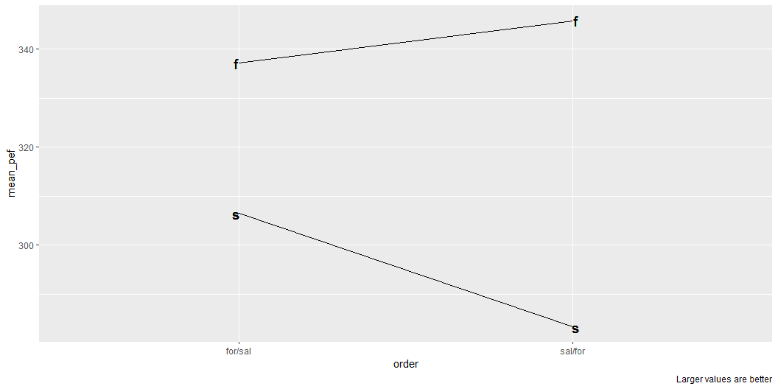
Treatment by order plot
Notes:
Speaker notes
I like this graph better than the earlier one. You see a clear gap between formoterol and salbutamol. The gap is a bit wider for the sal/for order. This makes sense. In the sal/for order, salbutamol is at its worst because it is period1. Formoterol is at its best because it is period2.

Slide 39
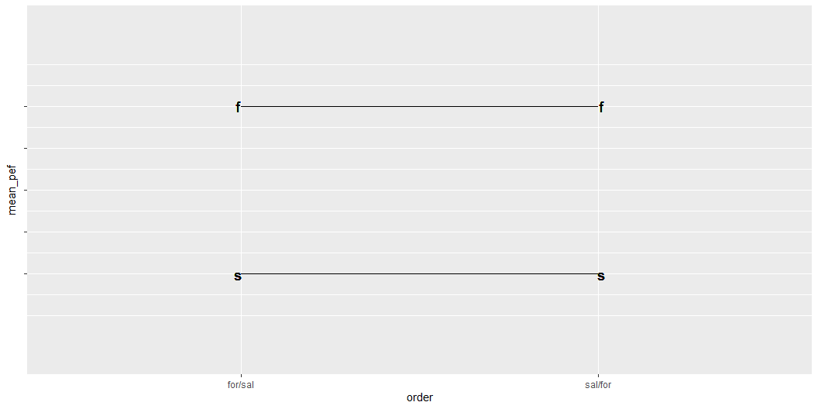
What this graph would look like without a period effect
Notes:
Speaker notes
If there were no effect due to period, both lines would be flat.

Slide 40
Accounting for period effects
Analysis of Variance Table Response: pef Df Sum Sq Mean Sq F value Pr(>F) order 1 335 335.2 0.4467 0.517697 id 11 114878 10443.5 13.9171 6.495e-05 *** period 1 985 984.6 1.3121 0.276323 treatment 1 14036 14035.9 18.7044 0.001205 ** Residuals 11 8254 750.4 --- Signif. codes: 0 '***' 0.001 '**' 0.01 '*' 0.05 '.' 0.1 ' ' 1
Notes:
Speaker notes
The model that properly accounts for period effects has to include a factor for order, id, period, and treatment.

Slide 41
Details on the period model
id is nested within order
id is a random effect
Test of order should be MS(order)/MS(id)
Use partial (Type III) sums of squares if unbalanced
Notes:
Speaker notes
A few details on this model are needed. First, id is a nested within order. The way that id was coded in this dataset, you did not have to worry about it. If ids were code 1 through 7 in the patients in the for/sal arm and coded 1 through 6 in the sal/for arm, then you have to designate id as a nested factor.
The id factor is also a random effect. That means that the test of order should use MS(order) divided by MS(id). The test of order is a between subjects comparison.
Finally, this data is unbalanced. There are 7 subjects in the for/sal arm and 6 in the sal/for arm. With unbalanced data, even a very minor imbalance, you should use partial or type 3 sums of squares. I deliberately put treatment as the last term in the model to insure that the effect of treatment is adjusted for every other factor.

Slide 42
Break #3
What you have learned
Period effects and carry-over
What’s coming next
When should you use or not use a cross-over

Slide 43
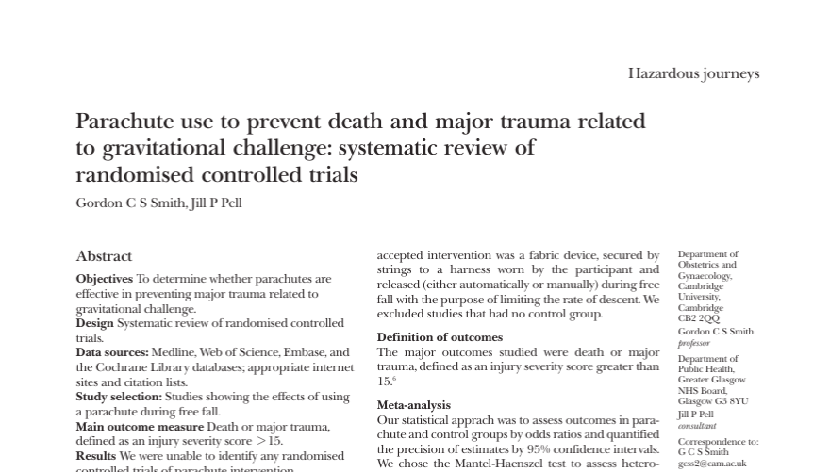
Systematic overview of parachute use
Notes:
Speaker notes
From the abstract: “As with many interventions intended to prevent ill health, the effectiveness of parachutes has not been subjected to rigorous evaluation by using randomised controlled trials. Advocates of evidence based medicine have criticised the adoption of interventions evaluated by using only observational data. We think that everyone might benefit if the most radical protagonists of evidence based medicine organised and participated in a double blind, randomised, placebo controlled, crossover trial of the parachute.”

Slide 44
When you cannot use a cross-over trial
Acute conditions
Mortality and other irreversible events
Training/education
Irreversible treatments
Persistent effects
Notes:
Speaker notes
These may be obvious, but it is worth stating them anyway. You can’t do a cross-over trial for an acute condition because everything will be over before you can rerun the second treatment.
You can’t do a cross-over trial for mortality because of the acronym YOLO. So don’t try to do a cross-over trial where you measure the outcome of using or not using a parachute on death. Well, of course, but the same applies for many other measures that are irreversible. Suppose the outcome you are trying to prevent is amputation of a limb. If that unfortunate event occurs during the first treatment, you can’t cross-over to the other treatment.
You can’t use a cross-over trial with a treatment that involves training or education. You would almost certainly have a carry-over effect unless you could figure out some way to “unlearn what you have learned.”
If one or both of the treatments are irreversible, you can’t run a cross-over trial. Surgery, for example, is irreversible. There are a series of surgeries that all end in “ectomy”. There’s appendectomy, hysterectomy, spleenectomy, and my least favorite, orchiectomy. If one treatment arm is an orchiectomy, you can’t cross-over to a time when you try to patch things back up.
Finally, if the outcome being sought is persistent, you are out of luck. If you want to test two treatments for acne, if the first one works well, there won’t be any acne for the second treatment to work on.

Slide 45
When you can use a cross-over trial
Chronic conditions
Short-term benefits
Adequate wash-out period
Drugs with a short half-life
Notes:
Speaker notes
Looking at all the things that you can’t use a cross-over trial for makes it much clear when you can use a cross-over trial. It has to be for a chronic condition and it has to measure benefits that are short-term and reversible.
When you are testing drugs, you need to make sure you have an adequate wash-out period. This means that you can only study drugs that have a short half life. The recommendation for most cross-over trials is that the wash-out period be equal to five half lives. Note that 1/2 raisded to the 5th power is 1/32 or 0.03126. Also the washout period should be significantly longer than the amount of time under evaluation for either arm. Don’t treat someone for a full month and then only have a two day washout period before starting a month on the other treatment.

Slide 46
Practical and ethical concerns
Can you ask a patient to endure two treatments?
Do you have enough time to run two treatments in succession?
Can you leave the patient untreated during the wash-out period?
Notes:
Speaker notes
There are limits to what we can ask patients to endure. I’ve had a few colonoscopies. They are no fun, but I endure them, once every three years. But I’m not going to sign up for a cross-over trial of two different colonoscopy devices. If they ask me to return in a week to test the second piece of equipment, that’s where I draw the line.
A cross-over trial takes twice as long as a parallel groups trial…more than twice as long if you have a wash-out period.
Speaking of wash-out periods, is it okay to ask your patients to forgo any therapy for a few days or a few weeks? There was a cross-over trial for comparing two drugs that treat depression. I don’t have the details, but if I recall things correctly, there was a wash-out period and several patients committed suicide during the wash-out period.

Slide 47
What if you have a carry-over effect?
No easy answer
Adjustments have poor power
Between subject comparison
Unclear where to make adjustments
Active treatment versus placebo:
Assign the carry-over to placebo
Two active treatments:
Split the difference
Carry-over could a temporal trend instead
Notes:
Speaker notes
Carry-over effects are a big problem. If they occur, it is almost impossible to resolve things.
You would like to just adjust for carry-over effects, but the estimate of carry-over is a between subjects comparison that has very little precision or power.
Also complicating things is that carry-over effects can manifest themselves in several different ways. If you are comparing an active drug to a placebo, there is no carry-over effect when you switch from the placebo to the active drug because the residual amount of placebo in your system is not going to have an impact on the active drug. But a residual amount of active drug can most certainly impact the evaluation of the placebo. So if you can estimate the carry-over effect, use it to adjust the measurement in the placebo arm only.
If you are comparing two active drugs, it may make sense to adjust both drugs because there will be a residual effect in either direction. But what if one of the drugs has a much shorter half life than the other?
What you estimate as a carry-over effect may actually be a temporal trend instead. Adjusting for temporal trends might not be the same as adjusting for carry-over.

Slide 48
Change test if carry-over is detected
Test hypothesis of no carry-over
Accept null? Run the cross-over
Reject null? Look at first period only
Not recommended
Limited power to test carry-over
First period analysis loses too much power/precision
Notes:
Speaker notes
One recommendation for carry-over is to run a conditional test. Screen for carry-over. If you accept the null hypothesis and conclude that there is no carry-over, go ahead with the cross-over trial that you have planned. If you find there is a carry-over, just discard the second period data. Using just the first period data converts your cross-over trial into a parallel groups trial.
This approach is not recommended. First, the test for carry-over is going to be a between subjects comparison which has very little power. Making things worse, if you do switch to analyzing just the first treatment received, you lose too much power and precision. You might as well just abandon the whole study.

Slide 49
The solution to carry-over
Design the study to avoid any carry-over
Requires in depth understanding of the treatments
Notes:
Speaker notes
Carry-over prevents an insolvable problem. You can’t adjust for it and you can’t modify your test if you detect carry-over. This is not my opinion. It is the opinion of Stephen Senn and other experts in the area.
The only thing you can do is to design the study so that you are reasonable confident that there will be no carry-over effect. This is not easy. You need to understand every detail of the two treatments you are examining. What is their mechanism of action? How long do the treatments impact your outcome measure?
If the treatments are drugs, how quickly are the drugs absorbed? How soon do the drugs reach a steady state? How rapidly does the drug disappear from the body once treatment ends?
Also think about the disease you are treating. What is the natural course of the disease? Is it steadily degenerative? Does it resolve quickly over time?
Put this all together and make a case, largely based on qualitative arguments, that the way you designed this study provides reasonable insurance that there is no carry-over effect.

Slide 50
Break #4
What you have learned
When should you use or not use a cross-over
What’s coming next
Cross-over trials with a binary outcome

Slide 51
Binary outcomes in a cross-over trial
Continuous outcomes almost always better
Binary outcomes require changes in the statistical model
Adjusting for period effects is tricky
Notes:
Speaker notes
You can do analyze binary outcomes in a cross-over trial, but always ask yourself why. Continuous outcomes are almost always preferred. Binary outcomes do not have shades of gray and this greatly limits power and precision.
If you have to use a binary outcome, your statistical model changes and it becomes harder to adjust for period effects.

Slide 52
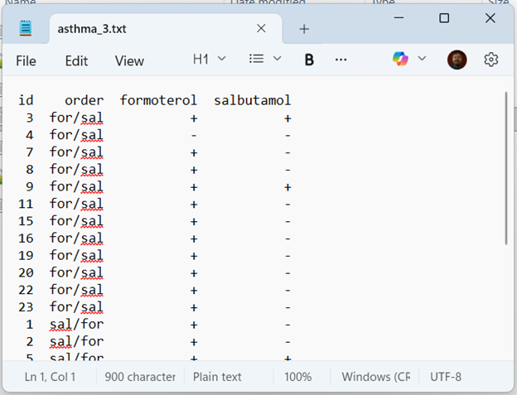
Example of a binary outcome
Notes:
Speaker notes
This data is from page 104 of Stephen Senn’s book on cross-over trials. The two drugs being tested are our old friends formoterol and salbutamol. The outcomes are classified as either good (a plus sign) or bad (a minus sign).

Slide 53
Descriptive statistics
 | F- | F+
S- | 2 | 15
S+ | 1 | 6

Slide 54
Analysis of binary cross-over data
Ignoring period effects
McNemar’s test
Incorporating period effects
Mainland-Gart test (hard to find)

Slide 55
Example of McNemar’s test
Table layout:
a b c d
Ignore a and d
Compute $T=\frac{{\left(b−c\right)}^{2}}{b+c}$
Compare to $χ^{2}\left(1\right)$

Slide 56

McNemar’s test on formoterol/salbutamol data
b=15, c=1
$T=\frac{{\left(15−1\right)}^{2}}{15+1}$=12.25
$χ^{2}\left(0.95,1\right)$=3.84
Reject H0. Formoterol is superior.
Notes:
Speaker notes
In the formoterol/salbutamol study, you ignore the two patients who improved with both drugs and the 6 patients who got worse with both drugs. Focus all your intention on the 15 patients who got better only with formoterol adn the 1 patient who only got better on salbutamol. If you calculate the test statistic, you get 12.25 which is much larger than 3.84, the critical value from a chi-squared distribution with one degree of freedom. You conclude that there is a statistically significant difference in favor of formoterol.
I did not find an easy way to compute the Mainland-Gart test that accounts for period effects.

Slide 57
Break #5
What you have learned
Cross-over trials with a binary outcome
What’s coming next
Cross-over trials with more than two treatments

Slide 58
Three treatment cross-over trial
The statistical models do not change, except…
The number of sequences increases dramatically.
Notes:
Speaker notes
All of the issues with an AB/BA cross-over trial are the same if you toss in a third treatment, C, or a fourth treatment, D. You have the same analysis: a completely randomized block design if you want to ignore the period effect and an analysis of variance table with factors for order, id, period, and treatment. You have the same concerns about carry-over effects.
The only real change is that the number of possible sequences increases dramatically.

Slide 59
Possible sequences
Three treatments
ABC, ACB, BAC, BCA, CAB, CBA
Four treatments
ABCD, ACBD, BACD, BCAD, CABD, CBAD,
ABDC, ACDB, BADC, BCDA, CADB, CBAD,
ADBC, ADCB, BDAC, BDCA, CDAB, CDBA,
DABC, DACB, DBAC, DBCA, DCAB, DCBA
Five treatments
How many possible treatment sequences?
Notes:
Speaker notes
With three treatments, there are six possible sequences. With four treatments, there are 24 possible sequences.
By the way, there is a typo in the list of possible sequences with four treatments. One sequence is actually listed twice. Can anyone spot it?
The sequence CBAD appears at the end of the first row and also at the end of the second row. In the second row, if I had followed the pattern correctly, the letter D would always be in the third position. So change the second CBAD to CBDA.
Karen Grace-Martin spotted this during a dry run of this talk, so if you spotted it also pat yourself on your back and tell yourself that you are just as smart as she is.
Now here’s a real challenge. Suppose you wanted to run a cross-over trial with five treatments. How many treatment sequences are there?
The answer is 5! (five factorial) or 120.

Slide 60
Latin square design to reduce the number of sequences
Three treatments
Sequence 1: A B C
Sequence 2: B C A
Sequence 3: C A B
Four treatments
Sequence 1: A B C D
Sequence 2: B C D A
Sequence 3: C D A B
Sequence 4: D A B C
Notes:
Speaker notes
You can reduce the number of sequences markedly by using a Latin square design. In this design, you have three sequences for testing among three different treatments and four sequences for testimg among four different treatments. The sequences are arranged so that every treatment appears once as the first treatment in exactly one sequence, every treatment appears once as the second treatment in exactly one sequence, and so forth.
The Latin square designs shown here are not the only possible Latin square designs. Any Latin square design will work equally well.

Slide 61
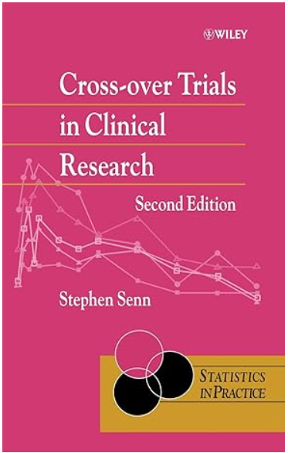
The definitive guide

Slide 62
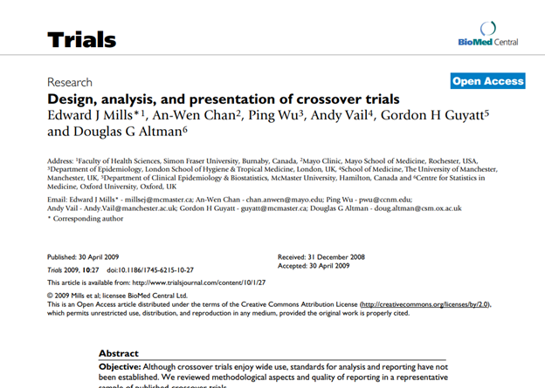
Nice reference
Notes:
Speaker notes
Mills, E.J., Chan, AW., Wu, P. et al. Design, analysis, and presentation of crossover trials. Trials 10, 27 (2009). DOI: 10.1186/1745-6215-10-27

Slide 63
Analysis Factor resources
Kim Love webinar on classical experimental designs
Karen Grace-Martin write-ups on long versus wide formats
Notes:
Speaker notes
There are several resources on the Analysis Factor website that you might find helpful.

Slide 64
Repeat of true/false pop quiz
Cross-over trials can only be used if the two treatments are drugs.
A paired t-test is a simple way to analyze a basic cross-over design.
A carry-over effect is easily accounted for and adjustments are relatively simple.
Cross-over trials should only be used if the disease being treated is acute, meaning that it does not persist over long periods of time.
Put your answers in the chat box as a sequence of T’s and F’s (e.g., TFFT).
Notes:
Speaker notes
Try these true/false questions again. Put your answers in the chat box.

Slide 65
Summary
What you have learned
The paired t-test
The AB/BA cross-over
Period effects and carry-over
When should you use or not use a cross-over
Cross-over trials with a binary outcome
Cross-over trials with more than two treatments
Notes:
Speaker notes
Here is an overview of the topics you’ve just seen.

