Slide 1
Clinical statistics for non-statisticians: Day one
Steve Simon

Slide 2
Introduction
Tell us one interesting number about yourself
Examples
I have traveled to eight countries outside the United States
(Canada, Italy, China, France, Russia, England, Holland, and Iceland)
I did not learn how to drive until I was 29 years old
My highest chess rating was 1802, but I am not that good any more.
Notes:
Speaker notes
I want to learn a bit about all of you, and I’m going to do this in a statistical way. Tell me three numbers about yourself. These could be something simple, like the number of children you have or something exotic like the height of the highest mountain you have climbed.
Here are three numbers about me.

Slide 3
Your turn

Slide 4
A bit more about myself
PhD in Statistics in 1982 from the University of Iowa
Currently full professor
Part-time statistical consultant
Funded on 18 research grants
Over 100 peer-reviewed publications
Website with over 2,000 pages
Many invitations to talk at conferences
Notes:
I have a PhD in Statistics from the University of Iowa. I have always had a strong interest in the computational side of Statistics. My dissertation was 150 pages, and 100 of those pages were computer generated graphs.
I am currently a full professor at the University of Missouri-Kansas City in the Department of Biomedical and Health Informatics. I also do statistical consulting on a part-time basis.
I have been a prolific researcher, receiving support from 18 different grants, and writing over 100 peer-reviewed publications.
I started a website in 1998, writing about data analysis, research ethics, and evidence based medicine. I wrote about two or three pages every week and my site now has over 2,000 pages. It shows the value of persistence.
I love to talk about Statistics and have given many presentations at regional, national, and international conferences. This ranges from short 15 minute talks to day long short courses.

Slide 5
Outline of the three day course
Day one: Numerical summaries and data visualization
Day two: Hypothesis testing and sampling
Day three: Statistical tests to compare treatment to a control and regression models
My goal: help you to become a better consumer of statistics
Notes:
Speaker notes

Slide 6
Day one topics
Numerical summaries
When should you present the mean versus the median
When should you present the range versus standard deviation
How should you display percentages
Why should you round liberally
Notes:
Speaker notes

Slide 7
Day one topics (continued)
Data visualization
How should you display continuous data
Why is the normal bell-shaped curve important
How should you display categorical data
How do you illustrate trends and patterns
What are some common mistakes in the choice of colors
Notes:
Speaker notes

Slide 8
Counting and proportions
Counts are the most common statistic
Counts are error prone
Counts require a solid operational definition
Notes:
Speaker notes
Let’s start with the simplest statistic of all a simple count. This is probably the most common statistic produced.
But counts can be tricky. The counting process is error prone and requires a solid operational definition.

Slide 9
Student exercise
Count the number of occurrences of the letter “e”.
A quality control program is easiest to implement from the top down. Make sure that you understand the the commitment of time and money that is involved. Every workplace is different, but think about allocating 10% of your time and 10% of the time of all your employees to quality control.
Notes:
Speaker notes
Here’s an exercise I want you to do. Just count the number of occurrences of the letter “e”. Once you have your answer, type it in the chat box.
[Pause here]
The numbers are different because of two things. First, it is easy to make mistakes. Did anyone notice the repetition of the word “the” at the end of the third line and the beginning of the fourth. It would be easy to miss that and count one less “e”.
What did you do with the first e in “Every”?
Did you count the e’s in the quotes itself or also on the slide instructions and the slide header?

Slide 10
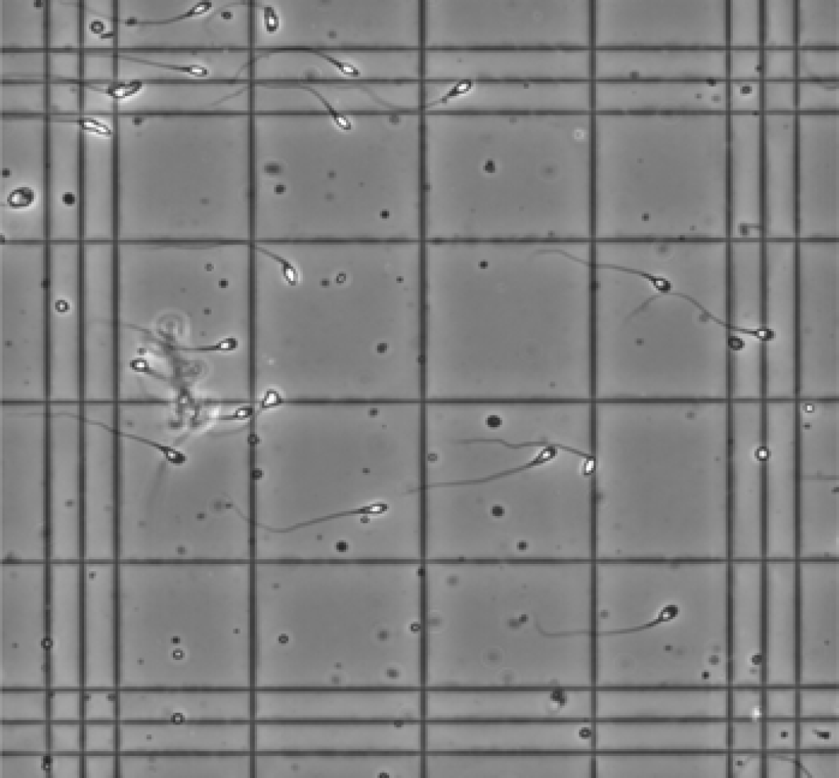
Counting sperm
Figure 1: Image of a haemocytometer
Notes:
Speaker notes
This image is take from the WHO laboratory manual for the examination and processing of human semen, published in 2021. It shows a haemocytometer, an instrument used for counting the number of cells. To get a proper count, you need to include any cells inside the four by four grid of large squares in the middle of this micrograph. But what does “inside” mean? Should you count only those cells entirely inside the four by four grid. Or should you include cells that are partially inside the grid?
One rule is to count cells if the head of the sperm cell touches the top or right side of a square, but not if it touches the bottom or left side of the square. And don’t count a sperm cell if only the tail is inside the square.
That’s not the only way you can do this, but just make sure that whatever convention you use for deciding “inside” versus “outside” is consistent across your laboratory.

Slide 11
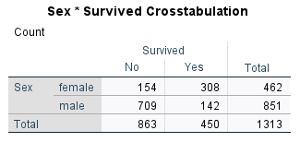
Tables of counts, using the Titanic data.
Figure 2: Counts of survival by gender
Notes:
Speaker notes

Slide 12
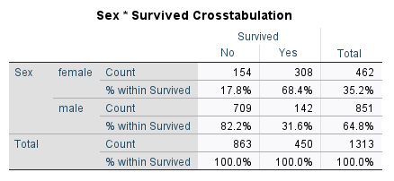
Percentages dividing by column totals
Figure 3: Column percentages
Notes:
Speaker notes

Slide 13
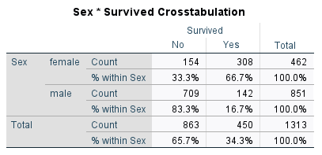
Percentages dividing by row totals
Row percentages
Notes:
Speaker notes

Slide 14
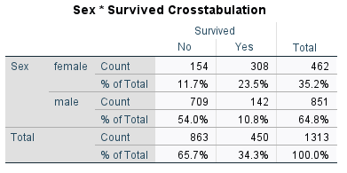
Percentages divided by grand total
Cell percentages
Notes:
Speaker notes

Slide 15
My recommendations
Treatment or exposure as rows
Outcome as columns
Usually report row percentages
Female mortality rate: 33%
Male mortality rate: 83%
But sometimes column percentages
Survivors: 68% female, 32% male
Notes:
Speaker notes

Slide 16
Some rationale for these choices
My way
Survived No Yes Sex Female 33% (154) 67% (308) Male 83% (863) 17% (142)
Not my way
Sex Female Male Survived No 33% (154) 83% (863) Yes 67% (308) 17% (142)
Notes:
Speaker notes
Now, I believe it is important to think carefully about which is your rows and which is your columns. Here’s the layout that I recommend on the left and the layout that I don’t recommend on the right. The key comparison is among survival rates, 67% for females and only 17% for males. When you orient my way with the treatment/exposure (Sex) as rows and the outcome (Survived) as the columns, the numbers 67% and 17% are very close to one another. In the alternate layout the numbers you are most interested in comparing are not as close together.
Now this is not an absolute rule. Sometimes I’ll switch things up. But about 90% of the time, I find that the layout with the treatment or exposure as the rows and the outcome as the columns, the table just looks better.

Slide 17
On your own
Calculate row and column percentages for the following tables. Interpret your results.

Slide 18
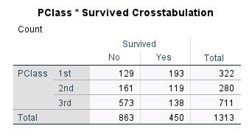
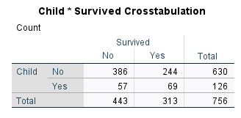
Figure 4: Titanic passenger class counts
Figure 5: Titanic child counts
Notes:
Speaker notes
Now try to report both column and row percents for one of these two tables. Breakout room #1 work on the passenger class table and breakout room #2 work on the child data.
Put your percentages in a table using a word processing program or text editor so you can share your results with the group.
Be sure to interpret these numbers. Come back together again in about 10 minutes.

Slide 19
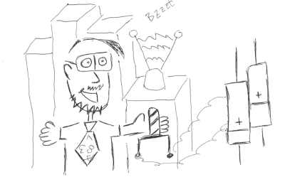
The mean (average)
Figure 6: Cartoon image of Professor Mean
Notes:
Speaker notes
Here’s a cartoon image of Professor Mean. I know this looks like it was drawn by a professional artist, but it was actually drawn by me. Really!
Professor Mean is my alter ego on the Internet. For those who don’t get the inside joke, I point out that Professor Mean is not just your average professor.
I will use the terms mean and average interchangeably througout this talk.

Slide 20

The median
Figure 7: Road with a median strip
Notes:
Speaker notes
This is an image of a traffic median. This is a strip of land, typically raised from the road surface, that splits the road in half.
In Statistics, the median is the data value that splits the data in half. Half of the data is smaller than the median and half of the data is larger than the median.

Slide 21
Calculation of the mean and median
Mean
Add up all the values, divide by the sample size
Median
Sort the data
Select the middle value if n is odd
go halfway between the two middle values if n is even
Notes:
Speaker notes
You already know how to compute the average. Add up all the values and divide by the sample size.
The median is also simple. Sort the data and choose the “middle” value. If n is odd, there is one value that is right in the middle. With five data values, the median is the third value of the sorted list. The first and second values are smaller and the fourth and fifth values are larger.
With an even number, there are two middle values. Go halfway between them. If you have eight data values, the midpoint between the fourth and fifth values splits the data in half. The first through fourth values in the sorted list are smaller and the fifth through eighth values are larger.

Slide 22
Formal mathematical definitions
Mean
$\overset{‾}{X}=\frac{1}{n}ΣX_{i}$
Median
Sorted values $X_{\left[1\right]},X_{\left[2\right]},...,X_{\left[n\right]}$
$X_{\left[\left(n+1\right)/2\right]}$ if n is odd,
$\left(X_{\left[n/2\right]}+X_{\left[n/2+1\right]}\right)/2$ if n is even
Notes:
Speaker notes
Here are the mathematical formulas for the mean and median. I know some people hate formulas, but I love them. With a few symbols and Greek letters, you can express really deep and beautiful ideas. Well these formulas aren’t all that deep.

Slide 23
Bacteria before and after A/C upgrade
Room Before After Change 121 11.8 10.1 -1.7 125 7.1 3.8 -3.3 163 8.2 7.2 -1.0 218 10.1 10.5 0.4 233 10.8 8.3 -2.5 264 14 12 -2.0 324 14.6 12.1 -2.5 325 14 13.7 -0.3
Notes:
Speaker notes

Slide 24
Calculation of the mean and median
Mean
Add up all the values
Divide by the sample size
Median
Sort the data
Notes:
Speaker notes
The calculation of the mean and median are fairly simple. For the mean, you just add up all the values and divide by the sample size.
For the median, you sort the data and choose the middle value. If the sample size is odd, there will be one middle value. If it is even, there will be two middle values. Just split the difference and go halfway between the two middle values.

Slide 25
Before remediation mean
11.8 + 7.1 + 8.2 + 10.1 + 10.8 + 14 + 14.6 + 14 = 90.6 90.6 / 8 = 11.325 Round to 11.3
Notes:
Speaker notes
Here’s the data for bacterial counts before remediation. If you add the eight values up, you get 90.6. Divide this by eight to get 11.325. Always round liberally when you are talking about the mean.

Slide 26
After remediation mean
10.1 + 3.8 + 7.2 + 10.5 + 8.3 + 12 + 12.1 + 13.7 = 77.7 77.7 / 8 = 9.7125 Round to 9.7
Notes:
Speaker notes
Here are the same calculations for the bacterial counts after remediation.

Slide 27
Before remediation median (1/4)
121 11.8 125 7.1 163 8.2 218 10.1 233 10.8 264 14.0 324 14.6 325 14.0
Notes:
Speaker notes
Here is the data for bacteria counts before remediation. Notice that the data is arranged by room number.

Slide 28
Before remediation median (2/4)
125 7.1 163 8.2 218 10.1 233 10.8 121 11.8 264 14.0 325 14.0 324 14.6
Notes:
Speaker notes
The first thing you do is sort the data from the lowest bacteria count to the highest bacteria count.

Slide 29
Before remediation median (3/4)
125 7.1 163 8.2 218 10.1 233 10.8 10.8 121 11.8 11.8 264 14.0 325 14.0 324 14.6
Notes:
Speaker notes
Then pick out the middle value. If you have an even number of data points, there will be two middle values.

Slide 30
Before remediation median (4/4)
125 7.1 163 8.2 218 10.1 233 10.8 10.8 (10.8 + 11.8) / 2 = 11.3 121 11.8 11.8 264 14.0 325 14.0 324 14.6
Notes:
Speaker notes
If there are two middle values, just average them.

Slide 31
After remediation median (1/4)
121 10.1 125 3.8 163 7.2 218 10.5 233 8.3 264 12.0 324 12.1 325 13.7
Notes:
Speaker notes
Here is the data for bacteria counts after remediation.

Slide 32
After remediation median (2/4)
125 3.8 163 7.2 233 8.3 121 10.1 218 10.5 264 12.0 324 12.1 325 13.7
Notes:
Speaker notes
Just like before, you sort the data.

Slide 33
After remediation median (3/4)
125 3.8 163 7.2 233 8.3 121 10.1 10.1 218 10.5 10.5 264 12.0 324 12.1 325 13.7
Notes:
Speaker notes
Then pick out the middle value. Here again, there are two middle values.

Slide 34
After remediation median (4/4)
125 3.8 163 7.2 233 8.3 121 10.1 10.1 (10.1 + 10.5) / 2 = 10.3 218 10.5 10.5 264 12.0 324 12.1 325 13.7
Notes:
Speaker notes
Just average the two middle values.

Slide 35
Choosing between the mean and median
When do you use the mean?
When totals are important
When do you use the median
When outliers/skewness might distort your conclusions
Often, either is fine
Notes:
Speaker notes

Slide 36
Criticisms of the mean and median
Are you combining apples and onions?
Are you ignoring minorities?
Notes:
There’s a wonderful cartoon by Dana Fradon that appeared in The New Yorker in 1976. She shows a road going into town and the sign by the side of the road reads “Hillsdale, Founded 1802, Altitude 600, Population 3,700. Total 6,122.” You can’t add these things together.
It’s similar for means. There was a dataset showing housing prices for homes in Boston and none of the analyses seemed to make sense. The problem in Boston is that a small number of the houses had prices that were out of sync with their other homes. These were historical houses, such as Paul Revere’s house.
When you are averaging numbers, maybe it’s okay to have a few oranges in with the apples. A mix of apples and oranges is just fruit salad. You shouldn’t have a problem with that.
When it becomes a problem is when the data are so diverse that it becomes a mix of apples and onions. There are lots of great recipes that mix apples and oranges, but none that mix apples and onions.
The other problem is that an average may be a reasonable number to represent the majority of patients in your sample, but it may masks some important trends that appear in a minority.
This is a big problem in a larger context than just the mean or median. There are some very fancy high tech predition models that work very well for most people and the statistics like the mean and median back this up quite nicely. But the prediction models perform terribly for minority groups.

Slide 37
Use of the mean for ordinal data

Slide 38
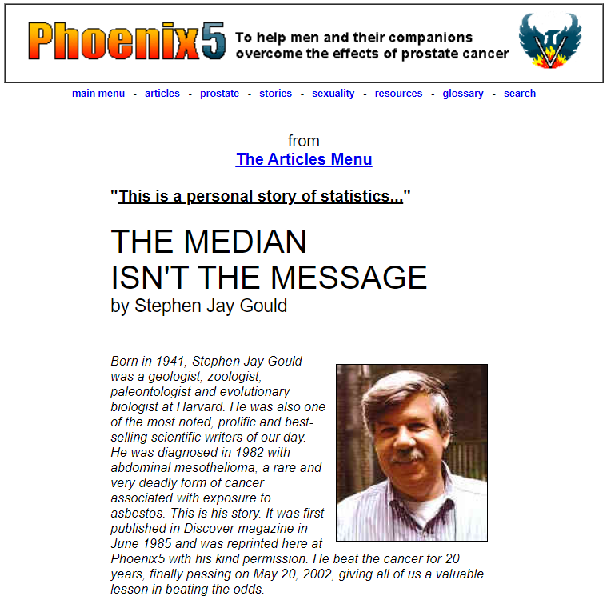
Gould 1985
Figure 8: Gould 1985
Notes:
Speaker notes
Stephen Jay Gould was a famous Evolutionary Biologist. He was a prolific writer with 20 books and 300 essays. Much of his writing was for academic researchers, but just as much was for the general public.
One of his most famous essays was “The Median Isn’t the Message”. The title is a take-off of a quote by Marshall McLuhan, “The medium is the message” which itself has an interesting history that you should investigate on your own.
The Gould essay was written in 1985 for Discover Magazine. It has been reprinted many times, and you can easily find the full text with a simple Google search.
The image shown here is taken from phoenix5.org, an informational site for patients with prostate cancer.

Slide 39
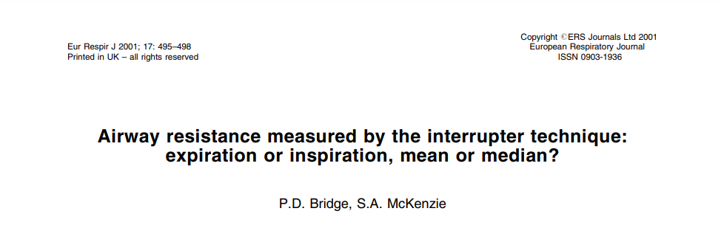
Bridge 2001, PMID: 11405531
Figure 9: Bridge and McKenzie 2001
Notes:
Speaker notes

Slide 40
Bridge 2001, PMID: 11405531 (continued)
The measurement of airway resistance by the interrupter technique (Rint) needs standardization. Should measurements be made be during the expiratory or inspiratory phase of tidal breathing? In reported studies, the measurement of Rint has been calculated as the median or mean of a small number of values, is there an important difference?
Notes:
Speaker notes

Slide 41
Bridge 2001, PMID: 11405531 (continued)
In the present data the mean of a set of values contributing to a measurement was not significantly different from the median. However, the use of the median has been recommended since it is less affected by possible outlying values such as might be included by fully automated equipment.
Notes:
Speaker notes

Slide 42
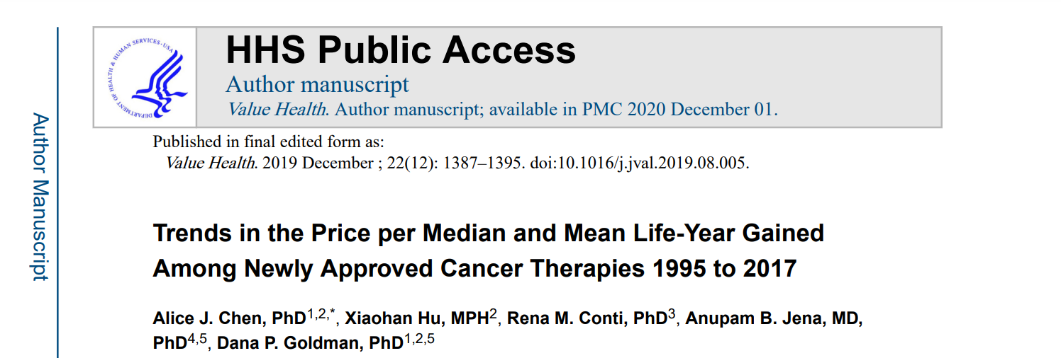
Chen 2019, PMID: 31806195
Figure 10: Chen et al 2019
Notes:
Speaker notes

Slide 43
Chen 2019, PMID: 31806195 (continued)
Background: The prices of newly approved cancer drugs have risen over the past decades. A key policy question is whether the clinical gains offered by these drugs in treating specific cancer indications justify the price increases.
Notes:
Speaker notes

Slide 44
Chen 2019, PMID: 31806195 (continued)
Results: We found that between 1995 and 2012, price increases outstripped median survival gains, a finding consistent with previous literature. Nevertheless, price per mean life-year gained increased at a considerably slower rate, suggesting that new drugs have been more effective in achieving longer-term survival. Between 2013 and 2017, price increases reflected equally large gains in median and mean survival, resulting in a flat profile for benefit-adjusted launch prices in recent years.
Notes:
Speaker notes

Slide 45
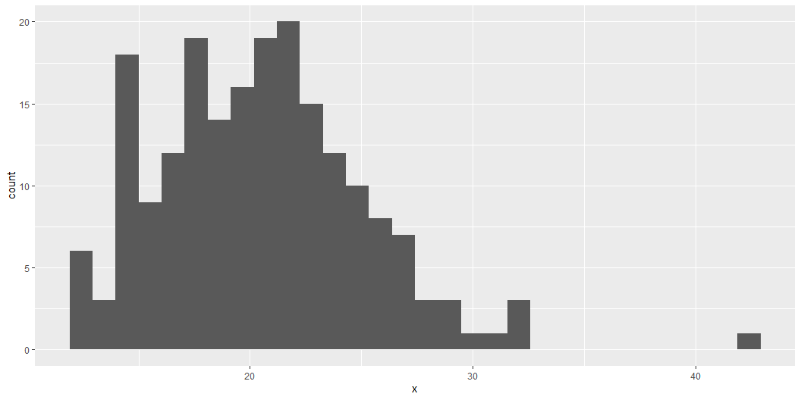
Percentiles

Slide 46

Gould 2006
Figure 11: Gould 2006
Notes:
Speaker notes
This cover is taken from the Amazon website.

Slide 47

Best 2012
Figure 12: Best 2012
Notes:
Speaker notes
First edition, 2001. Second edition, 2012.
Image taken from Amazon website.

Slide 48

O’Neil 2016
Figure 13: O’Neil 2016
Notes:
Speaker notes
First edition, 2016.
Image taken from Amazon website.

Slide 49
How companies learn your secrets
https://www.nytimes.com/2012/02/19/magazine/shopping-habits.html

Slide 50
Machine Bias
https://www.propublica.org/article/machine-bias-risk-assessments-in-criminal-sentencing

Slide 51
Bias in Algorithms
https://fra.europa.eu/sites/default/files/fra_uploads/fra-2022-bias-in-algorithms_en.pdf

