Slide 1
What are splines and how are they used?

Slide 2
Topics to be covered
What you will learn
Variety of regressions
Building cubic splines from scratch
B-splines, natural splines
How many knots and where to put them
Logistic regression example
Some code hints for R, SAS, Stata

Slide 3
xkcd comic
Title “CURVE-FITTING METHODS AND THE MESSAGE THEY SEND”
Drawn by Scott Munro
Open-source license
Link to comic at xkcd.com
More details at explain-xkcd.com
Notes:
Let me start with a cartoon from the xkcd site of Scott Munro. Scott Munro produces comics that poke fun at various scientific and mathematical concepts. There are a handful that directly address statistics, including this one. The actual panels in the comic are small, so I split them up onto separate slides.

Slide 4
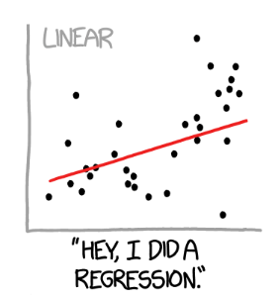
xkcd comic, panel 01
Notes:
This shows a scatter of data points with a linear regression fit. The caption reads, “Hey, I did a regression.”

Slide 5
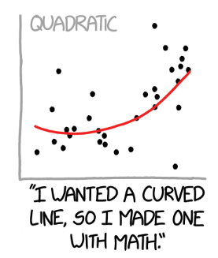
xkcd comic, panel 02
Notes:
This shows a scatter of data points with a quadratic regression fit. The caption reads, “I wanted a curved line, so I made one with Math.”

Slide 6
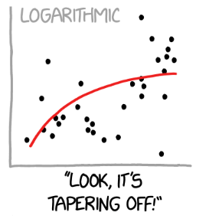
xkcd comic, panel 03
Notes:
This shows a scatter of data points with a logarithmic regression fit. The caption reads, “Look, it’s tapering off!”

Slide 7
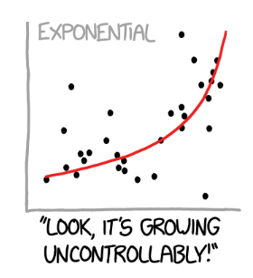
xkcd comic, panel 04
Notes:
This shows a scatter of data points with an exponential regression fit. The caption reads, “Look, it’s growing uncontrollably.”

Slide 8
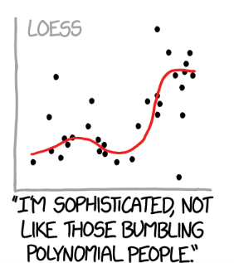
xkcd comic, panel 05
Notes:
This shows a scatter of data points with a loess smoothing curve. The caption reads, “I’m sophisticated, not like those bumbling polynomial people.”

Slide 9
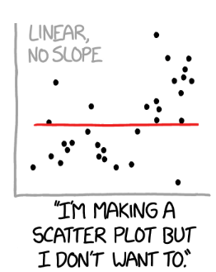
xkcd comic, panel 06
Notes:
This shows a scatter of data points with a flat linear regression fit (slope=0). The caption reads, “I’m making a scatter plot but I don’t want to.”

Slide 10
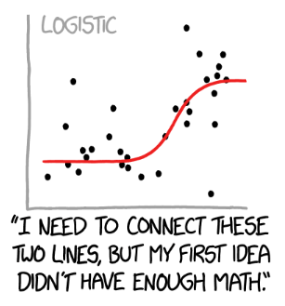
xkcd comic, panel 07
Notes:
This shows a scatter of data points with a logistic curve regression fit. The caption reads, “I need to connect these two lines, but my first idea didn’t have enough Math.”

Slide 11
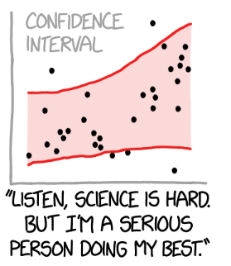
xkcd comic, panel 08
Notes:
This shows a scatter of data points with no particular regression line, but a very wide (nd probably appropriate) confidence band. This captures the idea that there is uncertainty not only in the deviation of the points from the regression curve, but true uncertainty about the shape of that regression curve. The caption reads, “Listen, science is hard. But I’m a serious person doing my best.”
There is an active field of research under the topic uncertainty quantification that tries to take into account all the sources of uncertainty including uncertainty about which model is the correct model.

Slide 12
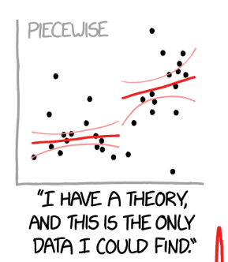
xkcd comic, panel 09
Notes:
This shows a scatter of data points with a piecewise linear regression fit. The caption reads, “I have a theory and this is the only data I could find.”

Slide 13
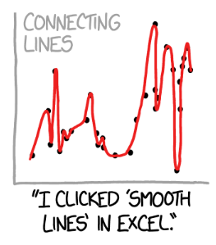
xkcd comic, panel 10
Notes:
Here the proposed regression model gets a bit silly. This shows a scatter of data points with a smooth curve connecting every data point. The caption reads, “I clikced ‘smooth lines’ in Excel.”

Slide 14
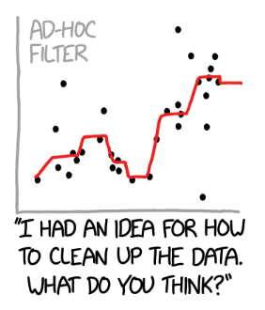
xkcd comic, panel 11
Notes:
This shows a scatter of data points with a smoother that looks like it uses medians somehow. The caption reads, “I had an idea for how to clean up the data. What do you think?”

Slide 15
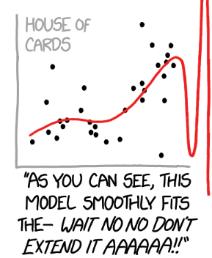
xkcd comic, panel 12
Notes:
This shows a scatter of data points with what looks like a B-spline. The caption reads, “As you can see, this model smoothly fits the - Wait, No, No, Don’t extend it. AAAAAA!!”

Slide 16
A real-world problem, without the data
Threshold model
Nothing happens until you meet a threshold
Then things get worse
Notes:
Several decades ago, I was faced with a data analysis problem. I wanted to fit a threshold model where everything is fine and normal until the exposure level meets a certain threshold. Then things get worse.
I don’t have the data for this problem but let me illustrate conceptually how a threshold model might work. It provides a simple but useful analog to regression splines.

Slide 17
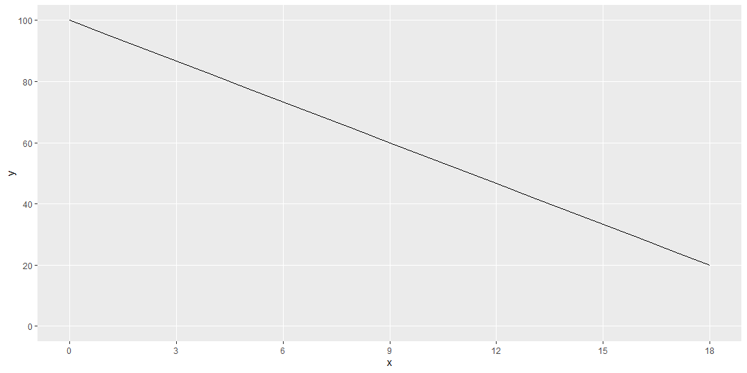
Linear function
Notes:
Here is what a linear function might look like. It is not what we want, but always start with the easiest model.

Slide 18
$Y=β_{0}+β_{1}X$
1 0 1 3 1 6 1 9 1 12 1 15 1 18
Notes:
This is the formula and the design matrix for a linear fit.

Slide 19
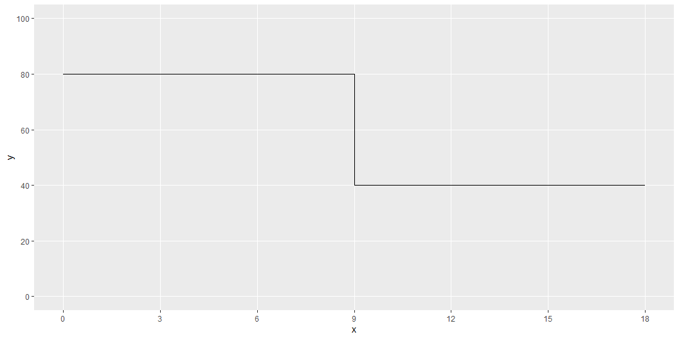
Step function
Notes:
A threshold model could look like this. It is a step function that is at a high level prior to the threshold at X=9 and then drops after.
This is a discontinuous function. It might make sense in some settings. In other settings, you might expect the decline to be not so sudden and abrupt.

Slide 20
$Y=β_{0}+β_{1}I_{\left[X>9\right]}$
1 0 1 0 1 0 1 0 1 1 1 1 1 1
Notes:
Here is the formula and the design matrix for a step function. The I notation is an indicator function that is equal to 1 if the logical comparison is true and 0 if it is false.

Slide 21
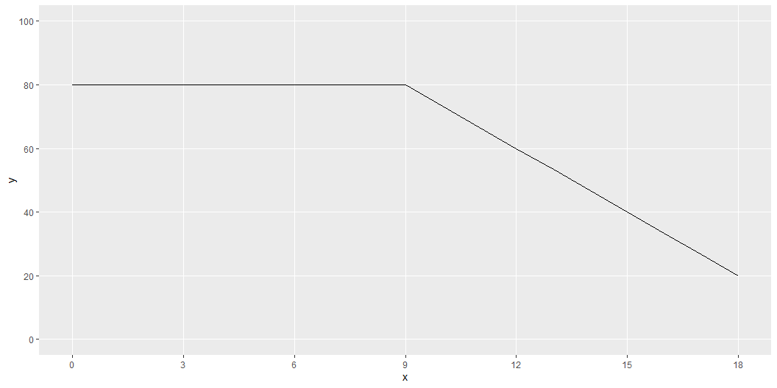
Elbow regression
Notes:
Here is a better model. It is flat and at a high level for values less than 9 and declines linearly for values greater than 9.
Note the “elbow” at the threshold. This might be okay, but it might be better for a transition that does not change slope so suddenly.

Slide 22
$Y=β_{0}+β_{1}I_{\left[X>9\right]}\left(X−9\right)$
1 0 1 0 1 0 1 0 1 3 1 6 1 9
Notes:
This is the formula and design matrix for an elbow regression. The independent variable is computed by multiplying the indicator variable by the value of X, but only after subtracting the threshold of 9. It is important to subtract the nine so that the linear decline after the threshold matches up with the flat section before the threshold.

Slide 23
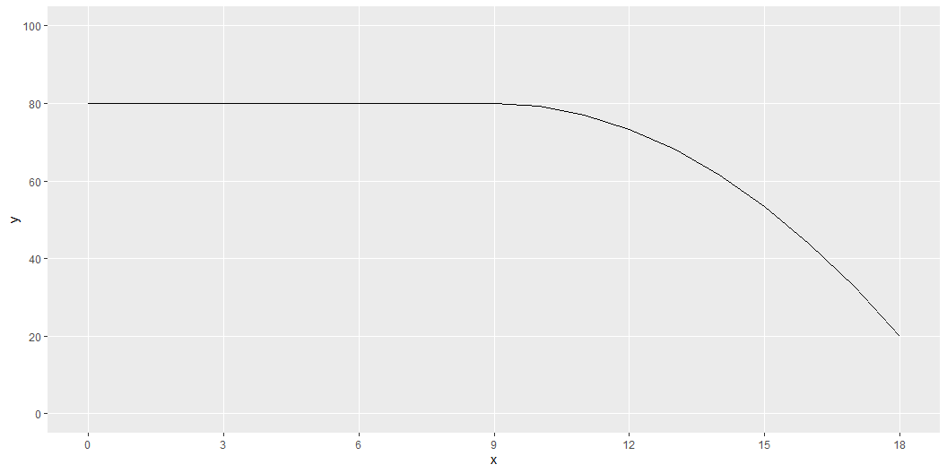
Quadratic analog
Notes:
Here is a functional form that avoid the elbow at the threshold value. It fits a quadratic decline, or a parabola, but the parabola starts at the point where the derivative is equal to zero.

Slide 24
$Y=β_{0}+β_{1}I_{\left[X>9\right]}{\left(X−9\right)}^{2}$
1 0 1 0 1 0 1 0 1 9 1 36 1 81
Notes:
This is the formula and design matrix for the quadratic analog, or the elbowless regression.

Slide 25
Break #1
What you have learned
Variety of regressions
What’s coming next
Building cubic splines from scratch

Slide 26
Splines
Piecewise cubic polynomial
Continuous
Smooth
Transition points = knots
Notes:
A spline is a piecewise cubic polynomial. It converts from one cubic polynomial to a different cubic polynomial at pre-defined transition points known as knots. The individual cubic polynomials are constrained to be continuous and smooth at the knots. Smooth means a continuous first and second derivative. In practical terms, smooth means “no elbows”.

Slide 27
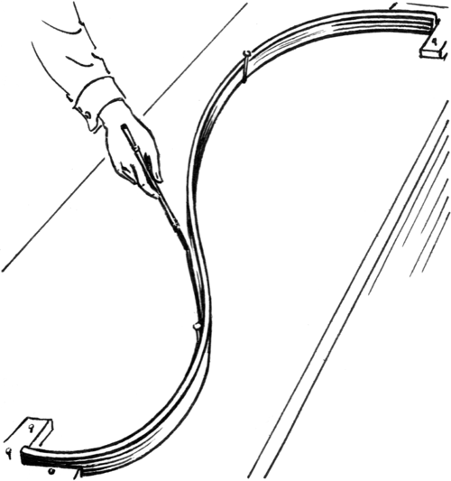
A physical spline
Notes:
Before computers became powerful enough to compute splines, we had several alternatives.
Here is an image from Wikipedia of physical spline. It is a thin strip of wood–thin enough to allow it to bend. It is constrained so that the bend follows a path that covers a few points.

Slide 28
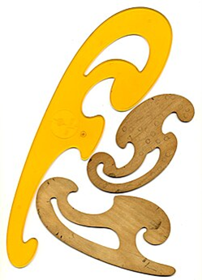
A french curve
Notes:
The french curve was a plastic template that showed a range of curvatures. You would line up the curve to four data points, draw along the french curve between the two interior points and then shift to the right and line up the french curve again. The resulting path looked seamless.

Slide 29
Artificial data, 1
x | y
0 | 39.8
1 | 41.0
2 | 40.3
3 | 39.4
4 | 39.3
5 | 38.9
6 | 35.4
7 | 32.3
8 | 32.0
9 | 28.2
10 | 24.2
Notes:
Suppose you have some data where you suspect the behavior differs for x=1 to 5, x=6 to 10, x=11 to 15, and x=16 to 20.

Slide 30
Artificial data, 2
x | y
11 | 28.9
12 | 32.8
13 | 37.6
14 | 41.6
15 | 45.1
16 | 48.9
17 | 49.2
18 | 48.0
19 | 46.9
20 | 39.9

Slide 31
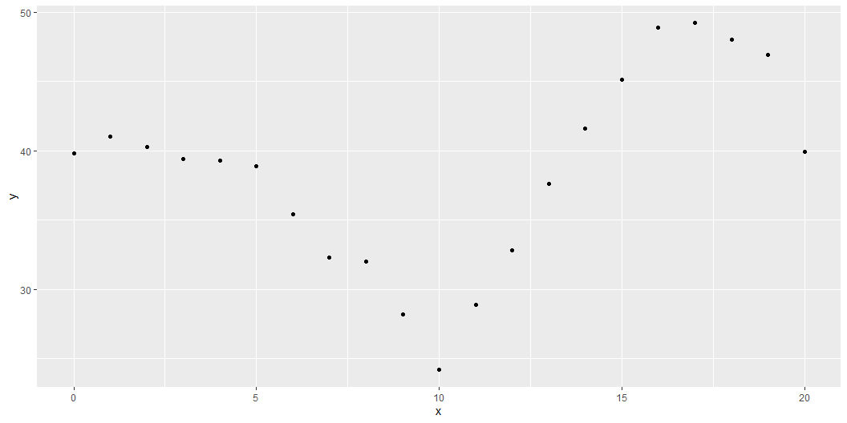
Graph of artificial data

Slide 32
Components needed for a cubic spline, 1
c1 | c2 | c3 | c4 | c5 | c6 | c7 | c8 | c9 | c10 | c11 | c12 | c13 | c14 | c15 | c16
1 | 0 | 0 | 0 | 0 | 0 | 0 | 0 | 0 | 0 | 0 | 0 | 0 | 0 | 0 | 0
1 | 1 | 1 | 1 | 0 | 0 | 0 | 0 | 0 | 0 | 0 | 0 | 0 | 0 | 0 | 0
1 | 2 | 4 | 8 | 0 | 0 | 0 | 0 | 0 | 0 | 0 | 0 | 0 | 0 | 0 | 0
1 | 3 | 9 | 27 | 0 | 0 | 0 | 0 | 0 | 0 | 0 | 0 | 0 | 0 | 0 | 0
1 | 4 | 16 | 64 | 0 | 0 | 0 | 0 | 0 | 0 | 0 | 0 | 0 | 0 | 0 | 0
1 | 5 | 25 | 125 | 0 | 0 | 0 | 0 | 0 | 0 | 0 | 0 | 0 | 0 | 0 | 0
Notes:
You can get a variety of splines by defining constant, linear, quadratic, and cubic terms and then shift those functions to the right. After shifting, fill in the hole to the left with zeros.

Slide 33
Components needed for a cubic spline, 2
c1 | c2 | c3 | c4 | c5 | c6 | c7 | c8 | c9 | c10 | c11 | c12 | c13 | c14 | c15 | c16
1 | 6 | 36 | 216 | 1 | 1 | 1 | 1 | 0 | 0 | 0 | 0 | 0 | 0 | 0 | 0
1 | 7 | 49 | 343 | 1 | 2 | 4 | 8 | 0 | 0 | 0 | 0 | 0 | 0 | 0 | 0
1 | 8 | 64 | 512 | 1 | 3 | 9 | 27 | 0 | 0 | 0 | 0 | 0 | 0 | 0 | 0
1 | 9 | 81 | 729 | 1 | 4 | 16 | 64 | 0 | 0 | 0 | 0 | 0 | 0 | 0 | 0
1 | 10 | 100 | 1000 | 1 | 5 | 25 | 125 | 0 | 0 | 0 | 0 | 0 | 0 | 0 | 0

Slide 34
Components needed for a cubic spline, 3
c1 | c2 | c3 | c4 | c5 | c6 | c7 | c8 | c9 | c10 | c11 | c12 | c13 | c14 | c15 | c16
1 | 11 | 121 | 1331 | 1 | 6 | 36 | 216 | 1 | 1 | 1 | 1 | 0 | 0 | 0 | 0
1 | 12 | 144 | 1728 | 1 | 7 | 49 | 343 | 1 | 2 | 4 | 8 | 0 | 0 | 0 | 0
1 | 13 | 169 | 2197 | 1 | 8 | 64 | 512 | 1 | 3 | 9 | 27 | 0 | 0 | 0 | 0
1 | 14 | 196 | 2744 | 1 | 9 | 81 | 729 | 1 | 4 | 16 | 64 | 0 | 0 | 0 | 0
1 | 15 | 225 | 3375 | 1 | 10 | 100 | 1000 | 1 | 5 | 25 | 125 | 0 | 0 | 0 | 0

Slide 35
Components needed for a cubic spline, 4
c1 | c2 | c3 | c4 | c5 | c6 | c7 | c8 | c9 | c10 | c11 | c12 | c13 | c14 | c15 | c16
1 | 16 | 256 | 4096 | 1 | 11 | 121 | 1331 | 1 | 6 | 36 | 216 | 1 | 1 | 1 | 1
1 | 17 | 289 | 4913 | 1 | 12 | 144 | 1728 | 1 | 7 | 49 | 343 | 1 | 2 | 4 | 8
1 | 18 | 324 | 5832 | 1 | 13 | 169 | 2197 | 1 | 8 | 64 | 512 | 1 | 3 | 9 | 27
1 | 19 | 361 | 6859 | 1 | 14 | 196 | 2744 | 1 | 9 | 81 | 729 | 1 | 4 | 16 | 64
1 | 20 | 400 | 8000 | 1 | 15 | 225 | 3375 | 1 | 10 | 100 | 1000 | 1 | 5 | 25 | 125

Slide 36
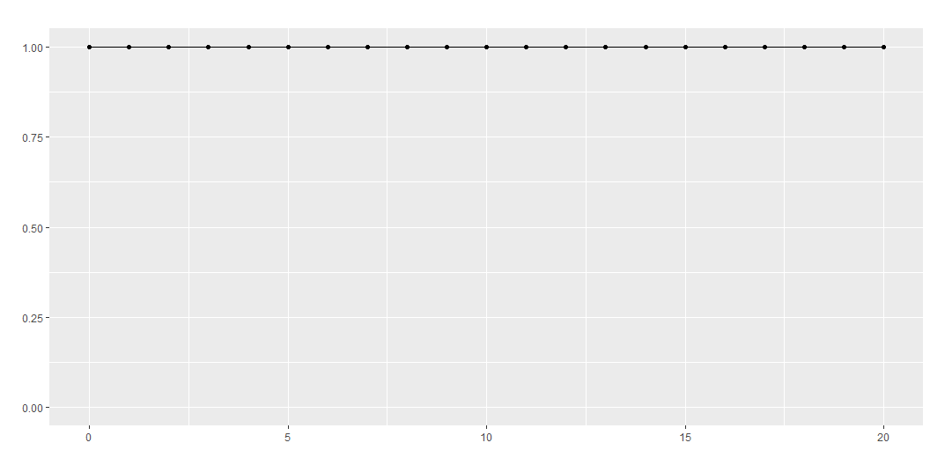
Intercept for the full range

Slide 37
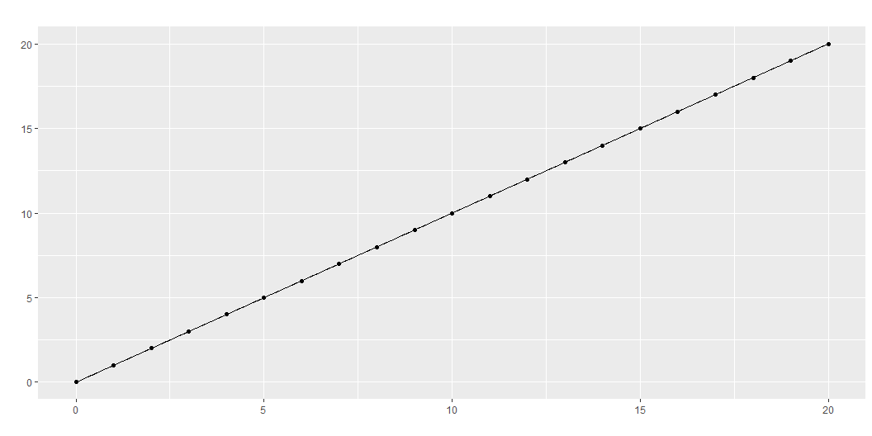
Linear term for the full range

Slide 38
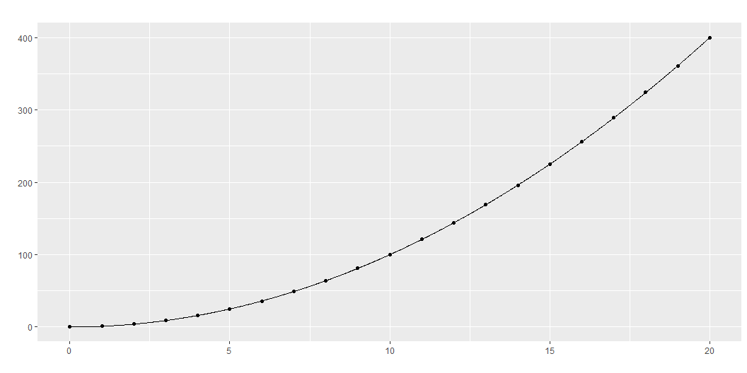
Quadratic term for the full range

Slide 39
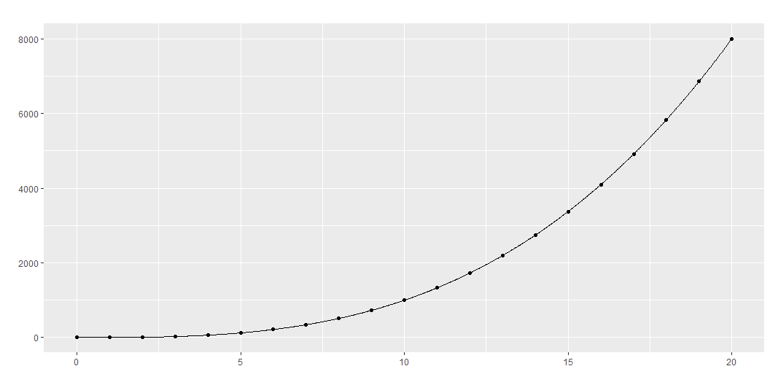
Cubic term for the full range

Slide 40
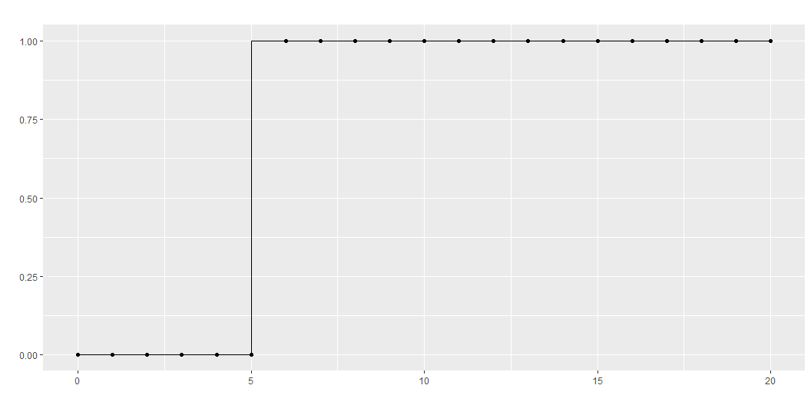
Intercept restarted at x=5

Slide 41
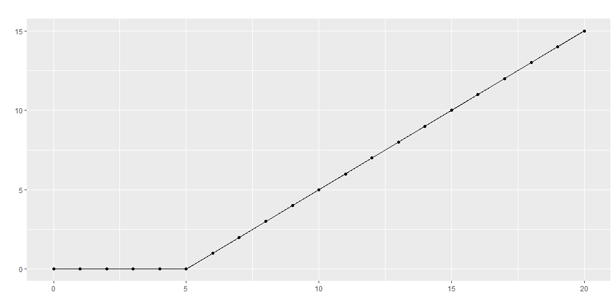
Linear term restarted at x=5

Slide 42
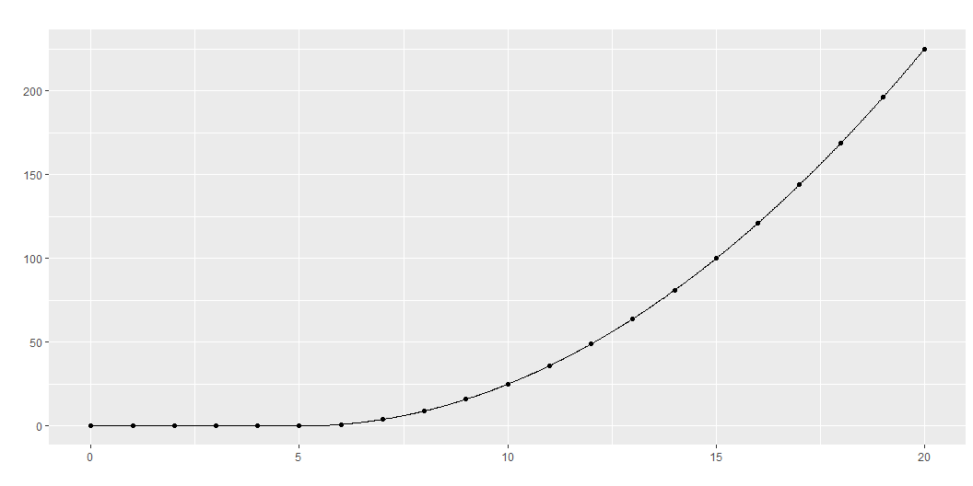
Quadratic term restarted at x=5

Slide 43
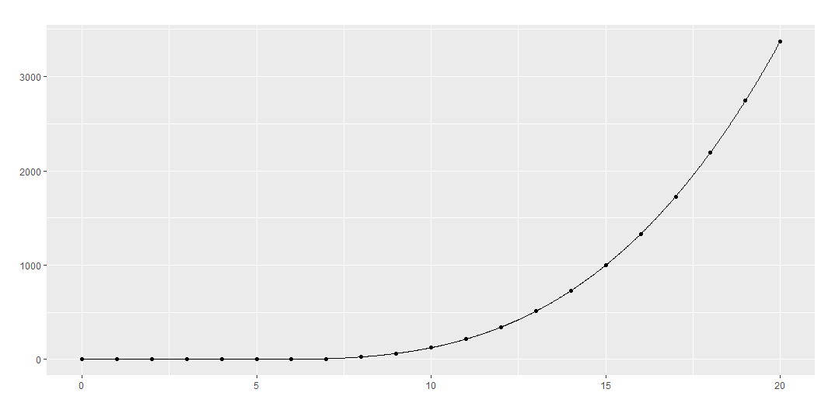
Cubic term restarted at x=5

Slide 44
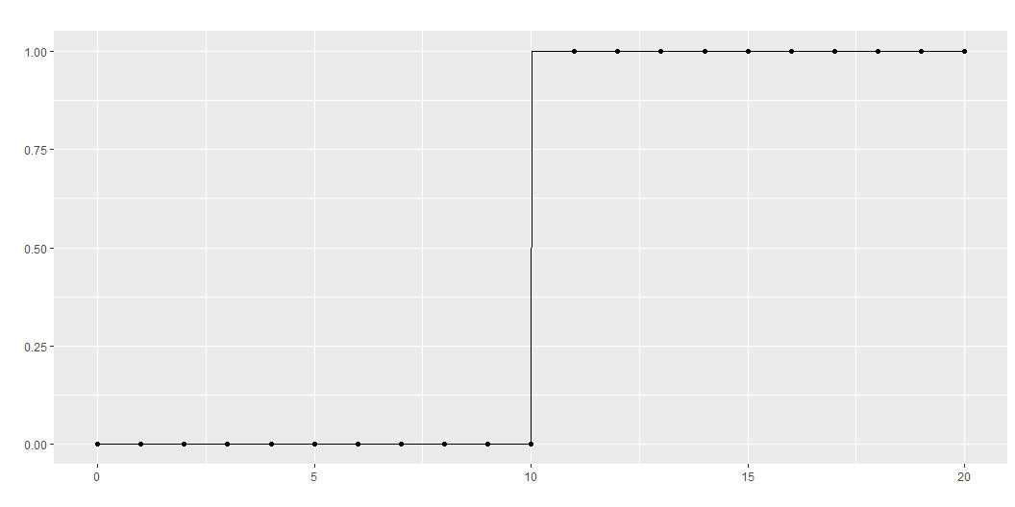
Intercept restarted at x=10

Slide 45
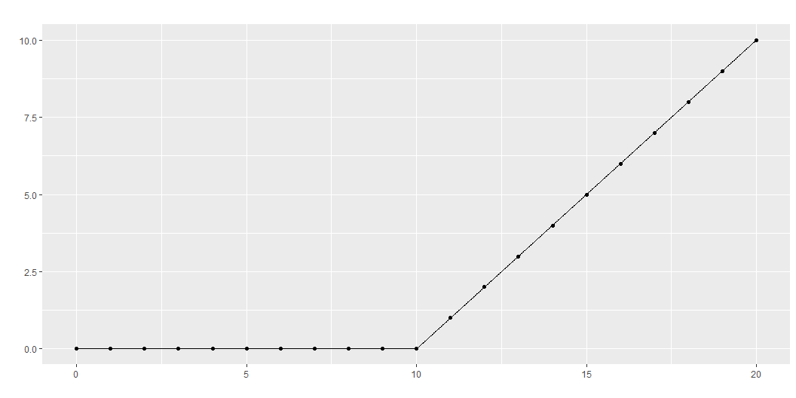
Linear term restarted at x=10

Slide 46
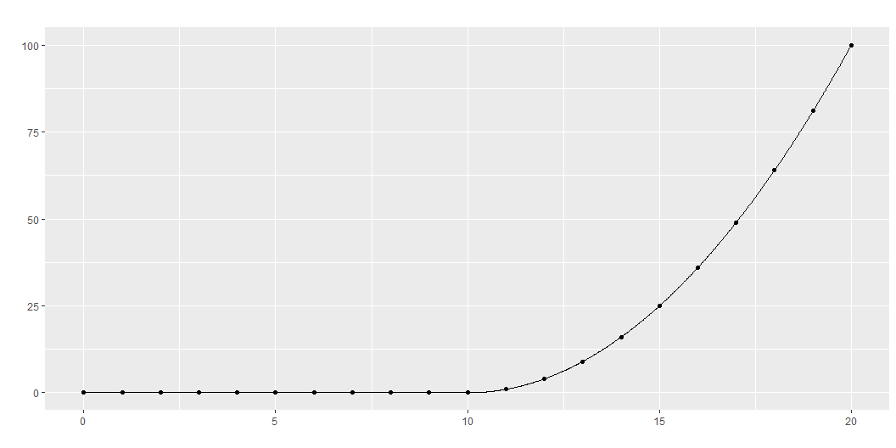
Quadratic term restarted at x=10

Slide 47
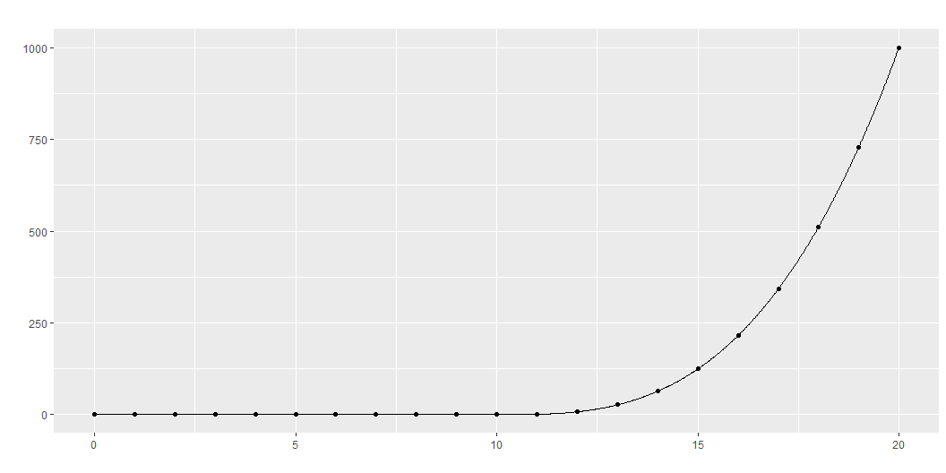
Cubic term restarted at x=10

Slide 48
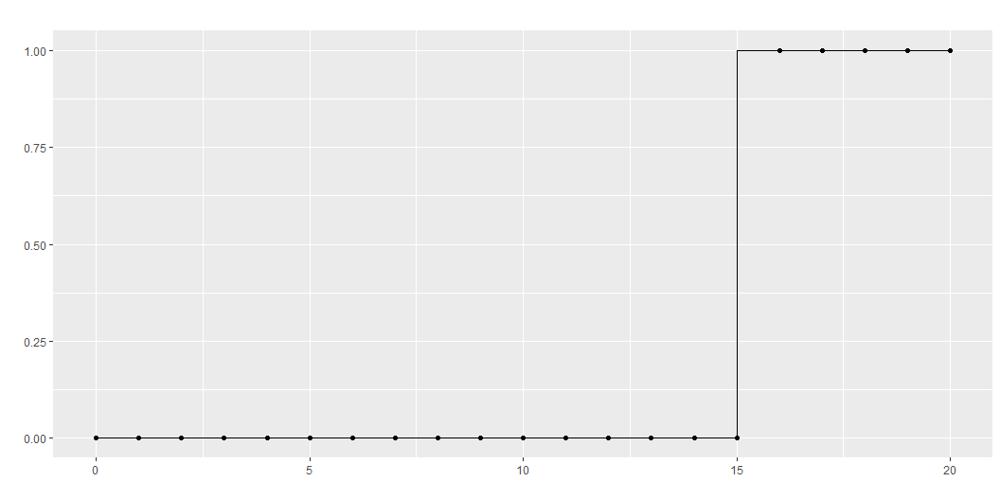
Intercept restarted at x=15

Slide 49
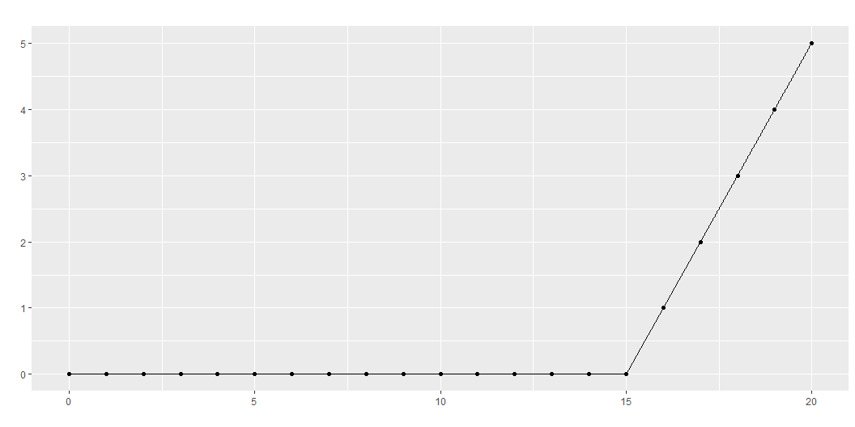
Linear term restarted at x=15

Slide 50
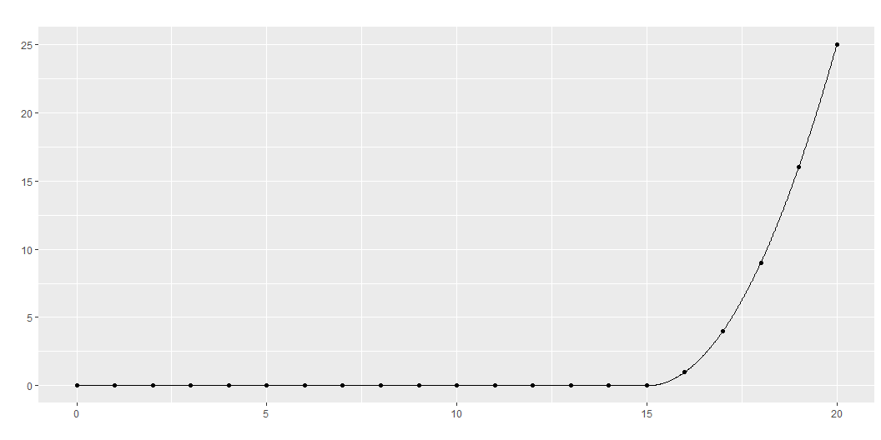
Quadratic term restarted at x=15

Slide 51
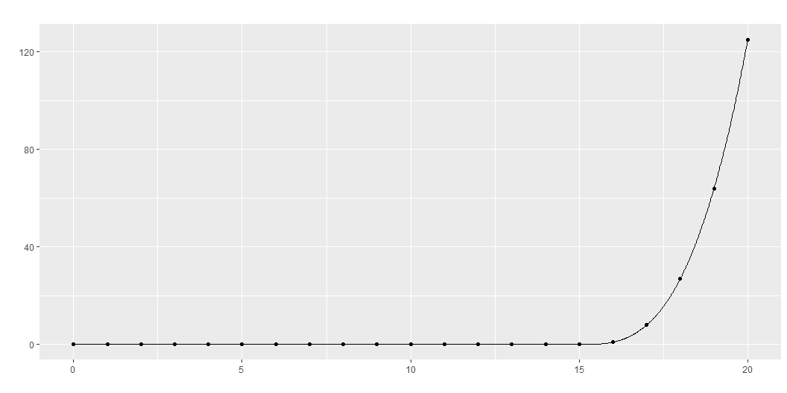
Cubic term restarted at x=15

Slide 52
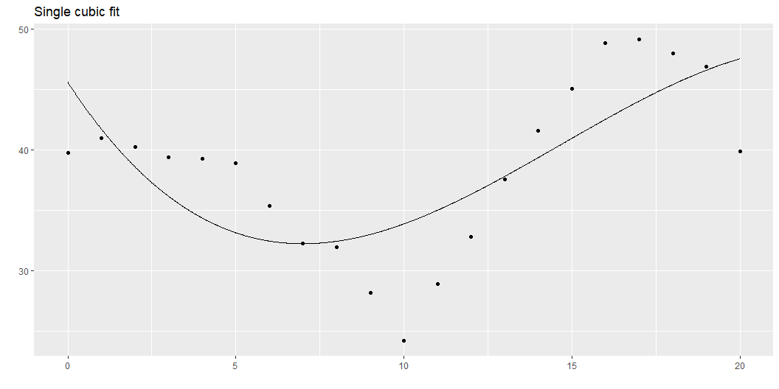
Single cubic polynomial
Notes:
The graph shown here represents the best fitting single cubic polynomial. It uses
c1, the intercept for the overall range,
c2, the linear term for the overall range,
c3, the quadratic term for the overall range, and
c4, the cubic term for the overall range.
It doesn’t fit the data very well.

Slide 53
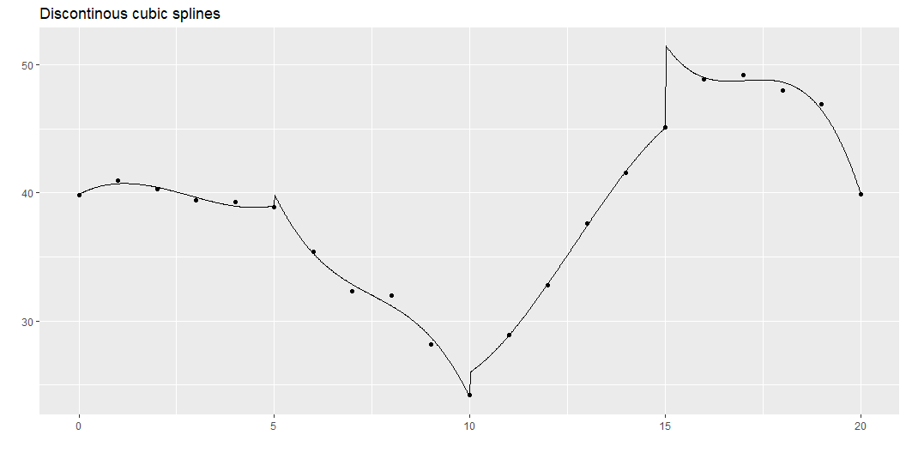
Discontinuous cubic polynomials
Notes:
So, we could fit a cubic model for the first five data points, for the second five, the third five, and the fourth five. This is a bit much: a cubic model has four parameters, so fitting four of them would use up 16 degrees of freedom in a data set with only 20 observations. But bear with me a bit on this.
The trick to fitting four separate cubic polynomials is to “restart” the intercept, linear, quadratic, and cubic terms after x=5, x=10, and x=15, as shown above. This leads to a model with 16 degrees of freedom. This is way too many degrees of freedom for only 20 data points, but it helps anchor a series of more reasonable models.
This function is not continuous or smooth. To make the function continuous, drop the extra intercept terms.

Slide 54
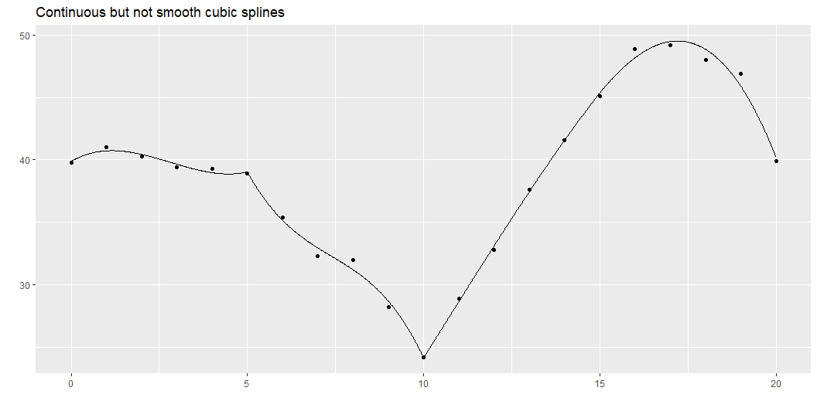
Continuous splines
Notes:
While this graph is continuous, it still takes some abrupt turns. What this curve lacks is smoothness. The mathematical concept of smoothness is measured in terms of the continuity of derivatives.

Slide 55
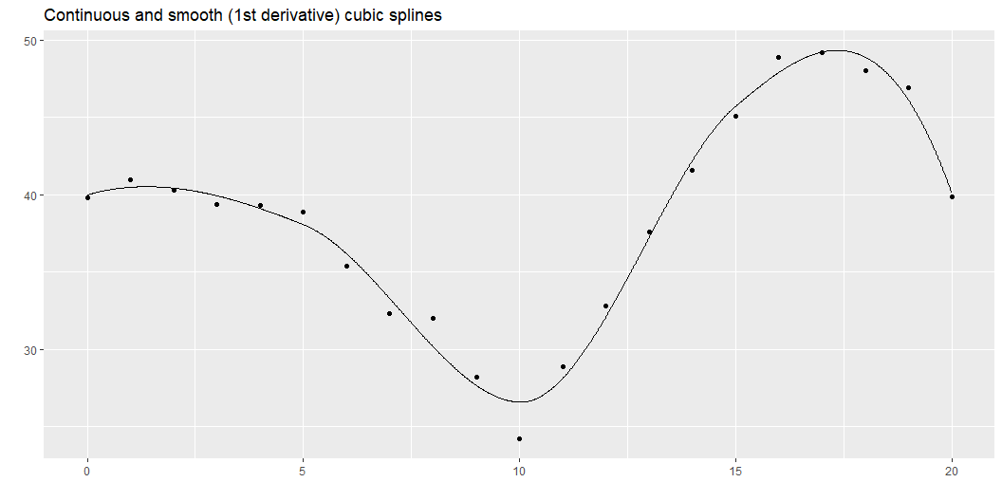
Smooth splines
Notes:
Here is a function that has a continuous first derivative. You fit this model by dropping the extra linear terms beyond the first one. Notice a pattern here. As you place additional restrictions on the spline (continuity, smoothness), you need fewer parameters. The four cubic models with no restrictions used up 16 degrees of freedom. When you added a continuity restriction, you only needed 13 degrees of freedom for the model. Add a smoothness restriction and you only need 10 degrees of freedom.

Slide 56
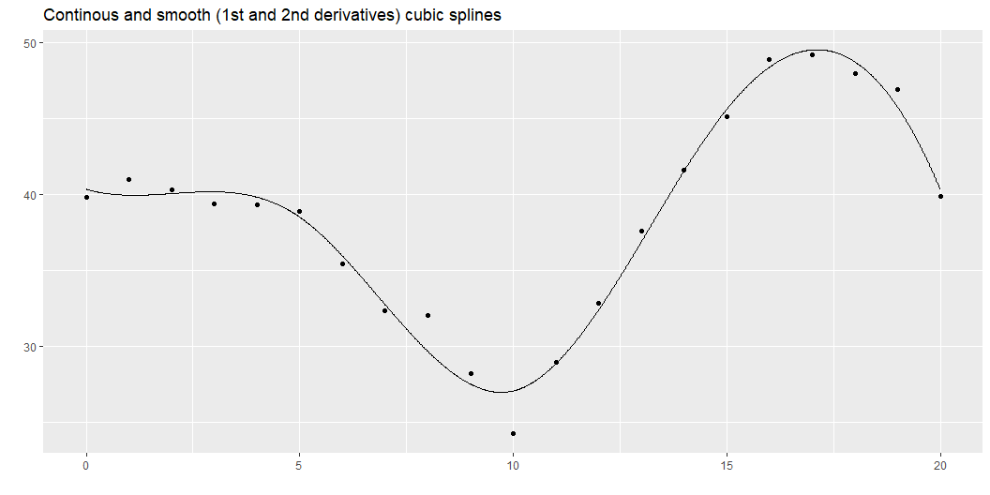
Even smoother
Notes:
Here is a function that has continuous first and second derivatives. This is a greater degree of smoothness than above and it requires only 7 degrees of freedom.
This is what most people refer to when they talk about splines: a piecewise cubic model with continuity and continuous first and second derivatives. It is a fairly simple model (not that many degrees of freedom), but it produces a curve that has the flexibility to fit a variety of curves that have the aesthetically pleasing features of continuity and smoothness.
Continuity and smoothness are more than just aesthetics, though. There are many scientific settings where we expect no jumps (discontinuities) and no abrupt turns (lack of smoothness). If you are measuring the onset of symptoms from a disease, you know that the viruses or bacteria that are causing the disease are increasing in a continuous and smooth pattern. So any problems that they cause should also increase in a continuous and smooth pattern.
Other settings, however, should not necessarily be expected to produce continuous and smooth outcomes. If a particular metabolic pathway becomes saturated or an anotomical barrier is breached, the suddenness transition could result in an abrupt turn or a discontinuity. So do think about the particular context of your problem when deciding what type of spline model to use.
This approach is simple and easy to follow, but there is one catch. There is an issue with multicollinearity.

Slide 57
Multicollinearity
c2 | c3 | c4 | c8 | c12 | c16
1.00 | 0.97 | 0.92 | 0.85 | 0.73 | 0.55
0.97 | 1.00 | 0.99 | 0.95 | 0.86 | 0.67
0.92 | 0.99 | 1.00 | 0.99 | 0.93 | 0.76
0.85 | 0.95 | 0.99 | 1.00 | 0.97 | 0.83
0.73 | 0.86 | 0.93 | 0.97 | 1.00 | 0.92
0.55 | 0.67 | 0.76 | 0.83 | 0.92 | 1.00
Notes:
The correlations are quite high and this can lead to computational problems, including rounding errors. So most spline models implemented on a computer use a different approach.

Slide 58
Break #2
What you have learned
Building cubic splines from scratch
What’s coming next
B-splines, natural splines

Slide 59
B-splines
Mathematically equivalent form
Much less collinearity
Notes:
B-splines provide a solution with less issues of multi-collinearity.

Slide 60
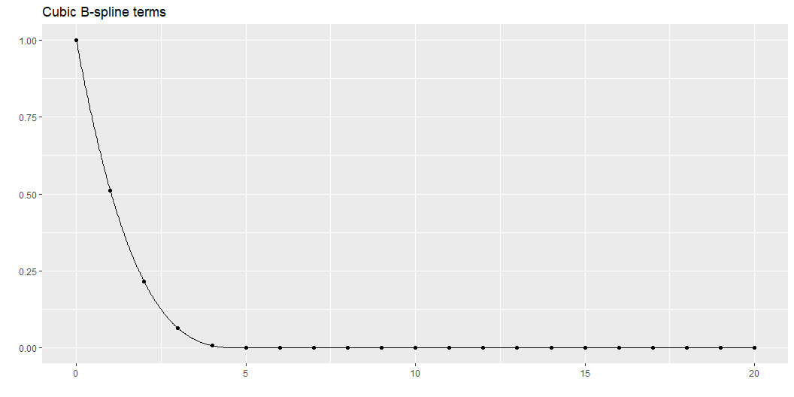
B-spline, 1
Notes:
The individual columns represent piecwise cubic polynomials. As I cycle through these graphs, notice how they are concentrated in certain intervals and there is only a partial overlap between these intervals. Also notice how they transition smoothly to zero outside those intervals.

Slide 61
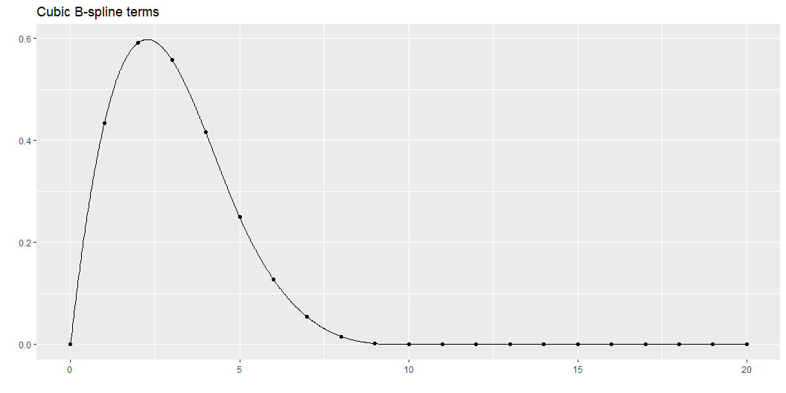
B-spline, 2

Slide 62
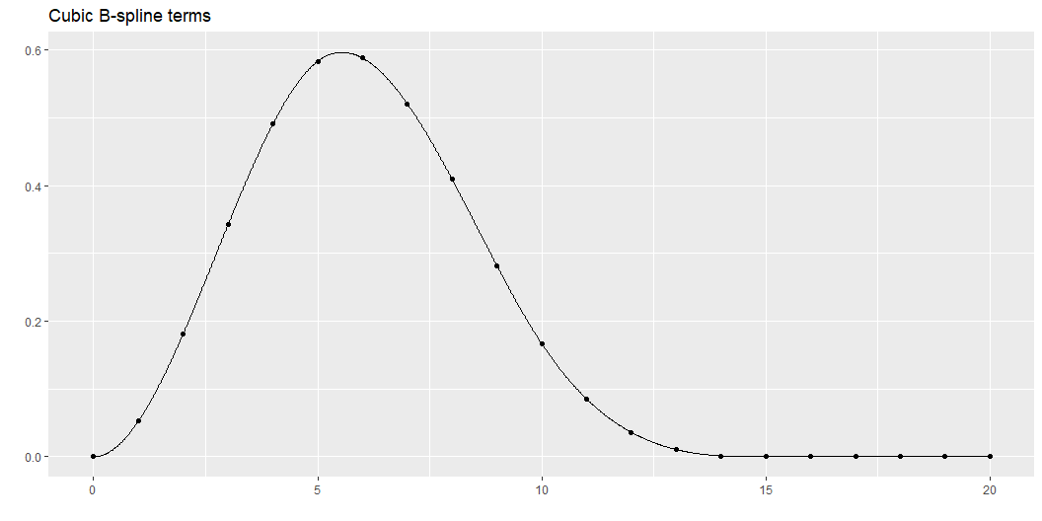
B-spline, 3

Slide 63
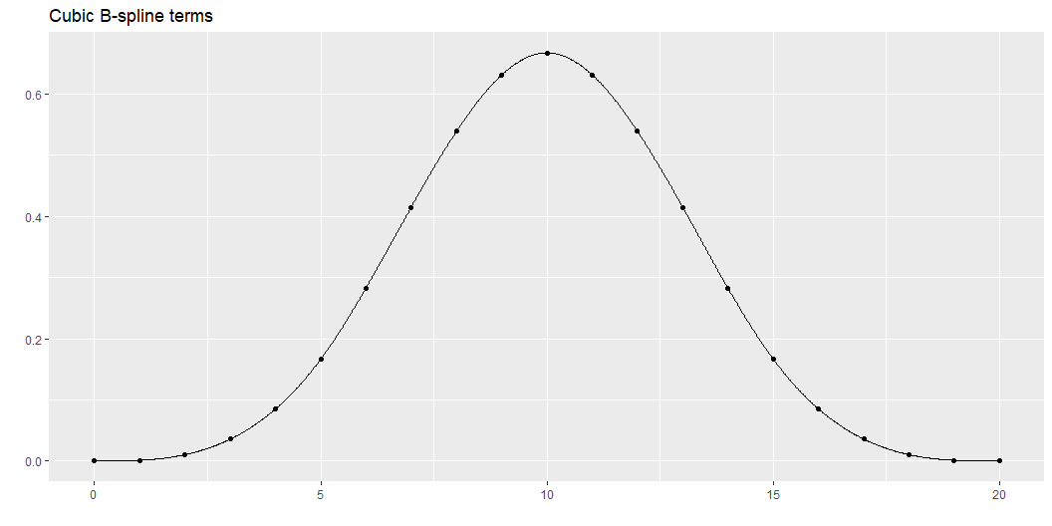
B-spline, 4

Slide 64
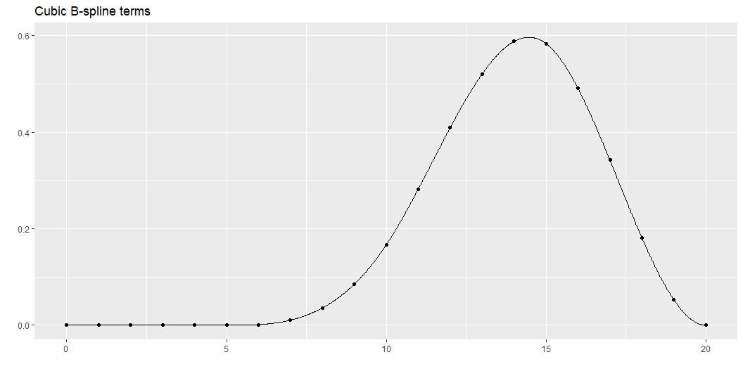
B-spline, 5

Slide 65
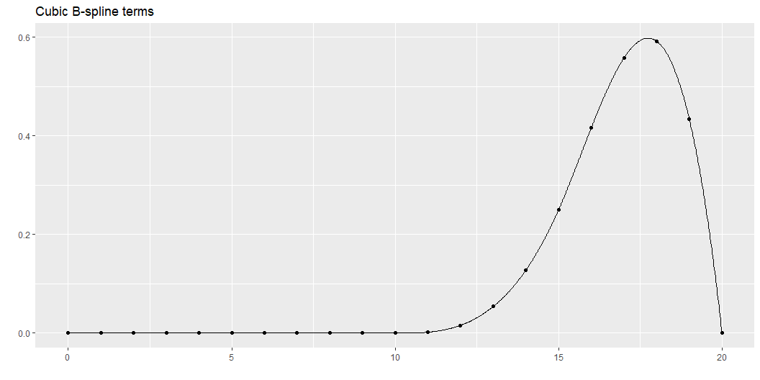
B-spline, 6

Slide 66
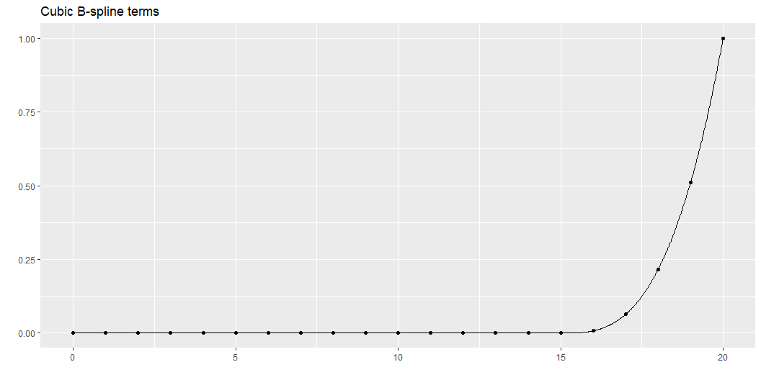
B-spline, 7

Slide 67
B-splines have less issues with multicollinearity.
X1 | X2 | X3 | X4 | X5 | X6 | X7
1.00 | 0.39 | -0.19 | -0.36 | -0.30 | -0.22 | -0.12
0.39 | 1.00 | 0.36 | -0.47 | -0.54 | -0.39 | -0.22
-0.19 | 0.36 | 1.00 | 0.18 | -0.63 | -0.54 | -0.30
-0.36 | -0.47 | 0.18 | 1.00 | 0.18 | -0.47 | -0.36
-0.30 | -0.54 | -0.63 | 0.18 | 1.00 | 0.36 | -0.19
-0.22 | -0.39 | -0.54 | -0.47 | 0.36 | 1.00 | 0.39
-0.12 | -0.22 | -0.30 | -0.36 | -0.19 | 0.39 | 1.00
Notes:
Although there is some correlation, this not nearly as bad as the piecewise approach.

Slide 68
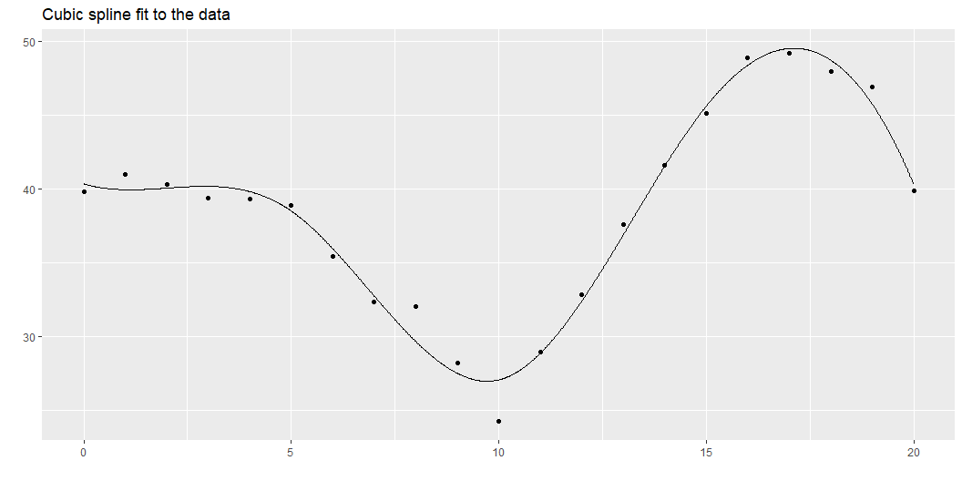
B-spline fit to the artificial data

Slide 69
Natural splines
B-spline restrictions
Continuity
Smoothness
Natural spline additional restriction
Linear extrapolation beyond the outside knots
Notes:
A variant on B splines are natural splines (also called restricted cubic splines). These splines place an additional restriction to the left of the first X value and to the right of the last X value. The spline is constrained to be linear at both extremes. This makes practical sense, as there is less data at the extremes, making estimation of a complex cubic function here worrisome. This also makes extrapolation outside of the range of data less problematic. Cubic polynomials have the potential of extreme shifts and if these occur outside the range of the data, they could lead to some awful extrapolations.
You should always be very careful, of course, as any effort to extrapolate beyond the range of data is dangerous. Nevertheless, restricting the extrapolation to a linear function is probably safer than letting the cubic polynomial wiggle around.

Slide 70
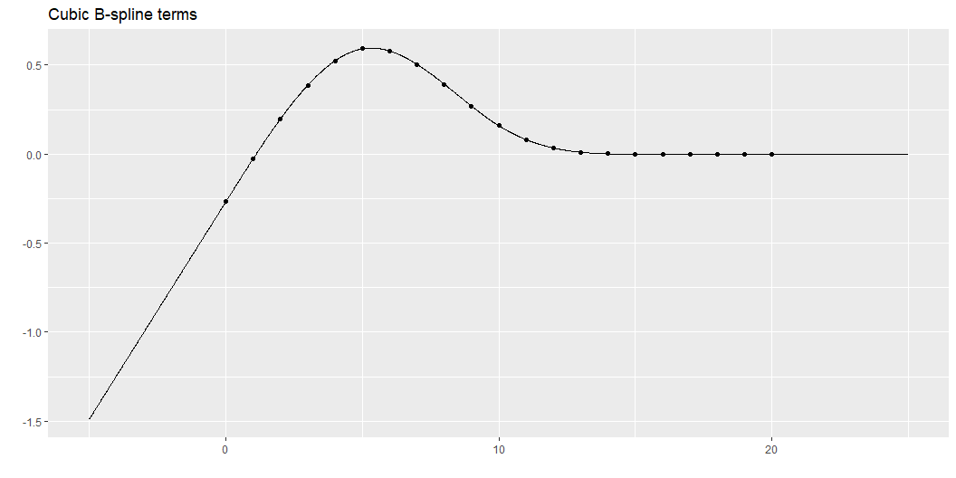
Natural spline, 1

Slide 71
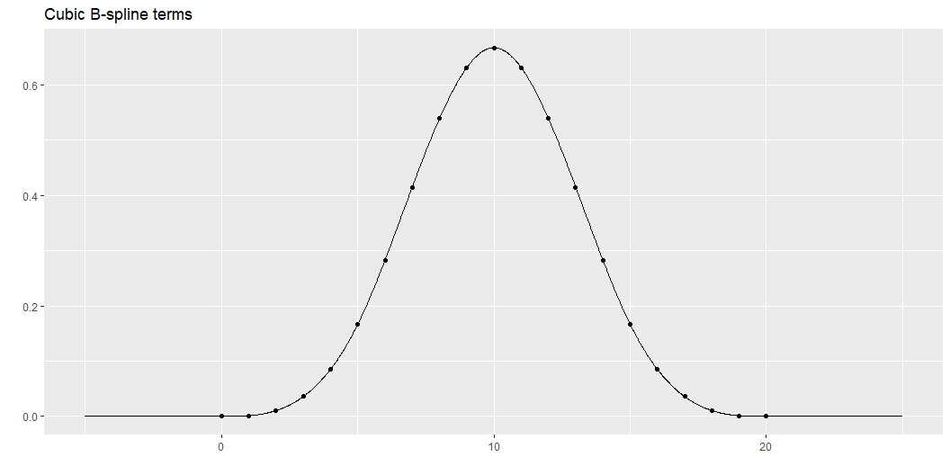
Natural spline, 2

Slide 72

Natural spline, 3

Slide 73

Natural spline, 4

Slide 74

Natural spline, 5

Slide 75

Natural spline fit
Notes:
Here is the natural spline fit to your simulated dataset.
You can probably see the linearity at the extremes of the data.

Slide 76
Break #3
What you have learned
B-splines, natural splines
What’s coming next
How many knots and where to put them

Slide 77
How many knots?
Use AIC or BIC
Eyeball the data
Frank Harrell’s suggestion
Use 4 knots if n < 100
Otherwise use 5 knots
Use your a priori beliefs
Looking at some preliminary graphs
Notes:
A difficult question is how many knots to use. Too many knots and you might end up overfitting. Too few and you might end up with not enough flexibility to fit your data well.
The AIC (Akaike Information Criterion) and the BIC (Bayesian Information Criterion) are useful measures for comparing different statistical models. In linear regression both AIC and BIC look at how close the fitted curve is to the data, but adds a penalty for model complexity. This helps avoid the situation where an excessively complex model with only marginally better predictive power is selected over a simpler model that predicts almost as well.
Note that a p-value will not work here except in some special cases where all of the knots but one coincide. The p-value fails because (with a few rare exceptions) one spline model is not nested inside another.
Look at the number of bends in the data. If the data increases to a single maximum and then decreases after that, a simpler spline with 2 or 3 knots may be sufficient. This also applies if the data decreases to a single minimum and then increases after that. If there are more bends (e.g., increase to a maximum, decrease to a minimum, and then increase again), then a larger number of knots may be needed.
Frank Harrell has a simple suggestion. Use 4 knots for small data sets. Small means n < 100. Use 5 knots for large data sets.
You may have a feel for how much complexity is appropriate based on your years of experience as a data analyst and your scientific knowledge of the process at hand. After you work with enough splines, you do get an appreciation on how wiggly they can get. If you also have a rough idea of how the nonlinear relationship is going to be, perhaps based on seeing other similar problems in the area, you can match the degrees of freedom of the spline to your expectation, prior to looking at the data.
Sometimes you have knowledge of the specific application that will help you to figure out where to put your knots.
I am not an expert on cars, but I have been told that many newer cars with automatic transmission change how the transmission behaves around 40 miles per hour. This transition helps with highway mileage. So if you are fitting a spline curve to data where how the transmission behaves, make sure that you place one or two of your knots near 40 miles per hour.
I am also not an expert on kidneys, but I have been told that the Glomerural Filtration Rate is not too critical if the value is above 90, but becomes very serious when it is less than 30. So a model looking at health effects using GFR should probably have knots around 30 and 90.
Similarly, CD4 cell counts above 500 are a good sign, but things turn rapidly worse if they dip below 200.
This is a bit controversial. Selecting a statistical model post hoc (after viewing the data) leaves you open to a charge of data dredging or going on a fishing expedition. To be fair, it is not as bad as some approaches (such as running ten tests and then choosing the one with the smallest p-value).

Slide 78

AIC for a linear fit

Slide 79

AIC for a three knot spline

Slide 80

AIC for a four knot spline

Slide 81

AIC for a five knot spline

Slide 82
Use inside knowlege to place the knots
Automatic transmission locks in at 40 miles per hour
Kidney function is fine above 90, problematic below 30
CD4 counts fine above 500, trouble below 200
Notes:
I am not an expert on cars, but I have been told that many newer cars with automatic transmission change how the transmission behaves around 40 miles per hour. This transition helps with highway mileage. So if you are fitting a spline curve to data where how the transmission behaves, make sure that you place one or two of your knots near 40 miles per hour.
I am also not an expert on kidneys, but I have been told that the Glomerural Filtration Rate is not too critical if the value is above 90, but becomes very serious when it is less than 30. So a model looking at health effects using GFR should probably have knots around 30 and 90.
Similarly, CD4 cell counts above 500 are a good sign, but things turn rapidly worse if they dip below 200.

Slide 83
Frank Harrell’s suggestion for knot placement
Simple choice
Outer knots at fifth smallest and fifth largest X
Alternative: Set outer knots at key quantiles
For 3 knots, use $q_{0.1}$ and $q_{0.9}$
For 4-6 knots, use $q_{0.05}$ and $q_{0.95}$
For 7 or more knots, use $q_{0.025}$ and $q_{0.975}$
Inner knots are evenly spaced quantiles between outer knots
Notes:
Frank Harrell suggests that you place the knots not evenly across the range of X but at equally spaced quantiles of the X distribution. This makes sense when the distribution of the X values is not uniform. If, for example, X is skewed to the right (has a tendency to produce most of the data on the left with a few scattered outliers on the right), the knots will tend to favor the data-rich left side of the distribution. He also suggests placing the leftmost and rightmost knots near, but not at the extremes of the X values, such as at the 10th or 90th percentiles or at the fifth smallest and the fifth largest values in the data. The actual percentiles are a bit tricky to explain.
“For 3 knots, the outer quantiles used are 0.10 and 0.90. For 4-6 knots, the outer quantiles used are 0.05 and 0.95. For more than 6 knots, the outer quantiles are 0.025 and 0.975. The knots are equally spaced between these on the quantile scale. For fewer than 100 non-missing values of x, the outer knots are the 5th smallest and the 5th largest x.” as quoted here,
If you pick this apart, you can deduce that 4 knots for a large dataset would be placed at the 5th, 35th, 65th and 95th percentiles.

Slide 84
Knot placement doesn’t matter
Number of knots is important
Placement of knots is not important
Notes:
Most references I have looked at state that it is the number of knots rather than the placement of the knots that is critical.

Slide 85
Break #4
What you have learned
How many knots and where to put them
What’s coming next
Logistic regression example

Slide 86
Most models will accept splines
Easy
Linear regression
Random effects regression models
Harder but not too difficult
Generalized linear model
Cox regression
Not at all helpful for data science models
Random forests
Deep neural nets
Notes:
Splines work with a variety of statistical models. They work very nicely with linear regresion and random effects regression models.
It takes a bit more work with the generalized linear model because of the nonlinear relationship with the outcome variable. With a bit of care, you will be fine.
Cox regression models also require a bit of care.
Many of the recent data science models do not work well with splines. The random forest model and deep neural nets, to name two, have their own way of modeling non-linearity and the spline functions would just get in the way.
Let me show how to use a spline in a logistic regression model with data from survival of passengers on the Titanic.

Slide 87
Some general points
Coefficients are uninterpretable
Splines are a package
But can test linear versus nonlinear
Graphs, graphs, graphs
Don’t over-interpret the tails
Notes:
Before I show some results using real data, let me make a few general points. The slope coefficient in a linear regression model without splines is easy to interpret. It is the estimated average change in Y when X increases by one unit, holding all the other independent variables constant.
You will not find such an easy interpretation associated with the coefficients attached to the spline terms. In fact, there is not a difficult interpretation either. The coefficients that you see have no practical meaning. You can’t say that a certain coefficient means that the relationship flattens out for large values of the independent variable. Just ignore the numbers altogether.
The other thing you need to keep in mind is that the spline terms are a package deal. You can’t zero out one of the five or seven spline terms because it is not statistically significant. You have to either include all of the spline terms in your final model or exclude all of the spline terms. There is no “in between” choice.
The one thing you can do is to compare a linear model to a spline model. The linear model is implicitly nested within the spline model, even though none of the spline terms look at all linear. You look at how much the sums of squares for error decrease when you move from a linear model to a spline model and test using the standard F ratio that you use when comparing nested models.
The other thing to note is that splines just scream out “Graph me!”. The coefficients themselves may be uninterpretable, but the graphs usually illustrate an interesting pattern.
I was helping someone with an analysis of nonlinearity in a logistic regression model. In this context, that means non-linear on a log odds scale. This person ran all sorts of tests and measures and couldn’t make any sense of all the numbers they produced. These were really complex and detailed tests, and I had to run to Google more than once to figure out what these numbers were trying to measure.
But a simple graph revealed an obvious pattern. High values of a particular variable showed a strong linear effect, but middling values and low values were all about the same. Kind of like that example I showed at the beginning of the talk.
While you do want to look carefully at all the trends, be cautious about what happens at the tails, the very smallest values and the very largest values. There is less data to use for the splines at the tails and the standard errors will typically explode. Be especially cautious about outlier in the variable you are splining. A sharp bend in the spline might be driven by one or two data points.

Slide 88
About the Titanic
Largest passenger ship at its time
Maiden voyage in 1912
Hit an iceberg and sank
Detailed information on all passengers
Survived (no/yes)
Sex (female/male)
Passenger class (1st, 2nd, 3rd)
Age (2 months to 71 years)
Notes:
The Titanic was a large cruise ship, the biggest of its kind in 1912. It was thought to be unsinkable, but when it set sail from England to American in its maiden voyage, it struck an iceberg and sank, killing many of the passengers and crew. You can get fairly good data on the characteristics of passengers who died and compare them to those that survived. The data indicate a strong effect due to age and gender, representing a philosophy of “women and children first” that held during the boarding of life boats. Let’s look at the effect of age on survival using a logistic regression model.

Slide 89
First few rows of data
name | pclass | age | sex | survived
Allen, Miss Elisabeth Walton | 1st | 29.00 | female | 1
Allison, Miss Helen Loraine | 1st | 2.00 | female | 0
Allison, Mr Hudson Joshua Creighton | 1st | 30.00 | male | 0
Allison, Mrs Hudson JC (Bessie Waldo Daniels) | 1st | 25.00 | female | 0
Allison, Master Hudson Trevor | 1st | 0.92 | male | 1

Slide 90
A few descriptive statistics, 1
age_mean | age_sd | age_min | age_max | n
30.39799 | 14.25905 | 0.17 | 71 | 756

Slide 91
A few descriptive statistics, 2
pclass | n
1st | 322
2nd | 280
3rd | 711

Slide 92
A few descriptive statistics, 3
sex | n
female | 462
male | 851

Slide 93
A few descriptive statistics, 4
survived | n
0 | 863
1 | 450

Slide 94

Boxplots
Notes:
The boxplots reveal little differences between the ages of survivors and deaths. If something is going on, it is subtle.

Slide 95
Fit a linear model first.
term | estimate | std.error | statistic | p.value
(Intercept) | -0.08142783 | 0.17386170 | -0.4683483 | 0.63953556
age | -0.00879462 | 0.00523158 | -1.6810637 | 0.09275054
Notes:
There may be a downward trend in the odds of survival over time, but it is not statistically significant.

Slide 96
Now fit a spline function.
term | estimate | std.error | statistic | p.value
(Intercept) | 1.2923278 | 0.39909550 | 3.2381418 | 0.0012031099
rcs(age)age | -0.1015127 | 0.02964437 | -3.4243511 | 0.0006162695
rcs(age)age' | 0.2225054 | 0.15885843 | 1.4006520 | 0.1613181579
rcs(age)age'' | -0.1409403 | 1.19790026 | -0.1176561 | 0.9063401205
rcs(age)age''' | -0.7520566 | 1.57492863 | -0.4775179 | 0.6329933910
Notes:
The coefficients from the restricted cubic spline are pretty much uninterpretable. You have to visualize the spline graphically. First do this on the log odds scale to see how far from linear the spline fit is.

Slide 97

Predictions on a log odds scale
Notes:
It looks like a definite departure from linearity. The log odds for survival are best for very young children. They decline in older children and are at their worst for young adults. The log odds rise again starting at age 30 but this is a smaller and less dramatic change than you see in the children versus young adults.
The final dip for very old passengers, starting around 45, might be real and could reflect their relative frailty. But be careful about interpreting results in the tails.

Slide 98

Predictions on the probability scale
Notes:
The ages fall on whole number boundaries and in order to see things clearly, I jittered the data.
It looks like “women and children” first might actually be “women, children, and old people first”.

Slide 99
Break #5
What you have learned
Logistic regression example
What’s coming next
Some code hints for R, SAS, Stata

Slide 100
R
splines package
bs function
ns function
rms pckage
rcs function

Slide 101
SAS
pbspline keyword

Slide 102
Stata
mkspline
rc_spline

Slide 103
References
Donald H. House. Chapter 14. Spline Curves. Available in pdf format.
Aris Perperoglou, Willi Sauerbrei, Michal Abrahamowicz, Matthias Schmid. A review of spline function procedures in R. BMC Medical Research Methodology 19, 46 (2019). DOI: 10.1186/s12874-019-0666-3. Available in html format or pdf format.

Slide 104
Summary
What you have learned
Variety of regressions
Building cubic splines from scratch
B-splines, natural splines
How many knots and where to put them
Logistic regression example
Some code hints for R, SAS, Stata

