Slide 1
Clinical statistics for non-statisticians: Day two
Steve Simon

Slide 2
Outline of the three day course
Day one: Numerical summaries and data visualization
Day two: Hypothesis testing and sampling
Day three: Statistical tests to compare treatment to a control and regression models
My goal: help you to become a better consumer of statistics
Day two topics
Hypothesis testing
What does a p-value tell you
Why you might prefer a confidence interval
What sample size do you need
How does a Bayesian data analysis differ
What should you do if you do not have a hypothesis to test
Day two topics (continued)
Sampling
What do you gain with a random sample
When might you prefer a non-random sample
When should you use randomization or blinding
What are the benefits of matching
How can you ensure that your sampling approach is ethical
Notes:
Speaker notes
Speaker notes
Speaker notes

Slide 3
Introduction
P-values and confidence intervals are the fundamental tools used in most inferential data analyses. They are possibly the most commonly reported statistics in the medical literature. Unfortunately, both p-values and confidence intervals are subject to frequent misinterpretations.
In this webinar, you will review the interpretation of p-values and confidence intervals, and see an alternative approach based on Bayesian data analysis.
In this seminar, you will learn how to: - interpret p-values and confidence intervals; - explain the difference between informative and diffuse priors; - interpret statistics from a posterior distribution.

Slide 4
Bad quiz question
A research paper computes a p-value of 0.45. How would you interpret this p-value?
Strong evidence for the null hypothesis
Strong evidence for the alternative hypothesis
Little or no evidence for the null hypothesis
Little or no evidence for the alternative hypothesis
More than one answer above is correct.
I do not know the answer.

Slide 5
A bad confidence interval
A research paper computes a confidence interval for a relative risk of 0.82 to 3.94. What does this confidence interval tell you.
The result is statistically significant and clinically important.
The result is not statistically significant, but is clinically important.
The result is statistically significant, but not clinically important.
The result is not statistically significant, and not clinically important.
The result is ambiguous.
I do not know the answer.

Slide 6
Bayesian question
A Bayesian data analysis can incorporate subjective opinions through the use of Bayes rule.
data shrinkage.
a prior distribution.
a posterior distribution.
p-values.
I do not know the answer.

Slide 7
What is a population?
Population: the group you wish to generalize your research results to.
Usually defined in terms of
Demography,
Geography,
Occupation,
Time,
Care requirements,
Diagnosis,
Or some combination of the above.

Slide 8
Example of a population
An example of a population would be all infants born in the state of Missouri during the 1995 calendar year who have one or more visits to the Emergency room during their first year of life.

Slide 9
What is a sample?
Sample: subset of a population.
Random sample: every item in the population has the same probability of being in the sample.
Biased sample: some items in the population have a decreased probability of being in the sample.

Slide 10
What is a Type I error?
A Type I error is rejecting the null hypothesis when the null hypothesis is true (false positive).
Example involving drug approval: a Type I error is allowing an ineffective drug onto the market.

Slide 11
What is a Type II error?
A Type II error is accepting the null hypothesis when the null hypothesis is false.
An example involving drug approval: a Type II error is keeping an effective drug off of the market.

Slide 12
What is a p-value?
A p-value is a measure of how much evidence we have against the null hypothesis.
The null hypothesis, traditionally represented by the symbol H0, represents the hypothesis of no change or no effect.
The smaller the p-value, the more evidence we have against H0.
The p-value is also a measure of how likely we are to get a certain sample result or a result “more extreme,” assuming H0 is true.
The type of hypothesis (right tailed, left tailed or two tailed) will determine what “more extreme” means.

Slide 13
What is a confidence interval?
A confidence interval is a range of values that tries to quantify uncertainty associated with the sampling process.
Consider it as a range of plausible values.
There is a confidence level associated with any confidence interval, usually 95%, but sometimes 90% or 99%.
The confidence level is related to the alpha level (probability of a Type I error).
It also has a long range sampling interpretation.
If you repeatedly sampled from the same population, then 95% (or 90% or 99%) of the confidence intervals produced would contain the true value in the population.

Slide 14
Bayesian example
There’s a wonderful example of Bayesian data analysis at work that is simple and fun. It’s taken directly from an article by Jim Albert in the Journal of Statistics Education (1995, vol. 3 no. 3) which is available on the web at
www.amstat.org/publications/jse/v3n3/albert.html.
I want to use his second example, involving a comparison of ECMO to conventional therapy in the treatment of babies with severe respiratory failure.
In this study, 28 of 29 babies assigned to ECMO survived and 6 of 10 babies assigned to conventional therapy survived.
Refer to the Albert article for the source of the original data.

Slide 15
Bayes rule
Wikipedia gives a nice general introduction to the concept of Bayesian data analysis with the following formula:
P (H|E) = P(E|H) P(H) / P(E)
where H represents a particular hypothesis, and E represents evidence (data). P, of course, stands for probability.

Slide 16
Prior
The first step is to specify P(H), which is called the prior probability. Specifying the prior probability is probably the one aspect of Bayesian data analysis that causes the most controversy. The prior probability represents the degree of belief that you have in a particular hypothesis prior to collection of your data.
The prior distribution can incorporate data from previous related studies or it can incorporate subjective impressions of the researcher. What!?! you’re saying right now. Aren’t statistics supposed to remove the need for subjective opinions?
Actually, a bit of subjectivity is a good thing.
First, it is impossible to totally remove subjective opinion from a data analysis. You can’t do research without adopting some informal rules. These rules may be reasonable, they may be supported to some extent by empirical data, but they are still applied in a largely subjective fashion.
Here are some of the subjective beliefs that I use in my work:
you should always prefer a simple model to a complex model if both predict the data with the same level of precision.
you should be cautious about any subgroup finding that was not pre-specified in the research protocol.
if you can find a plausible biological mechanism, that adds credibility to your results.
Second, the use of a range of prior distributions can help resolve controversies involving conflicting beliefs. For example, an important research question is whether a research finding should “close the book” to further research. If data indicates a negative result, and this result is negative even using an optimistic prior probability, then all researchers, even those with the most optimistic hopes for the therapy, should move on.
Third, while Bayesian data analysis allows you to incorporate subjective opinions into your prior probability, it does not require you to incorporate subjectivity. Many Bayesian data analyses use what it called a diffuse or non-informative prior distribution. This is a prior distribution that is neither optimistic nor pessimistic, but spreads the probability more or less evenly across all hypotheses. ## ECMO prior
Here’s a simple example of a diffuse prior that Dr. Albert used for the ECMO versus conventional therapy example. Let’s assume that the true survival rate could be either 0, 10%, 20%, …, 100% in the ECMO group and similarly for the conventional therapy group. This is not an optimal assumption, but it isn’t terrible either, and it allows us to see some of the calculations in action.
With 11 probabilities for ECMO and 11 probabilities for conventional therapy, we have 121 possible combinations. How should we arrange those probabilities? One possibility is to assign half of the total probability to combinations where the probabilities are the same for ECMO and conventional therapy and the remaining half to combinations where the probabilities are different. Split each of these probabilities evenly over all the combinations.
This is P(H). For simplicity, we multiplied each probability by 1000 and rounded.

Slide 17
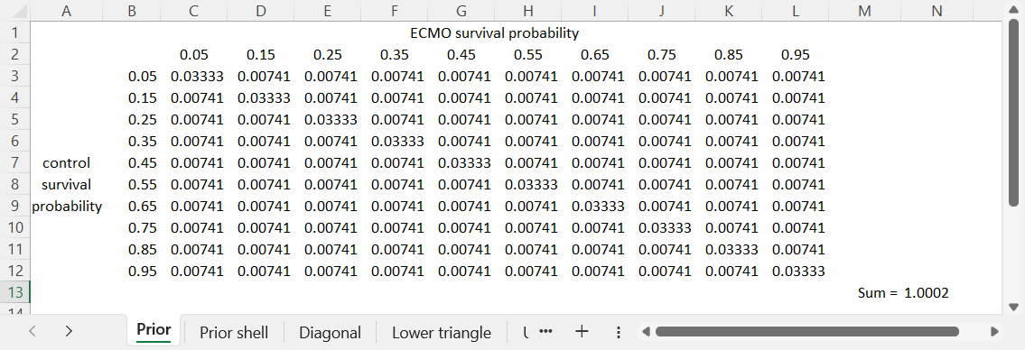
Prior table
Figure 1: Table of prior probabilities

