Slide 1
Test image sizes
Steve Simon

Slide 2
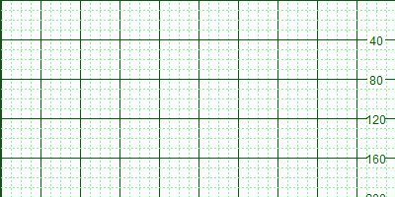
Test 200 by 400
Figure 1. 123456789 223456789 323456789 423456789 523456789 623456789 723456789

Slide 3
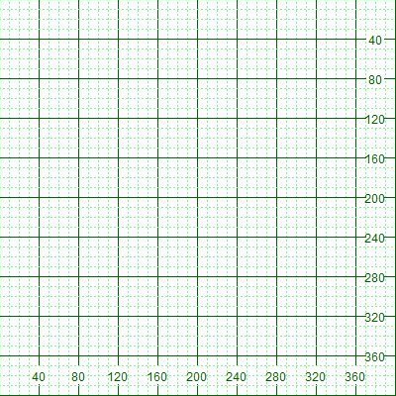
Test 400 by 400
Figure 2. 123456789 223456789 323456789 423456789 523456789 623456789 723456789

Slide 4
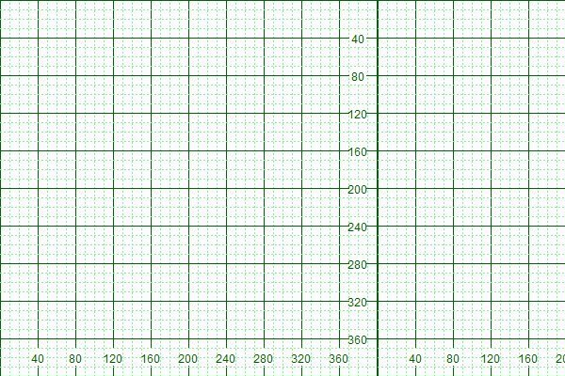
Test 400 by 600
Figure 3. 123456789 223456789 323456789 423456789 523456789 623456789 723456789

Slide 5
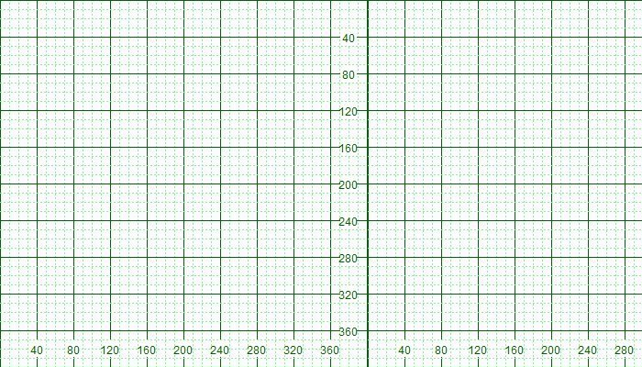
Test 400 by 700
Figure 4. 123456789 223456789 323456789 423456789 523456789 623456789 723456789

Slide 6
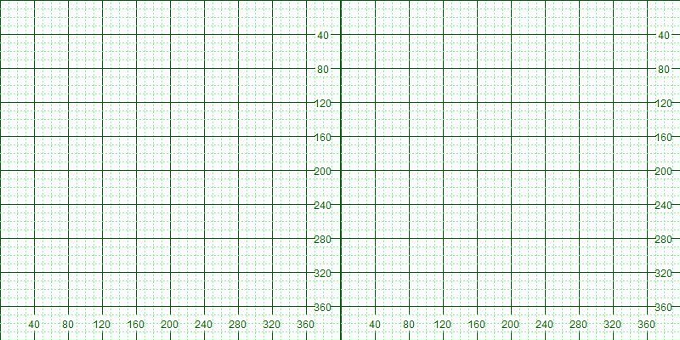
Test 400 by 800
Figure 5. 123456789 223456789 323456789 423456789 523456789 623456789 723456789

Slide 7
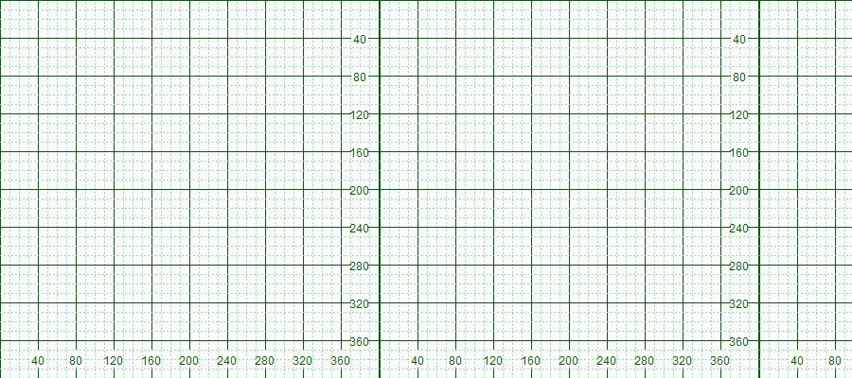
Test 400 by 900
Figure 6. 123456789 223456789 323456789 423456789 523456789 623456789 723456789

Slide 8
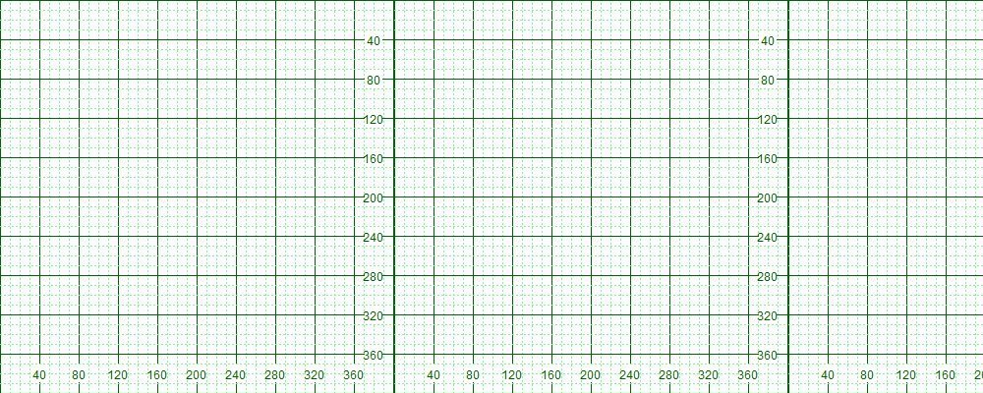
Test 400 by 1000
Figure 7. 123456789 223456789 323456789 423456789 523456789 623456789 723456789

Slide 9
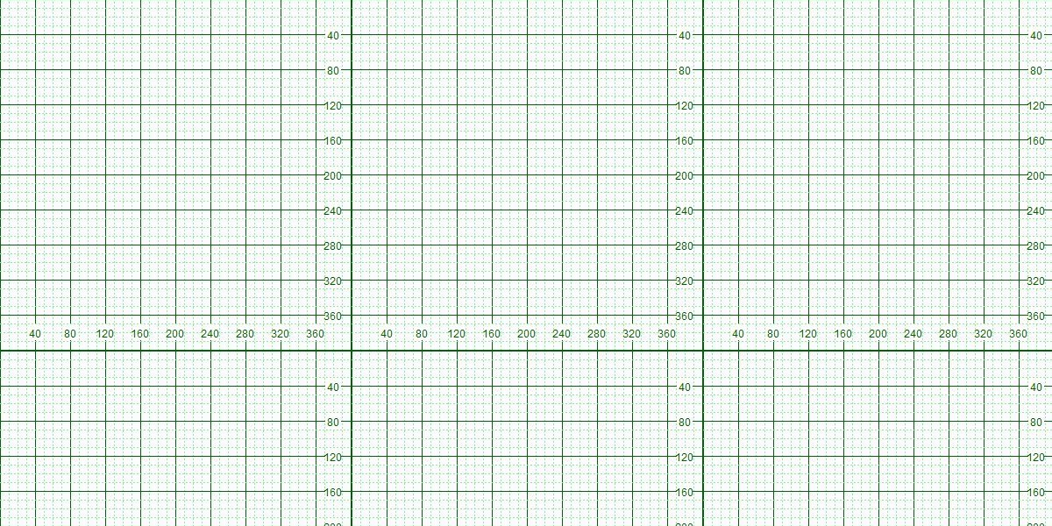
Test 600 by 1200
Figure 8. 123456789 223456789 323456789 423456789 523456789 623456789 723456789

