Slide 1
Sample size justification
Steve Simon

Slide 2
Who am I?
Steve Simon
PhD Statistics, 1982, U Iowa
Teach in Biomedical and Health Informatics
Previous jobs at CMH, CDC
Part-time independent statistical consultant (P.Mean Consulting)
Married to a Pediatric Cardiologist (retired)
Run 5K and 4 mile races
Notes:
Let me introduce myself. I am Steve Simon. I got a PhD in Statistics almost 40 years ago from the University of Iowa. The world has changed a lot since then, but I have tried to keep up. Today, if you want to sound trendy, you are a “data scientist”. I teach in the Department of Biomedical and Health Informatics at UMKC. I have had previous jobs at Children’s Mercy Hospital, and the Centers for Disease Control and Prevention. I’m also a part-time statistical consultant. I have a sole proprietorship, P.Mean Consulting. That’s short for Professor Mean. For people who don’t get the joke, I point out that Professor Mean is not just your average Professor. Related to this talk, I should point out that I am obsessed with computers.

Slide 3
Outline of this talk
Pop quiz
Sample size justification is an economic justification
Definitions
Specifying a research hypothesis
Identifying the variation in your outcome
Determining the minimum clinically important difference
Repeat of pop quiz
Notes:
We’ll start with a pop quiz. Don’t worry, it’s not graded.

Slide 4
Pop quiz, question #1
A good sample size will produce
Large values for both alpha and beta.
A large value for alpha and a small value for beta.
A small value for alpha and a large value for beta.
Small values for both alpha and beta.
I’m awfully glad I’m a Beta, because I don’t work so hard.
I don’t know the answer.
Notes:
Does anyone know the reference to the quote in #5. It is from Aldous Huxley’s Brave New World, a dystopic book about a future where people are bred into classes of alphas, betas, and gammas. And if you were a beta you were brainwashed into believing that you should be glad to be a beta.

Slide 5
Pop quiz, question #2
One of the three things you need to calculate an appropriate sample size is
A confidence interval for your outcome variable
A range for your outcome variable
A standard deviation for your outcome variable.
A standard error for your outcome variable.
Any of these is fine.
I don’t know the answer.
Notes:
Here’s the second question.

Slide 6
Pop quiz, question #3
The minimum clinically important difference is determined by
Finding a balance between the benefits and the harms of a new drug.
Finding a balance between the cost of sampling an additional patient and the incremental reduction in uncertainty.
Finding a balance between Type I and Type II error rates.
Finding a balance between your work and your family.
More than one answer above is correct.
I don’t know the answer.
Notes:
Here’s the third question. If you don’t know the answers to these questions now, that’s okay. But if you don’t know the answer after I finish my lecture, then I have not done a good job.

Slide 7
A sad tale of research
A researcher is finishing up a six year, ten million dollar NIH grant and writes up in the final report
“This is a new and innovative surgical procedure and we are 95% confident that the cure rate is somewhere between 3% and 98%.”
Notes:
Here’s a story I tell all the time when someone comes in and asks me what their sample size should be. It’s one of those stories that isn’t true but should be. When I tell this story to someone, it doesn’t matter how much or how little they know about Statistics. They still get the punchline. Ten years and six million dollars and the best you could do is come up with a confidence interval that goes from 3% to 98%? Good grief! That’s a huge waste.
The heart and soul of all sample size calculations is economic. You want to insure that your research dollars are well spent, that you are getting something of value for your investment.

Slide 8
A second sad tale of research
Confidence interval for an odds ratio: 0.82 to 3.14.
Interpret this interval
Notes:
Here’s a more subtle example that I typically include in a talk about confidence intervals. Recall that an odds ratio of 1 implies that the control and treatment arm have the same risk.
Now most people I show this interval to look at with a blank expression. No! This is something that should make you gag and retch. This is a terrible interval.
It includes the value of 1 which means no change in risk. But it also includes the value of 2, which means a doubling of risk. So you are looking at a research study with such a pathetically small sample size that it cannot distinguish a difference between no change in risk and a doubling of risk.
No, it’s worse than that. This study can’t distinguish between no change and a tripling of risk.

Slide 9
Sample size justification is an economic justification
Larger samples cost more money
but provide more precision
diminishing returns
Balance cost versus precision
Notes:
There’s a tradeoff between cost and precision. You want to spend as little money as possible, but not so little that you get a confidence interval for a cure that goes from 3% to 98% or for an odds ratio that goes from 0.82 to 3.14. So keep adding money to pay for a larger sample size until you get to the point where any additional money spent provides such a small improvement in precision that it is not worth your effort anymore.

Slide 10
Real example of economic tradeoff
Overbilling problem
Need to estimate excess to process a refund
Audit of all records too expensive
2,000 records, $100 per record
Sample how many records?
Notes:
Sometimes it is hard to put a dollar figure on precision, but here’s a simple example where you can see the relationship.

Slide 11
Solution
Estimate 95% confidence interval for excess
Pay the upper limit
Balance size of upper limit versus cost
Notes:
The solution I proposed was to pay not the estimated excess charges but the upper limit of the 95% confidence interval. It seems fair for us to bear the cost of the uncertainty associated with our failure to do a 100% audit.
So now, we have a good idea of when to stop sampling. Say that it costs 100 dollars to add a new record to the sample, but the interval shrinks by 200 dollars. That’s more than enough justification to increase the sample size.
But these calculations have a diminishing return because the interval width is inversely proportional to the square root of the sample size. So you might get to the point where an additional record only buys you a 50 dollar reduction in the upper confidence limit. This means you’ve gone too far.

Slide 12
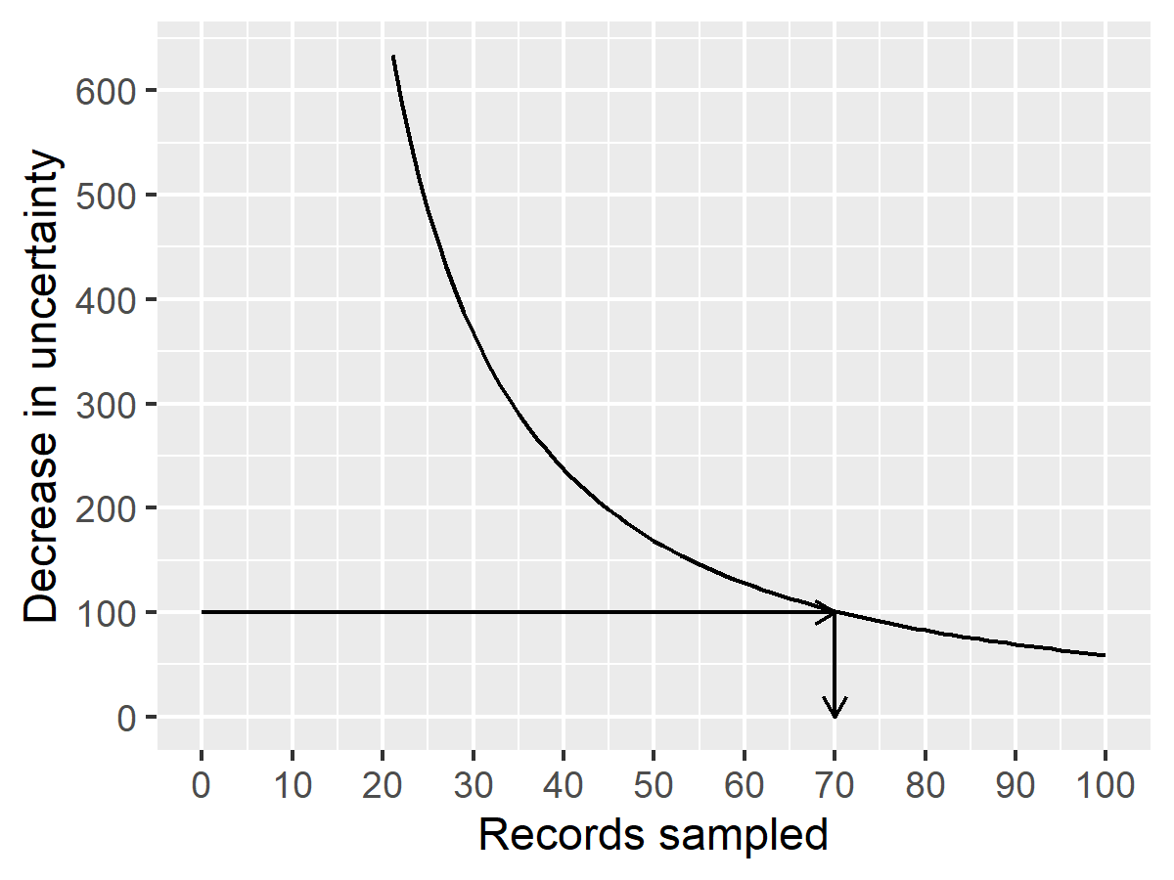
Solution displayed graphically
Figure 1. Decrease in uncertainty versus sample size
Notes:
This graph shows the decrease in uncertainty associated with the 95% confidence interval. Anything less than a sample size of 70, and the gain in precision more than offsets the cost of additional sampling. But once the sample size increases beyond 70, diminishing returns take over and a further increase in sample size is not justified.
The curve in the previous graph shows the general concept of diminishing returns. With a small sample size, each additional record has a large payoff in reduction of uncertainty. But as the sample size increases, the incremental payoff grows smaller. Eventually, the incremental benefit of further reducing uncertainty is counterbalanced by the incremental increase in sampling costs.
In most examples, there is not a one-to-one relationship between the shrinkage of the confidence interval and the saving of money. But the principle still applies.
– Your current level of uncertainty is costing you money.
– Sampling can reduce that uncertainty, but the sample itself costs money.
– You have to balance the benefits in reduction of uncertainty against the costs of sampling

Slide 13
Ethical concerns about an inadequate sample size
People volunteer for research studies for three reasons:
To earn some money,
To find out more about the research process, or
To help other people.
An inadequate sample size invalidates third reason
Notes:
The motivation for people to volunteer for a clinical trial fall into three broad categories. First, they may be in it for the money. You shouldn’t trivialize this. The get up early and sacrifice their opportunitiy to watch their favorite Saturday morning cartoons. Especiall that weird one: Sponge Something Square Bob? It is perfectly fine to compensate them for their time, as long as the amount is not excessive.
Other people volunteer out of curiosity. They want to learn more about how medical research works.
But perhaps the biggest reason is that people volunteer because they want to help people in the future who have the same disease. They want to make the world safer and healthier.
If the research study has such a small sample size that the results are uninterpretable then you have helped no one. You have broken an implicit promise to those volunteers. Almost no one would volunteer for a study if the only value in it is the ability for you to pad your own resume.

Slide 14
Ethical concerns about an excessive sample size
Features of some (not all) clinical trials
Small/moderate amount of pain
Endure a risky procedure, or
Forgoing an appropriate medical treatment
In these cases, too large a sample is problematic.
Notes:
Too large a sample size is also an ethical problem.
Too large a sample size creates needless suffering among research volunteers. Not every study requires suffering and the amount that we ask people to endure has to be small or moderate. But sometimes there is some pain involved (for example, through a blood draw) or you ask the volunteers to undergo a procedure with small risks (such as a lumbar puncture) or if you ask them to accept possible randomization in an arm of the study that uses a placebo, thus forgoing a possibly superior medical treatment. If this is the case, you have to minimize the number of people who have to endure these sacrifices.

Slide 15
Definition: population
The group you wish to generalize your research results to. Usually defined in terms of one or more of the following
Demography,
Geography,
Occupation,
Time,
Care requirements,
Diagnosis,

Slide 16
Example of a population
All infants born in the state of Missouri during the 1995 calendar year who have one or more visits to the Emergency room during their first year of life.
Notes:
Here’s an example of a population that hits on most of these elements
“infants” is demography
“Missouri” is geography
“1995” is time
“visits to the Emergency Room” is care requirements.

Slide 17
Definitions: sample
Subset of a population.
Random sample: every item in the population has the same probability of being in the sample.
Biased sample: some items in the population have a decreased probability of being in the sample.
Notes:
A population is usually so large that it is impossible from a logistical or financial perspective to measure everyone in the population. So you take a sample, a subset of the population. Ideally, you have a sample that is representative

Slide 18
Definitions: parameter and statistic
Parameter: number computed from a population
$μ$, $σ$, $π$, $ρ$
Statistic: number computed from a sample
$\overline{X}$, $S$, $p$ or $\hat{p}$, $r$.
Notes:
A parameter is a number computed from a population. It is often designated by a Greek letter. The Greek letters mu and sigma represent the population mean and population standard deviation, pi represents a population proportion, and rho represents a population correlation.
A statistic is a number computed from a sample. It is usually represented by a letter in the standard (Roman) alphabet, though sometimes with a symbol above it. The sample mean and sample standard deviation are represented by X-bar and S, the sample proportion by p or p-hat, and the sample correlaton by r.

Slide 19
Putting it all togther
Statistics is the use of one or more statistics computed from a sample to make an inference about one or more parameters from a population.
Notes:
It’s a bit simplistic, perhaps, but here’s a definition of statistics.

Slide 20
Definition: null hypothesis
The null hypothesis is, by tradition, a hypothesis that represents
no change,
no difference, or
the status quo
The null hypothesis is expressed using parameters (Greek)
$H_{0} μ=100$
$H_{0} π_{1}=π_{2}$
$H_{0} ρ=0$
Notes:
The null hypothesis is often described as the “negative” hypothesis, but this is judgemental. It represents no change, no difference, or the status quo. It is written in terms of parameters and usually involves an equality.

Slide 21
Definition: alternative hypothesis
The alternative hypothesis is complementary to the null hypothesis
$H_{1} μ≠100$
$H_{1} π_{1}≠π_{2}$
$H_{1} ρ≠0$
Note: no discussion of
one-sided hypotheses,
equivalence hypotheses,
non-inferiority hypotheses
Notes:
The alternative hypothesis is complementary. I need to mention one-sided hypotheses. These are controversial but I don’t wnat to get into all the details about when you use them. There are also equivalence hypotheses and non-inferiority hypotheses.

Slide 22
Definitions: Type I and II error rates
A Type I error is
rejecting the null hypothesis when the null hypothesis is true.
It is also known as a false positive.
A Type II error is
accepting the null hypothesis when the null hypothesis is false.
It is also known as a false negative
Example involving drug approval:
a Type I error is allowing an ineffective drug onto the market.
a Type II error is keeping an effective drug off of the market.
Notes:
One you have the null and alternative hypotheses, you collect statistics to help you accept or reject the null hypothesis. Since a sample is only part of the population, there is sampling error. This means that your statistic is only an estimate of a parameter. If you make a choice to accept or reject the null hypothesis, you could make an error. There are two types of errors, labeled Type I and Type II errors.

Slide 23
Definition: Power function
Probablity of rejecting the null hypothesis for various values in the alternative hypothesis
Power is a function of
Parameter(s)
Alpha
Sample size
Power = 1 - $β$
Notes:
Many sample size justifications mention the power function. Power is the probability of rejecting the null hypothesis.

Slide 24
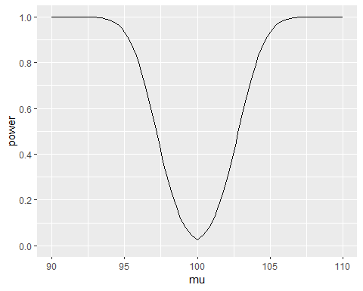
Example of a power function

Slide 25
Notes:
Here’s an example of a power function for a one sample t-test of the hypothesis H0 mu=100 for a sample of size 50 and a standard deviation of 10. Notice that the power is lowest when you are close to the hypothesized value of 100. When you move away from 100 in either direction, the power increases to almost 1.0.

Slide 26
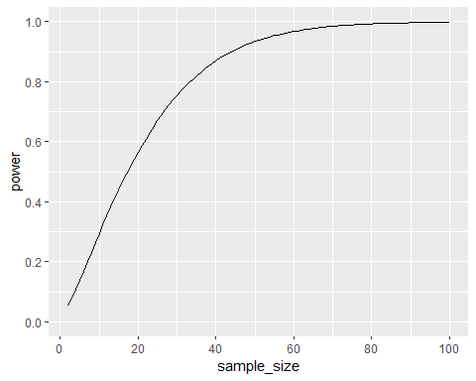
Power as a function of sample size

Slide 27
Sample size justification
In a nutshell, choose a sample size large enough + to insure that the chances of making a Type I or a Type II error are both small. or + (equivalently) to insure that alpha is small and power is large. or + to produce a reasonably narrow confidence interval.
Notes:
There are two basic ways that you justify a sample size. You can choose a sample size large enoug so that the chances of making either type of error (Type I or Type II) is small. Since power is inversely related to beta, the probability of a Type II error, you can say equivalane

Slide 28
Three things that you need to justify your sample size.
Research hypothesis
Standard deviation of your outcome measure
Minimum clinically important difference
Notes:
When a client asks me for a sample size, I ask for three things. The first is a research hypothesis. The client may not have a hypothesis, so my job is to develop one with them. Of course, not all research has to have a hypotheis and I want to talk a bit more about that case later.
The second thing I ask for is a bit harder, the standard deviation of the outcome measure.
Hardest yet is the minimum clinically important difference.

Slide 29
Finding the standard deviation
Run a pilot study
From previous research
Maybe already sitting in your draft bibliography
Reasonably comaparable
Same outcome measure
Similar study population
Notes:
You might consider getting an estimate of the standard deviation from the data you collectin in a pilot study. There are lots of good reasons to run a pilot study anyway, so this should always be a consideration.
You’ve already done a literature review haven’t you? If so, search through the papers in your review that used the same outcome measure that you are proposing in your study and a reasonably similar patient population. This is not always easy, and you will sometimes be forced to use a study where the patients are quite different from your patients. Don’t fret too much about this, but make a good faith effort to find the most representative population that you can.
Some clients will raise an objection here and say that their research is unique, so it is impossible to find a comparable paper. It is true that most research is unique (otherwise it wouldn’t be research). But what these people are worried about is that their intervention is unique. It’s easier to find a match on the other details of the proposed research: the patients being studied and the outcome being measured. These are the more important details. If you find a study where the patient population and the outcome match, the you are probably going to get a good estimate of variation.

Slide 30
Inferring a standard deviation from other measures of variation
If the paper does not have a standard deviation, look for
a standard error,
a coefficient of variation,
a confidence intervals, or
a range ($S≈RANGE/4$)
For a binary outcome
No standard deviation needed
Find the baseline or control proportion instead
Notes:
If you find a good research paper that is a reasonable match to your proposed research, you might not see a standard deviation in any of the tables. If instead you find a standard error, that’s good enough. The standard error is just the standard deviation divided by the square root of the sample size, so it is easy to calculate one from the other.
Likewise, if you know the coefficient of variation (defined as the mean divided by the standard deviation), you can usually figure out what the standard deviation is.
If you can find a confidence interval for the outcome measure, that’s a bit more work, but you can usually invert the confidence intervals formula to get the standard deviation.
There is only an approximate relationship between the range and the standard deviation, but if that is the only measure of variation in the paper, the range divided by 4 is usually a pretty good estimate of the standard deviation.
If your outcome is binary (two possible outcomes) then you don’t need a standard deviation to calculate power and justify your sample size. Instead, find the proportion at baseline or in your control group.

Slide 31
Determining the minimum clinically important difference
Requires clinical judgement
Some differences are clinically trivial
Large enough to change professional opinion
Large enough so that patients notice
Example: Pain score
Measured on visual analog scale (0-100)
Patients only feel better with a shift of 15 points
Notes:
The minimum clinically significant difference is the boundary between a difference so small that no one would adopt the new intervention on the basis of such a meager changer and a difference large enough to make a difference (that is, to convince health care professionals to change their behavior and adopt the new therapy). Or ask yourself what size difference is going to be noticed by the patients.
An example of establishing the minimum clinically important difference is with pain as an outcome measure. In many studies, pain is measured on a visual analog scale. The patient is shown a line of exactly 100 millimeters with one end marked as “no pain” and the other end marked as “worst” or “ubearable” pain. The patient makes a mark anywhere in that line and you measure the distance.
Studies have been done that showed that patients who report a reduction in pain after receiving analgesics move the mark about 15 millimeters to the right.

Slide 32
Cost-benefit tradeoff
For a binary outcome
X = the cost of the treatment
kX = benefit of the cure
MCD = 1/k
Examples
Aromatherapy
Gerson therapy (coffee enemas)
Notes:
For binary outcomes, the choice is not too difficult in theory. Suppose that an intervention “costs” X dollars in the sense that it produces that much pain, discomfort, and inconvenience, in addition to any direct monetary costs. Suppose the value of a cure is kX where k is a number greater than 1. A number less than 1, of course, means that even if you could cure everyone, the costs outweigh the benefits of the cure.
For k>1, the minimum clinically significant difference in proportions is 1/k. So if the cure is 10 times more valuable than the costs, then you need to show at least a 10% better cure rate (in absolute terms) than no treatment or the current standard of treatment. Otherwise, the cure is worse than the disease.
It helps to visualize this with certain types of alternative medicine. If your treatment is aromatherapy, there is almost no cost involved, so even a very slight probability of improvement might be worth it. But Gerson therapy, which involves, among other things, coffee enemas, is a different story. An enema is reasonably safe, but is not totally risk free. And it involves a substantially greater level of inconvenience than aromatherapy. So you’d only adopt Gerson therapy if it helped a substantial fraction of patients. Exactly how many depends on the dollar value that you place on having to endure a coffee enema, a task that I will leave for someone else to quantify.

Slide 33
Practical example of sample size justification
Comparison of two skin barriers for burn patients
Pain
Healing time
Cost
Notes:
In a study of two different skin barriers for burn patients, we are interested in three outcome measures: pain, healing time, and cost. We will randomly assign half of the patients to one skin barrier and half to the other.

Slide 34
Sample size justification using pain
Oucher scale
S = 1.5
MCD = 1
$$n=\frac{(σ_{1}^{2}+σ_{2}^{2})(z_{1−α/2}+z_{1−β})}{MCD^{2}}$$
n=35.3, round up to n=36 per group.
Notes:
For pediatric patients we usually measure pain with the Oucher, a five point scale that has been validated for children. A review of previous studies using the Oucher have shown that it has a standard deviation of about 1.5 units. We would be interested in seeing how large a sample size is needed to show a change of 1 unit, the smallest individual change attainable on the Oucher. We want to have a power of .80, or equivalently, the probability of a Type II error of .20.
The formula for the sample size in each group is a bit messy, but nothing that you can’t handle. Plug in the standard deviation of 1.5 in both spots, the various percentiles for the standard normal distribution, and the minimum clinically important difference. The sample size required to produce 80% power for a two-sided test at an alpha level of 0.05 is 35.3. Round this up to n=36 per group.

Slide 35
Sample size calculation using R
> power.t.test(delta=1, sd=1.5, sig.level=0.05, power=0.80, type="two.sample") Two-sample t test power calculation n = 36.3058 delta = 1 sd = 1.5 sig.level = 0.05 power = 0.8 alternative = two.sided NOTE: n is number in *each* group
Notes:
For pediatric patients we usually measure pain with the Oucher, a five point scale that has been validated for children. A review of previous studies using the Oucher have shown that it has a standard deviation of about 1.5 units. We would be interested in seeing how large a sample size is needed to show a change of 1 unit, the smallest individual change attainable on the Oucher. We want to have a power of .80, or equivalently, the probability of a Type II error of .20.

Slide 36
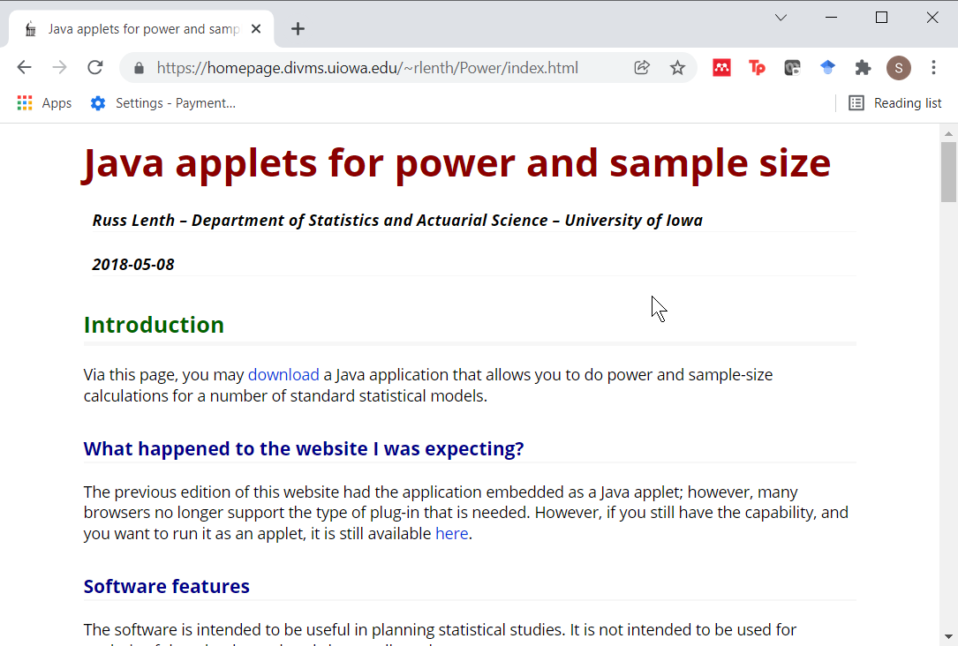
Power calculation using PiFace
Figure 2. Excerpt from PiFace website

Slide 37
Pop quiz, question #1
A good sample size will produce
Large values for both alpha and beta.
A large value for alpha and a small value for beta.
A small value for alpha and a large value for beta.
Small values for both alpha and beta.
I’m awfully glad I’m a Beta, because I don’t work so hard.
I don’t know the answer.
Notes:
Ideally, (4) is the best answer. Larger sample sizes can insure fewer chances for Type I and Type II errors. But if you want to quibble and say that we always hold alpha constant at 0.05 and only beta would decrease, that’s a fine answer also.

Slide 38
Pop quiz, question #2
One of the three things you need to calculate an appropriate sample size is
A confidence interval for your outcome variable
A range for your outcome variable
A standard deviation for your outcome variable.
A standard error for your outcome variable.
Any of these is fine.
I don’t know the answer.
Notes:
Actually any of these is fine. The simplest thing is to have a standard devation, but if you know any of the others, then it is pretty easy to calculate an exact value for the standard deviation except in the case of the range, where you can get an approximate standard deviation.

Slide 39
Pop quiz, question #3
The minimum clinically important difference is determined by
Finding a balance between the benefits and the harms of a new drug.
Finding a balance between the cost of sampling an additional patient and the incremental reduction in uncertainty.
Finding a balance between Type I and Type II error rates.
Finding a balance between your work and your family.
More than one answer above is correct.
I don’t know the answer.
Notes:
It’s tricky to calculate the minimum clinically important difference, but I did show one example where you compare the costs (pain, discompfort, inconvenience) versus the benefits of cure to establish what proportion of cures is needed to outweigh the costs.

