Slide 1
Working with strings in R, https://github.com/pmean/papers-and-presentations/tree/master/strings
Steve Simon

Slide 2
Overview
Definitions
Combining and splitting
Searching and Replacing
Regular expressions
Notes:
Here’s an outline of what I want to cover.

Slide 3
Definitions
A string in R is data value that includes
letters,
numbers, and/or
symbols
Strings are also known as
alphanumeric,
character, or
text
Notes:
A string is a data value that consists of letters (such as a person’s name) or a mix of letters and numbers (such as a person’s address). It can include special symbols and/or spaces.

Slide 4
Use quotes to designate data as a string
name <- 'Steve Simon' work_address <- c( "School of Medicine", "2401 Holmes St.", "Kansas City, MO 64108")

Slide 5
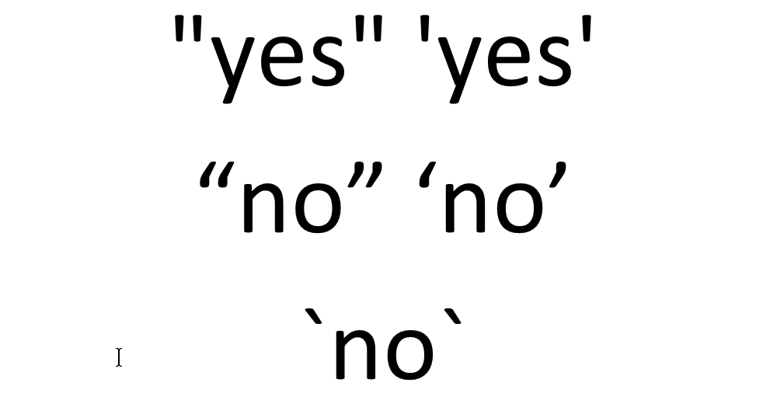
Do NOT use curly quotes or back quotes.
Figure 1. Good and bad quote marks
Notes:
The quote marks that you should use are called straight quotes. These are the ones that appear in the first row of this image. Most of the time, you will get this by default, but once in a while some alternate quotes will sneak in. These are called curly quotes. These are shown in the second line of the image. With curly quotes, the ones on the left look different from the ones on the right. You might get these if your code or your dataset was prepared in a word processing program like Microsoft Word. They look nicer on the printed page than the straight quotes in the first line. But R will produce an error message if your string is surrounded by curly quotes.
The third line shows the back quote or the back tick. This is also not valid for strings.

Slide 6
The evolution of computer characters
EBCDIC
ASCII
Unicode
Notes:
Computers have to store various letters, numeric digits, and symbols on computers that place everything into binary, 0s and 1s.
The system of converting to binary is called encoding. There are many standards for encoding that have been used in the computer age. I want to talk about three dominant encoding standards: EBCDIC, ASCII, and Unicode.

Slide 7
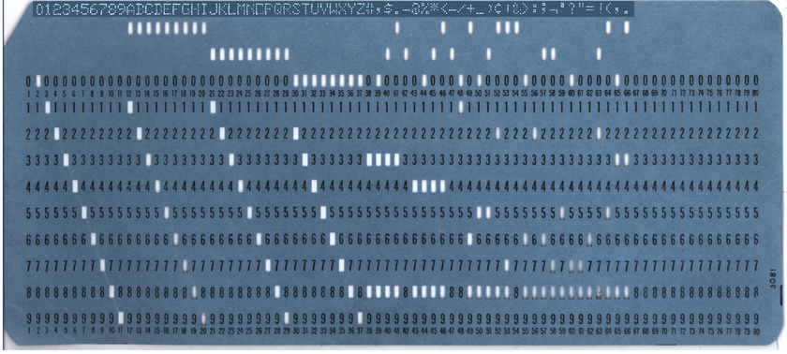
Extended Binary Coded Decimal Interchange Code (EBCDIC)
Figure 2. Punched card used for IBM mainframe computers
Notes:
The first major standard for this was EBCDIC. This was developed for IBM mainframe computers and was a dominant standard in the 1950s and 60s.
The EBCDIC standard evolved in the 1950s as a way of digitizing computer punch cards for IBM mainframe computers. This was a dominant standard during the era of big mainframe computers. There are a few computer files where the strings are stored in EBCDIC, but these have mostly been replaced by the ASCII and Unicode standards.

Slide 8
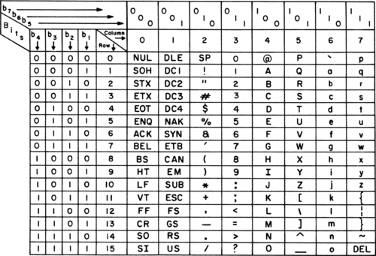
American Standard Code for Information Interchange (ASCII)
Figure 3. ASCII code (7 bit)
Notes:
The ASCII standard was developed in the mid 1960s and became prominent around the time that personal computers became available. The original ASCII standard used 7 binary digits for a total of characters associated with the binary representations of 0 through 127. These included upper and lower case letters, numeric digits, special symbols, and some non-printing characters, such as the tab character.

Slide 9
Seven bit ASCII
00 through 7E
00-1E unprintable control characters
20-2E various symbols
30-39 digits 0-9
3A-40 various symbols
41-5A capital letters (A-Z)
5B-60 various symbols
61-7A lower case letters (a-z)
7B-7E various symbols

Slide 10
Getting the numbers behind the code
“There are 10 types of programmers in the world, those who understand binary and those who don’t.”
Binary
Digits: 0, 1
${01000001}_{2}=0×2^{7}+1×2^{6}+0×2^{5}+...+1×2^{0}=65$
${01111010}_{2}=0×2^{7}+1×2^{6}+1×2^{5}+...+0times2^{0}=122$
Hexadecimal
Digits: 0, 1, 2, 3, 4, 5, 6, 7, 8, 9, A, B, C, D, E, F
${41}_{16}=4×{16}^{1}+1×{16}^{0}=65$
$7A_{16}=7×{16}^{1}+10*{16}^{0}=122$
Notes:
There’s a joke rolling around on the Internet about programmers and binary numbers. Here’s a quick review of binary numbers as well as hexadecimal numbers.
Binary numbers are computed using the sum of either 0 or 1 times descending powers of 2. So the binary 01000001 is 0 times 2 raised to the seventh power plus one times 2 raised to the sixth power, etc.
Hexadecimal uses powers of 16. There are no digits beyond 9, so you use A for 10, B for 11, and so forth through F for 15.

Slide 11
Converting from hexadecimal to character
"\x41"
## [1] "A"

Slide 12
Converting from character to hexadecimal
charToRaw("A")
## [1] 41

Slide 13
Eight bit ASCII
Characters for 80-EE
Accented letters (Ç é ì)
Math symbols (± ÷ ½ ¾)
Box drawing (╗ ╝)
No common standard
Code pages
Notes:
Computers normally fetch and retrieve data in batches of 8 bits at a time. So stopping the characters at 7 bits seemed like a waste. Using the eighth bit would allow you to double the characters that could be represented. So programmers rushed to fill the gap. They started including accented letters, math symbols, and box drawing characters.
The box drawing characters require a bit of explanation. Early personal computers could not display arbitrary graphics. They could only display a limited character set on fixed locations on the screen. But the programmers of that day tried to craft a limited set of single line and double line characters to represent the sides and corners of various boxes. They used these boxes to surround important text messages. It all seems rather primitive now.
The problem with the eighth bit is that no one could agree on what the characters should be. So dozens of different standards appeared on scene and a text file that displayed a series of mathematical formulas on one system would get converted to a seemingly random set of accented characters on another system.
Each different 8 bit ASCII system was given a code page, a numeric designation that described what the characters were represented by numbers larger than 127.
The other problem was that many languages (Chinese, for example) required a lot more characters than could be displayed in 8 bits.
https://yihui.org/en/2018/11/biggest-regret-knitr/ https://danielmiessler.com/study/encoding/
https://en.wikipedia.org/wiki/Code_page

Slide 14
Unicode
Unicode is a multilingual standard
Developed in 1990’s.
Mix of 8 bits, 16 bits, 24 bits, and 32 bits
Compatible with 7 bit ASCII
Room for 160 thousand characters
161 languages
Emojis
Extra symbols (curly quotes, em and en dashes)
Notes:
In response to the problems with eight bit ASCII, an international consortium developed the Unicode standard in the 1990s. This standard has been widely adopted and allows easy representation of text in just about any language.
Unicode is a mixture of 8, 16, 24, and 32 bits. It is compatible with 7 bit ASCII and unifies all the varying 8 bit ASCII code pages.

Slide 15
Using binary, octal, and hexadecimal codes
"\x41"
## [1] "A"
"\101"
## [1] "A"
"\u41"
## [1] "A"
"\U41"
## [1] "A"
This was quickly extended to 8 binary digits, which provided 256 characters, but there were problems with standardization of the characters from 128 through 255.
In the
The
The common standard for strings is ASCII, which is short for the American Standard for Information Exchange.

Slide 16
Unicode
Mix of 8, 16, 24, and 32 bits
Support for all alphabets
Includes emoji symbols

Slide 17
The ASCII standard
American Standard Code for Information Exchange
Supplants an earlier standard, EBCDIC.
7 bit ASCII
Commonly agreed upon on all systems
8 bit ASCII
Accented characters, math symbols, or box drawing characters
No standard
Unicode
Mix of 8, 16, 24, and 32 bits
Support for all alphabets
Includes emoji symbols
Notes:
The common standard for strings is ASCII, which is short for the American Standard for Information Exchange.

Slide 18
Designating special symbols

Slide 19
A special vector of upper case …
LETTERS
## [1] "A" "B" "C" "D" "E" "F" "G" "H" ## [9] "I" "J" "K" "L" "M" "N" "O" "P" ## [17] "Q" "R" "S" "T" "U" "V" "W" "X" ## [25] "Y" "Z"
Notes:
R provides a vector of the individual letters of the English alphabet. LETTERS (all upper case) provides all the upper case letters.

Slide 20
… and lower case letters.
letters
## [1] "a" "b" "c" "d" "e" "f" "g" "h" ## [9] "i" "j" "k" "l" "m" "n" "o" "p" ## [17] "q" "r" "s" "t" "u" "v" "w" "x" ## [25] "y" "z"
Notes:
Use letters (all lower case) to get all the lower case letters.

Slide 21
Break #1
What have you learned
Basic definitions
What’s coming next
Combining and splitting
Notes:
You just learned about strings, also known as alphanumeric, character, or text data. Next, you’ll learn about how to combine and split strings.

Slide 22
The paste function
first_name <- "Steve" last_name <- "Simon" paste(first_name, last_name)
## [1] "Steve Simon"
paste(first_name, last_name, sep="_")
## [1] "Steve_Simon"
paste(last_name, first_name, sep=", ")
## [1] "Simon, Steve"
Notes:
The paste function combines two or more strings into a single string. By default, it places a space between each string, but you can change this using the sep= argument.

Slide 23
The paste0 function
paste(LETTERS[1:3], 1, sep="")
## [1] "A1" "B1" "C1"
paste0(LETTERS[1:3], 1)
## [1] "A1" "B1" "C1"
Notes:
Often you want to paste without using an delimiters. While this works with Use “paste”, and a delimiter of quote-quote, this occurs often enough that R offers a helper function, paste0. A helper function is an adaptation of a a function with mutliple arguments to a simpler function where some of the arguments are pre-specified. For paste0, it is equivalent to paste, but with the sep= argument set to quote-quote.

Slide 24
Collapsing a vector
paste(LETTERS[1:3], collapse=", ")
## [1] "A, B, C"
Sometimes you want to collapse all the strings in a vector to a single string.

Slide 25
The tidyverse libraries for string manipulation
stringr

Slide 26
The str_sub function

Slide 27
The str_split function

Slide 28
The glue function

Slide 29
Break #2
What have you learned
Combining and splitting
What’s coming next
Searching and Replacing
Any questions?
Notes:
Use the precip dataset for illustrations.

Slide 30
Break #3
What have you learned
Searching and Replacing
What’s coming next
Regular expressions
Any questions?

Slide 31
Summary
Definitions
Combining and splitting
Searching and Replacing
Regular expressions
Any questions?
Notes:
This talk covered a lot of topics. You saw some basic definitions for string data, looked at how to combine and separate strings, how to search and replace within strings, and had a brief introduction to regular expressions.
Any questions?

