Slide 1
Exact and randomization tests
Steve Simon

Slide 2
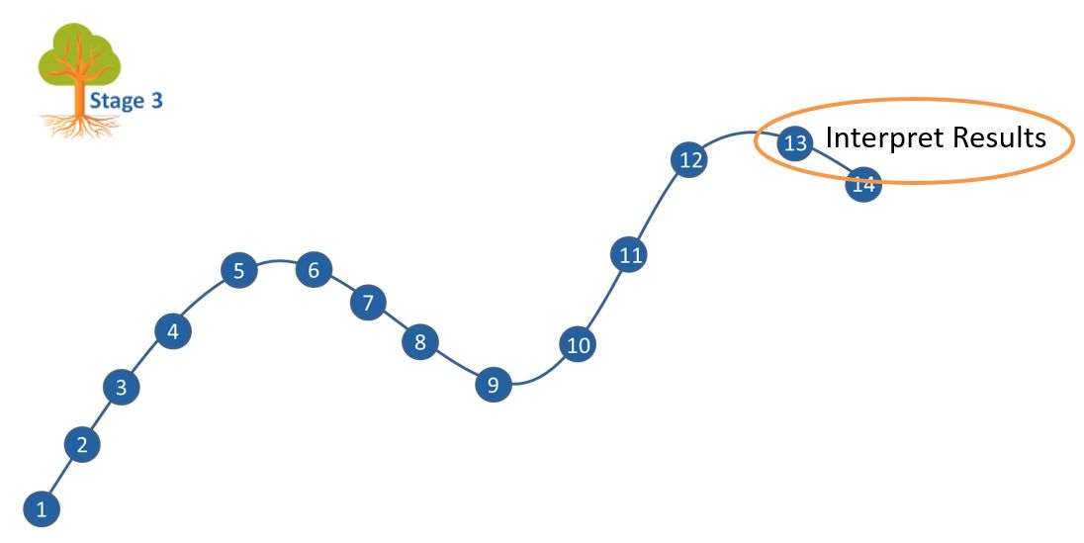
Where this fits
Notes:
Most of you should be familiar with the components and stages that The Analysis Factor uses to classify their talks. This talk is in Stage 3, Extensions of Linear Models. It covers a pretty broad swath, but might be considered as interpreting results. Perhaps validating results might be a second component.

Slide 3
Goal
For you to have a good understanding of:
what randomization and exact tests are,
when it is appropriate to use them,
the steps to implement them.
The goal is not to cover every possible application of the randomization and exact tests.
Notes:
I want to start with an appreciation of when you might consider using exact or randomization tests. These tests are very general, and I will try to show a variety of applications. If you want to implement these tests yourself, it is not too difficult for simpler hypotheses. For more complex hypotheses, you need some basic programming skills. It is not too difficult, if you know how to use loops inside SAS, R, or Stata.
It’s not possible to cover every possible application of exact and randomization tests today. I hope just to get you a bit more comfortable with the methodology in general.

Slide 4
What you’ll learn today
Historical origins
Fisher’s Exact Test
Other exact tests
Ranomization tests
Three specific randomization tests
Programming requirements
When should you use these tests
Notes:
First, I will provide a historical overview, with an example derived in 1931, when Statistics was still in its infancy.

Slide 5
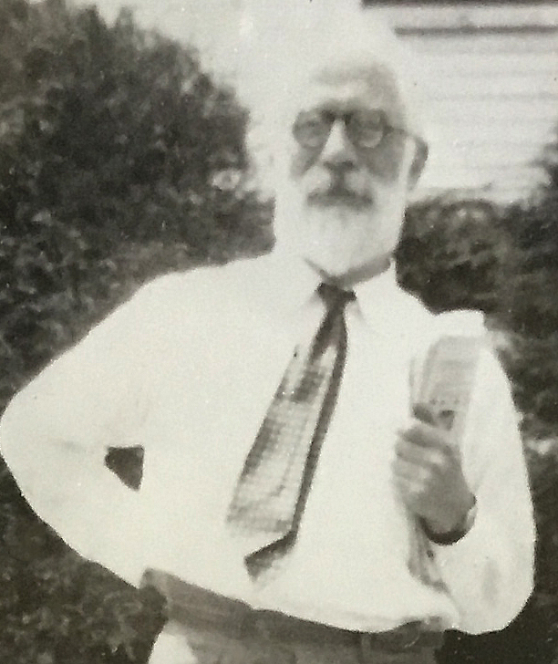
1. Historical origins
Figure 1. Ronald A. Fisher
Notes:
Let’s start with a historical overview.

Slide 6

The lady tasting tea
Figure 2. Tea with milk added

Slide 7

If you change the order?
Figure 3. Milk with tea added

Slide 8
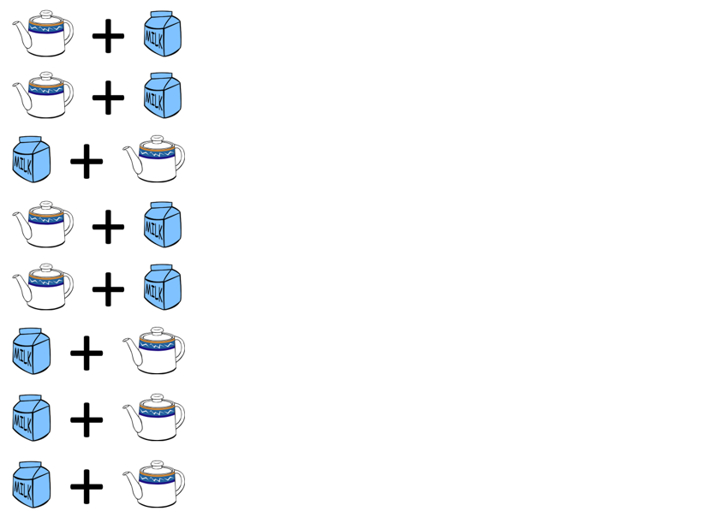
The experiment
Figure 4. A randomized experiment

Slide 9
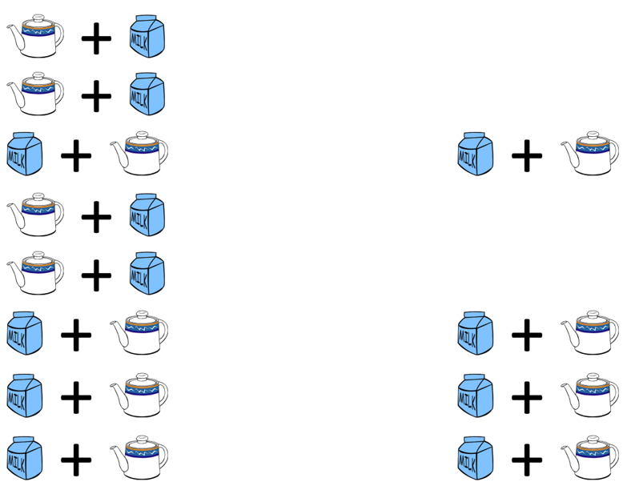
The result
Figure 5. Result of the randomized experiment

Slide 10
How likely is this result?
If the lady had no ability to tell whether the milk was added first and was effectively picking at random, the probability would be
$\frac{4}{8}×\frac{3}{7}×\frac{2}{6}×\frac{1}{5}=\frac{1}{70}$
Note: the probability is NOT ${\left(\frac{1}{2}\right)}^{4}$

Slide 11
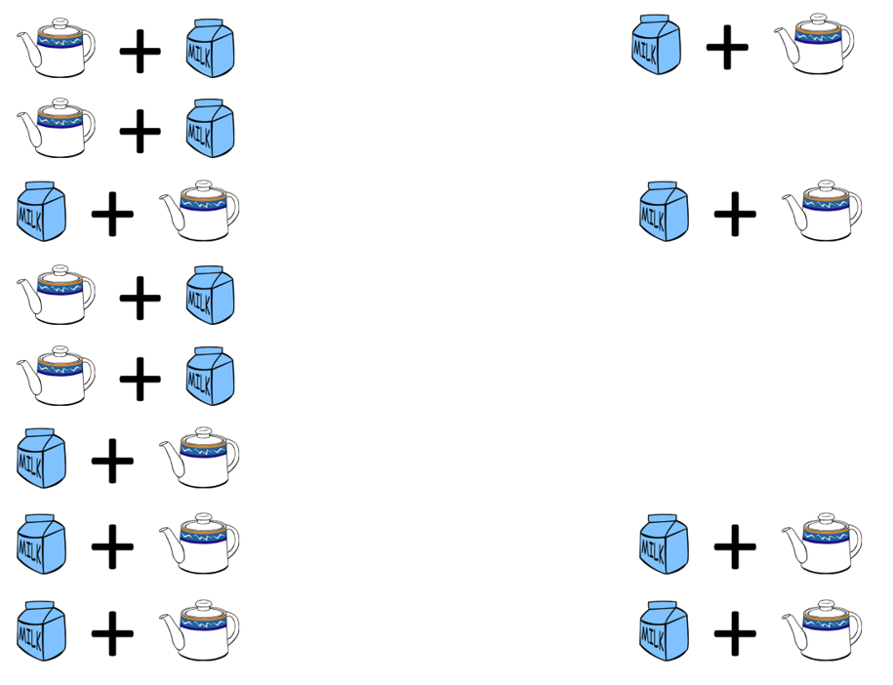
An alternate result
Figure 6. An alternate result with one miss

Slide 12
How likely is three correct results?
$\frac{4}{8}×\frac{4}{7}×\frac{3}{6}×\frac{2}{5}+\frac{4}{8}×\frac{4}{7}×\frac{3}{6}×\frac{2}{5}+...$
Too messy! Use the hypergeometric distribution. Note: this is NOT a binomial distribution.

Slide 13
Balls in an urn analogy
| W | | B | | B B | | W | | W B | | W | __________________
Notes:
Most of the discussion of these functions describe the hypergeometric distribution as an abstract problem of drawing balls from an urn. So think of the eight cups of tea as an urn with eight balls, four white and four black. The white balls represent correctly identifying the cup of tea as having the milk added first. The black balls represent mistakes in identification. So what is the probability of getting 3 white balls after drawing 4 balls without replacement?

Slide 14
Use the hypergeometric distribution
SAS: PDF(‘HYPER’, 3, 8, 4, 4)
R: dhyper(3, 4, 4, 4)
Stata: dis hypergeometricp(8, 4, 4, 3)
SPSS: PDF.HYPER(3, 8, 4, 4)
Notes:
The functions to calculate hypergeometric probabilities vary from package to package. SAS uses a PDF function (short for Probability Density Function) with the ‘HYPER’ argument. R uses the dhyper function. Stata uses dis hypergeometricp. SPSS uses the PDF.HYPER function.
All of these packages arrange the numeric arguments differently.

Slide 15
Use the hypergeometric distribution
W=# of white balls in the urn
B=# of black balls in the urn
N=W+B=# of balls total in the urn
d=# of balls drawn from the urn
x=# of drawn balls that are white
SAS: PDF(‘HYPER’, x, N, W, d)
R: dhyper(x, W, B, d)
Stata: dis hypergeometricp(N, W, d, x)
SPSS: PDF.HYPER(x, N, W, D)
Notes:
Notice that R asks you to specify the number of white balls and the number of black balls. The other packages ask you to specify the number of white balls and the total number of balls, The order that you specify these values in is also inconsistent from package to package.
I show this to emphasize that if you plan to calculate hypergeometric probabilities, read the manual closely. It also helps to first do some simple calculations like an urn with 4 white and 4 black balls. Compare what the statistical package tells you with what you calculated by hand.
Fortunately, you don’t need to resort to the hypergeometric probabilities.

Slide 16
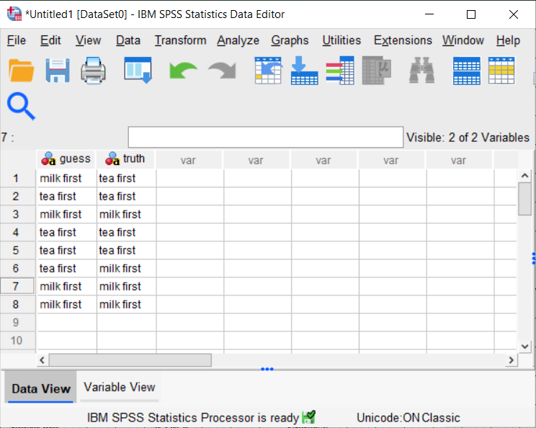
Fisher’s Exact Test in SPSS (1/4)
Figure 7. SPSS Dialog box

Slide 17
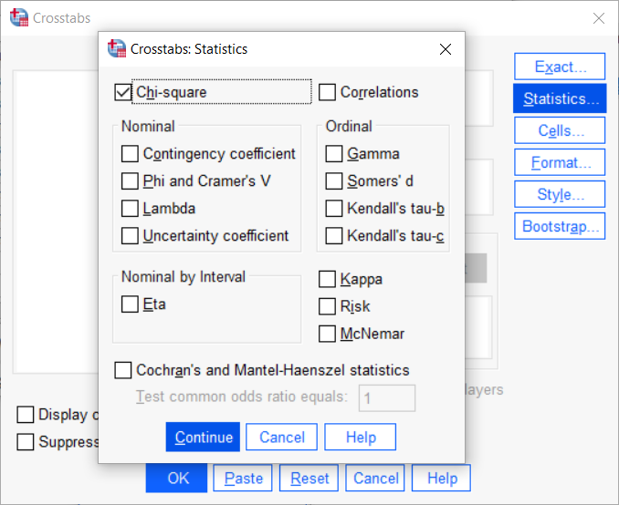
Fisher’s Exact Test in SPSS (2/4)
Figure 7. SPSS Dialog box

Slide 18
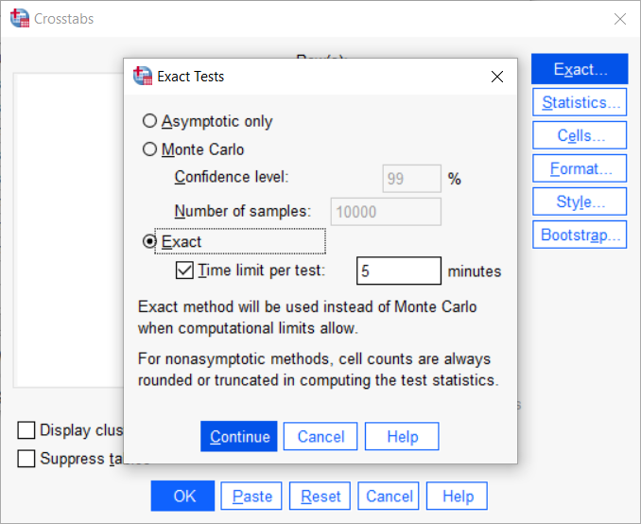
Fisher’s Exact Test in SPSS (3/4)
Figure 7. SPSS Dialog box

Slide 19
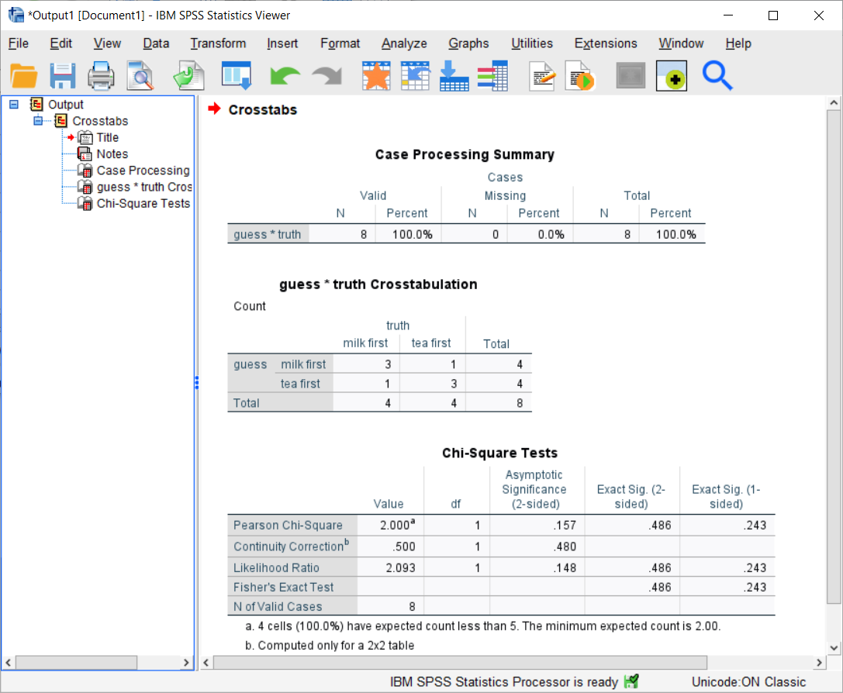
Fisher’s Exact Test in SPSS (4/4)
Figure 7. SPSS output box

Slide 20
Fisher’s Exact Test in R (1/2)
labs <- c( "Milk first", "Tea first") guess <- c(1, 2, 1, 2, 2, 2, 1, 1) truth <- c(2, 2, 1, 2, 2, 1, 1, 1) fisher.test( factor(guess, labels=labs), factor(truth, labels=labs))

Slide 21
Fisher’s Exact Test in R (2/2)
p-value = 0.4857 alternative hypothesis: true odds ratio is not equal to 1 95 percent confidence interval: 0.2117329 621.9337505 sample estimates: odds ratio 6.408309

Slide 22
Fisher’s Exact Test in Stata
. tabulate guess truth, exact Fisher's exact = 0.486 1-sided Fisher's exact = 0.243

Slide 23
How do you compute the p-value? (1/5)
p-value=P[sample results or more extreme| H0]
What does “more extreme” mean?

Slide 24
How do you compute the p-value? (2/5)
List all possible 2 by 2 tables
? ? | 4 ? ? | 4 ----+-- 4 4 | 8

Slide 25
How do you compute the p-value? (3/5)
4 0 3 1 2 2 1 3 0 4 0 4 1 3 2 2 3 1 4 0 1.4% 22.9% 51.4% 22.9% 1.4%

Slide 26
How do you compute the p-value? (4/5)
For a one-sided p-value
4 0 3 1 0 4 1 3 1.4% + 22.9% = 24.3%

Slide 27
How do you compute the p-value? (5/5)
For a two sided p-value
4 0 3 1 1 3 0 4 0 4 1 3 3 1 4 0 1.4% + 22.9% + 22.9% + 1.4% = 48.6%

Slide 28
Mann-Whitney U
1,2,3 1,2,4 1,2,5 1,2,6 1,2,7 1,3,4 1,3,5 1,3,6 1,3,7 1,4,5 1,4,6 1,4,7 1,5,6 1,5,7 1,6,7 2,3,4 2,3,5 2,3,6 2,3,7 2,4,5 2,4,6 2,4,7 2,5,6 2,5,7 2,6,7 3,4,5 3,4,6 3,4,7 3,5,6 3,5,7 3,6,7 4,5,6 4,5,7 4,6,7 5,6,7

Slide 29
Mann-Whitney U
2,6,7 3,5,7 3,6,7 4,5,6 4,5,7 4,6,7 5,6,7

Slide 30
Mann-Whitney U
1,2,3 1,2,4 1,2,5 1,2,6 1,3,4 1,3,5 2,3,4

Slide 31
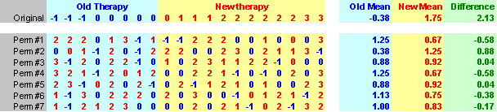
Randomization test
Figure x. 25 permutations

Slide 32
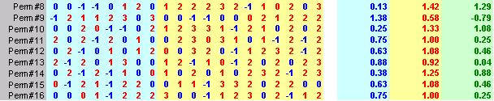
Randomization test
Figure x. 25 permutations

Slide 33
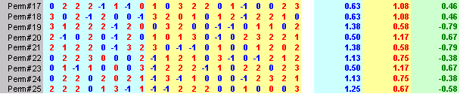
Randomization test
Figure x. 25 permutations

