Slide 1


ADVISOR ZONE · ADVISOR ONBOARDING
Declaration Assistant
✦
How to search, interpret tags, and get every declaration right the first time.
KNOW WHAT TO DECLARE. KNOW WHERE TO DECLARE.
DECLARATION ASSISTANT — YOUR PAYMENT ASSISTANT

Slide 2
TRAINING AGENDA
What We'll Cover
01
02
03
04
Advisor Home & the Mapping Engine
Where advisors land, and how a lookup begins
Multi-condition search
Queuing every PED before you run a match
Linked PED Narrative
The mandatory chronic-risk conversation
Specific Illness tag & list
Plan-level declaration precision
05
06
07
Quick Reference sidebar
Overlap Rules, Payment Journey, Illness List
My Activity Journal
Every lookup, logged and searchable
Quick Access drawer
Resources and preview controls on demand
DECLARATION ASSISTANT — YOUR PAYMENT ASSISTANT
2

Slide 3
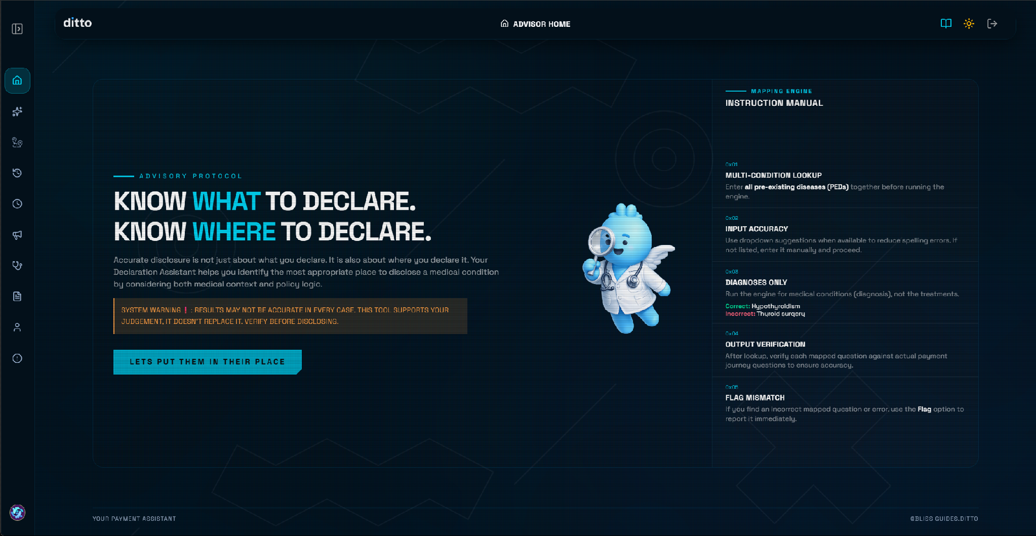
PART 1 · GETTING STARTED
Advisor Home
The landing page for every advisor session, it sets the tone: “know what to declare, know where to declare.”
The Declaration Assistant identifies WHERE in the payment journey to disclose a PED.
The System Warning banner is a standing reminder: results support your judgement, they don't replace it. Always verify before disclosing.
The Instruction Manual panel recaps five ground rules: multi-condition lookup, input accuracy, diagnoses only, output verification, and flagging mismatches.
DECLARATION ASSISTANT — YOUR PAYMENT ASSISTANT
3

Slide 4
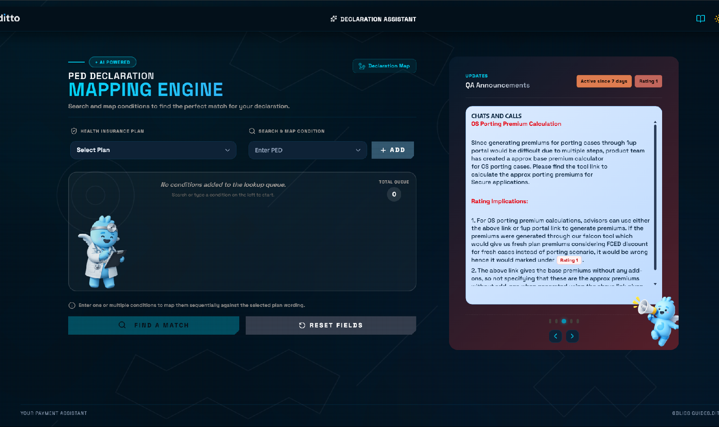
PART 1 · GETTING STARTED
Starting a Lookup
Step 01
Define Core Inputs
Two inputs drive every lookup: Health Insurance Plan and Pre Existing Condition.
Step 02
Select Plan First
Select the customer's plan first — matching logic is plan-specific.
Step 03
Queue Conditions
Type or pick a PED from the dropdown, then click + ADD to queue it. Nothing is searched yet.
Step 04
Search Smart
Use dropdown suggestions when available to reduce spelling errors; free-text entry works when a condition isn't listed.
Step 05
Stay Updated
The Updates Feed will show live General and QA Announcements
DECLARATION ASSISTANT — YOUR PAYMENT ASSISTANT
4

Slide 5
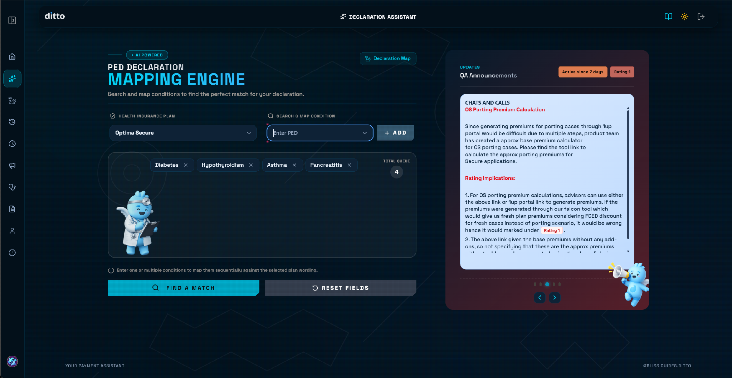
PART 2 · GETTING STARTED
Queue Every Condition First
Step 01
Queue All Conditions
Add all of a customer's pre-existing conditions to the queue before searching — e.g. Diabetes, Hypothyroidism, Asthma, Pancreatitis.
Step 02
Verify the Counter
The TOTAL QUEUE counter confirms exactly what's about to be mapped before you trigger the search.
Step 03
Find a Match
Click FIND A MATCH only once every known condition is queued — each one is mapped sequentially.
Step 04
Reset to Start Over
RESET FIELDS clears the entire queue instantly if you need to start fresh with a different customer.
DECLARATION ASSISTANT — YOUR PAYMENT ASSISTANT
5

Slide 6
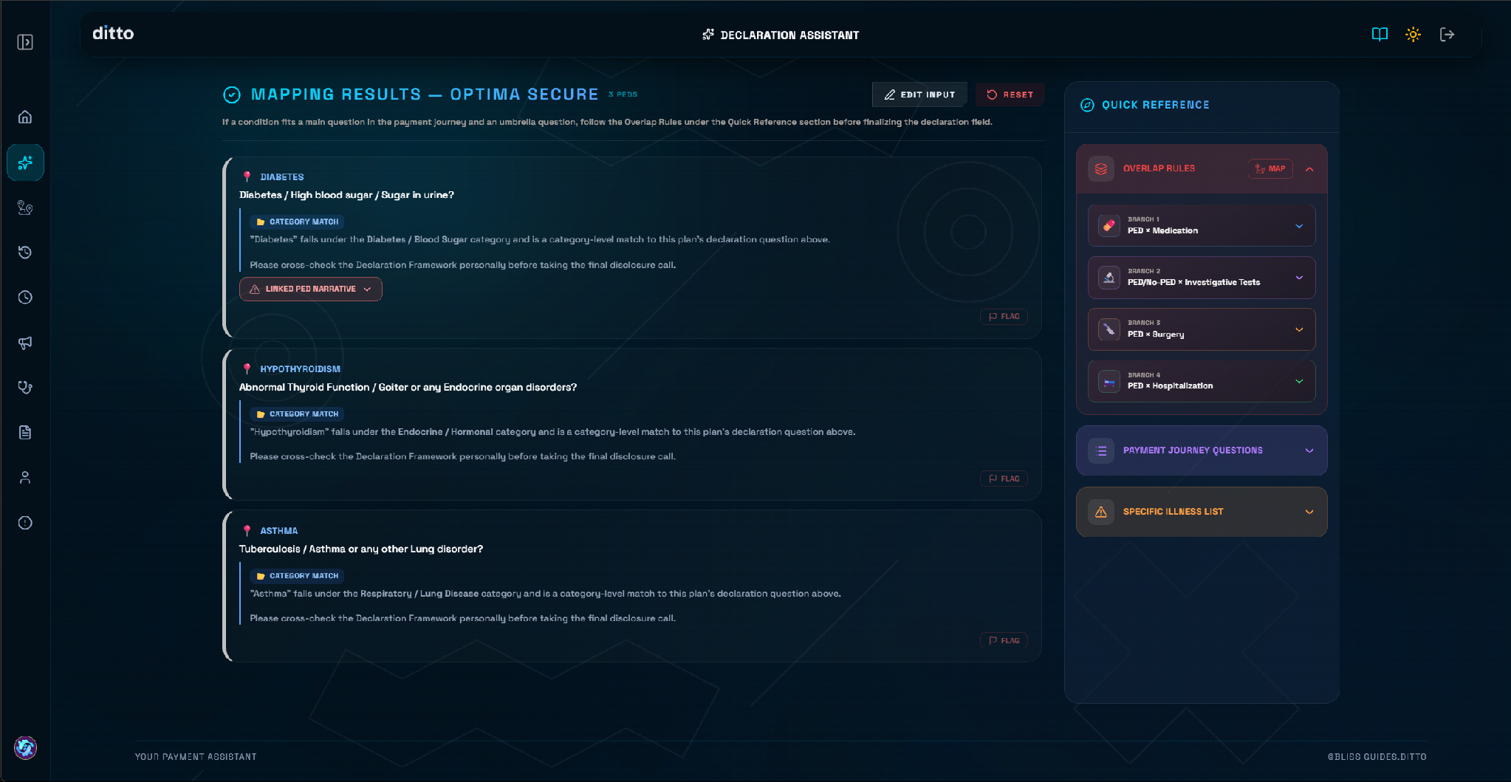
PART 2 · INTERPRETING RESULTS
Every PED Gets a Match Result and Mapping Logic
01 Condition Cards
Individualized Results
Each queued condition returns as its own card: the PED name, the matching declaration question, and a colored match tag.
02 Match Tags
Broader Categorization
Match tag defined how the mapping was done. For example, Category match mean the condition falls under a broader declared category — e.g. "Hypothyroidism" matches under Endocrine / Hormonal.
03 Mapping Logic
Verify the Reasoning
The mapping logic explains why the match was made - read it carefully, don't just trust the output question at a glance.
04 Quick Reference
Persistent Sidebar
A Quick Reference panel stays open on the right side for the duration of the whole session.
DECLARATION ASSISTANT — YOUR PAYMENT ASSISTANT
6

Slide 7
PART 2 · INTERPRETING RESULTS
Know Your Tags
Direct Match
Exact wording match to the plan's declaration question.
Action:Declare confidently under the matched question.
Category Match
Falls under a broader declared category, not an exact wording hit.
Action:Cross-check the Declaration Framework before finalizing.
AI-Assisted Match
AI inferred the mapping from clinical similarity.
Action:Review carefully — verify the reasoning before disclosing.
Fallback - Manual Review
Engine couldn't confidently map the condition to a main Question.
Action:Personally verify no question applies and proceed.
Not a Medical Ailment
Entered term isn't a diagnosable medical condition.
Action:Re-enter a diagnosis, not a treatment or procedure.
Needs Clarification
Term is ambiguous, or unrecognized by the engine.
Action:Ask the customer for more detail, or flag it.
DECLARATION ASSISTANT — YOUR PAYMENT ASSISTANT
7

Slide 8
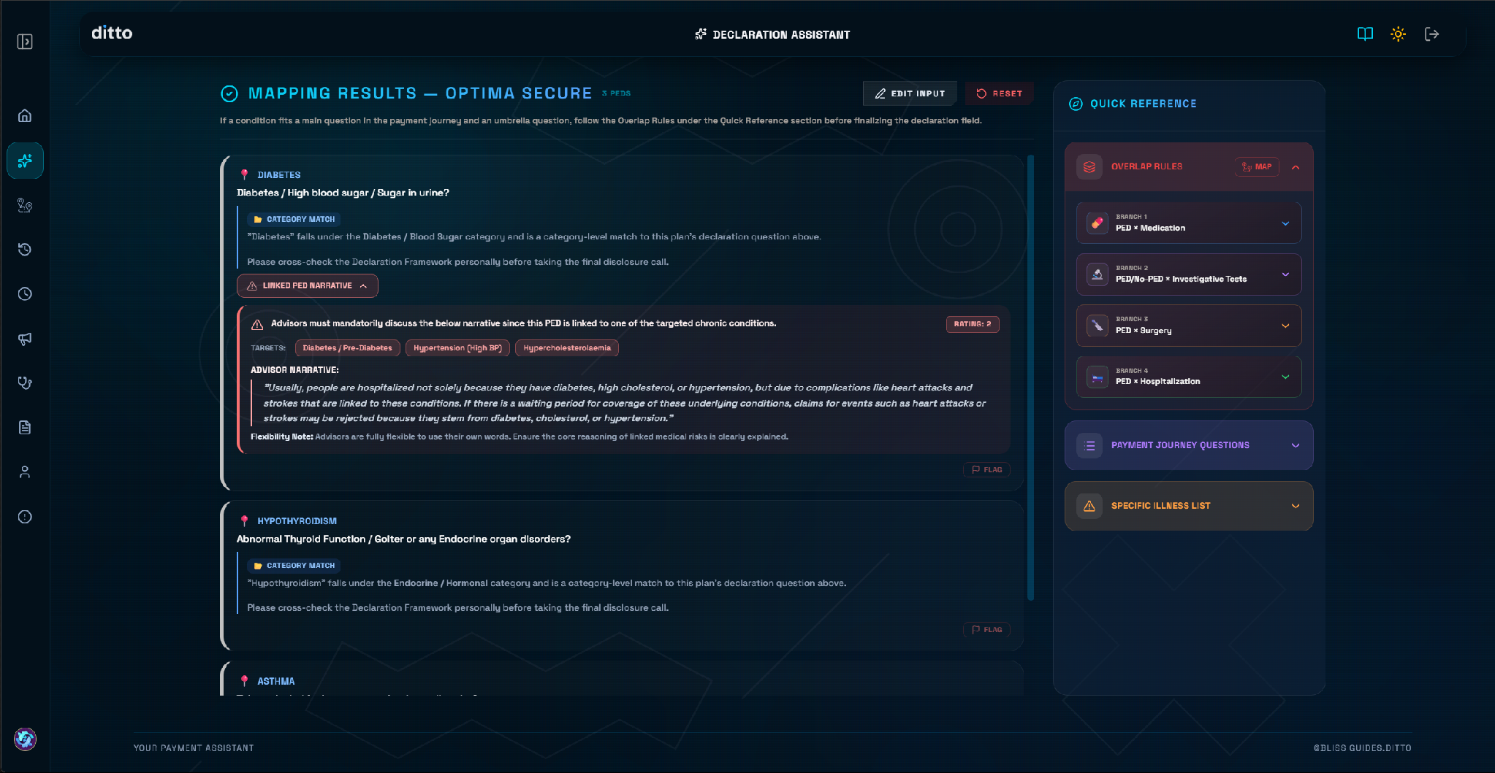
PART 3 · MANDATORY ADVISORIES
Linked PED Narrative
01 · AUTOMATIC TRIGGER
Chronic-Complication Risk
Triggers automatically for conditions linked to chronic-complication risk — Diabetes, Hypertension, high cholesterol, and similar.
02 · TARGETS CHIPS
Covered Conditions
TARGETS chips show every linked condition the narrative covers — e.g. Diabetes/Pre-Diabetes, Hypertension, Hypercholesterolaemia.
03 · ADVISOR NARRATIVE
Enhance With Example
The Advisor Narrative explains the real risk in plain language: e.g. claims for heart attacks or strokes can be rejected if they stem from an undeclared linked condition.
DECLARATION ASSISTANT — YOUR PAYMENT ASSISTANT
8

Slide 9
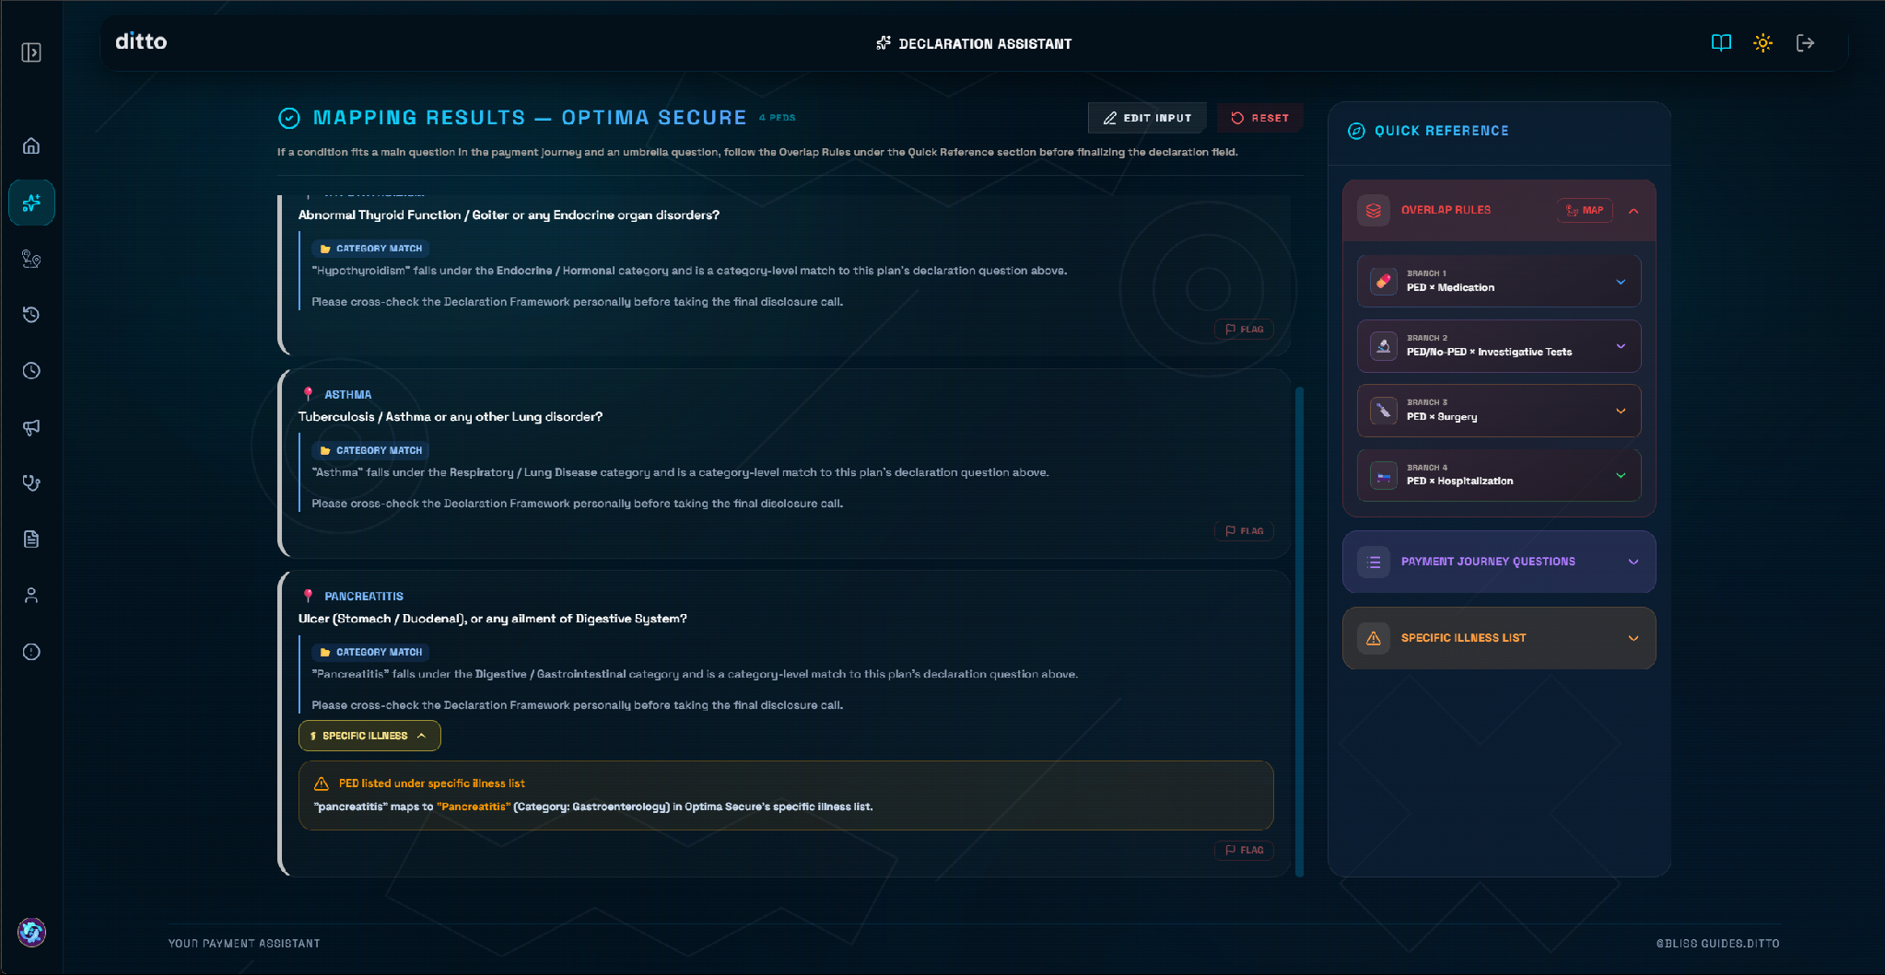
PART 4 · MANDATORY ADVISORIES
Specific Illness Tag
01 · CURATED LIST
Specific Illness List
Plans maintain a curated Specific Illness List to help identify whether a PED falls under specific illness rules.
02 · AUTO TAGGING
Specific Illness Tag
When a queued PED appears on that list, a SPECIFIC ILLNESS tag appears inside the PED specific result tab.
03 · DETAILED MAPPING
Expanded Panel
Shows exactly how the raw term was interpreted — e.g. "pancreatitis" maps to "Pancreatitis" under Gastroenterology.
04 · ADVISOR ACTION
Verify Applicability
Check and verify the applicability inside the list for the plan before pitching the rider to reduce waiting period.
DECLARATION ASSISTANT — YOUR PAYMENT ASSISTANT
9

Slide 10
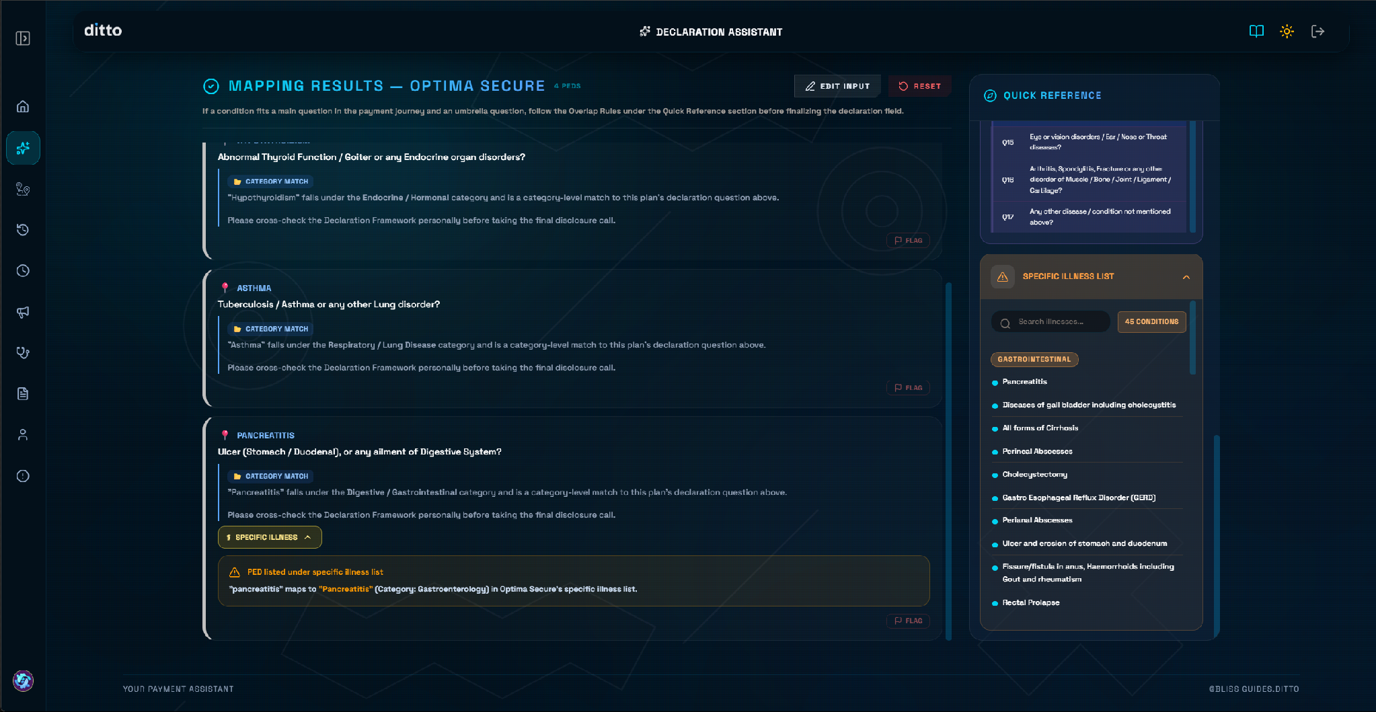
PART 3 · QUICK REFERENCE SIDEBAR
Specific Illness List
01 · PLAN INTEGRATION
Full Searchable List
The full, searchable, per-plan list of every condition with plan-specific handling.
02 · LIVE COUNTS
Intelligent Grouping
Grouped by category (e.g. Gastrointestinal) with a live condition count badge — 45 conditions in this example.
03 · INSTANT FILTERS
Smart Search
Search narrows instantly by illness name or category to find specific rules immediately.
DECLARATION ASSISTANT — YOUR PAYMENT ASSISTANT
12

Slide 11
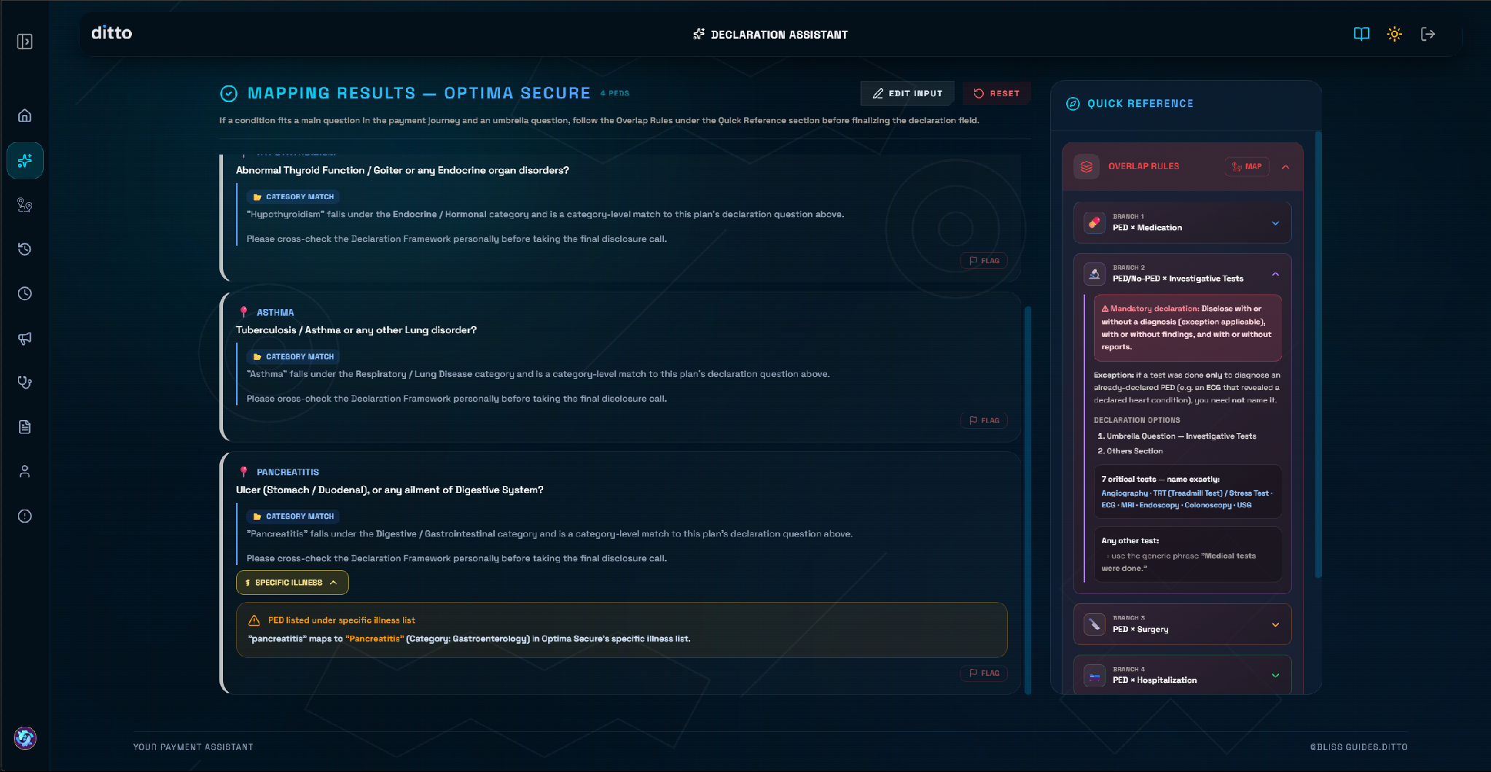
PART 5 · QUICK REFERENCE SIDEBAR
Overlap Rules
01 · CORE CONCEPT
Tricky Overlaps
Handles cases where a condition fits both a main declaration question and an umbrella question.
02 · THE FLOW
Four Decision Branches
Covered by: PED × Medication, PED/No-PED × Investigative Tests, PED × Surgery, and PED × Hospitalization.
03 · FINAL DECISION LAYER
Find the Priorities and Options
Read applicable branch content and decide how and where to declare from the available listed options
DECLARATION ASSISTANT — YOUR PAYMENT ASSISTANT
10

Slide 12
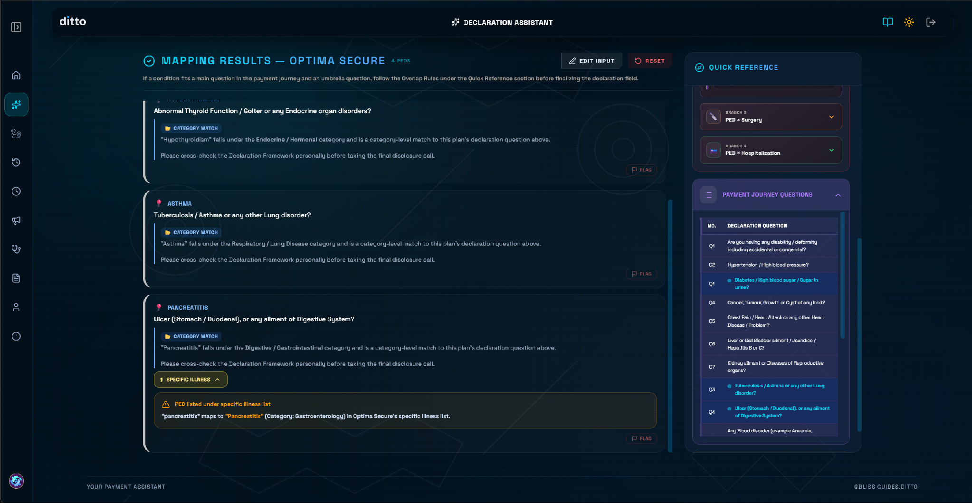
PART 5 · QUICK REFERENCE SIDEBAR
Payment Journey Questions
01 · GROUND TRUTH
Declaration Questions
The full numbered list of declaration questions in the actual payment journey — the ground truth advisors map every PED against.
02 · INLINE HIGHLIGHT
Matched Questions
Matched questions highlight inline as you look them up, so you can see exactly which numbered question a PED lands on.
03 · OUTPUT VERIFICATION
Verify Mappings
Use this to independently verify a mapping the engine gave you — the Instruction Manual's “output verification” rule, in practice.
DECLARATION ASSISTANT — YOUR PAYMENT ASSISTANT
11

Slide 13
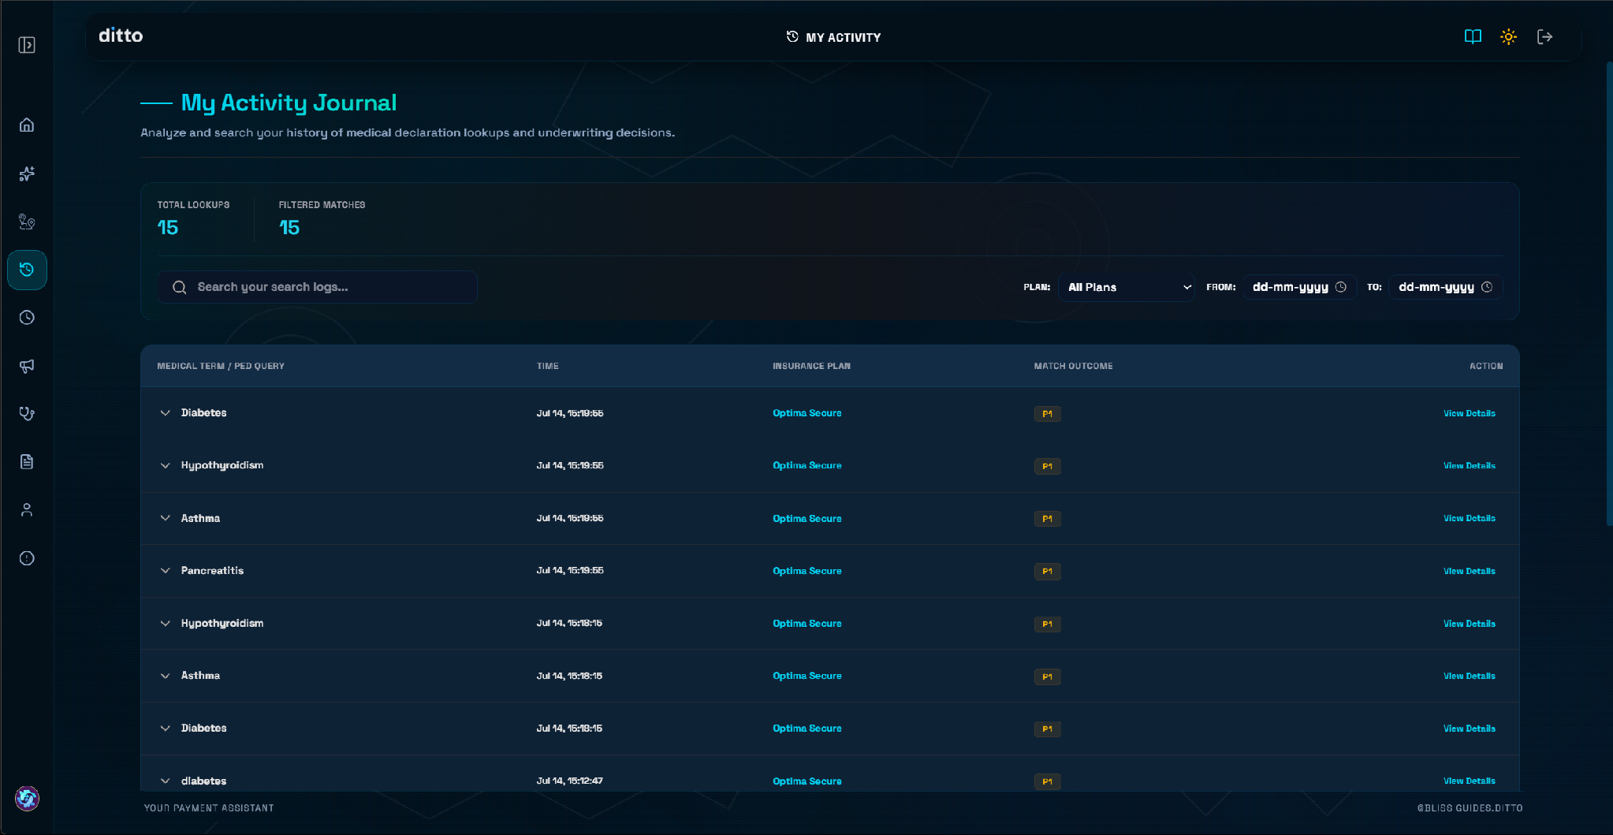
PART 6 · YOUR HISTORY
My Activity Journal
01 · AUTOMATIC LOGGING
Every Lookup Logged
Condition, plan, timestamp, and match outcome are stored automatically.
02 · SESSION SUMMARY
At-a-Glance Counters
Total Lookups and Filtered Matches counters provide quick session summaries.
03 · FILTER & SEARCH
Quick Log Search
Filter by plan or date range, or search logs directly to revisit past cases.
04 · DETAILED AUDITS
View Full Mapping
Reopen full mapping results for any lookup row — highly useful for self-audits.
DECLARATION ASSISTANT — YOUR PAYMENT ASSISTANT
13

Slide 14

PART 7 · ALWAYS-ON RESOURCES
Quick Access Drawer
01 · QUICK ACCESS
Reference Documents
One-click access to critical guidelines, tools, and visual materials directly:
✦QA Dashboard — Real-time performance metrics
✦SOPs & Guides — Operating procedures
✦Playbook & Updates — Product and Process Rule Books
✦Other Resources & Links — Essential external shortcuts
DECLARATION ASSISTANT — YOUR PAYMENT ASSISTANT
14

Slide 15
BEFORE YOU GO
Remember This Before You Declare
✓
Enter ALL known PEDs together
✓
Run Diagnoses
Never one at a time — the engine maps sequentially against the plan.
Run the engine on conditions, not on treatments or procedures.
✓
Read the explanation, not just the tag
✓
Linked PED Narrative is mandatory
Every match includes the mapping logic — use it.
Not an optional note when it appears — that's your queue to discuss it with customer.
✓
Cross-check Quick Reference
✓
Flag anything that looks wrong
Overlap Rules, Payment Journey Questions, Specific Illness List — before finalizing.
Don't guess — use the Flag option to report a mismatch.
DECLARATION ASSISTANT — YOUR PAYMENT ASSISTANT
15

Slide 16
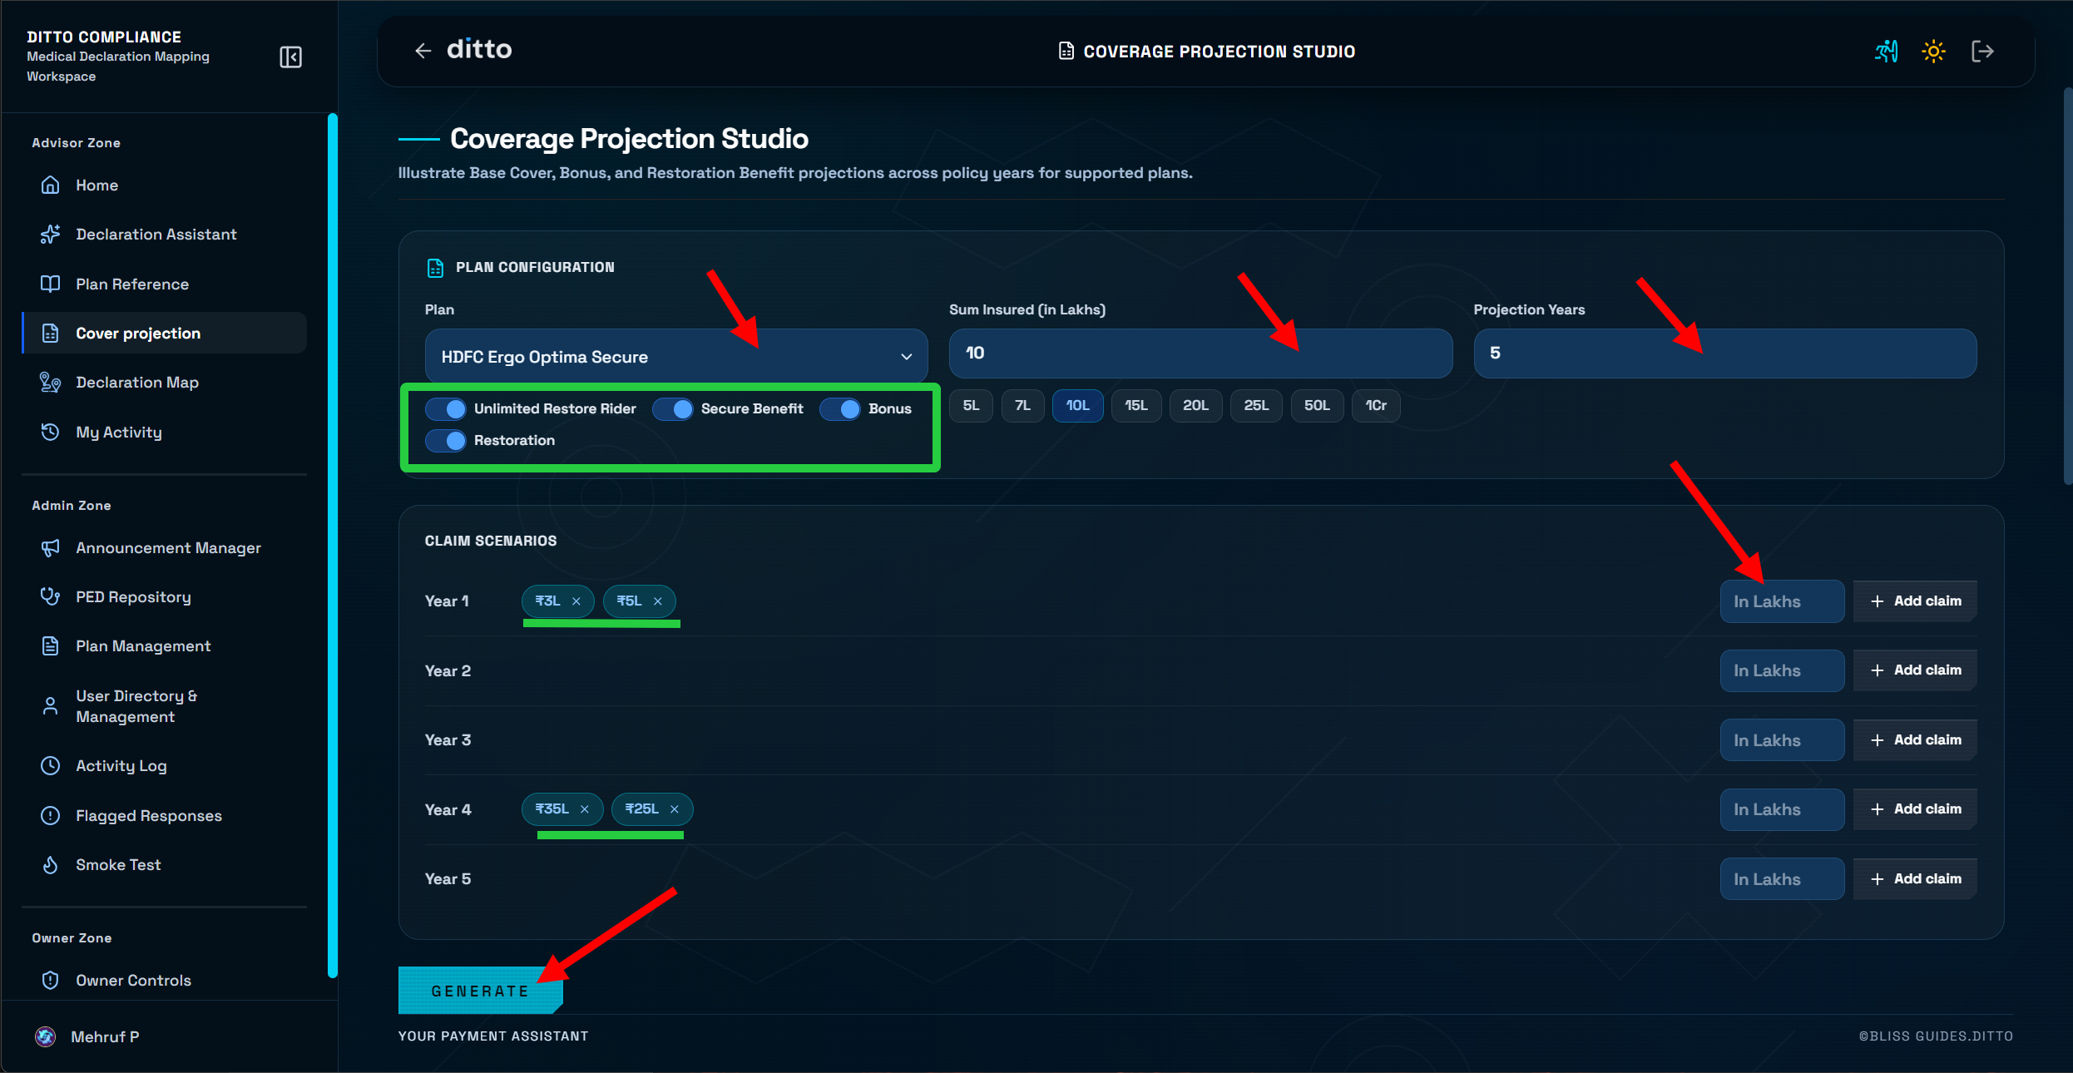
PART 8 · COVERAGE PROJECTION STUDIO
Configuring a Projection
01 · PLAN & COVER
Set the Foundation
Pick the Plan, then Sum Insured from the preset chips (or a custom amount in lakhs) and the Projection Years to illustrate.
02 · RIDERS & BENEFITS
Match the Real Policy
Toggle Unlimited Restore Rider, Secure Benefit, and Bonus/Restoration on only if the customer's actual plan includes them.
03 · CLAIM SCENARIOS
Model Claims, Then Generate
Add hypothetical claim amounts against any policy year to see how cover responds, then click Generate.
DECLARATION ASSISTANT — YOUR PAYMENT ASSISTANT
16

Slide 17
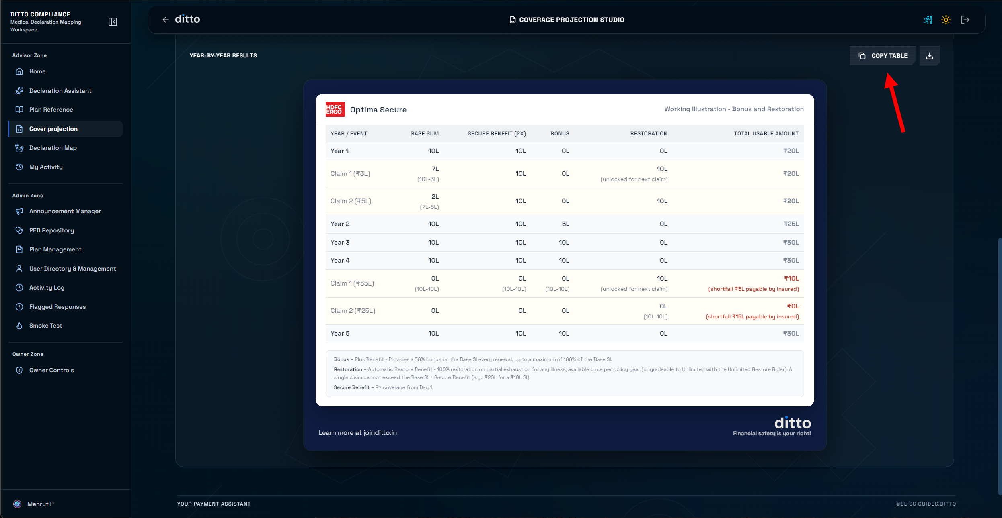
PART 9 · COVERAGE PROJECTION STUDIO
Reading the Year-by-Year Results
01 · COVER COMPONENTS
Base Sum, Secure Benefit, Bonus
Each column tracks how much of that benefit remains after every event; Bonus adds up to 50% extra per claim-free renewal, capped at 100% of Base SI.
02 · RESTORATION
Automatic Top-Up Mid-Year
100% restoration on partial exhaustion, unlocked for the next claim within the same policy year — a single claim still can't exceed Base SI + Secure Benefit.
03 · SHORTFALLS & EXPORT
Flag Gaps, Then Share
Any claim beyond available cover shows in red as a shortfall payable by the insured; use Copy Table or the download icon to export the illustration.
DECLARATION ASSISTANT — YOUR PAYMENT ASSISTANT
17

Slide 18
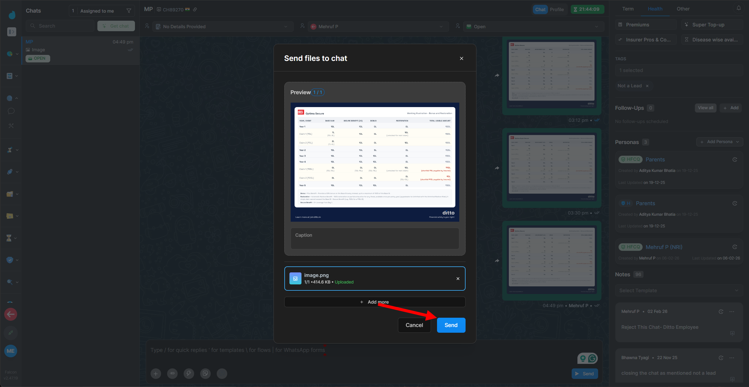
PART 10 · COVERAGE PROJECTION STUDIO
Sharing the Projection with Your Client
01 · EXPORT AS AN IMAGE
Turn the Table Into a Visual
Copy Table or Download renders the projection as a branded image, not a raw data table, ready to send.
02 · SEND DIRECTLY IN CHAT
No Separate Tool Needed
Attach the exported image straight to the customer's chat from inside the same workspace.
03 · STAYS ON THE RECORD
Tied to the Client's Profile
The shared illustration sits in that lead's chat thread alongside their persona and tags, so it's easy to find later.
DECLARATION ASSISTANT — YOUR PAYMENT ASSISTANT
18

Slide 19
✦
Questions?
Reach out to your Respective Guide
DITTO · DECLARATION ASSISTANT

