Slide 1

listing analysis
Made By-
Prachi Mehta

Slide 2
Introduction
This project focuses on analyzing Airbnb listings in cities like Chicago and New Orleans using data sourced from Inside Airbnb. The goal is to uncover key insights into pricing trends, availability, host activity, and neighborhood popularity. Visualizations were created using Tableau Public to help stakeholders make data-driven decisions regarding short-term rental performance and market dynamics.

Slide 3
Dataset
Id – Unique identifier for each listing.
Name – Title of the Airbnb listing.
Host_id – Unique identifier for the host.
Host_name – Name of the host.
Neighbourhood – Area or locality where listing is located.
Latitude – Latitude coordinate of the listing.
Longitude – Longitude coordinate of the listing.
Room_type – Type of space offered (e.g. private room, house/apt etc).
Price – Cost per night for the listing.
Minimum_nights – minimum number of nights required per booking.
Number_of_reviews – Total reviews received by the listing.
Last_review – Date of the most recent review.
Reviews_per_month – Average number of reviews per month.
Calculated_host_listings_count – Number of listings the host manages.
Availability_365 – Number of days the listing is available in a year.
Number_of_reviews_ltm – Reviews received in last 12 months.
City – The city where the listing is located.

Slide 4
Data cleaning
Data cleaning ensures the dataset is accurate, consistent, and ready for analysis by handling errors, missing values, and irrelevant data. The data cleaning for this project is performed using Python, and visualization is then conducted using Tableau. Some of the data cleaning steps taken for this project are –
Handled Missing Values by filling host_name with "Unknown", price with median, last_review with "No reviews", and reviews_per_month with 0.
Dropped irrelevant column license.
Cleaned text data by removing whitespace and capitalizing names in name and host_name.
Standardized neighbourhood names for consistency.
Capped minimum_nights at 365 to remove outliers.

Slide 5
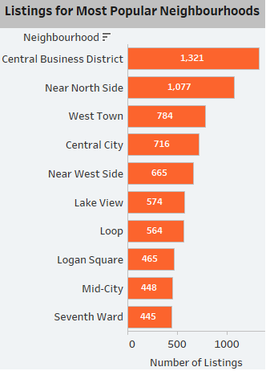
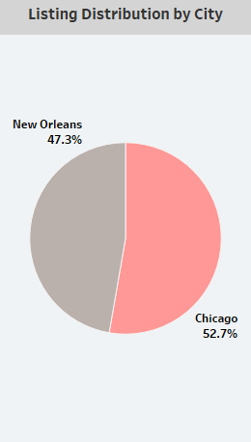
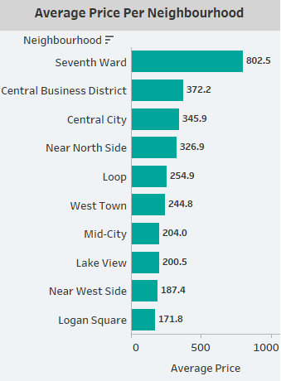
Overview of Airbnb
Which are the popular neighbourhoods, their average price and number of listings ?
Top Neighbourhoods: Central Business District and Near North Side have the highest number of listings.
Highest Avg Price: Seventh Ward has the highest average price ($802.5).
City Distribution: Chicago leads with 52.7% of listings, followed by New Orleans (47.3%).

Slide 6
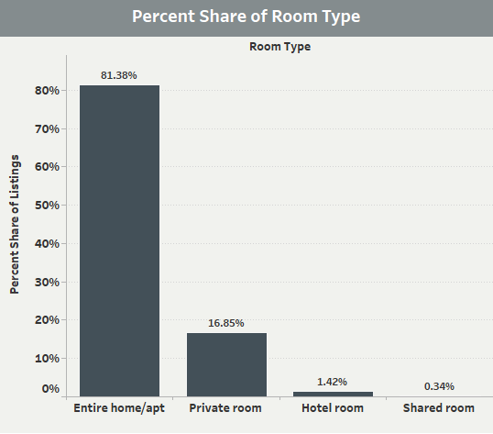
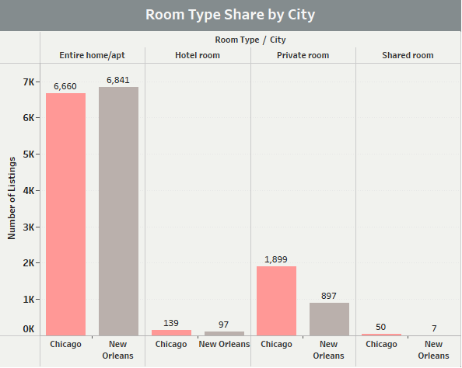
Property Analysis
Which is the percentage share of different property type and room types?
Dominant Room Type: Entire home/apt makes up 81.38% of total listings.
City-wise Room Type: New Orleans has slightly more entire home/apt listings than Chicago.
Private Room Preference: Chicago has more private room listings compared to New Orleans.

Slide 7
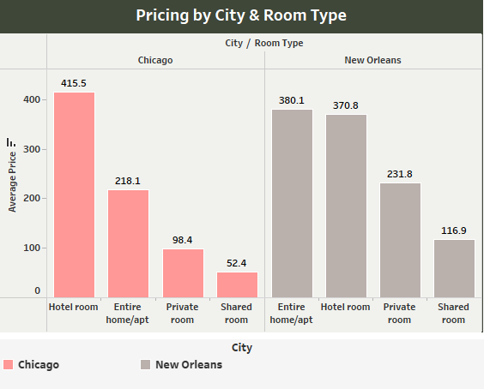
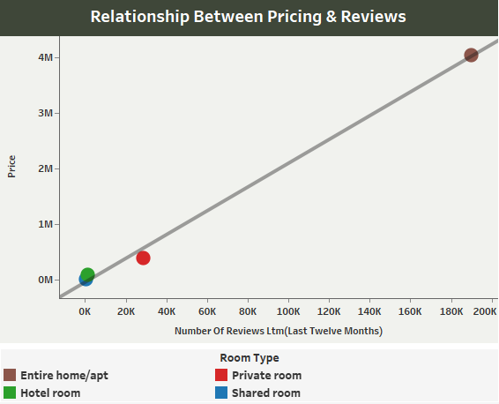
price analysis
How the pricing is varying with location, property type and reviews?
Most Expensive Type: Hotel rooms in Chicago are the most expensive ($415.5).
New Orleans Pricing: Entire home/apt and hotel rooms have similar high prices.
Price vs Reviews: Listings with more reviews tend to have higher prices, especially entire homes.

Slide 8
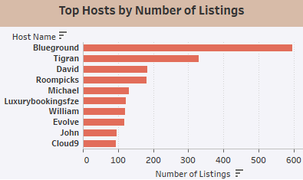
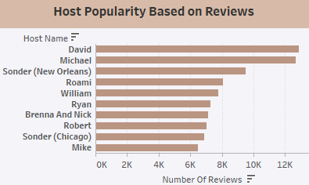
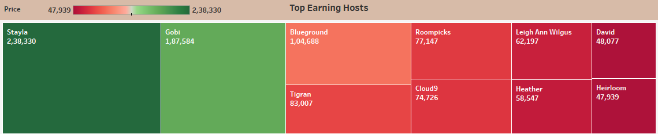
host analysis
What are the different correlations between type of hosts and factors like – reviews & price?
Top Listing Hosts: Blueground and Tigran lead in number of listings.
Popular Hosts: David and Michael have the highest reviews.
Top Earners: Stayla and Gobi earn the most, with revenue above $180K.
Price-Review Correlation: Higher-priced listings generally attract more reviews.

Slide 9
conclusion
Chicago dominates the Airbnb market with over half the listings, but New Orleans also holds a strong share with competitive pricing.
Entire homes/apartments are the most preferred room type across both cities, making up more than 80% of total listings.
Hotel rooms in Chicago command the highest average prices, while New Orleans listings offer more price consistency across property types.
Hosts like Blueground and Tigran manage the most properties, but David and Michael stand out with high engagement through reviews.
Top hosts like Stayla and Gobi generate the highest revenue, reflecting a strong link between listing quality, pricing, and customer satisfaction.
Overall, location, room type, and host performance are the key drivers of listing success on Airbnb.

Slide 10
Thank you
Project Link – Airbnb Listing Analysis

