Slide 1
Translating “An Introduction to Statistical Learning with Applications in R” into Python
PETER MELENEY
HUMAN CENTERED DATA SCIENCE
12/5/2019

Slide 2
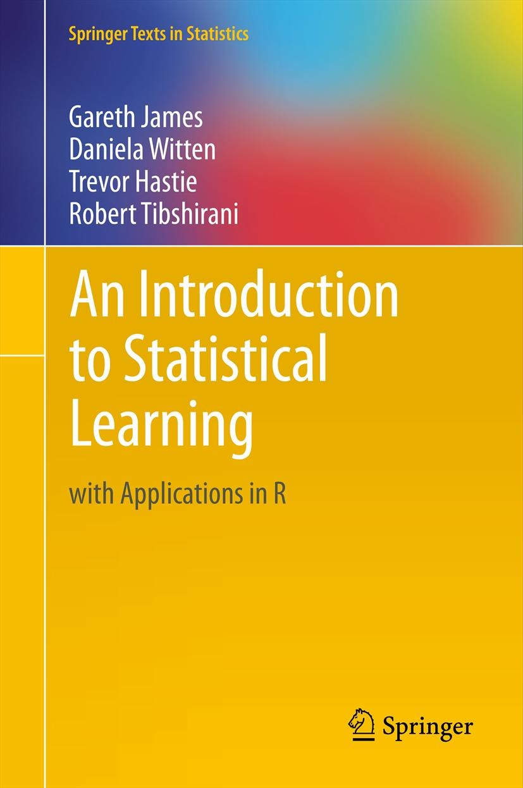
The Book
An Introduction to Statistical Learning with Applications in R (ISLR) is one of the most recommended books on data science.¹
Written by Gareth James, Daniela Witten, Trevor Hastie, and Robert Tibshirani.
Published in 2013.
426 pp., 10 chapters
Applications are written as lab sections in the back of 8 of the 10 chapters.
¹ Martin, Brendan. LearnDataSci. Most Recommended Data Science and Machine Learning
Books by Top Master’s Programs. © 2019, Accessed November 4, 2019.
https://www.learndatasci.com/articles/data-science-machine-learning-books-masters/
Image from http://faculty.marshall.usc.edu/gareth-james/ISL/

Slide 3
At the time most data scientists used R
A study by KD Nuggets in 2013 found that a majority of data scientists used R.³
“What programming/statistics languages you used for an analytics / data mining / data science work in 2013?”
713 respondents.
³ Piatetsky, Gregory. August 18, 2014. Four Main Languages for Analytics, Data Mining, Data Science. Accessed December 5, 2019
https://www.kdnuggets.com/2014/08/four-main-languages-analytics-data-mining-data-science.html

Slide 4
By 2018 Most Data Scientists Use Python
A study conducted by Kaggle in October of 2018 surveyed 23,859 data scientists.
Question: “What specific programming language do you use most often?”
Python is more than 4x more popular than R.
² Hayes, Bob. January 13, 2019. Business Broadway. Programming Languages most used and Recommended by Data Scientists.
Accessed November 14, 2019.
https://businessoverbroadway.com/2019/01/13/programming-languages-most-used-and-recommended-by-data-scientists/

Slide 5
Solution: Translate Application Sections into Python
Total of 8 chapters with Labs at the end.
I will focus my efforts on 4 chapters, with the intention of completing the others after the quarter is finished:
Chapter 3: Linear Regression
Chapter 4: Logistic Regression, LDA, QDA, and KNN
Chapter 6: Ridge Regression and Lasso
Chapter 9: Support Vector Machines
Will make all work freely available on Github!
Image from http://faculty.marshall.usc.edu/gareth-james/ISL/

Slide 6
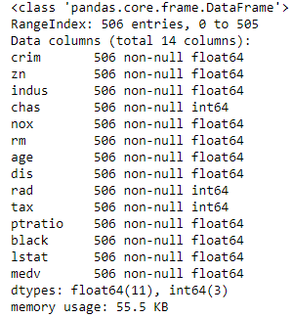
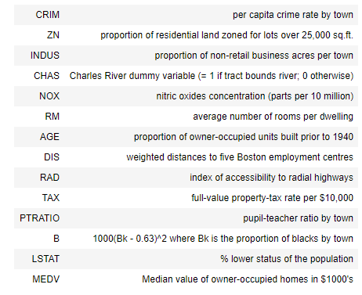
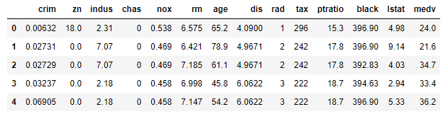
Simple Linear Regression Data Exploration

Slide 7
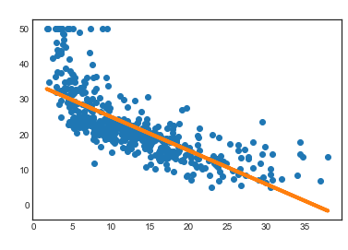
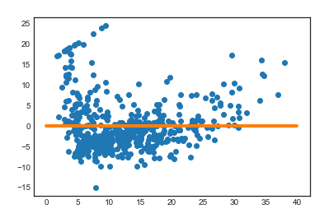
Simple Linear Regression
Intercept: 25.56
Lstat coefficient: -0.573
Clear shape to residuals
R² = 0.247

Slide 8
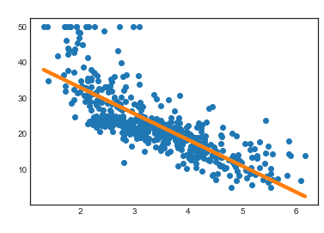
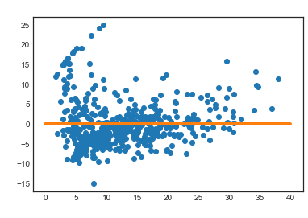
Simple Linear Regression
Intercept: 47.53
Sqrt(lstat) coefficient: -7.31
R² = 0.616

Slide 9
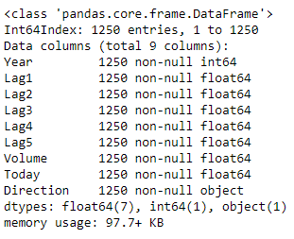
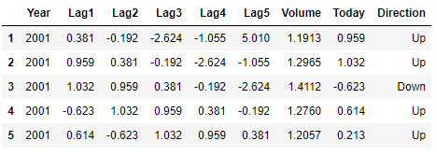
Logistic Regression Data Exploration

Slide 10
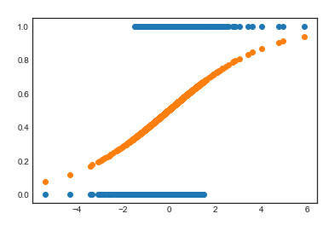
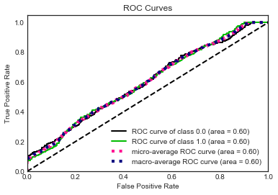
Logistic Regression
Data have been modified to enhance curvature of Logistic Regression Model.

Slide 11
Questions?

