Slide 1
Splunking Infoblox
Using Rest api and python
Phil Meyerson
January 30, 2018

Slide 2
Standard Disclaimers
Views and opinions expressed are my own and do not represent my employer.
Test first, and not in production.

Slide 3
Agenda
Review Splunk Add-On for Infoblox
IPAM – the missing piece
Setup IPAM export into Splunk
Prepare Infoblox
Prepare Splunk data inputs & lookup
Utilize new lookup data
Python script samples to export DNS RPZ Threat Feeds
What next?
Resource List
Notes:
If we have time dive into python samples and posted gists

Slide 4
About Me
https://www.linkedin.com/in/philmeyerson
@pmeyerson on splunk slack
10+ years Enterprise Route/Switch and Server Engineering
5 years metro ethernet
Minimal scripting, a few years of Splunk use and administration. Few years of Infoblox administration - ~500 networks. Attend local Splunk User Group, Splunk Live! Workshops, and .conf2017

Slide 5
Goals for Today
Export IPAM details into Splunk
Use IPAM details to provide additional context in Splunk
Export your Infoblox DNS Threat Feed lists
DNS Threat Feed export – use case in Splunk

Slide 6
Splunk Add-On for Infoblox Splunk_TA_Infoblox
Splunk your Infoblox syslog
https://splunkbase.splunk.com/app/2934 - docs linked from details tab.
Supports analysis of DHCP & DNS log data
Googlefu: splunk dns threat hunting
https://github.com/rkovar/dns_detection/blob/master/known_unknown_DNS.pdf (full video link at end)
Notes:
If you are not looking through dns query logs for malicious activity I highly recommend Ryan Kovar et al’s work. There’s a video too.

Slide 7
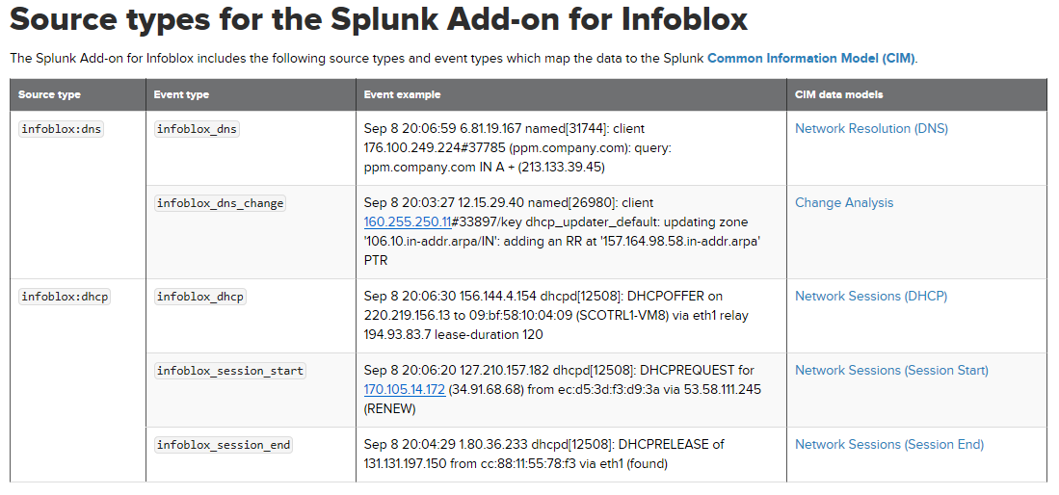
Splunk Add-On for Infoblox

Slide 8
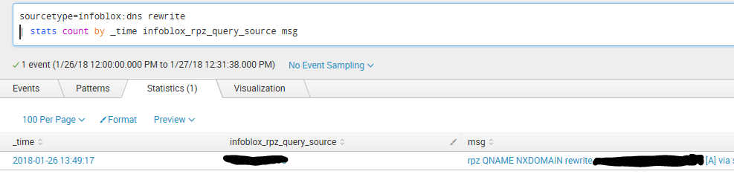
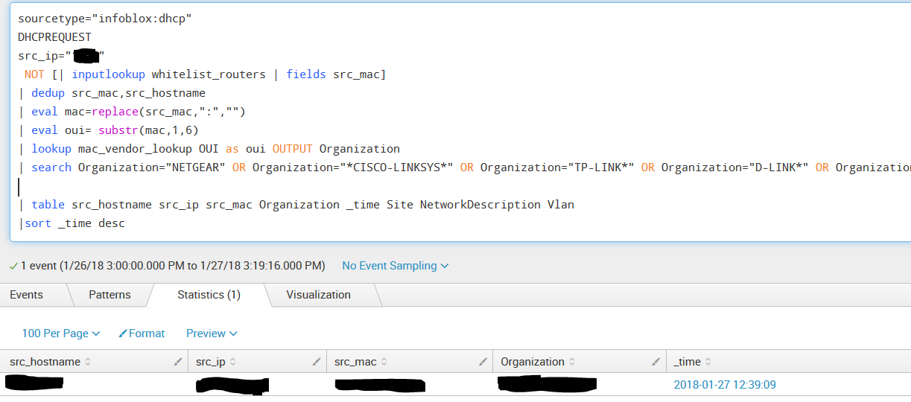
Where is this on my network?!
http://standards-oui.ieee.org/oui.txt
Download, cut the noise and save as csv lookup
Notes:
Lack of context makes this data less useful, more likely to not be acted on.

Slide 9
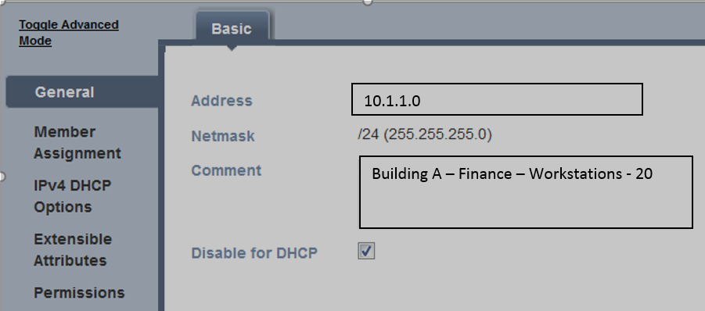
Add intelligence with IPAM
Determine priority and team to alert
Splunk search fields can be used for upstream alerts
Threat detection by Site/LAN – similar user behavior …or lateral movement
Cut noisy events from less relevant networks/sites in your searches
Notes:
Determine whatever contextual data will most suit your needs. Filter out workstations if the call is coming from inside the house.

Slide 10
What should I put in my IPAM data?
Depends on your Network Topology…..
Identify building, department, floor
Identify network type - wired, vpn, wifi, cloud, guest
Identify network use – workstations, phones, servers, storage, printers, management, security, etc.
Don’t be afraid to get started with basic info and flesh it out over time.

Slide 11
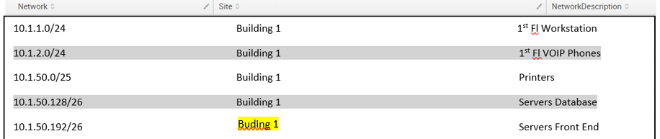
Tips
Standardize comment syntax
Easy to audit the consistency in Splunk!
| lookup networks | search Site!=“Building 1” AND Site!=“Building 2”
Schedule your data check searches to alert you. Your future self will thank you.

Slide 12
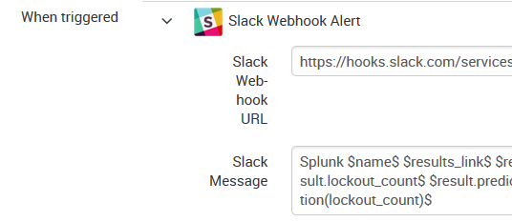
Additional IPAM Uses
| timechart count by Site – for security data, patch status, etc
Sourcetype=Infoblox:dns | rare by NetworkDescription | stats count query NetworkDescription
Filter out noise from standard workstations | search NetworkDescription!=“Workstations”
Provide context to upstream alerts – ticketing system, slack notification, or email $result.field_name$ - check the Splunk docs

Slide 13
Additional IPAM use – traffic between workstations
index=wiretraffic | lookup networks Network as dest OUTPUT Site as dest_Site, Description as dest_Description | lookup networks Network as src OUTPUT Site as src_Site, Description as src_Description | search src_Description=“Workstations” AND dest_Description=“Workstations” | stats count by src src_Site dest dest_Site
Notes:
Apply this search to wiretraffic or connectivity logs

Slide 14
Deployment Overview
Notes:
OK if you are in a single instance splunk deployment

Slide 15
Prepare Infoblox Environment
Create Infoblox account and apply security controls
Decide on a standard syntax and text to describe your networks – enter this info in Infoblox network Comment box
Determine API query to fit needs
Test

Slide 16
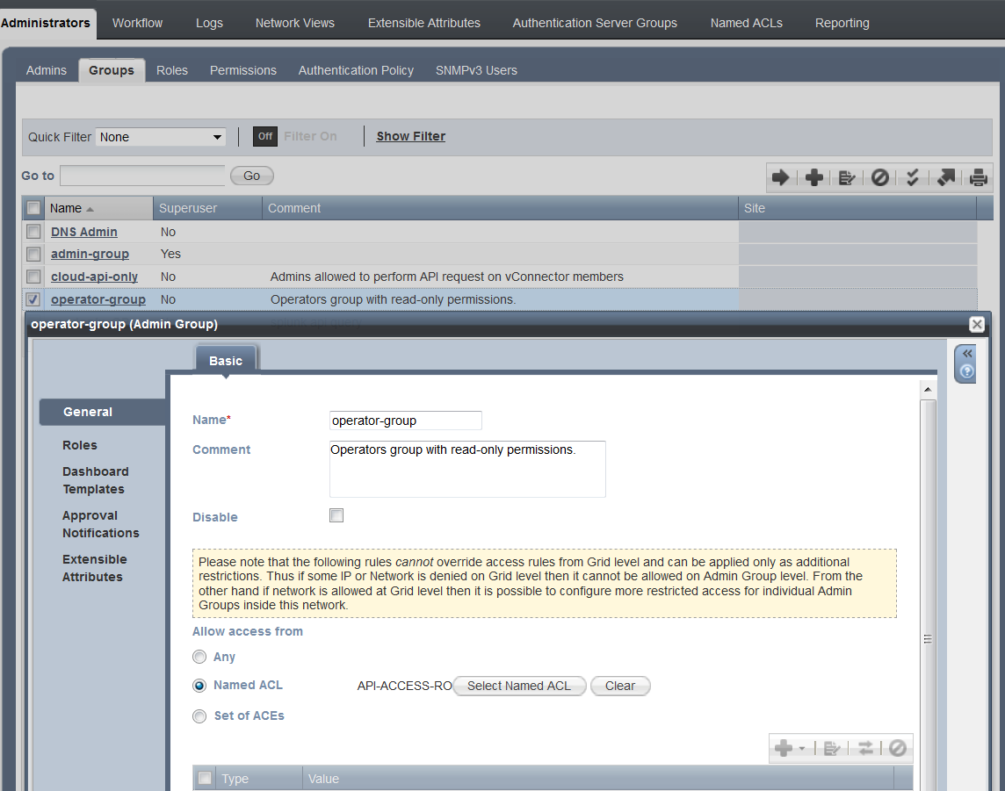
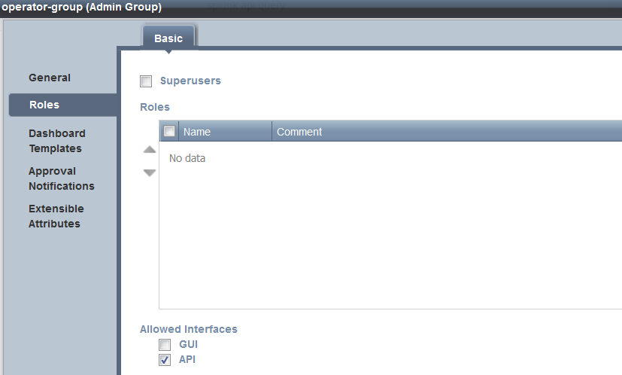
Infoblox |Administrator Groups Settings

Slide 17
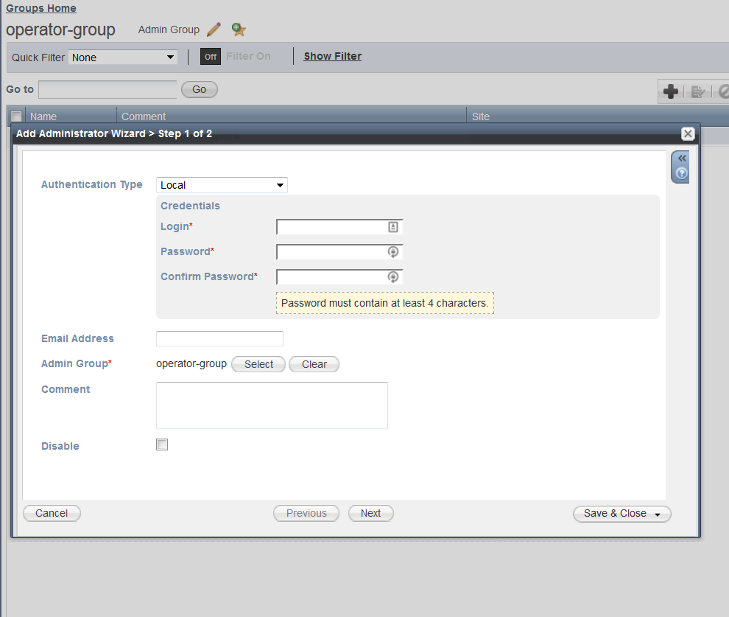
Infoblox |Add user to group

Slide 18
Infoblox |Verify API query
https://Infoblox.local/wapi/v2.0/network -- test API query in browser!
Add comment text or extensible attributes to your networks using Infoblox GUI
Ref: https://Infoblox.local/wapidoc

Slide 19
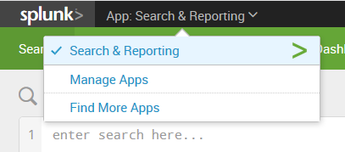
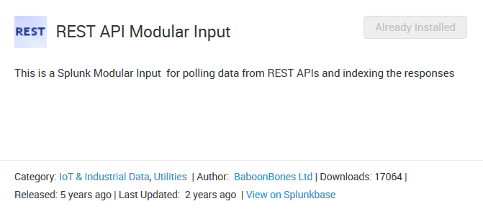
Splunk |Install Splunk Add-on for REST API Modular Input
https://www.splunk.com/blog/2013/06/18/getting-data-from-your-rest-apis-into-splunk.html

Slide 20
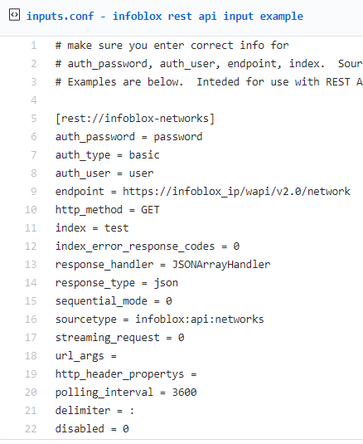

Splunk |Configure new REST input - CLI
https://gist.github.com/pmeyerson/7e4eb308392eb6b273dd1b61abaf45da
https://gist.github.com/pmeyerson Sample config available for use with Splunk or stand-alone python execution

Slide 21
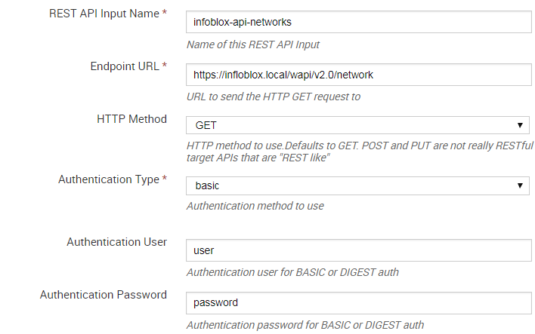


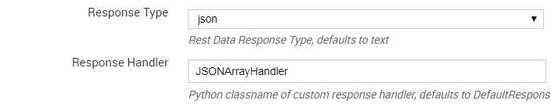
Splunk |Configure new REST Input

Slide 22
Splunk |Test REST Input
Index = ddi sourcetype=Infoblox:api:networks (as assigned in your REST input settings)
Should see one event for each network + comment json result block

Slide 23
Splunk |Field Extraction and Save Lookup File
Schedule search: index=ddi sourcetype="infoblox:api:networks" ← match index and sourcetype from REST input | dedup network | rex field=comment "(?<Site>[\s\S^-]*)\s-\s(?<Vlan>[0-9xX]*)\s-\s(?<NetworkDescription>[\s\S]*)" | rename network as Network ← for consistency since I capitalized all my other fields | table Network Site NetworkDescription Vlan | sort Network num | outputlookup networks createinapp=true append=false ← saves result table as lookup file
NOTE: use the rex command to extract fields from the comments you entered in your Infoblox networks. Configure regex to suit your fields and change field extraction names accordingly. We don’t have to extract the “network” field value – it comes in with the original JSON data from the API query. I just chose to change the case on the field name.
Regexr.com, regex101.com, etc

Slide 24
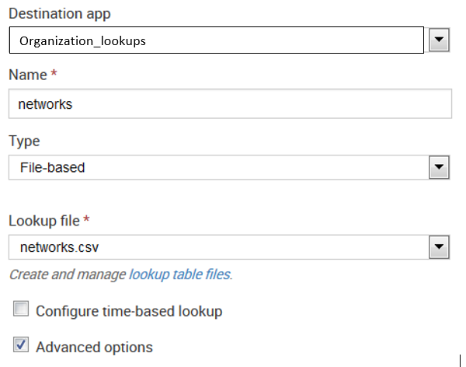
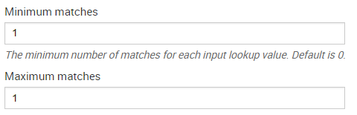


Splunk |Create Lookup Definition
Configure Lookup Definition – allows for CIDR matching
Use the field name from your lookup file

Slide 25
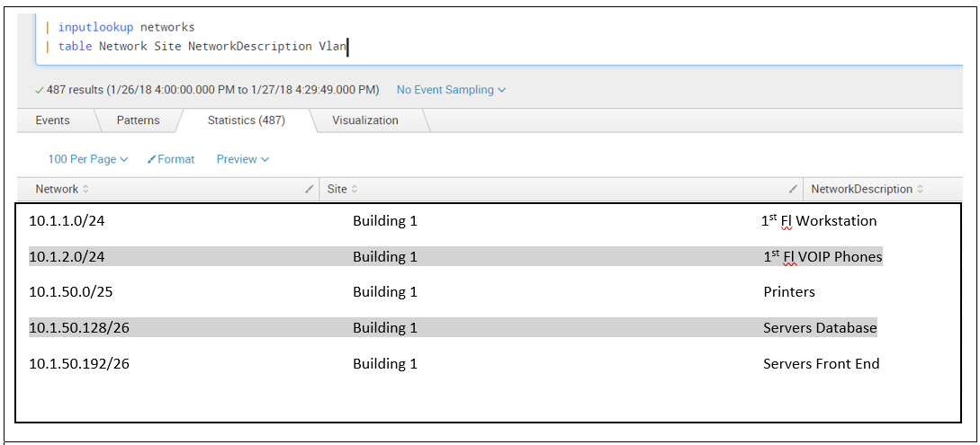
$$$ - Mission Accomplished

Slide 26
$$$ - Putting Your Lookup to Work
| inputlookup networks (should display your lookup csv data)
Search xxx | lookup networks Network as dest OUTPUT Network, Site , NetworkDescription , Vlan Syntax: networks = lookup definition name (transforms.conf) Network = field name we are matching from the lookup definition as dest = name of field from current search data we are going to match against OUTPUT xxx = name of fields from lookup we wish to retrieve

Slide 27
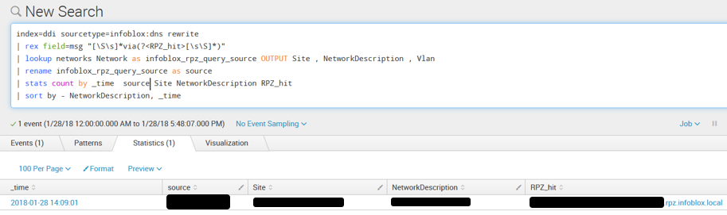
$$$ - Everyone’s Favorite Step!
Jan 28 19:09:01 infoblox_nameserver 10.1.1.1 named[22002]: CEF:0|Infoblox|NIOS|8.1.6-360192|RPZ-QNAME|NXDOMAIN|7|app=DNS dst=10.1.1.1 src=10.2.1.1 spt=62089 view=_default qtype=A msg="rpz QNAME NXDOMAIN rewrite badsite.com [A] via badsite.com.antimalware.rpz.infoblox.local"

Slide 28
Gotchas
Splunk will hide data from | stats if a value is null/blank use | fillnull value=“ “ before your |stats or |table
index=x sourcetype=y … |lookup network Network as dest OUTPUT NetworkDescription |search NetworkDescription=“Workstation” -> No results found? Audit your lookup file for typos .. update comment in Infoblox as necessary, check |inputlookup networks ☺
Can disable/enable REST input to trigger polling manually
|inputlookup networks doesn’t work but |inputlookup networks.csv does? check your lookup definition

Slide 29

Question Time
Review Splunk Add-On for Infoblox
IPAM – the missing piece
Setup IPAM export into Splunk
Code samples to export DNS RPZ Threat Feeds
Possible Next Steps
Resource List

Slide 30
Now I’m thinking:
Understand RPZ threat feeds better…. Get my security tools working together
What’s the churn rate?
Do I have overlap with feeds from other sources?
I want to do retroactive analysis?
I want to compare these feeds against another reputation source – Google Safe Browsing, virustotal.com, other vendor subscription
I want to automate custom updates to local rpz feed????? (Can I?)
I want to alert on google safe browsing hits from my users
Check for your corporate public domains or other business critical domains

Slide 31
RPZ Feed -
https://gist.github.com/pmeyerson/ script to download RPZ files using your csp.Infoblox.com api credentials (same as your Infoblox does). Also generates list of newly added domains for retroactive analysis…. Python is great!
Retrieve API credential from https://csp.Infoblox.com
Click Administration link -> On-Prem DNS Firewall Configuration link
Click Configure button
Click Next Step button at bottom of page.
Note Distribution Server IP, Key Name, and TSIG Key.

Slide 32
Retroactive RPZ Feed Hit
Take rpz_additions.csv from rpz_grabber.py and upload to Splunk
Index=x sourcetype="infoblox:dns" query="*" earliest=-2d@d latest=-0d@d [| inputlookup rpz_additions.csv] | lookup network Networks as dest OUTPUT Site, NetworkDescription | stats count by _time dest Site NetworkDescription query

Slide 33
Exploring dnspython
Pip install dnspython; http://www.dnspython.org/ for docs
Dns.tsigkeyring
Dns.zone
Dns.query

Slide 34
Further Steps and Notable Work
Create custom dns rpz feed based on domain/urls from other security tools??
Using cluster maps? Chart events visually by internal network context instead of ip location.
https://www.mlsecproject.org/ - TIQ Test on RPZ Feed? Gglsbl-rest?
Optiv Threat Intel - https://splunkbase.splunk.com/app/2837/
Google safe browsing reference implementation and API https://developers.google.com/safe-browsing/. Keep in mind our dns query data is not a complete url. Usage terms apply for free tier.

Slide 35
Thank you!
Questions? Comments?
It takes a village – share what you can
Infoblox community, github, answers.splunk.com, splunk slack channel … RFC1149 – IP over AC submissions also accepted ;)
Next Up: “Detecting Dictionary DGA Using Machine Learning” - Mayana Pereira Data, Scientist, Infoblox Feb 6 10a PST

Slide 36
References
Contact:
Splunk slack channel @pmeyerson
https://community.infoblox.com/t5/user/viewprofilepage/user-id/25546 (Phillip Meyerson @ community.Infoblox.com)
https://www.linkedin.com/in/philmeyerson
https://Gist.github.com/pmeyerson
https://docs.google.com/forms/d/e/1FAIpQLScQ6gM0v8bmUq6vbPd77fdWv8BCmd77UaPaDSh-7YhcXbVXXQ/viewform (Splunk slack channel sign up)
Splunk Add-Ons
Infoblox (syslog export method) - https://splunkbase.splunk.com/app/2934
REST API Modular Input - http://splunkbase.com/app/1546
https://splunkbase.splunk.com/app/3330/ (.conf archive search of presentations!)
DNS Threat Hunting – Ryan Kovar & Steve Brant
https://github.com/rkovar/dns_detection/blob/master/known_unknown_DNS.pdf
http://conf.splunk.com/session/2015/recordings/2015-splunk-136.mp4

Slide 37
References
Docs
http://docs.splunk.com/Documentation/AddOns/latest/Infoblox/About
https://www.infoblox.com/wp-content/uploads/infoblox-deployment-infoblox-rest-api.pdf
https://local-Infoblox/wapidoc
https://www.splunk.com/blog/2013/06/18/getting-data-from-your-rest-apis-into-splunk.html
http://www.dnspython.org/
Tools
Postman – API development tool – save queries, credentials, etc. http://www.getpostman.com

