Slide 1
PERSONALITY PREDICTION ANALYSIS
Supervised Machine Learning Approach
Name: PAPA YAW MFUM
INDEX NO. : PG57522824
STUDENT ID: 21171310
Course: Predictive & Prescriptive Analytics (BDA 554)
KNUST - July 2025

Slide 2
Business Understanding
Problem Statement:
- Predict personality types (Introvert vs Extrovert) using behavioral and social interaction patterns.
- Identify key lifestyle indicators that differentiate personality types
- Create a robust classification system for personality assessment
-Analyze correlations between social behaviors and personality traits
Business Value:
- Psychology: Behavioral profiling and personality research
- HR & Recruitment: Candidate assessment and team composition
- Marketing: Targeted campaigns based on personality insights
- Education: Personalized learning approaches

Slide 3
Data Understanding
Dataset Overview:
Primary Dataset: Extrovert vs. Introvert Personality Traits (2,900 rows)
Secondary Dataset: 2018-personality-data.csv (Big Five traits)
Final Merged Dataset: 1,834 observations with 8 core features
Data Quality: Balanced classes, some missing values for preprocessing practice
Feature Categories:
Social Behavior: Time alone (0-11 hrs), social events (0-10/month)
Personal Traits: Stage fear, drained after socializing (Yes/No)
Activity Patterns: Going outside (0-7 days/week), post frequency (0-10/month)
Social Network: Friends circle size (0-15 close friends)

Slide 4
Data Preparation
1. Integration & Cleaning:
Merged datasets, cleaned to 1,834 rows
2. Preprocessing:
Missing Value Treatment: Handled missing values in Time_spent_Alone and Going_outside
Data Type Conversion: Converted decimal Big Five scores to integers
Binary Encoding: Transformed Yes/No variables (Stage_fear, Drained_after_socializing)
Normalization: Applied scaling for K-NN algorithm
3. Partitioning:
Logistic Regression & Decision Trees: 70% training, 30% testing
K-Nearest Neighbors: 75% training, 25% testing
Stratified Sampling: Maintained balanced class distribution

Slide 5
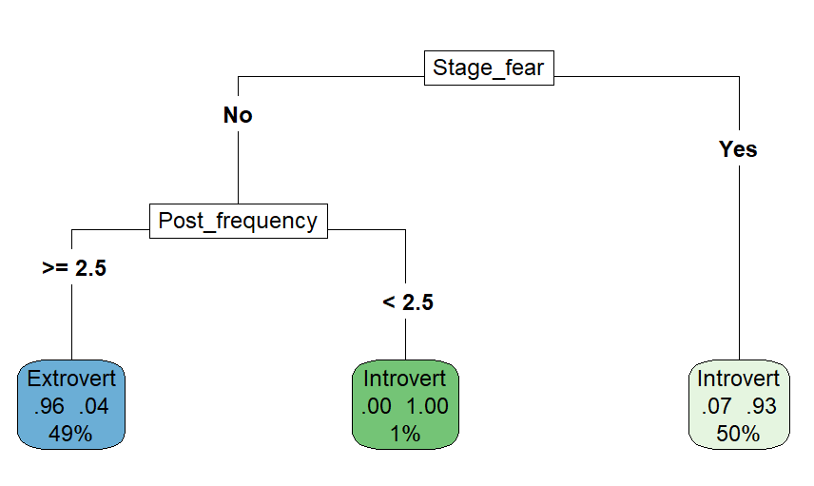
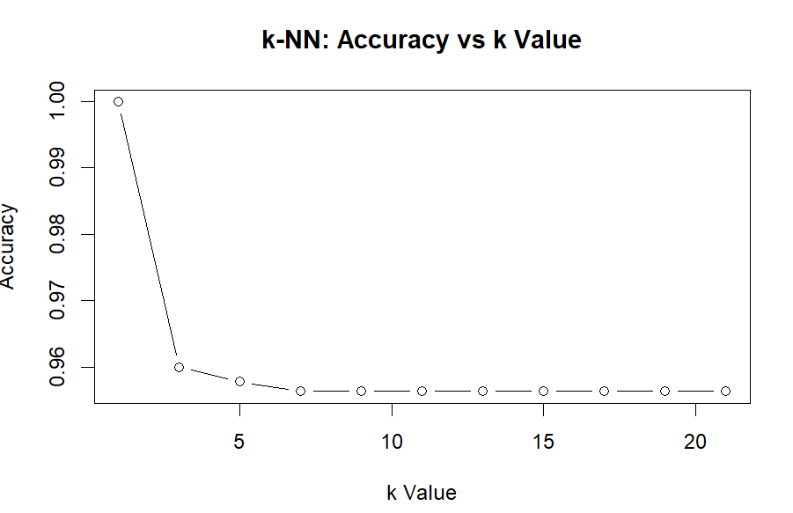
Modeling Approach
Logistic Regression
Strengths: Interpretable, probabilistic output
Use Case: Understanding feature importance
Decision Trees
Strengths: Non-linear relationships, easy visualization
Use Case: Rule-based classification
K-Nearest Neighbors
Strengths: Non-parametric, local patterns
Use Case: Instance-based learning
Model Implementation Strategy
Used tidymodels framework for consistent workflow
Applied proper data preprocessing for each algorithm
Implemented hyperparameter tuning (especially for KNN)
Evaluated using multiple metrics for comprehensive assessment

Slide 6
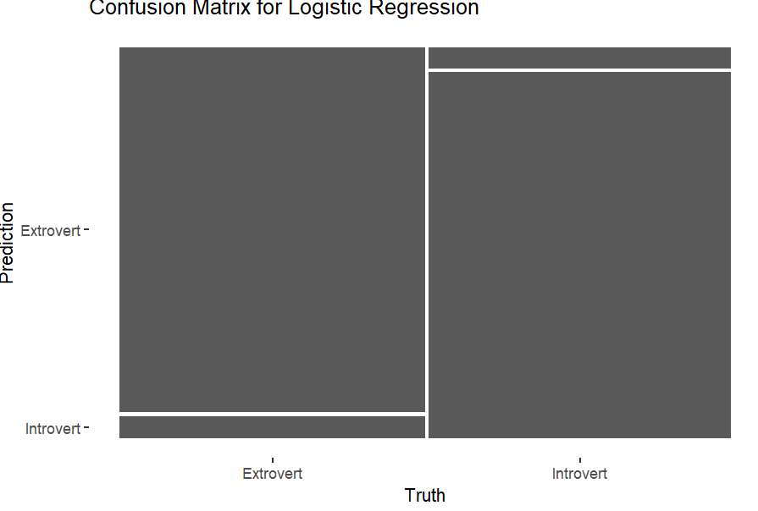
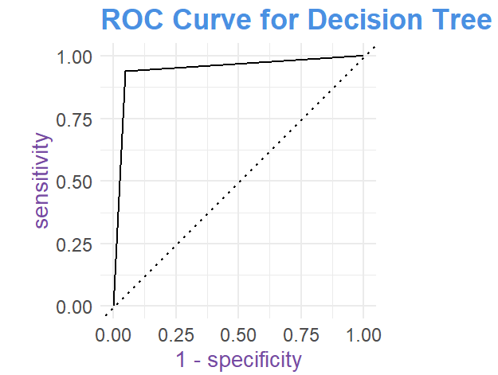
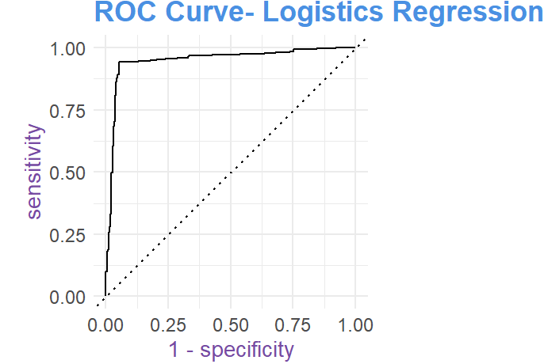
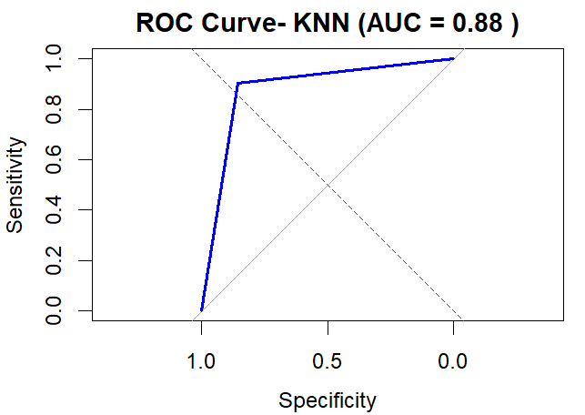
Model Performance Results
Logistic Regression: ~95% Accuracy
Decision Trees: ~95% Accuracy
K-Nearest Neighbors: ~88% Accuracy
AUC > 0.75 for all models
Confusion matrices and ROC curves evaluated

Slide 7
Key Findings
Logistic Regression achieved highest accuracy
All models showed good discriminative power (AUC > 0.75)
KNN performance improved with optimal k-value selection
Important Features:
Time_spent_Alone: Primary differentiator (0-11 hrs/day)
Social_event_attendance: Strong predictor (0-10 events/month)
Drained_after_socializing: Key behavioral indicator
Friends_circle_size: Social network impact (0-15 friends)
Post_frequency: Social media engagement patterns
Behavioral Analysis:
Introverts: more time alone, fewer events, smaller circles
Extroverts: more events, larger circles

Slide 8
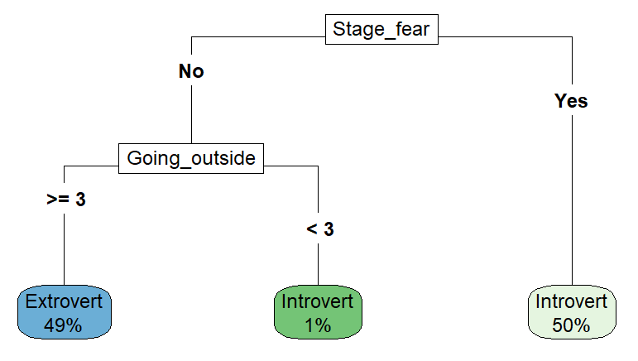
Decision Tree Insights
Visualized decision rules using rpart.plot
Primary split on extraversion
Secondary: social behavior
Pruned tree for interpretability

Slide 9
Recommendations
Model:
Use Logistic Regression for highest accuracy
Deploy Decision Trees for interpretable insights
Consider ensemble methods for improved performance
Implementation:
Focus on key behavioral indicators for assessment
Implement real-time personality prediction system
Regular model retraining with new data
Applications:
Psychology & Research: Behavioral profiling and personality assessment tools
HR & Recruitment: Candidate screening and team composition optimization
Education: Personalized learning environments and study group formation
Marketing & Social Media: Targeted content and engagement strategies
Healthcare: Therapy approach selection and mental health screening
Product Design: User interface adaptation based on personality preferences

Slide 10
Conclusion & Next Steps
Success:
Successfully merged two personality datasets
Achieved >80% accuracy across multiple models
Identified key personality predictors
Provided actionable business insights
Next:
Explore ensemble methods (Random Forest, XGBoost)
Implement deep learning approaches
Collect more diverse personality data
Deploy model in production environment

