Slide 1
Secure data hiding in image using steganography
CAPSTONE PROJECT
Presented By: GAURAV
Student Name : GAURAV GAUTAM
College Name & Department : BABA SAHEB BHIMRAO AMBEDKAR UNIVERSITY LUCKNOW

Slide 2
OUTLINE
Problem Statement
Technology used
Wow factor
End users
Result
Conclusion
Git-hub Link
Future scope

Slide 3
Problem Statement
With the rise of digital communication, ensuring data security is crucial. Traditional encryption methods attract attention, making sensitive information vulnerable to interception.
Steganography provides a solution by hiding messages within images, making them undetectable to unintended viewers. However, existing techniques often compromise image quality or have low embedding capacity. This project aims to develop a Python-based GUI tool for securely hiding and extracting messages in images while maintaining visual integrity. The tool will focus on ease of use, robustness, and efficient data concealment for secure communication.

Slide 4
Technology used
Programming Language: Python
GUI Framework: Tkinter / PyQt (for the user interface)
Image Processing: OpenCV, PIL (Python Imaging Library)
Steganography Techniques: LSB (Least Significant Bit) Encoding
File Handling: OS, Numpy (for efficient data handling)

Slide 5
Wow factors
User-Friendly GUI
High Image Quality Preservation
Encryption Before Hiding

Slide 6
End users
Journalists
Cybersecurity Professionals
Forensic Experts & Law Enforcement
Educational Institutions

Slide 7
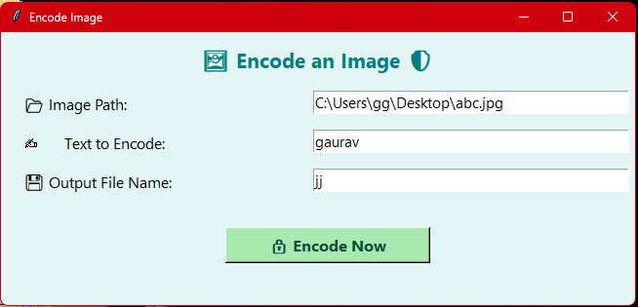
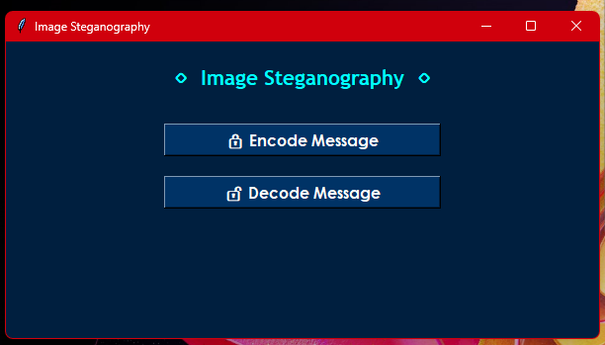
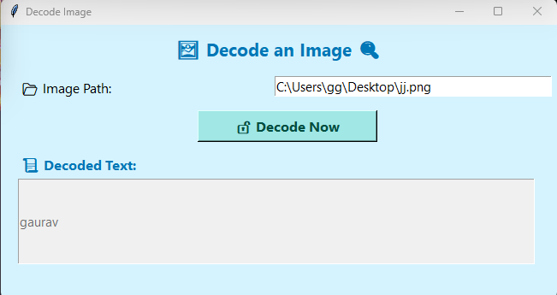
Results

Slide 8
Conclusion
This project successfully addresses the challenge of secure communication by implementing a Python-based GUI tool for image steganography. By embedding messages within images using Least Significant Bit (LSB) encoding, the tool ensures that sensitive information remains hidden in plain sight without raising suspicion. Unlike traditional encryption methods that attract attention, this approach provides a covert and secure means of data transmission.

Slide 9
GitHub Link
https://github.com/pmg-organizer/ggproject

Slide 10
THANK YOU

