Slide 1

PROTONX NLP 03 PROJECT
Semantic Search Thesis
Người hướng dẫn: Nguyễn Bá Ngọc
Người thực hiện: Lê Hoàng Anh

Slide 2
Overview
Goal
• Enhance search capabilities with semantic processing
• Efficiently handle large volumes of data for meaningful results

Slide 3

Components
1. Data Ingestion Pipeline
2. Search Pipeline
3. Evaluation
4. Query Classification
5. Workflow Orchestration
6. Data Storage

Slide 4
1. Data Ingestion Pipeline
Key Processes
• Connectors: Hugging Face, SQL, File Systems
• Data Extraction: Standardized Document structure
• Semantic Chunking: Dividing data into meaningful chunks
• Embedding Generation: Semantic vector representations
• Indexing:
• Inverted Index (keywords)
• Semantic Index (meanings)

Slide 5
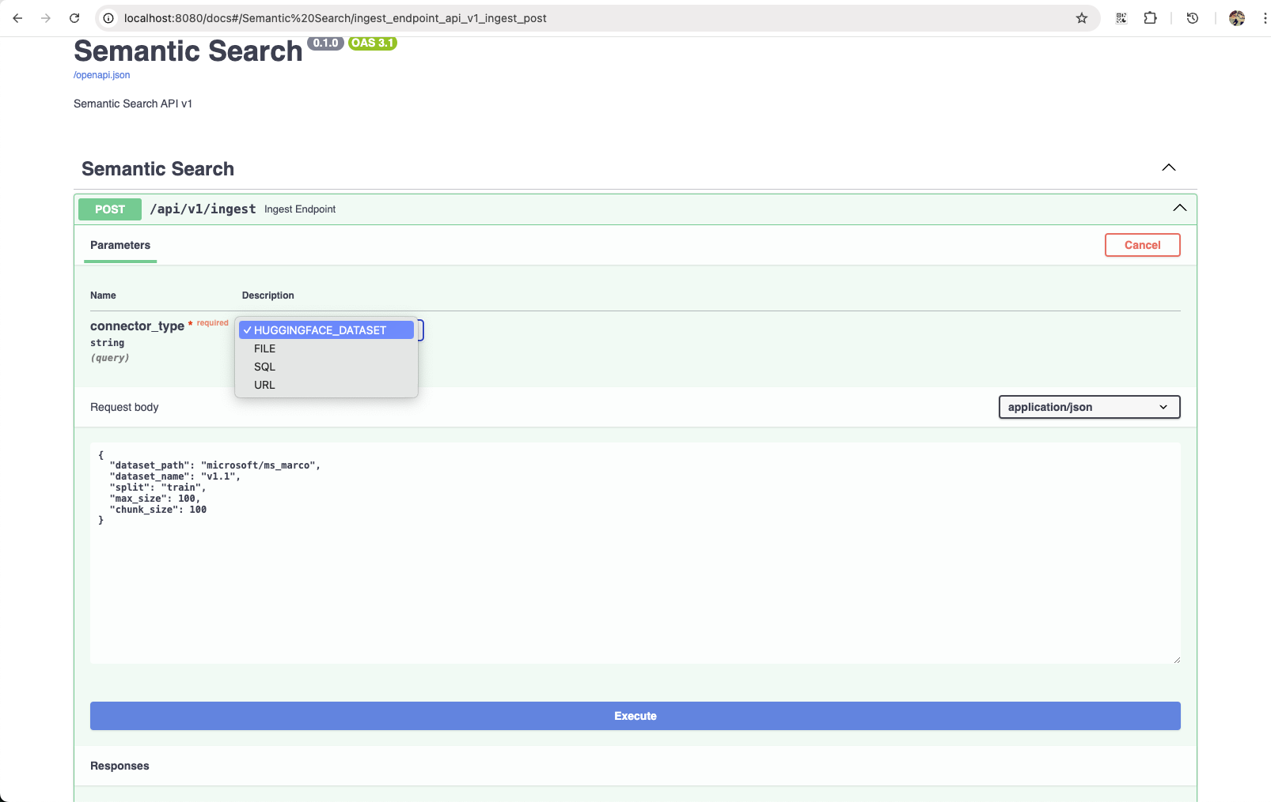

Slide 6
2. Search Pipeline
Search Strategies
• Hybrid Search: Keywords-first, rerank with Semantic
• Fallback Mechanism: Semantic-first, fallback to Keywords
• Tiered Search: Simple = Keywords; Complex = Semantic

Slide 7
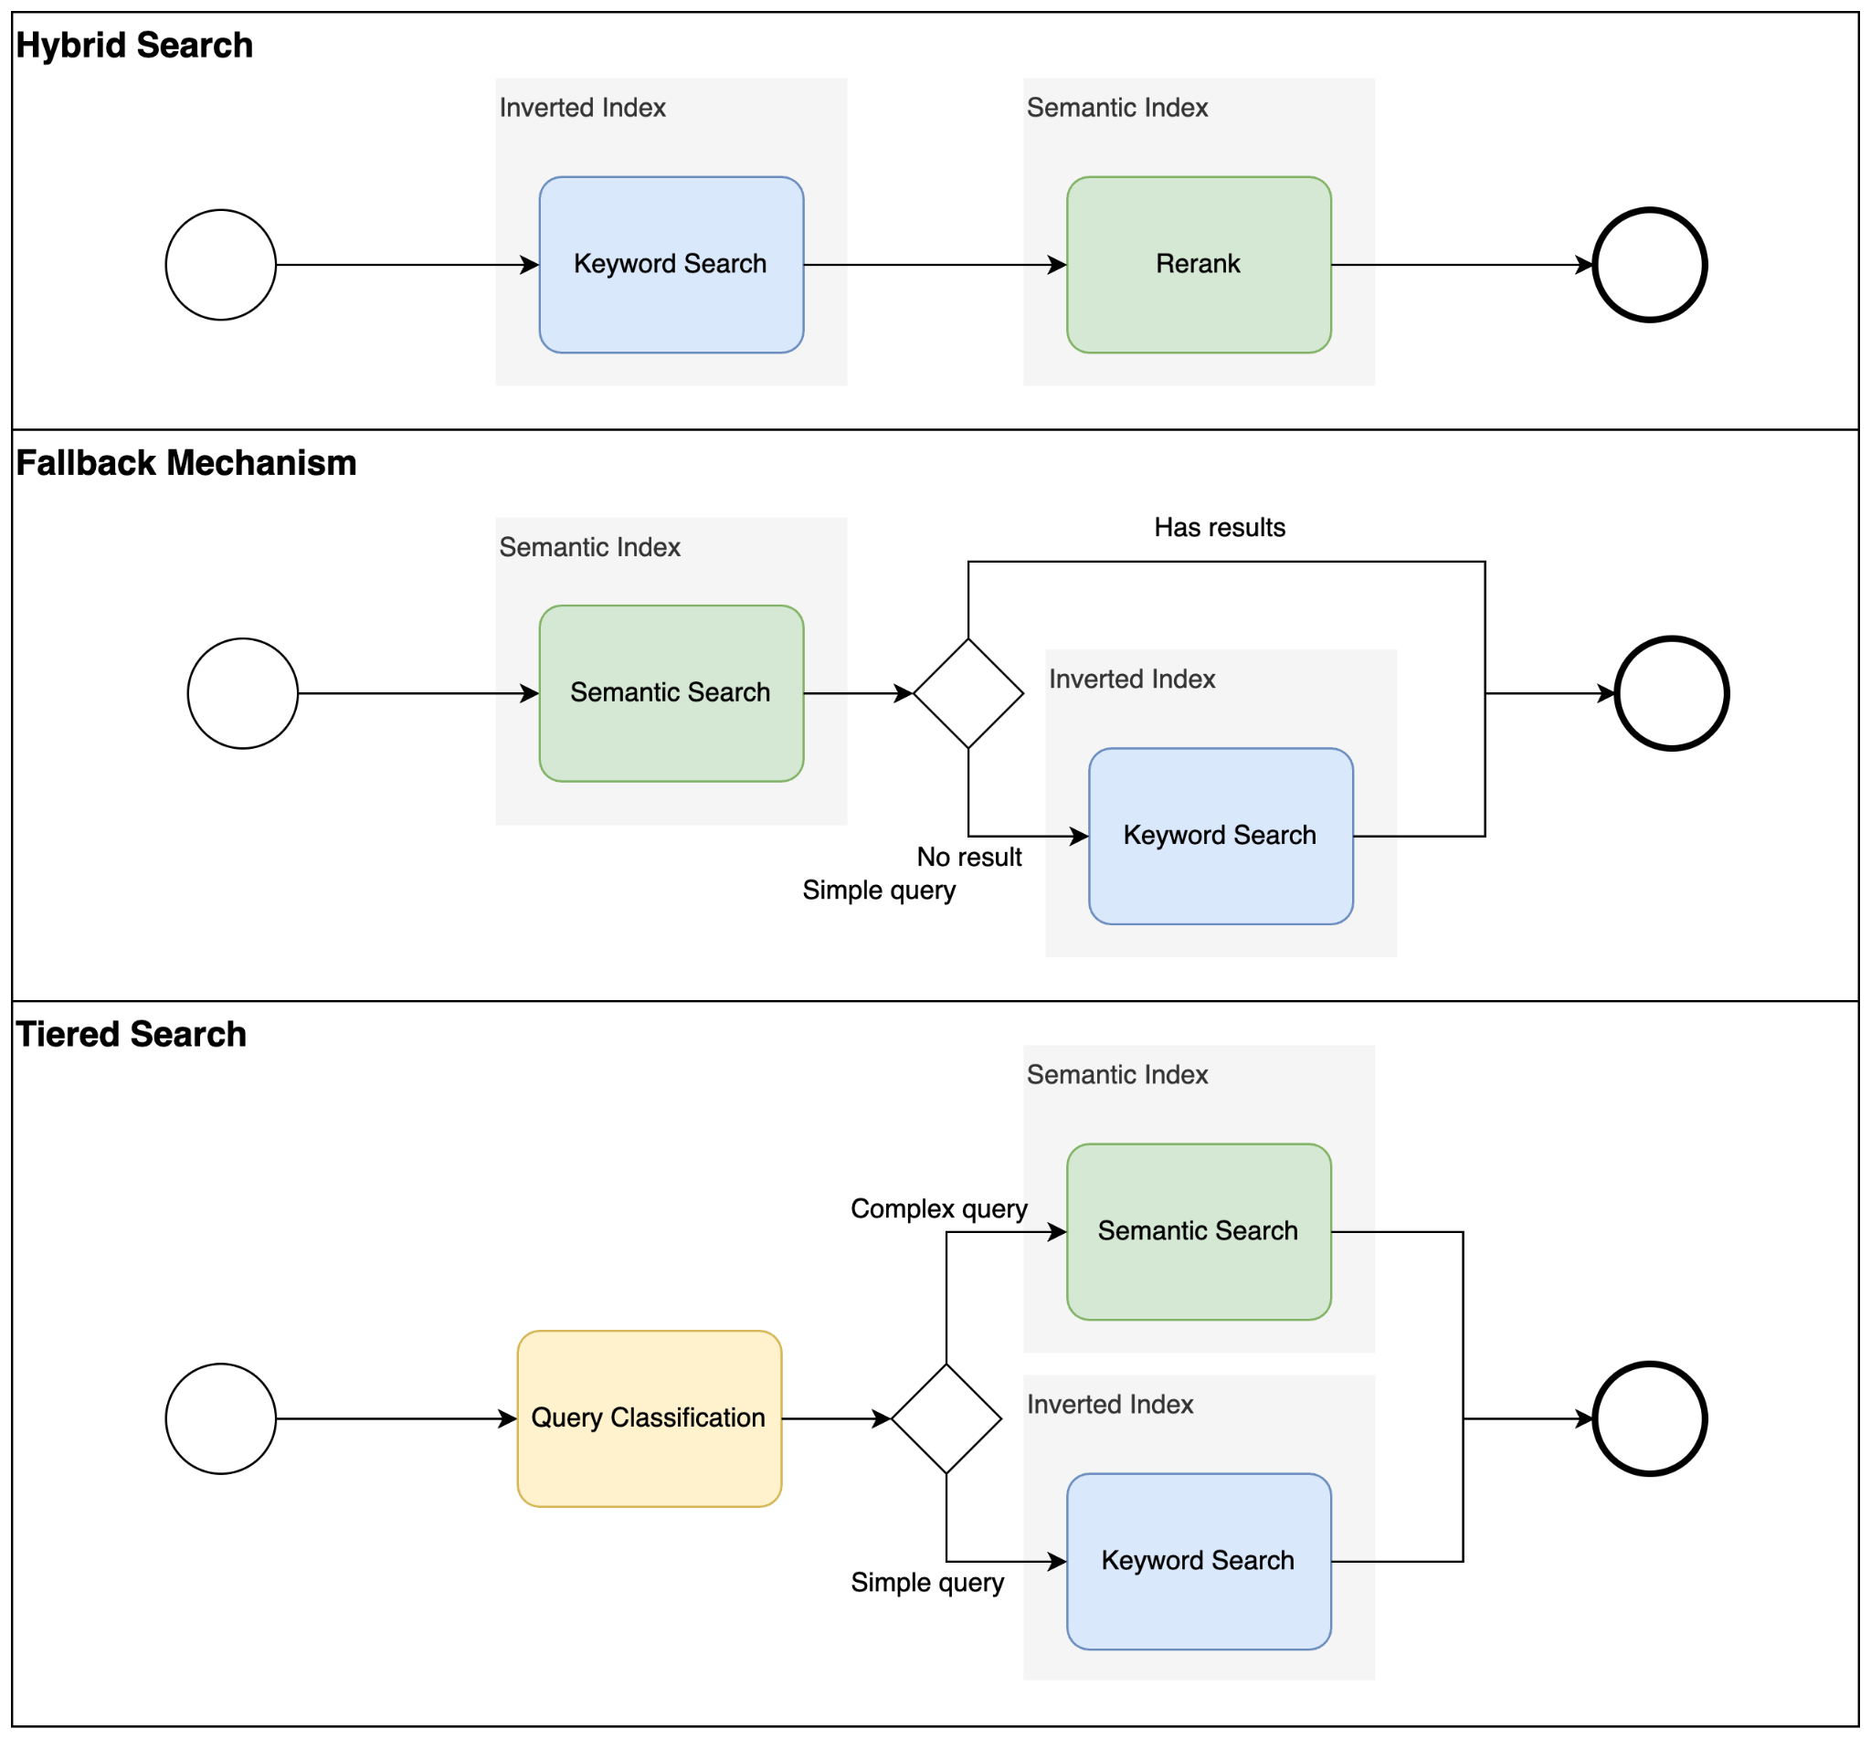

Slide 8
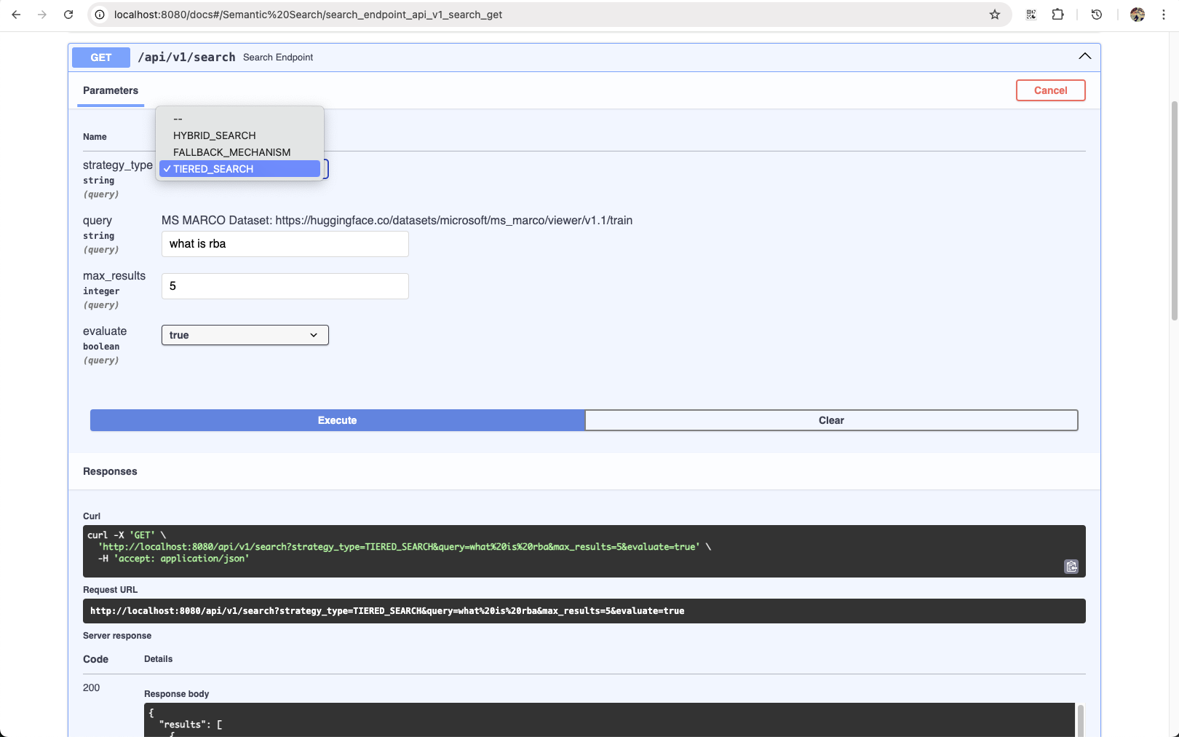

Slide 9
3. Evaluation
Dataset
• MS MARCO: Real user queries with passage ranking
Metrics
• Precision@k: Relevance of top-k results
• MRR@10: Ranking quality for top 10 results

Slide 10
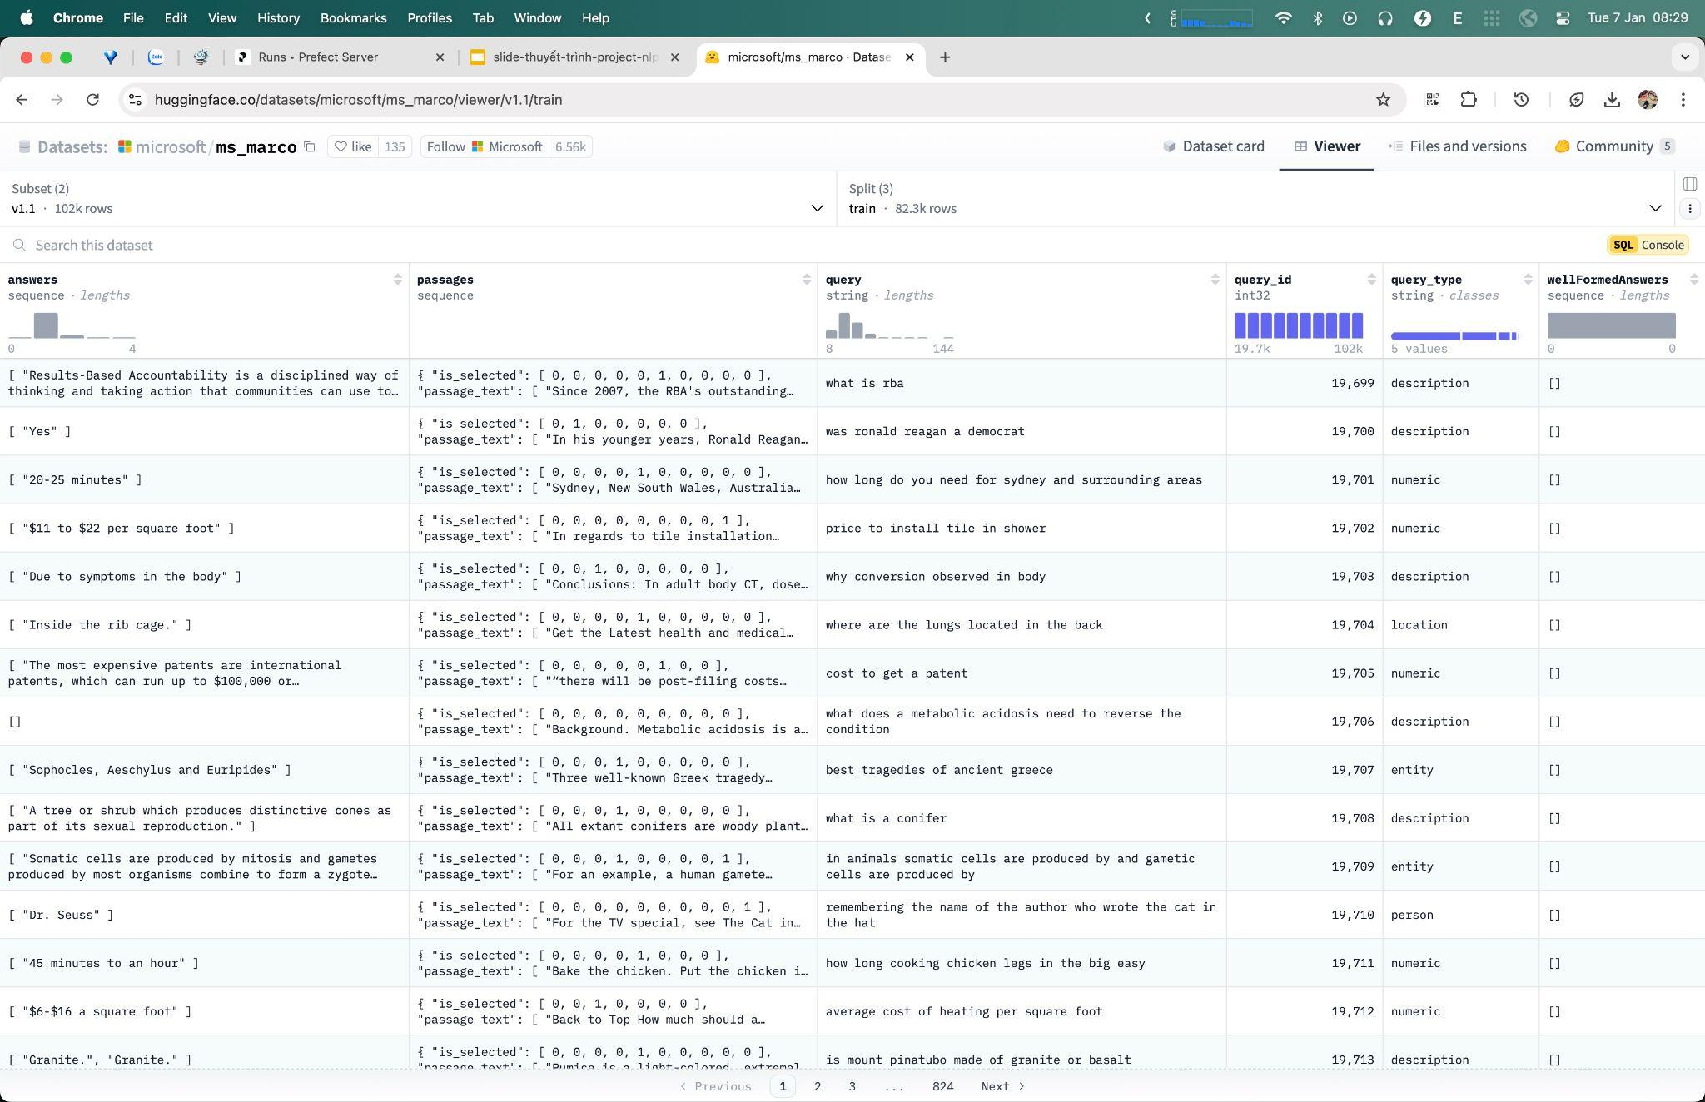

Slide 11
4. Query Classification
Tiered Search by query_type
• Simple: Labeled as `description`
• Complex: Include `entity`, `location`, `numeric`, and other types
Steps
• Data Preparation → Embedding → Model Training
• Fine-tune classifier for binary labels
• Evaluate with MS MARCO test set

Slide 12
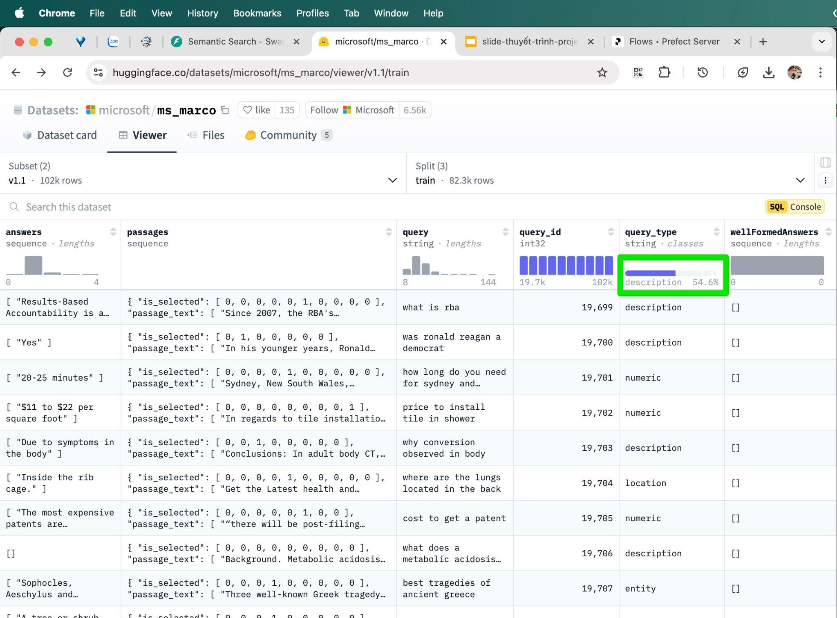

Slide 13
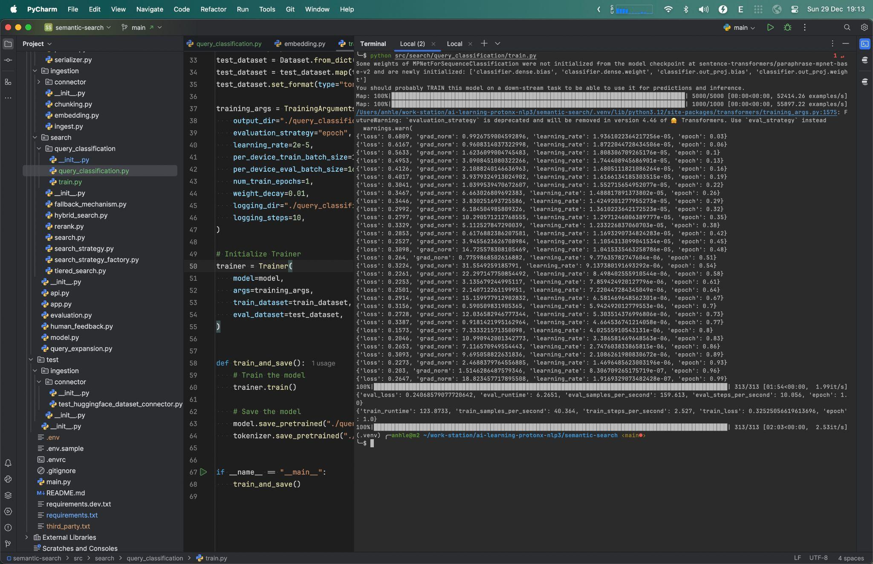

Slide 14
5. Workflow Orchestration
Tool Used: Prefect
• Flow: End-to-end process (ingestion, search, feedback)
• Tasks: Chunking, embedding, query classification

Slide 15
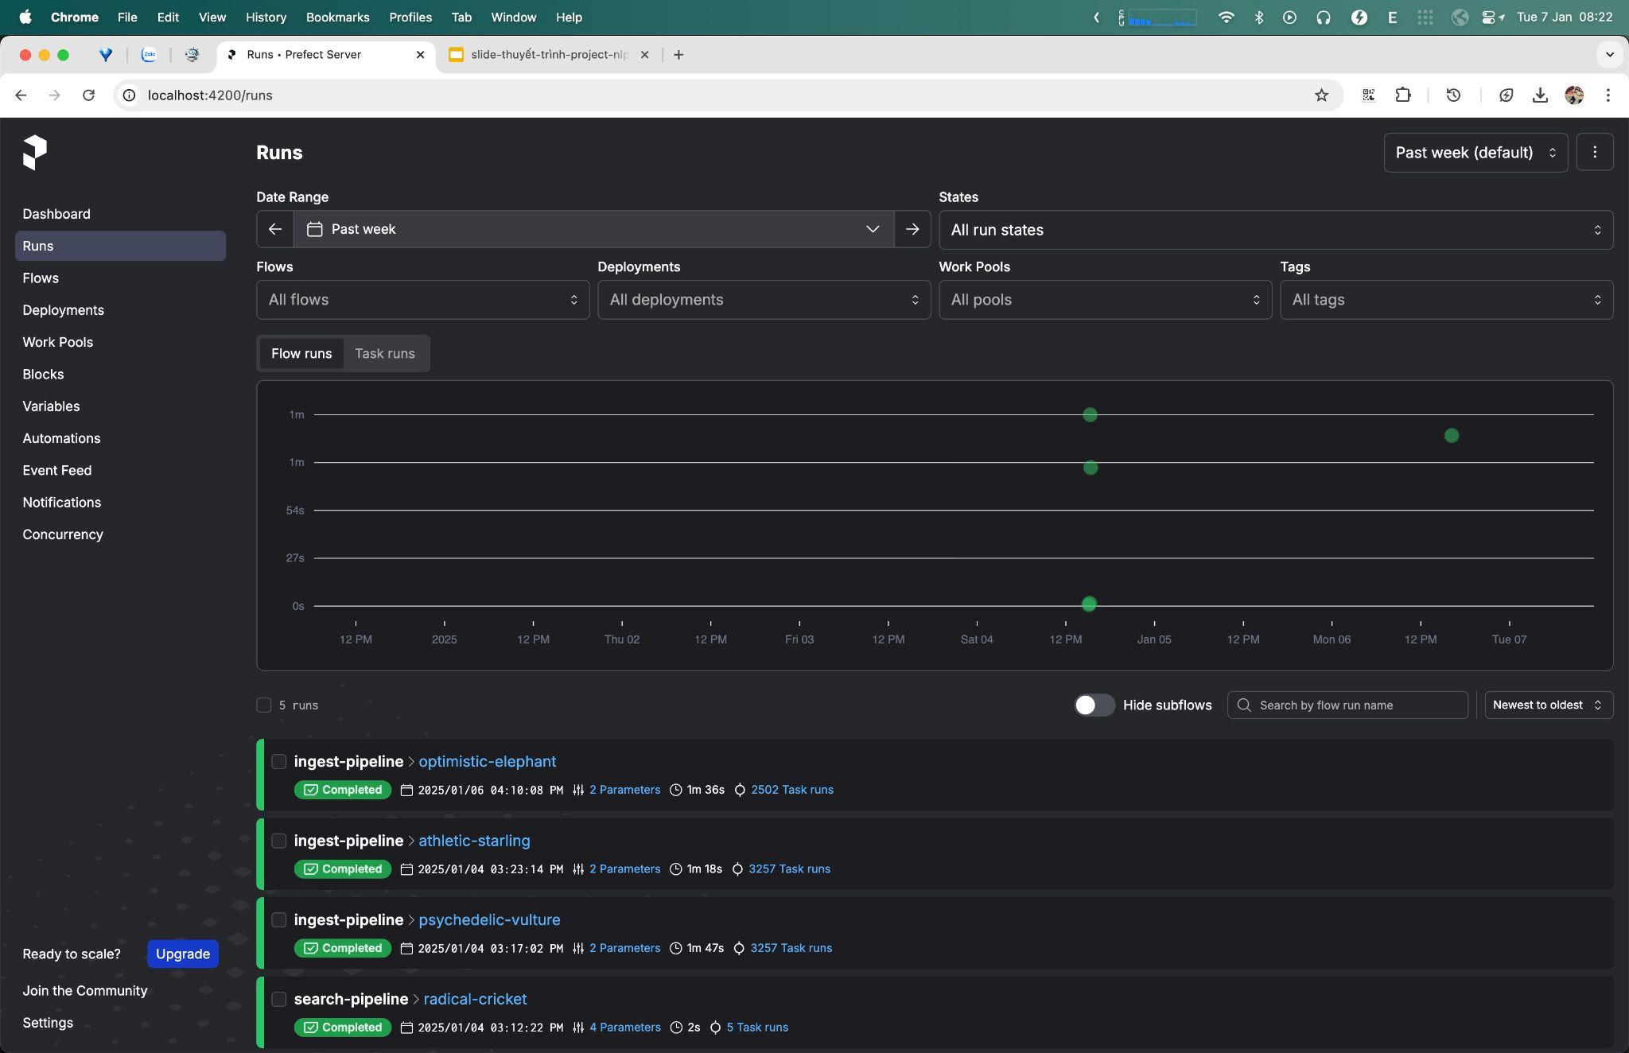

Slide 16
6. Data Storage
• Raw Data: MongoDB
• Processed Data: Elasticsearch
• Supports scalable, efficient storage and retrieval

Slide 17
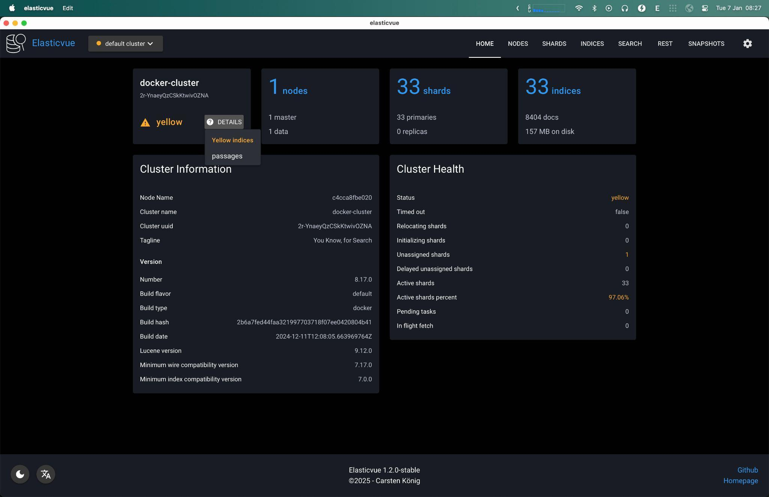

Slide 18
Project Structure
Main Folders
• data/: Raw and processed documents
• src/: Code for ingestion, embedding, search, evaluation
Key Scripts
• ingest.py, search.py, evaluation.py
• flow.py: Prefect orchestration logic

Slide 19
Setup and Run
Prerequisites
• Docker (Elasticsearch, Postgres)
• Python 3.12
Commands
• Setup: bash scripts/setup.sh
• Run: bash scripts/start.sh
• Test: bash scripts/test.sh

Slide 20
Comparison of Approaches
Search Methods
• Elastic Search: Powerful ranking & distributed storage
• FAISS: Fast, in-memory, no CRUD support
• TF-IDF: Simple, but slow for large datasets

Slide 21
Comparison of Approaches
Embedding Storage
• Vector Database: Optimized for similarity search
• Elastic KNN Plugin: Efficient k-nearest neighbor
Search Strategies
• Hybrid: Compute cost efficiency
• Tiered: Balances accuracy & efficiency
• Fallback: Ensures coverage

Slide 22
Expansion Areas
• Connectors: Add more data integrations
• Human Feedback: Improve relevance with user input
• Complex Ranking: Semantic relevance + metadata factors
• GPU Acceleration: Boost performance for embeddings & search
• Applications:
• Requirement analysis
• Customer support
• Legal document analysis

Slide 23
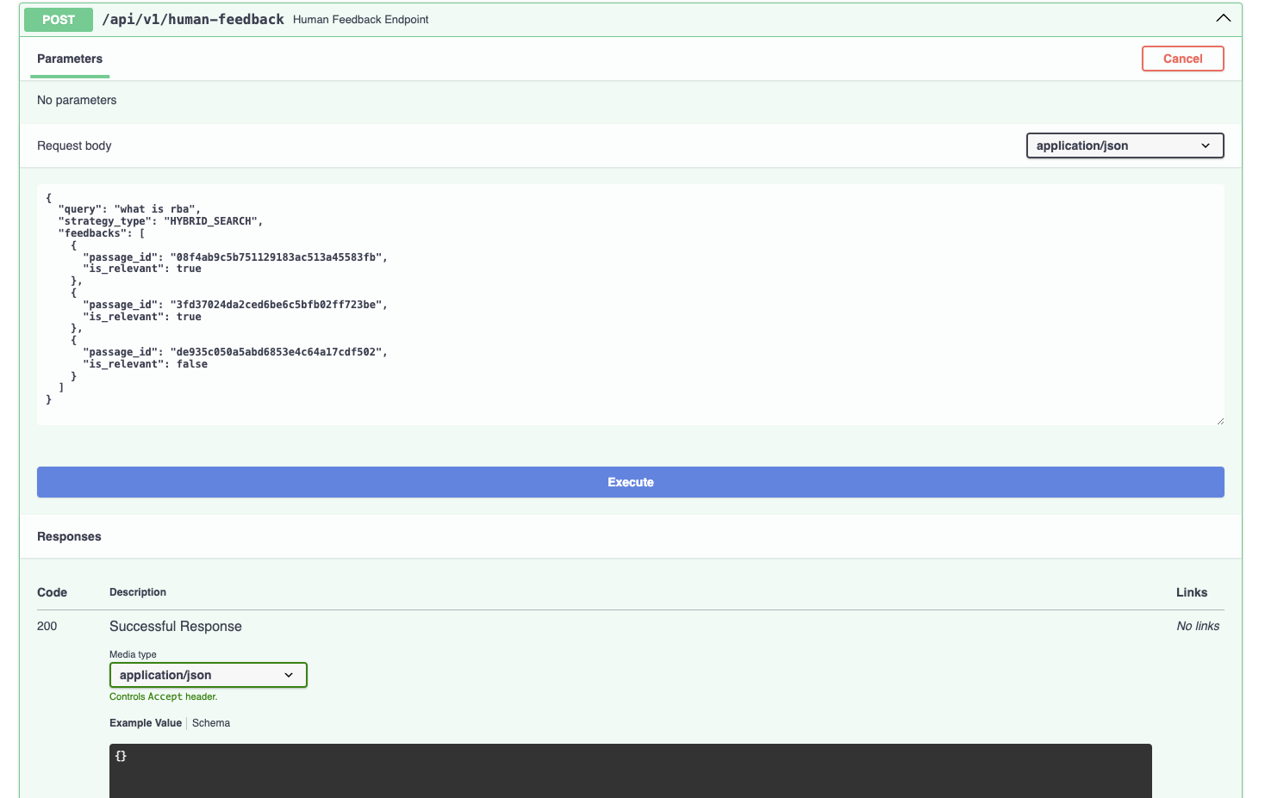

Slide 24

Cảm ơn vì đã lắng nghe
Mong nhận được nhiều góp ý nhất từ phía mọi người để cải thiện sản phẩm

