Slide 1
Foundations of Machine Learning
Module 9: Clustering
Part A: Introduction and kmeans
Sudeshna Sarkar
IIT Kharagpur

Slide 2
Unsupervised learning
Unsupervised learning:
Data with no target attribute. Describe hidden structure from unlabeled data.
Explore the data to find some intrinsic structures in them.
Clustering: the task of grouping a set of objects in such a way that objects in the same group (called a cluster) are more similar to each other than to those in other clusters.
Useful for
Automatically organizing data.
Understanding hidden structure in data.
Preprocessing for further analysis.

Slide 3
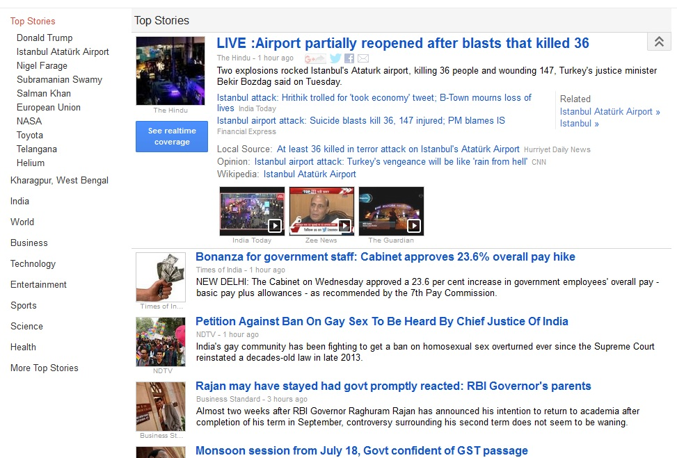
Applications: News Clustering (Google)

Slide 4
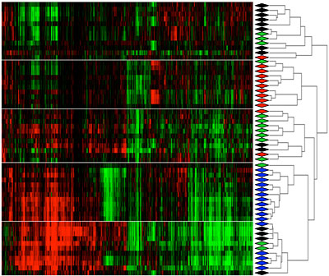
Gene Expression Clustering

Slide 5
Other Applications
Biology: classification of plants and animal kingdom given their features
Marketing: Customer Segmentation based on a database of customer data containing their properties and past buying records
Clustering weblog data to discover groups of similar access patterns.
Recognize communities in social networks.

Slide 6
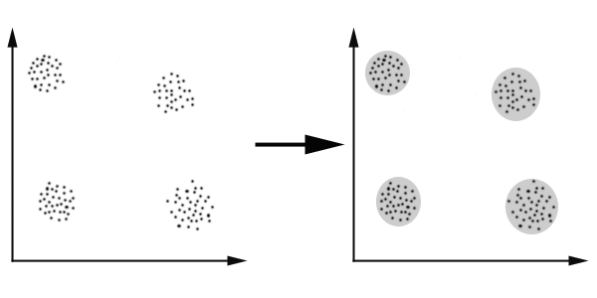
An illustration
This data set has four natural clusters.

Slide 7
An illustration
This data set has four natural clusters.

Slide 8
Aspects of clustering
A clustering algorithm such as
Partitional clustering eg, kmeans
Hierarchical clustering eg, AHC
Mixture of Gaussians
A distance or similarity function
such as Euclidean, Minkowski, cosine
Clustering quality
Inter-clusters distance ⇒ maximized
Intra-clusters distance ⇒ minimized
The quality of a clustering result depends on the algorithm, the distance function, and the application.

Slide 9
Major Clustering Approaches
Partitioning: Construct various partitions and then evaluate them by some criterion
Hierarchical: Create a hierarchical decomposition of the set of objects using some criterion
Model-based: Hypothesize a model for each cluster and find best fit of models to data
Density-based: Guided by connectivity and density functions
Graph-Theoretic Clustering

Slide 10
Partitioning Algorithms
Partitioning method: Construct a partition of a database D of m objects into a set of k clusters
Given a k, find a partition of k clusters that optimizes the chosen partitioning criterion
Global optimal: exhaustively enumerate all partitions
Heuristic method: k-means (MacQueen, 1967)

Slide 11
Hierarchical Clustering
animal
vertebrate
invertebrate
fish reptile amphib. mammal worm insect crustacean
Produce a nested sequence of clusters.
One approach: recursive application of a partitional clustering algorithm.

Slide 12
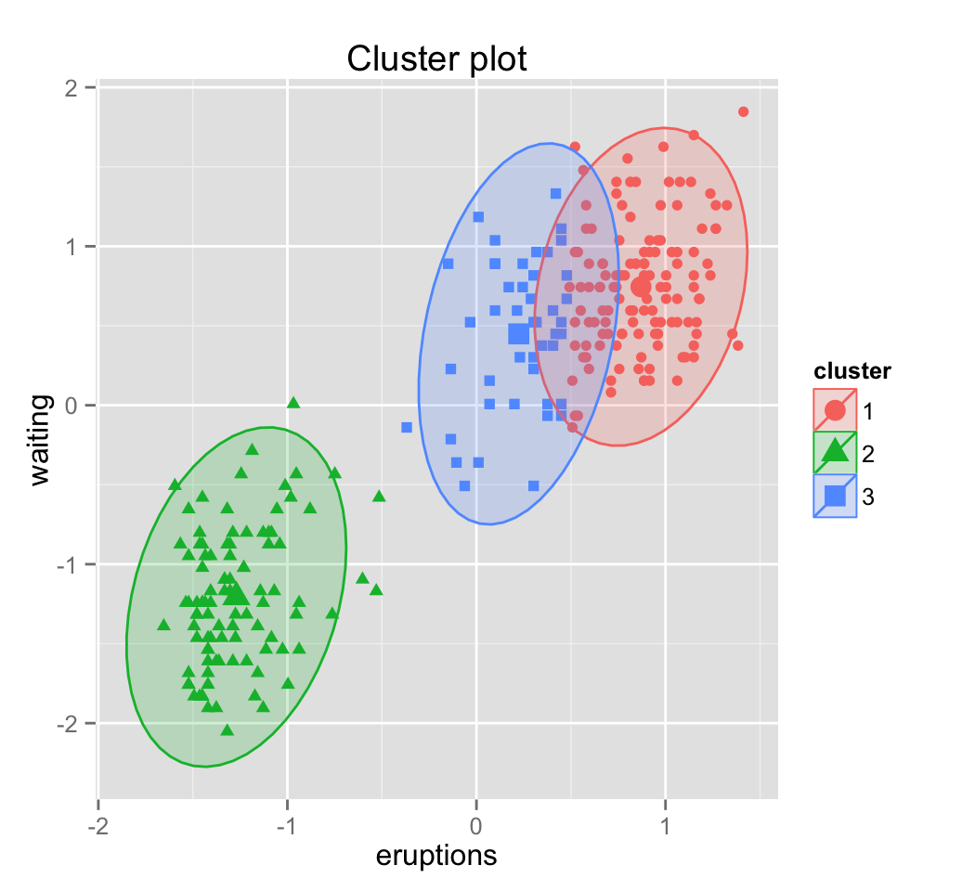
Model Based Clustering
A model is hypothesized
e,g., Assume data is generated by a mixture of underlying probability distributions
Fit the data to model

Slide 13
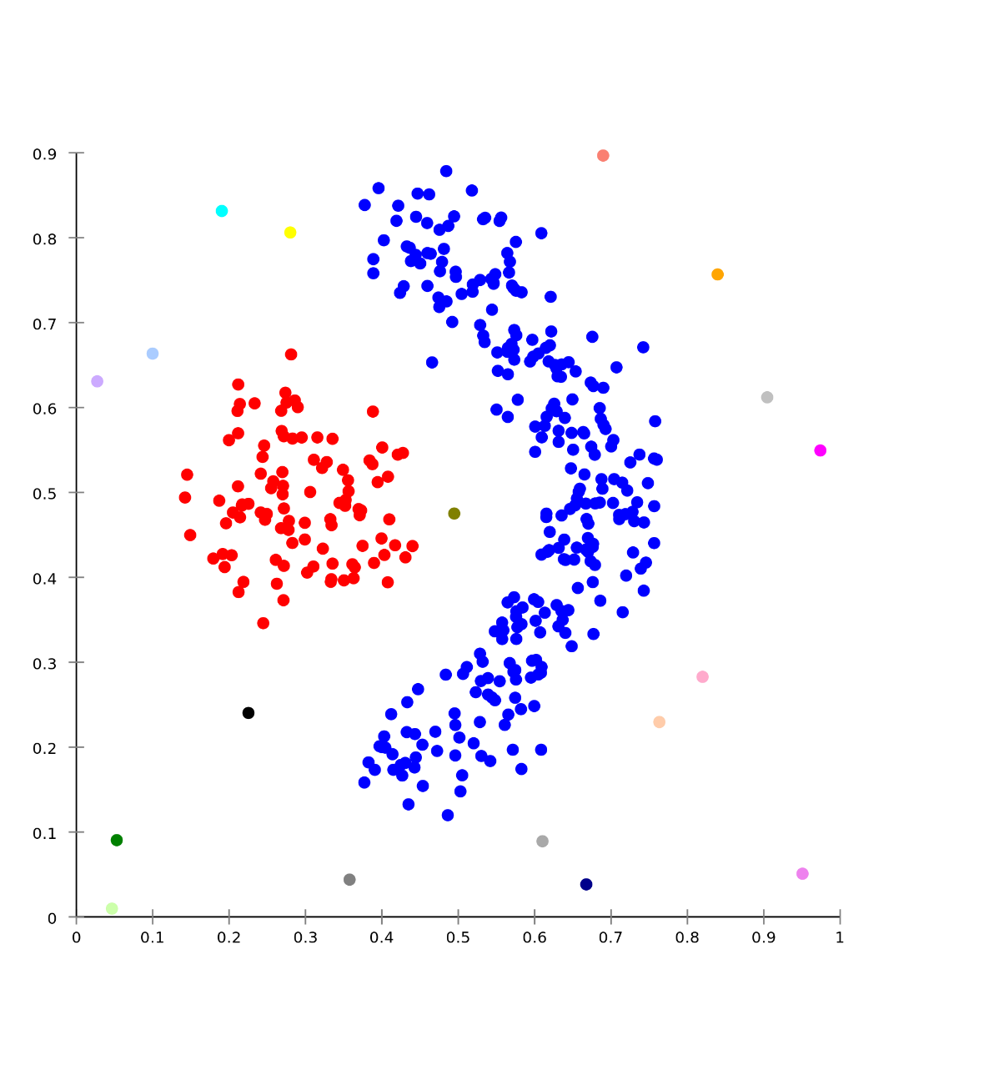
Density based Clustering
Based on density connected points
Locates regions of high density separated by regions of low density
e.g., DBSCAN

Slide 14
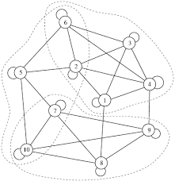
Graph Theoretic Clustering
Weights of edges between items (nodes) based on similarity
E.g., look for minimum cut in a graph

Slide 15
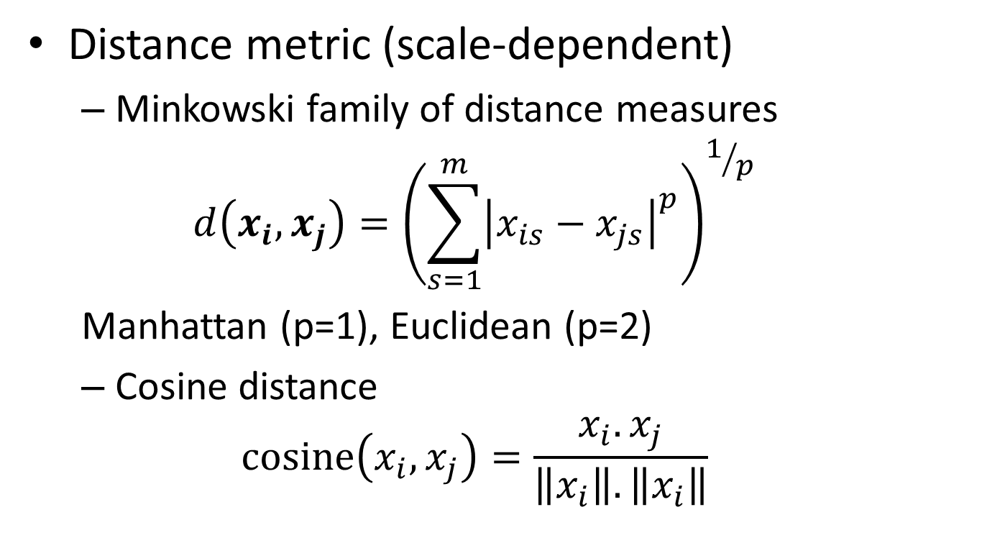
(Dis)similarity measures
Distance metric (scale-dependent)
Minkowski family of distance measures
$$d\left(x_{i},x_{j}\right)={\left(\sum_{s=1}^{m}{{\left|x_{is}−x_{js}\right|}^{p}}\right)}^{1/p}$$
Manhattan (p=1), Euclidean (p=2)
Cosine distance
$$cosine\left(x_{i},x_{j}\right)=\frac{x_{i}.x_{j}}{\left\|x_{i}\right\|.\left\|x_{i}\right\|}$$

Slide 16
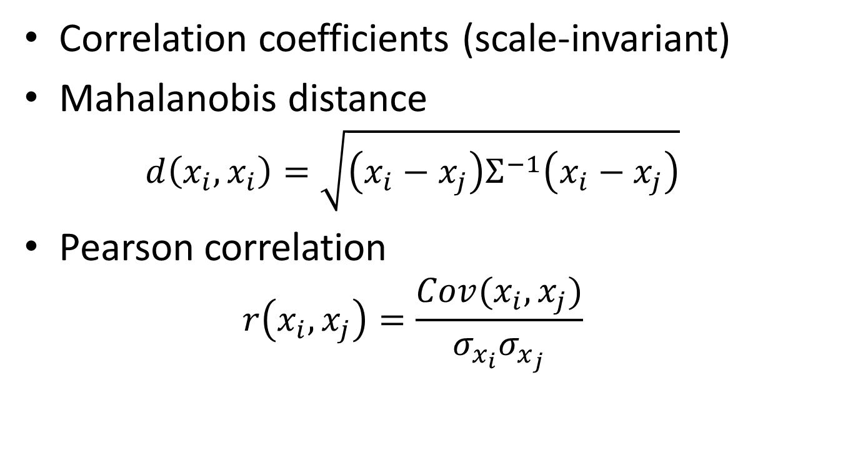
(Dis)similarity measures
Correlation coefficients (scale-invariant)
Mahalanobis distance
$$d\left(x_{i},x_{i}\right)=\sqrt{\left(x_{i}−x_{j}\right)Σ^{−1}\left(x_{i}−x_{j}\right)}$$
Pearson correlation
$$r\left(x_{i},x_{j}\right)=\frac{Cov(x_{i},x_{j})}{σ_{x_{i}}σ_{x_{j}}}$$

Slide 17
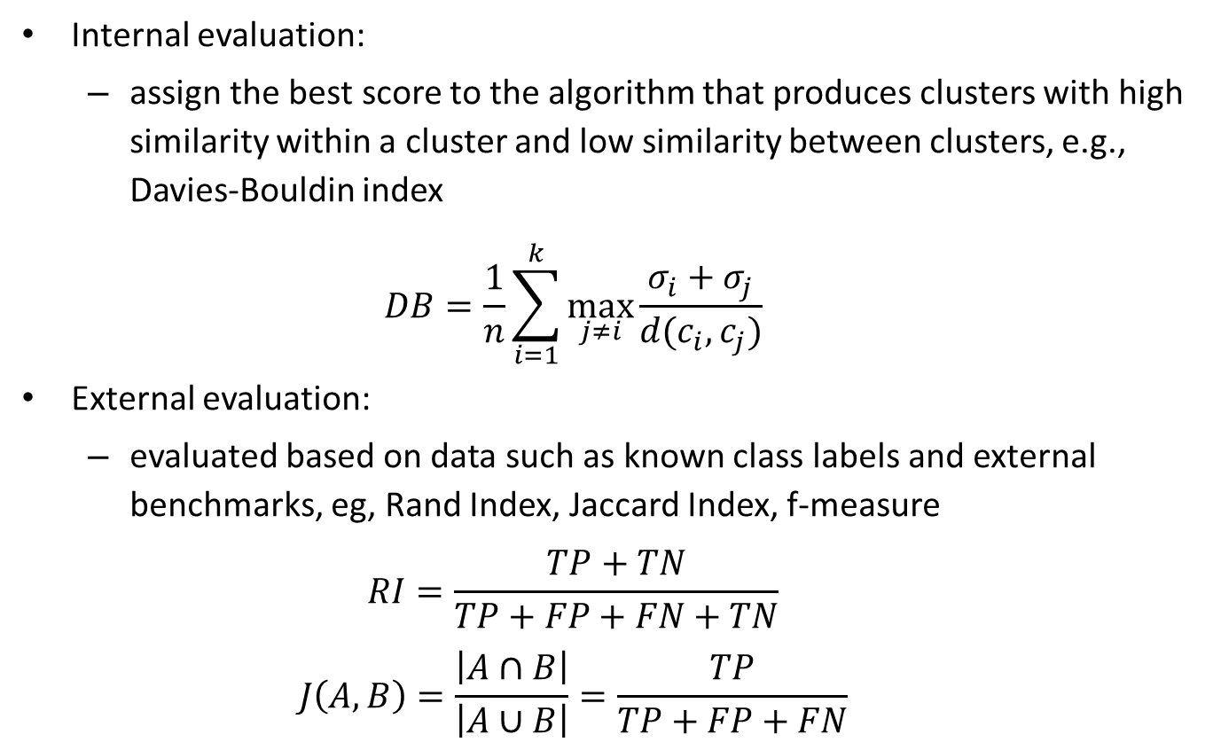
Quality of Clustering
Internal evaluation:
assign the best score to the algorithm that produces clusters with high similarity within a cluster and low similarity between clusters, e.g., Davies-Bouldin index
$$DB=\frac{1}{n}\sum_{i=1}^{k}{\max_{j≠i}{\frac{σ_{i}+σ_{j}}{d(c_{i},c_{j})}}}$$
External evaluation:
evaluated based on data such as known class labels and external benchmarks, eg, Rand Index, Jaccard Index, f-measure
$$RI=\frac{TP+TN}{TP+FP+FN+TN}$$
$$J\left(A,B\right)=\frac{\left|A∩B\right|}{\left|A∪B\right|}=\frac{TP}{TP+FP+FN}$$

Slide 18
Thank You

