Slide 1
Foundations of Machine Learning
Module 9: Clustering
Part B: kmeans clustering
Sudeshna Sarkar
IIT Kharagpur

Slide 2
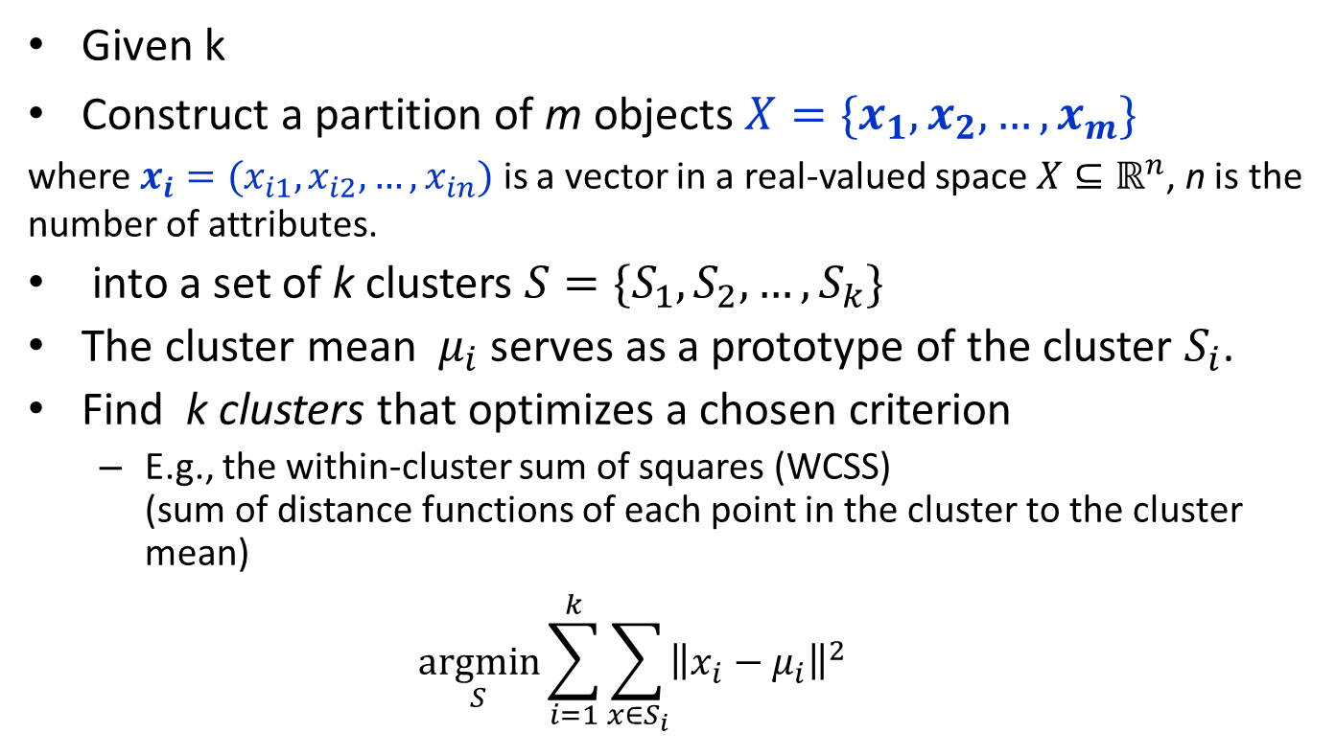
Partitioning Algorithms
Given k
Construct a partition of m objects $X=\{x_{1},x_{2},…,x_{m}\}$
where $x_{i}=(x_{i1},x_{i2},…,x_{in})$ is a vector in a real-valued space $X⊆ℝ^{n}$, n is the number of attributes.
into a set of k clusters $S=\{S_{1},S_{2},…,S_{k}\}$
The cluster mean $μ_{i}$ serves as a prototype of the cluster $S_{i}$.
Find k clusters that optimizes a chosen criterion
E.g., the within-cluster sum of squares (WCSS) (sum of distance functions of each point in the cluster to the cluster mean)
$$\underset{S}{argmin}{\sum_{i=1}^{k}{\sum_{x∈S_{i}}{{\left\|x_{i}−μ_{i}\right\|}^{2}}}}$$
Heuristic method: k-means (MacQueen, 1967)

Slide 3
K-means algorithm
Given k
Randomly choose k data points (seeds) to be the initial cluster centres
Assign each data point to the closest cluster centre
Re-compute the cluster centres using the current cluster memberships.
If a convergence criterion is not met, go to 2.

Slide 4
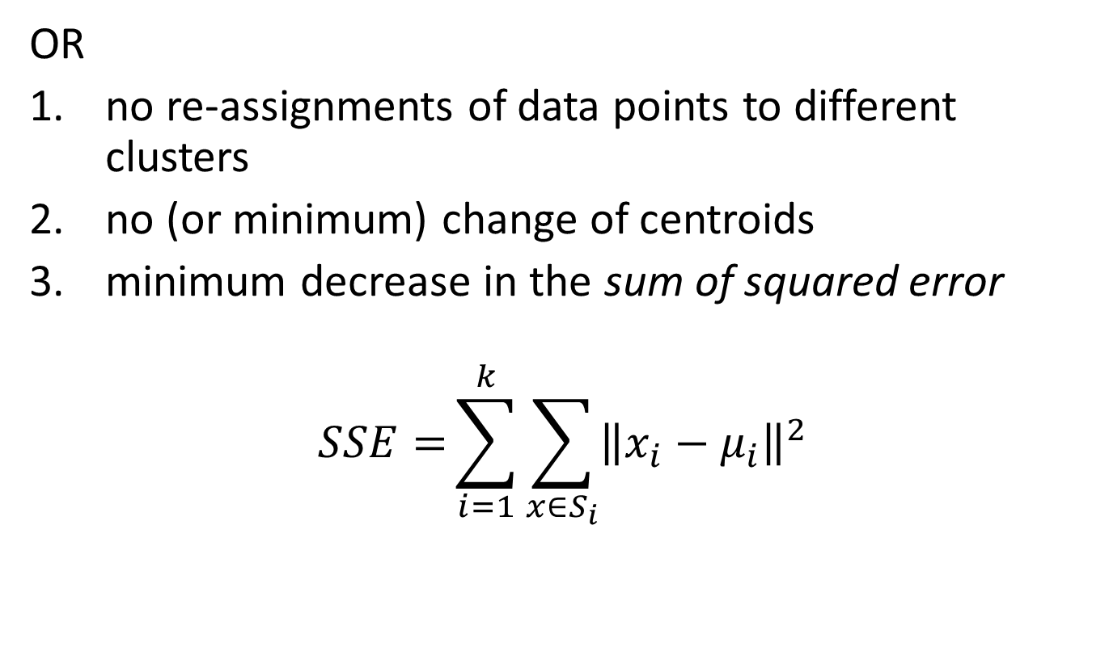
Stopping/convergence criterion
OR
no re-assignments of data points to different clusters
no (or minimum) change of centroids
minimum decrease in the sum of squared error
$$SSE={\sum_{i=1}^{k}{\sum_{x∈S_{i}}{{\left\|x_{i}−μ_{i}\right\|}^{2}}}}$$

Slide 5
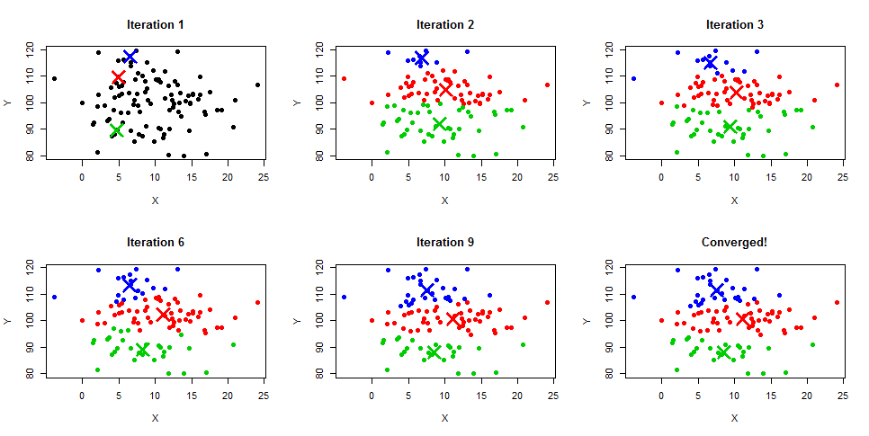
Kmeans illustrated

Slide 6
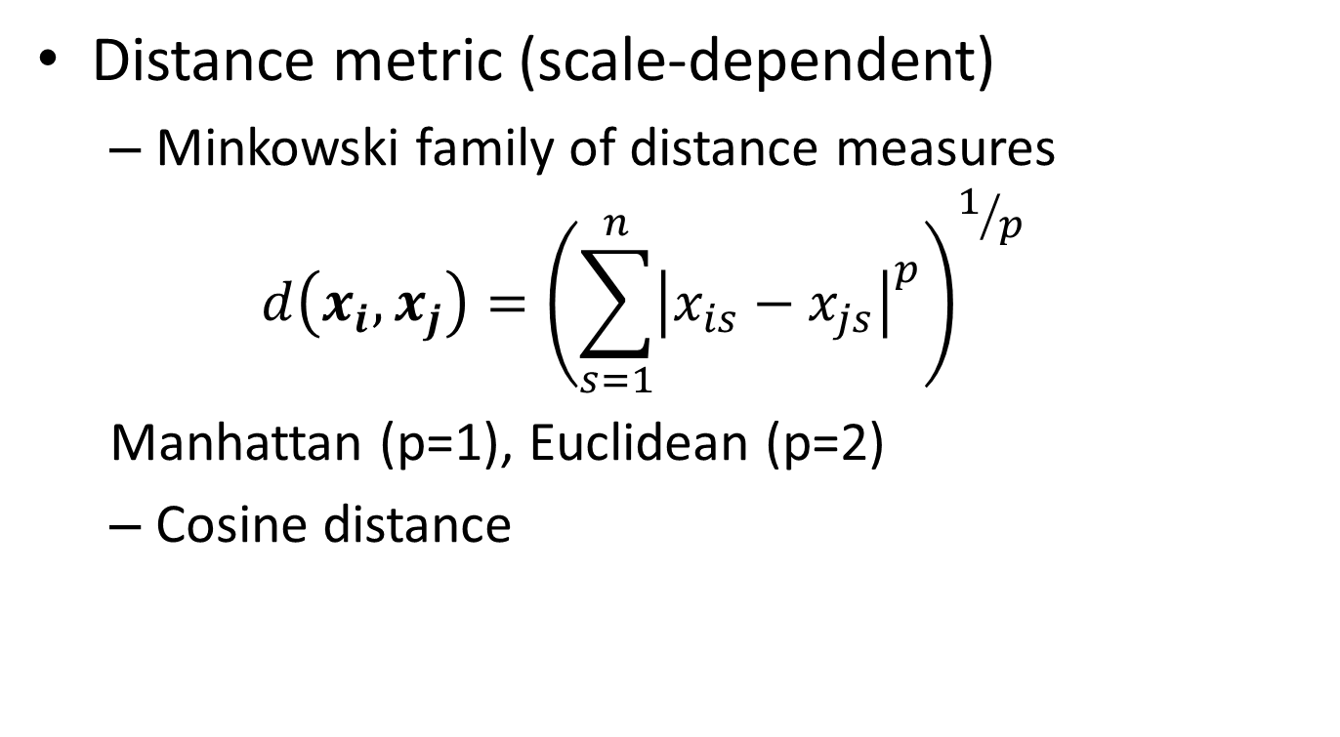
Similarity / Distance measures
Distance metric (scale-dependent)
Minkowski family of distance measures
$$d\left(x_{i},x_{j}\right)={\left(\sum_{s=1}^{n}{{\left|x_{is}−x_{js}\right|}^{p}}\right)}^{1/p}$$
Manhattan (p=1), Euclidean (p=2)
Cosine distance

Slide 7
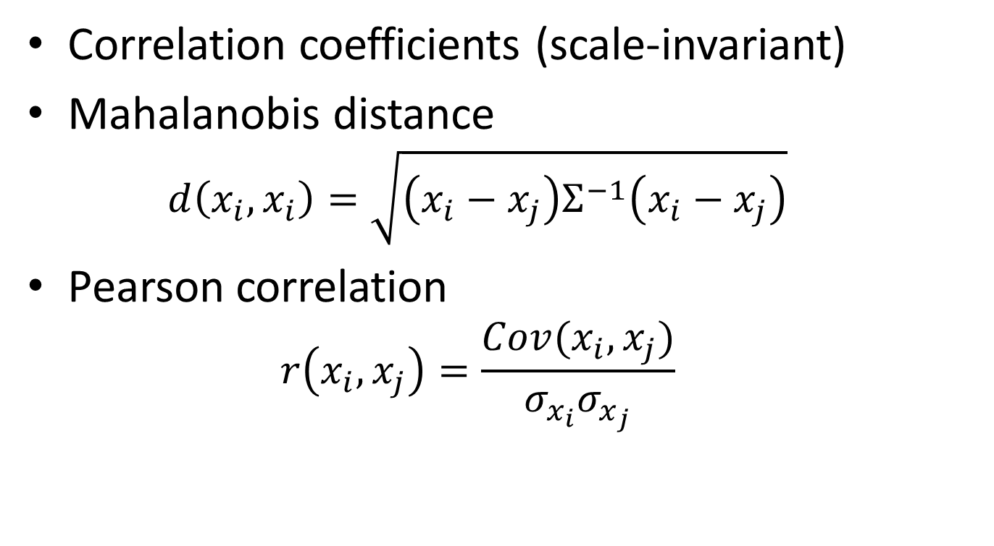
Similarity / Distance measures
Correlation coefficients (scale-invariant)
Mahalanobis distance
$$d\left(x_{i},x_{i}\right)=\sqrt{\left(x_{i}−x_{j}\right)Σ^{−1}\left(x_{i}−x_{j}\right)}$$
Pearson correlation
$$r\left(x_{i},x_{j}\right)=\frac{Cov(x_{i},x_{j})}{σ_{x_{i}}σ_{x_{j}}}$$

Slide 8
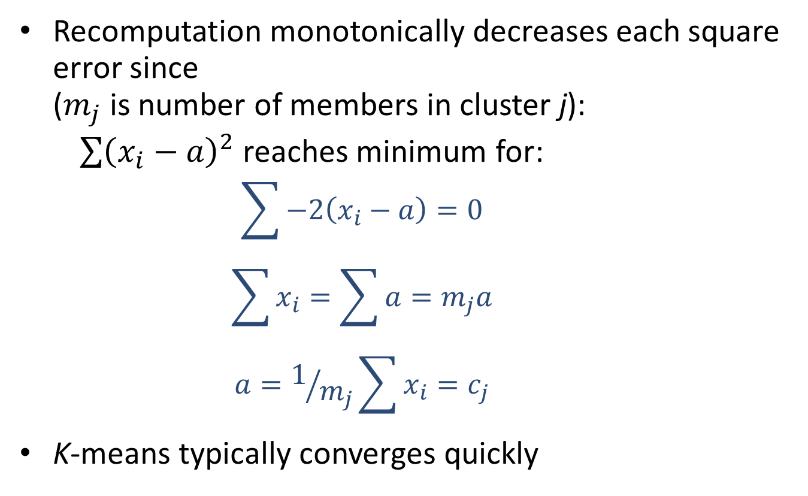
Convergence of K-Means
Recomputation monotonically decreases each square error since ($m_{j}$ is number of members in cluster j):
$\sum{{\left(x_{i}−a\right)}^{2}}$ reaches minimum for:
$$\sum{−2\left(x_{i}−a\right)=0}$$
$$\sum{x_{i}}=\sum{a=m_{j}a}$$
$$a=1/{m_{j}}\sum{x_{i}}=c_{j}$$
K-means typically converges quickly

Slide 9
Time Complexity
Computing distance between two items is O(n) where n is the dimensionality of the vectors.
Reassigning clusters: O(km) distance computations, or O(kmn).
Computing centroids: Each item gets added once to some centroid: O(mn).
Assume these two steps are each done once for t iterations: O(tknm).

Slide 10
Advantages
Fast, robust easy to understand.
Relatively efficient: O(tkmn)
Gives best result when data set are distinct or well separated from each other.

Slide 11
Disadvantages
Requires apriori specification of the number of cluster centers.
Hard assignment of data points to clusters
Euclidean distance measures can unequally weight underlying factors.
Applicable only when mean is defined i.e. fails for categorical data.
Only local optima

Slide 12
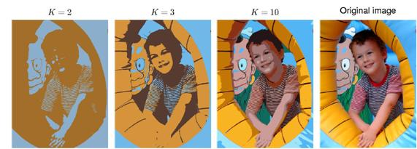
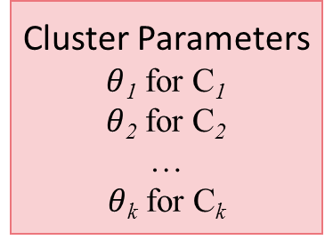
K-Means on RGB image
x₁={r₁, g₁, b₁}
x₂={r₂, g₂, b₂}
…
x_{i}={r_{i}, g_{i}, b_{i}}
…
Classification Results
x₁→C(x₁)
x₂→C(x₂)
…
x_{i}→C(x_{i})
…
Classifier
(K-Means)
Cluster Parameters
$θ$₁ for C₁
$θ$₂ for C₂
…
$θ$_{k} for C_{k}
example from Bishop’s Book

Slide 13
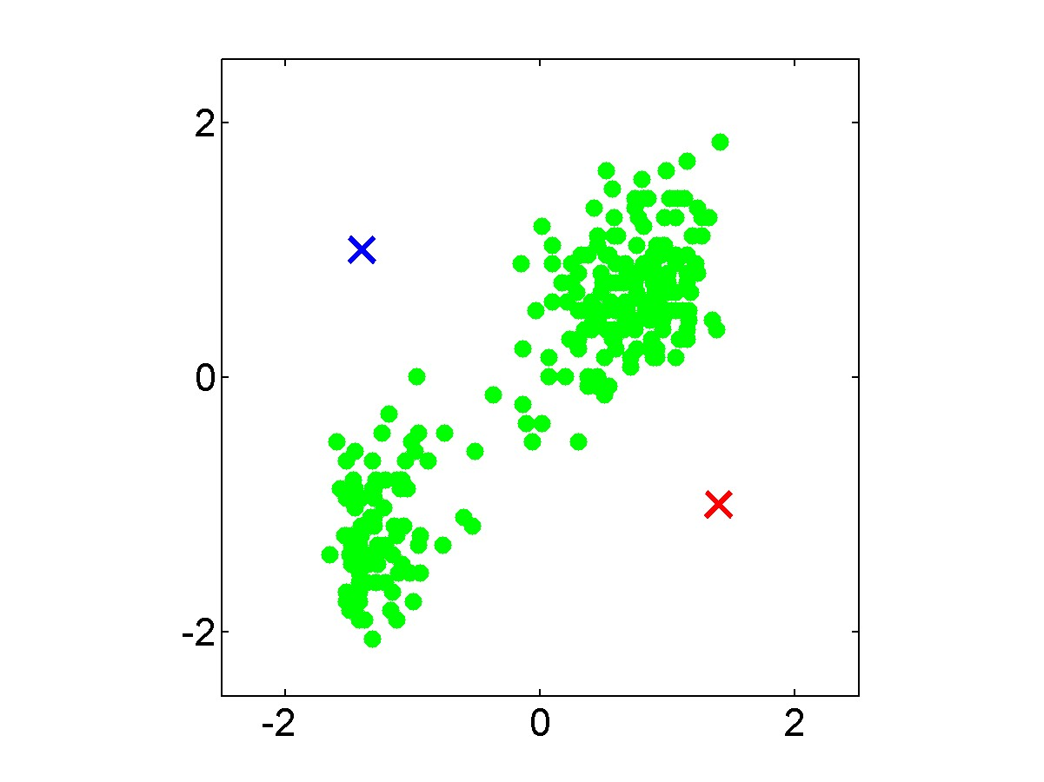
example from Bishop’s Book

Slide 14
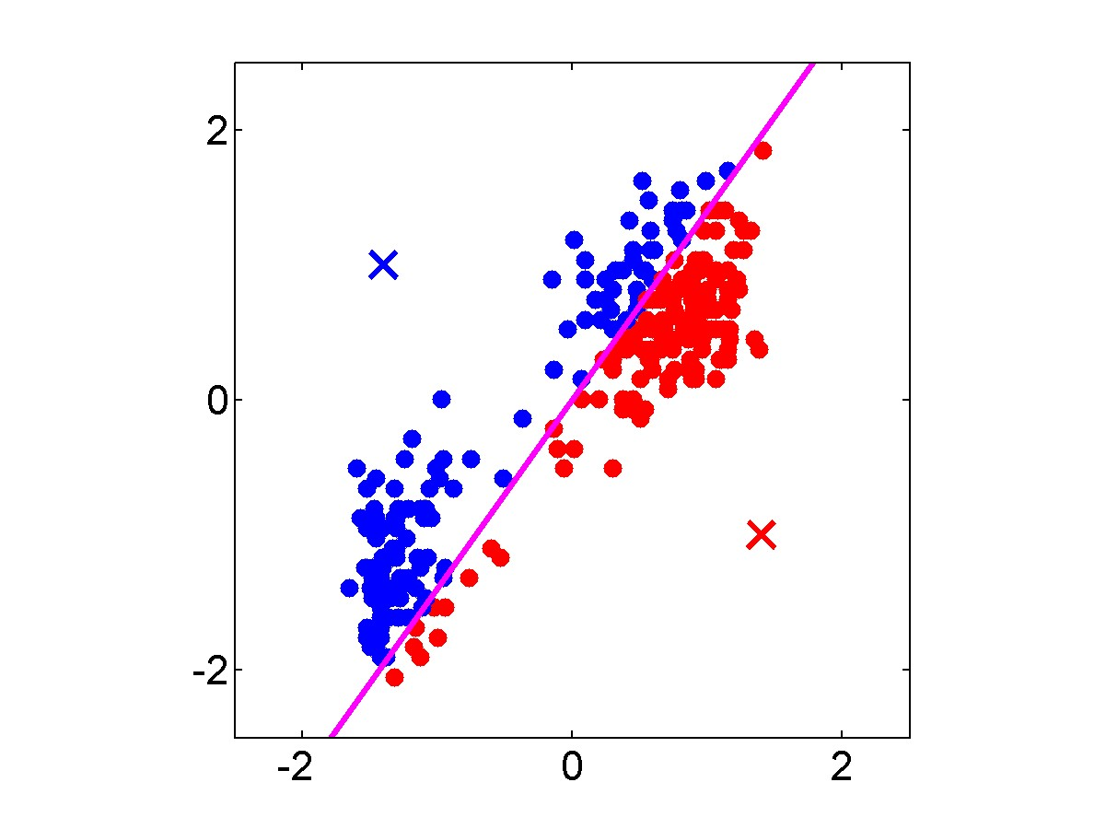
example from Bishop’s Book

Slide 15
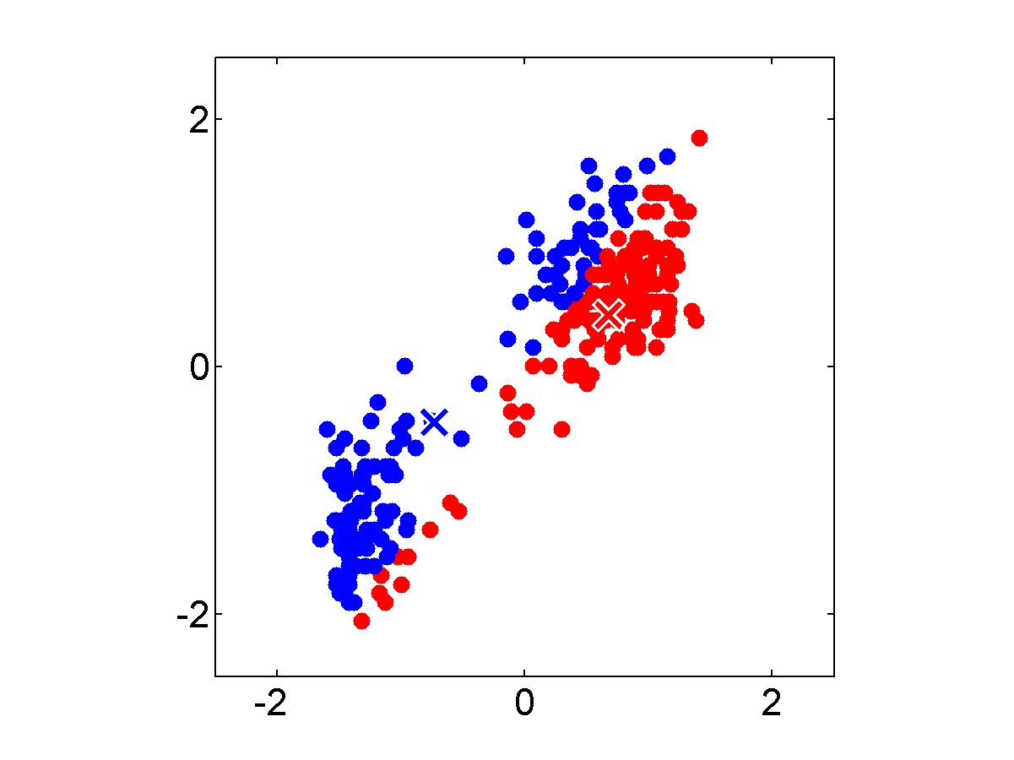
example from Bishop’s Book

Slide 16
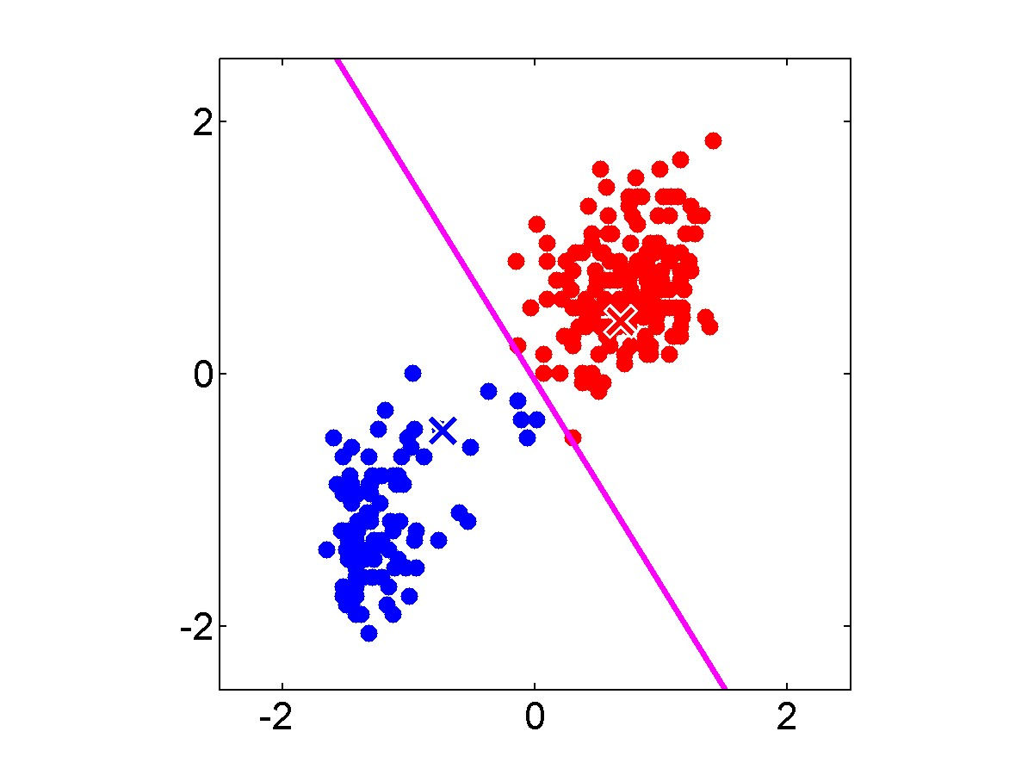
example from Bishop’s Book

Slide 17

example from Bishop’s Book

Slide 18
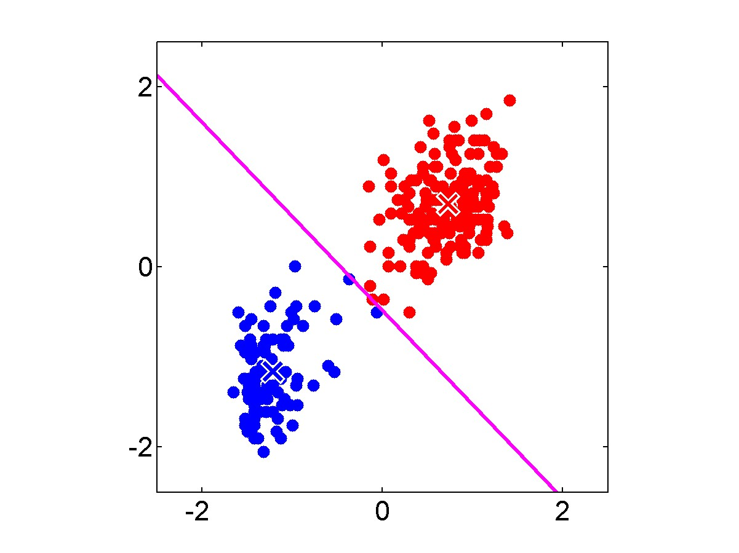

Slide 19

example from Bishop’s Book

Slide 20

example from Bishop’s Book

Slide 21

example from Bishop’s Book

Slide 22
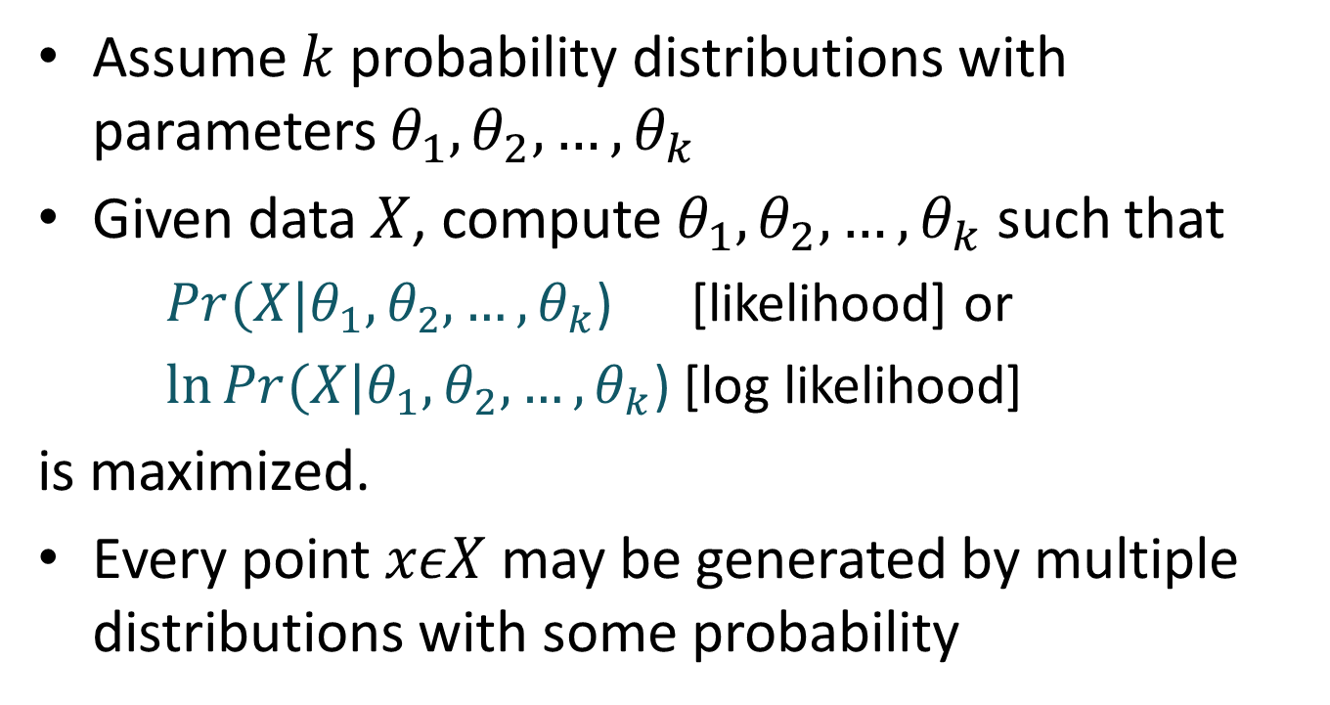
Model-based clustering
Assume $k$ probability distributions with parameters $θ_{1},θ_{2},…,θ_{k}$
Given data $X$, compute $θ_{1},θ_{2},…,θ_{k}$ such that
$Pr(X|θ_{1},θ_{2},…,θ_{k}$) [likelihood] or
$\ln{Pr(X|θ_{1},θ_{2},…,θ_{k}\text{)}}$ [log likelihood]
is maximized.
Every point $xεX$ may be generated by multiple distributions with some probability

Slide 23
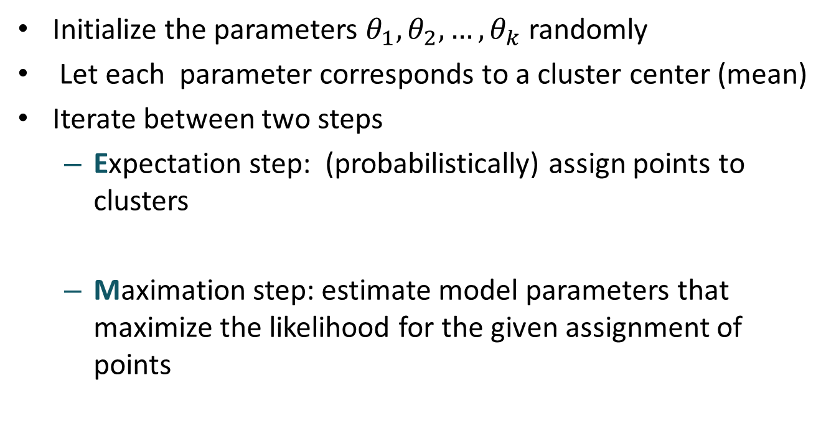
EM Algorithm
Initialize the parameters $θ_{1},θ_{2},…,θ_{k}$ randomly
Let each parameter corresponds to a cluster center (mean)
Iterate between two steps
Expectation step: (probabilistically) assign points to clusters
Maximation step: estimate model parameters that maximize the likelihood for the given assignment of points

Slide 24
EM Algorithm
Expectation step: (probabilistically) assign points to clusters
compute Prob(point|mean)
Prob(mean|point) = Prob(mean) Prob(point|mean) / Prob(point)
Maximation step: estimate model parameters that maximize the likelihood for the given assignment of points
Each mean = Weighted avg. of points
Weight = Prob(mean|point)

Slide 25
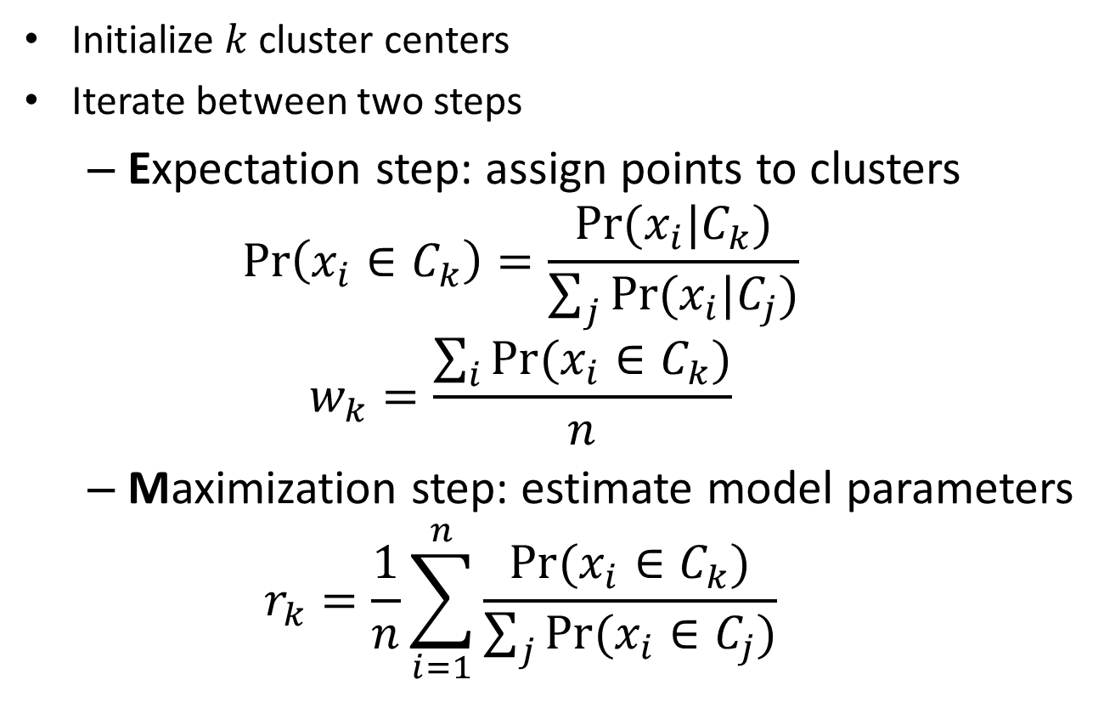
EM Algorithm
Initialize $k$ cluster centers
Iterate between two steps
Expectation step: assign points to clusters
$$\operatorname{Pr}\left(x_{i}∈C_{k}\right)=\frac{Pr⁡(x_{i}|C_{k})}{\sum_{j}{Pr⁡(x_{i}|C_{j})}}$$
$$w_{k}=\frac{\sum_{i}{Pr⁡(x_{i}∈C_{k})}}{n}$$
Maximization step: estimate model parameters
$$r_{k}=\frac{1}{n}\sum_{i=1}^{n}{\frac{Pr⁡(x_{i}∈C_{k})}{\sum_{j}{Pr⁡(x_{i}∈C_{j})}}}$$

Slide 26
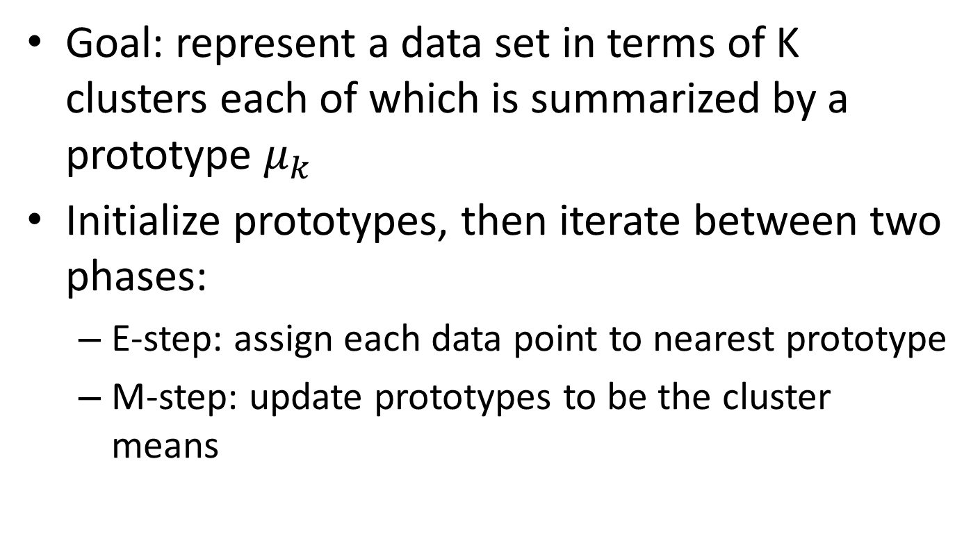
K-means Algorithm
Goal: represent a data set in terms of K clusters each of which is summarized by a prototype $μ_{k}$
Initialize prototypes, then iterate between two phases:
E-step: assign each data point to nearest prototype
M-step: update prototypes to be the cluster means

Slide 27
Thank You

