Slide 1
Foundations of Machine Learning
Module 9: Clustering
Part C: Hierarchical Clustering
Sudeshna Sarkar
IIT Kharagpur

Slide 2
Hierarchical Clustering
animal
vertebrate
invertebrate
fish reptile amphib. mammal worm insect crustacean
Produce a nested sequence of clusters.
One approach: recursive application of a partitional clustering algorithm.

Slide 3
Types of hierarchical clustering
Agglomerative (bottom up) clustering: It builds the dendrogram (tree) from the bottom level, and
merges the most similar (or nearest) pair of clusters
stops when all the data points are merged into a single cluster (i.e., the root cluster).
Divisive (top down) clustering: It starts with all data points in one cluster, the root.
Splits the root into a set of child clusters. Each child cluster is recursively divided further
stops when only singleton clusters of individual data points remain, i.e., each cluster with only a single point

Slide 4
Dendrogram: Hierarchical Clustering
Dendrogram
Given an input set S
nodes represent subsets of S
Features of the tree:
The root is the whole input set S.
The leaves are the individual elements of S.
The internal nodes are defined as the union of their children.
4

Slide 5
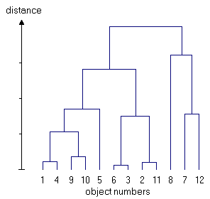
Dendrogram: Hierarchical Clustering
Dendrogram
Each level of the tree represents a partition of the input data into several (nested) clusters or groups.
May be cut at any level: Each connected component forms a cluster.
5

Slide 6
Hierarchical clustering

Slide 7
Hierrarchical Agglomerative clustering
Initially each data point forms a cluster.
Compute the distance matrix between the clusters.
Repeat
Merge the two closest clusters
Update the distance matrix
Until only a single cluster remains.
Different definitions of the distance leads to different algorithms.

Slide 8
Initialization
Each individual point is taken as a cluster
Construct distance/proximity matrix
p1
p2
p3
p4
p5
. . .
p1
p2
p3
p4
p5
.
.
.
Distance/Proximity Matrix

Slide 9
Intermediate State
After some merging steps, we have some clusters
C1
C2
C3
C4
C5
C1
C2
C3
C3
C4
C4
C5
C1
Distance/Proximity Matrix
C2
C5

Slide 10
Intermediate State
Merge the two closest clusters (C2 and C5) and update the distance matrix.
C1
C2
C3
C4
C5
C1
C3
C2
C4
C3
C4
C5
C1
Distance/Proximity Matrix
C2
C5

Slide 11
After Merging
Update the distance matrix
C2 U C5
C1
C3
C4
C3
C1
?
C4
C2 U C5
? ? ? ?
C3
?
C1
C4
?
C2 U C5

Slide 12

Closest Pair
A few ways to measure distances of two clusters.
Single-link
Similarity of the most similar (single-link)
Complete-link
Similarity of the least similar points
Centroid
Clusters whose centroids (centers of gravity) are the most similar
Average-link
Average cosine between pairs of elements

Slide 13
Distance between two clusters
Single-link distance between clusters C_{i} and C_{j} is the minimum distance between any object in C_{i} and any object in C_{j}

Slide 14
Single Link Example
It Can result in “straggly” (long and thin) clusters due to chaining effect.

Slide 15
Single-link clustering: example
Determined by one pair of points, i.e., by one link in the proximity graph.
1
2
3
4
5

Slide 16
Complete link method
The distance between two clusters is the distance of two furthest data points in the two clusters.
Makes “tighter,” spherical clusters that are typically preferable.
It is sensitive to outliers because they are far away

Slide 17
Complete-link clustering: example
Distance between clusters is determined by the two most distant points in the different clusters
1
2
3
4
5

Slide 18
Complete Link Example

Slide 19
Computational Complexity
In the first iteration, all HAC methods need to compute similarity of all pairs of N initial instances, which is O(N²).
In each of the subsequent N−2 merging iterations, compute the distance between the most recently created cluster and all other existing clusters.
In order to maintain an overall O(N²) performance, computing similarity to each other cluster must be done in constant time.
Often O(N³) if done naively or O(N² log N) if done more cleverly

Slide 20
Average Link Clustering
Similarity of two clusters = average similarity between any object in Ci and any object in Cj
Compromise between single and complete link. Less susceptible to noise and outliers.
Two options:
Averaged across all ordered pairs in the merged cluster
Averaged over all pairs between the two original clusters

Slide 21
The complexity
All the algorithms are at least O(n²). n is the number of data points.
Single link can be done in O(n²).
Complete and average links can be done in O(n²logn).
Due the complexity, hard to use for large data sets.

Slide 22
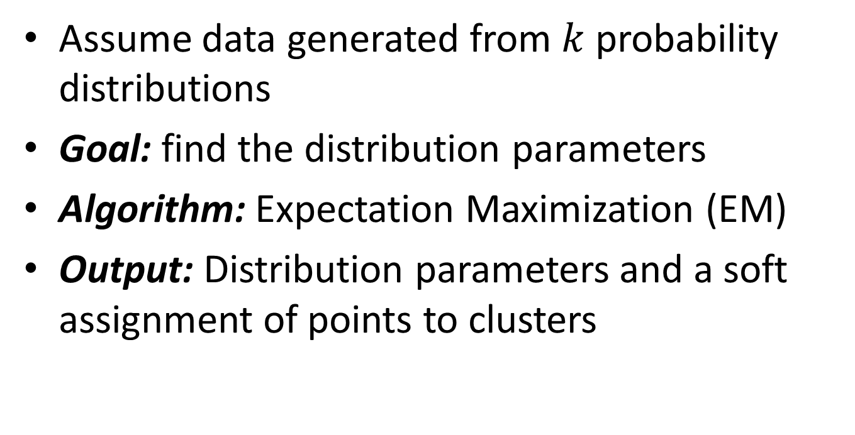
Model-based clustering
Assume data generated from $k$ probability distributions
Goal: find the distribution parameters
Algorithm: Expectation Maximization (EM)
Output: Distribution parameters and a soft assignment of points to clusters

Slide 23
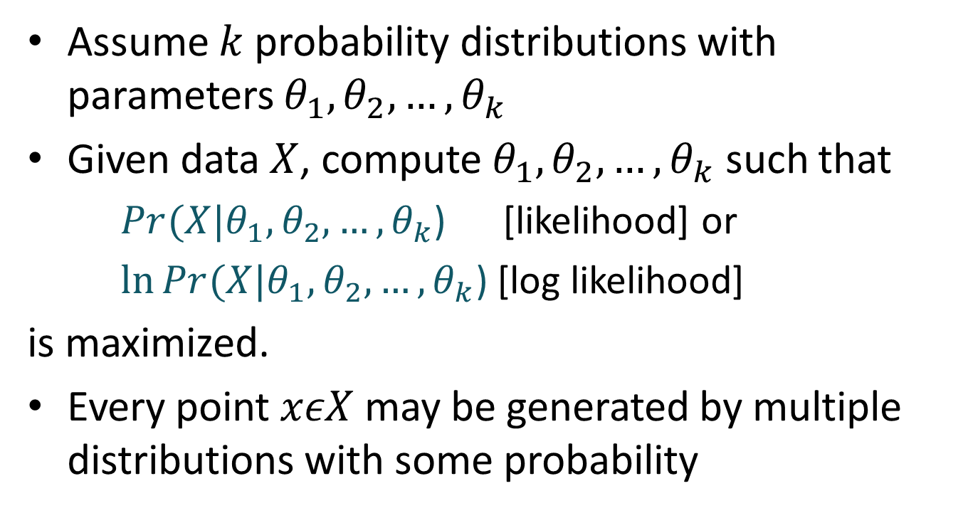
Model-based clustering
Assume $k$ probability distributions with parameters $θ_{1},θ_{2},…,θ_{k}$
Given data $X$, compute $θ_{1},θ_{2},…,θ_{k}$ such that
$Pr(X|θ_{1},θ_{2},…,θ_{k}$) [likelihood] or
$\ln{Pr(X|θ_{1},θ_{2},…,θ_{k}\text{)}}$ [log likelihood]
is maximized.
Every point $xεX$ may be generated by multiple distributions with some probability

Slide 24
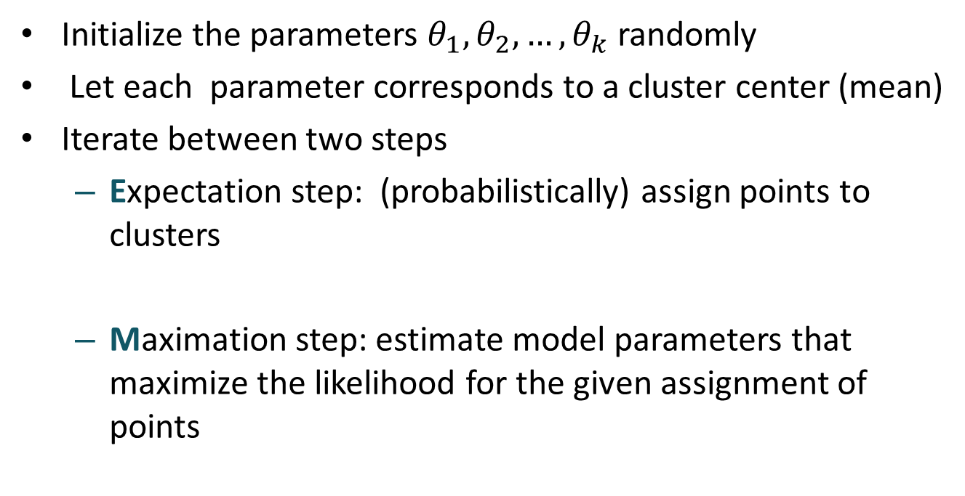
EM Algorithm
Initialize the parameters $θ_{1},θ_{2},…,θ_{k}$ randomly
Let each parameter corresponds to a cluster center (mean)
Iterate between two steps
Expectation step: (probabilistically) assign points to clusters
Maximation step: estimate model parameters that maximize the likelihood for the given assignment of points

Slide 25
EM Algorithm
Expectation step: (probabilistically) assign points to clusters
compute Prob(point|mean)
Prob(mean|point) = Prob(mean) Prob(point|mean) / Prob(point)
Maximation step: estimate model parameters that maximize the likelihood for the given assignment of points
Each mean = Weighted avg. of points
Weight = Prob(mean|point)

Slide 26
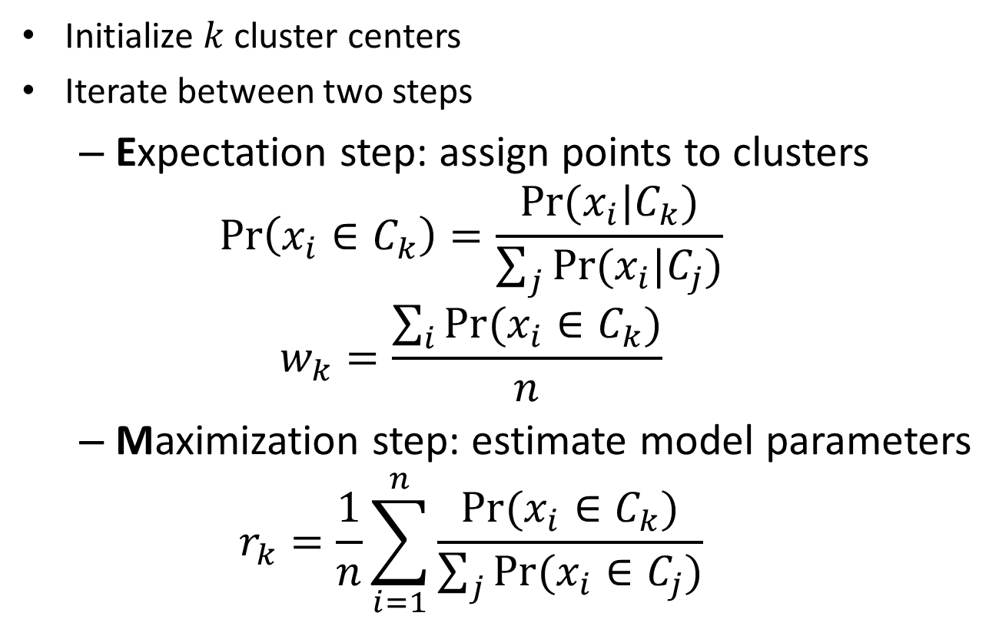
EM Algorithm
Initialize $k$ cluster centers
Iterate between two steps
Expectation step: assign points to clusters
$$\operatorname{Pr}\left(x_{i}∈C_{k}\right)=\frac{Pr⁡(x_{i}|C_{k})}{\sum_{j}{Pr⁡(x_{i}|C_{j})}}$$
$$w_{k}=\frac{\sum_{i}{Pr⁡(x_{i}∈C_{k})}}{n}$$
Maximization step: estimate model parameters
$$r_{k}=\frac{1}{n}\sum_{i=1}^{n}{\frac{Pr⁡(x_{i}∈C_{k})}{\sum_{j}{Pr⁡(x_{i}∈C_{j})}}}$$

Slide 27
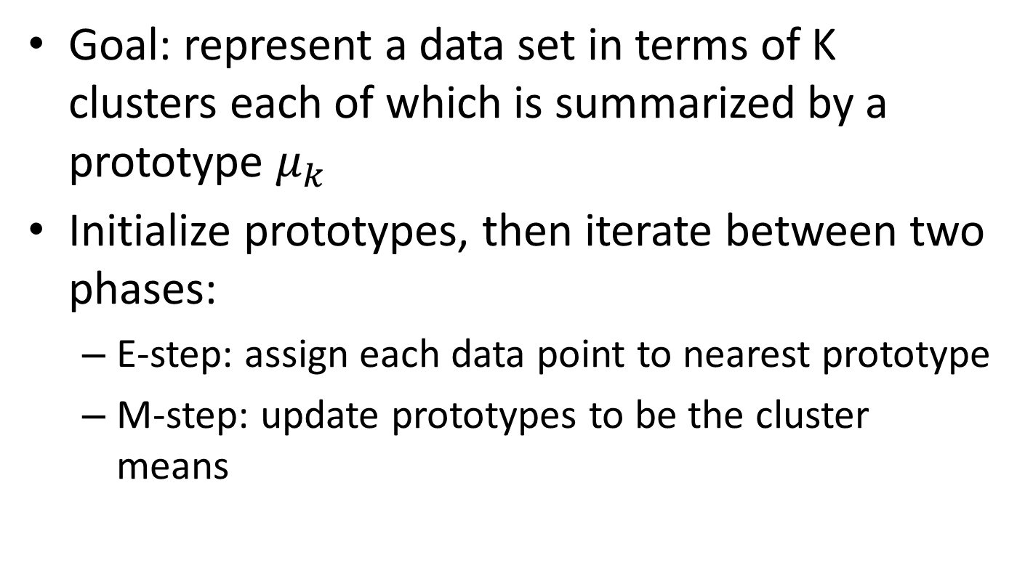
K-means Algorithm
Goal: represent a data set in terms of K clusters each of which is summarized by a prototype $μ_{k}$
Initialize prototypes, then iterate between two phases:
E-step: assign each data point to nearest prototype
M-step: update prototypes to be the cluster means

Slide 28
Thank You

