Slide 1
Azure Lab

Slide 2
Présrequis

Slide 3
Portal & CLI

Slide 4
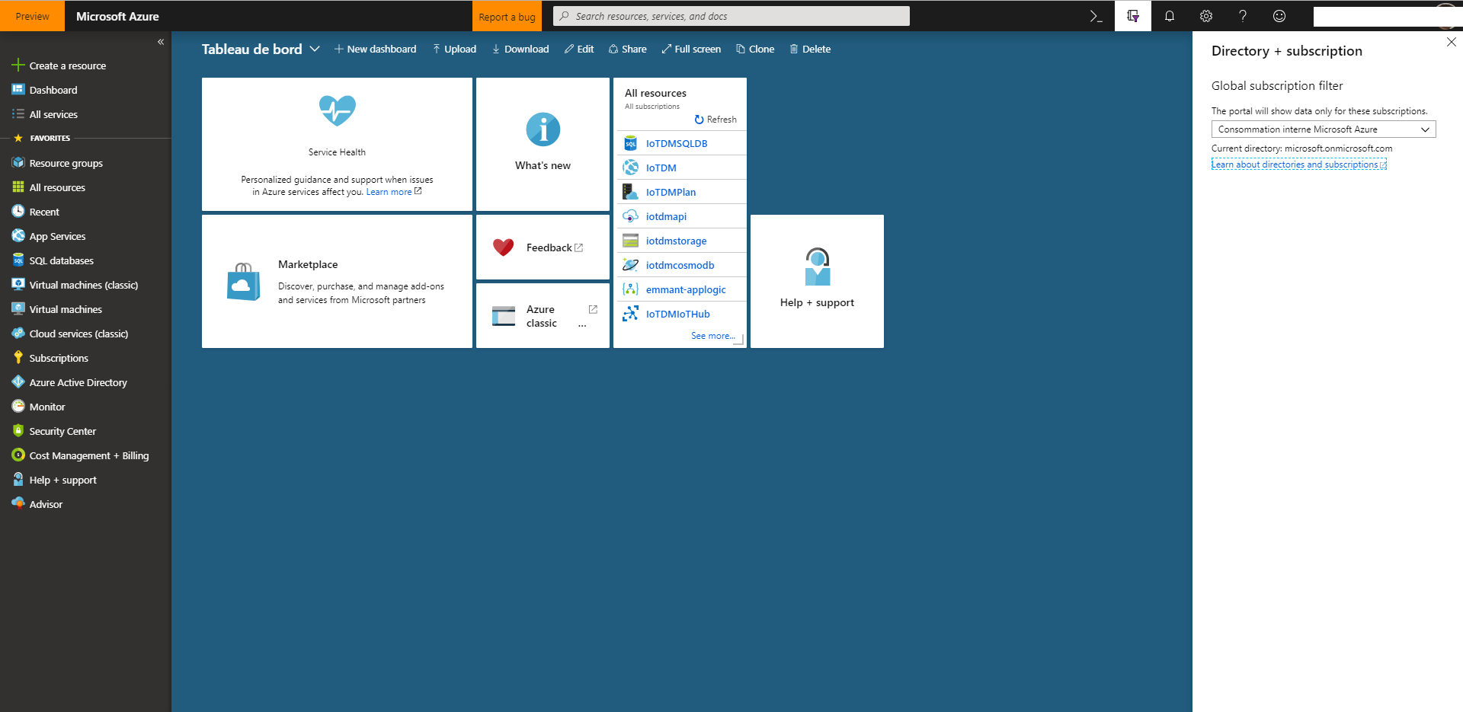
Portal & CLI
Azure Portal: discovered the web interface
Principal menu
Search
CLI
Directories
Settings
Account
Add a ressource
Ressource groups
Subscriptions
All ressources
Dashboard

Slide 5
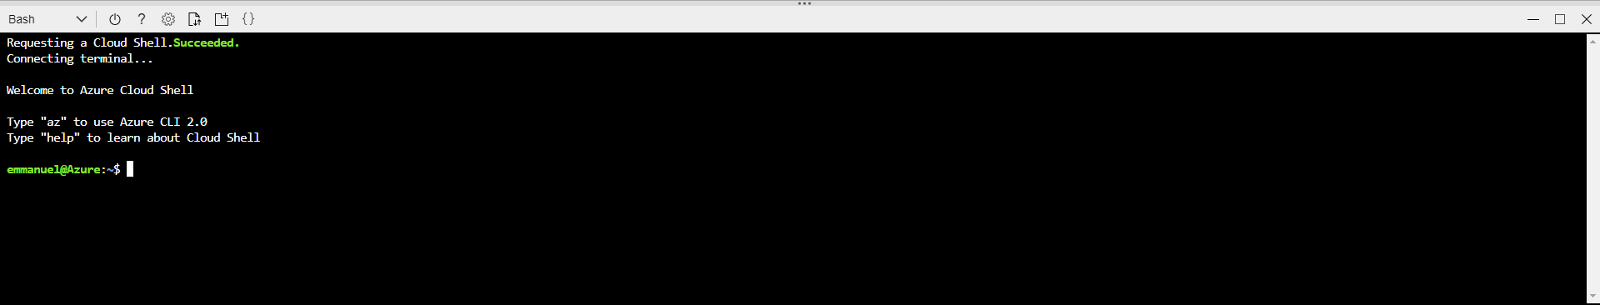
Portal & CLI
Azure Portal: launch CLI from the portal
CLI
Shell choice
Upload a file
Open editor

Slide 6
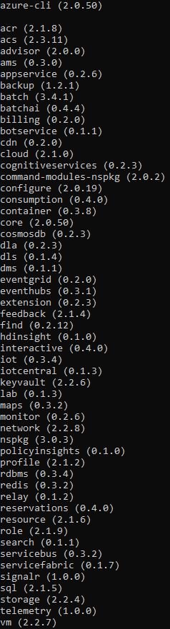
Portal & CLI
Azure CLI: install the command line tool
# Click on the weblink and install the tool
https://docs.microsoft.com/en-us/cli/azure/install-azure-cli?view=azure-cli-latest
# Show versions
az --version
Azure CLI Install

Slide 7
Portal & CLI
Azure CLI: install and connect to Azure in command line
# Connect to Azure (sign-in into the browser)
az login
# List all subscription
az account list
# Set a active subscription
az account set ––subscription {id}
Azure CLI Subscriptions
Azure CLI Sign-in

Slide 8
Resource Groups

Slide 9
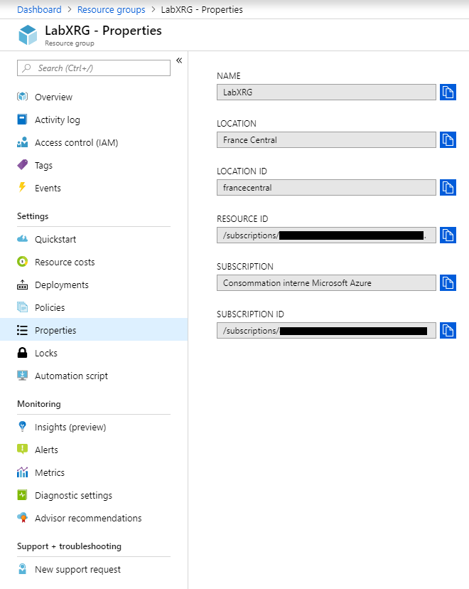
Resources Groups
Resource Group: create, list and delete
# Create a resource group
az group create --name LabXRG --location francecentral
# List all resource groups
az group list
# Add tags on the resource group
az group update -n LabXRG --set tags.Environment=Test tags.Dept=IT
# Delete a resource group
az group delete -n LabXRG
# Create a resource group for the suite
az group create --name LabXRG --location francecentral
Manage Resource Group with Azure Portal

Slide 10
Storage

Slide 11
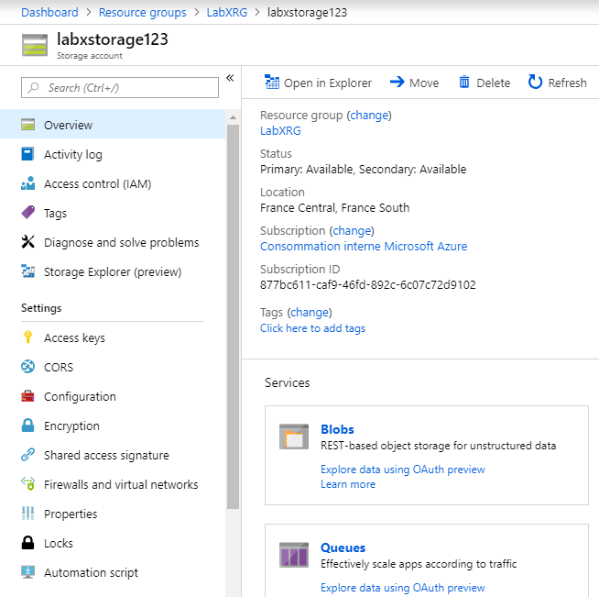
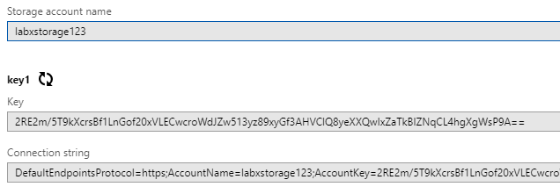
Storage
Storage account: create, list, delete and renew keys
# Create a general-purpose standard storage account
az storage account create --name labxstorage --resource-group LabXRG --location francecentral --sku Standard_RAGRS --encryption blob
# List the storage account access keys
az storage account keys list -g LabXRG --account-name labxstorage
# Renew (rotate) the PRIMARY access key
az storage account keys renew –g LabXRG --account-name labxstorage --key primary
# Renew (rotate) the SECONDARY access key
az storage account keys renew –g LabXRG --account-name labxstorage --key secondary
# Delete the storage account
az storage account delete -g LabXRG -n labxstorage --yes
Azure Storage Overview

Slide 12
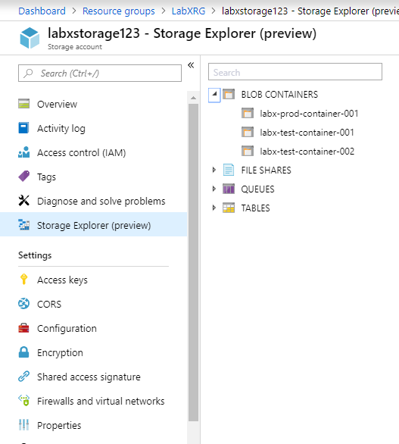
Storage
Storage container: create, list and delete
# Set variables of the storage account
export AZURE_STORAGE_ACCOUNT=labxstorage
export AZURE_STORAGE_ACCESS_KEY={primary_key}
# Create some test containers
az storage container create --name labx-test-container-001
az storage container create --name labx-test-container-002
az storage container create --name labx-prod-container-001
# List only the containers with a specific prefix
az storage container list --prefix "labx-test-" --query "[*].[name]" --output tsv
# Delete all containers start with "labx-test-“
for container in `az storage container list --prefix "labx-test-" --query "[*].[name]" --output tsv`; do
az storage container delete --name $container
done
# List all containers
az storage container list --output table

Slide 13
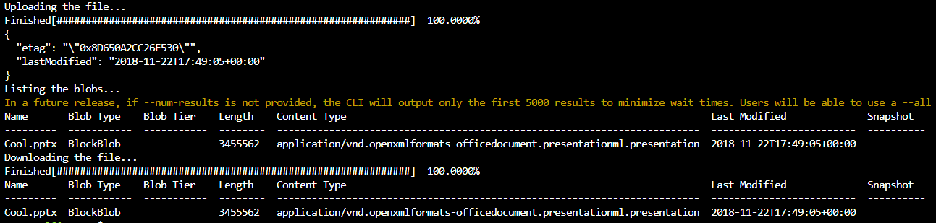
Storage
Storage blob: upload, list, download and delete
# Set variables
export AZURE_STORAGE_ACCOUNT="labxstorage"
export AZURE_STORAGE_KEY=<storage_account_key>
export container_name=labx-prod-container-001
export blob_name=labxfile.txt
export file_to_upload=<file_to_upload>
export destination_file=<destination_file>
# Upload file
echo "Uploading the file... "
az storage blob upload --container-name $container_name --file $file_to_upload --name $blob_name
# List blob
echo "Listing the blobs... "
az storage blob list --container-name $container_name --output table
# Downlink file
echo "Downloading the file... "
az storage blob download --container-name $container_name --name $blob_name --file $destination_file --output table

Slide 14
VM Networking

Slide 15
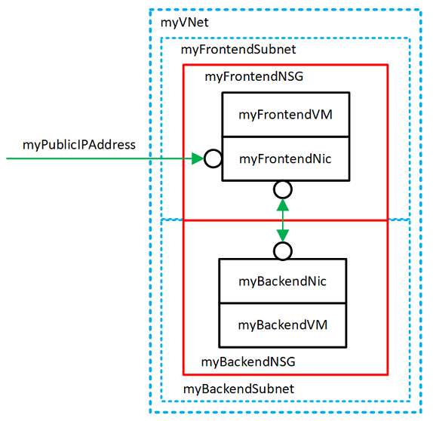
VM Networking
VM networking Overview
Azure virtual networks enable secure network connections between virtual machines, the internet, and other Azure services such as Azure SQL database. Virtual networks are broken down into logical segments called subnets. Subnets are used to control network flow, and as a security boundary. When deploying a VM, it generally includes a virtual network interface, which is attached to a subnet.
myVNet - The virtual network that the VMs use to communicate with each other and the internet.
myFrontendSubnet - The subnet in myVNet used by the front-end resources.
myPublicIPAddress - The public IP address used to access myFrontendVM from the internet.
myFrontentNic - The network interface used by myFrontendVM to communicate with myBackendVM.
myFrontendVM - The VM used to communicate between the internet and myBackendVM.
myBackendNSG - The network security group that controls communication between the myFrontendVM and myBackendVM.
myBackendSubnet - The subnet associated with myBackendNSG and used by the back-end resources.
myBackendNic - The network interface used by myBackendVM to communicate with myFrontendVM.
myBackendVM - The VM that uses port 22 and 3306 to communicate with myFrontendVM.

Slide 16
VM Networking
Create, update and check all network components
# Create virtual network
az network vnet create --resource-group LabXRG --name LabXVNet --address-prefix 10.0.0.0/16 --subnet-name LabXFrontendSubnet --subnet-prefix 10.0.1.0/24
# Create subnet
az network vnet subnet create --resource-group LabXRG --vnet-name LabXVNet --name LabXBackendSubnet --address-prefix 10.0.2.0/24
# Create a public IP address
az network public-ip create --resource-group LabXRG --name LabXPublicIPAddress
# Create network security groups
az network nsg create --resource-group LabXRG --name LabXBackendNSG
# Update existing subnet
az network vnet subnet update --resource-group LabXRG --vnet-name LabXVNet --name LabXBackendSubnet --network-security-group LabXBackendNSG
# Secure incoming traffic
az network nsg rule create --resource-group LabXRG --nsg-name LabXFrontendNSG --name http --access allow --protocol Tcp --direction Inbound --priority 200 --source-address-prefix "*" --source-port-range "*" --destination-address-prefix "*" --destination-port-range 80
# Check NSG configuration
az network nsg rule list --resource-group LabXRG --nsg-name LabXFrontendNSG --output table

Slide 17
VPN Gateway

Slide 18
Linux Virtual Machine

Slide 19
Linux Virtual Machine
Quick create, connect, stop, start and delete
# List VM images
az vm image list --output table
# List CentOS VM images only (wait a few seconds)
az vm image list --offer CentOS --all --output table
# Quick create a VM
az vm create --resource-group LabXRG --name LabXVM01 --image CentOS --admin-username labuser --generate-ssh-keys
# Connect to VM
ssh labuser@{Public IP}
# Get IP address
az vm list-ip-addresses --resource-group LabXRG --name LabXVM01 --output table
# Open port 80
az vm open-port --port 80 --resource-group LabXRG --name LabXVM01
# Find the power state
az vm get-instance-view --name LabXVM01 --resource-group LabXRG --query instanceView.statuses[1] --output table
# Stop virtual machine
az vm stop --resource-group LabXRG --name LabXVM01
# List VM with details
az vm list -g LabXRG -d
# Start virtual machine
az vm start --resource-group LabXRG --name LabXVM01
# Delete the VM
az vm delete -g LabXRG -n LabXVM01 --yes

Slide 20
Linux Virtual Machine
Quick create with a specific size and resize
# List all available VM sizes
az vm list-sizes --location francecentral --output table
# Quick create a VM with specific size
az vm create --resource-group LabXRG --name LabXVM02 --image CentOS --size Standard_F4s --generate-ssh-keys
# Show the current size of the VM
az vm show --resource-group LabXRG --name LabXVM02 --query hardwareProfile.vmSize
# Check if the desired size is available on the current Azure cluster
az vm list-vm-resize-options --resource-group LabXRG --name LabXVM02 --query [].name
# Resize the VM (Warning the VM will reboot during the operation)
az vm resize --resource-group LabXRG --name LabXVM02 --size Standard_DS4_v2
# Resize the VM: if the desired size is not on the current cluster, the VM needs to be deallocated before the resize operation can occur
az vm deallocate --resource-group LabXRG --name LabXVM02
az vm resize --resource-group LabXRG --name LabXVM02 --size Standard_GS1
az vm start --resource-group LabXRG --name LabXVM02

Slide 21
Linux Virtual Machine
Create a fully configured Linux VM
# Create a virtual network.
az network vnet create --resource-group LabXRG --name LabXVnet --subnet-name LabXSubnet
# Create a public IP address
az network public-ip create --resource-group LabXRG --name LabXPublicIP
# Create a network security group
az network nsg create --resource-group LabXRG --name LabXNSG
# Create a virtual network card and associate with public IP address and NSG
az network nic create --resource-group LabXRG --name LabXNic --vnet-name LabXVnet --subnet LabXSubnet --network-security-group LabXNSG --public-ip-address LabXPublicIP
# Create a new virtual machine, this create SSH keys if not present.
az vm create --resource-group LabXRG --name LabXVM03 --nics LabXNic --image CentOS --generate-ssh-keys
# Open port 22 to allow SSh traffic to host
az vm open-port --port 22 --resource-group LabXRG --name LabXVM03
# Delete the VM
az vm delete -g LabXRG -n LabXVM03 --yes

Slide 22
Avaiability

Slide 23
Availability Set
Create an availability set for VMs
# Create an availability set
az vm availability-set create --resource-group LabXRG --name LabXAvailabilitySet --platform-fault-domain-count 2 --platform-update-domain-count 2
# Create VMs inside an availability set
for i in `seq 1 2`; do
az vm create --resource-group LabXRG --name LabXVMAS$i --availability-set LabXAvailabilitySet --size Standard_DS1_v2 --vnet-name myVnet --subnet mySubnet --image CentOS --admin-username labxuser --generate-ssh-keys
done
# Check for available VM sizes
az vm availability-set list-sizes --resource-group LabXRG --name LabXAvailabilitySet --output table

Slide 24
Availability Zones
Create a Linux VM on a specific availability zone
# Check VM SKU availability
az vm list-skus --location francecentral --output table
# Create virtual machine in a specific zone
az vm create --resource-group LabXRG --name LabXVM04 --location francecentral --image CentOS --generate-ssh-keys --zone 1
# Confirm zone for managed disk
osdiskname=$(az vm show -g LabXRG -n LabXVM04 --query "storageProfile.osDisk.name" -o tsv)
az disk show --resource-group LabXRG --name $osdiskname
# Confirm zone for IP address
ipaddressname=$(az vm list-ip-addresses -g myResourceGroupVM -n myVM --query "[].virtualMachine.network.publicIpAddresses[].name" -o tsv)
az network public-ip show --resource-group LabXRG --name $ipaddressname
# Delete the VM
az vm delete -g LabXRG -n LabXVM04 --yes

Slide 25

microsoft.com/azure

